Slide 1


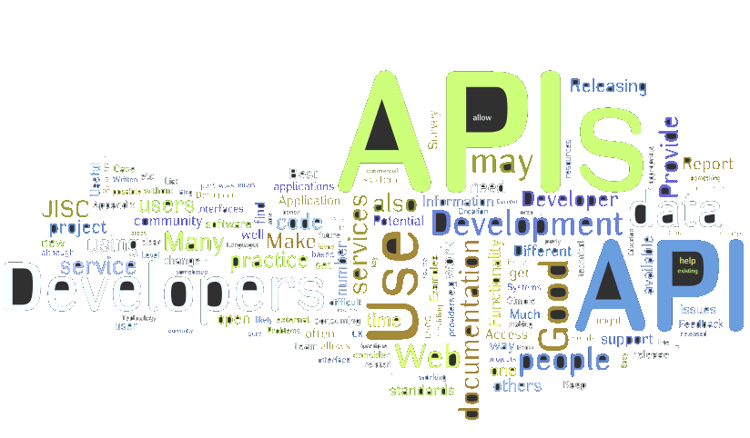
Third Party APIs
Google APIs and Facebook API
Ivaylo Kenov
Penka Borukova
Telerik Academy Students
Telerik Corporation
http:/telerikacademy.com

Slide 2

Table of Contents
What is API?
Google API
Google Maps API
YouTube API
Google+ API
Additional APIs
Facebook API

Slide 3
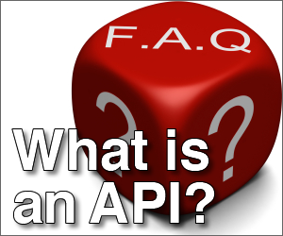
What is API?
Pleasures from beyond

Slide 4

What is API? (1)
Application Control Interface
Provides ready functionality
Usually from a remote server
Tools for easy developing
Normally is divided by blocks
Programmers creates new application by combining these blocks

Slide 5

What is API? (2)
How to use it
Include a script into the HTML containing the URL to the API
Done! You are ready to use all the functionality
Example for Google Maps
<script src="https://maps.googleapis.com/maps/api/js?v=3.exp&sensor=false">
</script>

Slide 6

Google APIs
Thousands!

Slide 7

Google+ APIs
Go to https://developers.google.com/
YouTube
Google+
Google Maps
Android
Google Places
Chrome
Google TV
Games

Slide 8
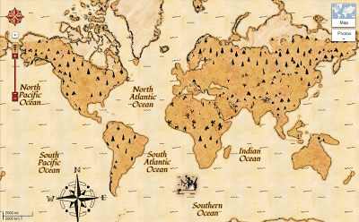
Google Maps API
The globe is yours

Slide 9
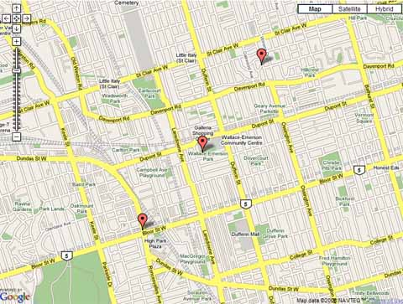
Simple map (1)
Simple map
The most basic map
Can get coordinates with zoom and display them
API link
<script src="https://maps.googleapis.com/maps/api/js?v=3.exp&sensor=false">
</script>

Slide 10
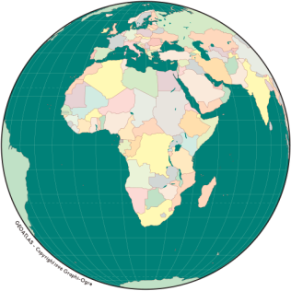
Simple map (1)
Coordinates are objects with two arguments: Latitude and Longitude
Options for the map:
Type – ROADMAP and SATELLITE
Center – where to initialize the map
Zoom
Methods
panTo(coordinates) – moves the map
setZoom(number) , setCenter(coordinates)

Slide 11
Simple Map
Live demo

Slide 12

Advanced options
Geolocation
Get it with HTML5 functionality and pass the coordinates to the map
Information window
Shows custom content on a particular position and map
Language option
Displays the map in preset language

Slide 13
Advanced options
Live demo

Slide 14
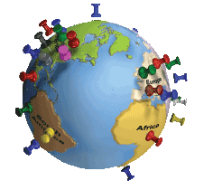
Markers and Events
Marker
Mark a special position on your map
Has properties for map, position and title
Events
On the map - center_changed, zoom_changed, etc.
On the marker
On other DOM elements

Slide 15
Markers and Events
Live demo

Slide 16
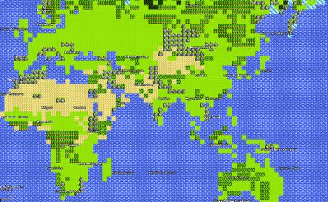
Other map options
Styles
Layers
Controls
Map types
Services
Find more at:
https://developers.google.com/maps/documentation/javascript/

Slide 17

YouTube API
Streaming videos from beyond

Slide 18

YouTube API
Embed the player in your page
Functionality for various controls
.playVideo()
.pauseVideo()
.loadVideoById()
.loadPlaylist()
.nextVideo()
.previousVideo()

Slide 19
YouTube API
Live demo

Slide 20

Google+ API
Share, +1, Login, Profiles

Slide 21
Google+ API (1)
To use Google+ you need Client ID
Go to https://developers.google.com/console
Create new project
In Services enable Google+ API
In API Access create an OAuth 2.0 Client ID
Select Web Application
In more options delete all URLs
Enter URL in Authorized JavaScript Origins

Slide 22

Google+ API (2)
Share button
Lets you share predefined URL
+1 Button
Lets you like a page
Sign In
Use Google+ login in your page
Fetch information about a profile
Get profile picture, information and more

Slide 23
Google+ API
Live demo

Slide 24

Facebook API
Creating API, login, post, friends

Slide 25

Facebook
Social Graph
Graph API
Read from Facebook
Write data into Facebook
Javascript SDK
Client-side functionality
Social Plugins,API calls, Login

Slide 26
Facebook APP
Live demo

Slide 27

Facebook
fb-root
Must do! It's the place holder for the Facebook javascript script to attach elements to the DOM
Channel file
Better communication speed in old browsers
Internet Explorer

Slide 28

Facebook
Core methods
FB.init
Initializing
Allow calls to Facebook API
FB.api
make call to the Graph API
FB.api('/me', function(response) {…});
FB.ui
triggering dialogs – feeds, requests, messages

Slide 29

Facebook
Auth Methods
FB.getLoginStatus
FB.getAuthResponse
FB.login
login, authorize, permissions
FB.logout

Slide 30
FB.init, FB.api, FB.ui
Live demo

Slide 31

Facebook
Social Plugins
Like
Follow
Comments
Etc.

Slide 32
Social Plugins
Live demo

Slide 33
http://algoacademy.telerik.com

Slide 34
Exercises
Create an “Online Map Tourism” application using Google maps
Choose 10 capital cities from the world
Make two buttons for “Next” and “Previous” which should iterate through the cities
When one of the buttons is clicked, map should pan to the new location of the new city
Each city should have Infobox with more information about it on the map
Show lists of the cities on the page. If the user chooses a city, the map should pan directly to it

Slide 35
Exercises (2)
Combine Google+ and YouTube APIs
If the user logins with Google+ the player should show, otherwise it should be hidden
When the user logs, his profile picture should be shown
Create custom controls for the video – pause, stop, load by id, load playlist, next, previous, mute, unmute, set volume, playback quality options
Add options to share the current video on Google+

Slide 36
Exercises (3)
Create an application using Facebook API to show all of your Facebook friends’ photos and their names. When clicking on the photo the clicked photo must be enlarged. When clicking enlarged photo, then it must resize again to its original size.
Create an application using Facebook API to show your birthday and location and show it to the screen.
Create an application using Facebook API to send message to one of your Facebook friends
Create an application using Facebook API to logout of Facebook.

Slide 37



Free Trainings @ Telerik Academy
“C# Programming @ Telerik Academy
csharpfundamentals.telerik.com
Telerik Software Academy
academy.telerik.com
Telerik Academy @ Facebook
facebook.com/TelerikAcademy
Telerik Software Academy Forums
forums.academy.telerik.com

