Slide 1
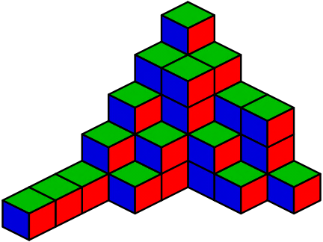

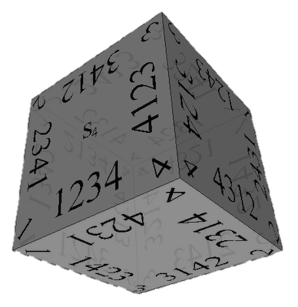


Combinatorics
Brief Overview of Combinations, Permutations and Binary Vectors
Nikolay Kostov
Technical Trainer
Telerik Corporation
http://Nikolay.IT

Slide 2

Table of Contents
Definitions in Combinatorics
Permutations
Combinations
Pascal's Triangle
Binary Vectors
Resources
Test Questions

Slide 3
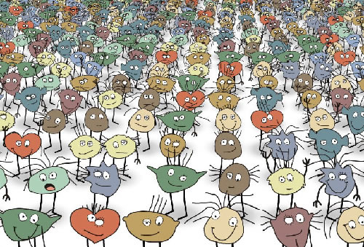
Definitions in Combinatorics

Slide 4
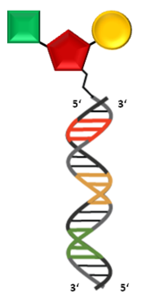
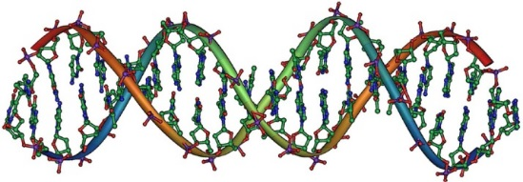
Combinatorics
Combinatorics is a branch of mathematics
Concerning the study of finite or countable discrete structures
Combinatorial problems arise in many areas of pure mathematics
Notably in algebra, probability theory, topology, geometry, physics, chemistry, biology, etc.

Slide 5
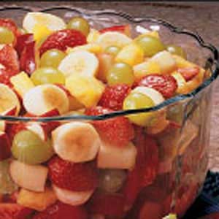
Combinations
"My fruit salad is a combination of grapes, strawberries and bananas"
We don't care what order the fruits are in
"bananas, grapes and strawberries" or "grapes, bananas and strawberries" → it is the same salad
If the order doesn't matter, it is a combination

Slide 6
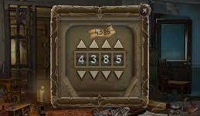
Permutations / Variations
"The combination to the safe is 4385".
Now we do care about the order
"8453" would not work, nor would "4538"
It has to be exactly 4-3-8-5
If the order does matter it is a permutation / variation
A permutation / variation is an ordered Combination
Easy to remember: "Permutation ... Position"

Slide 7
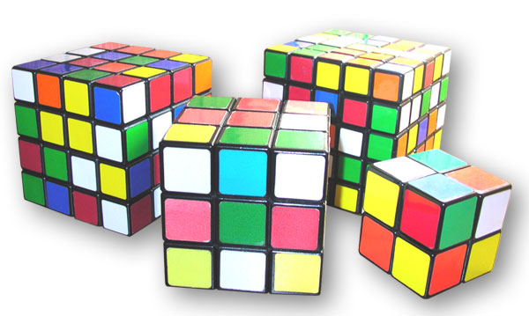
Variations

Slide 8
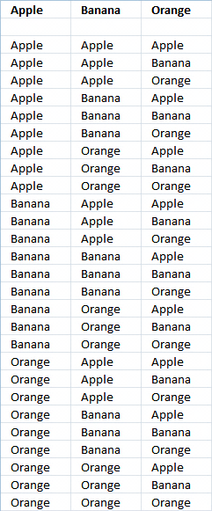
Variations
Variations (with repetitions)
Easiest to calculate
When you have n things to choose from ... you have n choices each time!
When choosing k of them, the variations are:
n × n × ... × n (k times)
n^{k}

Slide 9
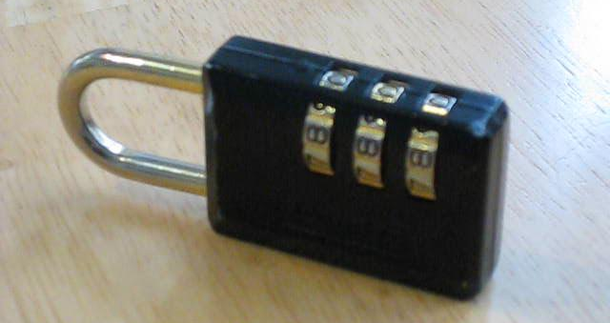
Variations (2)
Example: in the lock below, there are 10 numbers to choose from (0, 1, … 9) and you choose 3 of them:
10 × 10 × 10 (3 times) = 10³ = 1 000 variations
All variations from (0, 0, 0) to (9, 9, 9)

Slide 10

Generating Variations
static void Main()
{
GenerateVariations(0);
}
static void GenerateVariations(int index)
{
if (index >= k)
Print(arr);
else
for (int i = 0; i < n; i++)
{
arr[index] = i;
GenerateVariations(index + 1);
}
}

Slide 11
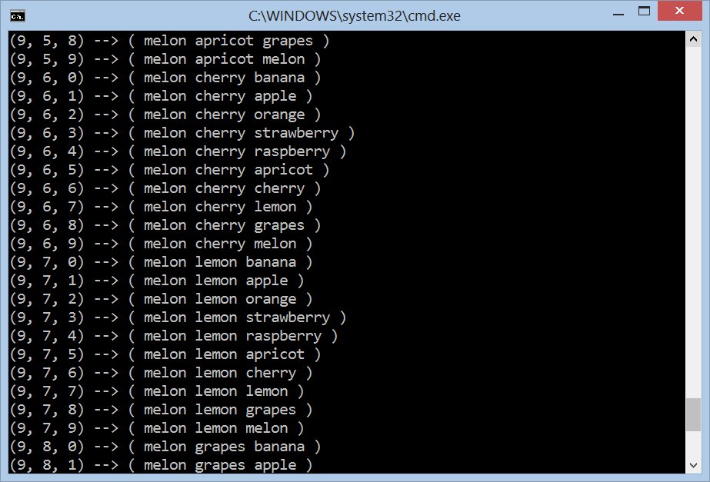
Variations with Repetitions
Live Demo

Slide 12
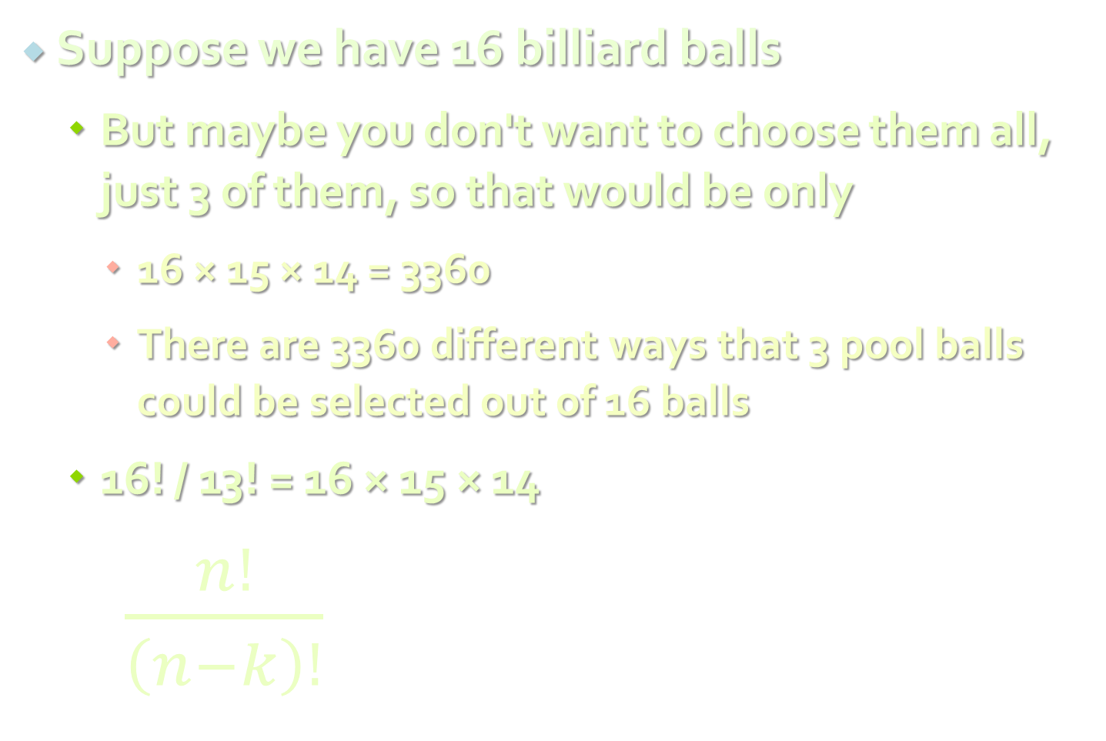
Variations without Repetition
Suppose we have 16 billiard balls
But maybe you don't want to choose them all, just 3 of them, so that would be only
16 × 15 × 14 = 3360
There are 3360 different ways that 3 pool balls could be selected out of 16 balls
16! / 13! = 16 × 15 × 14
$\frac{n!}{\left(n−k\right)!}$
where n is the number of things to choose from, and you choose k of them (No repetition, order matters)

Slide 13

Variations without Repetition
Example:
How many words of 2 different letters can you make with 4 letters { a, b, c, d }?
How to generate variations without repetitions?
The same way like variations with repetitions
Just use each element at most once
ab, ac, ad, ba, bc, bd, ca, cb, cd, da, db, dc

Slide 14

Generating Variations without Repetitions
static void GenerateVariationsNoReps(int index)
{
if (index >= k)
PrintVariations();
else
for (int i = 0; i < n; i++)
if (!used[i])
{
used[i] = true;
arr[index] = i;
GenerateVariationsNoReps(index + 1);
used[i] = false;
}
}
GenerateVariationsNoReps(0);

Slide 15
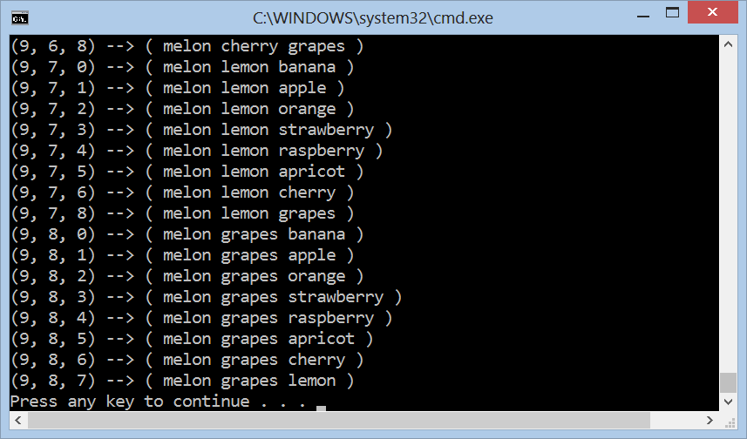
Variations without Repetitions
Live Demo

Slide 16

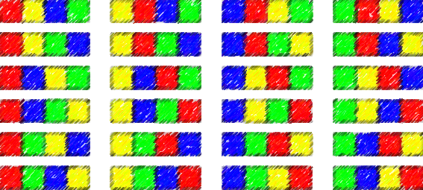

Permutations

Slide 17
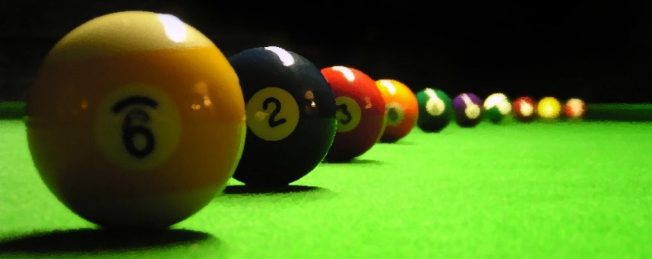
Permutations
Less number of available choices each time
What order could 16 pool balls be in?
After choosing, ball 9 we can't choose the same ball again
First choice = 16 possibilities
Second choice = 15 possibilities, etc., etc.
Total permutations:
16 × 15 × 14 ×...× 2 × 1 = 16! = 20 922 789 888 000

Slide 18

Generating Permutations
static void Perm<T>(T[] arr, int k)
{
if (k >= arr.Length)
Print(arr);
else
{
Perm(arr, k + 1);
for (int i = k + 1; i < arr.Length; i++)
{
Swap(ref arr[k], ref arr[i]);
Perm(arr, k + 1);
Swap(ref arr[k], ref arr[i]);
}
}
}

Slide 19
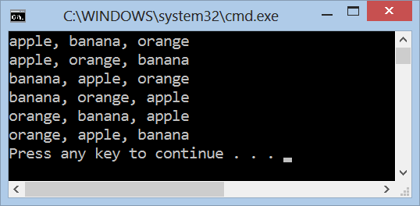
Generating Permutations
Live Demo

Slide 20
Permutations with Repetitions
We have a set of elements, with repetitions
E. g. set = { 3, 5, 1, 5, 5 }
We want to generate all unique permutations (without duplicates):
{ 1, 3, 5, 5, 5 } { 1, 5, 3, 5, 5 } { 1, 5, 5, 3, 5 } { 1, 5, 5, 5, 3 }
{ 3, 1, 5, 5, 5 } { 3, 5, 1, 5, 5 } { 3, 5, 5, 1, 5 } { 3, 5, 5, 5, 1 }
{ 5, 1, 3, 5, 5 } { 5, 1, 5, 3, 5 } { 5, 1, 5, 5, 3 } { 5, 3, 1, 5, 5 }
{ 5, 3, 5, 1, 5 } { 5, 3, 5, 5, 1 } { 5, 5, 1, 3, 5 } { 5, 5, 1, 5, 3 }
{ 5, 5, 3, 1, 5 } { 5, 5, 3, 5, 1 } { 5, 5, 5, 1, 3 } { 5, 5, 5, 3, 1 }
We to efficiently avoid the repeating combinations, i.e. to work fast for { 1, 5, 5, 5, 5, 5, 5, 5, 5, 5, 5, 5, 5, 5, 5, 5, 5, 5}

Slide 21
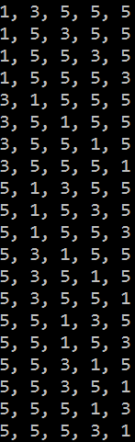
Generating Permutations with Repetitions
var arr = new int[] { 3, 5, 1, 5, 5 };
Array.Sort(arr);
PermuteRep(arr, 0, arr.Length);
static void PermuteRep(int[] arr, int start, int n)
{
Print(arr);
for (int left = n - 2; left >= start; left--)
{
for (int right = left + 1; right < n; right++)
if (arr[left] != arr[right])
{
Swap(ref arr[left], ref arr[right]);
PermuteRep(arr, left + 1, n);
}
var firstElement = arr[left];
for (int i = left; i < n - 1; i++)
arr[i] = arr[i + 1];
arr[n - 1] = firstElement;
}
}

Slide 22
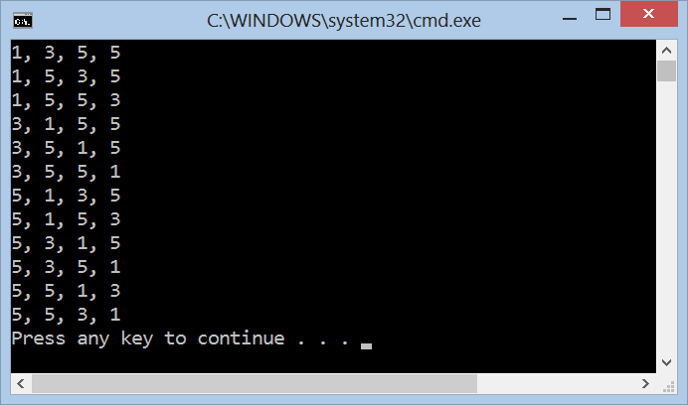
Generating Permutations with Repetitions
Live Demo

Slide 23
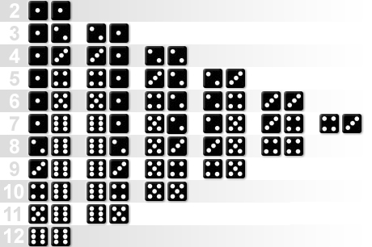
Combinations

Slide 24
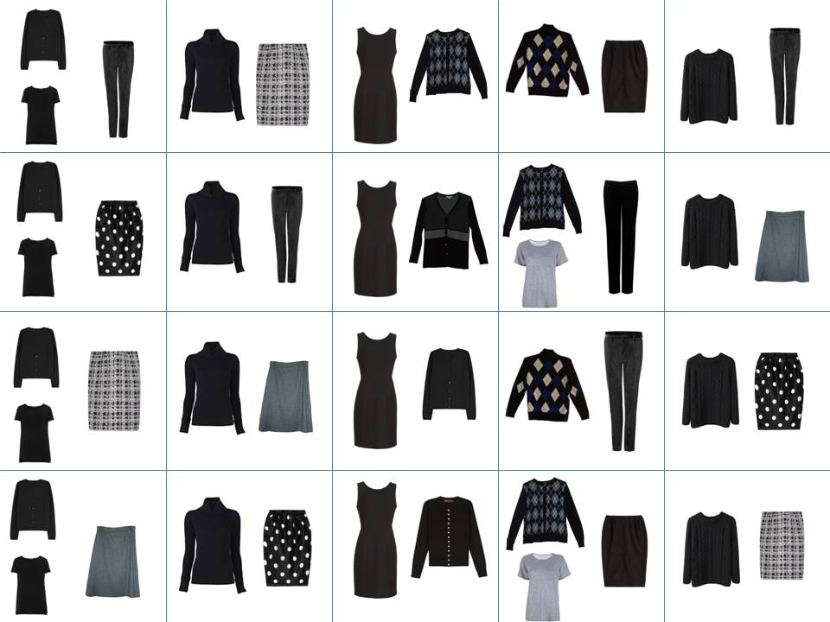
Combinations
Order does not matter!
Two types of combinations:
Repetition is allowed
Coins in your pocket
5,5,20,20,20,10,10
No repetition
Lottery numbers
TOTO 6/49, 6/42, 5/35
2,14,15,27,30,33

Slide 25
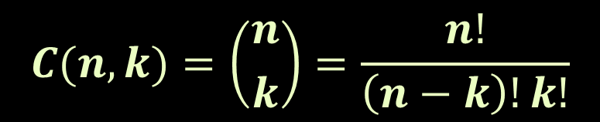
Combinations without Repetition
Back to the 3 of 16 billiard balls
Many comb. will be the same
We don't care about the order
Permutations w/o repetitions reduced by how many ways the objects could be in order:
This is how lotteries work (TOTO 6/49)
Often called "n choose k" (Google it!)
Order does matter | Order doesn't matter
1 2 3 1 3 2 2 1 3 2 3 1 3 1 2 3 2 1 | 1 2 3
$$C(n, k)=\left({n \atop k}\right)=\frac{n!}{\left(n−k\right)!k!}$$

Slide 26

Generate Combinations without Repetitions
static void Main()
{
Comb(0, 0);
}
static void Comb(int index, int start)
{
if (index >= k)
PrintVariations();
else
for (int i = start; i < n; i++)
{
arr[index] = i;
Comb(index + 1, i + 1);
}
}

Slide 27
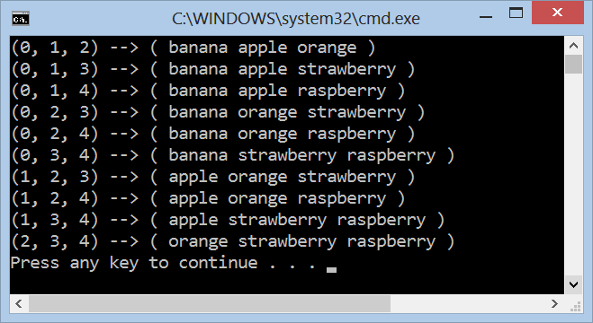
Combinations without Repetitions
Live Demo

Slide 28
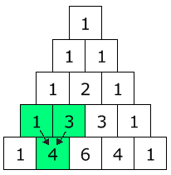

Pascal's Triangle
The Pascal's triangle shows you how many combinations of objects without repetition are possible
Go down to row "n" (the top row is 0)
Move along "k" places
The value there is your answer
Build the triangle: start with "1" at the top, then continue placing numbers below it in a triangular pattern
$$\left({n \atop k}\right)=\frac{n!}{\left(n−k\right)!k!}$$

Slide 29
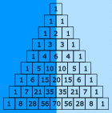
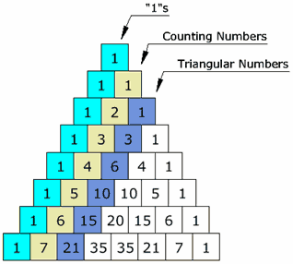
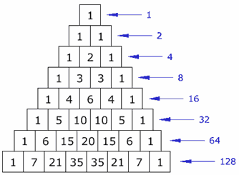
Pascal's Triangle's (2)
The triangle is symmetrical
Numbers on the left side have identical matching numbers on the right side, like a mirror image
Diagonals:
First diagonal – only “1”s
Second diagonal – 1, 2, 3, etc.
Third diagonal – triangular numbers
Horizontal sums: powers of 2

Slide 30

Binomial Coefficients
Calculate using recursion:
$$\left({n \atop k}\right)=\left({n−1 \atop k−1}\right)+\left({n−1 \atop k}\right)$$
static decimal Binom(int n, int k)
{ if (k > n) return 0;
else if (0 == k || k == n) return 1;
else return Binom(n-1, k-1) + Binom(n-1, k);
}
Calculate using dynamic programming:
decimal m[MAX], i, j;
for (i = 0; i <= n; i++) {
m[i] = 1;
if (i > 1) {
if (k < i - 1) j = k; else j = i - 1;
for (; j >= 1; j--) m[j] += m[j - 1];
}
} // The answer is in m[k]

Slide 31
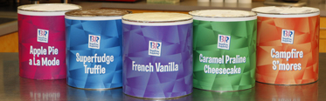
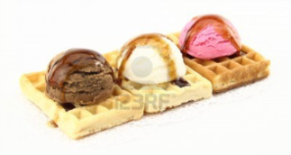
Combinations with Repetition
Ice-cream example
5 flavors of ice-cream: banana, chocolate, lemon, strawberry and vanilla
3 scoops
How many combinations will there be?
Let's use letters for the flavors: {b, c, l, s, v}
{c, c, c} (3 scoops of chocolate)
{b, l, v} (one each of banana, lemon and vanilla)
{b, v, v} (one of banana, two of vanilla)

Slide 32

Combinations with Repetition
Ice-cream example
n=5 things to choose from, choose k=3 of them
Order does not matter, and we can repeat
Think about the ice cream being in boxes
arrow means move, circle means scoop
{c, c, c} (3 scoops of chocolate)
{b, l, v} (banana, lemon, vanilla)
{b, v, v} (banana, two of vanilla)

Slide 33
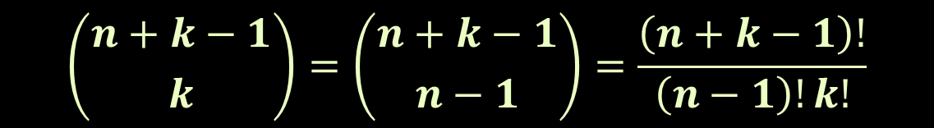
Combinations with Repetition
We have a simpler problem to solve
How many different ways can you arrange arrows and circles?
3 circles (3 scoops) and 4 arrows (we need to move 4 times to go from the 1st to 5th container)
There are k + (n-1) positions, and we want to choose k of them to have circles
$$\left({n+k−1 \atop k}\right)=\left({n+k−1 \atop n−1}\right)=\frac{\left(n+k−1\right)!}{\left(n−1\right)!k!}$$

Slide 34

Generate Combinations with Repetitions
static void Main()
{
Comb(0, 0);
}
static void CombReps(int index, int start)
{
if (index >= k)
PrintVariations();
else
for (int i = start; i < n; i++)
{
arr[index] = i;
CombReps(index + 1, i);
}
}

Slide 35
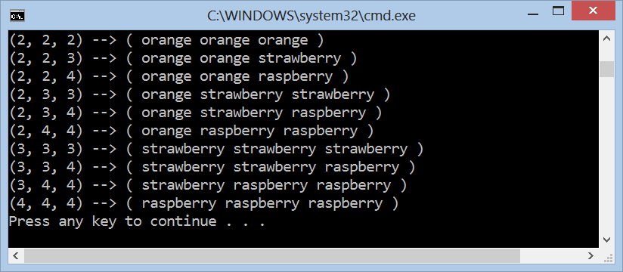
Generating Combinations with Repetitions
Live Demo

Slide 36
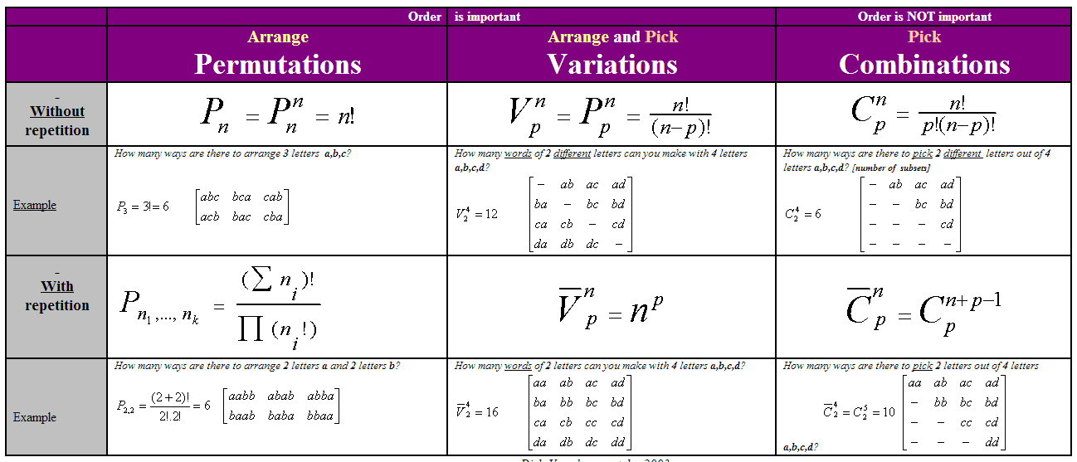
Combinatorial Formulas
Calculating the number of permutations, variations, combinations
Use the well known formulas:
Source: http://users.telenet.be/vdmoortel/dirk/Maths/PermVarComb.html

Slide 37
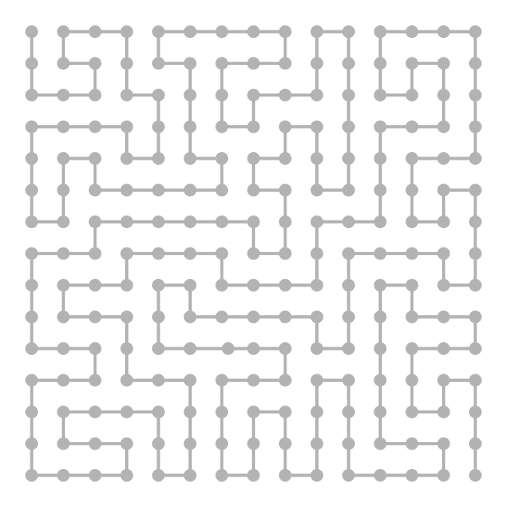
Binary Vectors

Slide 38
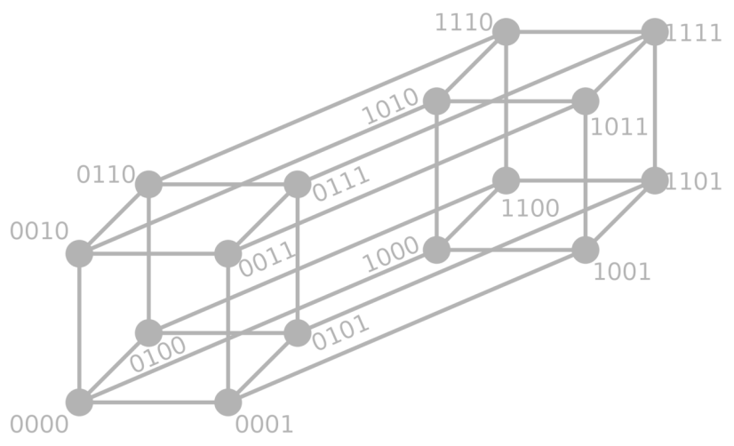
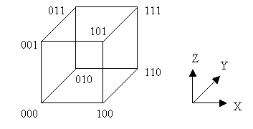
Binary Vectors
Some problems can be reformulated in terms of binary vectors – (1, 0, 1, 1, 1, 0, …)
Combinatorial properties of binary vectors:
Number of binary vectors of length n: 2^{n}.
Number of binary vectors of length n and with k `1` is C(n, k) (we choose k positions for n `1`)

Slide 39
Gray Code
Gray code (a.k.a. reflected binary code) is a binary numeral system where two successive values differ by only one bit
Gray code by bit width
2-bit | 4-bit
00 01 11 10 | 0000 0001 0011 0010 0110 0111 0101 0100 1100 1101 1111 1110 1010 1011 1001 1000
3-bit
000 001 011 010 110 111 101 100
Decimal | Gray | Binary
0 | 000 | 000
1 | 001 | 001
2 | 011 | 010
3 | 010 | 011
4 | 110 | 100
5 | 111 | 101
6 | 101 | 110
7 | 100 | 111

Slide 40

Gray Code – Source Code
int n = 4, a[1000], i;
void print(void)
{ for (i = n; i >= 1; i--) printf("%d ", a[i]);
printf("\n");
}
void backgray(int k)
{ if (0 == k) { print(); return; }
a[k] = 1; forwgray(k - 1);
a[k] = 0; backgray(k - 1);
}
void forwgray(int k)
{ if (0 == k) { print(); return; }
a[k] = 0; forwgray(k - 1);
a[k] = 1; backgray(k - 1);
}
int main() { forwgray(n); return 0; }

Slide 41
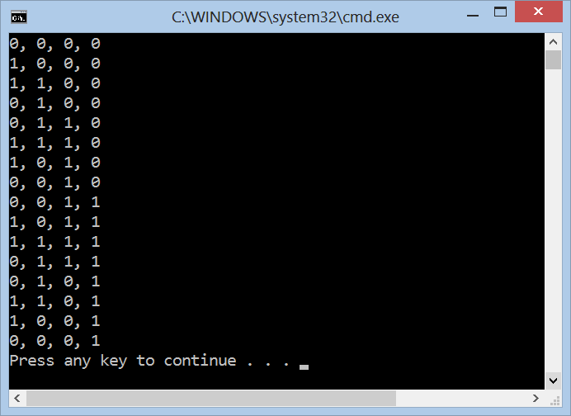
Gray Code
Live Demo

Slide 42
Combinatorics
http://algoacademy.telerik.com

Slide 43
Exercises
Solve 2 problems by choice from Algo Academy (October 2012 – Combinatorics): http://academy.telerik.com/algoacademy/season-2012-2013/training-27-28-Oct-2012-combinatorics
You may test your solutions in BG Coder: http://bgcoder.com/Contest/Practice/59

Slide 44




Free Trainings @ Telerik Academy
C# Programming @ Telerik Academy
csharpfundamentals.telerik.com
Telerik Software Academy
academy.telerik.com
Telerik Academy @ Facebook
facebook.com/TelerikAcademy
Telerik Software Academy Forums
forums.academy.telerik.com

