Slide 1
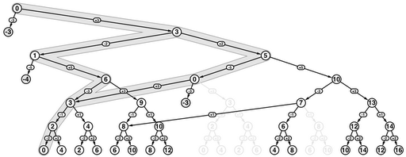
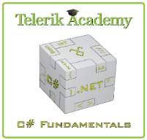
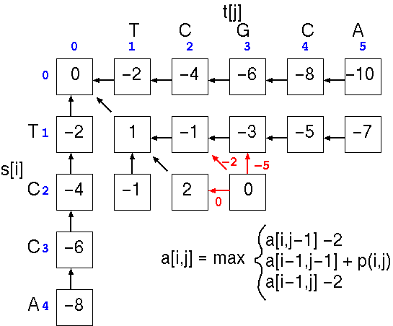


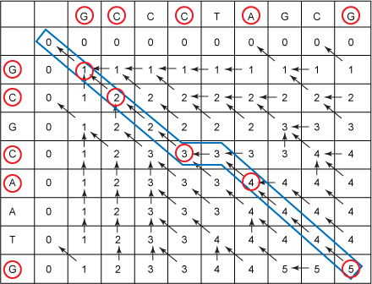
Dynamic Programming
Brief Introduction in Problem Solving using Dynamic Programming and Memoization
Nikolay Kostov
Telerik Corporation
www.telerik.com

Slide 2
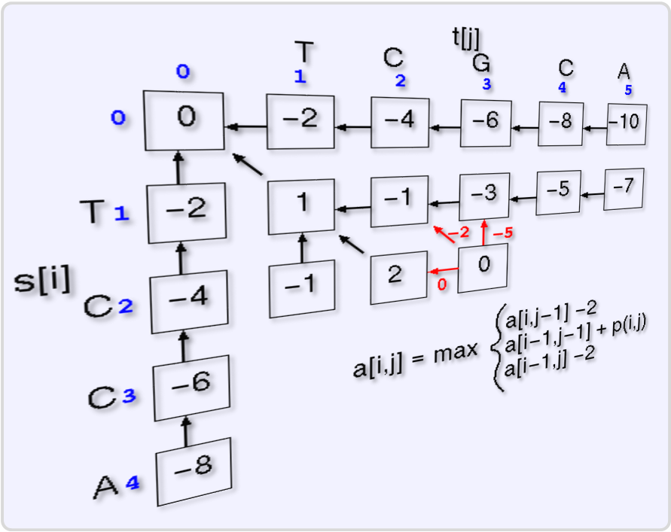

Table of Contents
Minimum and Maximum
Divide-and-Conquer
Dynamic Programming Concepts
Fibonacci Numbers
Longest Increasing Subsequence
Longest Common Subsequence

Slide 3
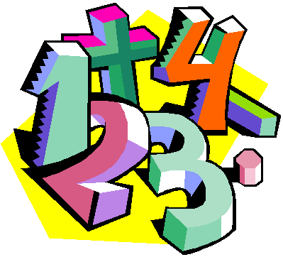
Minimum and Maximum

Slide 4
Minimum and Maximum
The minimum of a set of N elements
The first element in list of elements ordered in incremental order (index = 1)
The maximum of a set of N elements
The last element in list of elements ordered in incremental order (index = N)
The median is the “halfway point” of the set
When N is odd, index = (N+1) / 2 = unique value
When N is even, index = ⎣(n+1)/2⎦ (lower median) or index = ⎡(n+1)/2⎤ (upper median)

Slide 5
Finding Min and Max Element
Minimum element
Maximum element
int FindMin(int[] arr)
{
int min = arr[0];
for (int i = 1; i < arr.Length; i++)
if (arr[i] < min) min = arr[i];
return min;
}
int FindMax(int arr[])
{
int max = arr[0];
for (int i = 1; i < arr.Length; i++)
if (arr[i] > max) max = arr[i];
return max;
}

Slide 6
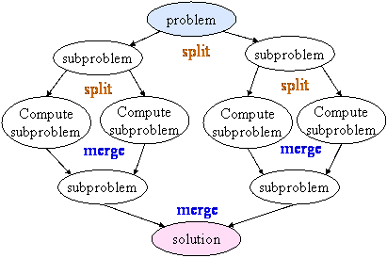
Divide-and-Conquer

Slide 7
Divide-and-Conquer
Divide: If the input size is too large to deal with in a straightforward manner
Divide the problem into two or more disjoint subproblems
Conquer: conquer recursively to solve the subproblems
Combine: Take the solutions to the subproblems and "merge" these solutions into a solution for the original problem

Slide 8
Divide-and-Conquer Example
Merge Sort
The subproblems are independent, all different
void MergeSort(int[] arr, int left, int right)
{
if (right > left)
{
int mid = (right + left) / 2;
MergeSort(arr, left, mid);
MergeSort(arr, (mid+1), right);
Merge(arr, left, (mid+1), right);
}
}

Slide 9


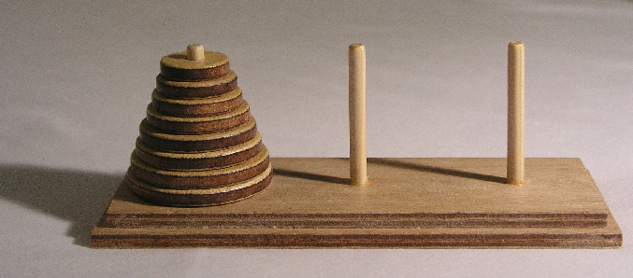
Divide-and-Conquer Algorithms
Binary search
Closest pair in 2D geometry
Quick sort
Merging arrays
Merge sort
Finding majorant
Tower of Hanoi
Fast multiplication
Strassen’s Matrix Multiplication

Slide 10
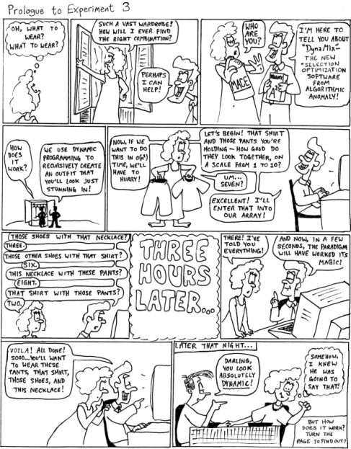
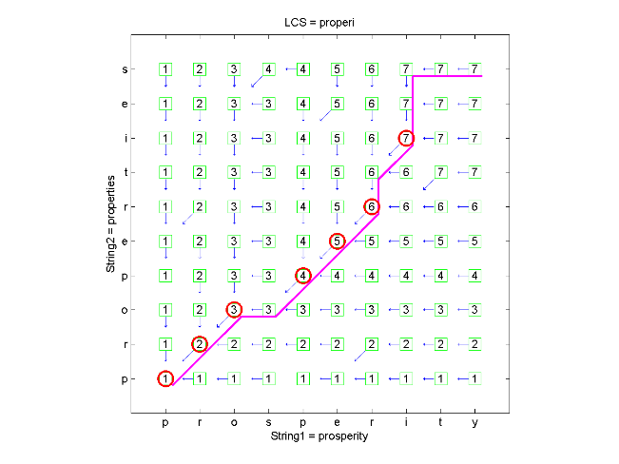
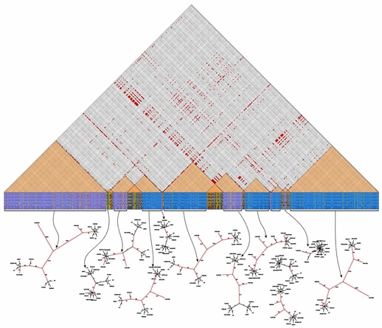
Dynamic Programming

Slide 11
Dynamic Programming
How dynamic programming (DP) works?
Approach to solve problems
Store partial solutions of the smaller problems
Usually they are solved bottom-up
Steps to designing a DP algorithm:
Characterize optimal substructure
Recursively define the value of an optimal solution
Compute the value bottom up
(if needed) Construct an optimal solution

Slide 12
Elements of DP
DP has the following characteristics
Simple subproblems
We break the original problem to smaller sub-problems that have the same structure
Optimal substructure of the problems
The optimal solution to the problem contains within optimal solutions to its sub-problems
Overlapping sub-problems
There exist some places where we solve the same sub-problem more than once

Slide 13
Common Characteristics
The problem can be divided into levels with a decision required at each level
Each level has a number of states associated with it
The decision at one level transforms one state into a state in the next level
Given the current state, the optimal decision for each of the remaining states does not depend on the previous states or decisions

Slide 14
Difference between DP and Divide-and-Conquer
Using Divide-and-Conquer to solve problems (that can be solved using DP) is inefficient
Because the same common sub-problems have to be solved many times
DP will solve each of them once and their answers are stored in a table for future use
Technique known as “memoization”

Slide 15

Fibonacci Numbers
From "divide and conquer" to dynamic programming

Slide 16
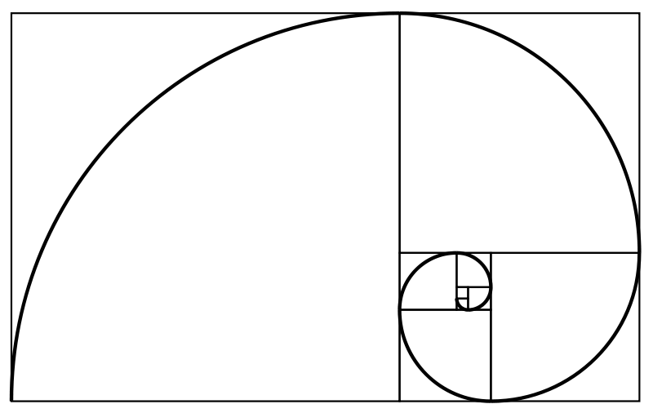
Fibonacci sequence
The Fibonacci numbers are the numbers in the following integer sequence:
0, 1, 1, 2, 3, 5, 8, 13, 21, 34, 55, 89, 144, …
The first two numbers are 0 and 1
Each subsequent number is the sum of the previous two numbers
In mathematical terms:
F_{n} = F_{n-1} + F_{n-2}
F₀ = 0, F₁ = 1

Slide 17
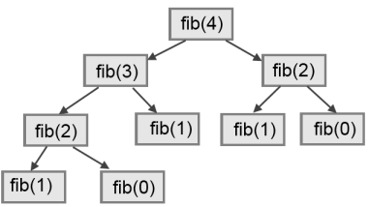
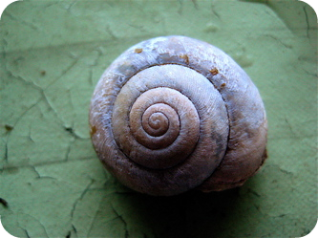
Divide and Conquer Approach
How can we find the n^{th} Fibonacci number using recursion (“divide and conquer”)
Directly applying the recurrence formula
decimal Fibonacci(int n)
{
if (n == 0) return 0;
if (n == 1) return 1;
return Fibonacci(n - 1) + Fibonacci(n - 2);
}

Slide 18
Fibonacci and Memoization
We can save the results from each function call
Every time when we call the function we check if the value is already calculated
This saves a lot of useless calculations!
http://en.wikipedia.org/wiki/Memoization
decimal Fibonacci(int n)
{ if (memo[n] != 0) return memo[n];
if (n == 0) return 0;
if (n == 1) return 1;
memo[n] = Fibonacci(n - 1) + Fibonacci(n - 2);
return memo[n];
}

Slide 19
Fibonacci and DP
How to find the n^{th} Fibonacci number using the dynamic programming approach?
We can start solving the Fibonacci problem from bottom-up calculating partial solutions
We know the answer for the 0th and the 1st number of the Fibonacci sequence
And we know the formula to calculate each of the next numbers (F_{i} = F_{i-1} + F_{i-2})
0 | 1
0 | 1
2
1
3
2
4
3
5
5
6
8
...
...
i^{th}
F_{i-1} + F_{i-2}
...
...
n^{th}
...

Slide 20
Compare Fibonacci Solutions
Recurrent solution
Complexity: ~ O(1.6^{n})
DP or memoization solution
Complexity: ~ O(n)
Dynamic programming solutions is way faster than the recurrent solution
If we want to find the 36th Fibonacci number:
Recurrent solution takes ~48 315 633 steps
Dynamic programming solution takes ~36 steps

Slide 21
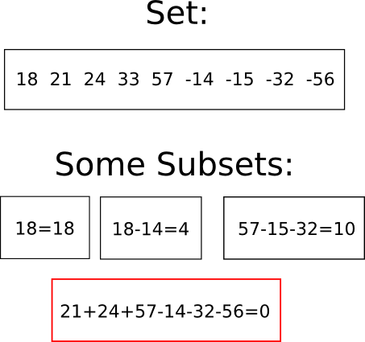
Subset Sum Problem

Slide 22
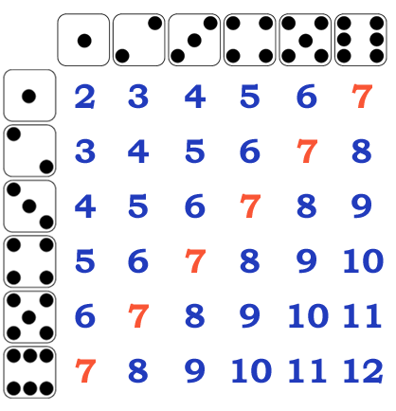
Subset Sum Problems
Given a set of integers, is there a non-empty subset whose sum is zero?
Given a set of integers and an integer S, does any non-empty subset sum to S?
Given a set of integers, find all possible sums
Can you equally separate the value of coins?

Slide 23
Subset Sum Problem
Solving the subset sum problem:
numbers = { 3, 5, -1, 4, 2 }, sum = 6
start with possible = { 0 }
Step 1: obtain all possible sums of { 3 }
possible = { 0 } ∪ { 0+3 } = { 0, 3 }
Step 2: obtain all possible sums of { 3, 5 }
possible = { 0, 3 } ∪ { 0+5, 3+5 } = { 0, 3, 5, 8 }
Step 3: obtain all possible sums of { 3, 5, -1 }
possible = { 0, 3, 5, 8 } ∪ { 0-1, 3-1, 5-1, 8-1 } = { -1, 0, 2, 3, 4, 5, 7, 8 }
…

Slide 24
Subset Sum Problem – C++
for(int i = 0; i < N; i++)
{
int newminpos = minpos, newmaxpos = maxpos;
int newpossible[OFFSET + OFFSET] = { 0 };
for(int j = maxpos; j >= minpos; j--) // j = one possible sum
{
if (possible[j+OFFSET]) newpossible[j+nums[i]+OFFSET] = 1;
if (j+nums[i] > newmaxpos) newmaxpos = j+nums[i];
if (j+nums[i] < newminpos) newminpos = j+nums[i];
}
minpos = newminpos;
maxpos = newmaxpos;
for(int j = maxpos; j >= minpos; j--)
if (newpossible[j+OFFSET] == 1)
possible[j+OFFSET] = 1;
if (nums[i] > maxpos) maxpos = nums[i];
if (nums[i] < minpos) minpos = nums[i];
possible[nums[i]+OFFSET] = 1;
}

Slide 25

Subset Sum Problem – Answer
int S = 5;
if (possible[0+OFFSET]) cout << "Sum 0 is possible" << endl;
else cout << "Sum 0 is not possible" << endl;
if (possible[S+OFFSET]) cout << "Sum " << S << " is possible" << endl;
else cout << "Sum " << S << " is not possible" << endl;
cout << "Possible sums:";
for(int i = minpos; i <= maxpos; i++)
{
if (possible[i+OFFSET] == 1) cout << " " << i;
}

Slide 26
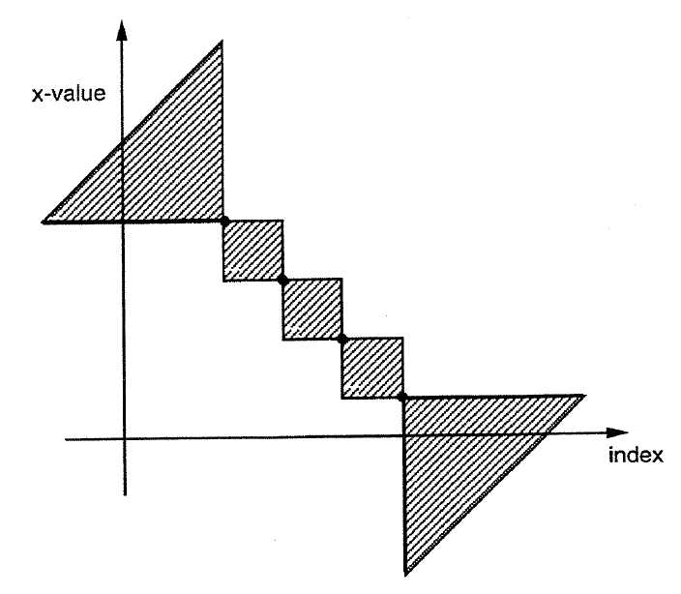
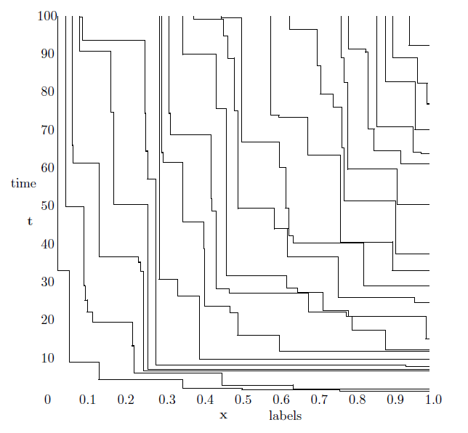
Longest Increasing Subsequence

Slide 27
Longest Increasing Subsequence
Find a subsequence of a given sequence in which the subsequence elements are in sorted order, lowest to highest, and in which the subsequence is as long as possible
This subsequence is not necessarily contiguous, or unique
The longest increasing subsequence problem is solvable in time O(n log n)
We will review one simple DP algorithm with complexity O(n * n)

Slide 28
LIS – C++ Solution
L[0] = 1; P[0] = -1; for (int i = 1; i < N; i++)
{
L[i] = 1;
P[i] = -1;
for (int j = i - 1; j >= 0; j--)
{
if (L[j] + 1 > L[i] && S[j] < S[i])
{
L[i] = L[j] + 1;
P[i] = j;
}
}
if (L[i] > maxLength)
{
bestEnd = i;
maxLength = L[i];
} }
i = | 0 | 1 | 2 | 3 | 4 | 5 | 6 | 7 | 8
Sequence S_{i} = | 2 | 4 | 3 | 5 | 1 | 7 | 6 | 9 | 8
Length L_{i} = | 1 | 2 | 3 | 3 | 1 | 4 | 4 | 5 | 5
Predecessor P_{i} = | -1 | 1 | 1 | 2 | -1 | 4 | 4 | 6 | 6

Slide 29

LIS – Restore the Sequence
cout << "Max length: " << maxLength << endl;
cout << "Sequence end index: " << bestEnd << endl;
cout << "Longest subsequence:";
int ind = bestEnd;
while(ind != -1)
{
cout << " " << S[ind];
ind = P[ind];
}
cout << endl;
i = | 0 | 1 | 2 | 3 | 4 | 5 | 6 | 7 | 8
Sequence S_{i} = | 2 | 4 | 3 | 5 | 1 | 7 | 6 | 9 | 8
Length L_{i} = | 1 | 2 | 3 | 3 | 1 | 4 | 4 | 5 | 5
Predecessor P_{i} = | -1 | 1 | 1 | 2 | -1 | 4 | 4 | 6 | 6

Slide 30
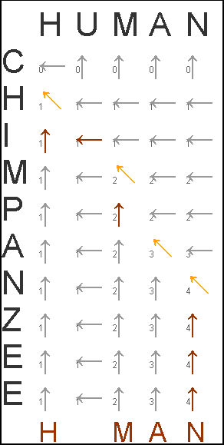
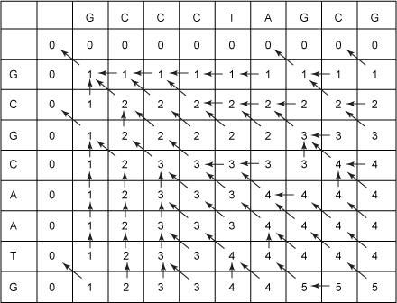
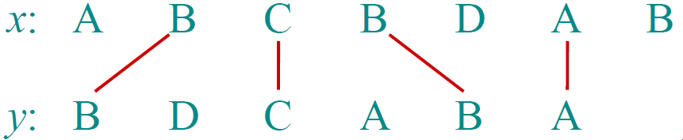
Longest Common Subsequence
Recursive and DP Approach

Slide 31
Longest Common Subsequence
Given two sequences x[1 . . m] and y[1 . . n], find a longest common subsequence (LCS) to them both
For example if we have x = "ABCBDAB" and y = "BDCABA" their longest common subsequence will be "BCBA"

Slide 32
LCS – Recursive Approach
S₁ = GCCCTAGCG, S₂ = GCGCAATG
Let C₁ = the right-most character of S₁
Let C₂ = the right-most character of S₂
Let S₁' = S₁ with C₁ "chopped-off"
Let S₂' = S₂ with C₂ "chopped-off"
There are three recursive subproblems:
L₁ = LCS(S₁', S₂)
L₂ = LCS(S₁, S₂')
L₃ = LCS(S₁', S₂')

Slide 33
LCS – Recursive Approach (2)
The solution to the original problem is whichever of these is the longest:
L₁
L₂
If C₁ is not equal to C₂, then L₃
If C₁ equals C₂, then L₃ appended with C₁
This recursive solution requires multiple computations of the same sub-problems
This recursive solution can be replaced with DP

Slide 34
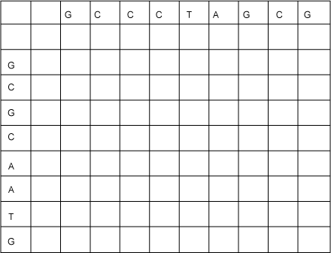
Initial LCS table
To compute the LCS efficiently using dynamic programming we start by constructing a table in which we build up partial results

Slide 35
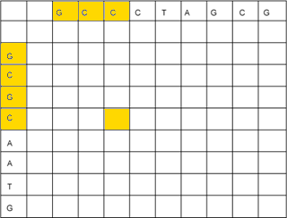
Initial LCS table (2)
We'll fill up the table from top to bottom, and from left to right
Each cell = the length of an LCS of the two string prefixes up to that row and column
Each cell will contain a solution to a sub-problem of the original problem
S₁ = GCCCTAGCG
S₂ = GCGCAATG

Slide 36
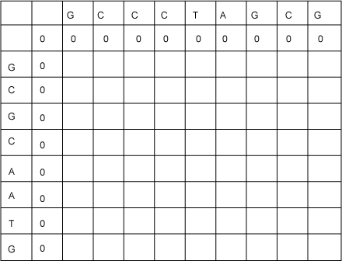
LCS table – base cases filled in
Each empty string has nothing in common with any other string, therefor the 0-length strings will have values 0 in the LCS table
for (i=0; i<=n; i++) {
c[i][0] = 0; }
for (i=0; i<=m; i++) {
c[0][i] = 0; }

Slide 37
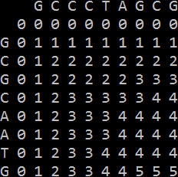
LCS – C++ Code Solution
int LCS(string X, string Y) {
int m = X.length(); int n = Y.length(); for (int i = 1; i <= m; i++) {
for (int j = 1; j <= n; j++)
{
if (X[i-1] == Y[j-1]) {
c[i][j] = c[i-1][j-1] + 1;
}
else {
c[i][j] = max(c[i][j-1], c[i-1][j]); }
} } return c[m][n];
}

Slide 38
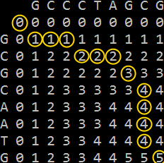
LCS – Reconstruct the Answer
void printLCS(int i,int j)
{
if (i==0 || j==0) return;
if (X[i-1] == Y[j-1])
{
printLCS(i-1, j-1);
cout << X[i-1];
}
else if (c[i][j] == c[i-1][j])
{
printLCS(i-1, j);
}
else
{
printLCS(i, j-1);
}
}

Slide 39
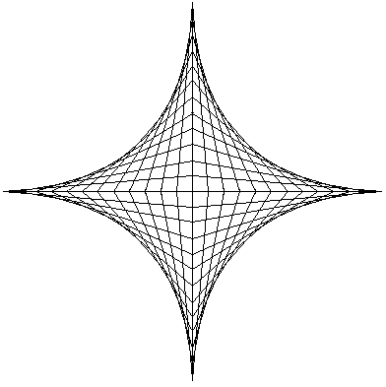
DP Applications
Areas
Bioinformatics
Control theory
Information theory
Operations research
Computer science:
Theory
Graphics
AI

Slide 40
Some Famous Dynamic Programming Algorithms
Integer Knapsack Problem
Unix diff for comparing two files
Bellman–Ford algorithm for finding the shortest distance in a graph
Floyd's All-Pairs shortest path algorithm
Cocke-Kasami-Younger for parsing context free grammars
en.wikipedia.org/wiki/Dynamic_programming#Algorithms_that_use_dynamic_programming

Slide 41
Summary
Divide-and-conquer method for algorithm design
Dynamic programming is a way of improving on inefficient divide-and-conquer algorithms
Dynamic programming is applicable when the sub-problems are dependent, that is, when sub-problems share sub-sub-problem
Recurrent functions can be solved efficiently
Longest increasing subsequence and Longest common subsequence problems can be solved efficiently using dynamic programming approach

Slide 42
Dynamic Programming
http://academy.telerik.com

Slide 43
Exercises
Write a program based on dynamic programming to solve the "Knapsack Problem": you are given N products, each has weight W_{i} and costs C_{i} and a knapsack of capacity M and you want to put inside a subset of the products with highest cost and weight ≤ M. The numbers N, M, W_{i} and C_{i} are integers in the range [1..500]. Example: M=10 kg, N=6, products:
beer – weight=3, cost=2
vodka – weight=8, cost=12
cheese – weight=4, cost=5
nuts – weight=1, cost=4
ham – weight=2, cost=3
whiskey – weight=8, cost=13
Optimal solution:
nuts + whiskey
weight = 9
cost = 17

Slide 44
Exercises (2)
Write a program to calculate the "Minimum Edit Distance" (MED) between two words. MED(x, y) is the minimal sum of costs of edit operations used to transform x to y. Sample costs are given below:
cost (replace a letter) = 1
cost (delete a letter) = 0.9
cost (insert a letter) = 0.8
Example: x = "developer", y = "enveloped" → cost = 2.7
delete ‘d’: "developer" → "eveloper", cost = 0.9
insert ‘n’: "eveloper" → "enveloper", cost = 0.8
replace ‘r’ → ‘d’: "enveloper" → "enveloped", cost = 1

Slide 45
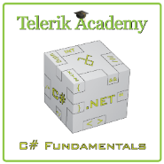



Free Trainings @ Telerik Academy
C# Programming @ Telerik Academy
csharpfundamentals.telerik.com
Telerik Software Academy
academy.telerik.com
Telerik Academy @ Facebook
facebook.com/TelerikAcademy
Telerik Software Academy Forums
forums.academy.telerik.com

