Slide 1


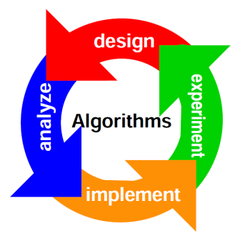
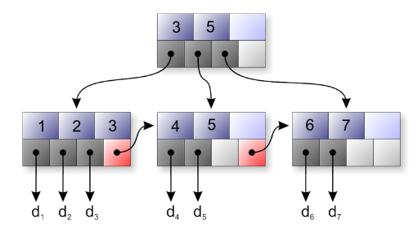
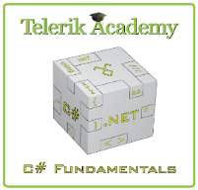
Other Algorithms
Telerik Software Academy
academy.telerik.com

Slide 2

Table of Contents
Heuristics
Greedy
Genetic algorithms
Randomization
Geometry

Slide 3

Heuristics

Slide 4
Heuristics
Solving problem more quickly than classic methods
Finding approximate solution
When optimal solution is complex and hard to find (requires time and memory)
Heuristics give simple solution (not optimal!)
Quickly produce solution that is good enough vs finding optimal solution very very slow (mostly NP-complete problems)

Slide 5

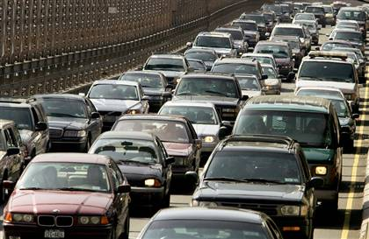

Heuristics
Usage
anti-virus scanners
A* - Dijkstra + some cool stuff
Computes path quickly but the path might not be the shortest

Slide 6

Greedy

Slide 7
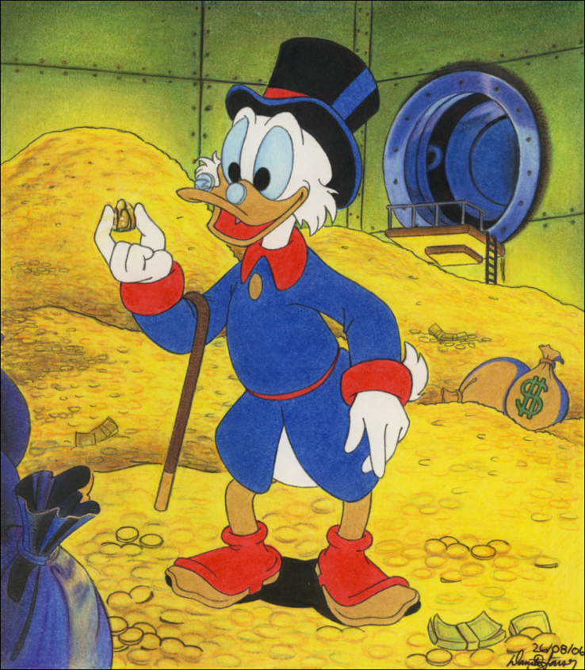
Greedy
Locally optimal choice at each stage
Finds local extremum (not always global)
Much faster than always finding optimal solution
Example:
Knapsack
Travelling salesman
Prim and Kruskal
Etc.

Slide 8
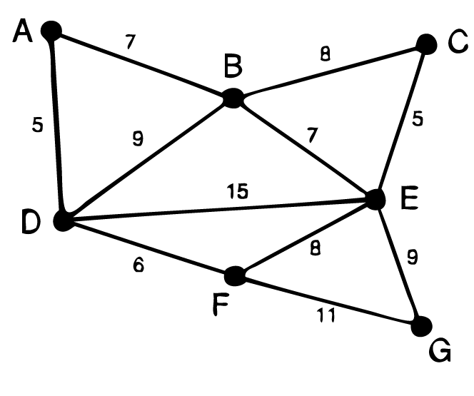
Greedy
What do we need:
Candidate set
Selection function
Feasibility function
Objective function
Solution function
The result is NOT
the optimal solution

Slide 9

Greedy
Live Demo

Slide 10
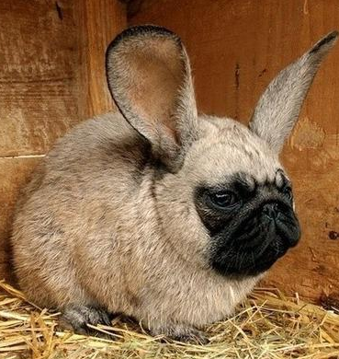
Genetic Algorithms

Slide 11

Genetic Algorithm
Part of Artificial Intelligence
Mimics the process of natural evolution
Terminology
Population
Fitness
Operators
Crossover
Mutation

Slide 12
Genetic Algorithm
Crossover
Mutation
2 | 3 | 1 | 5 | 4 | 8 | 0 | 7 | 9 | 6
0 | 7 | 6 | 5 | 1 | 4 | 3 | 2 | 9 | 8
2 | 3 | 1 | 5 | 4 | 0 | 7 | 6 | 9 | 8
2 | 3 | 1 | 5 | 4 | 0 | 7 | 6 | 9 | 8
2 | 3 | 1 | 5 | 0 | 4 | 7 | 6 | 9 | 8

Slide 13
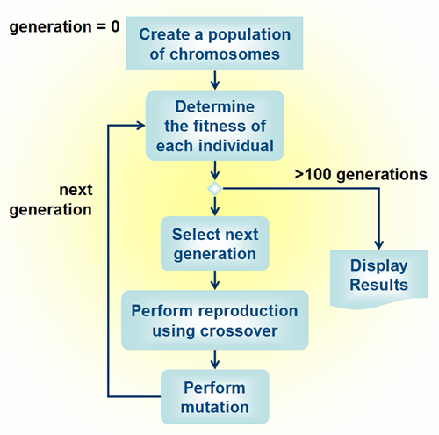
Genetic Algorithm - Steps
Create population
Do many times (at least for 100 generations)
Determine fitness of each individual
Select next generation
Crossover
Mutation
Back to 1
Display results

Slide 14

Genetic Algorithm
Live Demo

Slide 15
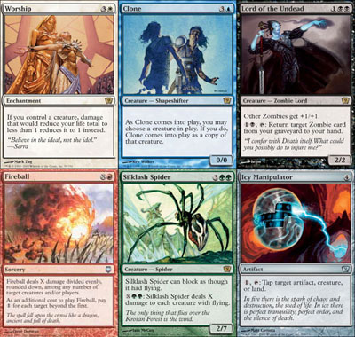
Randomization

Slide 16

Randomization
Process of making something random
Monte Carlo and Las Vegas algorithms
Examples:
Generate random permutation of a sequence
Select a random sample of population
Generate random numbers

Slide 17
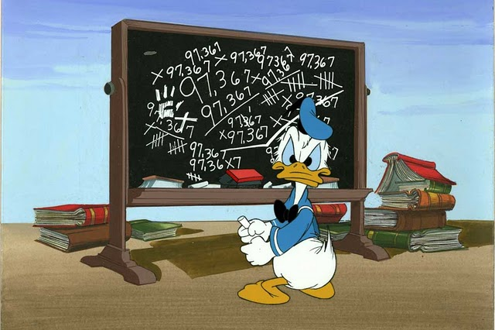
Geometry

Slide 18

Geometry
Vectors
Sum
Subtract
Normalization
Dot product
Cross product

Slide 19

Geometry
Distance between two points
Line equation
Intersection of two lines
Used very much in computer games and raytracing

Slide 20
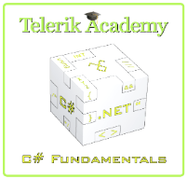
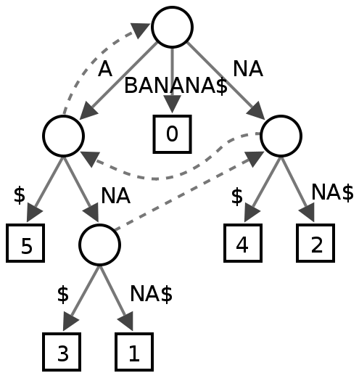
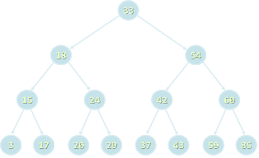
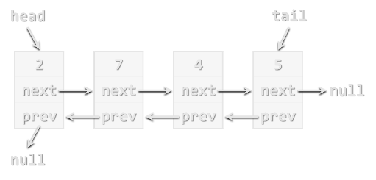
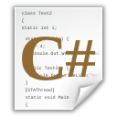
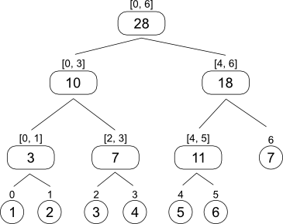
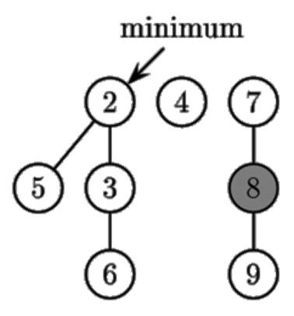
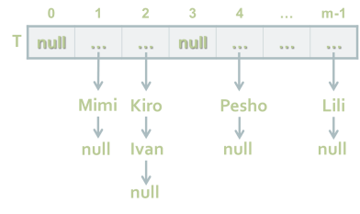
Other Algorithms
http://academy.telerik.com

Slide 21
Exercises
You are given a set of infinite number of coins (1, 2 and 5) and end value – N. Write an algorithm that gives the number of coins needed so that the sum of the coins equals N. Example: N = 33 => 6 coins x 5 + 1 coin x 2 + 1 coin x 1
You are given 3 points A, B and C, forming triangle, and a point P. Check if the point P is in the triangle or not.

Slide 22
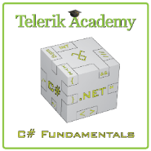



Free Trainings @ Telerik Academy
C# Programming @ Telerik Academy
csharpfundamentals.telerik.com
Telerik Software Academy
academy.telerik.com
Telerik Academy @ Facebook
facebook.com/TelerikAcademy
Telerik Software Academy Forums
forums.academy.telerik.com

