Slide 1
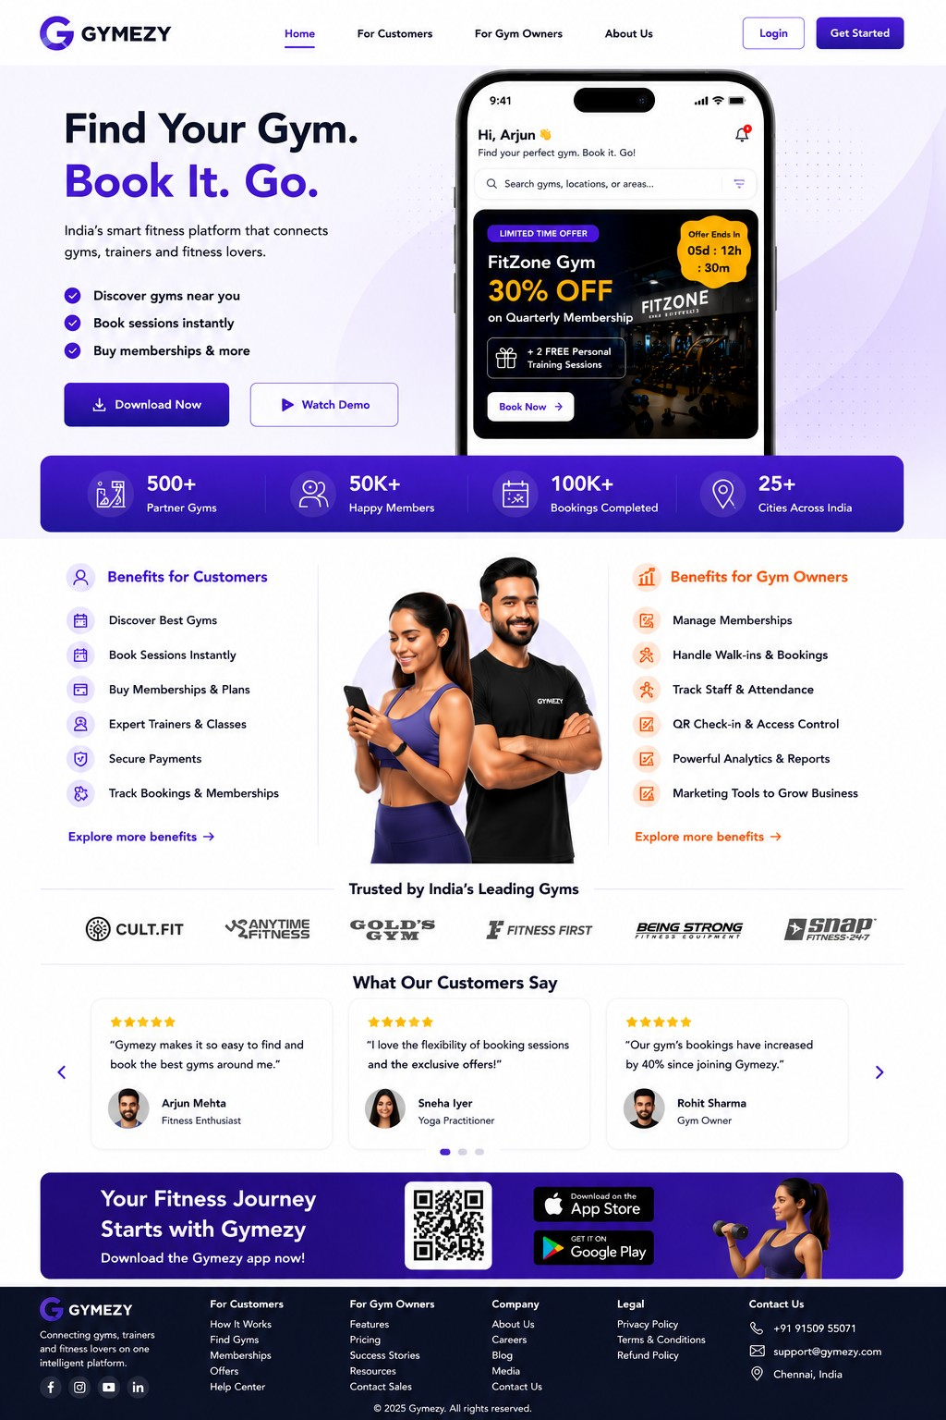
GYMEZY Website UI/UX
Website Design Presentation

Slide 2
Home Page

Slide 3
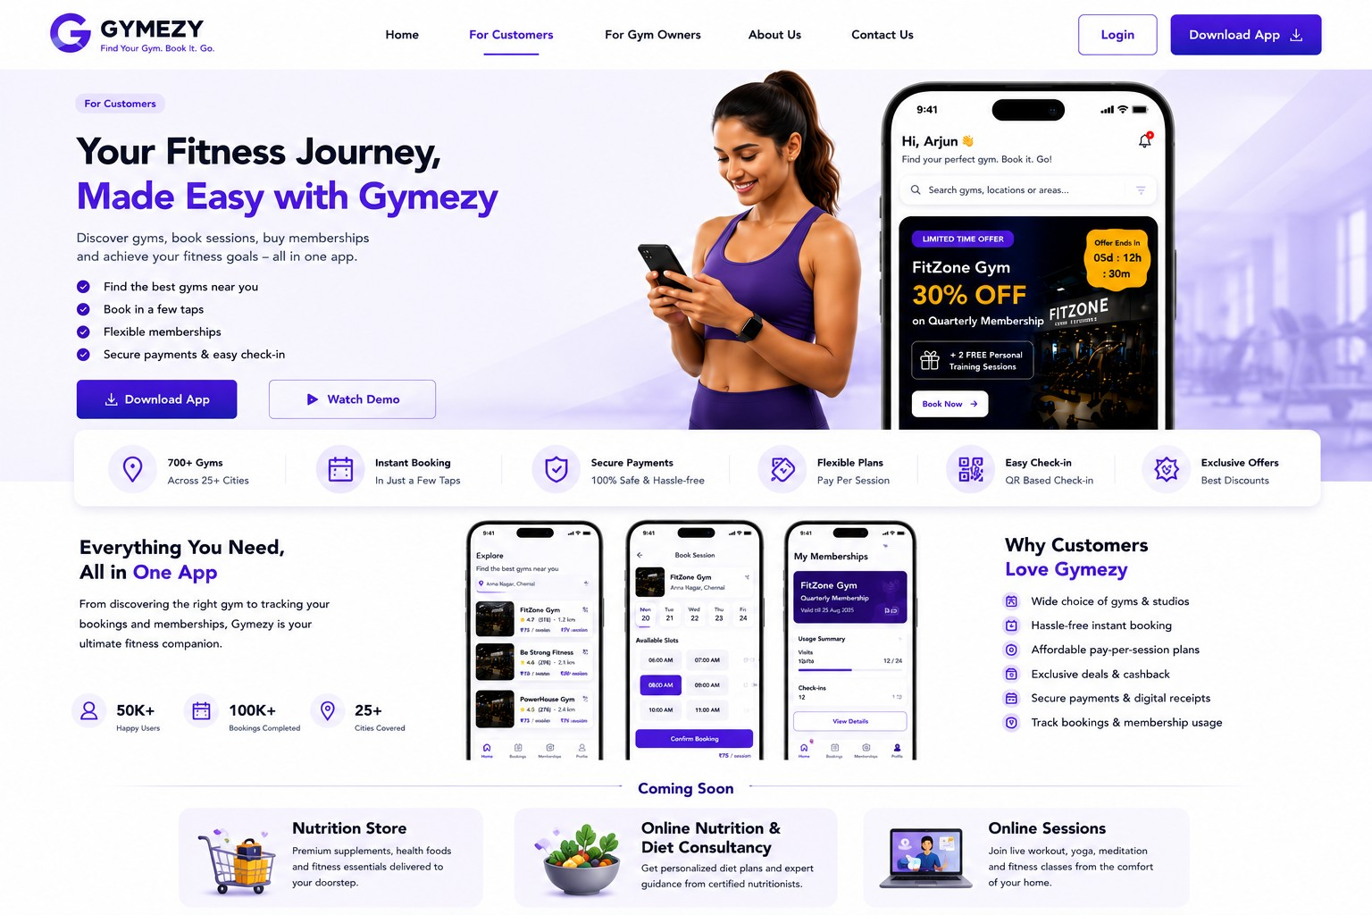
For Customers

Slide 4
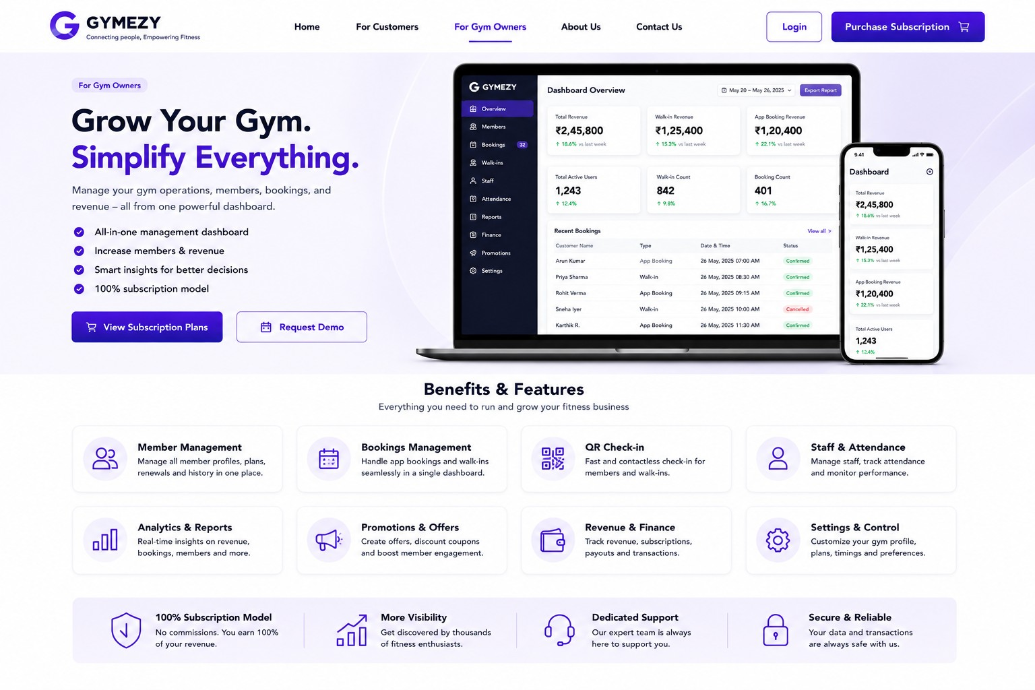
Gym Owners - Benefits & Features

Slide 5
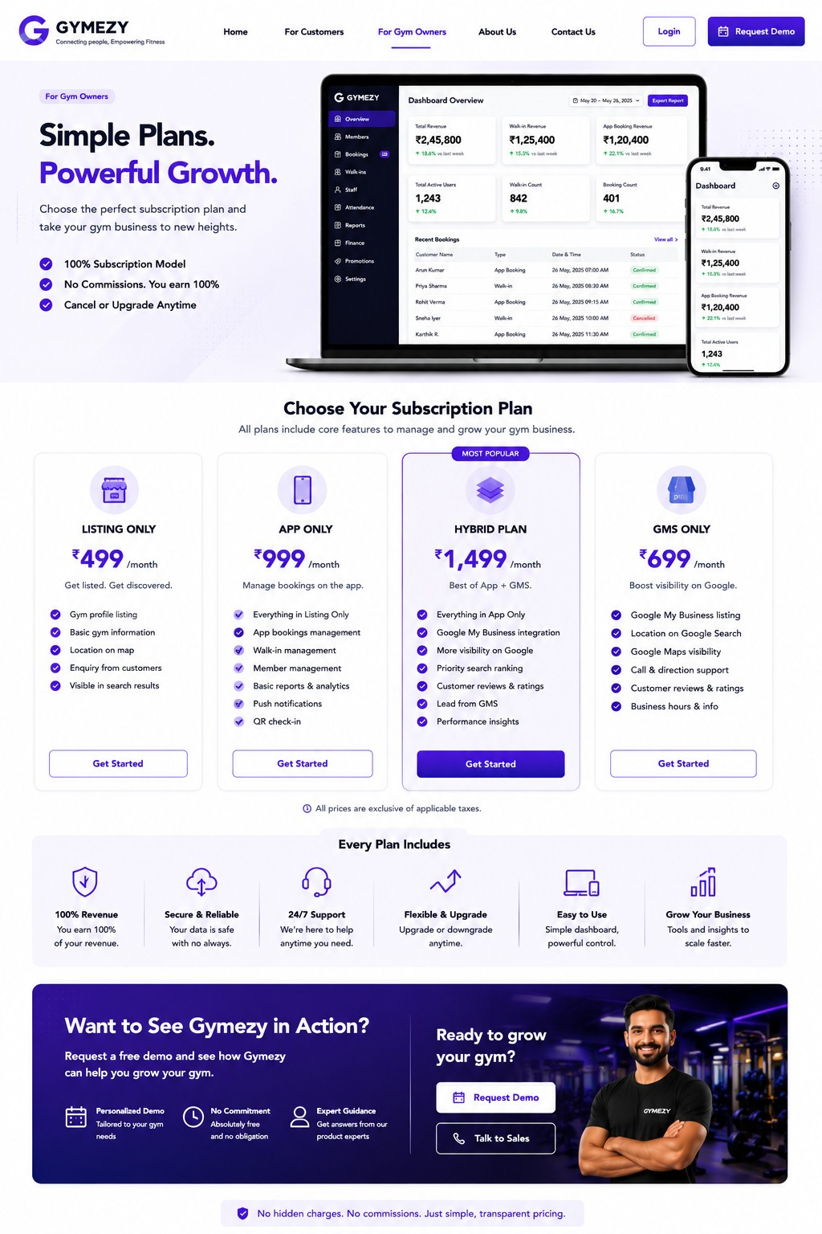
Gym Owners - Subscription Plans

Slide 6
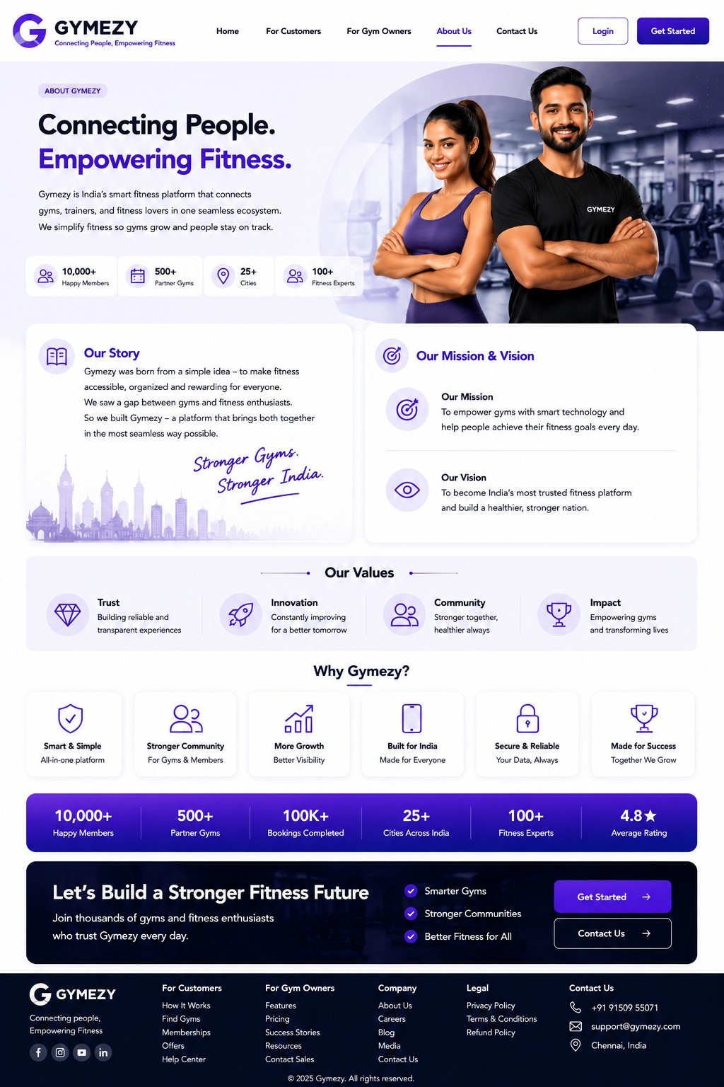
About Us

Slide 7
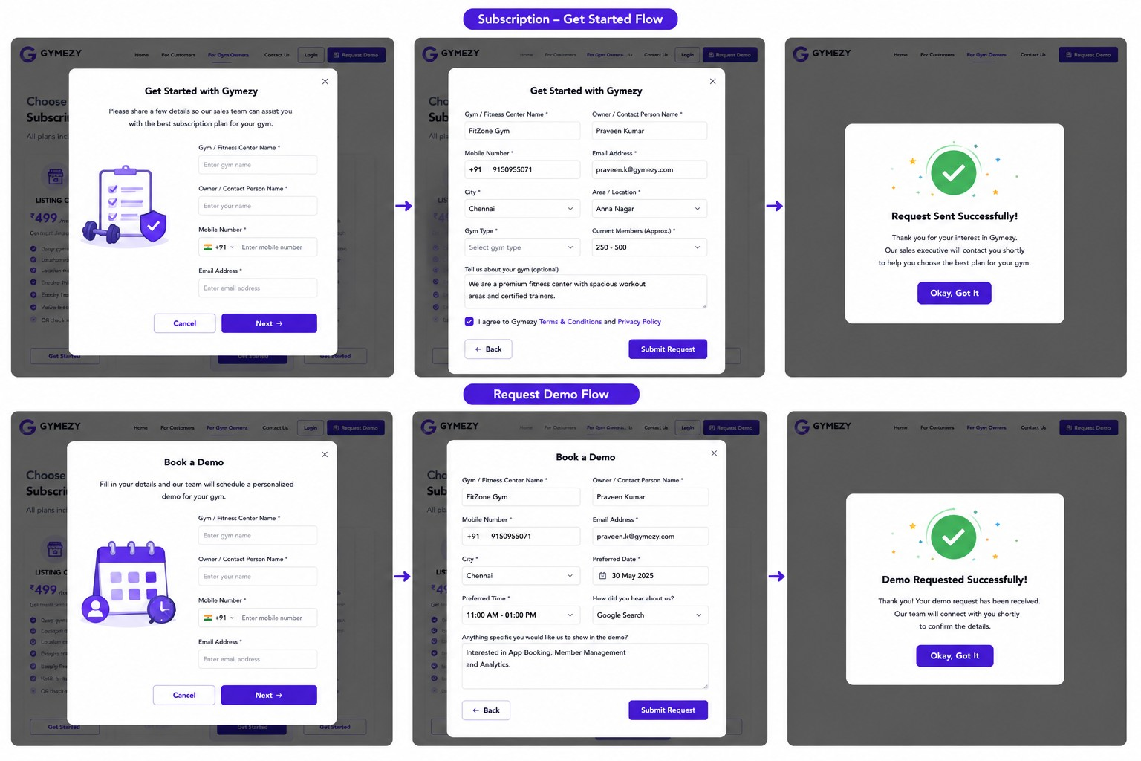
Subscription & Demo Lead Flow

