Slide 1
GYMEZY Company Admin Dashboard
UI/UX Design
Product Design Presentation

Slide 2
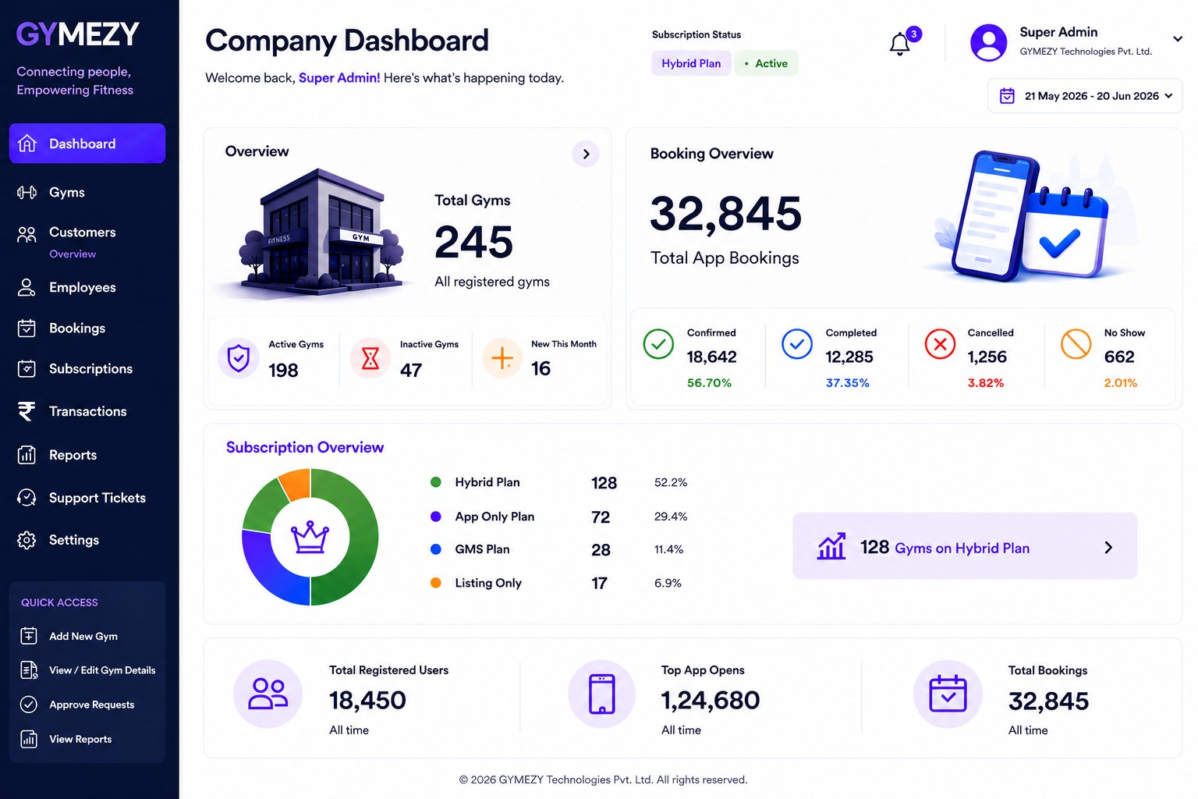
Company Dashboard

Slide 3
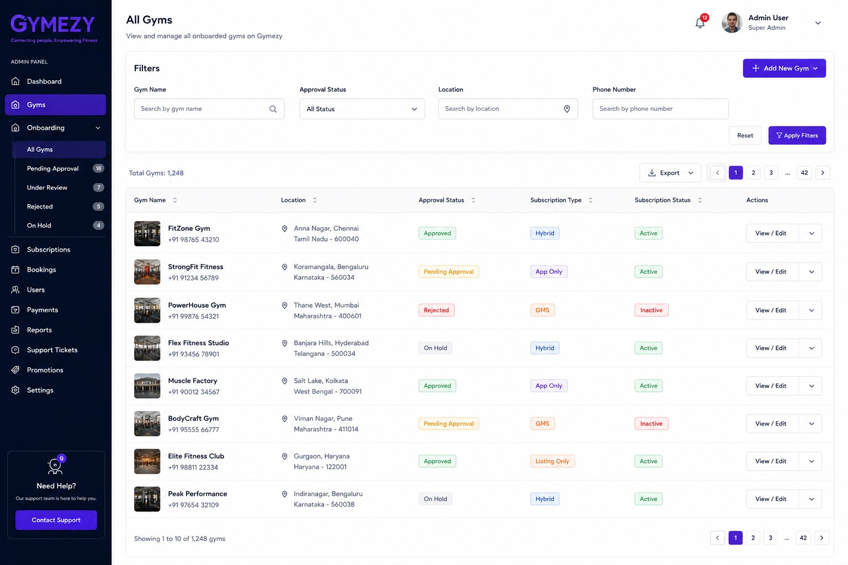
GYM Overview

Slide 4
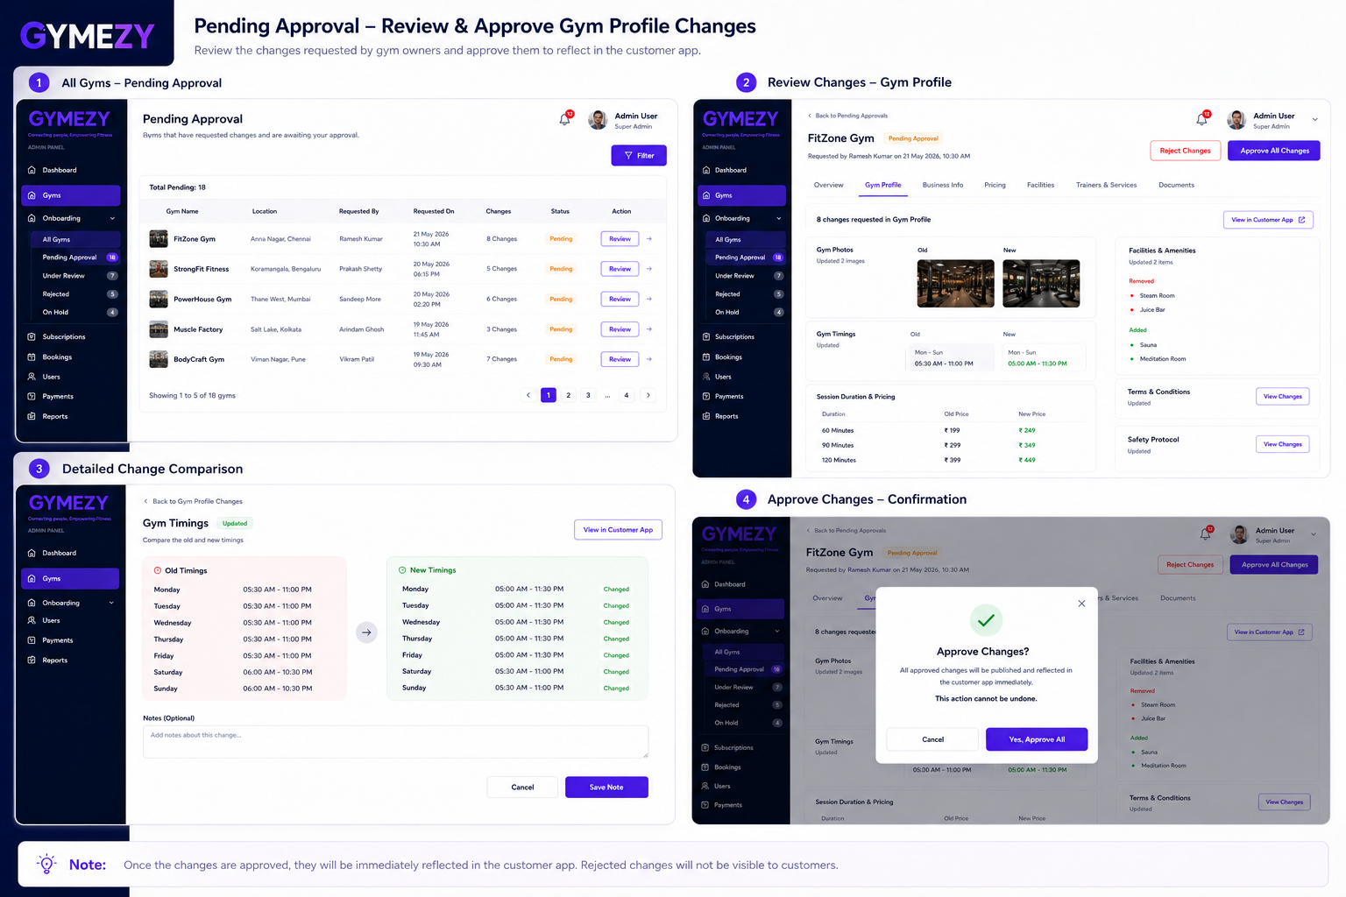
Approval flow

Slide 5
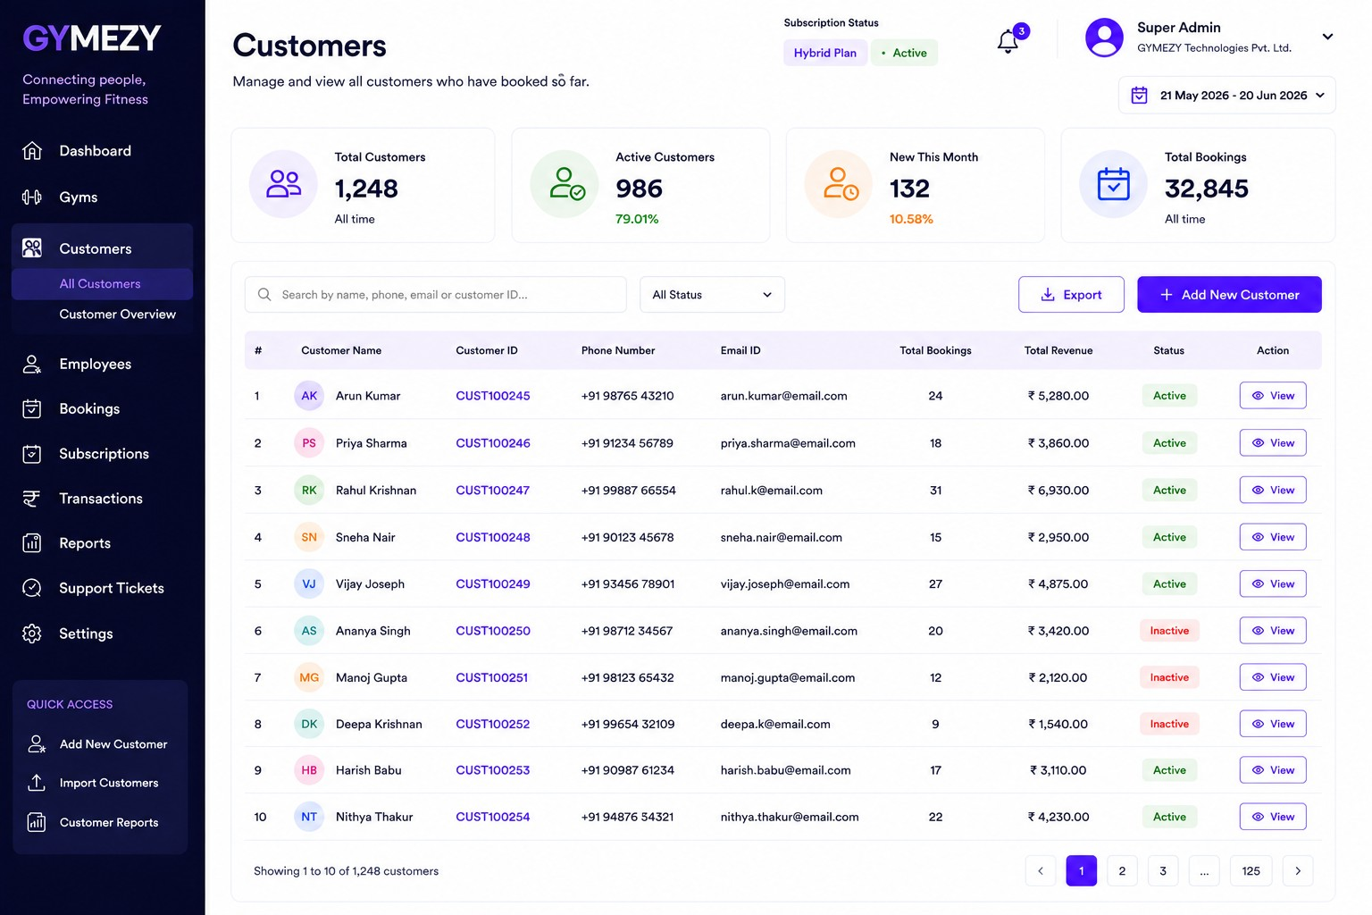
Customers Management

Slide 6
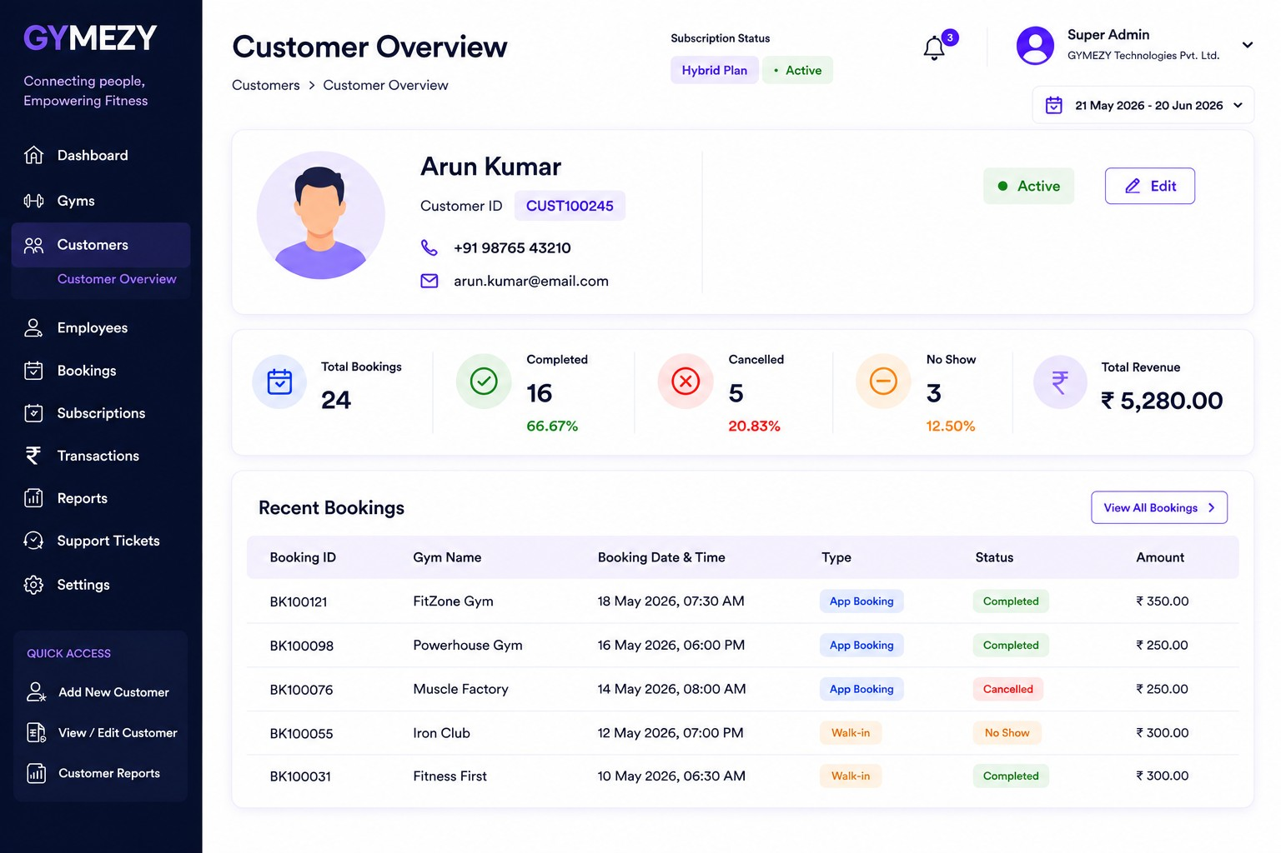
Customer Overview

Slide 7
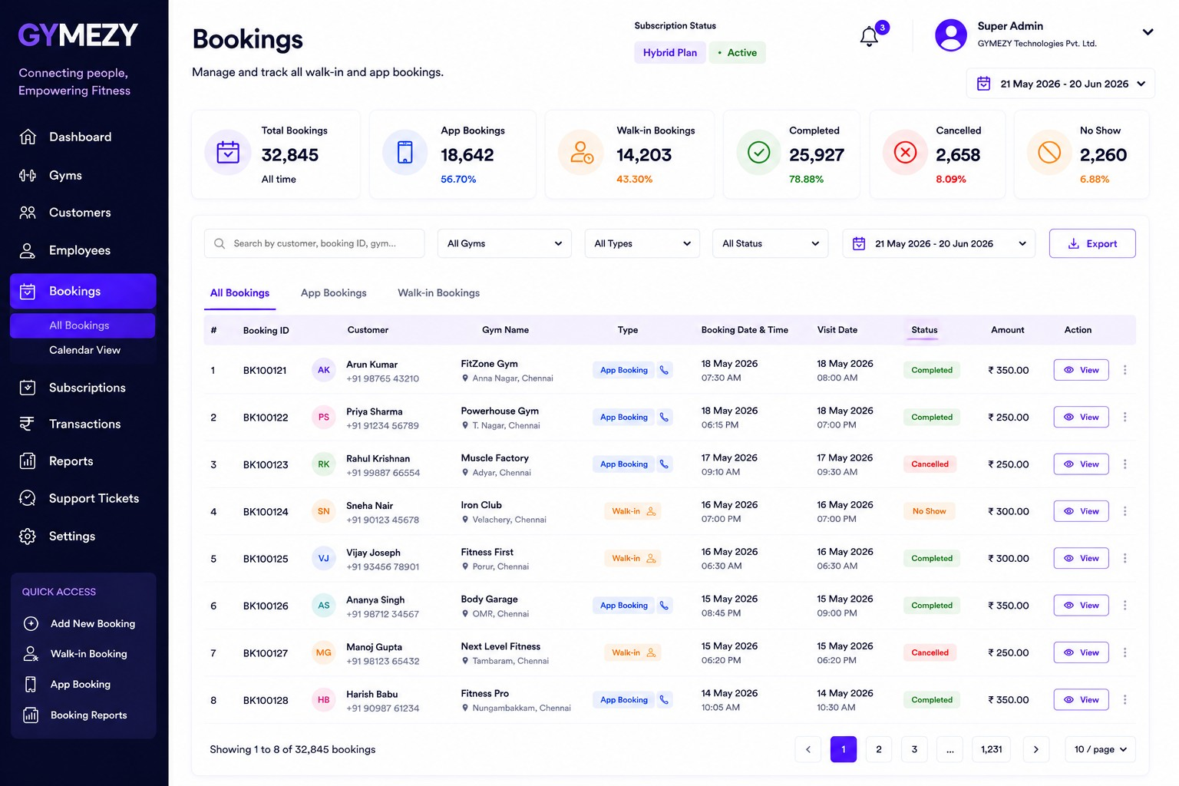
Bookings Management

Slide 8
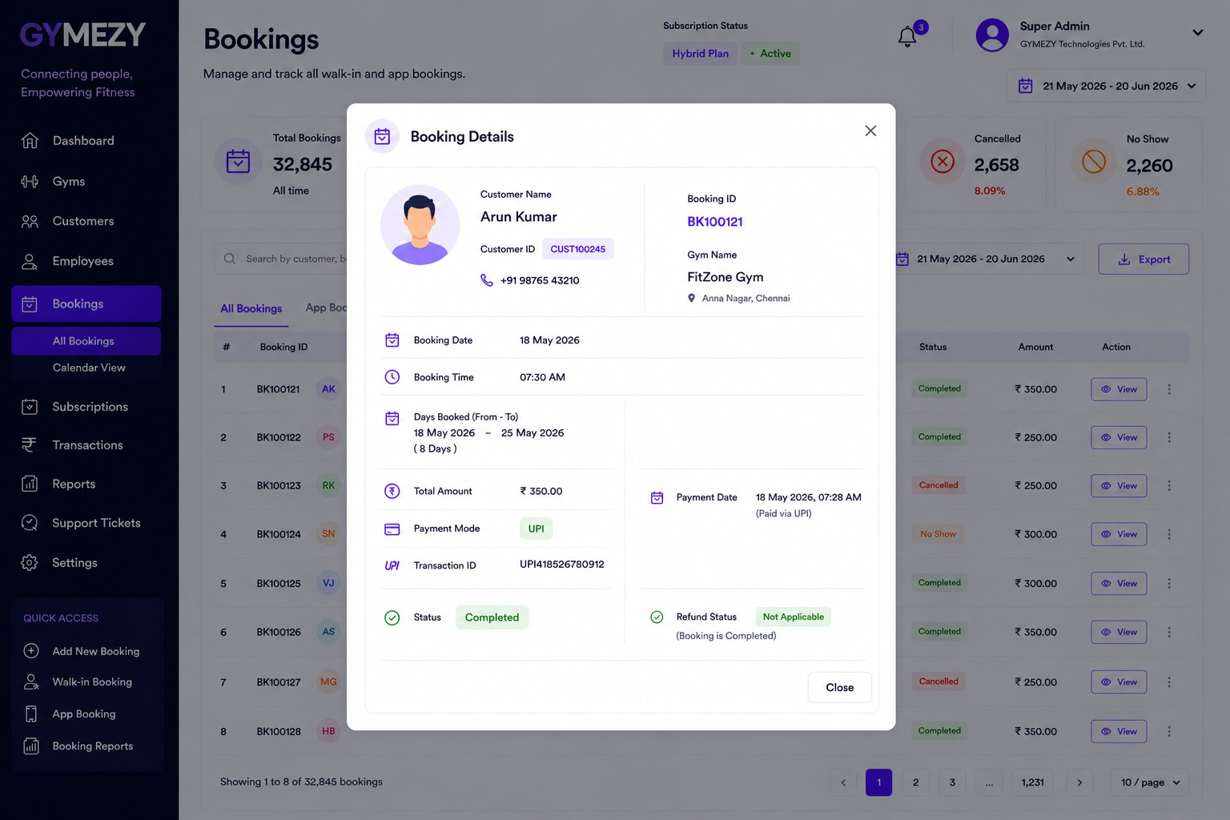
Booking Details

Slide 9
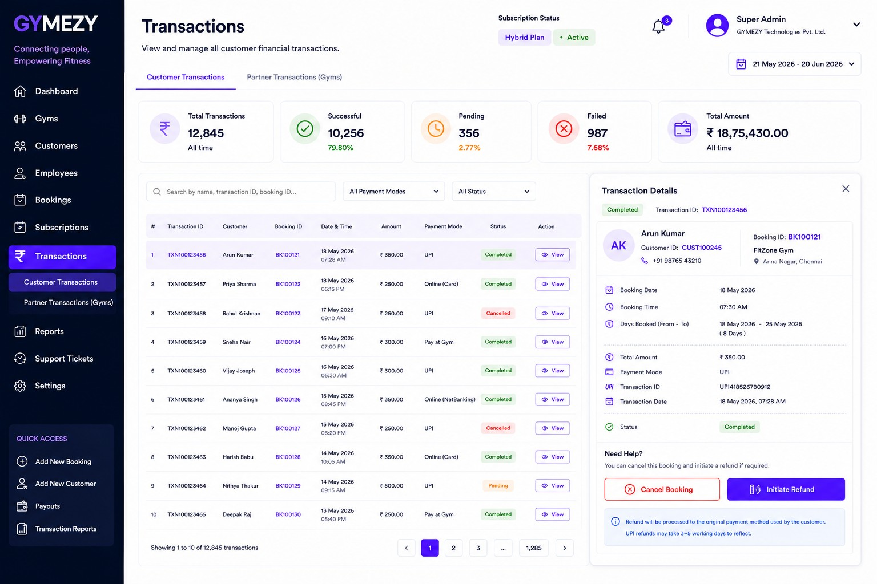
Customer Transactions

Slide 10
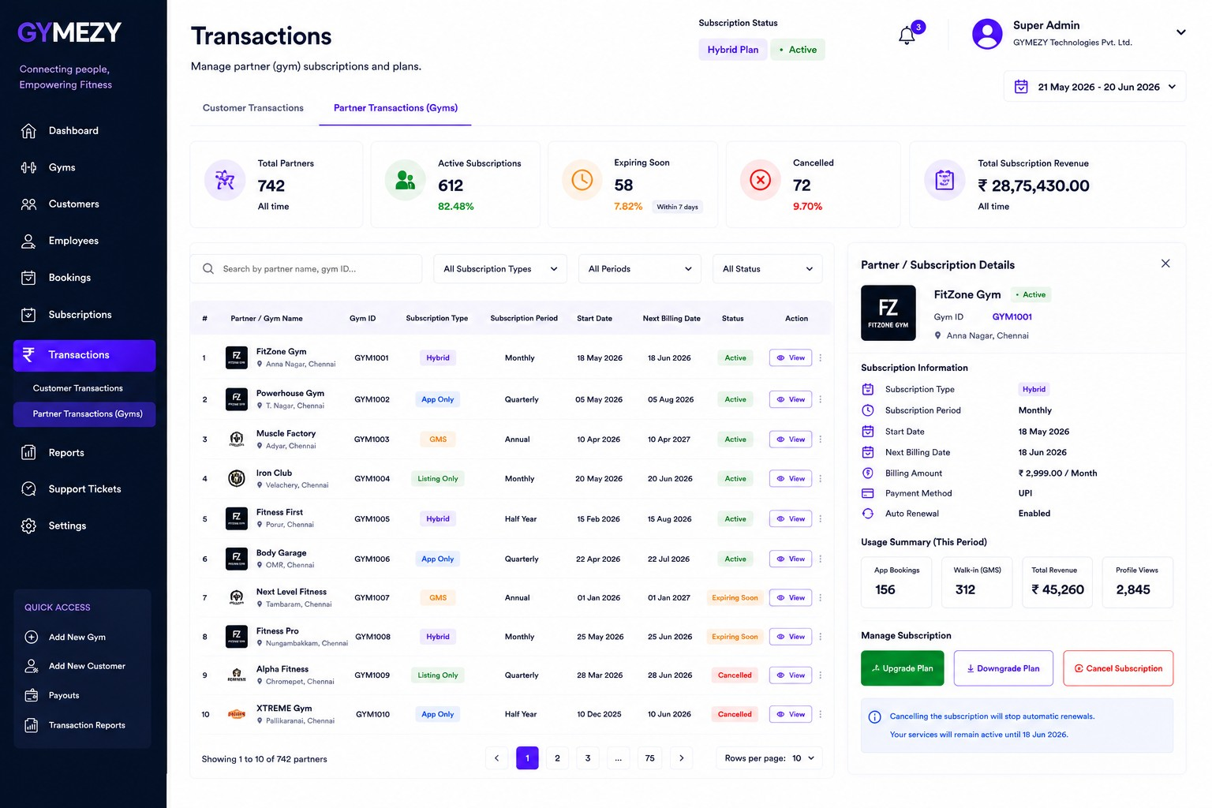
Partner Transactions

Slide 11
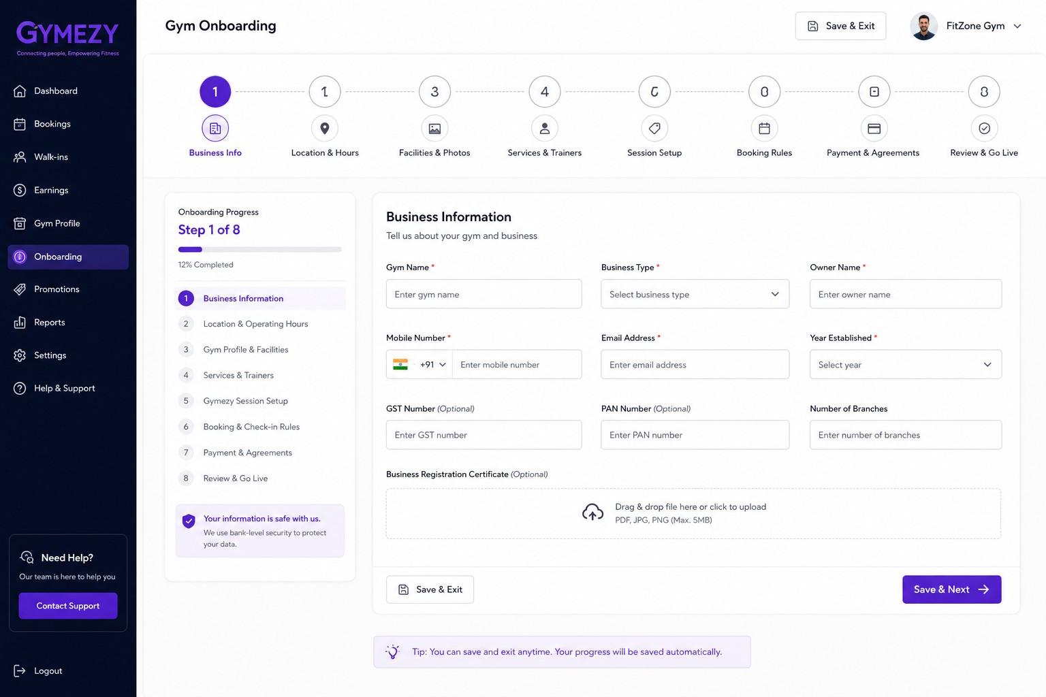
Onboarding

Slide 12
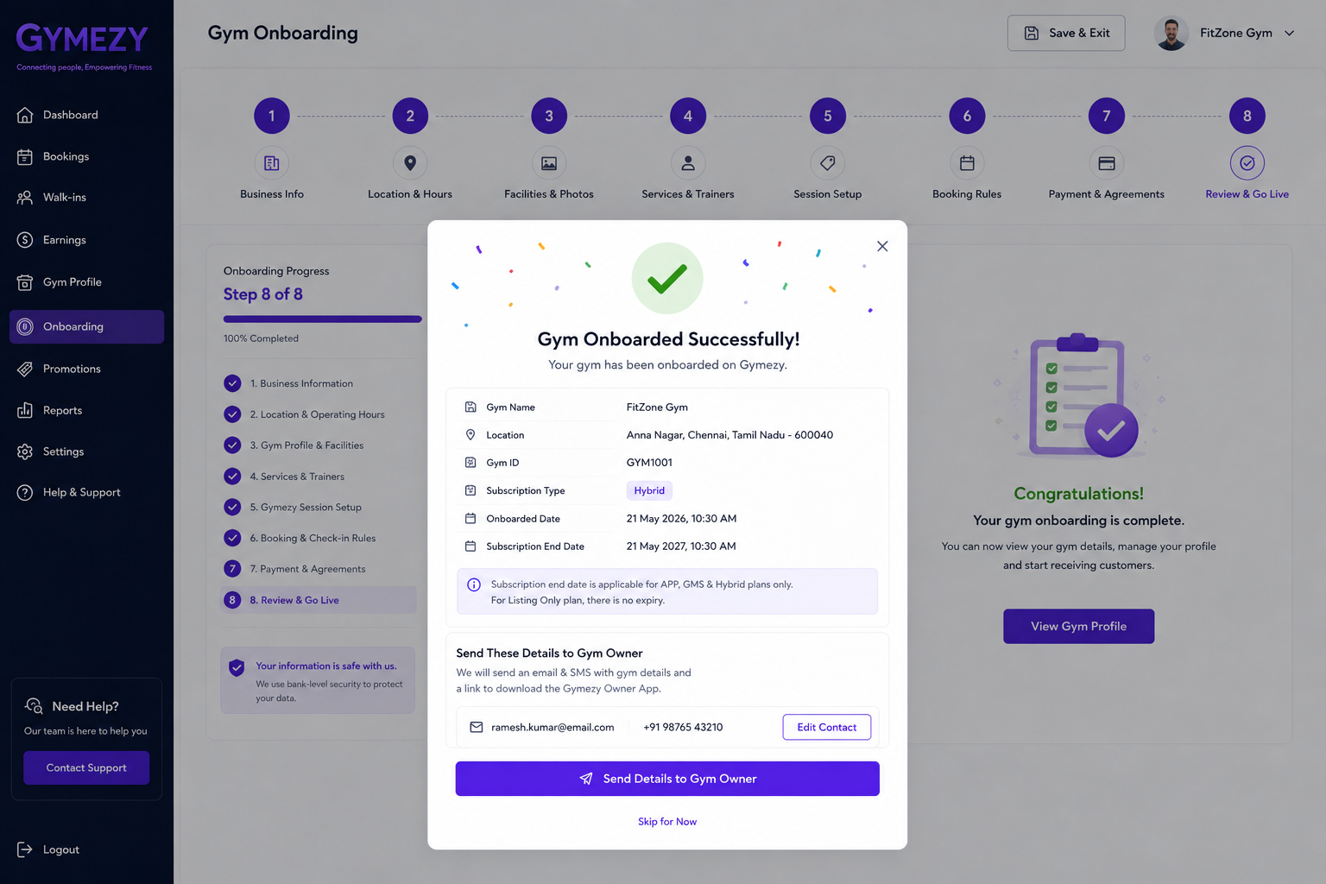
Onboarding status

Slide 13
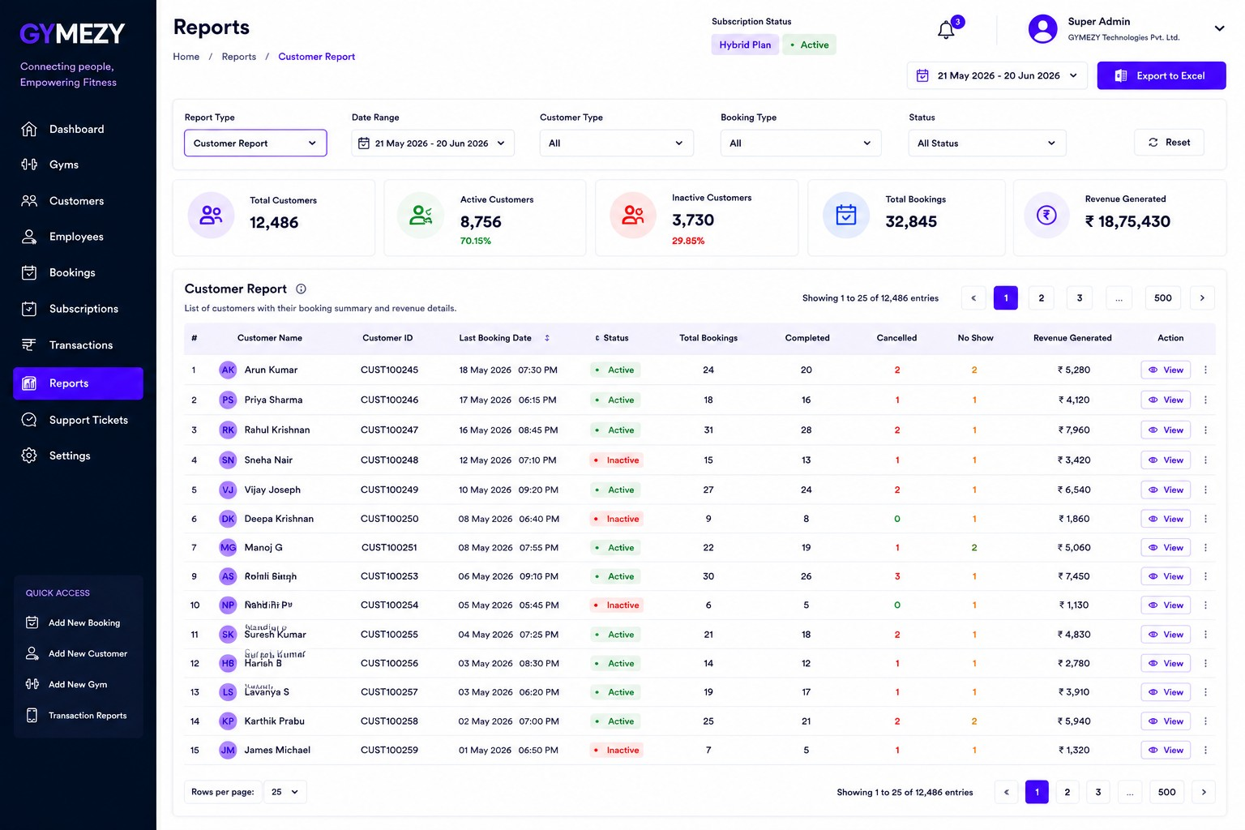
Customer Reports

