Slide 1
GYMEZY - Gym Owner Dashboard
UI/UX Walkthrough

Slide 2
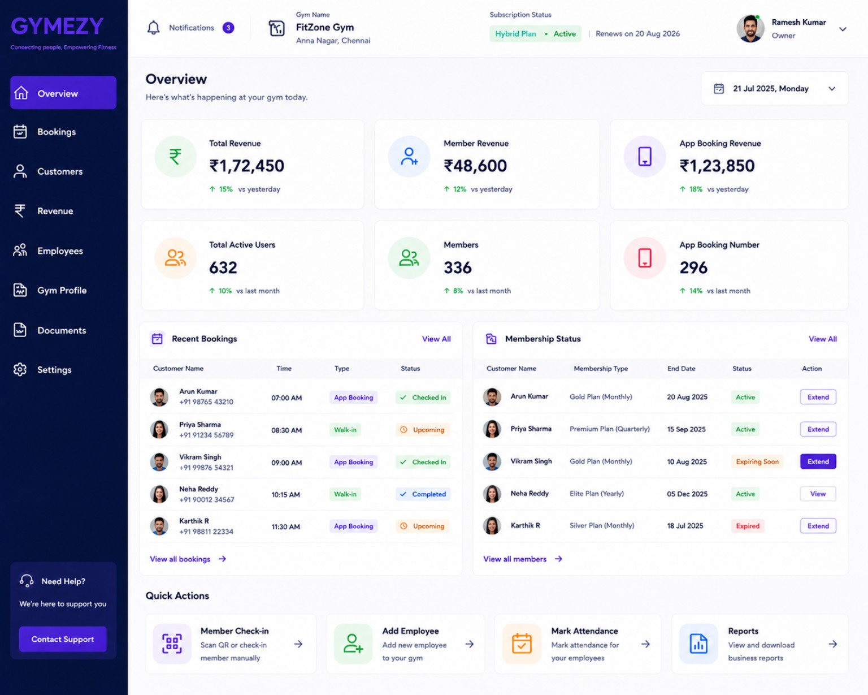
Overview

Slide 3
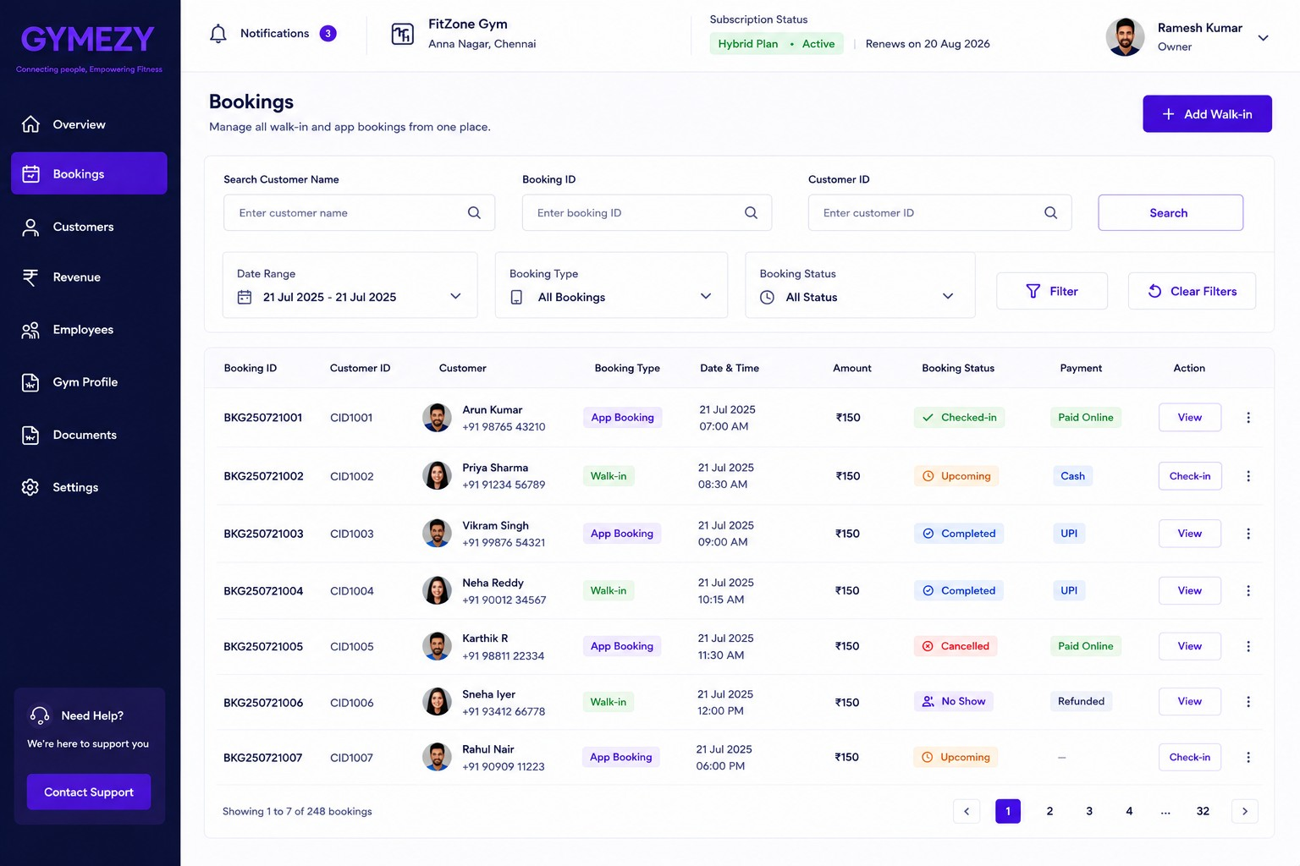
Bookings

Slide 4
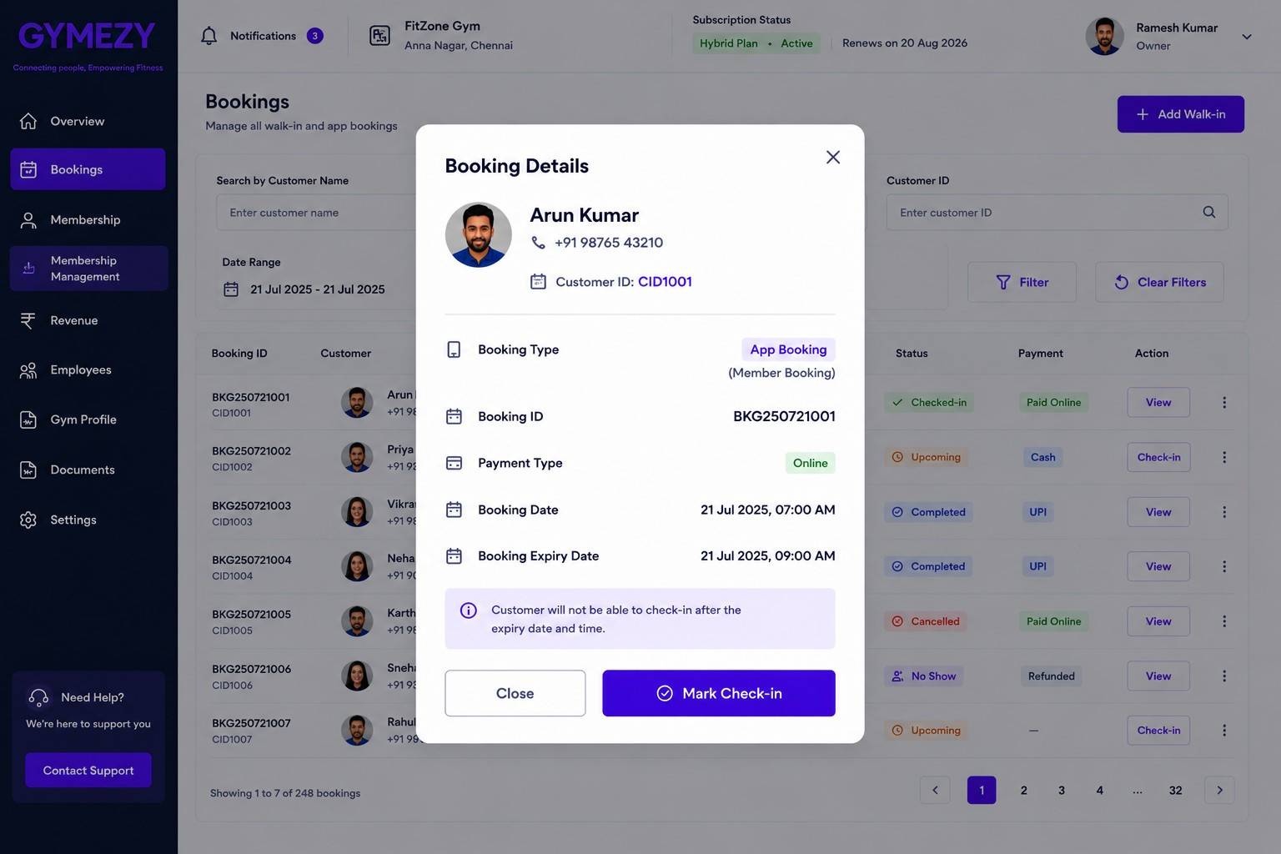
Customer checkin - Manual

Slide 5
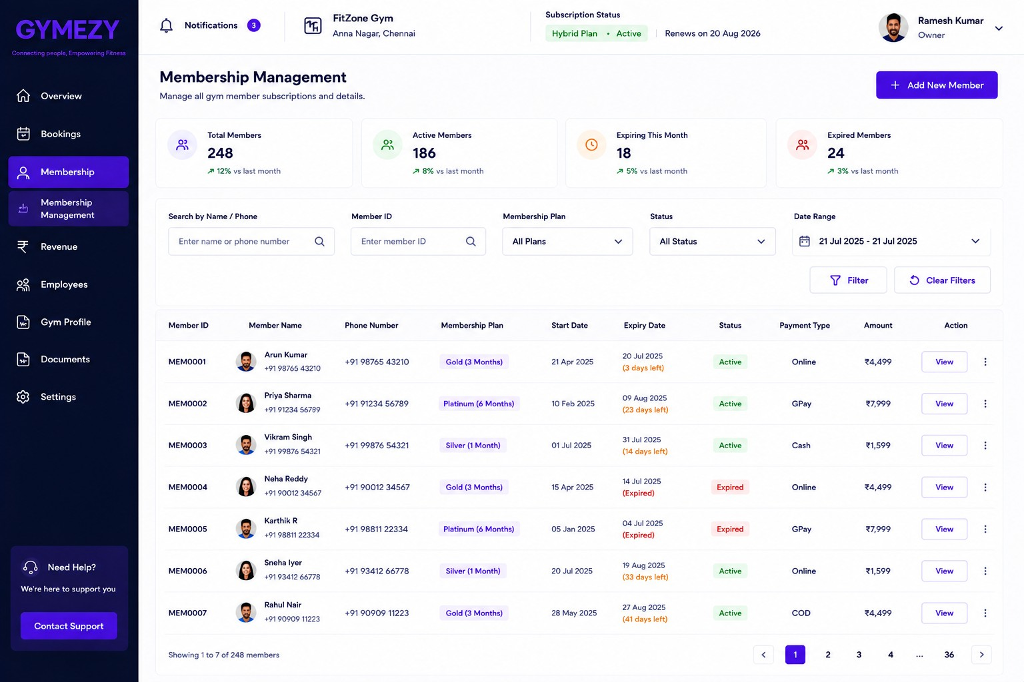
Membership Management

Slide 6
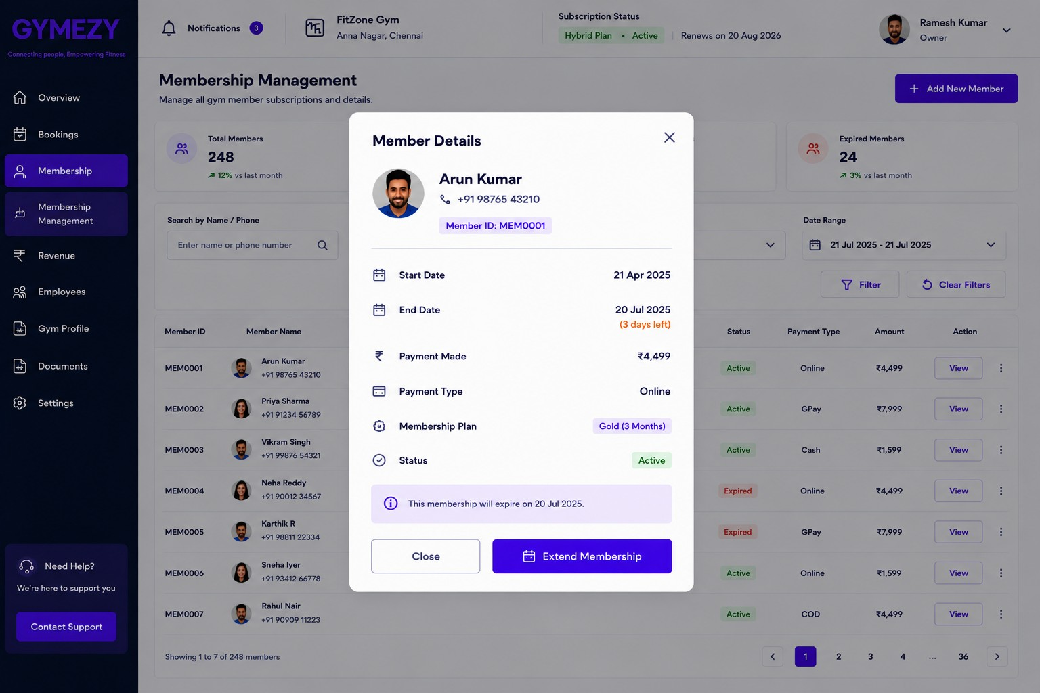
Member Details

Slide 7
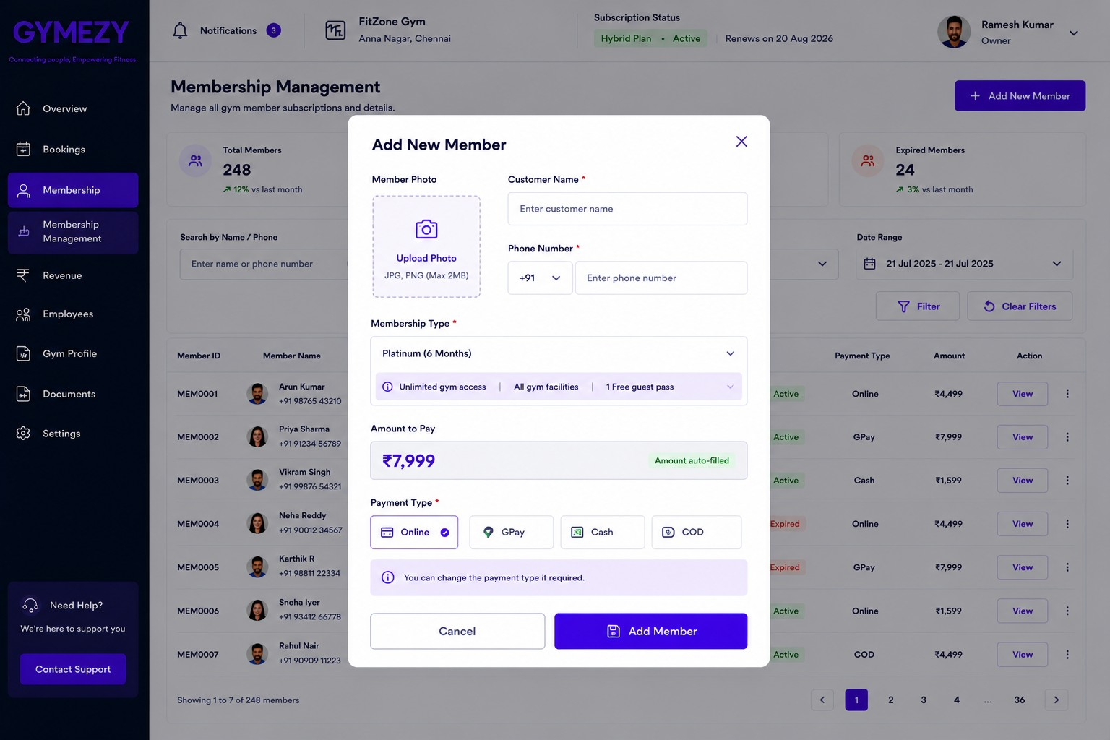
Add New Member

Slide 8
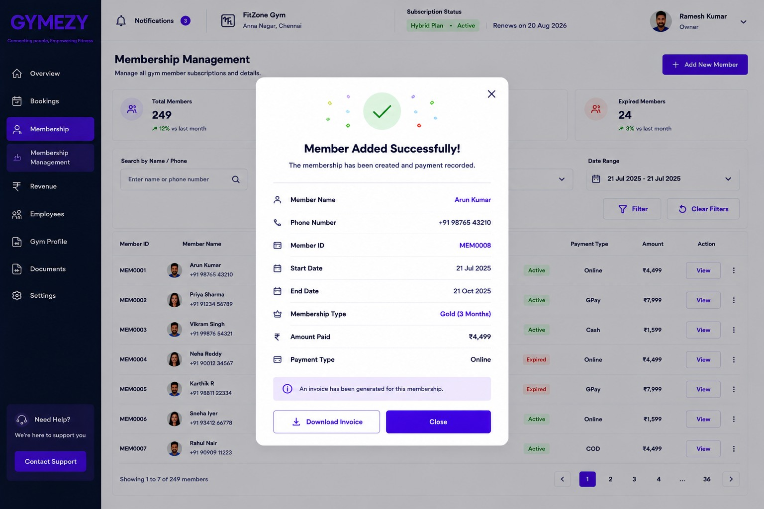
Member Added Successfully

Slide 9
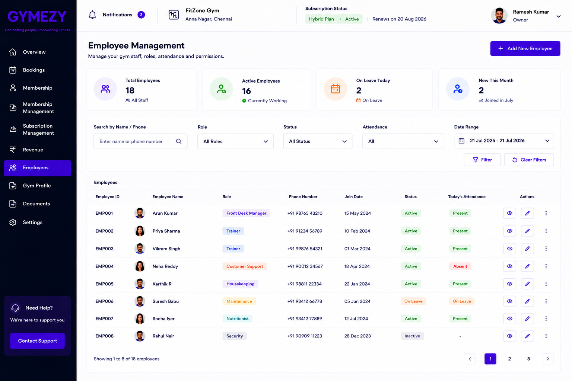
Employee Management

Slide 10
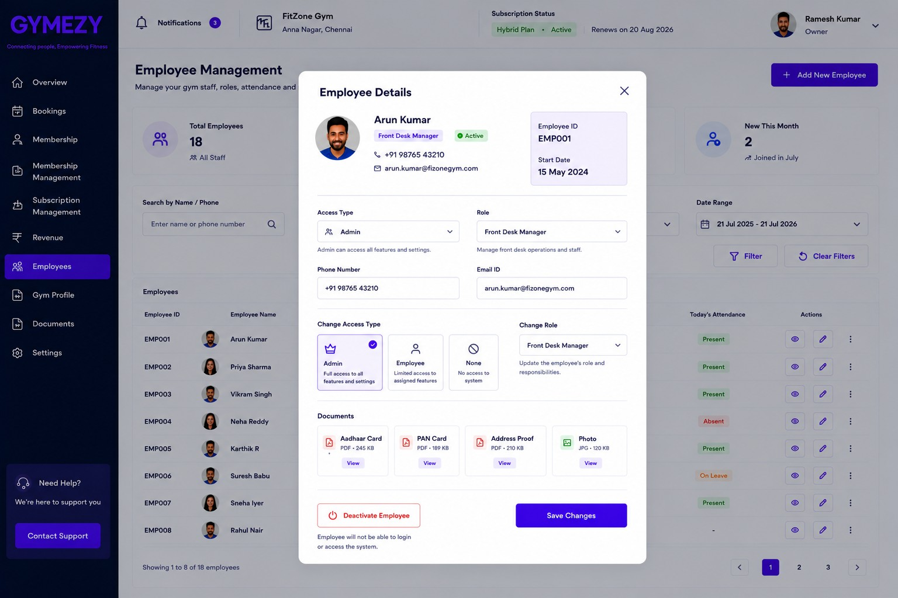
Employee Details

Slide 11
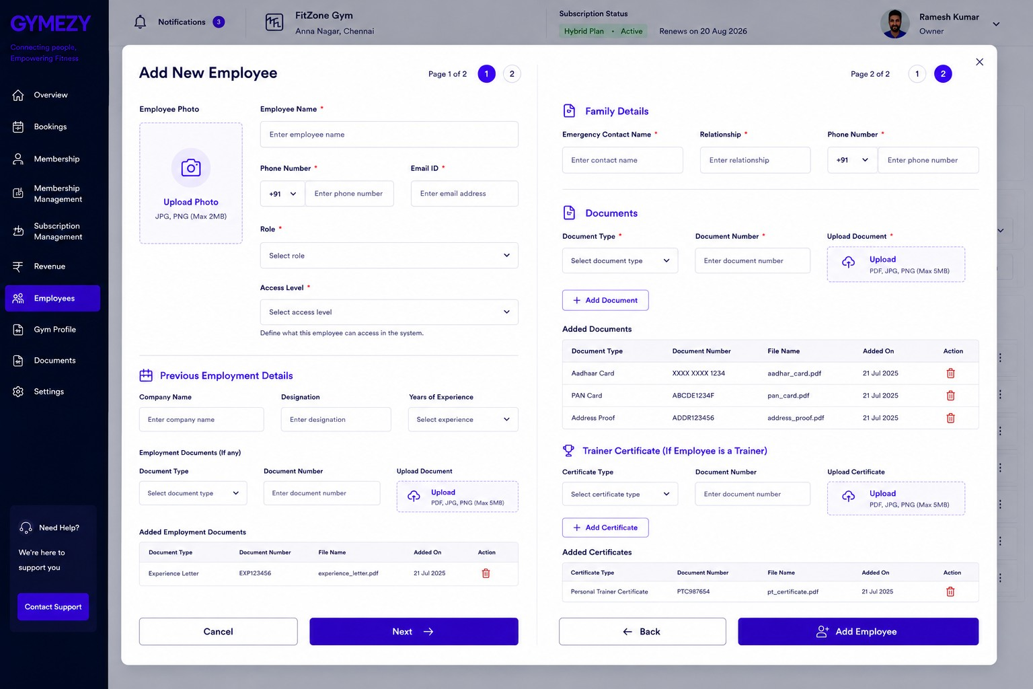
Add New Employee

Slide 12
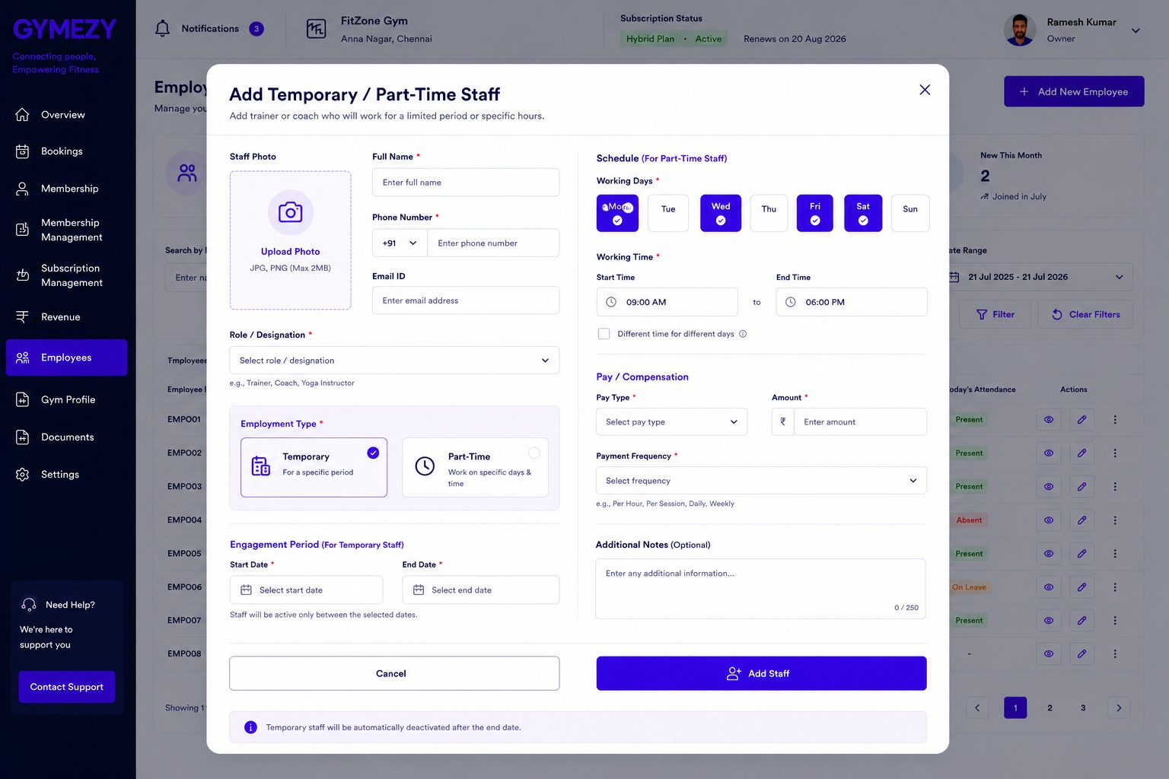
Add Temporary / Part-Time Staff

Slide 13
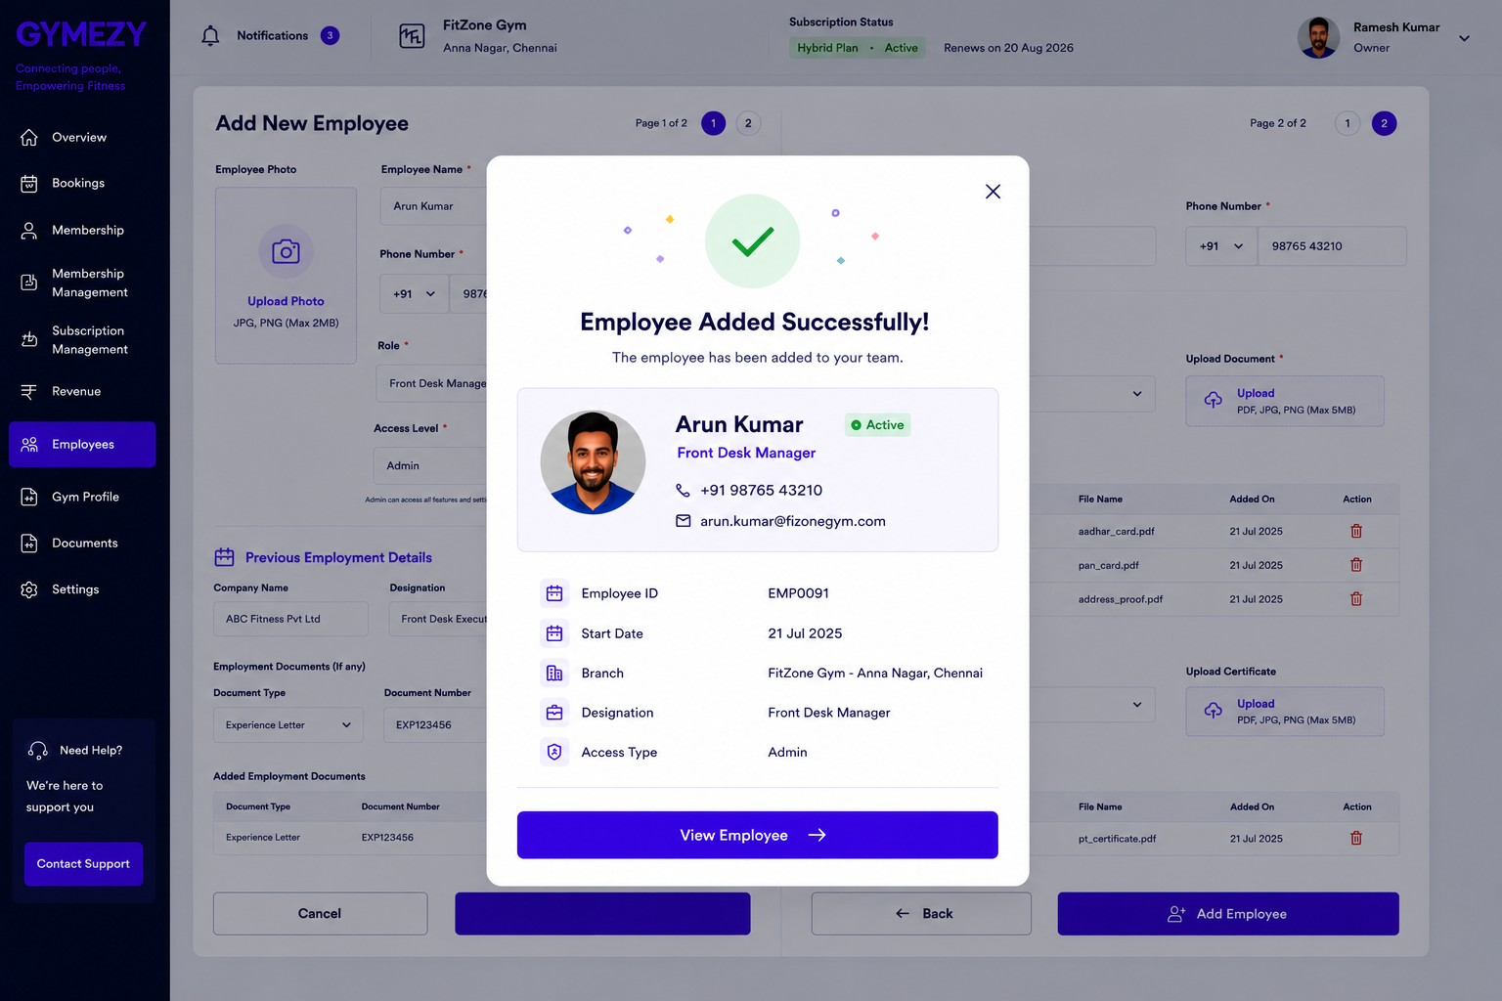
Employee Added Successfully

Slide 14
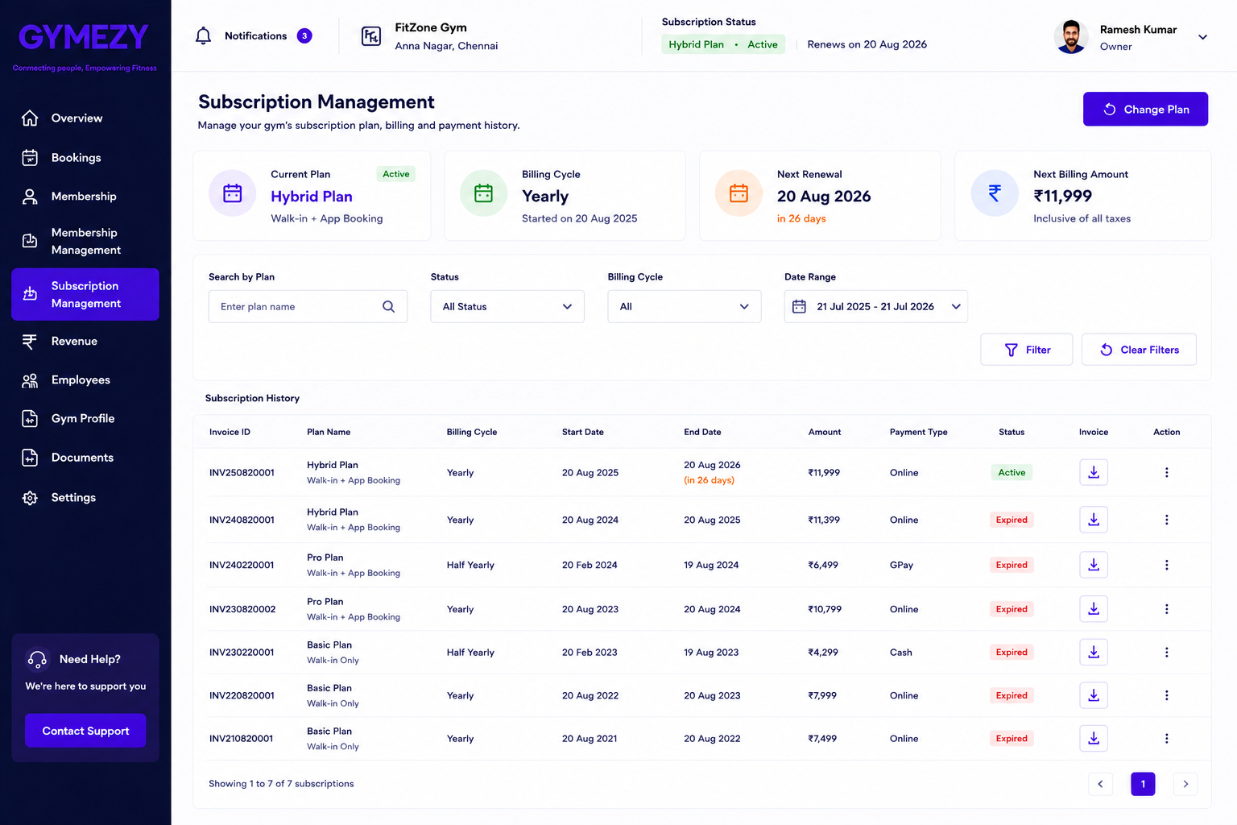
Subscription Management

Slide 15
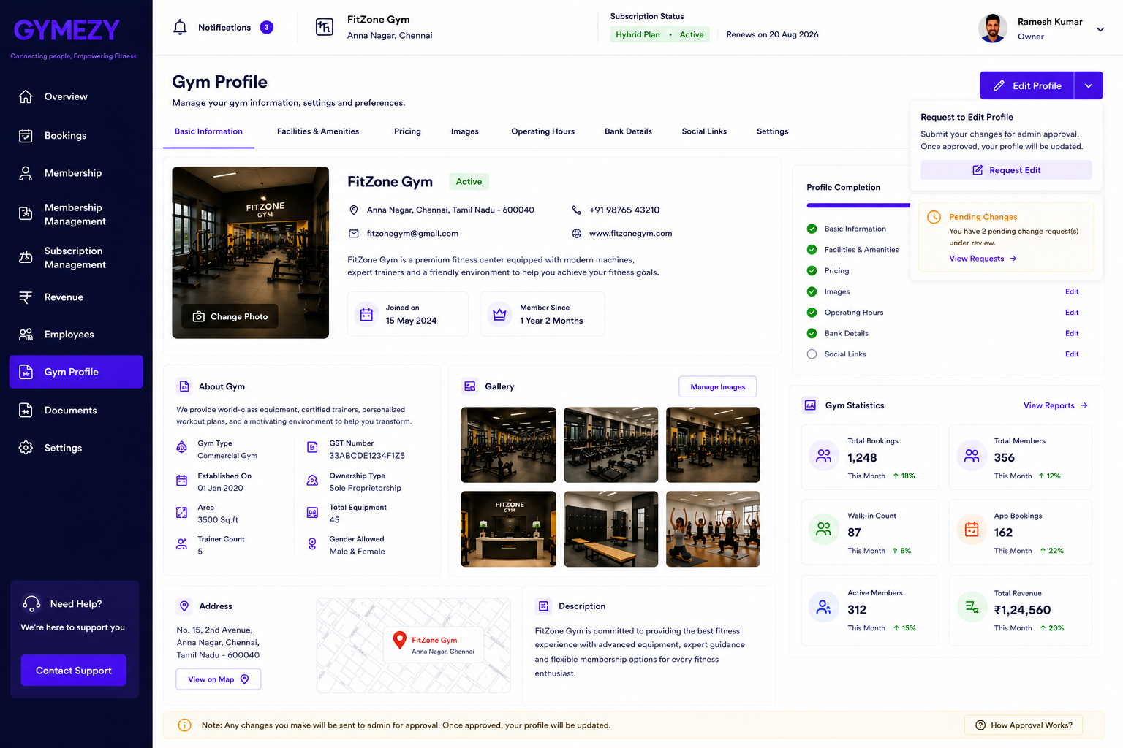
Gym Profile Approval

