Slide 1
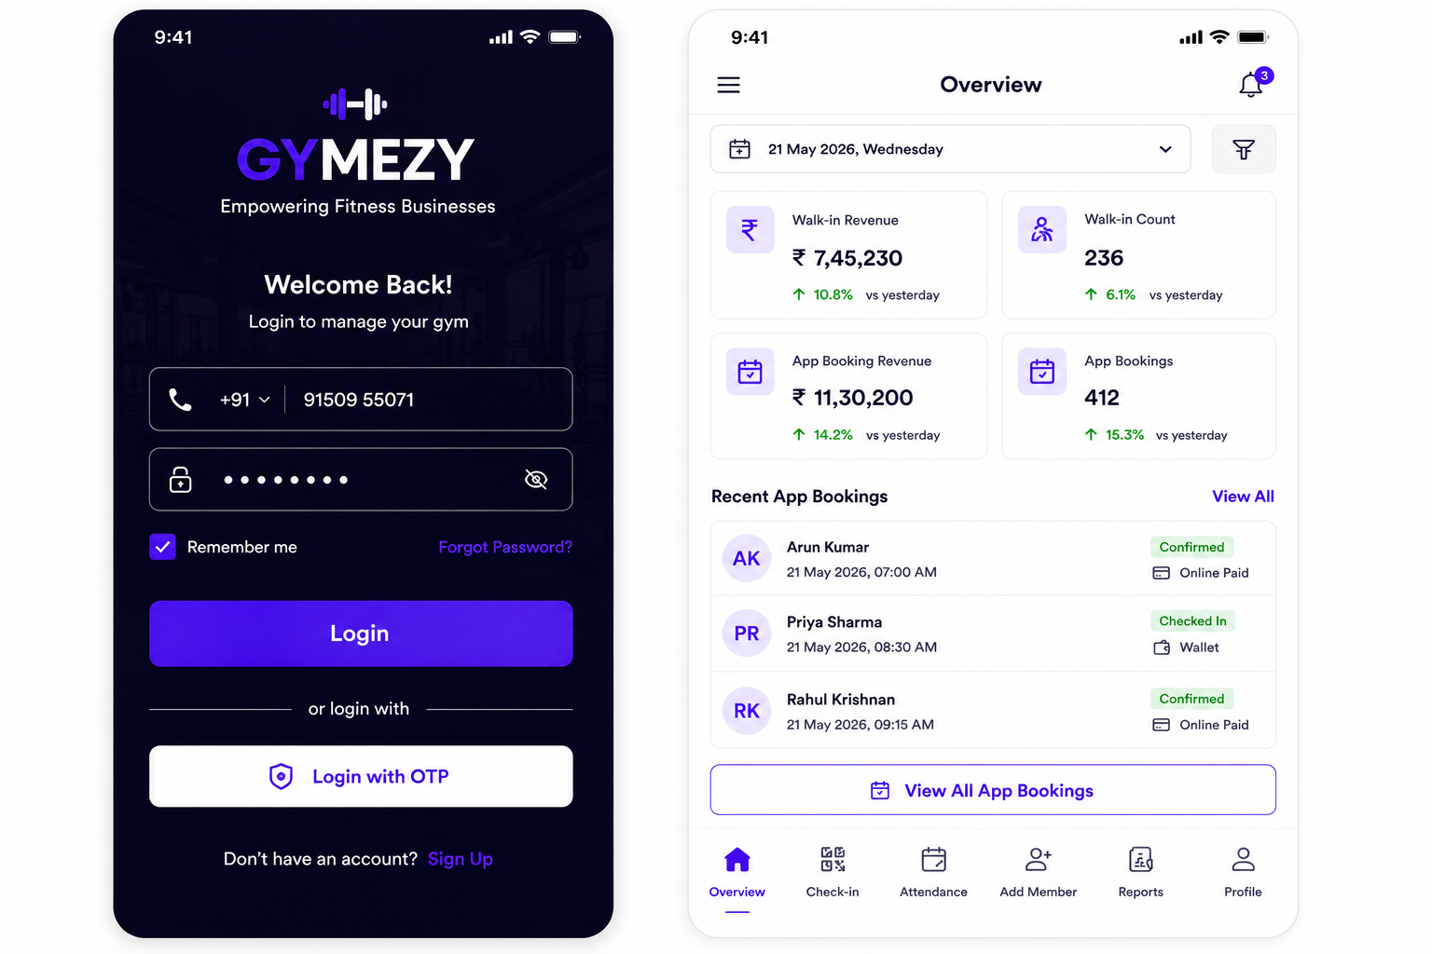
Login & Overview

Slide 2
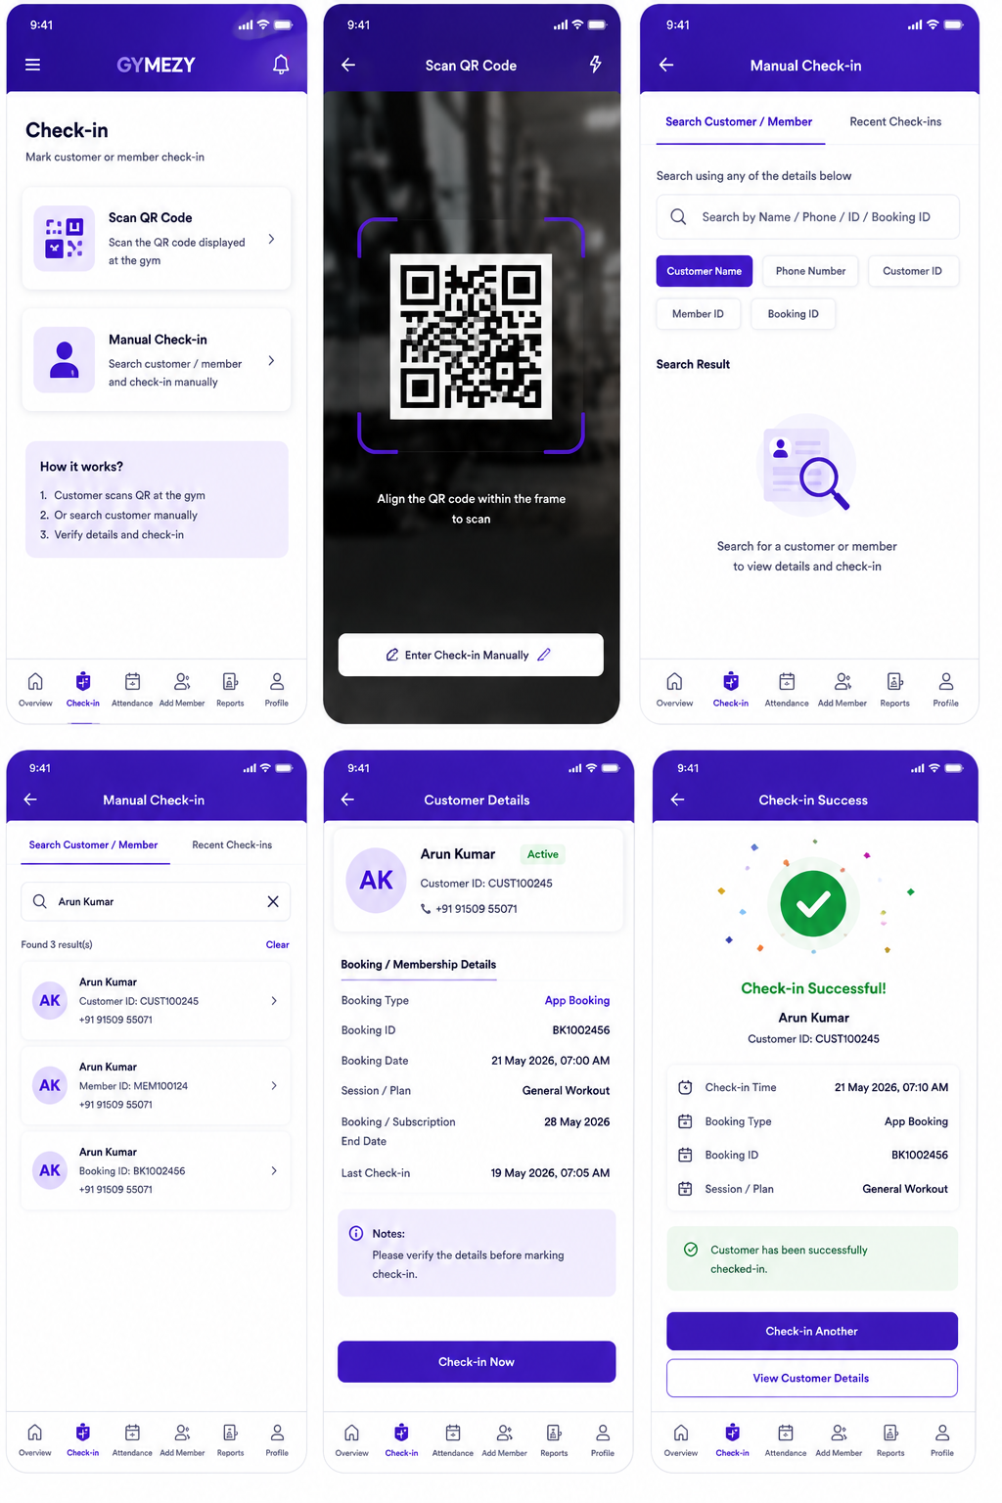
Customer Check-in

Slide 3
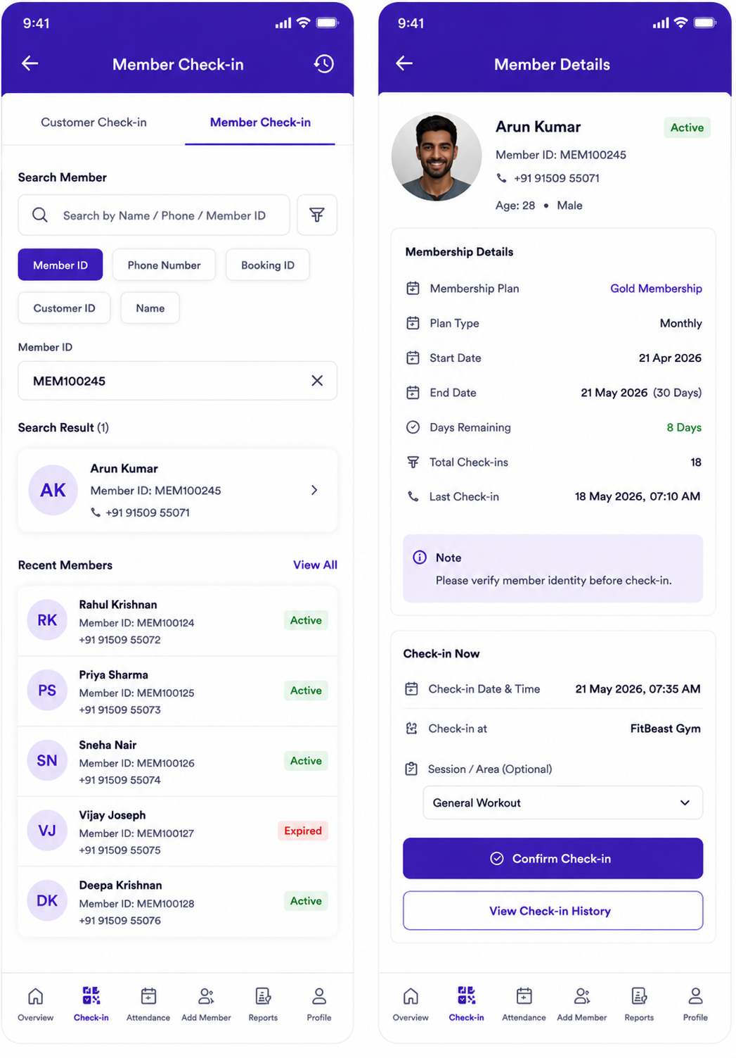
Member Check-in

Slide 4
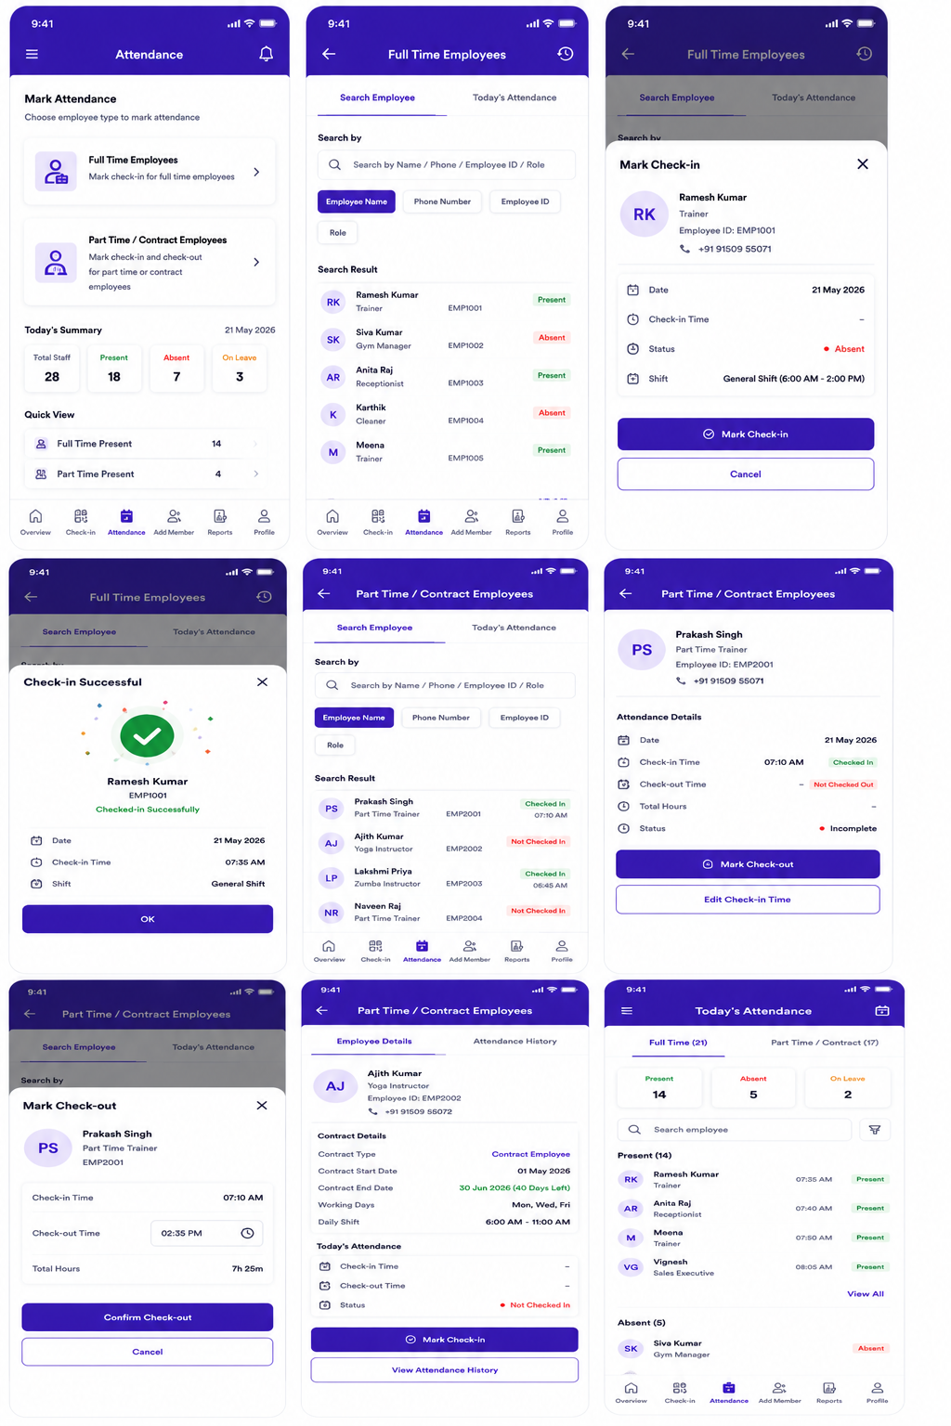
Employee Attendance

Slide 5
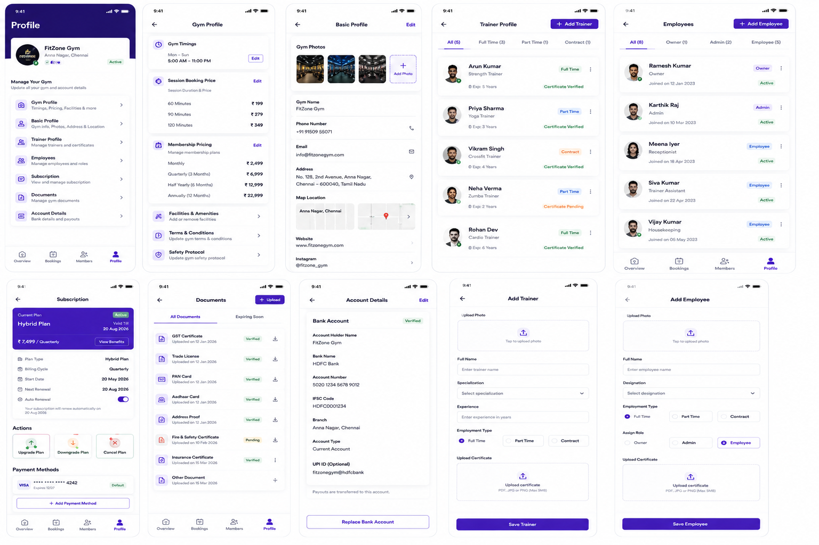
Profile view 1

Slide 6
Profile view 2

Slide 7
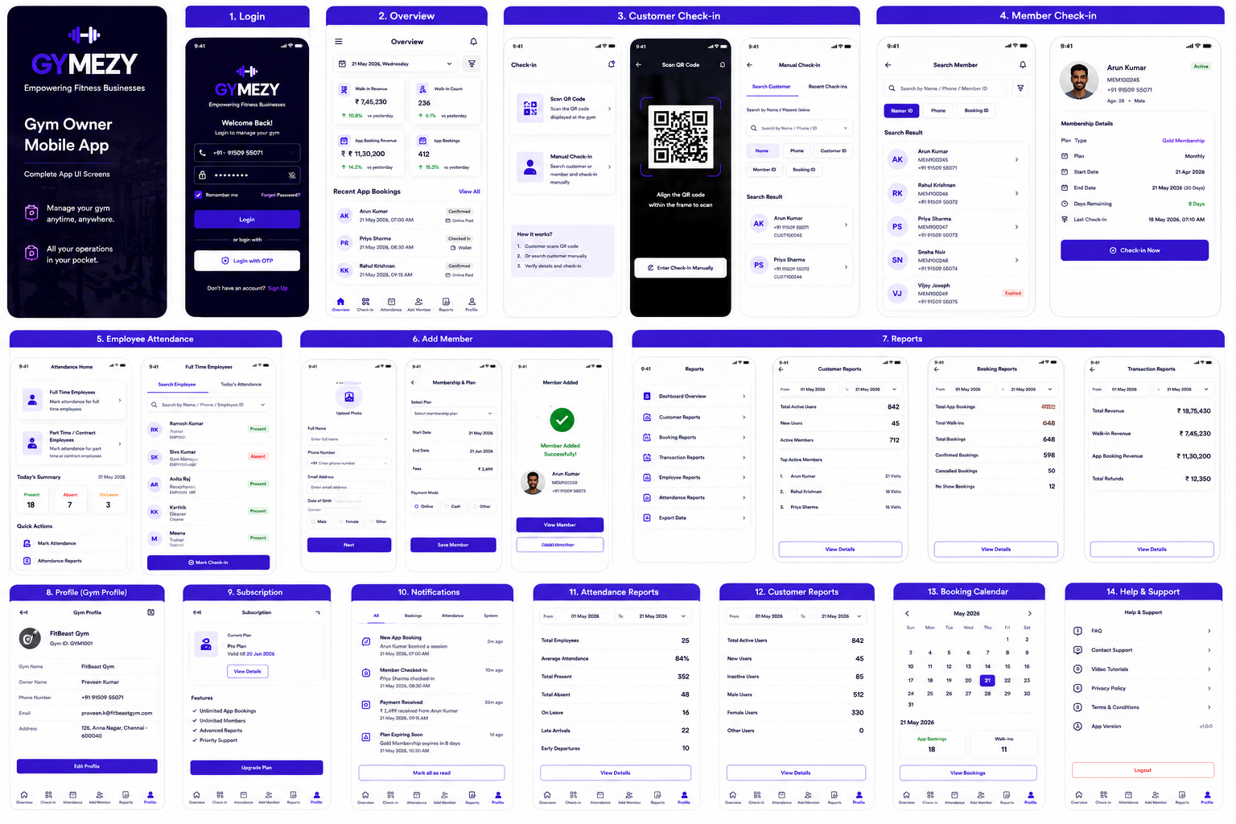
Complete Gym Owner Mobile App

