Slide 1
IBS LHC

Slide 2
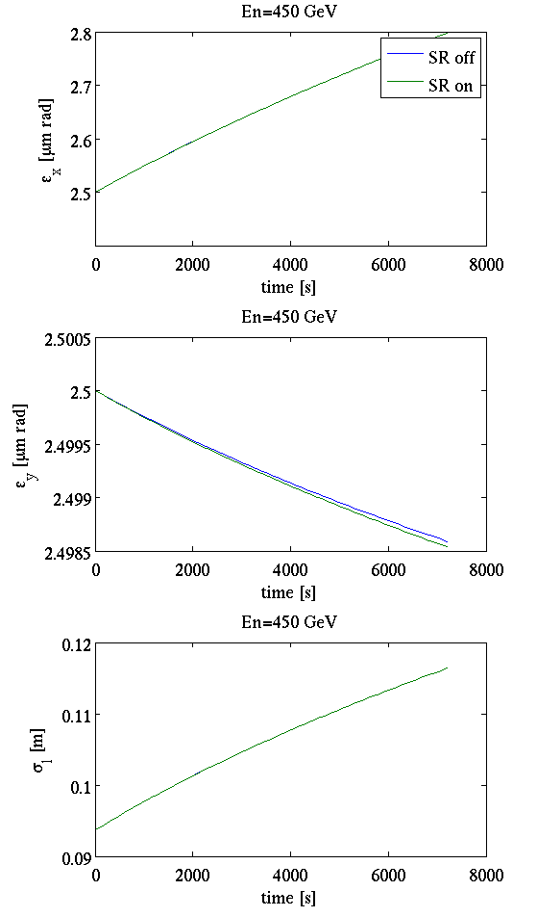
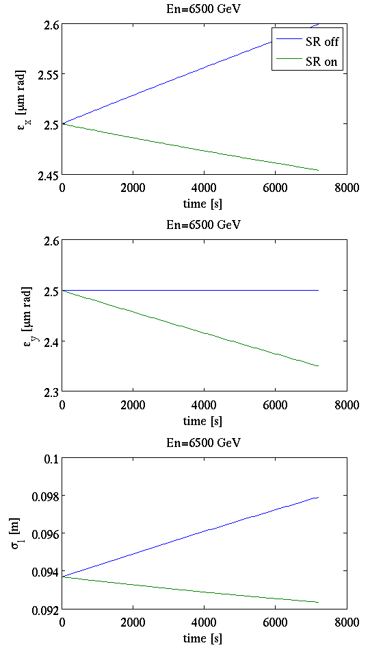
IBS & SR
IBS calculations at flat bottom (left) and flat top (right) with SR on (green) and SR off (blue)
  No effect at 450 GeV
  Clear effect at 5.5 TeV

Slide 3
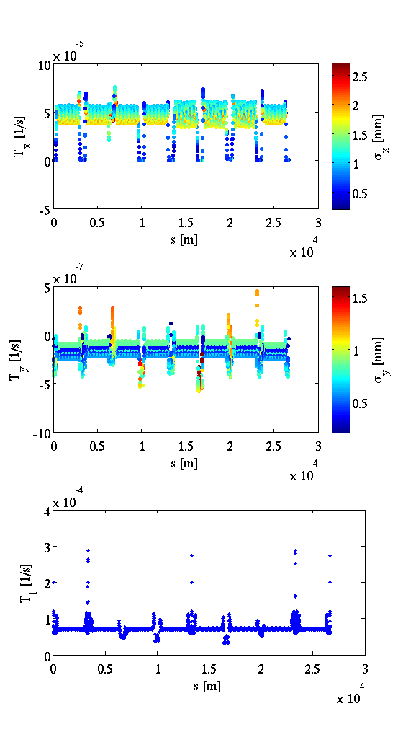
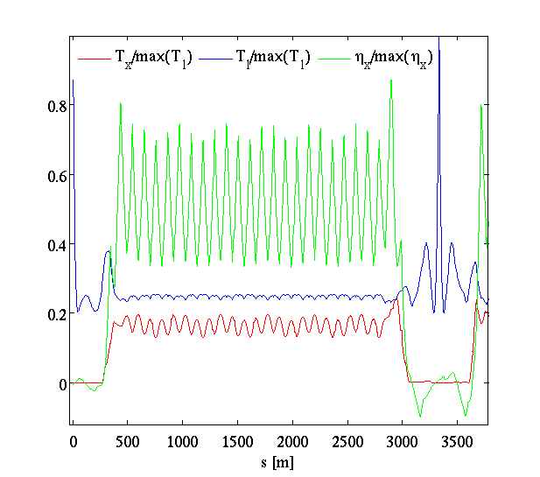
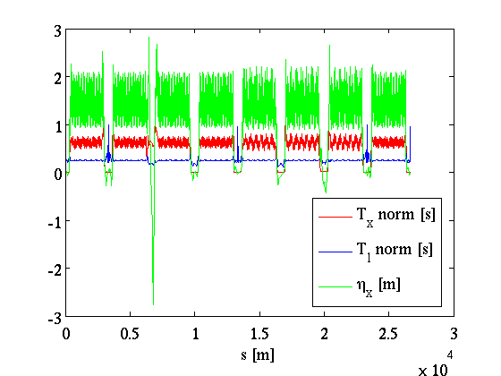
The horizontal growth rates follow the behavior of the horizontal dispersion --> The effect comes from coupling through the dispersion

Slide 4
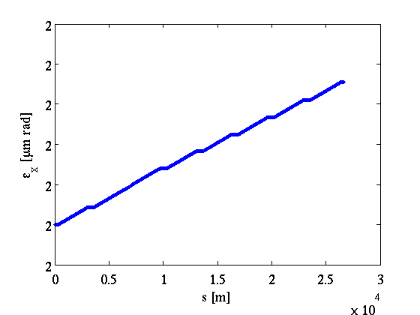
Tx=5.6h (~224e6 turns)
Tl=3.3h (~112e6 turns)
1-turn effect -> the difference in the 9th decimal
Very slow effect
Starting from the B-M integrals, considering mean values for the twiss functions (the effect is very slow (is it a valid assumption?)) and constant emittance in one turn (also Hy->0, dy->0) --> The growth rate is the same if the emittance is increased by a factor k while the Nb by k^2.
  Can we use this to speed up the simulations for LHC?

Slide 5
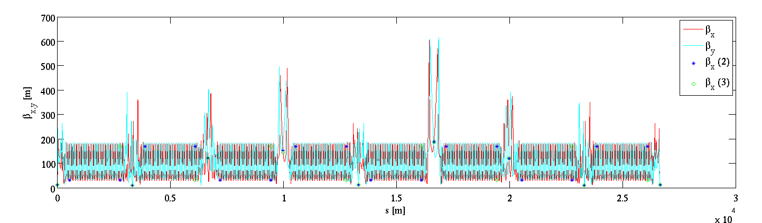
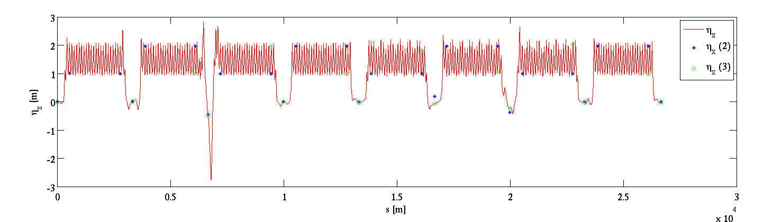
Optimal number of lattice points
To speed up the simulation time the number of points used for the calculations are reduced
  Case 2 -> blue stars
  Case 3 -> Green circles

Slide 6
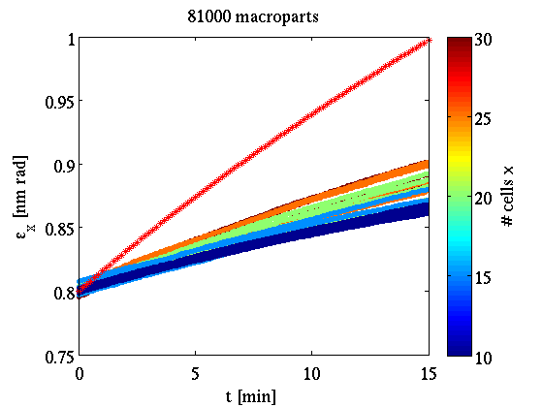
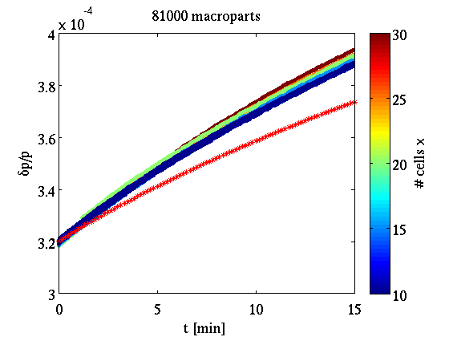
SIRE comparison with analytical (BM)
  Optics case 3
  SIRE (colored lines) underestimates the effect in the horizontal plane (overestimates in the longitudinal) with respect to B-M (red stars) --> The dispersion coupling effect is not taken into account correctly

Slide 7
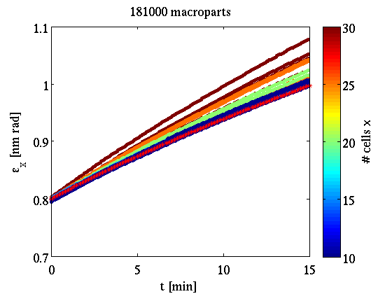
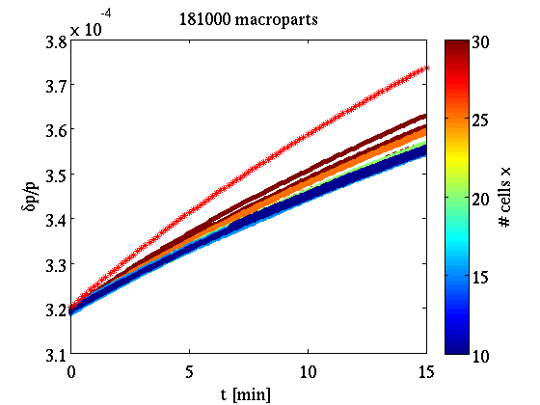
SIRE comparison with analytical (BM)
  Optics case 2
  SIRE (colored lines) overestimates the effect in the horizontal plane (underestimates in the longitudinal) with respect to B-M (red stars) --> The dispersion coupling effect is not taken into account correctly

Slide 8
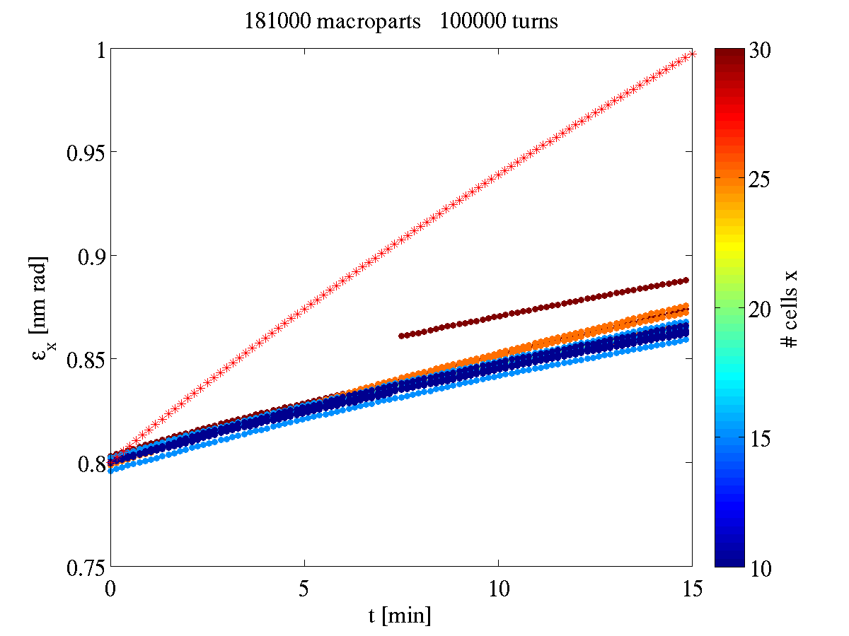
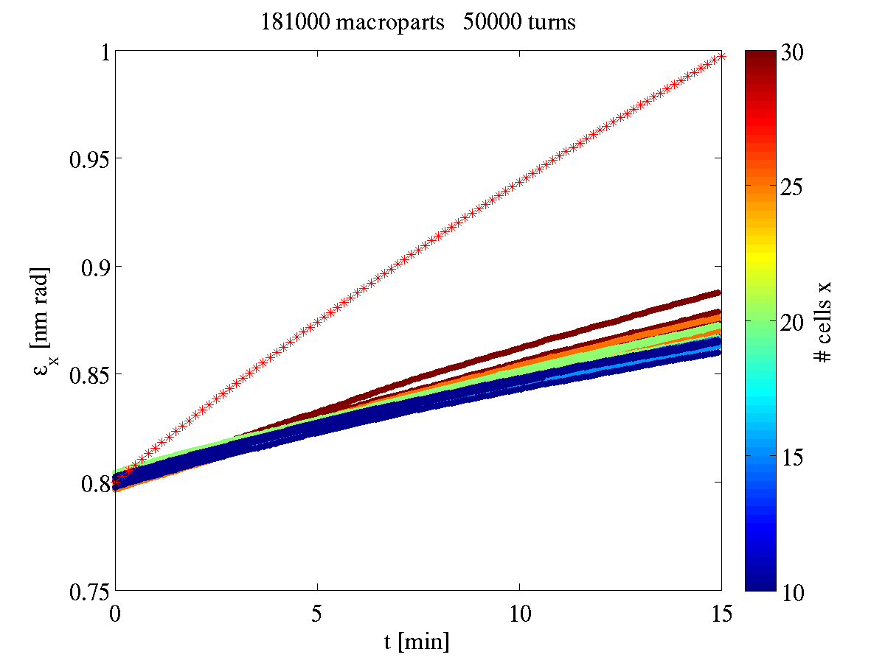
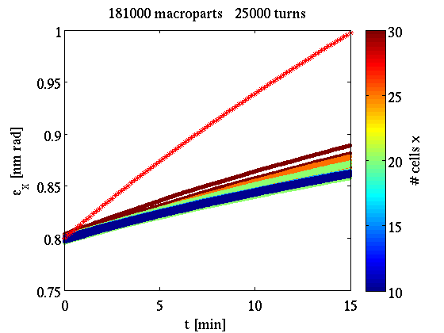
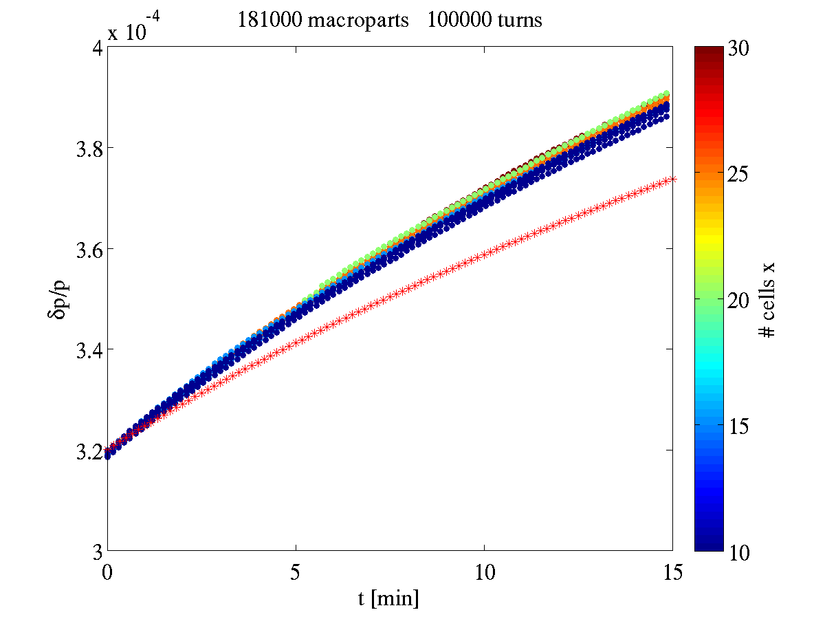
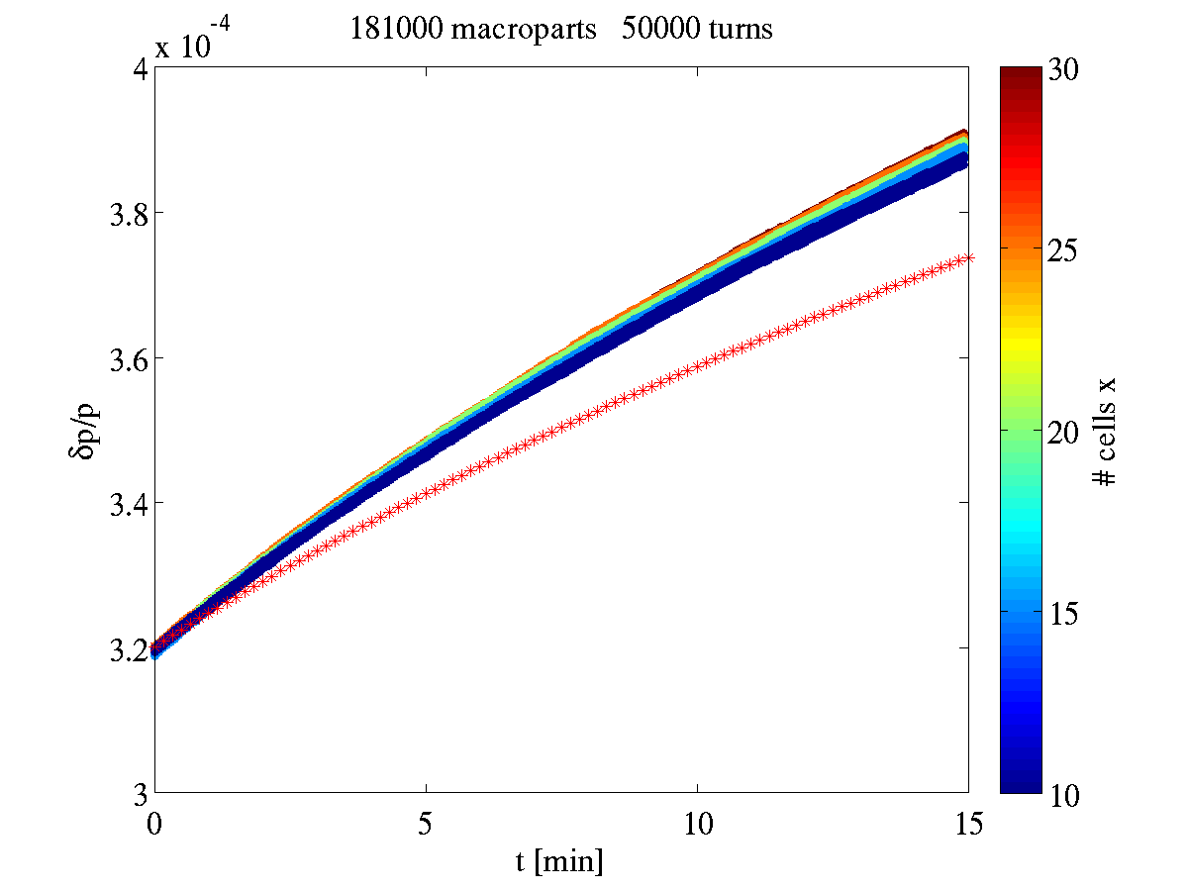
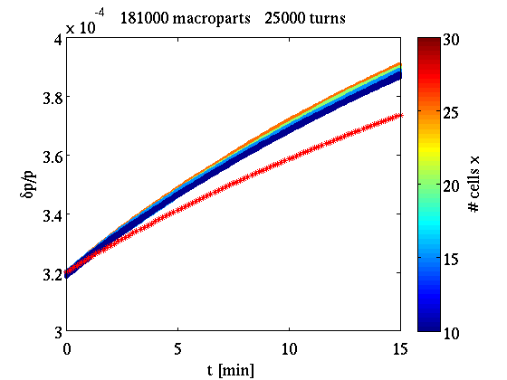
Test time step

Slide 9
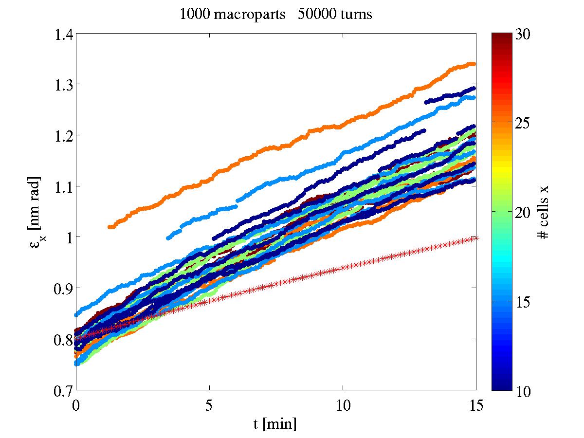
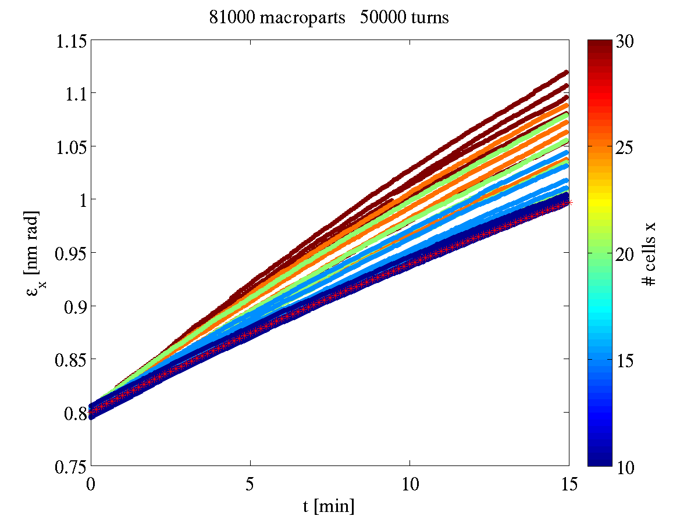
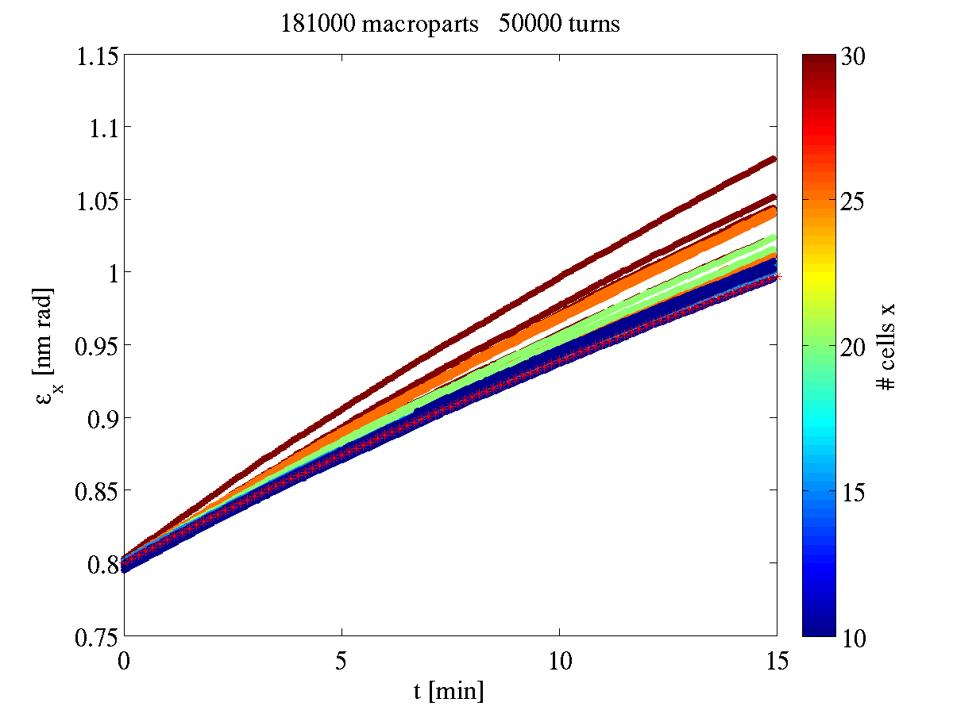
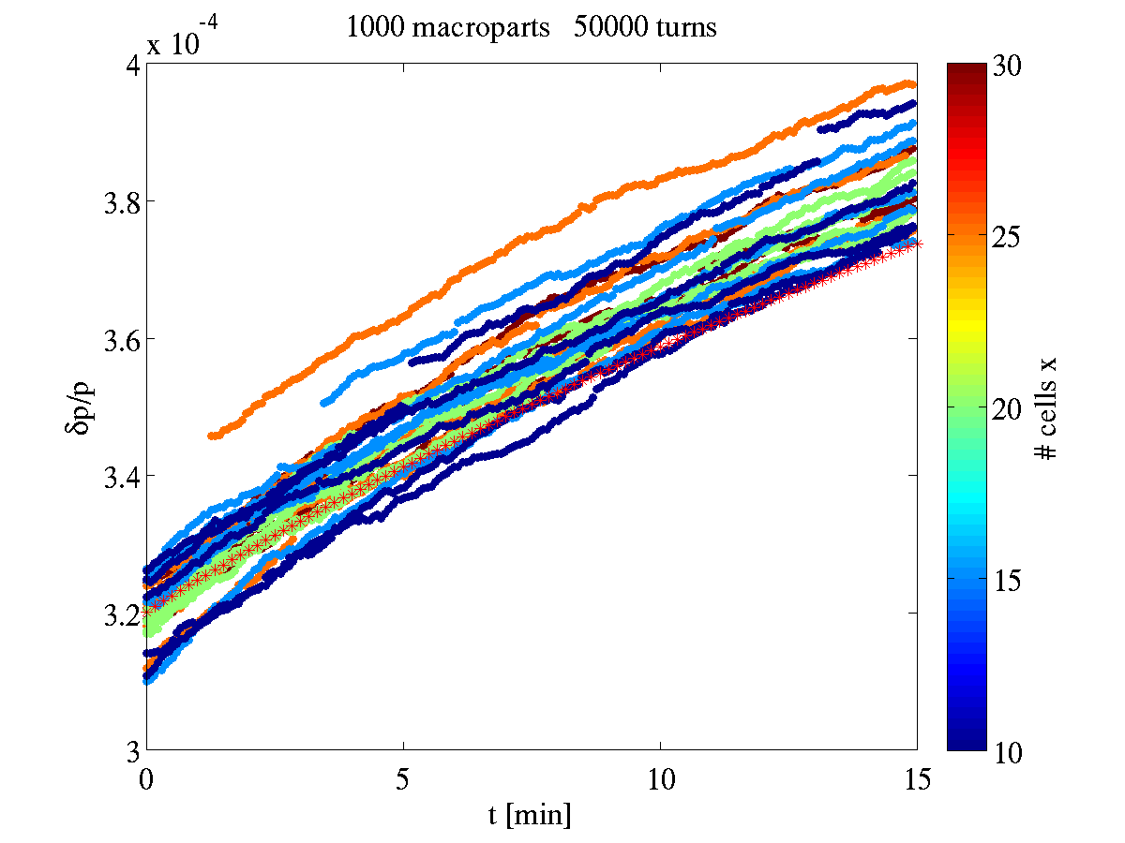
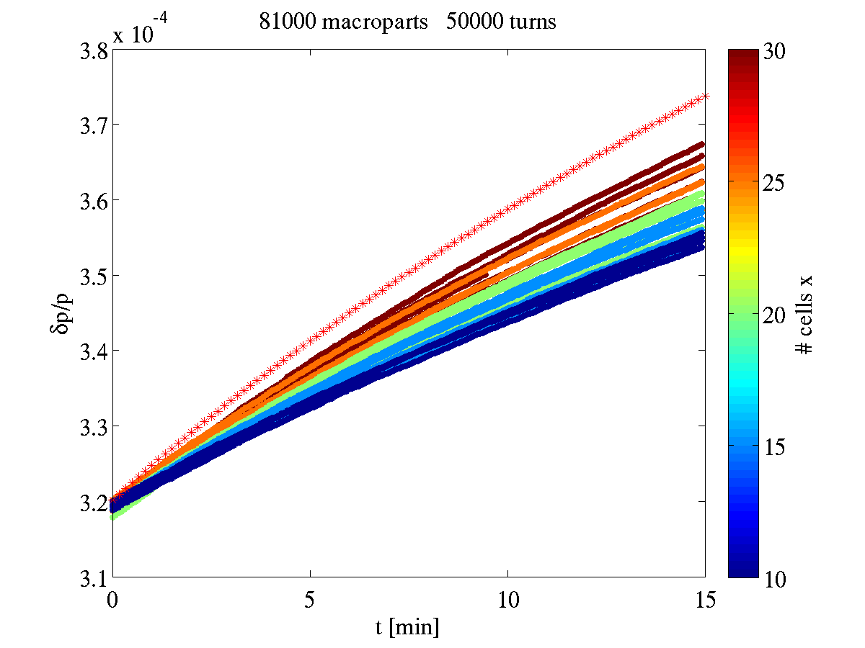
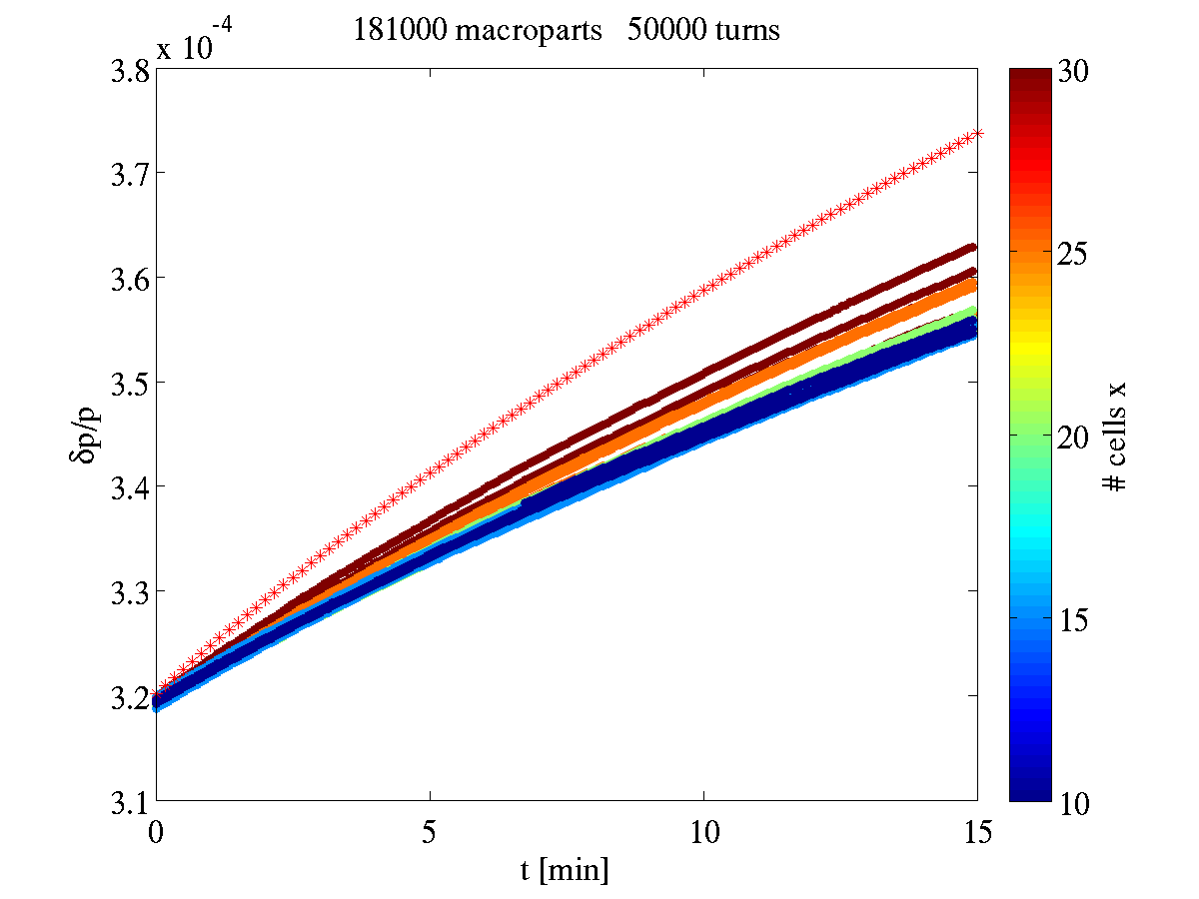
Test # macroparticles

Slide 10
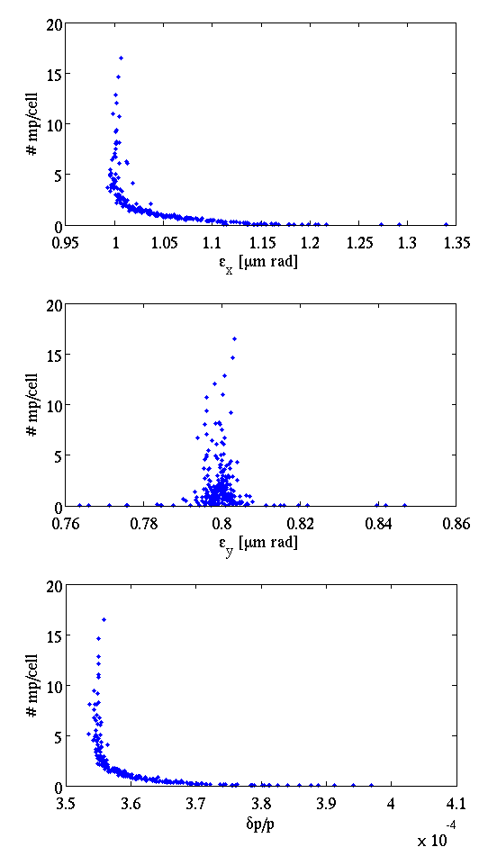
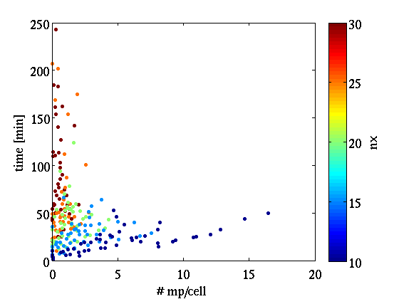
Time of run (optics case 2)

Slide 11
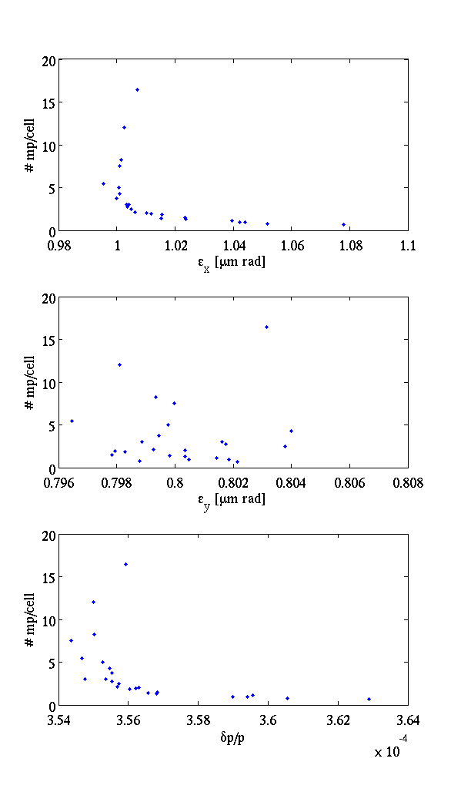
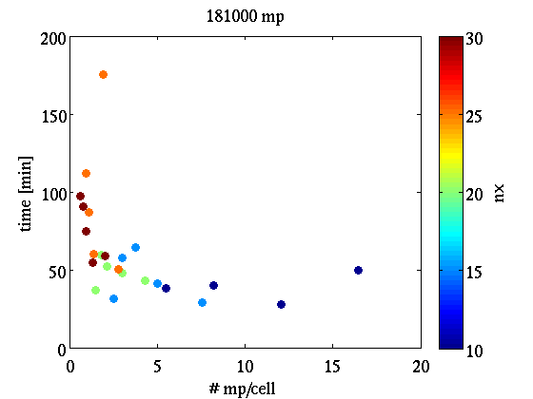
Time of run (optics case 2)

Slide 12
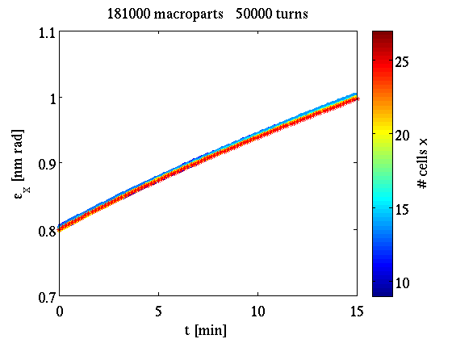
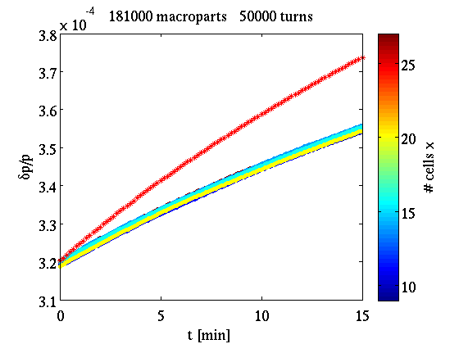
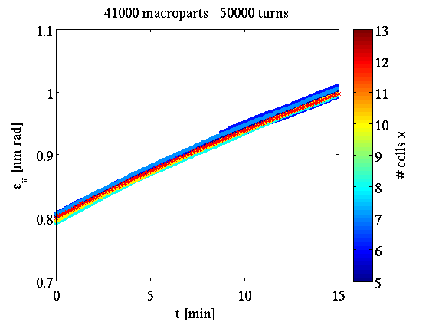
SIRE-BM comparison
Definition of ncellx such that: nmp/cell=5
nx=sqrt(nmp*ratio/(ncells*5))
  With: ratio=sqrt(bx/by)
  ncellz=ncellx/ratio
  Recalculation of ncellx, ncellz at each point of the lattice such that dx=dz=const
IBS effect in dp/p:
  17% (BM)
  11% (SIRE)

Slide 13
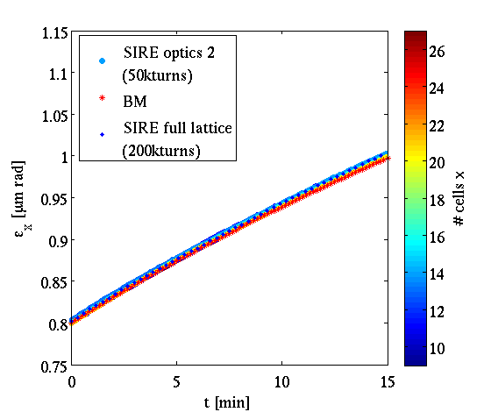
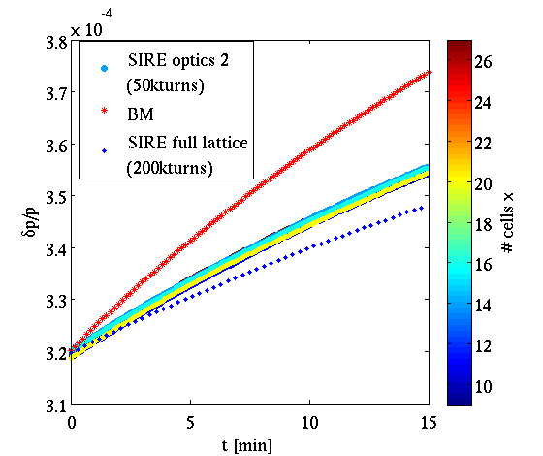
SIRE-BM comparison

Slide 14
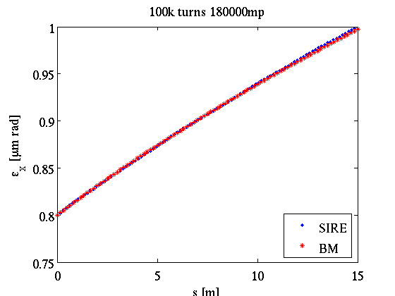
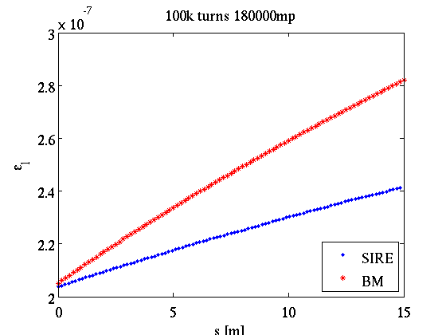
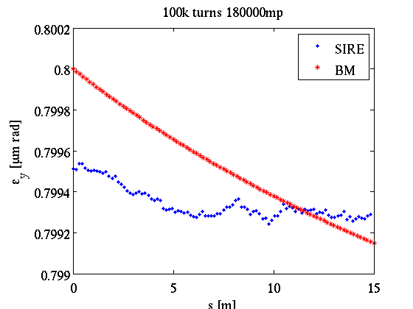
SIRE-BM comparison

