Slide 1
Software for IBS and Radiation
Effects (SIRE) revision summary: testing and improvements

Slide 2
SIRE
Code developed by A. Vivoli (2011)
  Based on MOCAC (Monte Carlo Code)
  Scattering angle based on Rutherford cross section
  Re-written in C
A revision of the code started in May
  More flexible and more user friendly (lots of improvement still needed)
  Flags added (to add flexibility)
  Aim to make it faster and able to run in parallel (an idea is to implement the module in orbit)

Slide 3
About the code
Input files
  Twiss file (madx form)
  Input parameters file (beam characteristics, # macroparticles, # cells (x,z,s), flags)
Output files
  New twiss after recurrences
  Growth rates and emittance evolution file
  Emittance file (if oneturn)
  Macroparticle distribution file

Slide 4
Structure of the code
Reads madx twiss and input parameters files and generates the names of the output files
If flag_rec then optimizes the number of points in the lattice to be used in order to speed up the simulation --> Generates new twiss file
Generates the distribution of macroparticles given the mean invariants and number of macroparticles and for random phases
if the IBSflag=1 then apply the transformation to the momentum frame, then apply the IBS routine in each point of the lattice, transform back to the invariants frame
If oneturn=1 the above calculation is done only once and the one-turn emittance evolution around the lattice is written in an output file
If oneturn=0 the tracking of the distribution evolution is followed for every element and for each turn for a time TEMPO or until convergence. The mean growth times and mean emittances are calculated and written in an output file every one timestep=TEMPO/NIBSruns (both defined in the input file)
If damping=1 and q_ex=1 then the effects of synchrotron radiation damping and quantum excitation are taken into account.

Slide 5
The IBS routine
The distributions are splitted in cells (uniform split with respect to x, z, s)
  nx, nz, ns (cell numbers) need to be optimized
Puts the macroparticles in cells and calculates the number of macroparticles and their density in each cell
Applies the scattering kicks between the macroparticles in each cell (binary collisions) --> redistribution of phase space

Slide 6
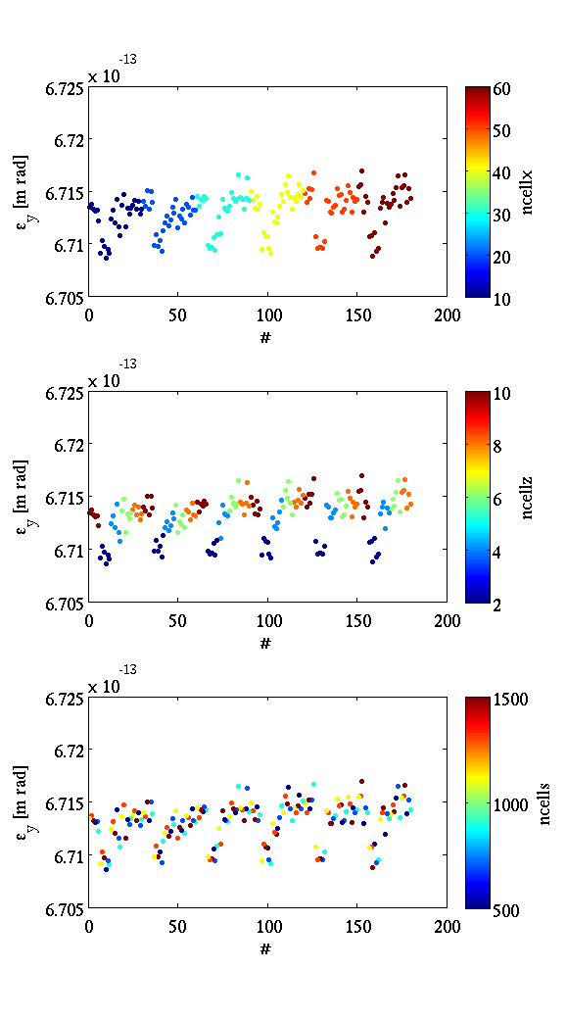
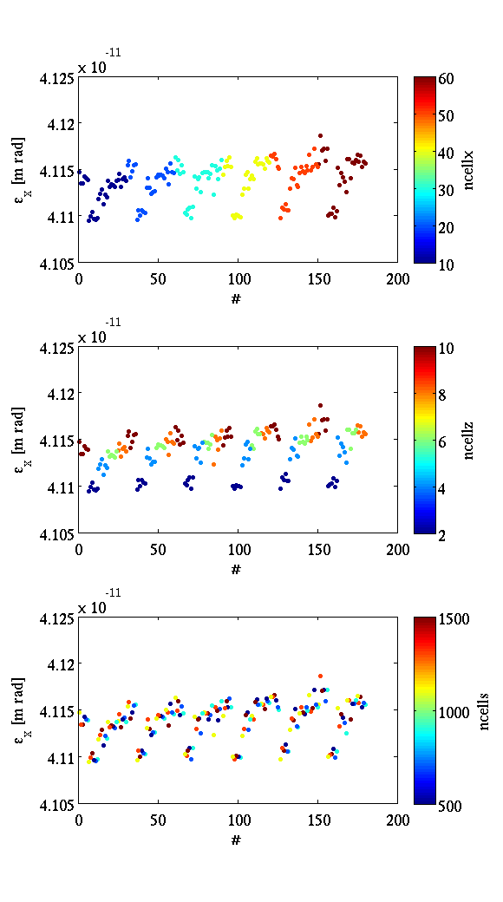
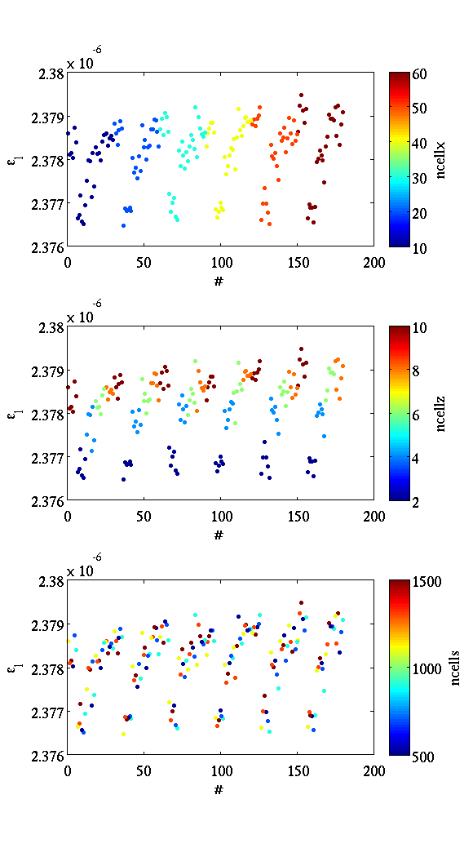
Ncells optimization - 1turn
Optimization of ncells (for the CLIC DR)
  For 100000 macroparticles, a scan was performed in different combinations of nx, nz, ns --> Can we come to conclusion only from 1 turn?
  Emittance comparison after 1-turn

Slide 7
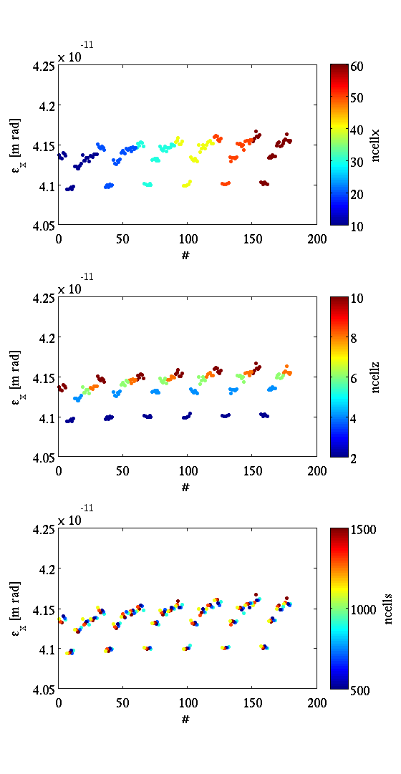
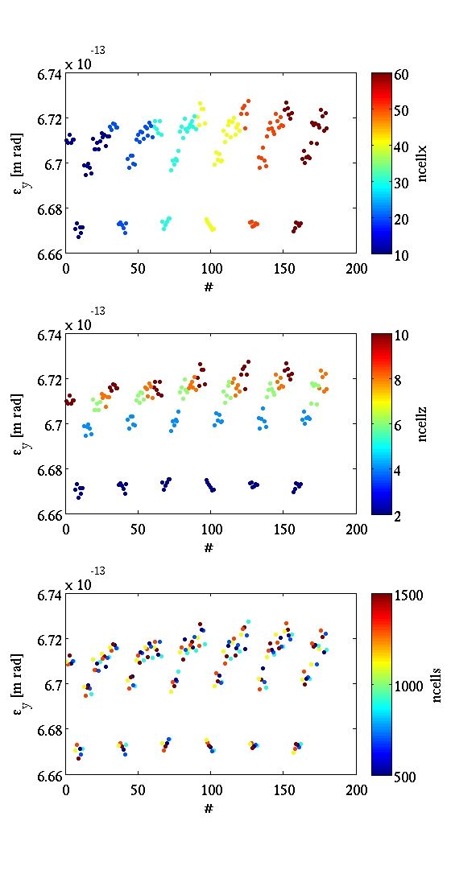
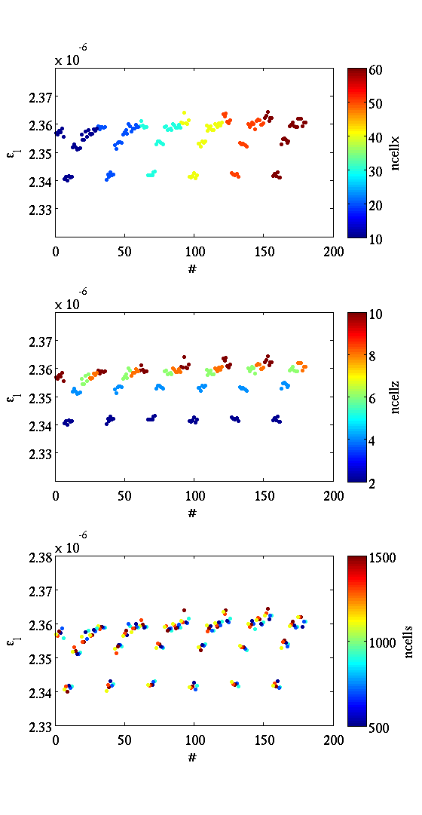
Ncells optimization – 10 turns
Emittance comparison after 10-turns
SR is on, QE not debugged yet

Slide 8
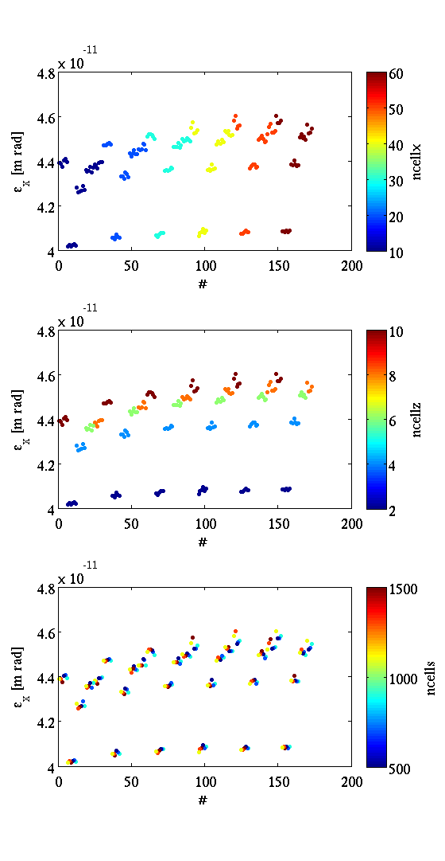
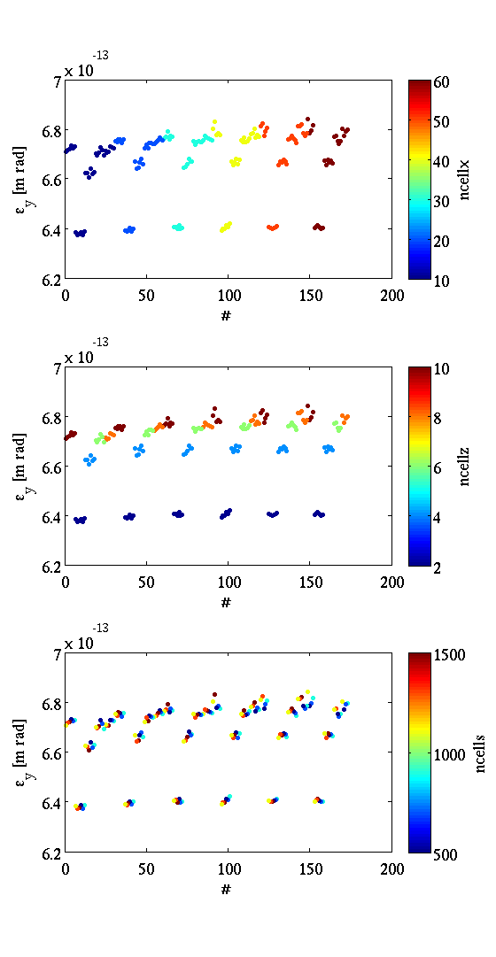
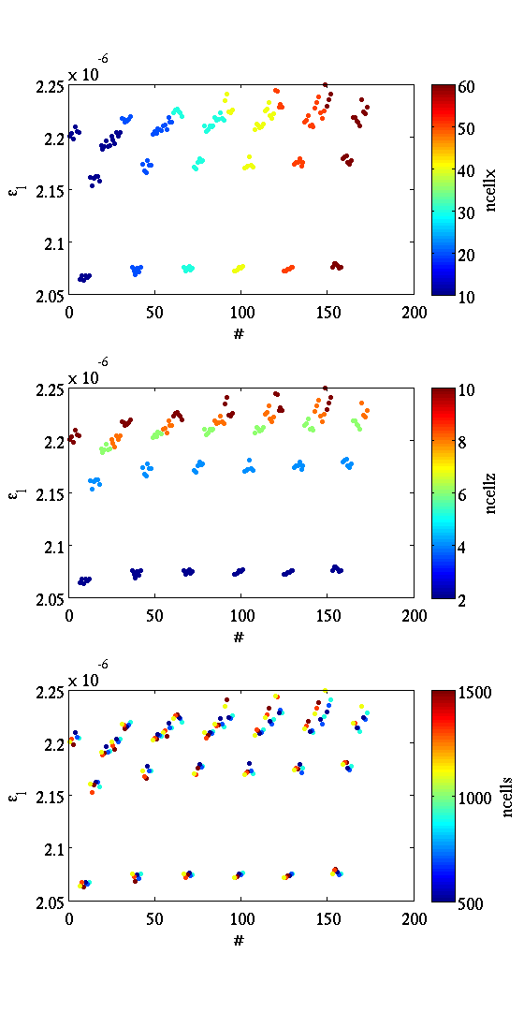
Ncells optimization – 100 turns

Slide 9
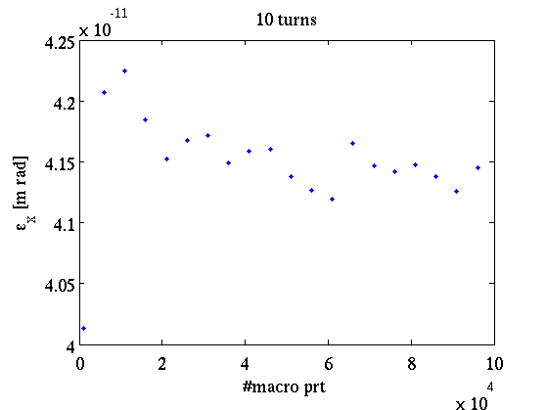
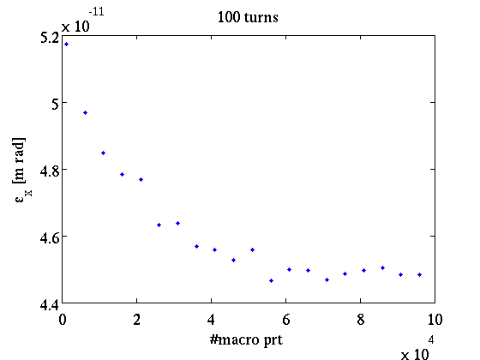
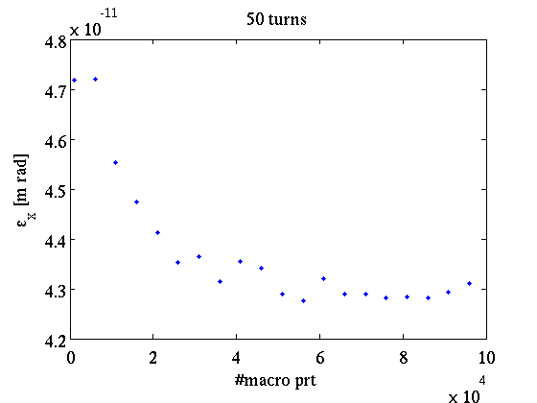
# macroparticles optimization
For fixed #cells settings (40,6,1000) the emittance after 10 (right, top), 50 (right, bottom) and 100 (left) turns is calculated --> Optimal number of mp: 60000 (?)

Slide 10
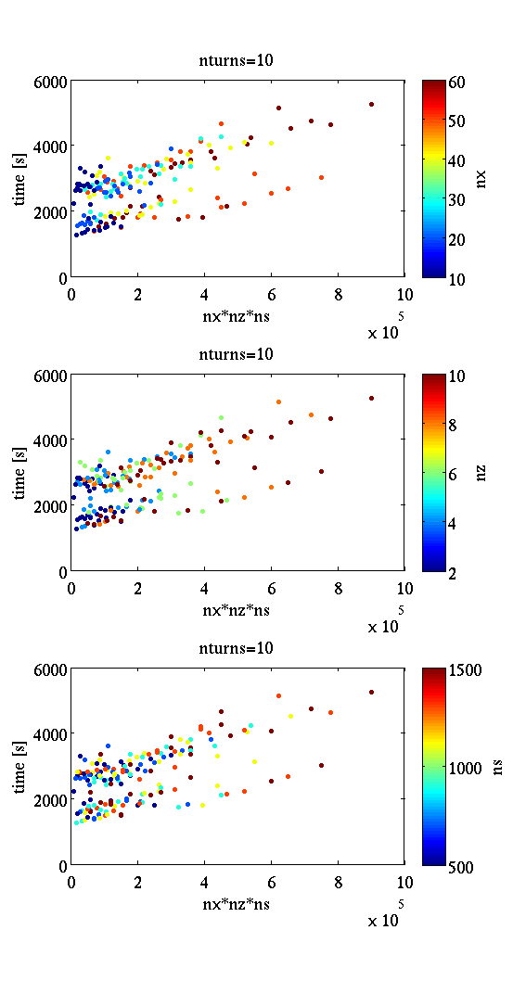
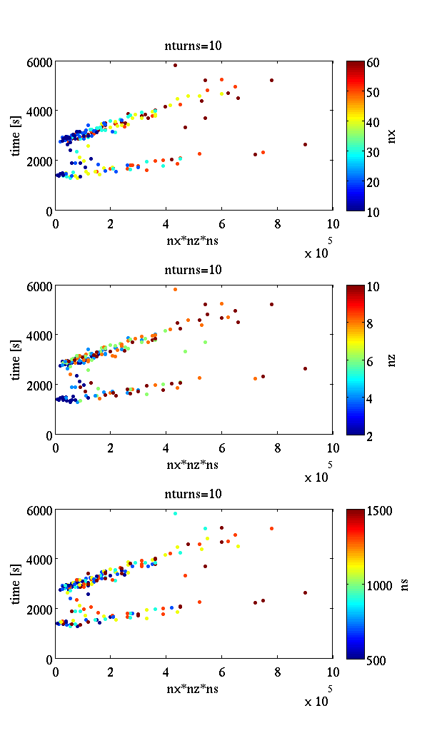
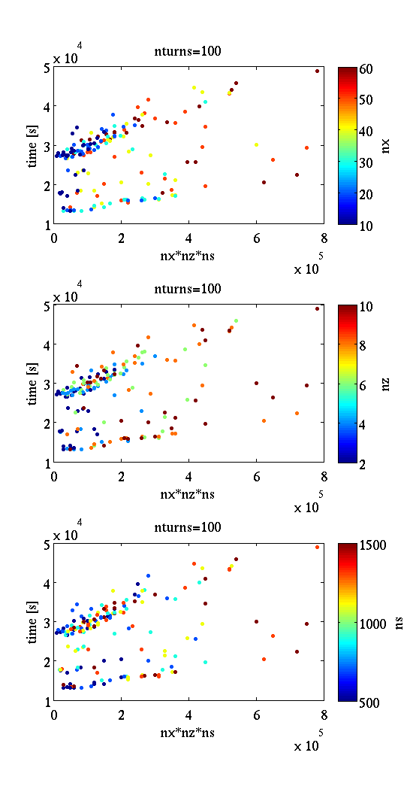
Run time Vs #cells
Different number of cells (nx,nz,ns)
  For 10 turns (left) and 100 turns (middle)
  Random initial dist. of 100000 macropart
Different number of cells (nx,nz,ns)
  For 10 (middle) and 100 (right) turns
  Same initial dist. of 100000 macropart

Slide 11
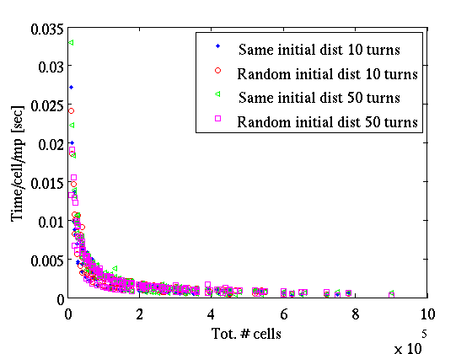
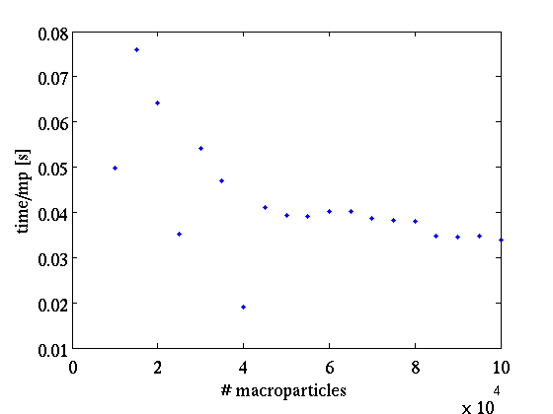
Code run time per setting
For 100000 macroparticles, the time of run/cell/mp is calculated for different number of cells (for 10 and 50 turns)
For a good setting of (40,6,1000), the time of run is calculated for different number of macroparticles (for 10 turns)

Slide 12
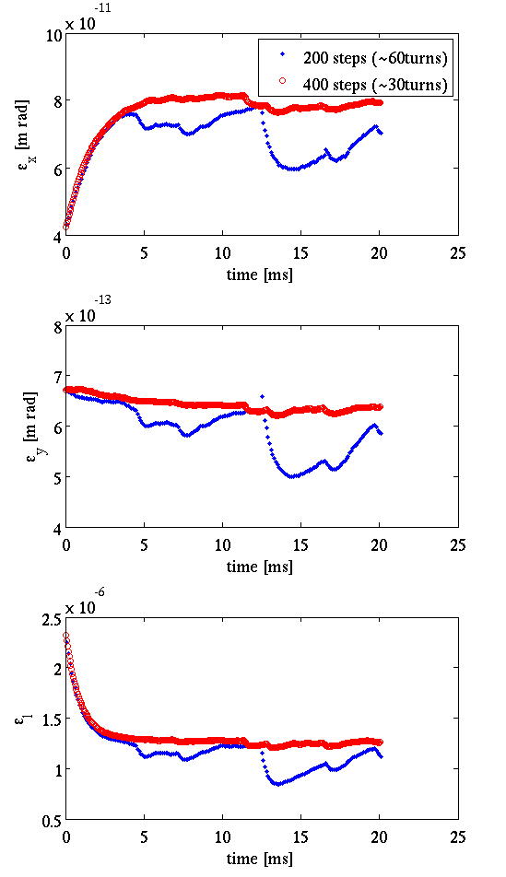
Full simulation with fast option
The fastrun flag has been added in order to speed up the simulation time
  The IBS growth time is calculated in 1 turn and assume to be unchanged (or very small variation) within a timestep (or number of turns). The new emittance state is then calculated for this time step considering the above growth time. The timestep is defined from the NIBSruns and the TEMPO from the input parameters file (timestep=TEMPO/NIBSruns)

Slide 13
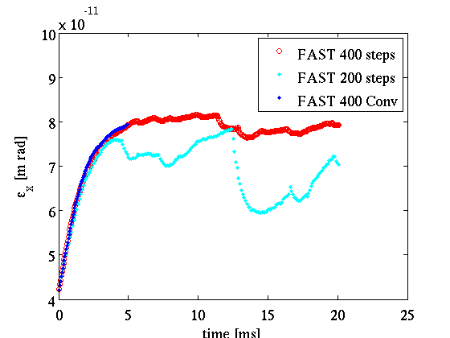
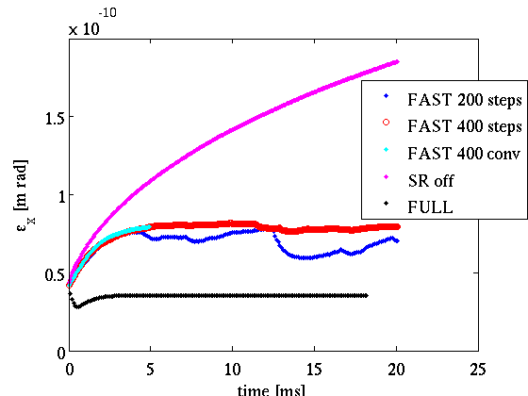
The convergence flag
Full simulation 400 steps
  fastrun=1
  fastrun=0
Comparison with full time evolution (full & fast)
Fluctuation around convergence (??)
  If we use the 1 sigma emittance instead of mean (sum over all)
Added in the code:
  If convergence limit achieved, continue until it is achieved for 10 times (valid??)

Slide 14
IBS on and off
Full simulation with fastrun on (400 steps)
SR on & IBS off
SR off & IBS on

Slide 15
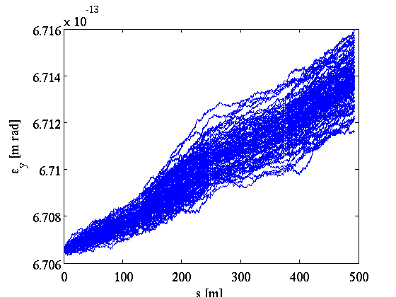
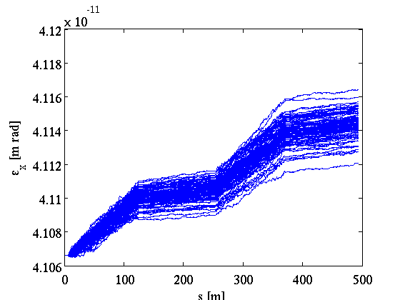
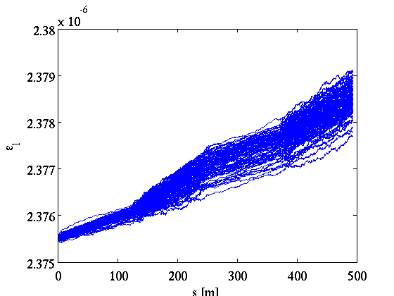
1-turn benchmarking with madx

Slide 16
Full simulation benchmarking with madx

Slide 17
Energy scan for the CLIC DR

Slide 18
Implementation of the module to py-orbit

Slide 19
The growth rates definition is not only IBS (the emittances used are after SR and QE)
Correct QE (what are the beta functions used? At the end of the lattice?)
MADX and Piwinski benchmarking (chose the last DR example)
Energy scan plot with fastrun
Write the final distribution in file and see the shape
Take into account phase advance
What happens to the halo particles?
What happens to non-G beam distr
Add Touschek

Slide 20
Open issues

