Slide 1
Test params for SIRE using LHC FT nominal params
Aug&July17
Parameters | Nominal (BCMS) for 10 MV (2016)
E [GeV] | 6500
ε_{x,y} [μm] | 2.5
4σ bunch length [ns] | 1.0
Bunch population [10¹¹] | 1.1

Slide 2
Oct17

Slide 3
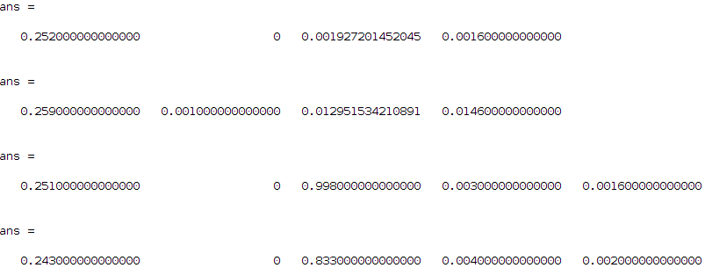
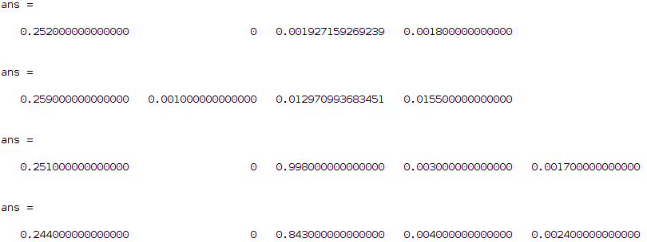
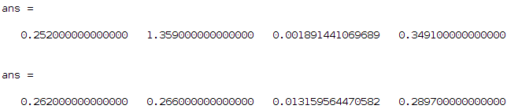
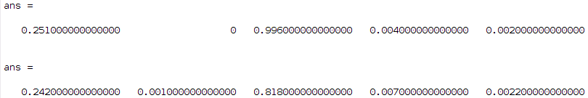
Check what happens if instead of having the full SIRE distribution we cut at 3sigma and at 2sigma
full
3sigma
2sigma
Nominal (BCMS)

Slide 4
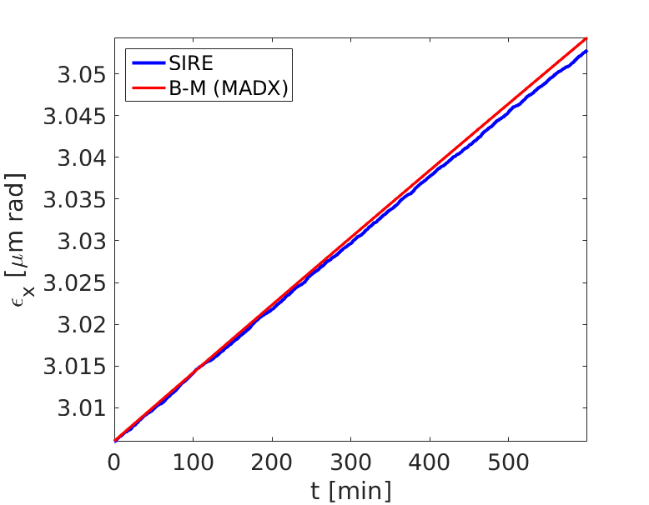
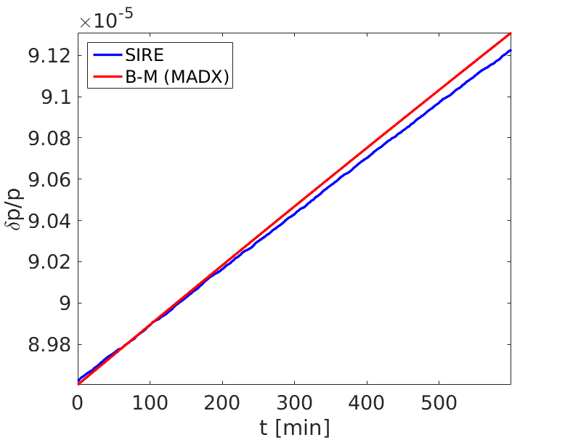
test_lessIBS: only IBS, #mp=200000, #mp/cell=5
Parameters | Nominal (BCMS) for 10 MV (2016)
E [GeV] | 6500
ε_{x,y} [μm] | 3.0
4σ bunch length [ns] | 1.0
Bunch population [10¹¹] | 0.1

Slide 5
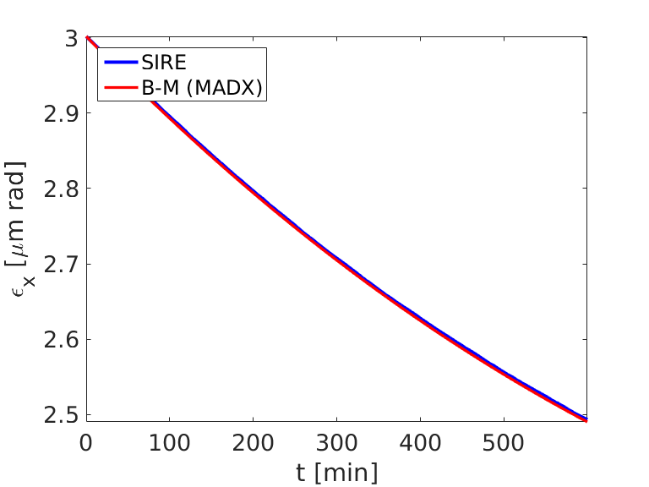
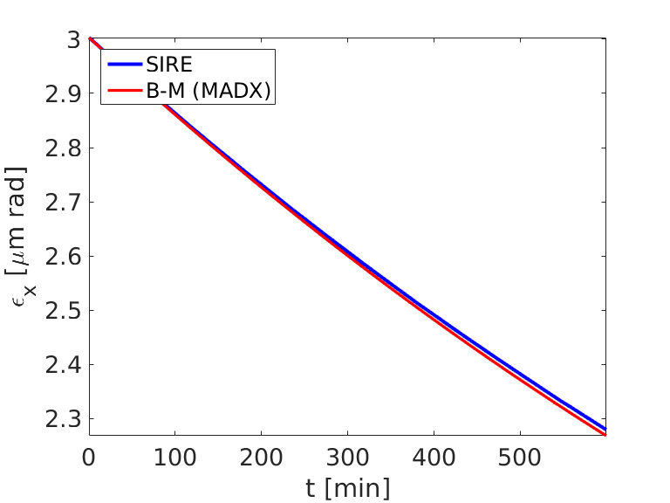
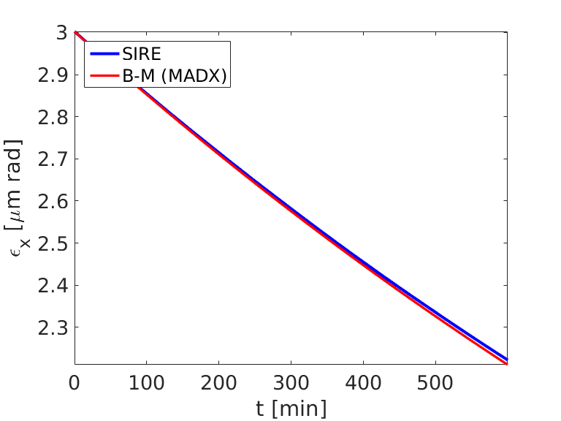
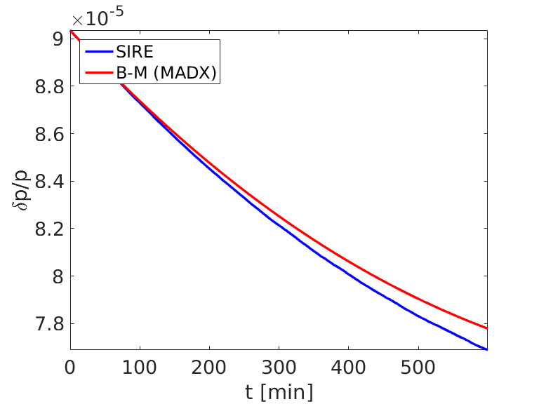
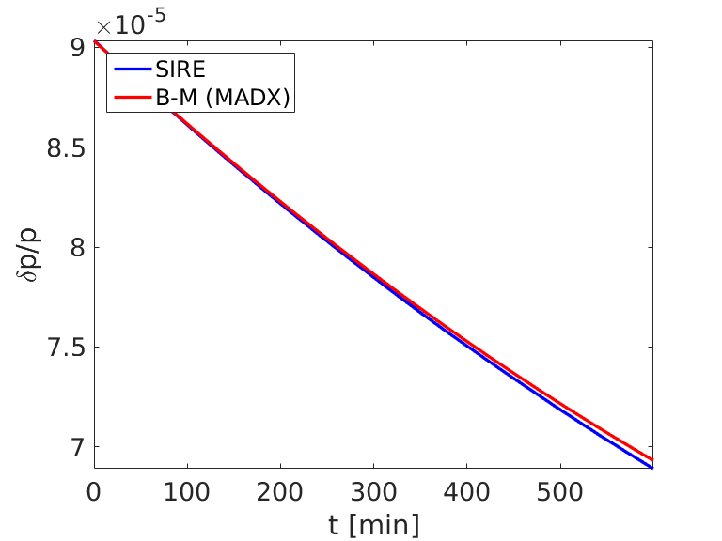

test_lessIBS: IBS&SR, #mp=175000, #mp/cell=5
Parameters @ FB | Nominal (BCMS) for 10 MV (2016)
E [GeV] | 6500
ε_{x,y} [μm] | 3.0
4σ bunch length [ns] | 1.0
Bunch population [10¹¹] | 0.5 , 0.1 and 0.01
0.5 10¹¹
0.1 10¹¹
0.01 10¹¹

Slide 6
Aug17

Slide 7
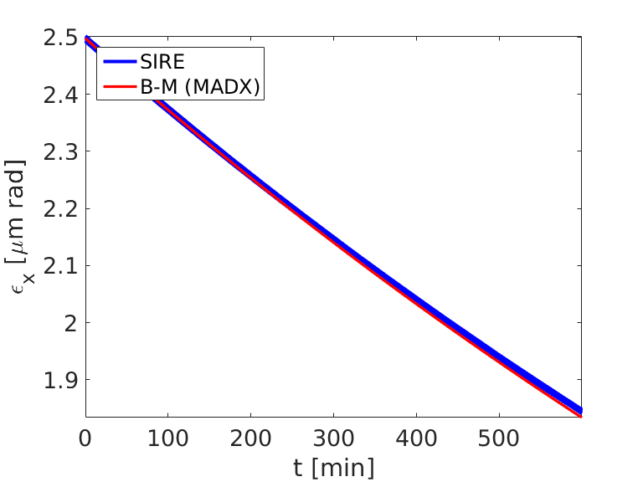
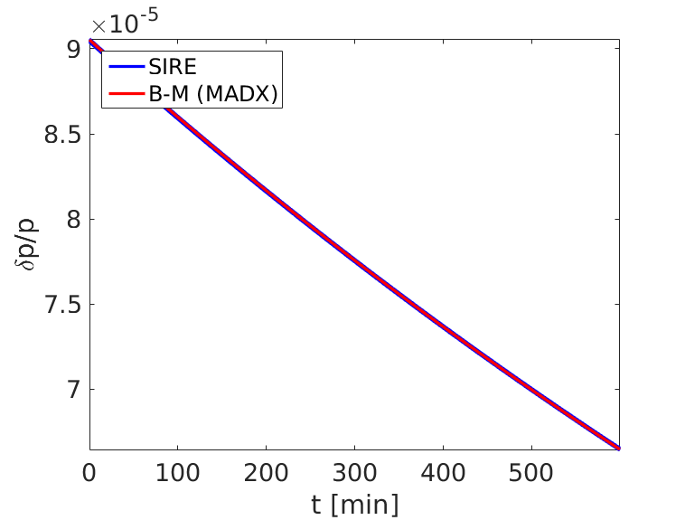
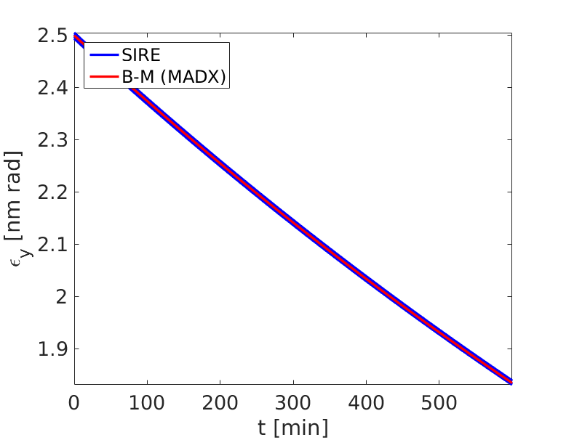
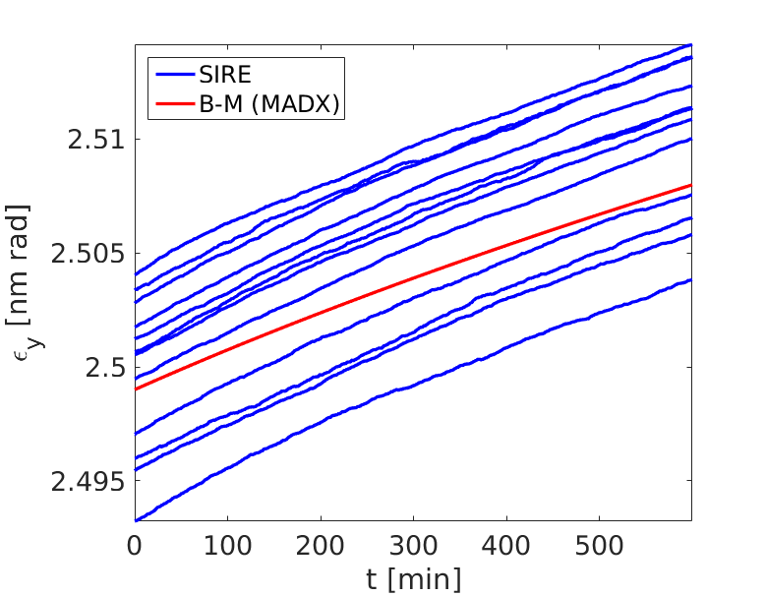
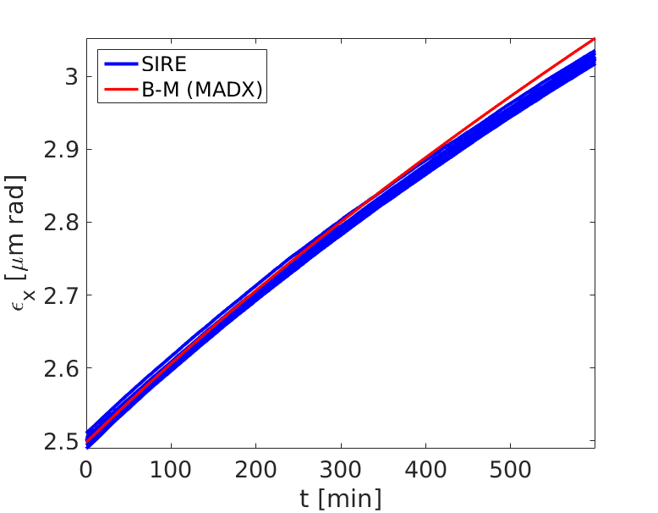
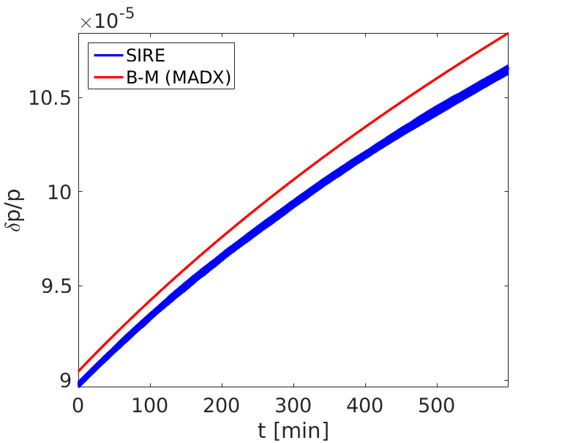
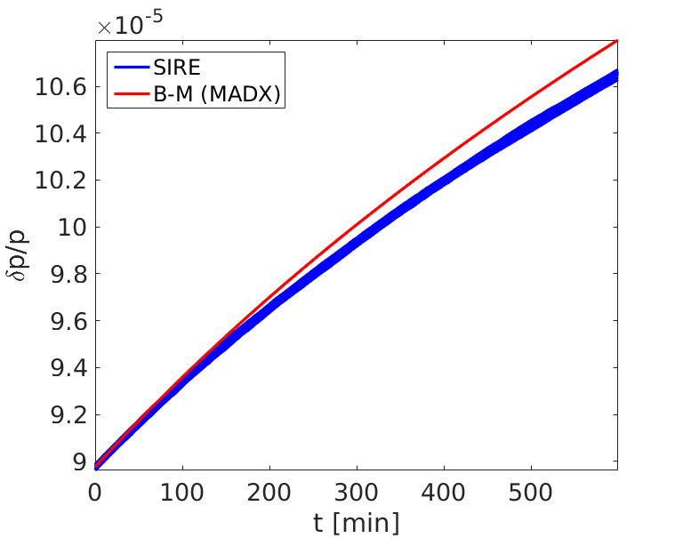
only SR
1% dif.
only IBS, scan #mp (170000:30000:500000)
Nothing changes for different #mp
SIRE doesn’t start from the requested dp/p value (1% dif.) and that is not because of the random generator!So why?
MADX assumes always a Gaussian, however SIRE updates the distribution→ that can explain the dif. Observed (see next slide).
BECAUSE I need to calculate it based on el=2(dp/p)^2 (no damping) . If I use that everything is ok

Slide 8
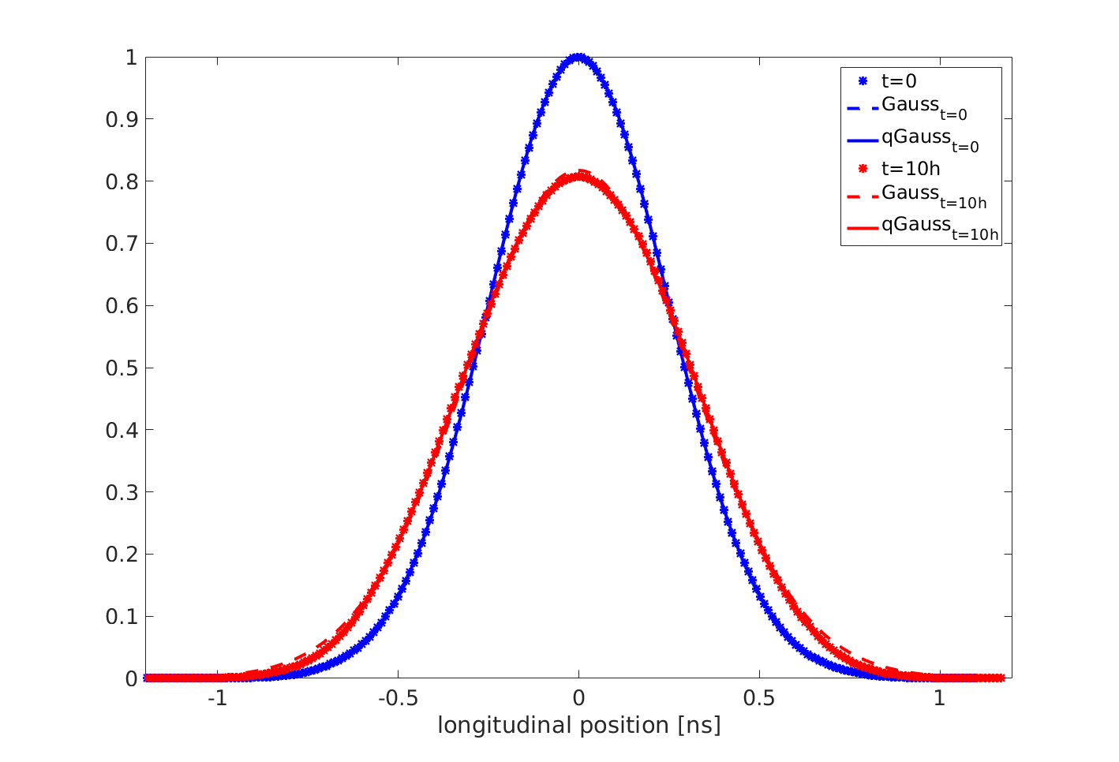
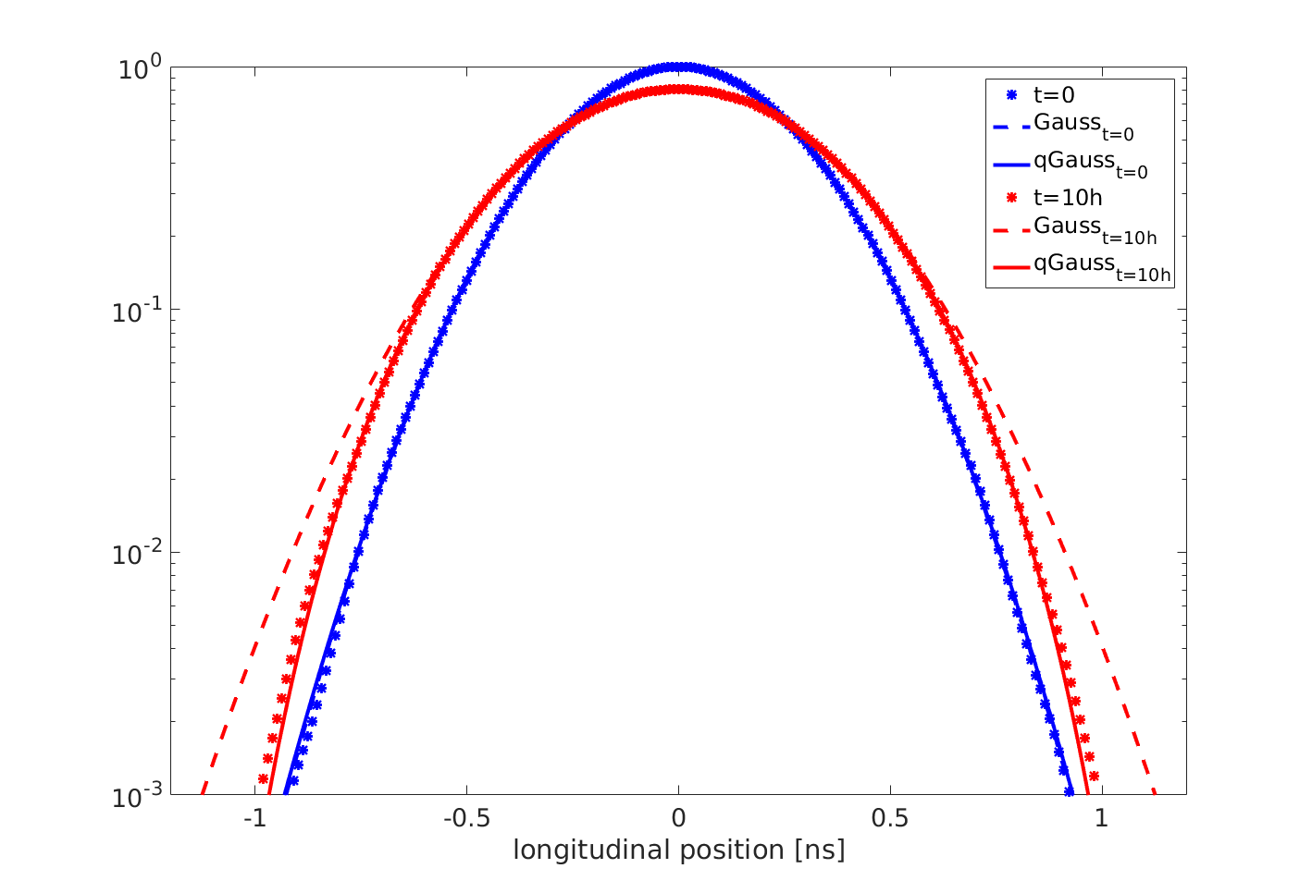
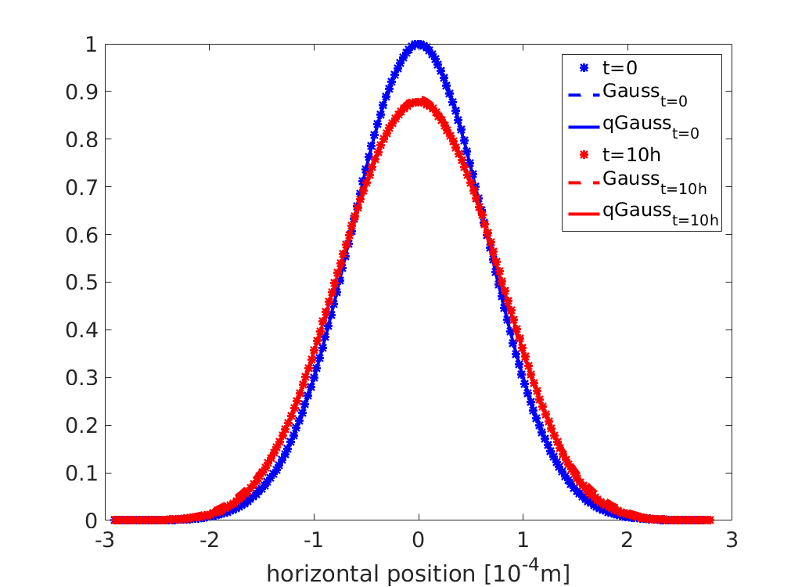
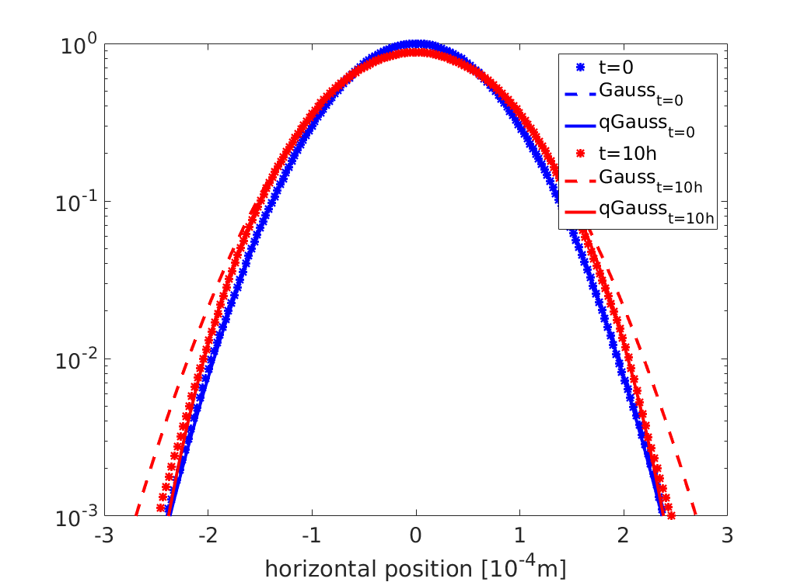
only IBS
Bunch profile evolution in all planes as computed by SIRE
normal scale
log scale
Longitudinal distribution
 | q initial | sigma initial | q final | sigma final
SIRE qGaussian | 1.010±0.003 | 0.250±0.001 | 0.874±0.003 | 0.295±0.001
rmse=0.001
rmse=0.002
Horizontal distribution
 | q initial | sigma initial | q final | sigma final
SIRE qGaussian | 0.995±0.003 | 0.643±0.002 | 0.872±0.004 | 0.702±0.003
rmse=0.001
rmse=0.001

Slide 9
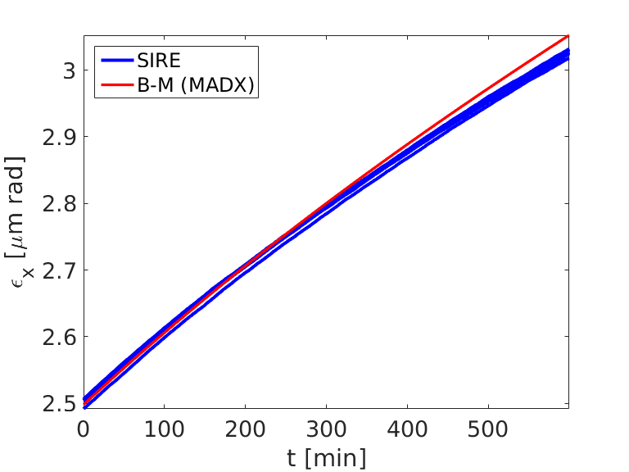
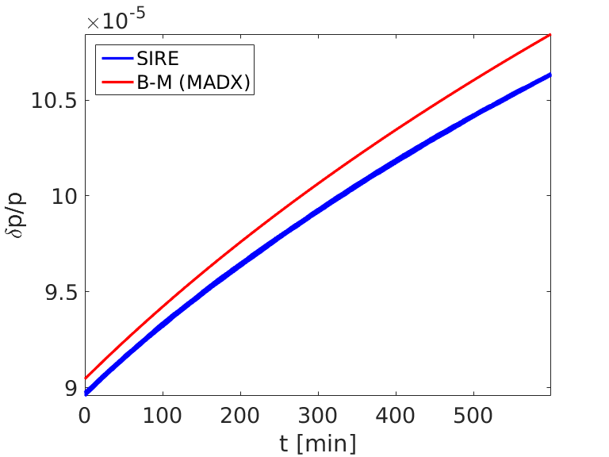
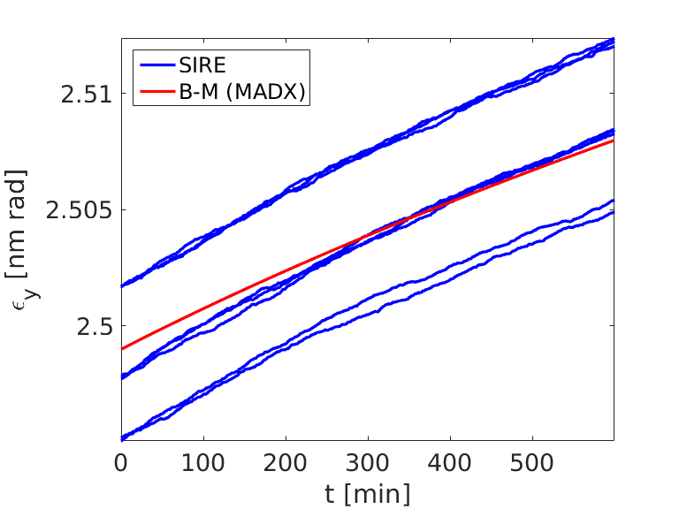
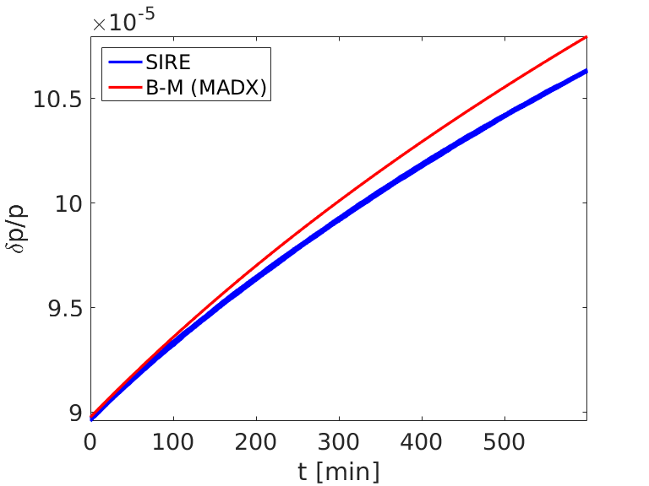
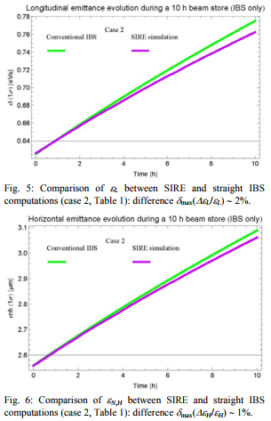
only IBS, scan #mp/cell (4:2:26)
Nothing changes for different #mp/cell
SIRE doesn’t start from the requested dp/p value (1% dif.) and that is not because of the random generator!So why?
BECAUSE I need to calculate it based on el=2(dp/p)^2 (no damping) . If I use that everything is ok!

Slide 10
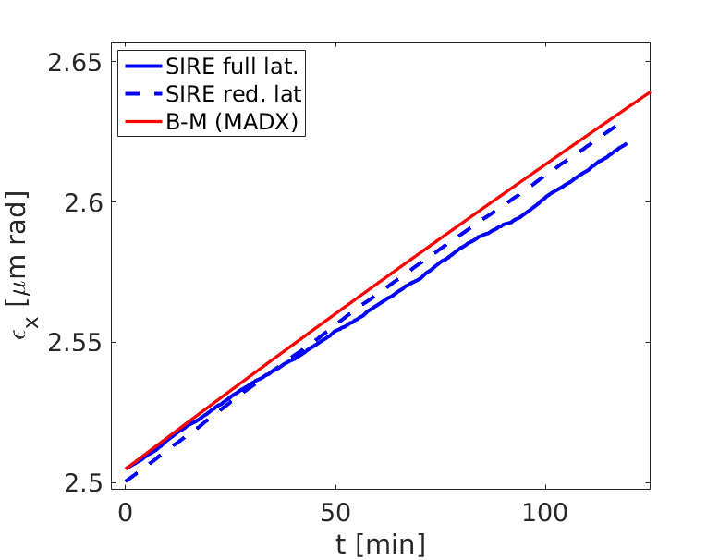
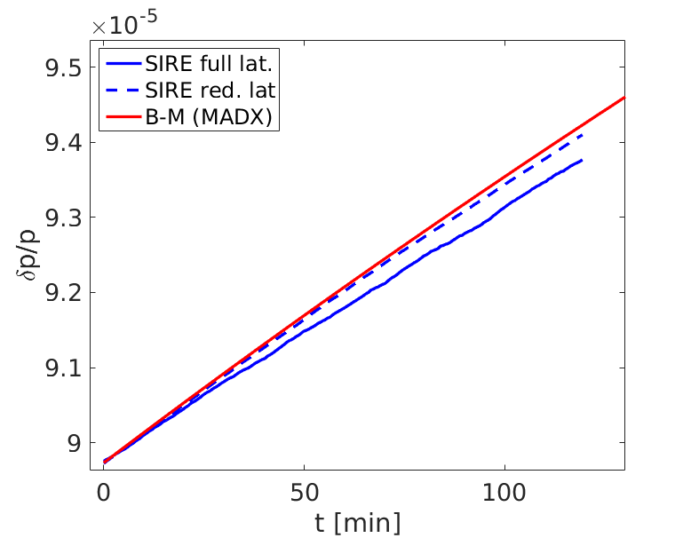
test_wholelattice_2h: only IBS, #mp=50000, #mp/cell=5, for 2h
The SIRE reduced lattice is closer to the full lattice MADX result, than the SIRE full lattice is, why?
The issue is why the full and the reduced lattice results disagree? At FB, there was not such a
disagreement.

Slide 11
compare reduced to full lattice for 1h at FB and at FT, nominal params
1h at FB
1h at FT

Slide 12
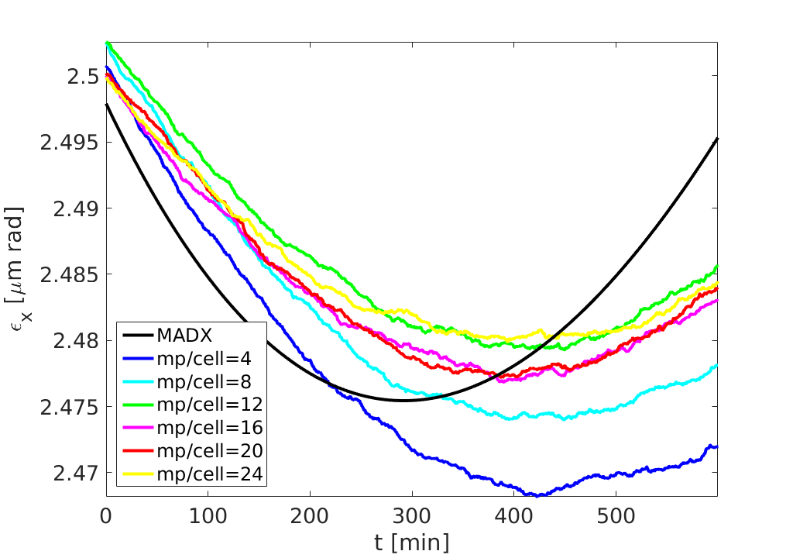
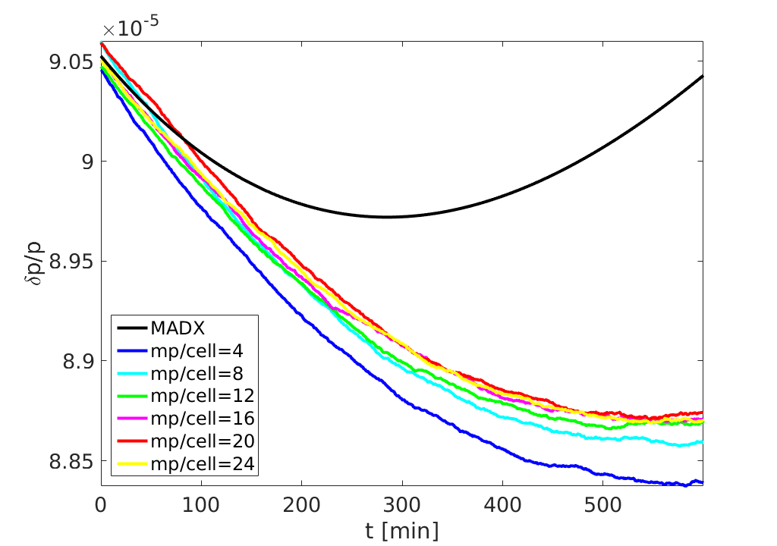
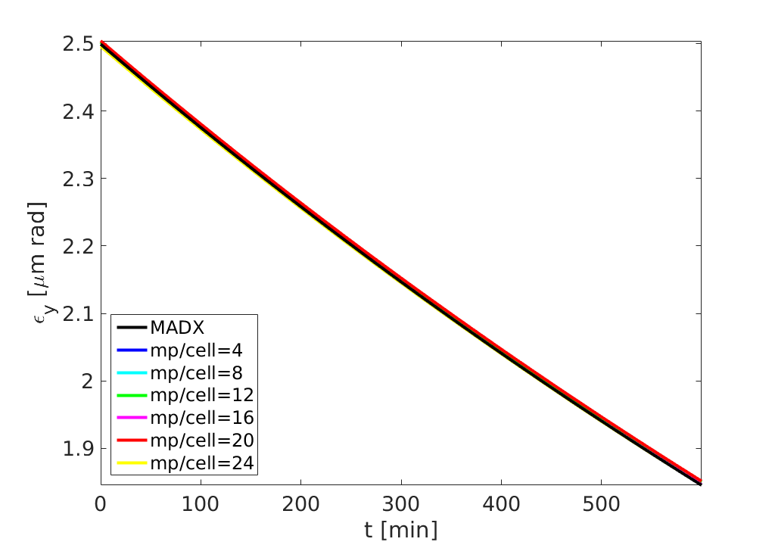
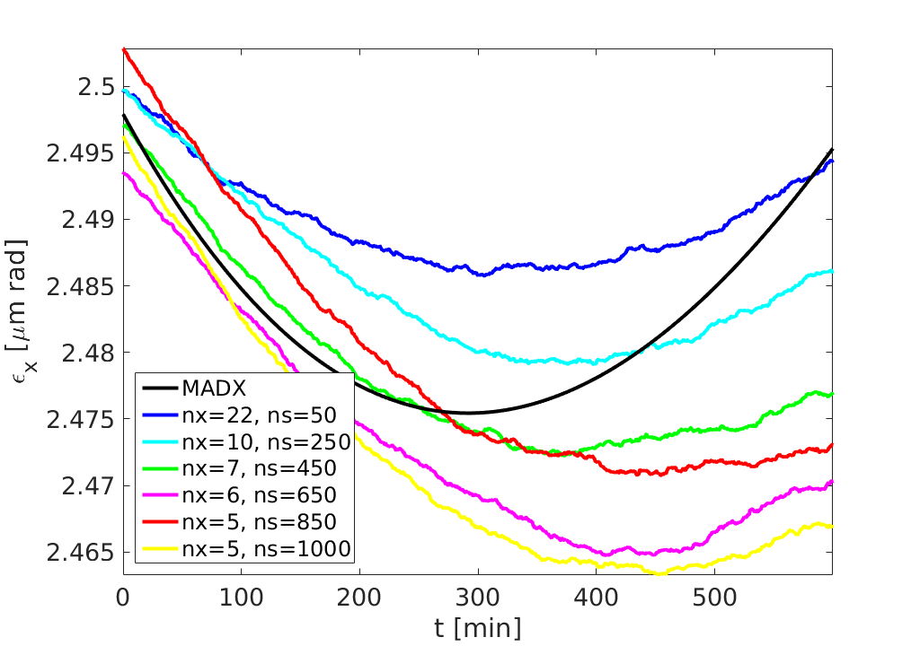
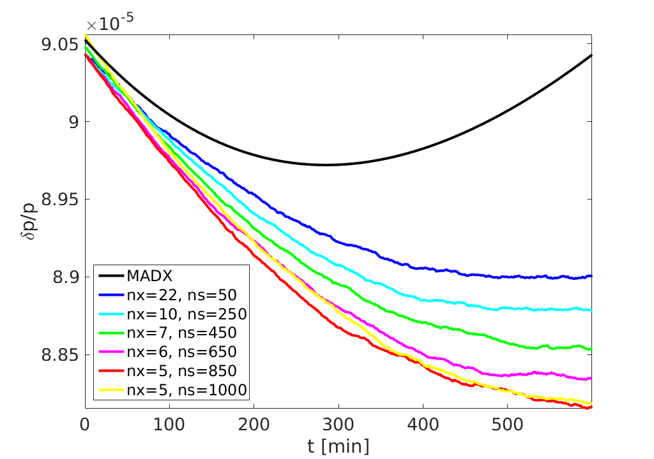
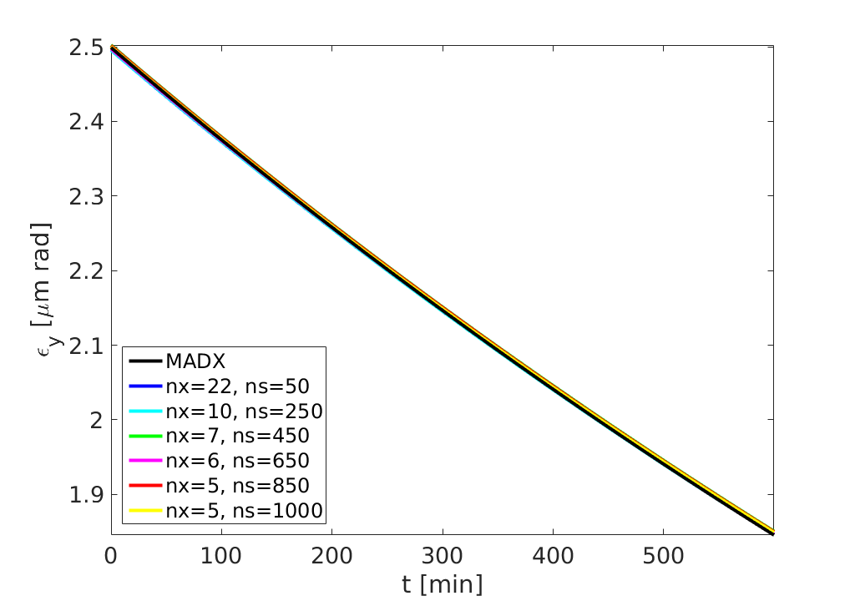
IBS+SR+QE, #mp=500000, scan #mp/cell (4:2:26)
IBS+SR+QE, #mp=500000, #mp/cell=20, scan #ncells (50:50:1000)

Slide 13
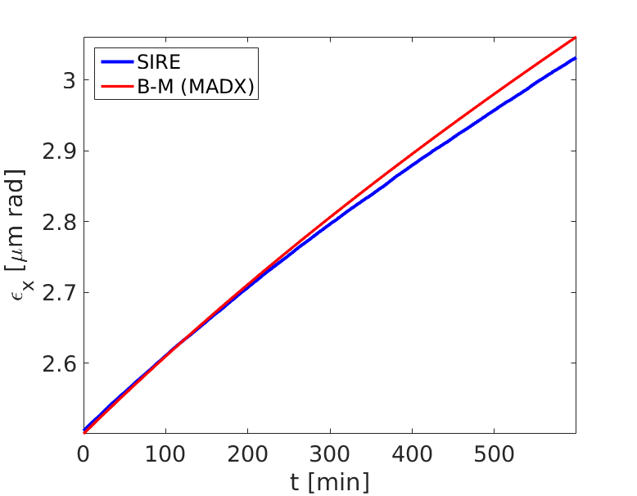
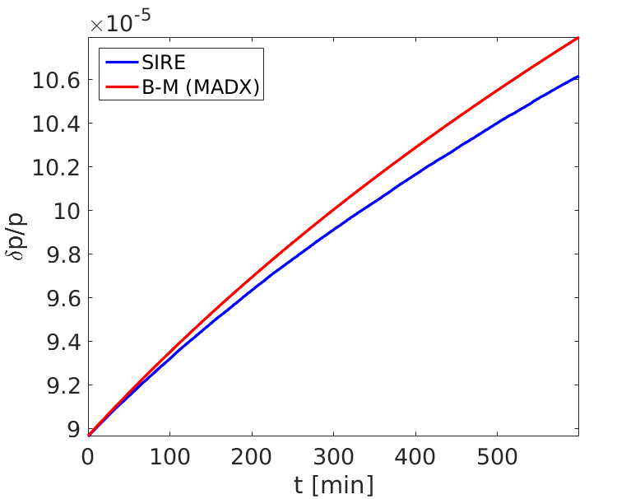
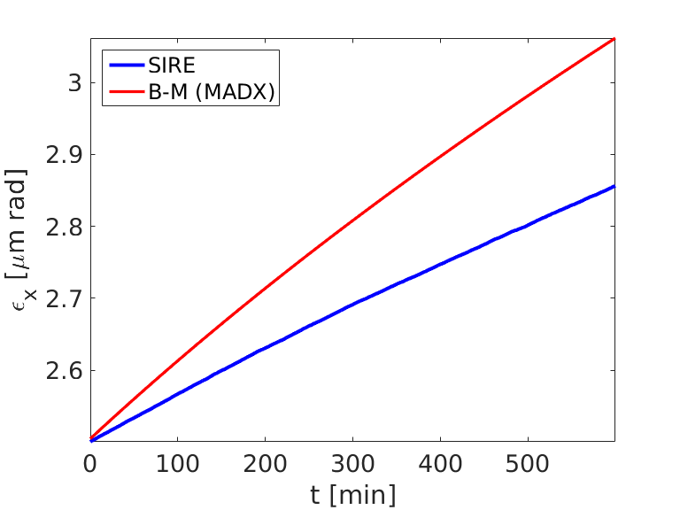
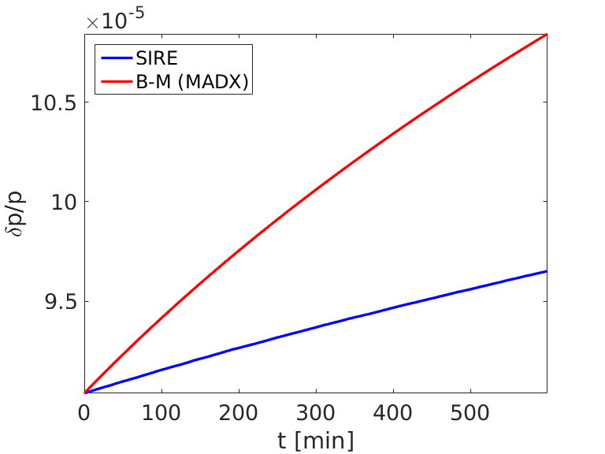
test longitudinal plane in SIRE
test1: invtune→1/betas, so es1[cont]=-(delta*delta+1/(betas*betas)*deltas*deltas)*log(1-ran2())
Very similar results to what already exists in SIRE (invtune approximation),
since invtune~1/betas
from Martini 2016 paper (pg 18)→ check my notes
test2: es1[cont]=-2*(delta*delta*betas+1/(betas)*deltas*deltas)*log(1-ran2())
That’s not a good idea

Slide 14
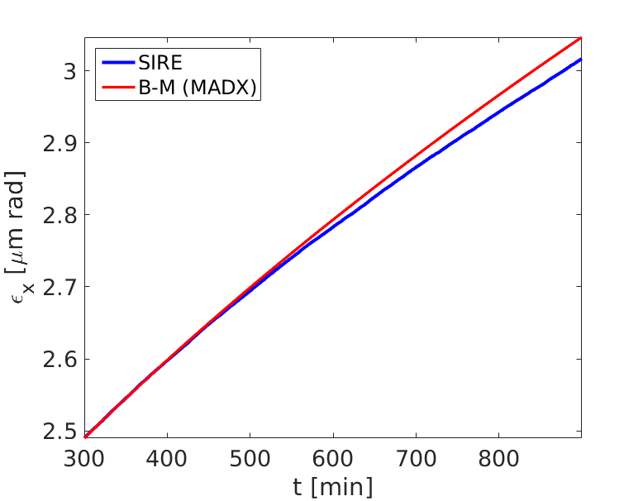
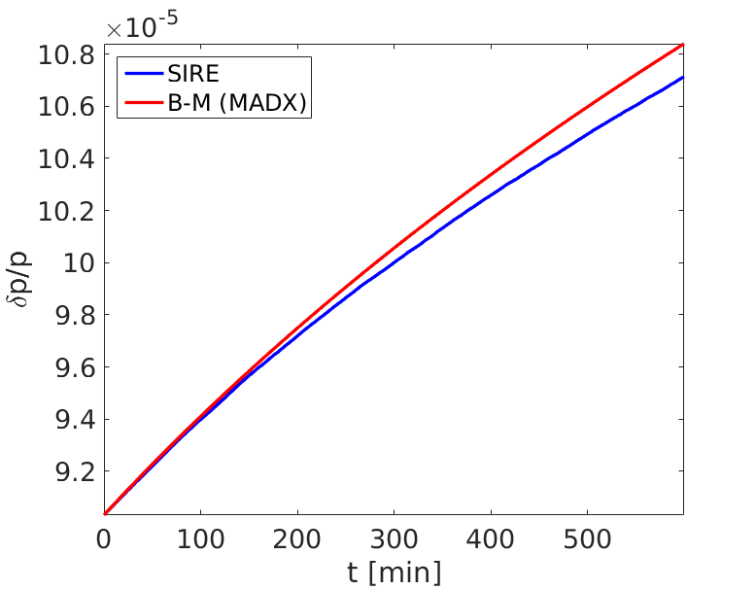
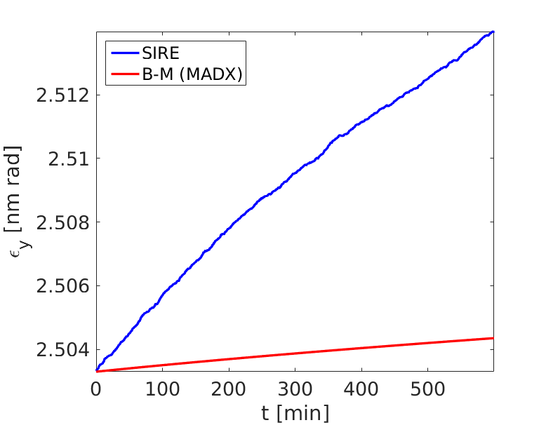
test longitudinal plane in SIRE
test1: invtune→1/betas, so es1[cont]=-(delta*delta+1/(betas*betas)*deltas*deltas)*log(1-ran2())
1.7% dif.
Very similar results to what already exists in SIRE (invtune approximation),
since invtune~1/betas
from Martini 2016 paper (pg 18)→ check my notes
test22: es1[cont]=-(delta*delta*betas+1/(betas)*deltas*deltas)*log(1-ran2())
1.2% dif.

Slide 15
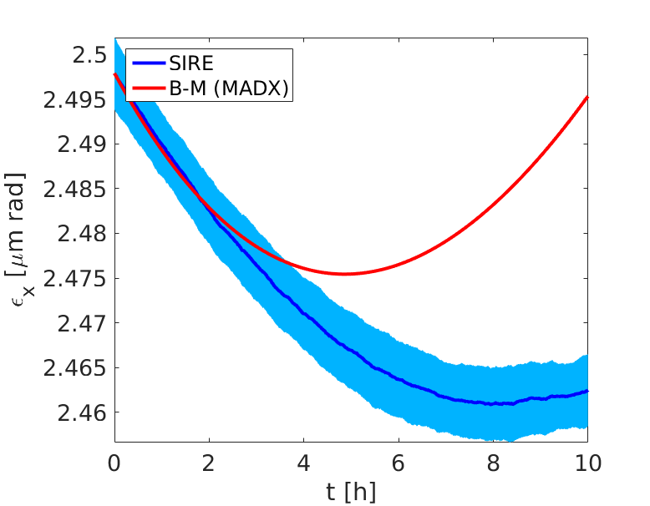
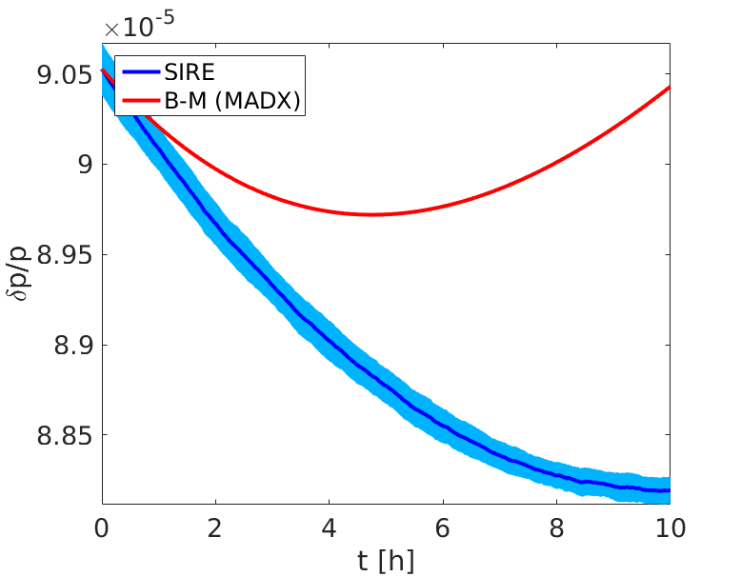
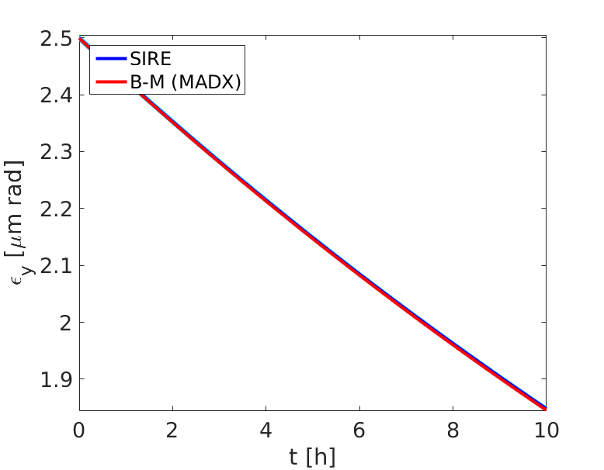
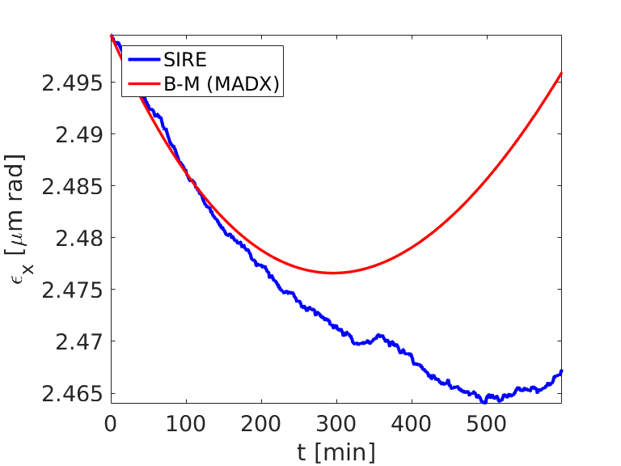
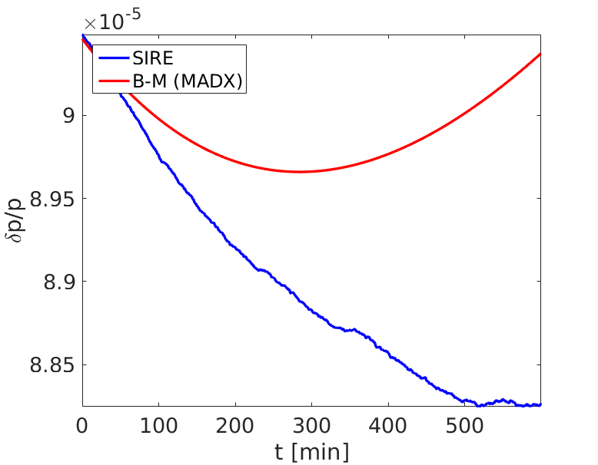
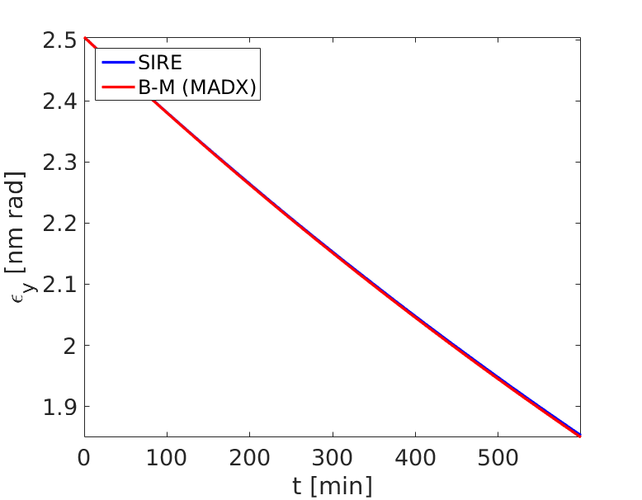
IBS+SR+QE
test longitudinal plane in SIRE
current SIRE: invtune approximation
1.4% dif.
2.6% dif.
Very similar results, so almost no improvement compared to the existing definition of longit. plane in SIRE, and so???
test22: es1[cont]=-(delta*delta*betas+1/(betas)*deltas*deltas)*log(1-ran2())
1.2% dif.
2.4% dif.

Slide 16
test longitudinal plane in SIRE
test1: invtune→1/betas, so es1[cont]=-(delta*delta+1/(betas*betas)*deltas*deltas)*log(1-ran2()) .
This test gives very similar results to what already exists in SIRE (invtune approximation), since invtune~1/betas.
Here: track in SIRE initially Gaussian distributions that correspond to the emit&enspread(and bunch length) values taken during specific timepoints within 10 h full tracking time in SIRE and the MADX results, that are not the same. Basically, I apply Gaussian distributions 2.5, 5 and 7.5 hours after the beginning, having in all planes the beam sizes that correspond to the values I see during the full 10h SIRE tracking and to the MADX results at this timepoints. So, in total I run 6 different cases for the timepoints mentioned (2.5, 5 and 7.5 hours), 3 based on the SIRE values and another 3 based on the MADX values. In this way we can see whether the discrepancy between sire and madx comes from the distribution form or not.
See the 2 following slides

Slide 17
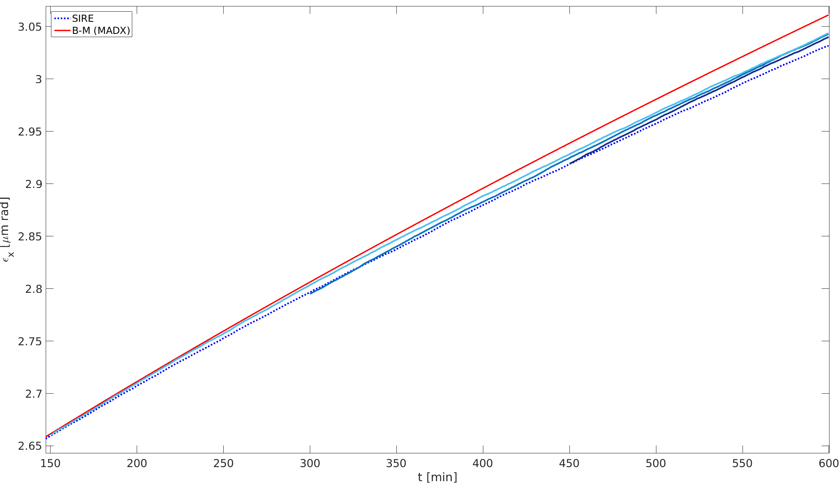
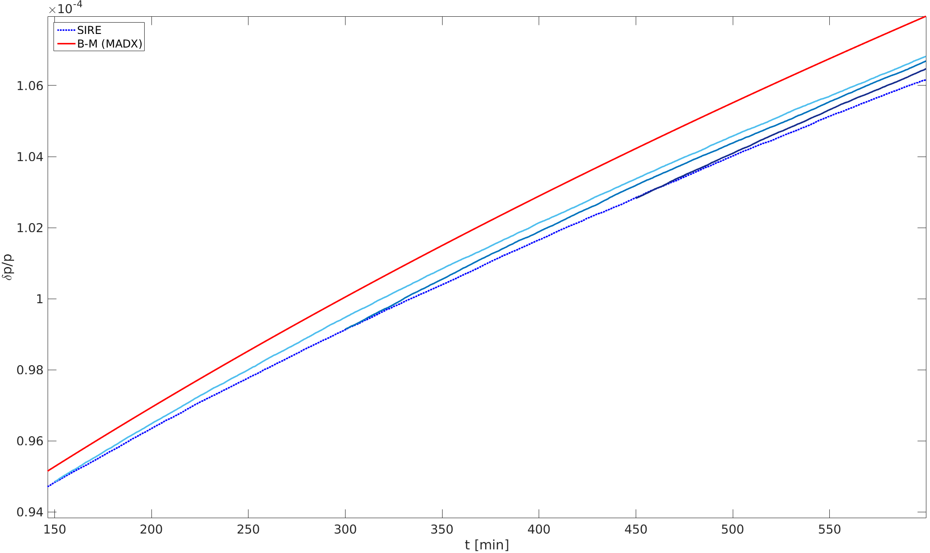
track in SIRE initially Gaussian distributions that correspond to the emit&enspread (and bunch length) values taken during specific timepoints within 10 h full tracking time in SIRE

Slide 18


track in SIRE initially Gaussian distributions that correspond to the emit&enspread(and bunch length) values taken during specific timepoints within 10 h from MADX results

Slide 19
July17

Slide 20




files/parameters | #mp | #mp/cell | ncellx* | ncells
Paramstest-forscanCells | 175000 | 5 | 10 | 350
params_moreMP | 250000 | 5 | 12 | 350
params_moreMPpercell | 175000 | 15 | 6 | 350
params_moreMPpercell_ncells** | 175000 | 87 | 2 | 500
test1 | 175000 | 20 | 4 | 500
test2 | 250000 | 10 | 10 | 250

Slide 21
files/parameters | #mp | #mp/cell | ncellx* | ncells
Paramstest-forscanCells | 175000 | 5 | 10 | 350
params_moreMP | 250000 | 5 | 12 | 350
params_moreMPpercell | 175000 | 15 | 6 | 350
params_moreMPpercell_ncells** | 175000 | 87 | 2 | 500
test1 | 175000 | 20 | 4 | 500
test2 | 250000 | 10 | 10 | 250
-test3 and tes6 see the #cells defined in the params file, without taking into account the #mp/cell
-test7 is for ncellz=ceil((numpart*ratio/(ncells*ncellx*mppercell)));
-All the other tests are for ncellx=sqrt((numpart*ratio/(ncells*mppercell)));
ncellz=ceil(ncellx/ratio);
*based on the ncellx=sqrt(#mp*ratio/(ncells*#mp/cell)), where the ratio is the sigmax/sigmay.
**the bl/sigmax~250 then for ncells=500 it should be ncellx=87, so, for #mp=175000, #mp/cell=2

Slide 22
files/parameters | #mp | #mp/cell | ncellx* | ncells
Paramstest-forscanCells | 175000 | 5 | 10 | 350
params_moreMP | 250000 | 5 | 12 | 350
params_moreMPpercell | 175000 | 15 | 6 | 350
params_moreMPpercell_ncells** | 175000 | 87 | 2 | 500
test1 | 175000 | 20 | 4 | 500
test2 | 250000 | 10 | 10 | 250

Slide 23




files/parameters | #mp | #mp/cell | ncellx* | ncells
Paramstest-forscanCells | 175000 | 5 | 10 | 350
test2 | 250000 | 10 | 10 | 250
test3 | 400000 | - | 20, 20 | 1000
test4 | 500000 | 20 | 16 | 100
test5 | 350000 | 15 | 10 | 250
test6 (no) | 300000 | - | 10, 10 | 500
test7 | 300000 | 10 | 10 | 500

Slide 25
ex1[cont]=-2*epsx*log(1-ran2()); // -2*exmean*log(1-ran2()) --> the factor of 2 is to go from emittance to action
ez1[cont]=-2*epsz*log(1-ran2());
es1[cont]=-(delta*delta+invtune*invtune*deltas*deltas)*log(1-ran2()); // this is alsready in action
phix1[cont]=2*pi*ran2();
phiz1[cont]=2*pi*ran2();
phis1[cont]=2*pi*ran2();
ratio=sqrt((betax[0]*exm[KINJ]+dispx[0]*dispx[0]*delta*delta)/(betaz[0]*ezm[KINJ]+dispz[0]*dispz[0]*delta*delta));
ncellx=ceil(sqrt((numpart*ratio/(ncells*mppercell))));
ncellz=ceil(ncellx/ratio);
phix[comodo]=2.0*pi*ran2();
phiz[comodo]=2.0*pi*ran2();
phis[comodo]=2.0*pi*ran2();
// double *x,*xp,*z,*zp,*deltasp,*deltap
deltap[comodo]=sqrt(es[comodo])*cos(phis[comodo])+qes1*eqdelta*sqrt(1-exp(-DTIME/dtimes));
deltasp[comodo]=sqrt(es[comodo])*sin(phis[comodo])/invtune+qes2*eqdeltas*sqrt(1-exp(-DTIME/dtimes));
x[comodo]=sqrt(ex[comodo]*betax[i])*cos(phix[comodo])+qex1*sqrt(betax[i]*eqx*(1-exp(-DTIME/dtimex)));
xp[comodo]=-sqrt(ex[comodo]/betax[i])*(alphax[i]*cos(phix[comodo])+sin(phix[comodo]))+qex2*sqrt(eqx*(1+alphax[i]*alphax[i])/betax[i]*(1-exp(-DTIME/dtimex)));
z[comodo]=sqrt(ez[comodo]*betaz[i])*cos(phiz[comodo])+qez1*sqrt(betaz[i]*eqz*(1-exp(-DTIME/dtimez)));
zp[comodo]=-sqrt(ez[comodo]/betaz[i])*(alphaz[i]*cos(phiz[comodo])+sin(phiz[comodo]))+qez2*sqrt(eqz*(1+alphaz[i]*alphaz[i])/betaz[i]*(1-exp(-DTIME/dtimez)));;
ex[comodo]=betax[i]*xp[comodo]*xp[comodo]+2.0*alphax[i]*xp[comodo]*x[comodo]+(1+alphax[i]*alphax[i])/betax[i]*x[comodo]*x[comodo];
ez[comodo]=betaz[i]*zp[comodo]*zp[comodo]+2.0*alphaz[i]*zp[comodo]*z[comodo]+(1+alphaz[i]*alphaz[i])/betaz[i]*z[comodo]*z[comodo];
es[comodo]=deltap[comodo]*deltap[comodo]+invtune*invtune*deltasp[comodo]*deltasp[comodo];
phis[comodo]=atan(invtune*deltasp[comodo]/deltap[comodo]);
phix[cont]=2.0*pi*ran2();
phiz[cont]=2.0*pi*ran2();
phis[cont]=2.0*pi*ran2();
// double *x,*xp,*z,*zp,*deltasp,*deltap
deltap[cont]=sqrt(es[cont])*cos(phis[cont]);
deltasp[cont]=sqrt(es[cont])*sin(phis[cont])/invtune;
x[cont]=sqrt(ex[cont]*betax[i])*cos(phix[cont])+dispx[i]*deltap[cont];
xp[cont]=-sqrt(ex[cont]/betax[i])*(alphax[i]*cos(phix[cont])+sin(phix[cont]))+disp1x[i]*deltap[cont];
z[cont]=sqrt(ez[cont]*betaz[i])*cos(phiz[cont])+dispz[i]*deltap[cont];
zp[cont]=-sqrt(ez[cont]/betaz[i])*(alphaz[i]*cos(phiz[cont])+sin(phiz[cont]))+disp1z[i]*deltap[cont];
ex[cont]=betax[i]*(xp[cont]-disp1x[i]*deltap[cont])*(xp[cont]-disp1x[i]*deltap[cont])+2.0*alphax[i]*(xp[cont]-disp1x[i]*deltap[cont])*(x[cont]-dispx[i]*deltap[cont])+(1+alphax[i]*alphax[i])/betax[i]*(x[cont]-dispx[i]*deltap[cont])*(x[cont]-dispx[i]*deltap[cont]);
ez[cont]=betaz[i]*(zp[cont]-disp1z[i]*deltap[cont])*(zp[cont]-disp1z[i]*deltap[cont])+2.0*alphaz[i]*(zp[cont]-disp1z[i]*deltap[cont])*(z[cont]-dispz[i]*deltap[cont])+(1+alphaz[i]*alphaz[i])/betaz[i]*(z[cont]-dispz[i]*deltap[cont])*(z[cont]-dispz[i]*deltap[cont]);
es[cont]=deltap[cont]*deltap[cont]+invtune*invtune*deltasp[cont]*deltasp[cont];
phis[cont]=atan(invtune*deltasp[cont]/deltap[cont]);
if (deltap[cont]<0)
{
phis[cont]=phis[cont]+pi;
}
phix[cont]=atan(-(xp[cont]-disp1x[i]*deltap[cont])/(x[cont]-dispx[i]*deltap[cont])*betax[i]-alphax[i]);
if (x[cont]-dispx[i]*deltap[cont]<0)
{
phix[cont]=phix[cont]+pi;
}
phiz[cont]=atan(-(zp[cont]-disp1z[i]*deltap[cont])/(z[cont]-dispz[i]*deltap[cont])*betaz[i]-alphaz[i]);
if (z[cont]-dispz[i]*deltap[cont]<0)
{
phiz[cont]=phiz[cont]+pi;

