Slide 1
MY CITY INFORMATION
PIP104 PROFESSIONAL PRACTICE-II
VIVA-VOCE
Batch Number:
Roll Number | Student Name
20201CCS0059 | SHIKHAR RAI
20201CCS0004 | SOURAV TIWARY
20201CCS0142 | JATIN KUMAR H
Under the Supervision of,
Ms. SUDHA Y
Associate Professor
School of Computer Science Engineering & Information Science
Presidency University

Slide 2
Introduction
In today's fast-paced, digital era, the need for a comprehensive city guide app for Indian cities is evident.
"My City Information" aims to be more than just an app; it's your friendly urban companion, simplifying city exploration.
Key Features:
Trustworthy Sidekick: Assists in navigating diverse landscapes and meeting distinct city-related needs.
Essential Information: Uncover intriguing places, locate local services, and ensure safety on the move.
Cutting-edge Technology: Leverages mobile tech for a seamless, go-to solution for all city-related inquiries.

Slide 3
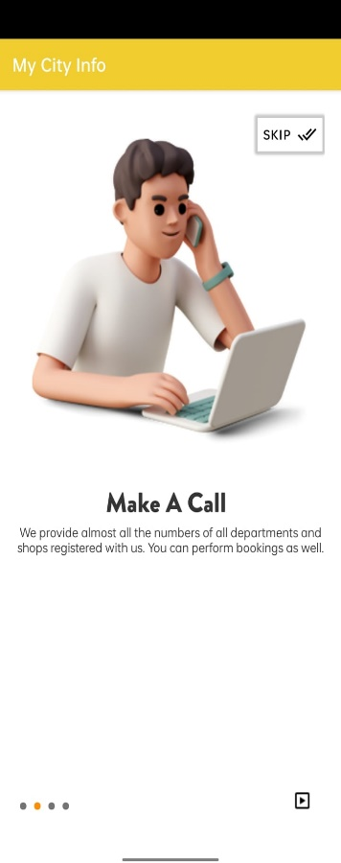
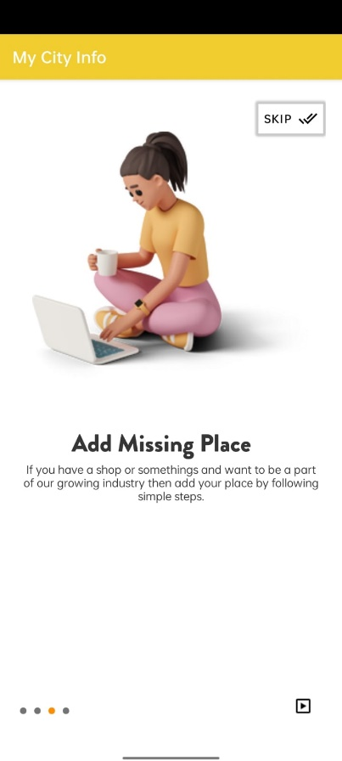
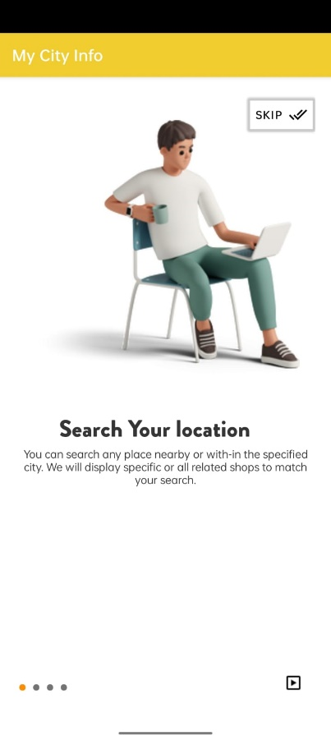
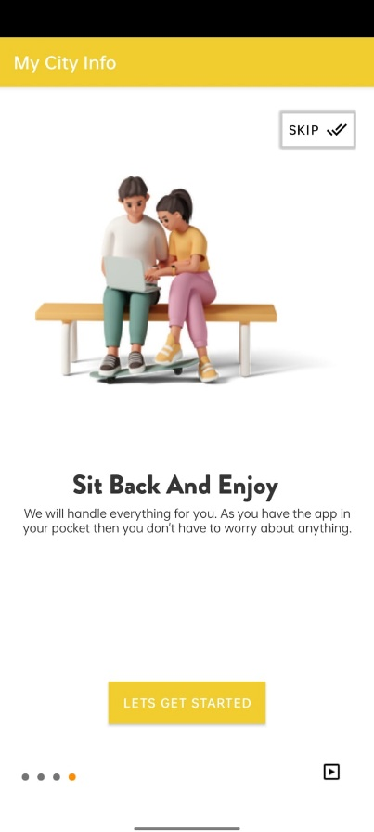
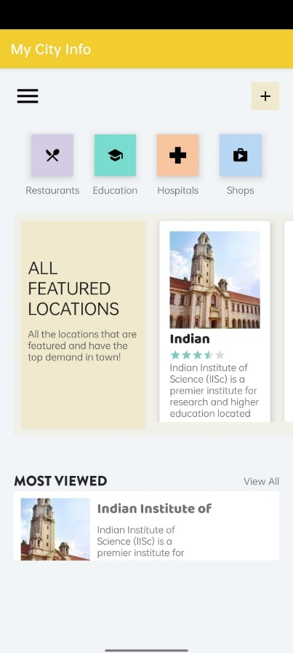
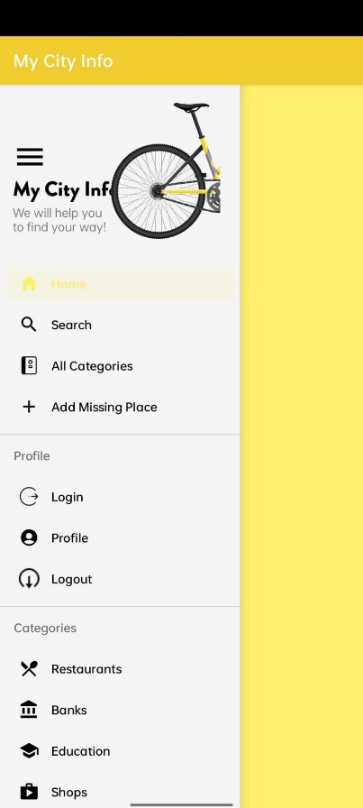

Slide 4
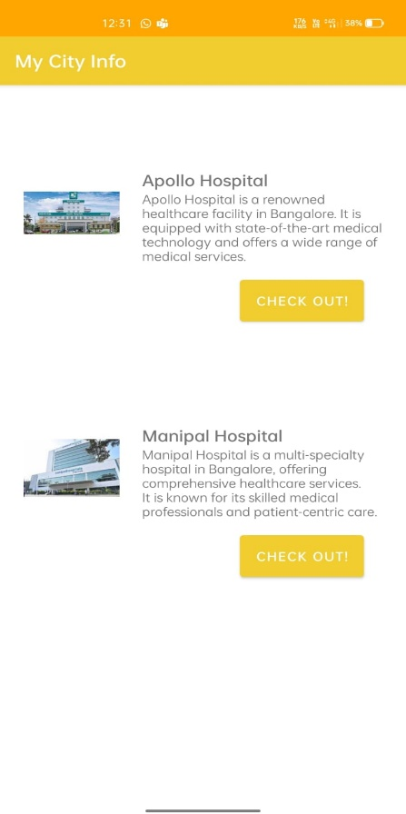
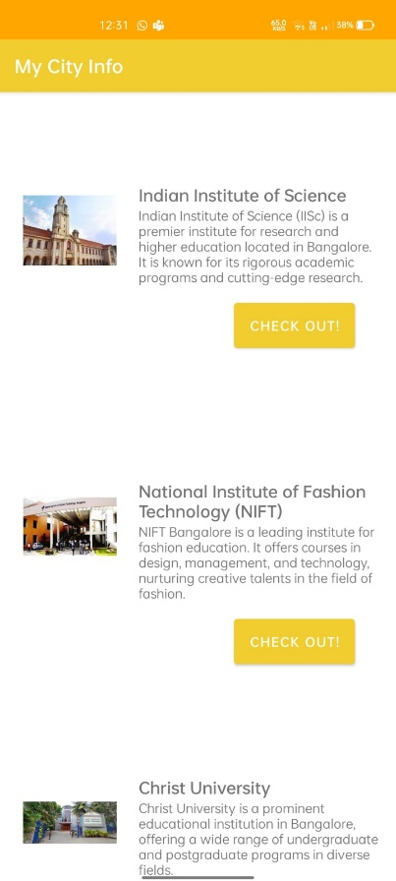
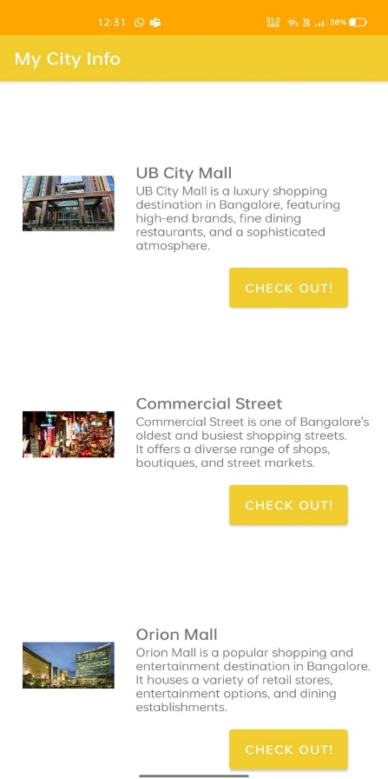
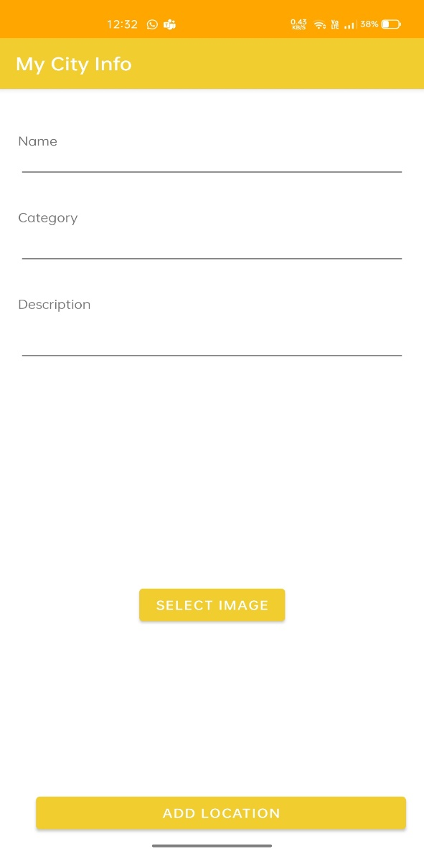
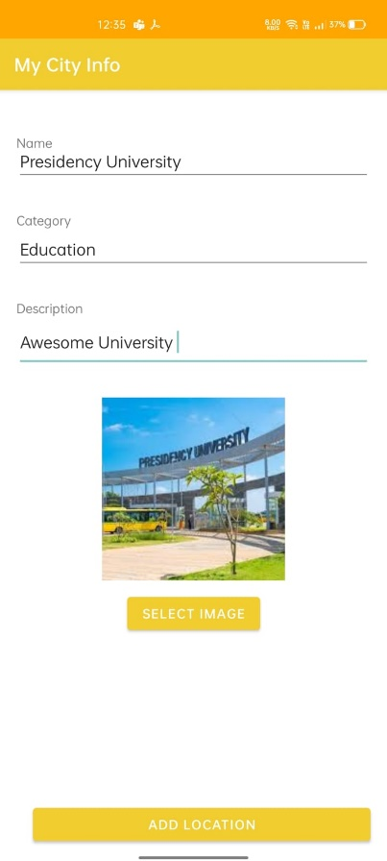

Slide 5
Literature Review
Mobile Application Development with Android
Introduction to Android's open-source nature.
Versatility across various devices beyond smartphones.
Fueled by a Linux-based core.
Collaboration among 30+ companies to democratize the mobile landscape.
Soaring demand for mobile app development on Android.

Slide 6
Mobile App Development for Tourist Guide in Pekanbaru City
Development of an Android-based tourist guide.
Utilization of KNN algorithm.
Implementation using Sublime Text and Android Studio.
Advantages: Easy exploration, detailed information, and convenient navigation.
Disadvantages: GPS accuracy, reliance on network signal.

Slide 7
Travel with us mobile application (IJCRT)
Focus on the impact of mobile evolution on travel experiences.
Categorization of smartphone apps for travelers.
Implementation using Android Studio.
Advantages: Simplicity, cost-free alternative, language diversity.
Disadvantages: GPS accuracy, reliance on network conditions.

Slide 8
CITY GUIDE FOR ANDROID
Development of a specialized city guide app for Android.
Emphasis on user-friendly design and Google Maps integration.
Architecture: Main Activity, Location Provider, Google Maps API.
Advantages: User-friendly, affordability, language diversity.
Disadvantages: GPS accuracy, privacy concerns, reliance on stable internet.

Slide 9
Summary and Conclusion
Recap of key points from each research paper.
Emphasis on the diversity and complexity of mobile applications.
Acknowledgment of advantages and challenges in mobile app development.
The importance of user-centric design and consideration of practical needs.

Slide 10
Research Gaps Identified
User Adoption and Engagement:
Research could investigate the factors influencing user adoption of city guide apps, particularly in the context of diverse user demographics and preferences in India.
Understanding user engagement patterns over time and identifying strategies to enhance long-term usage.
Effectiveness of Community-Driven Content:
Explore the effectiveness of community-driven content in providing accurate and up-to-date information, considering factors such as reliability, moderation, and user participation.
Language Inclusivity:
Evaluate the effectiveness of language inclusivity in breaking down communication barriers and attracting users from different linguistic backgrounds.
Assess user satisfaction and preferences concerning the availability of content in multiple languages.

Slide 11
Proposed Methodology
Market Research and Analysis:
Conduct a thorough analysis of the Indian app market, specifically focusing on city guide applications.
Identify existing apps, their features, and user reviews to understand strengths and weaknesses.
Evaluate user preferences and expectations regarding city guide apps through surveys and feedback.
User Persona Development:
Create detailed user personas representing the diverse audience the app aims to serve (locals, tourists, individuals with varying language preferences).
Define user goals, pain points, and expectations to guide the app's development.

Slide 12
Objectives
Comprehensive City Information:
Provide a user-friendly interface for accessing vital city-related information.
Offer a detailed and extensive guide covering diverse aspects of Indian cities.
Navigation and Exploration:
Assist locals and visitors in navigating the cities effortlessly.
Simplify the process of discovering new places and attractions.
Safety and Security:
Integrate features to ensure user safety on the go.
Provide real-time updates on safety-related information and alerts.
Community-Driven Experience:
Foster a sense of community by allowing users to contribute real-time updates and content.
Create a dynamic platform where users can share experiences and recommendations.

Slide 13
System Design & Implementation
Architecture: My City Information app employs Kotlin for Android, Node.js for server, and MySQL for structured data. Google Maps API enhances location services.
Database Design: Strongly related tables for cities, attractions, events, and user preferences ensure data integrity. Security measures include encrypted connections and user role-based access.
User Interface Design: The app follows Material Design principles for an intuitive layout and accessibility features like text-to-speech.
Performance: Optimization through caching, resource management, and extensive testing, including UI/UX, functionality, security, and performance.

Slide 14
Timeline of Project
Project Inception (Month 1):
Idea conceptualization and market research.
Identifying the gap in the Indian app market for a comprehensive city guide.
Defining the core features and functionalities.
Planning and Design (Months 2-3):
Detailed project planning, including feature prioritization.
Collaborating with UX/UI designers for the app interface.
Developing wireframes and mockups for the app.
Development Kick-off (Month 4):
Setting up the development environment.
Initiating coding and programming tasks.
Creating the basic structure of the app.
Beta Testing (Months 5-6):
Conducting internal testing for app functionalities.
Gathering feedback from a select group of users.
Iterative development based on beta testing results.

Slide 15
Feature Enhancement (Months 7-8):
Implementing personalized recommendation algorithms.
Adding multilingual support features.
Integrating real-time updates and community-driven content.
User Interface Refinement (Month 9):
Refining the user interface based on beta test feedback.
Ensuring easy navigation and user-friendly experience.
Conducting usability testing for further improvements.
Final Testing and Quality Assurance (Months 10-11):
Comprehensive testing for all features and functionalities.
Identifying and fixing any bugs or issues.
Ensuring compatibility with various devices.
Launch Preparation (Month 12):
Developing promotional materials and marketing strategies.
Preparing documentation and user guides.
Finalizing partnerships with local businesses and service providers.

Slide 16
Official Launch (Month 13):
Releasing the "My City Guide App" on major app stores.
Launching marketing campaigns to promote the app.
Monitoring app performance and user feedback.
Post-Launch Optimization (Ongoing):
Continuously monitoring user feedback and addressing issues.
Rolling out updates for new features and improvements.
Expanding partnerships and community engagement.
Long-Term Roadmap (Ongoing):
Exploring additional features based on user needs.
Expanding to more cities and regions in India.
Implementing emerging technologies for further innovation.

Slide 17
Outcomes / Results Obtained
Comprehensive City Information:
The app aims to offer comprehensive city-related information, suggesting that users can benefit from a centralized resource for various city-related queries.
User-Friendly Interface:
The emphasis on easy navigation suggests that the app focuses on providing a user-friendly experience, ensuring that users can efficiently access the information they need.
Real-Time Updates and Community Interaction:
The integration of real-time updates and content from users implies a dynamic and community-driven aspect. Users can contribute to the app's content, fostering a sense of community and ensuring that information remains current.

Slide 18
Conclusion
User-Centric Design Commitment:
The project is dedicated to revolutionizing access to city-related information with a strong commitment to user-centric design principles.
Swift Development Emphasis:
Core features have been efficiently developed, providing an accessible and efficient tool for navigating city life.
Usability Testing and Data-Driven Refinement:
Valuable insights from usability testing and data collection have informed ongoing refinement, ensuring the app's design meets user needs effectively.
Safety, Accessibility, and Up-to-Date Information:
The project prioritizes safety, accessibility, and the consistent provision of up-to-date information, adhering to high standards in these crucial aspects.

Slide 19
References
WHO Guidelines on Inclusion and Accessibility (2023):
Authoritative guidelines emphasizing the critical importance of accessibility in urban development.
Modern Trends in Mobile App Design (Johnson, 2022):
Contemporary insights from a reputable journal, Digital Trends.
ISO 9241-210:2022 (International Organization for Standardization):
Recognized standard governing the ergonomics of human-system interaction.
ISO 25010:2021 (Systems and Software Quality Models):
Recent ISO standard providing a framework for defining quality requirements and evaluating software systems.

Slide 20

Thank You

