Slide 1
NATIONAL UNIVERSITY OF SINGAPORE (NUS)
Which Asset Wins
Next Month?
Momentum-Weighted Risk Parity
for Dynamic Cross-Asset Allocation
FE5209 Financial Econometrics
Group Project - Weiming Alpha
Presentation date: 2 November
01
Notes:
Speaker 1. Quick Slide.
Technical reference or opening.
Core message: Momentum-Weighted Risk Parity for Dynamic Cross-Asset Allocation
Read-aloud script:
Good morning. Our project asks how to allocate across asset classes when both trends and risks change. We study Momentum-Weighted Risk Parity, or MWRP. The objective is a balanced portfolio construction process, rather than the highest possible backtested return. We will explain the economic motivation, show how the econometric model determines capital weights, and compare performance with strong, simple benchmarks. The results are exploratory historical evidence, not live investment performance.
Figure explanation: Explain the definitions and comparison on this page.
Sources:
/Users/wangyujing/Desktop/MFE_Macro_Rotation_6Assets/reports/phase4_research_report.md
/Users/wangyujing/Desktop/MFE_Macro_Rotation_6Assets/reports/research_report.md

Slide 2
01
The Investment Problem
Capture trends while controlling portfolio concentration
02
Notes:
Speaker 1. Quick Slide.
Section question: Why combine momentum with risk allocation?
Core message: Capture trends while controlling portfolio concentration
Read-aloud script:
This section asks: Why combine momentum with risk allocation? Capture trends while controlling portfolio concentration.
Figure explanation: Explain the definitions and comparison on this page.
Sources:
/Users/wangyujing/Desktop/MFE_Macro_Rotation_6Assets/reports/phase4_research_report.md
/Users/wangyujing/Desktop/MFE_Macro_Rotation_6Assets/reports/research_report.md

Slide 3
SECTION 01 INVESTMENT MOTIVATION & UNIVERSE
Six risk exposures and one defensive asset
Risk exposure | ETF ticker | Portfolio role
US equity | SPY | Risk asset
Singapore equity | ES3.SI | Risk asset
Long-term US Treasuries | TLT | Risk asset
Gold | GLD | Risk asset
Emerging markets equity | IEMG | Risk asset
Broad commodities | PDBC | Risk asset
Treasury bills | BIL | Defensive asset
ETF = exchange-traded fund. SGD = Singapore dollar. USD = United States dollar.
BIL retains USD/SGD currency risk. It is not risk-free SGD cash.
03
Notes:
Speaker 1. Core Slide.
Section question: Why combine momentum with risk allocation?
Core message: Diversification spans different economic exposures, with all returns measured in SGD.
Read-aloud script:
We use six risk exchange-traded funds, or ETFs. They provide US equities, Singapore equities, long-term US Treasuries, gold, emerging markets equities and broad commodities. BIL, a US Treasury-bill ETF, is the defensive destination. SGD means Singapore dollar and USD means United States dollar. We convert USD assets to SGD total returns so that the portfolio is evaluated from one investor currency. These are distinct exposures, but several still share equity, interest-rate and currency risks. In particular, BIL retains USD against SGD currency risk and should not be described as risk-free SGD cash.
Figure explanation: Explain the definitions and comparison on this page.
Sources:
/Users/wangyujing/Desktop/MFE_Macro_Rotation_6Assets/reports/phase4_research_report.md
/Users/wangyujing/Desktop/MFE_Macro_Rotation_6Assets/reports/research_report.md

Slide 4
SECTION 01 INVESTMENT MOTIVATION & UNIVERSE
Return relationships before the recent-month test
 | SPY | ES3.SI | TLT | GLD | IEMG | PDBC
SPY | 1.00 | 0.15 | -0.03 | 0.21 | 0.77 | 0.31
ES3.SI | 0.15 | 1.00 | -0.14 | 0.00 | 0.26 | 0.11
TLT | -0.03 | -0.14 | 1.00 | 0.25 | 0.01 | -0.11
GLD | 0.21 | 0.00 | 0.25 | 1.00 | 0.34 | 0.31
IEMG | 0.77 | 0.26 | 0.01 | 0.34 | 1.00 | 0.31
PDBC | 0.31 | 0.11 | -0.11 | 0.31 | 0.31 | 1.00
Diversification
opportunities
Equity, rate and currency
risks can overlap.
Pearson correlations of SGD daily total returns, 2020 Jan–2026 Sep 18. Historical background only.
04
Notes:
Recomputed from archived SGD total-return data through 2026-10-19. Source: research/src/evaluation_windows.py, research/outputs/windows/tables/performance.csv and asset_pnl_attribution.csv. Equal Weight uses identical frozen strategy/execution rules. Full quantitative source: .presentation-build/data.json. Retrospective research after strategy selection.

Slide 5
SECTION 01 INVESTMENT MOTIVATION & UNIVERSE
Momentum selection and equal-risk allocation
Dual Momentum
Equal Risk Contribution (ERC)
Ranks six-month asset returns
Allocates two 50% capital slots
Emphasizes strong winners
Balances forecast risk shares
Uses volatility and co-movement
Does not rank momentum strength
Momentum-Gated Risk Parity (MGRP) adds eligibility to equal-risk allocation.
05
Notes:
Speaker 1. Core Slide.
Section question: Why combine momentum with risk allocation?
Core message: Momentum emphasizes winners. Equal-risk allocation emphasizes forecast diversification.
Read-aloud script:
Dual Momentum ranks the six risk assets by their six-month SGD total return and assigns two equal capital slots. A selected asset must beat BIL over the same lookback, otherwise that slot moves to BIL. This can capture strong trends, but two slots create concentration. Equal Risk Contribution, or ERC, instead sets equal shares of forecast portfolio risk across all six risk assets. It uses covariance information but does not distinguish stronger from weaker momentum. These are useful starting points because their different objectives create a clear investment trade-off.
Figure explanation: Explain the definitions and comparison on this page.
Sources:
/Users/wangyujing/Desktop/MFE_Macro_Rotation_6Assets/reports/phase4_research_report.md
/Users/wangyujing/Desktop/MFE_Macro_Rotation_6Assets/reports/research_report.md

Slide 6
SECTION 01 INVESTMENT MOTIVATION & UNIVERSE
The portfolio-construction question
Can momentum strength improve risk budgeting
without sacrificing too much return?
01
Eligibility
Which assets qualify?
02
Risk preferences
How much forecast risk should each receive?
03
Capital allocation
How much money implements those preferences?
06
Notes:
Speaker 1. Core Slide.
Section question: Why combine momentum with risk allocation?
Core message: Use momentum to express risk preferences, then use covariance to determine capital.
Read-aloud script:
Our research question is whether momentum strength can improve risk budgeting without sacrificing too much return. We separate three decisions: which assets qualify, how much forecast risk each should receive, and how much capital implements those preferences. We compare MWRP with Dual Momentum as a strong investment benchmark. We also compare it with Momentum-Gated Risk Parity, or MGRP, which holds the same eligible set but assigns equal risk budgets. That second comparison helps isolate what momentum weighting changes. Speaker 2 will now explain the rules.
Figure explanation: Explain the definitions and comparison on this page.
Sources:
/Users/wangyujing/Desktop/MFE_Macro_Rotation_6Assets/reports/phase4_research_report.md
/Users/wangyujing/Desktop/MFE_Macro_Rotation_6Assets/reports/research_report.md

Slide 7
02
From Momentum to Portfolio Weights
Eligibility, risk preferences and covariance-based capital allocation
07
Notes:
Speaker 2. Quick Slide.
Section question: How does a momentum signal become a portfolio weight?
Core message: Eligibility, risk preferences and covariance-based capital allocation
Read-aloud script:
This section asks: How does a momentum signal become a portfolio weight? Eligibility, risk preferences and covariance-based capital allocation.
Figure explanation: Explain the definitions and comparison on this page.
Sources:
/Users/wangyujing/Desktop/MFE_Macro_Rotation_6Assets/reports/phase4_research_report.md
/Users/wangyujing/Desktop/MFE_Macro_Rotation_6Assets/reports/research_report.md

Slide 8
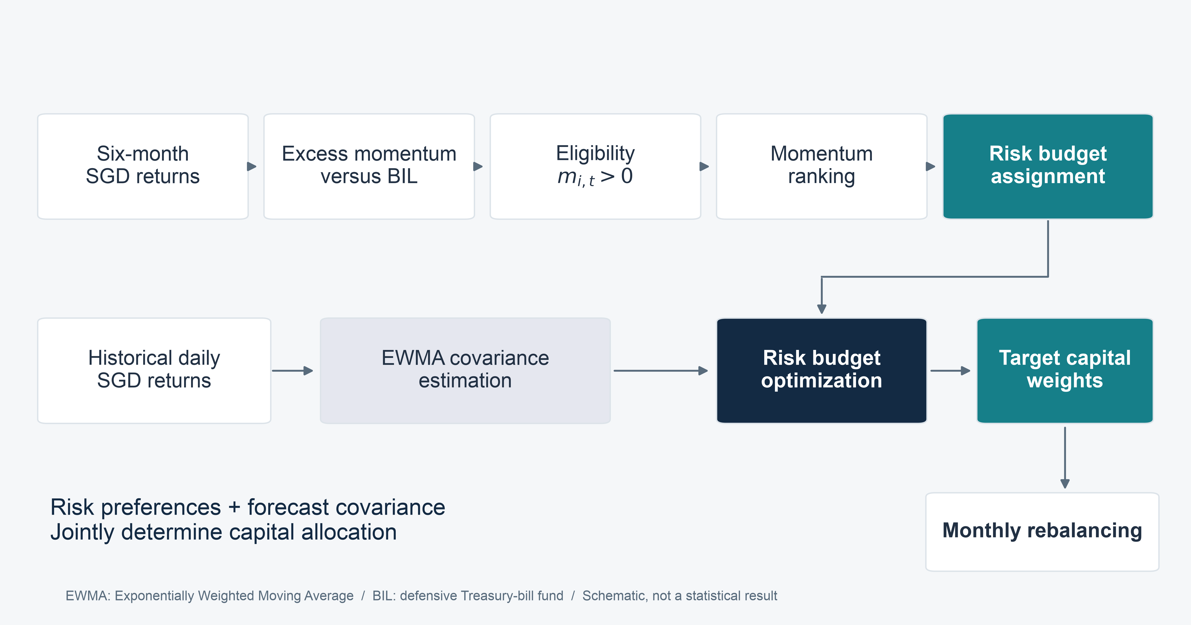
SECTION 02 OUR STRATEGY: MWRP
Momentum sets risk preferences, covariance sets capital
08
Notes:
Speaker 2. Core Slide.
Section question: How does a momentum signal become a portfolio weight?
Core message: The same covariance estimator maps different risk budgets into capital weights.
Read-aloud script:
The pipeline starts with month-end information already available at the signal time. Six-month returns relative to BIL determine eligibility. Eligible assets are ranked by momentum. Their ranks determine target risk budgets. The exponentially weighted moving average, or EWMA, covariance estimate then maps those budgets into capital weights. We hold all eligible assets, stay long only, use no leverage, and rebalance monthly. If no risk asset qualifies, we hold BIL. MWRP changes the risk budgets used by MGRP, while keeping the eligibility rule, covariance estimator and execution engine fixed.
Figure explanation: The same covariance estimator maps different risk budgets into capital weights.
Sources:
/Users/wangyujing/Desktop/MFE_Macro_Rotation_6Assets/presentation_assets/final_figures_v2/figures/main/FIG02_Pipeline_full.svg
/Users/wangyujing/Desktop/MFE_Macro_Rotation_6Assets/reports/phase4_research_report.md
/Users/wangyujing/Desktop/MFE_Macro_Rotation_6Assets/reports/research_report.md
/Users/wangyujing/Desktop/MFE_Macro_Rotation_6Assets/src/strategies.py
/Users/wangyujing/Desktop/MFE_Macro_Rotation_6Assets/src/phase4/models.py

Slide 9
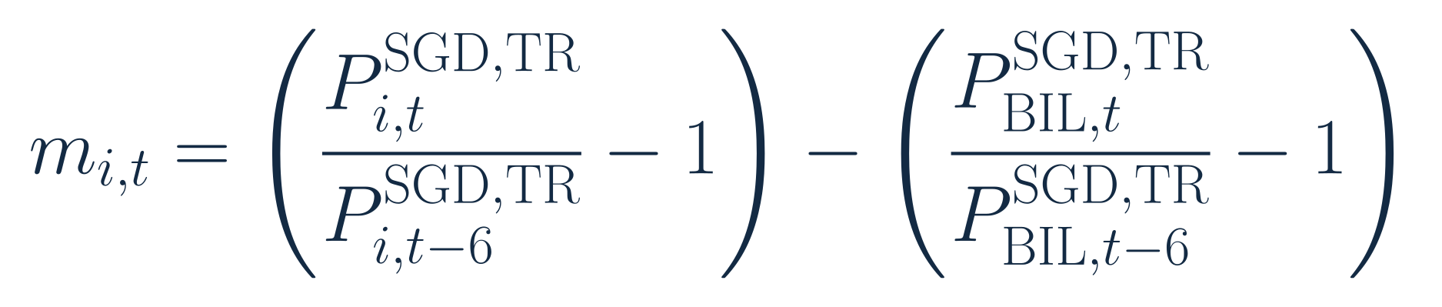
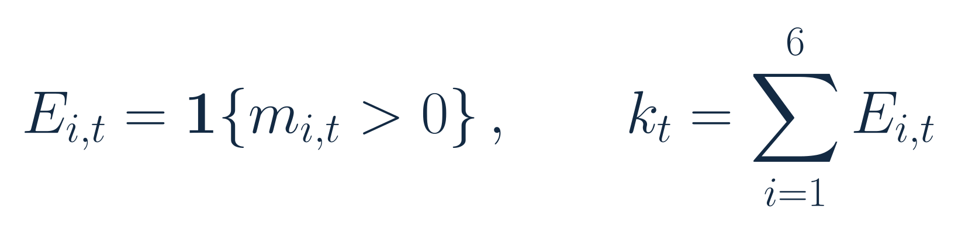
SECTION 02 OUR STRATEGY: MWRP
An asset must beat BIL to qualify
Six-month excess momentum
Eligibility and the number of qualifying risk assets
i: risk asset. t: month-end. P: SGD total-return index. k: eligible count.
Strictly positive spread. No eligible assets: 100% BIL. One eligible asset: 100% capital.
09
Notes:
Speaker 2. Core Slide.
Section question: How does a momentum signal become a portfolio weight?
Core message: Eligibility uses a strictly positive six-month SGD total-return spread.
Read-aloud script:
The first equation defines excess momentum as the asset's six-month simple total return less BIL's return over the same months. The second equation defines the eligibility indicator and counts eligible assets. A zero spread does not qualify because the inequality is strict. The prices are month-end SGD total-return indices, with dividends already reflected in adjusted prices. Subtracting the same BIL return does not change the relative ordering of risk assets. When no asset qualifies, MWRP holds one hundred percent BIL. When only one qualifies, that asset receives all risk and capital.
Figure explanation: Explain the definitions and comparison on this page.
Sources:
/Users/wangyujing/Desktop/MFE_Macro_Rotation_6Assets/reports/phase4_research_report.md
/Users/wangyujing/Desktop/MFE_Macro_Rotation_6Assets/reports/research_report.md
/Users/wangyujing/Desktop/MFE_Macro_Rotation_6Assets/presentation_assets/final_figures_v2/formulas/svg/F01_six-month_excess_momentum.svg
/Users/wangyujing/Desktop/MFE_Macro_Rotation_6Assets/presentation_assets/final_figures_v2/formulas/svg/F02_momentum_eligibility.svg

Slide 10
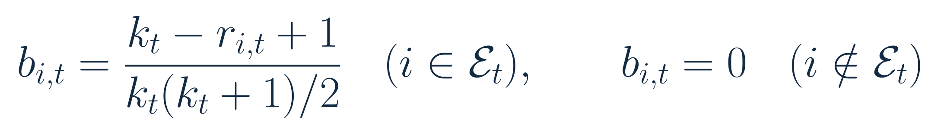
SECTION 02 OUR STRATEGY: MWRP
Stronger momentum receives a larger risk budget
k = eligible count. r = rank among eligible assets. Rank 1 is strongest.
Eligible rank | 1 | 2 | 3 | 4
Target risk share | 40% | 30% | 20% | 10%
Risk budget is not capital weight
Fixed linear rank rule. Budgets sum to 100%. The four-asset row illustrates the rule.
10
Notes:
Speaker 2. Core Slide.
Section question: How does a momentum signal become a portfolio weight?
Core message: Four eligible assets receive risk budgets of 40%, 30%, 20% and 10%.
Read-aloud script:
Here k is the number of eligible risk assets and r is the rank within that set, with one denoting the strongest momentum. The linear rule gives the strongest asset the largest share of forecast risk. With four eligible assets, the budgets are forty, thirty, twenty and ten percent. The denominator makes them sum to one. This is a fixed rule, not a fitted return forecast or a parameter chosen to maximize recent Sharpe. The key distinction is that these are risk budgets. They are not capital weights, because volatility and covariance also affect the capital required.
Figure explanation: Explain the definitions and comparison on this page.
Sources:
/Users/wangyujing/Desktop/MFE_Macro_Rotation_6Assets/reports/phase4_research_report.md
/Users/wangyujing/Desktop/MFE_Macro_Rotation_6Assets/reports/research_report.md
/Users/wangyujing/Desktop/MFE_Macro_Rotation_6Assets/presentation_assets/final_figures_v2/formulas/svg/F03_momentum-weighted_risk_budget.svg

Slide 11
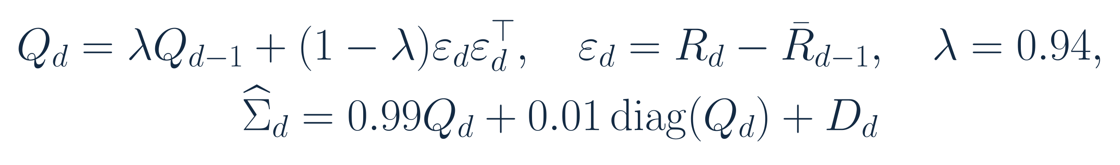
SECTION 02 OUR STRATEGY: MWRP
Recent observations receive more weight in covariance
Exponentially Weighted Moving Average (EWMA)
01
Recent information
lambda = 0.94. Use the prior expanding mean for innovations.
02
Fixed stabilization
Initialize with 252 returns. Apply 1% diagonal shrinkage and a 1e-12 floor.
Q: raw covariance. R: daily asset returns. D: diagonal floor correction. No parameter search.
11
Notes:
Speaker 2. Core Slide.
Section question: How does a momentum signal become a portfolio weight?
Core message: EWMA uses fixed lambda 0.94 and a fixed stabilization method.
Read-aloud script:
EWMA stands for exponentially weighted moving average. The covariance update assigns ninety-four percent weight to the previous raw covariance and six percent to the current innovation outer product. The innovation uses the prior expanding mean, so the centering information was already known. We initialize with two hundred fifty-two valuation returns, then apply fixed one percent diagonal shrinkage and a tiny variance floor. These choices are shared with MGRP and are not optimized for this evaluation period. They provide an adaptive estimate of risk and co-movement, without guaranteeing accurate future volatility.
Figure explanation: Explain the definitions and comparison on this page.
Sources:
/Users/wangyujing/Desktop/MFE_Macro_Rotation_6Assets/reports/phase4_research_report.md
/Users/wangyujing/Desktop/MFE_Macro_Rotation_6Assets/reports/research_report.md
/Users/wangyujing/Desktop/MFE_Macro_Rotation_6Assets/presentation_assets/final_figures_v2/formulas/svg/F04_ewma_covariance_update.svg

Slide 12
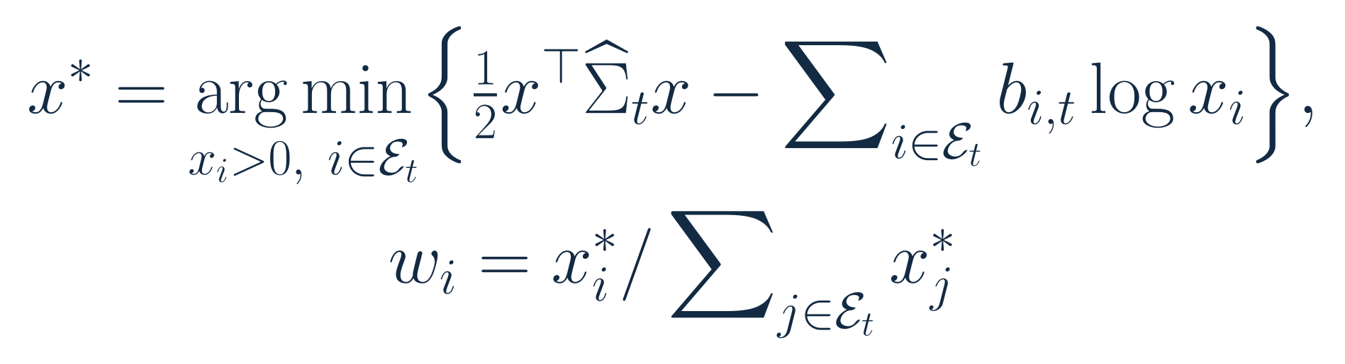
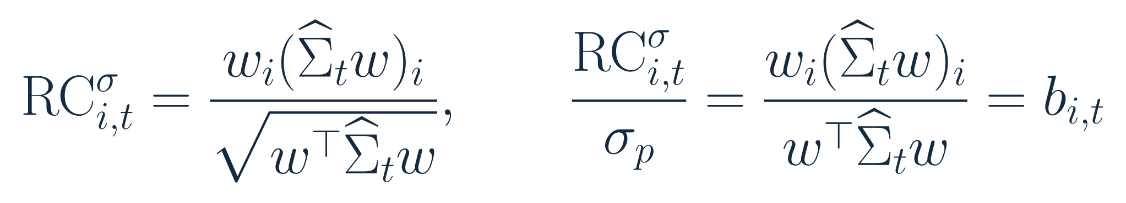
SECTION 02 OUR STRATEGY: MWRP
The optimizer converts risk budgets into capital weights
x: positive optimization variable. w: normalized capital weights. b: assigned risk shares.
Estimated risk shares equal assigned budgets. This equality is ex ante, not a future guarantee.
12
Notes:
Speaker 2. Core Slide.
Section question: How does a momentum signal become a portfolio weight?
Core message: Capital weights implement forecast risk shares while remaining long only and fully invested.
Read-aloud script:
We solve the convex risk-budget objective shown here over eligible assets and normalize the positive solution into capital weights. The first-order conditions imply that each asset's normalized forecast risk contribution equals its assigned budget. The covariance matrix contains both individual volatility and co-movement, so the largest risk budget need not produce the largest capital position. Multiplying the covariance matrix by a common annualization factor does not change normalized weights. These are ex ante targets. The optimizer cannot force future realized risk contributions to equal them.
Figure explanation: Explain the definitions and comparison on this page.
Sources:
/Users/wangyujing/Desktop/MFE_Macro_Rotation_6Assets/reports/phase4_research_report.md
/Users/wangyujing/Desktop/MFE_Macro_Rotation_6Assets/reports/research_report.md
/Users/wangyujing/Desktop/MFE_Macro_Rotation_6Assets/presentation_assets/final_figures_v2/formulas/svg/F05_risk_budget_optimization.svg
/Users/wangyujing/Desktop/MFE_Macro_Rotation_6Assets/presentation_assets/final_figures_v2/formulas/svg/F13_estimated_risk_contribution.svg

Slide 13
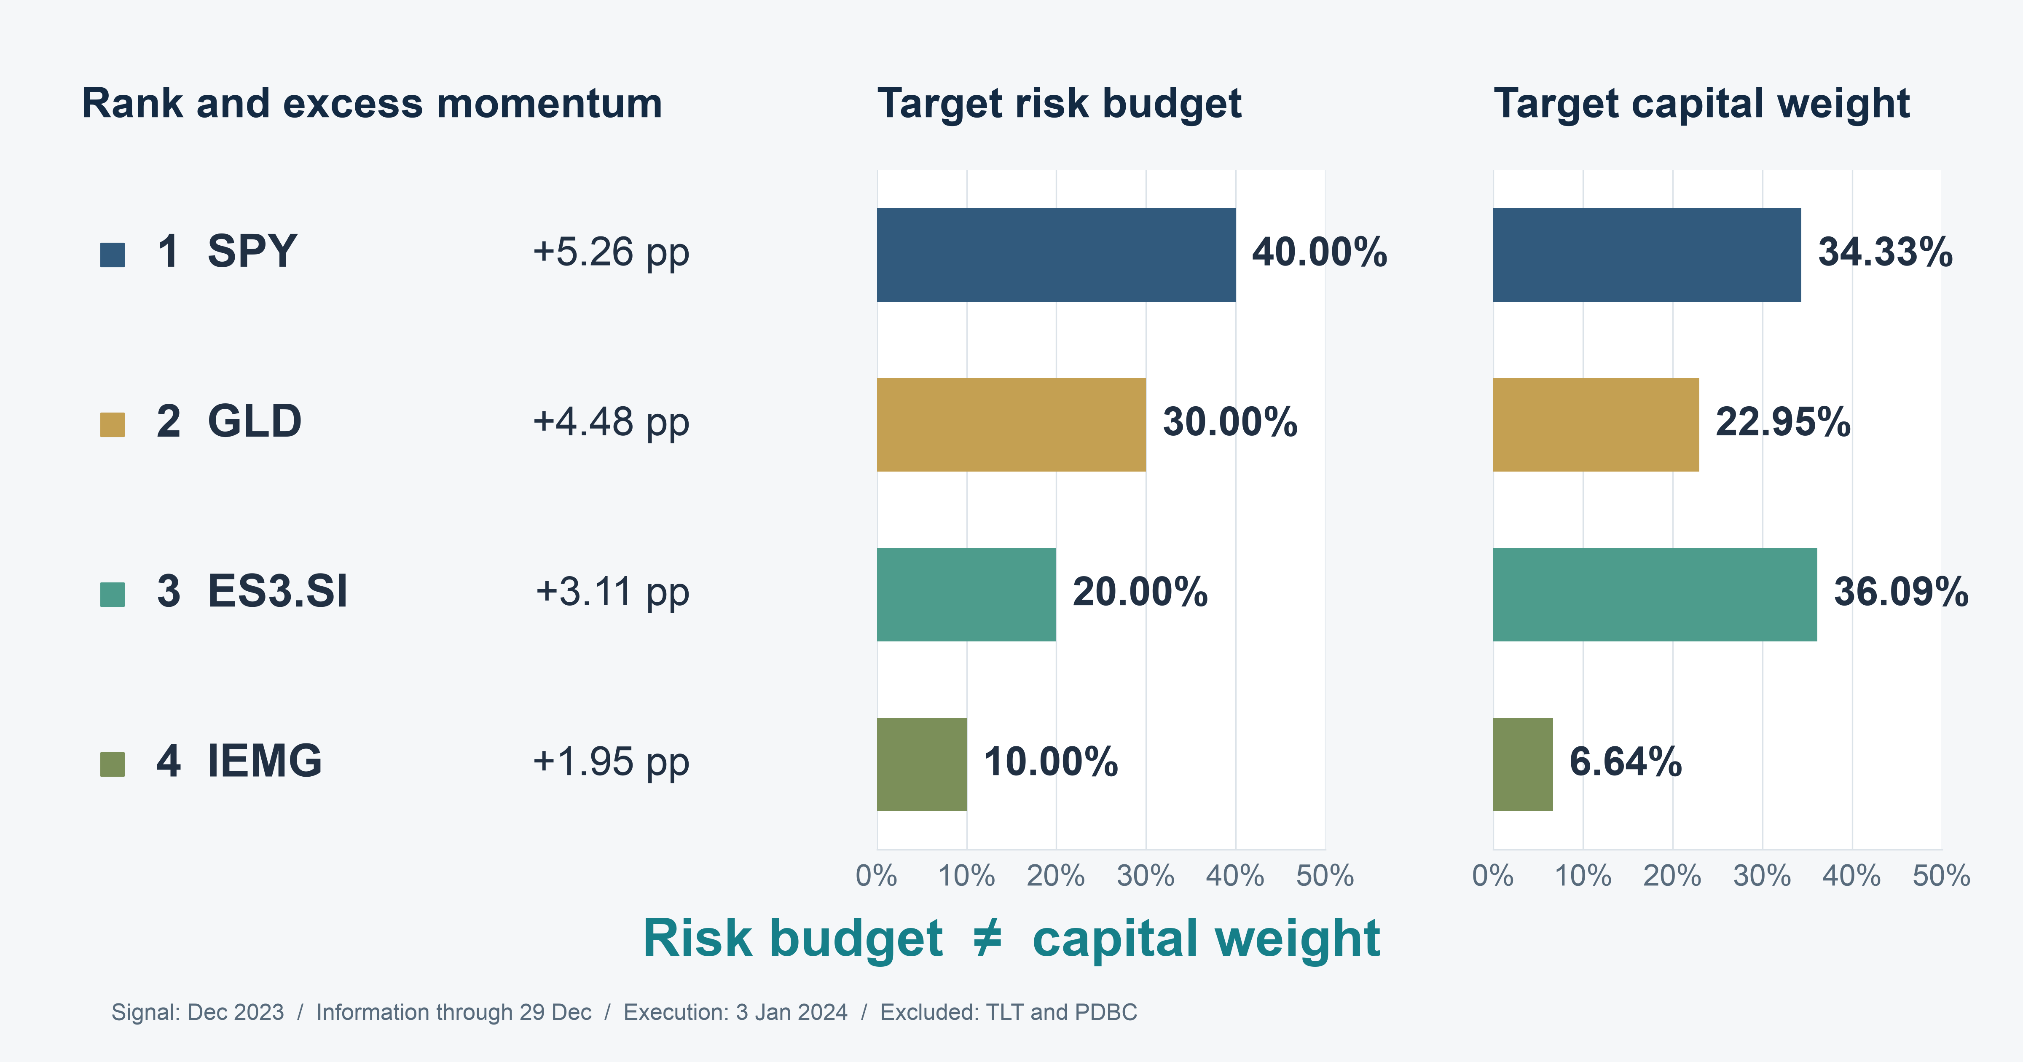
SECTION 02 OUR STRATEGY: MWRP
Risk budgets and capital differ in a real decision
13
Notes:
Speaker 2. Core Slide.
Section question: How does a momentum signal become a portfolio weight?
Core message: SPY has 40.00% of risk and 34.33% of capital. ES3 has 20.00% of risk and 36.09% of capital.
Read-aloud script:
This is the first evaluation execution with at least three eligible assets and complete records, selected without looking at subsequent returns. The information is through 29 December 2023, and execution is 3 January 2024. Four assets qualify. SPY ranks first and receives a forty percent risk budget, but only 34.33 percent of capital. ES3 ranks third and receives twenty percent of risk, yet 36.09 percent of capital. Gold and emerging markets complete the portfolio. This example shows why momentum preferences and covariance-based capital allocation are separate decisions. Speaker 3 will now assess the econometric framework.
Figure explanation: SPY has 40.00% of risk and 34.33% of capital. ES3 has 20.00% of risk and 36.09% of capital.
Sources:
/Users/wangyujing/Desktop/MFE_Macro_Rotation_6Assets/presentation_assets/final_figures_v2/figures/main/FIG03_Rank_Budget_Capital_full.svg
/Users/wangyujing/Desktop/MFE_Macro_Rotation_6Assets/reports/phase4_research_report.md
/Users/wangyujing/Desktop/MFE_Macro_Rotation_6Assets/reports/research_report.md
/Users/wangyujing/Desktop/MFE_Macro_Rotation_6Assets/outputs/phase4/tables/table07_monthly_allocation_decisions.csv

Slide 14
03
Econometric Framework & Diagnostics
Test information timing, covariance forecasts and risk contributions
14
Notes:
Speaker 3. Quick Slide.
Section question: Does the model work as intended, and what remains uncertain?
Core message: Test information timing, covariance forecasts and risk contributions
Read-aloud script:
This section asks: Does the model work as intended, and what remains uncertain? Test information timing, covariance forecasts and risk contributions.
Figure explanation: Explain the definitions and comparison on this page.
Sources:
/Users/wangyujing/Desktop/MFE_Macro_Rotation_6Assets/reports/phase4_research_report.md
/Users/wangyujing/Desktop/MFE_Macro_Rotation_6Assets/reports/research_report.md

Slide 15
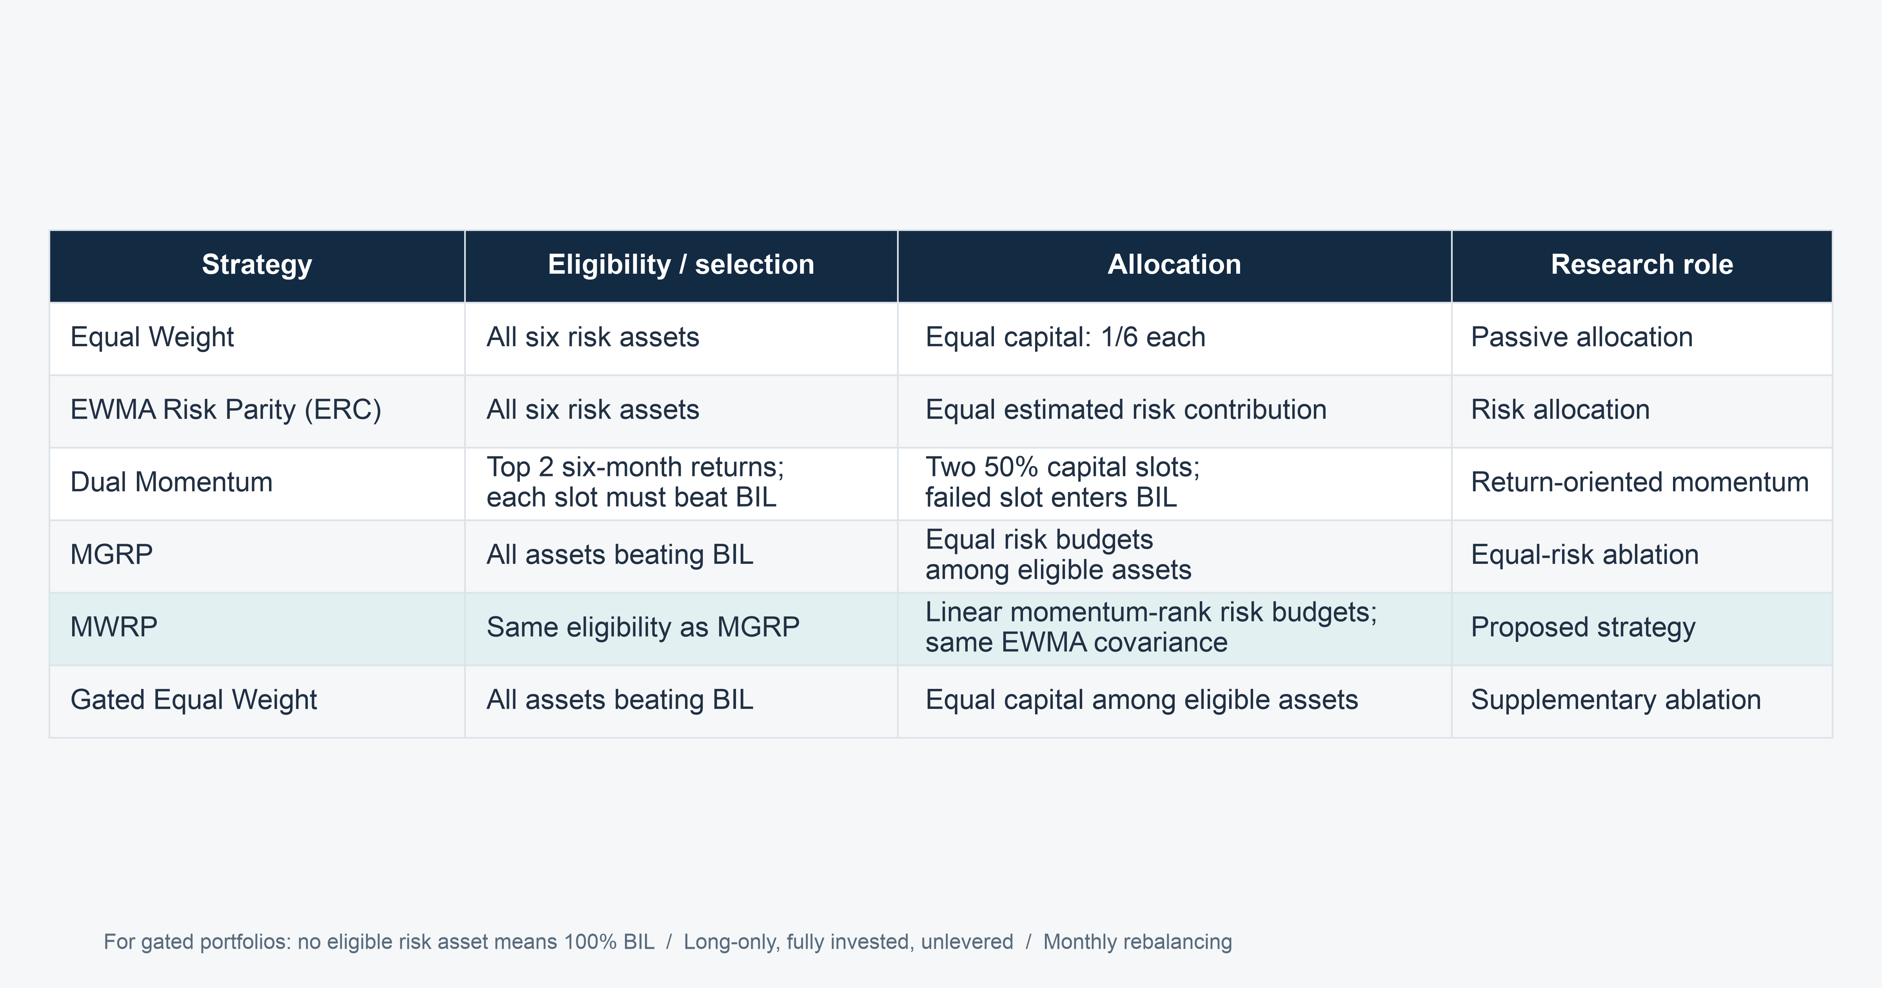
SECTION 03 ECONOMETRIC FRAMEWORK & MODEL DIAGNOSTICS
Benchmarks separate selection from allocation
15
Notes:
Speaker 3. Core Slide.
Section question: Does the model work as intended, and what remains uncertain?
Core message: MGRP versus MWRP is the closest comparison of risk-budget rules.
Read-aloud script:
This table separates each strategy's selection rule from its allocation rule. Equal Weight is our passive benchmark. EWMA Risk Parity tests covariance-based equal risk allocation across all six risk assets. Dual Momentum tests concentrated winner selection. Gated Equal Weight applies momentum eligibility but uses equal capital. MGRP applies the same gate with equal risk budgets, and MWRP changes those budgets according to momentum rank. Comparing MGRP with MWRP holds the asset set and covariance estimate fixed. These component comparisons are descriptive historical contrasts, not independent causal estimates.
Figure explanation: MGRP versus MWRP is the closest comparison of risk-budget rules.
Sources:
/Users/wangyujing/Desktop/MFE_Macro_Rotation_6Assets/presentation_assets/final_figures_v2/figures/main/DES01_Benchmark_Definitions_full.svg
/Users/wangyujing/Desktop/MFE_Macro_Rotation_6Assets/reports/phase4_research_report.md
/Users/wangyujing/Desktop/MFE_Macro_Rotation_6Assets/reports/research_report.md
/Users/wangyujing/Desktop/MFE_Macro_Rotation_6Assets/data/processed/sgd_daily_returns.csv
/Users/wangyujing/Desktop/MFE_Macro_Rotation_6Assets/data/processed/sgd_total_return_indices.csv
/Users/wangyujing/Desktop/MFE_Macro_Rotation_6Assets/outputs/diagnostics/Dual_Momentum_contribution.csv
/Users/wangyujing/Desktop/MFE_Macro_Rotation_6Assets/outputs/diagnostics/Dual_Momentum_daily.csv
/Users/wangyujing/Desktop/MFE_Macro_Rotation_6Assets/outputs/diagnostics/Dual_Momentum_weights.csv
/Users/wangyujing/Desktop/MFE_Macro_Rotation_6Assets/outputs/diagnostics/EWMA_Risk_Parity_contribution.csv
/Users/wangyujing/Desktop/MFE_Macro_Rotation_6Assets/outputs/diagnostics/EWMA_Risk_Parity_daily.csv
/Users/wangyujing/Desktop/MFE_Macro_Rotation_6Assets/outputs/diagnostics/EWMA_Risk_Parity_weights.csv
/Users/wangyujing/Desktop/MFE_Macro_Rotation_6Assets/outputs/diagnostics/Equal_Weight_contribution.csv
/Users/wangyujing/Desktop/MFE_Macro_Rotation_6Assets/outputs/diagnostics/Equal_Weight_daily.csv
/Users/wangyujing/Desktop/MFE_Macro_Rotation_6Assets/outputs/diagnostics/Equal_Weight_weights.csv
/Users/wangyujing/Desktop/MFE_Macro_Rotation_6Assets/outputs/diagnostics/Gated_Equal_Weight_contribution.csv
/Users/wangyujing/Desktop/MFE_Macro_Rotation_6Assets/outputs/diagnostics/Gated_Equal_Weight_daily.csv
/Users/wangyujing/Desktop/MFE_Macro_Rotation_6Assets/outputs/diagnostics/Gated_Equal_Weight_weights.csv
/Users/wangyujing/Desktop/MFE_Macro_Rotation_6Assets/outputs/diagnostics/MGRP-Base_contribution.csv
/Users/wangyujing/Desktop/MFE_Macro_Rotation_6Assets/outputs/diagnostics/MGRP-Base_daily.csv
/Users/wangyujing/Desktop/MFE_Macro_Rotation_6Assets/outputs/diagnostics/MGRP-Base_weights.csv
/Users/wangyujing/Desktop/MFE_Macro_Rotation_6Assets/outputs/phase4/diagnostics/MWRP_contribution.csv
/Users/wangyujing/Desktop/MFE_Macro_Rotation_6Assets/outputs/phase4/diagnostics/MWRP_daily.csv
/Users/wangyujing/Desktop/MFE_Macro_Rotation_6Assets/outputs/phase4/diagnostics/MWRP_weights.csv
/Users/wangyujing/Desktop/MFE_Macro_Rotation_6Assets/outputs/phase4/diagnostics/assigned_predicted_realized_risk.csv
/Users/wangyujing/Desktop/MFE_Macro_Rotation_6Assets/outputs/phase4/diagnostics/forecast_vs_realized_exact_holding_windows.csv
/Users/wangyujing/Desktop/MFE_Macro_Rotation_6Assets/outputs/phase4/tables/table01_three_period_performance.csv
/Users/wangyujing/Desktop/MFE_Macro_Rotation_6Assets/outputs/phase4/tables/table02_annual_returns.csv
/Users/wangyujing/Desktop/MFE_Macro_Rotation_6Assets/outputs/phase4/tables/table06_transaction_cost_sensitivity.csv
/Users/wangyujing/Desktop/MFE_Macro_Rotation_6Assets/outputs/phase4/tables/table07_monthly_allocation_decisions.csv
/Users/wangyujing/Desktop/MFE_Macro_Rotation_6Assets/outputs/tables/annual_performance.csv
/Users/wangyujing/Desktop/MFE_Macro_Rotation_6Assets/outputs/tables/full_2020_Sep2026_performance.csv
/Users/wangyujing/Desktop/MFE_Macro_Rotation_6Assets/outputs/tables/performance_all_cost_scenarios.csv
/Users/wangyujing/Desktop/MFE_Macro_Rotation_6Assets/outputs/tables/performance_main.csv

Slide 16
SECTION 03 ECONOMETRIC FRAMEWORK & MODEL DIAGNOSTICS
SGD total returns use adjusted prices and exchange rates
01
Archived adjusted prices
Distributions and splits are reflected in total-return indices.
02
One investor currency
Translate USD funds using SGD per USD. ES3 remains in SGD.
03
Cross-market valuation
Use information available at the time. Executions require fresh basket quotes.
FX means foreign exchange. Fund expenses are already reflected in prices, without duplicate deduction.
16
Notes:
Speaker 3. Core Slide.
Section question: Does the model work as intended, and what remains uncertain?
Core message: Retain dividends, currency exposure and the original cross-market valuation grid.
Read-aloud script:
The source data are archived daily adjusted ETF prices and the USD to SGD exchange rate. USD fund indices are translated using SGD per USD, while ES3 stays in SGD. Adjusted prices already reflect distributions and splits, so dividends and annual fund expenses are not deducted a second time. The valuation grid combines US and Singapore trading days. On holidays we retain the most recent information available, rather than interpolate from the future. Executions require fresh quotes across the basket and foreign exchange. Historical vendor revisions and asynchronous closes remain limitations of the data.
Figure explanation: Explain the definitions and comparison on this page.
Sources:
/Users/wangyujing/Desktop/MFE_Macro_Rotation_6Assets/reports/phase4_research_report.md
/Users/wangyujing/Desktop/MFE_Macro_Rotation_6Assets/reports/research_report.md

Slide 17
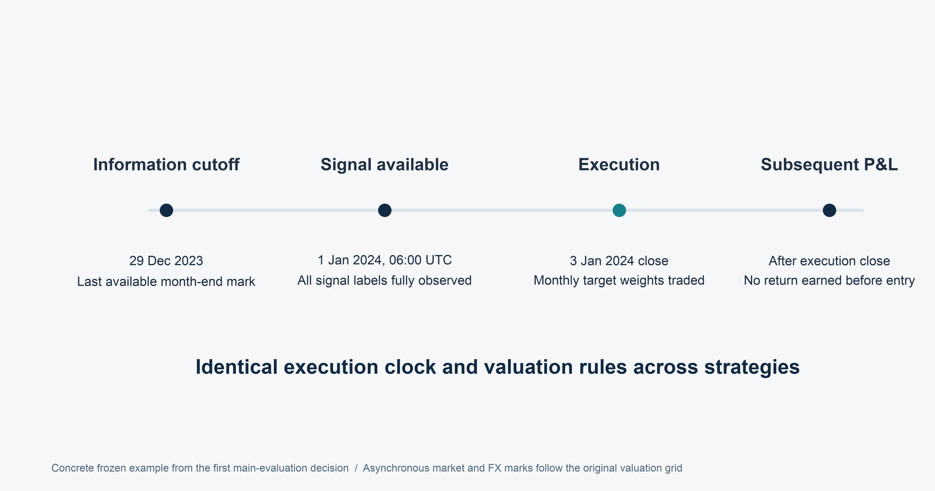
SECTION 03 ECONOMETRIC FRAMEWORK & MODEL DIAGNOSTICS
New positions earn returns only after execution
17
Notes:
Speaker 3. Core Slide.
Section question: Does the model work as intended, and what remains uncertain?
Core message: The signal and execution delay retain the frozen backtest convention.
Read-aloud script:
This timeline makes the information boundary explicit. The December signal uses information through 29 December. It is treated as available at 06:00 UTC on the next day. Execution occurs at the close basket on the second common fresh-quote trading day of January, which is 3 January in this example. Old holdings earn returns until that replacement close. New holdings earn only subsequent returns. This guards against crediting new positions with the execution day's move. However, US and Singapore closes are not simultaneous. The engine is a daily close-basket approximation, not an exact broker execution schedule.
Figure explanation: The signal and execution delay retain the frozen backtest convention.
Sources:
/Users/wangyujing/Desktop/MFE_Macro_Rotation_6Assets/presentation_assets/final_figures_v2/figures/main/DES02_Execution_Clock_full.svg
/Users/wangyujing/Desktop/MFE_Macro_Rotation_6Assets/reports/phase4_research_report.md
/Users/wangyujing/Desktop/MFE_Macro_Rotation_6Assets/reports/research_report.md
/Users/wangyujing/Desktop/MFE_Macro_Rotation_6Assets/data/processed/sgd_daily_returns.csv
/Users/wangyujing/Desktop/MFE_Macro_Rotation_6Assets/data/processed/sgd_total_return_indices.csv
/Users/wangyujing/Desktop/MFE_Macro_Rotation_6Assets/outputs/diagnostics/Dual_Momentum_contribution.csv
/Users/wangyujing/Desktop/MFE_Macro_Rotation_6Assets/outputs/diagnostics/Dual_Momentum_daily.csv
/Users/wangyujing/Desktop/MFE_Macro_Rotation_6Assets/outputs/diagnostics/Dual_Momentum_weights.csv
/Users/wangyujing/Desktop/MFE_Macro_Rotation_6Assets/outputs/diagnostics/EWMA_Risk_Parity_contribution.csv
/Users/wangyujing/Desktop/MFE_Macro_Rotation_6Assets/outputs/diagnostics/EWMA_Risk_Parity_daily.csv
/Users/wangyujing/Desktop/MFE_Macro_Rotation_6Assets/outputs/diagnostics/EWMA_Risk_Parity_weights.csv
/Users/wangyujing/Desktop/MFE_Macro_Rotation_6Assets/outputs/diagnostics/Equal_Weight_contribution.csv
/Users/wangyujing/Desktop/MFE_Macro_Rotation_6Assets/outputs/diagnostics/Equal_Weight_daily.csv
/Users/wangyujing/Desktop/MFE_Macro_Rotation_6Assets/outputs/diagnostics/Equal_Weight_weights.csv
/Users/wangyujing/Desktop/MFE_Macro_Rotation_6Assets/outputs/diagnostics/Gated_Equal_Weight_contribution.csv
/Users/wangyujing/Desktop/MFE_Macro_Rotation_6Assets/outputs/diagnostics/Gated_Equal_Weight_daily.csv
/Users/wangyujing/Desktop/MFE_Macro_Rotation_6Assets/outputs/diagnostics/Gated_Equal_Weight_weights.csv
/Users/wangyujing/Desktop/MFE_Macro_Rotation_6Assets/outputs/diagnostics/MGRP-Base_contribution.csv
/Users/wangyujing/Desktop/MFE_Macro_Rotation_6Assets/outputs/diagnostics/MGRP-Base_daily.csv
/Users/wangyujing/Desktop/MFE_Macro_Rotation_6Assets/outputs/diagnostics/MGRP-Base_weights.csv
/Users/wangyujing/Desktop/MFE_Macro_Rotation_6Assets/outputs/phase4/diagnostics/MWRP_contribution.csv
/Users/wangyujing/Desktop/MFE_Macro_Rotation_6Assets/outputs/phase4/diagnostics/MWRP_daily.csv
/Users/wangyujing/Desktop/MFE_Macro_Rotation_6Assets/outputs/phase4/diagnostics/MWRP_weights.csv
/Users/wangyujing/Desktop/MFE_Macro_Rotation_6Assets/outputs/phase4/diagnostics/assigned_predicted_realized_risk.csv
/Users/wangyujing/Desktop/MFE_Macro_Rotation_6Assets/outputs/phase4/diagnostics/forecast_vs_realized_exact_holding_windows.csv
/Users/wangyujing/Desktop/MFE_Macro_Rotation_6Assets/outputs/phase4/tables/table01_three_period_performance.csv
/Users/wangyujing/Desktop/MFE_Macro_Rotation_6Assets/outputs/phase4/tables/table02_annual_returns.csv
/Users/wangyujing/Desktop/MFE_Macro_Rotation_6Assets/outputs/phase4/tables/table06_transaction_cost_sensitivity.csv
/Users/wangyujing/Desktop/MFE_Macro_Rotation_6Assets/outputs/phase4/tables/table07_monthly_allocation_decisions.csv
/Users/wangyujing/Desktop/MFE_Macro_Rotation_6Assets/outputs/tables/annual_performance.csv
/Users/wangyujing/Desktop/MFE_Macro_Rotation_6Assets/outputs/tables/full_2020_Sep2026_performance.csv
/Users/wangyujing/Desktop/MFE_Macro_Rotation_6Assets/outputs/tables/performance_all_cost_scenarios.csv
/Users/wangyujing/Desktop/MFE_Macro_Rotation_6Assets/outputs/tables/performance_main.csv

Slide 18
SECTION 03 ECONOMETRIC FRAMEWORK & MODEL DIAGNOSTICS
Historical backtests and the recent-month test
Window | Role | Scope
2014 Nov–2019 Dec | Data preparation | EWMA initialization and lookback history
2020–2023 | Historical backtest A | 1,031 portfolio returns
2024 Jan–2026 Sep 18 | Historical backtest B | 702 portfolio returns
2020 Jan–2026 Sep 18 | Combined history A+B | 1,733 returns, overlaps A and B
2026 Sep 19–Oct 19 | Recent-month historical test | 21 returns, first return Sep 21
2026 Oct 1–19 | Partial course evaluation | 13 returns, subset of recent-month test
Rules fixed for this evaluation
Retrospective research after historical inspection. October coverage remains partial.
18
Notes:
Recomputed from archived SGD total-return data through 2026-10-19. Source: research/src/evaluation_windows.py, research/outputs/windows/tables/performance.csv and asset_pnl_attribution.csv. Equal Weight uses identical frozen strategy/execution rules. Full quantitative source: .presentation-build/data.json. Retrospective research after strategy selection.

Slide 19
SECTION 03 ECONOMETRIC FRAMEWORK & MODEL DIAGNOSTICS
Covariance forecasts remain imperfect in historical data
ERC: 80 cycles, r = 0.14
MGRP: 80 cycles, r = 0.53
MWRP: 80 cycles, r = 0.48
Combined history through Sep 18. Only complete holding cycles fully inside the window. Last realization: Sep 2, 2026.
19
Notes:
Recomputed from archived SGD total-return data through 2026-10-19. Source: research/src/evaluation_windows.py, research/outputs/windows/tables/performance.csv and asset_pnl_attribution.csv. Equal Weight uses identical frozen strategy/execution rules. Full quantitative source: .presentation-build/data.json. Retrospective research after strategy selection.

Slide 20
SECTION 03 ECONOMETRIC FRAMEWORK & MODEL DIAGNOSTICS
Forecast and realized risk across holding cycles
MWRP annualized portfolio volatility
2020-01-03
2021-09-02
2023-05-03
2024-12-03
2026-08-04
80 complete cycles contained in combined history. Recent-month and October tests contain no complete holding cycle.
20
Notes:
Recomputed from archived SGD total-return data through 2026-10-19. Source: research/src/evaluation_windows.py, research/outputs/windows/tables/performance.csv and asset_pnl_attribution.csv. Equal Weight uses identical frozen strategy/execution rules. Full quantitative source: .presentation-build/data.json. Retrospective research after strategy selection.

Slide 21
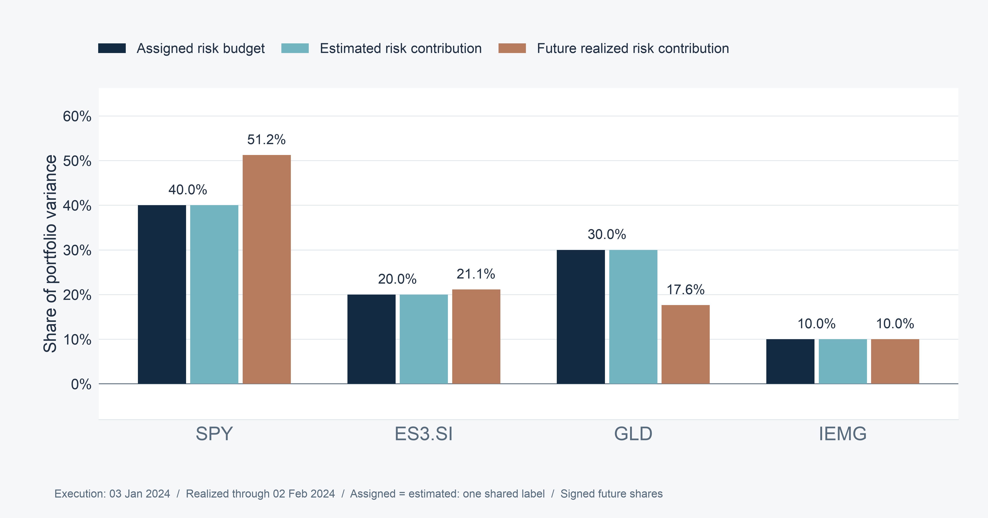
SECTION 03 ECONOMETRIC FRAMEWORK & MODEL DIAGNOSTICS
Estimated risk shares match assigned budgets
21
Notes:
Speaker 3. Core Slide.
Section question: Does the model work as intended, and what remains uncertain?
Core message: Numerical implementation is accurate. Future risk shares can still differ.
Read-aloud script:
The three bars for each asset distinguish assigned risk budget, estimated risk contribution and future realized risk contribution. The first two agree to numerical precision. Across all months, the maximum assigned-versus-estimated share error is about 3.72 times ten to the minus thirteen. That verifies the optimizer implements the intended ex ante problem. Future realized shares, however, can differ materially because returns and co-movements change after execution, and capital weights drift. Correct optimization and accurate forecasting are separate claims. The data support the first much more strongly than the second.
Figure explanation: Numerical implementation is accurate. Future risk shares can still differ.
Sources:
/Users/wangyujing/Desktop/MFE_Macro_Rotation_6Assets/presentation_assets/final_figures_v2/figures/appendix/APP04_First_Eligible_full.svg
/Users/wangyujing/Desktop/MFE_Macro_Rotation_6Assets/reports/phase4_research_report.md
/Users/wangyujing/Desktop/MFE_Macro_Rotation_6Assets/reports/research_report.md
/Users/wangyujing/Desktop/MFE_Macro_Rotation_6Assets/data/processed/sgd_daily_returns.csv
/Users/wangyujing/Desktop/MFE_Macro_Rotation_6Assets/data/processed/sgd_total_return_indices.csv
/Users/wangyujing/Desktop/MFE_Macro_Rotation_6Assets/outputs/diagnostics/Dual_Momentum_contribution.csv
/Users/wangyujing/Desktop/MFE_Macro_Rotation_6Assets/outputs/diagnostics/Dual_Momentum_daily.csv
/Users/wangyujing/Desktop/MFE_Macro_Rotation_6Assets/outputs/diagnostics/Dual_Momentum_weights.csv
/Users/wangyujing/Desktop/MFE_Macro_Rotation_6Assets/outputs/diagnostics/EWMA_Risk_Parity_contribution.csv
/Users/wangyujing/Desktop/MFE_Macro_Rotation_6Assets/outputs/diagnostics/EWMA_Risk_Parity_daily.csv
/Users/wangyujing/Desktop/MFE_Macro_Rotation_6Assets/outputs/diagnostics/EWMA_Risk_Parity_weights.csv
/Users/wangyujing/Desktop/MFE_Macro_Rotation_6Assets/outputs/diagnostics/Equal_Weight_contribution.csv
/Users/wangyujing/Desktop/MFE_Macro_Rotation_6Assets/outputs/diagnostics/Equal_Weight_daily.csv
/Users/wangyujing/Desktop/MFE_Macro_Rotation_6Assets/outputs/diagnostics/Equal_Weight_weights.csv
/Users/wangyujing/Desktop/MFE_Macro_Rotation_6Assets/outputs/diagnostics/Gated_Equal_Weight_contribution.csv
/Users/wangyujing/Desktop/MFE_Macro_Rotation_6Assets/outputs/diagnostics/Gated_Equal_Weight_daily.csv
/Users/wangyujing/Desktop/MFE_Macro_Rotation_6Assets/outputs/diagnostics/Gated_Equal_Weight_weights.csv
/Users/wangyujing/Desktop/MFE_Macro_Rotation_6Assets/outputs/diagnostics/MGRP-Base_contribution.csv
/Users/wangyujing/Desktop/MFE_Macro_Rotation_6Assets/outputs/diagnostics/MGRP-Base_daily.csv
/Users/wangyujing/Desktop/MFE_Macro_Rotation_6Assets/outputs/diagnostics/MGRP-Base_weights.csv
/Users/wangyujing/Desktop/MFE_Macro_Rotation_6Assets/outputs/phase4/diagnostics/MWRP_contribution.csv
/Users/wangyujing/Desktop/MFE_Macro_Rotation_6Assets/outputs/phase4/diagnostics/MWRP_daily.csv
/Users/wangyujing/Desktop/MFE_Macro_Rotation_6Assets/outputs/phase4/diagnostics/MWRP_weights.csv
/Users/wangyujing/Desktop/MFE_Macro_Rotation_6Assets/outputs/phase4/diagnostics/assigned_predicted_realized_risk.csv
/Users/wangyujing/Desktop/MFE_Macro_Rotation_6Assets/outputs/phase4/diagnostics/forecast_vs_realized_exact_holding_windows.csv
/Users/wangyujing/Desktop/MFE_Macro_Rotation_6Assets/outputs/phase4/tables/table01_three_period_performance.csv
/Users/wangyujing/Desktop/MFE_Macro_Rotation_6Assets/outputs/phase4/tables/table02_annual_returns.csv
/Users/wangyujing/Desktop/MFE_Macro_Rotation_6Assets/outputs/phase4/tables/table06_transaction_cost_sensitivity.csv
/Users/wangyujing/Desktop/MFE_Macro_Rotation_6Assets/outputs/phase4/tables/table07_monthly_allocation_decisions.csv
/Users/wangyujing/Desktop/MFE_Macro_Rotation_6Assets/outputs/tables/annual_performance.csv
/Users/wangyujing/Desktop/MFE_Macro_Rotation_6Assets/outputs/tables/full_2020_Sep2026_performance.csv
/Users/wangyujing/Desktop/MFE_Macro_Rotation_6Assets/outputs/tables/performance_all_cost_scenarios.csv
/Users/wangyujing/Desktop/MFE_Macro_Rotation_6Assets/outputs/tables/performance_main.csv

Slide 22
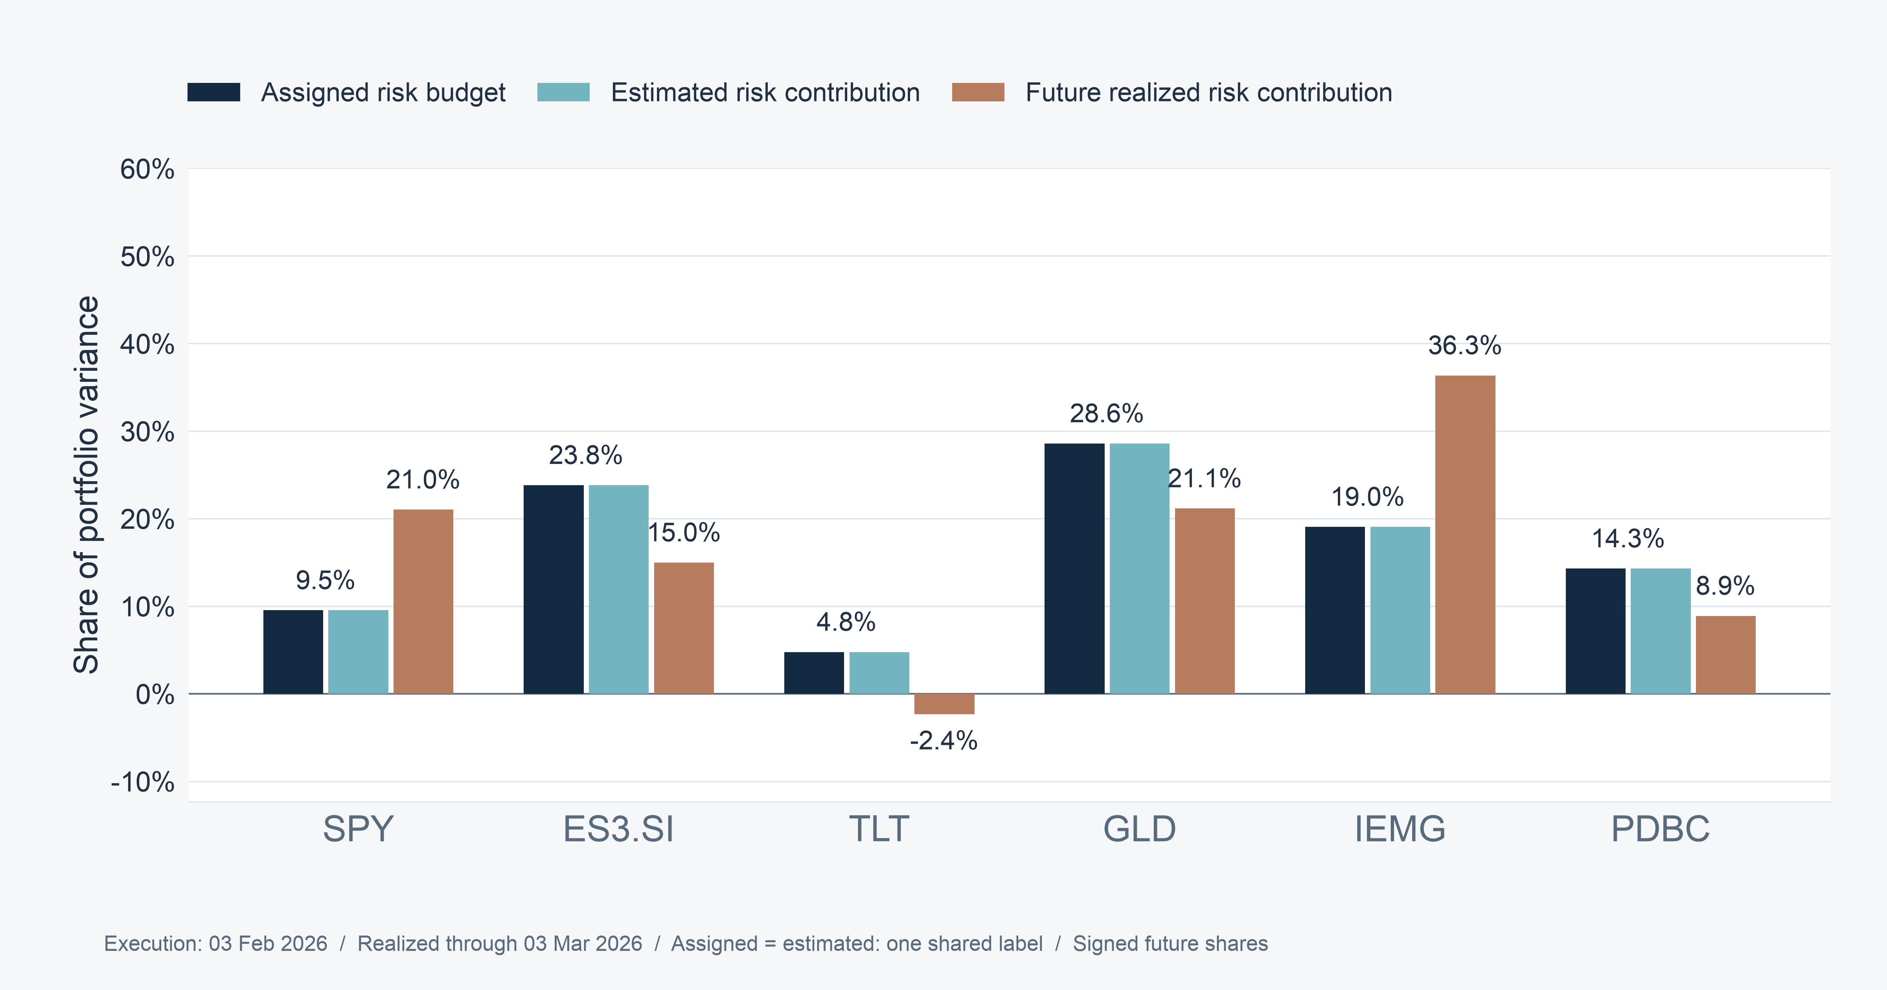
SECTION 03 ECONOMETRIC FRAMEWORK & MODEL DIAGNOSTICS
Realized risk contributions can be negative
22
Notes:
Speaker 3. Optional Detail.
Section question: Does the model work as intended, and what remains uncertain?
Core message: A negative covariance contribution can offset portfolio fluctuations.
Read-aloud script:
This example is selected by an objective rule: the first main-evaluation holding interval with a negative realized contribution. It runs from 3 February to 3 March 2026. TLT's realized share is about minus 2.4 percent. A negative share is possible because we define the contribution through covariance of each asset's gross return contribution with the total portfolio return. It can therefore offset other fluctuations. Signed shares sum to one, but individual values need not lie between zero and one. We retain that sign rather than clip it to make the budget appear to work better.
Figure explanation: A negative covariance contribution can offset portfolio fluctuations.
Sources:
/Users/wangyujing/Desktop/MFE_Macro_Rotation_6Assets/presentation_assets/final_figures_v2/figures/appendix/APP04_First_Negative_Realized_full.svg
/Users/wangyujing/Desktop/MFE_Macro_Rotation_6Assets/reports/phase4_research_report.md
/Users/wangyujing/Desktop/MFE_Macro_Rotation_6Assets/reports/research_report.md
/Users/wangyujing/Desktop/MFE_Macro_Rotation_6Assets/data/processed/sgd_daily_returns.csv
/Users/wangyujing/Desktop/MFE_Macro_Rotation_6Assets/data/processed/sgd_total_return_indices.csv
/Users/wangyujing/Desktop/MFE_Macro_Rotation_6Assets/outputs/diagnostics/Dual_Momentum_contribution.csv
/Users/wangyujing/Desktop/MFE_Macro_Rotation_6Assets/outputs/diagnostics/Dual_Momentum_daily.csv
/Users/wangyujing/Desktop/MFE_Macro_Rotation_6Assets/outputs/diagnostics/Dual_Momentum_weights.csv
/Users/wangyujing/Desktop/MFE_Macro_Rotation_6Assets/outputs/diagnostics/EWMA_Risk_Parity_contribution.csv
/Users/wangyujing/Desktop/MFE_Macro_Rotation_6Assets/outputs/diagnostics/EWMA_Risk_Parity_daily.csv
/Users/wangyujing/Desktop/MFE_Macro_Rotation_6Assets/outputs/diagnostics/EWMA_Risk_Parity_weights.csv
/Users/wangyujing/Desktop/MFE_Macro_Rotation_6Assets/outputs/diagnostics/Equal_Weight_contribution.csv
/Users/wangyujing/Desktop/MFE_Macro_Rotation_6Assets/outputs/diagnostics/Equal_Weight_daily.csv
/Users/wangyujing/Desktop/MFE_Macro_Rotation_6Assets/outputs/diagnostics/Equal_Weight_weights.csv
/Users/wangyujing/Desktop/MFE_Macro_Rotation_6Assets/outputs/diagnostics/Gated_Equal_Weight_contribution.csv
/Users/wangyujing/Desktop/MFE_Macro_Rotation_6Assets/outputs/diagnostics/Gated_Equal_Weight_daily.csv
/Users/wangyujing/Desktop/MFE_Macro_Rotation_6Assets/outputs/diagnostics/Gated_Equal_Weight_weights.csv
/Users/wangyujing/Desktop/MFE_Macro_Rotation_6Assets/outputs/diagnostics/MGRP-Base_contribution.csv
/Users/wangyujing/Desktop/MFE_Macro_Rotation_6Assets/outputs/diagnostics/MGRP-Base_daily.csv
/Users/wangyujing/Desktop/MFE_Macro_Rotation_6Assets/outputs/diagnostics/MGRP-Base_weights.csv
/Users/wangyujing/Desktop/MFE_Macro_Rotation_6Assets/outputs/phase4/diagnostics/MWRP_contribution.csv
/Users/wangyujing/Desktop/MFE_Macro_Rotation_6Assets/outputs/phase4/diagnostics/MWRP_daily.csv
/Users/wangyujing/Desktop/MFE_Macro_Rotation_6Assets/outputs/phase4/diagnostics/MWRP_weights.csv
/Users/wangyujing/Desktop/MFE_Macro_Rotation_6Assets/outputs/phase4/diagnostics/assigned_predicted_realized_risk.csv
/Users/wangyujing/Desktop/MFE_Macro_Rotation_6Assets/outputs/phase4/diagnostics/forecast_vs_realized_exact_holding_windows.csv
/Users/wangyujing/Desktop/MFE_Macro_Rotation_6Assets/outputs/phase4/tables/table01_three_period_performance.csv
/Users/wangyujing/Desktop/MFE_Macro_Rotation_6Assets/outputs/phase4/tables/table02_annual_returns.csv
/Users/wangyujing/Desktop/MFE_Macro_Rotation_6Assets/outputs/phase4/tables/table06_transaction_cost_sensitivity.csv
/Users/wangyujing/Desktop/MFE_Macro_Rotation_6Assets/outputs/phase4/tables/table07_monthly_allocation_decisions.csv
/Users/wangyujing/Desktop/MFE_Macro_Rotation_6Assets/outputs/tables/annual_performance.csv
/Users/wangyujing/Desktop/MFE_Macro_Rotation_6Assets/outputs/tables/full_2020_Sep2026_performance.csv
/Users/wangyujing/Desktop/MFE_Macro_Rotation_6Assets/outputs/tables/performance_all_cost_scenarios.csv
/Users/wangyujing/Desktop/MFE_Macro_Rotation_6Assets/outputs/tables/performance_main.csv

Slide 23
04
Performance Beyond Returns
Compare wealth, risk, trading and capital diversification
23
Notes:
Speaker 4. Quick Slide.
Section question: What does MWRP deliver relative to credible benchmarks?
Core message: Compare wealth, risk, trading and capital diversification
Read-aloud script:
This section asks: What does MWRP deliver relative to credible benchmarks? Compare wealth, risk, trading and capital diversification.
Figure explanation: Explain the definitions and comparison on this page.
Sources:
/Users/wangyujing/Desktop/MFE_Macro_Rotation_6Assets/reports/phase4_research_report.md
/Users/wangyujing/Desktop/MFE_Macro_Rotation_6Assets/reports/research_report.md

Slide 24
SECTION 04 PORTFOLIO PERFORMANCE
MWRP historical performance before the test
23.75%
2.082
-9.15%
Net compound annual growth rate
Sharpe ratio, reference rate = 0
Maximum drawdown (MDD)
Dual Momentum has the higher net CAGR: 27.26%
MWRP leads historical B Sharpe. The next slides separate historical and short test results.
Historical B: 2024 Jan–2026 Sep 18. Net of 10 bps per traded side.
24
Notes:
Recomputed from archived SGD total-return data through 2026-10-19. Source: research/src/evaluation_windows.py, research/outputs/windows/tables/performance.csv and asset_pnl_attribution.csv. Equal Weight uses identical frozen strategy/execution rules. Full quantitative source: .presentation-build/data.json. Retrospective research after strategy selection.

Slide 25
SECTION 04 PORTFOLIO PERFORMANCE
Historical B risk and return comparison
Historical B: 2024 Jan–2026 Sep 18. All metrics use the same boundary and 10 bps trading cost.
25
Notes:
Recomputed from archived SGD total-return data through 2026-10-19. Source: research/src/evaluation_windows.py, research/outputs/windows/tables/performance.csv and asset_pnl_attribution.csv. Equal Weight uses identical frozen strategy/execution rules. Full quantitative source: .presentation-build/data.json. Retrospective research after strategy selection.

Slide 26
SECTION 04 PORTFOLIO PERFORMANCE
Historical B: Dual leads CAGR, MWRP leads Sharpe
Net CAGR
Sharpe ratio
Historical B: 2024 Jan–2026 Sep 18. SGD returns, RF=0, net of trading costs.
26
Notes:
Recomputed from archived SGD total-return data through 2026-10-19. Source: research/src/evaluation_windows.py, research/outputs/windows/tables/performance.csv and asset_pnl_attribution.csv. Equal Weight uses identical frozen strategy/execution rules. Full quantitative source: .presentation-build/data.json. Retrospective research after strategy selection.

Slide 27
SECTION 04 PORTFOLIO PERFORMANCE
Historical B: lower risk than Dual, higher risk than MGRP
Annualized volatility
Maximum drawdown
Historical B: 2024 Jan–2026 Sep 18. Drawdown includes period-opening wealth.
27
Notes:
Recomputed from archived SGD total-return data through 2026-10-19. Source: research/src/evaluation_windows.py, research/outputs/windows/tables/performance.csv and asset_pnl_attribution.csv. Equal Weight uses identical frozen strategy/execution rules. Full quantitative source: .presentation-build/data.json. Retrospective research after strategy selection.

Slide 28
SECTION 04 PORTFOLIO PERFORMANCE
Historical B trading intensity and diversification
One-way turnover per rebalance
Mean effective holdings
Historical B: 2024 Jan–2026 Sep 18. Effective holdings: daily mean of 1 / sum(w²), including BIL.
28
Notes:
Recomputed from archived SGD total-return data through 2026-10-19. Source: research/src/evaluation_windows.py, research/outputs/windows/tables/performance.csv and asset_pnl_attribution.csv. Equal Weight uses identical frozen strategy/execution rules. Full quantitative source: .presentation-build/data.json. Retrospective research after strategy selection.

Slide 29
SECTION 04 PORTFOLIO PERFORMANCE
Historical B wealth and drawdown
Net wealth
Drawdown
2023-12-29
2024-09-04
2025-05-12
2026-01-15
2026-09-18
Historical B: 2024 Jan–2026 Sep 18. SGD, net of 10 bps per side. Continuous holdings, rebased at the preceding close.
29
Notes:
Recomputed from archived SGD total-return data through 2026-10-19. Source: research/src/evaluation_windows.py, research/outputs/windows/tables/performance.csv and asset_pnl_attribution.csv. Equal Weight uses identical frozen strategy/execution rules. Full quantitative source: .presentation-build/data.json. Retrospective research after strategy selection.

Slide 30
SECTION 04 PORTFOLIO PERFORMANCE
Recent-month test: MWRP trails MGRP
Strategy | Net total return | Sharpe | Max drawdown
Dual Momentum | -3.05% | -3.725 | -3.89%
MGRP | -1.34% | -2.025 | -2.41%
MWRP | -1.71% | -2.521 | -2.72%
Net wealth over 21 return dates
Sep 19–Oct 19. Baseline Sep 18 close, first return Sep 21. Annualized Sharpe describes a short retrospective sample.
30
Notes:
Recomputed from archived SGD total-return data through 2026-10-19. Source: research/src/evaluation_windows.py, research/outputs/windows/tables/performance.csv and asset_pnl_attribution.csv. Equal Weight uses identical frozen strategy/execution rules. Full quantitative source: .presentation-build/data.json. Retrospective research after strategy selection.

Slide 31
SECTION 04 PORTFOLIO PERFORMANCE
October course evaluation: partial through Oct 19
Strategy | Net total return | Sharpe | Max drawdown
Dual Momentum | -2.53% | -4.452 | -3.49%
MGRP | -1.25% | -2.815 | -2.41%
MWRP | -1.60% | -3.346 | -2.72%
13 daily returns, one scheduled rebalance
October is a subset of the recent-month test.
The full course evaluation must extend to the instructor’s week-11 cutoff.
Oct 1–19. Baseline Sep 30 close. Continuous holdings and 10 bps per traded side. No extra trade at the boundary.
31
Notes:
Recomputed from archived SGD total-return data through 2026-10-19. Source: research/src/evaluation_windows.py, research/outputs/windows/tables/performance.csv and asset_pnl_attribution.csv. Equal Weight uses identical frozen strategy/execution rules. Full quantitative source: .presentation-build/data.json. Retrospective research after strategy selection.

Slide 32
SECTION 04 PORTFOLIO PERFORMANCE
Combined historical wealth and drawdown
Net wealth
Drawdown
2019-12-31
2021-09-07
2023-05-12
2025-01-15
2026-09-18
Combined history: 2020 Jan–2026 Sep 18. SGD, net of 10 bps per side. Continuous holdings, rebased at the preceding close.
32
Notes:
Recomputed from archived SGD total-return data through 2026-10-19. Source: research/src/evaluation_windows.py, research/outputs/windows/tables/performance.csv and asset_pnl_attribution.csv. Equal Weight uses identical frozen strategy/execution rules. Full quantitative source: .presentation-build/data.json. Retrospective research after strategy selection.

Slide 33
SECTION 04 PORTFOLIO PERFORMANCE
Capital allocations across the historical window
Dual Momentum
MWRP
Combined history: 2020 Jan–2026 Sep 18. Actual daily closing weights, including position drift.
33
Notes:
Recomputed from archived SGD total-return data through 2026-10-19. Source: research/src/evaluation_windows.py, research/outputs/windows/tables/performance.csv and asset_pnl_attribution.csv. Equal Weight uses identical frozen strategy/execution rules. Full quantitative source: .presentation-build/data.json. Retrospective research after strategy selection.

Slide 34
SECTION 04 PORTFOLIO PERFORMANCE
Historical B diversification and peak concentration
Mean effective holdings
MWRP capital concentration
41.18%
Mean largest capital position
63.78%
Peak single-asset weight
Historical B: 2024 Jan–2026 Sep 18. Average diversification does not impose a hard position cap.
34
Notes:
Recomputed from archived SGD total-return data through 2026-10-19. Source: research/src/evaluation_windows.py, research/outputs/windows/tables/performance.csv and asset_pnl_attribution.csv. Equal Weight uses identical frozen strategy/execution rules. Full quantitative source: .presentation-build/data.json. Retrospective research after strategy selection.

Slide 35
SECTION 04 PORTFOLIO PERFORMANCE
Historical B trading costs and annualized return drag
Strategy | Fees / opening wealth | Gross minus net CAGR
Dual Momentum | 2.26% | 0.68 pp
MGRP | 1.90% | 0.69 pp
MWRP | 1.78% | 0.63 pp
Actual trade sizes and the wealth path determine cumulative fees.
Annualized return drag differs from cumulative cash fees.
Historical B: 2024 Jan–2026 Sep 18. Uniform 10 bps per buy/sell notional.
35
Notes:
Recomputed from archived SGD total-return data through 2026-10-19. Source: research/src/evaluation_windows.py, research/outputs/windows/tables/performance.csv and asset_pnl_attribution.csv. Equal Weight uses identical frozen strategy/execution rules. Full quantitative source: .presentation-build/data.json. Retrospective research after strategy selection.

Slide 36
05
Where Does the Improvement Come From?
Separate eligibility, allocation and momentum-weighted risk preferences
36
Notes:
Speaker 5. Quick Slide.
Section question: Which portfolio decisions explain the historical improvement?
Core message: Separate eligibility, allocation and momentum-weighted risk preferences
Read-aloud script:
This section asks: Which portfolio decisions explain the historical improvement? Separate eligibility, allocation and momentum-weighted risk preferences.
Figure explanation: Explain the definitions and comparison on this page.
Sources:
/Users/wangyujing/Desktop/MFE_Macro_Rotation_6Assets/reports/phase4_research_report.md
/Users/wangyujing/Desktop/MFE_Macro_Rotation_6Assets/reports/research_report.md

Slide 37
SECTION 05 ECONOMIC ATTRIBUTION & STRATEGY COMPONENTS
Eligibility and allocation across historical subperiods
Historical A net CAGR
Historical B net CAGR
Historical A: 2020–2023. Historical B: 2024 Jan–2026 Sep 18. Component comparisons, same accounting.
37
Notes:
Recomputed from archived SGD total-return data through 2026-10-19. Source: research/src/evaluation_windows.py, research/outputs/windows/tables/performance.csv and asset_pnl_attribution.csv. Equal Weight uses identical frozen strategy/execution rules. Full quantitative source: .presentation-build/data.json. Retrospective research after strategy selection.

Slide 38
SECTION 05 ECONOMIC ATTRIBUTION & STRATEGY COMPONENTS
MWRP improves historical B returns with more risk
Metric | MGRP | MWRP | MWRP minus MGRP
Net CAGR | 21.25% | 23.75% | 2.50 pp
Sharpe | 1.978 | 2.082 | 0.104
Annual volatility | 9.74% | 10.24% | 0.49 pp
Maximum drawdown | -9.66% | -9.15% | 0.50 pp
Turnover / rebalance | 23.35% | 20.90% | -2.44 pp
Historical B: 2024 Jan–2026 Sep 18. Historical paired comparison. Short test results differ.
38
Notes:
Recomputed from archived SGD total-return data through 2026-10-19. Source: research/src/evaluation_windows.py, research/outputs/windows/tables/performance.csv and asset_pnl_attribution.csv. Equal Weight uses identical frozen strategy/execution rules. Full quantitative source: .presentation-build/data.json. Retrospective research after strategy selection.

Slide 39
SECTION 05 ECONOMIC ATTRIBUTION & STRATEGY COMPONENTS
Momentum weighting changes participation, not eligibility
01
Same eligible set and defensive timing
MGRP and MWRP change allocation, not the list of qualifying assets.
02
33 of 33 historical B decisions have different target weights
Average allocation distance: 13.18%. This is not turnover.
03
The strongest momentum asset is largest in capital only 10/33 months
30.30%. Covariance still determines how risk preferences become money.
Historical B ends Sep 18. The 33 execution decisions remain unchanged. Historical A differs in 41/48 decisions.
39
Notes:
Speaker 5. Core Slide.
Section question: Which portfolio decisions explain the historical improvement?
Core message: The leading momentum asset is not always the largest capital position.
Read-aloud script:
MWRP and MGRP have the same eligible assets and BIL timing. In all thirty-three recent months, momentum weighting changes target capital weights. Their average allocation distance is 13.18 percent, measured as half the absolute difference between the two target weight vectors. That is a distance between strategies, not trading turnover. The strongest momentum asset is the largest MWRP capital position in only ten of thirty-three months, or 30.30 percent. Covariance therefore has a material role in capital allocation. In validation, only forty-one of forty-eight months differ because zero-asset and single-asset cases naturally coincide.
Figure explanation: Explain the definitions and comparison on this page.
Sources:
/Users/wangyujing/Desktop/MFE_Macro_Rotation_6Assets/reports/phase4_research_report.md
/Users/wangyujing/Desktop/MFE_Macro_Rotation_6Assets/reports/research_report.md

Slide 40
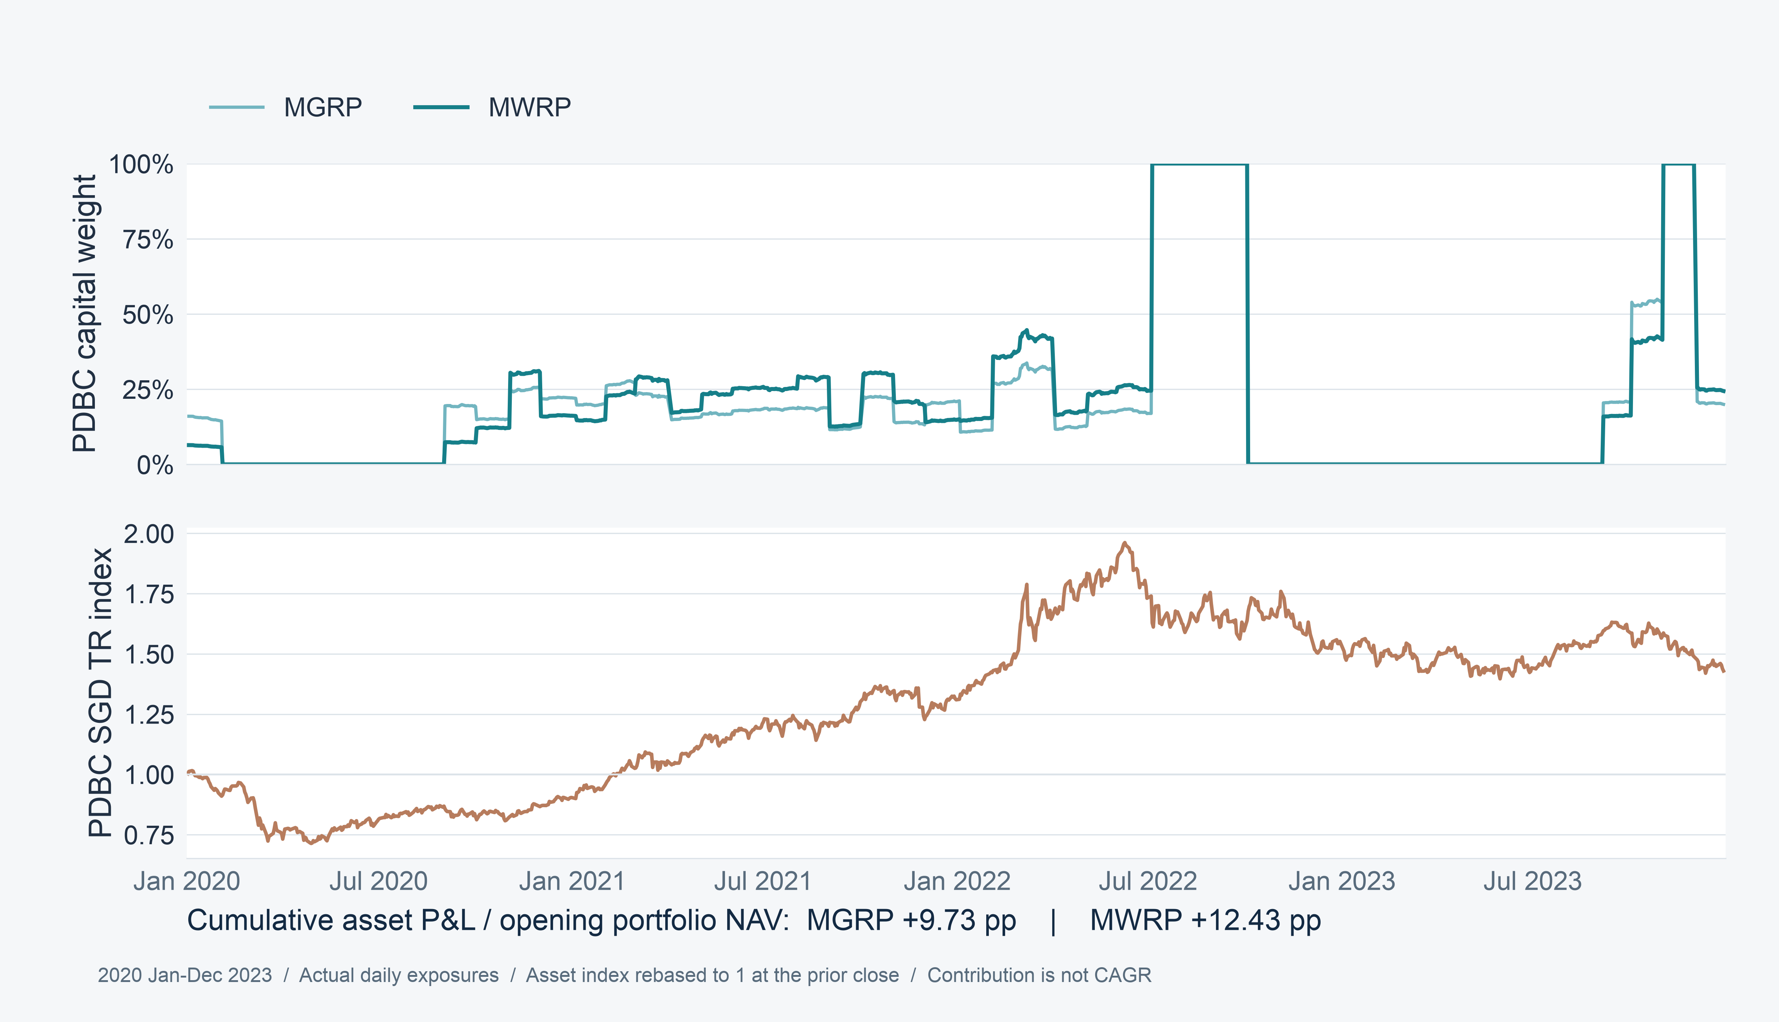
SECTION 05 ECONOMIC ATTRIBUTION & STRATEGY COMPONENTS
MWRP increases participation in the commodity trend
40
Notes:
Speaker 5. Core Slide.
Section question: Which portfolio decisions explain the historical improvement?
Core message: PDBC validation contribution increases from 9.73 pp to 12.43 pp.
Read-aloud script:
The commodity example covers 2020 through 2023. PDBC's average actual capital weight rises from 19.52 percent for MGRP to 20.45 percent for MWRP. Its cumulative profit-and-loss contribution rises from 9.73 to 12.43 percentage points of common opening wealth. Both methods select PDBC in thirty of forty-eight months. The improvement therefore comes from participation strength and timing rather than a higher selection frequency. Dual's PDBC contribution is larger at 26.29 percentage points, despite selecting it in fewer months. We retain the full exposure scale, including episodes at one hundred percent.
Figure explanation: PDBC validation contribution increases from 9.73 pp to 12.43 pp.
Sources:
/Users/wangyujing/Desktop/MFE_Macro_Rotation_6Assets/presentation_assets/final_figures_v2/figures/main/FIG10_A_PDBC_Participation_full.svg
/Users/wangyujing/Desktop/MFE_Macro_Rotation_6Assets/reports/phase4_research_report.md
/Users/wangyujing/Desktop/MFE_Macro_Rotation_6Assets/reports/research_report.md
/Users/wangyujing/Desktop/MFE_Macro_Rotation_6Assets/data/processed/sgd_daily_returns.csv
/Users/wangyujing/Desktop/MFE_Macro_Rotation_6Assets/data/processed/sgd_total_return_indices.csv
/Users/wangyujing/Desktop/MFE_Macro_Rotation_6Assets/outputs/diagnostics/Dual_Momentum_contribution.csv
/Users/wangyujing/Desktop/MFE_Macro_Rotation_6Assets/outputs/diagnostics/Dual_Momentum_daily.csv
/Users/wangyujing/Desktop/MFE_Macro_Rotation_6Assets/outputs/diagnostics/Dual_Momentum_weights.csv
/Users/wangyujing/Desktop/MFE_Macro_Rotation_6Assets/outputs/diagnostics/EWMA_Risk_Parity_contribution.csv
/Users/wangyujing/Desktop/MFE_Macro_Rotation_6Assets/outputs/diagnostics/EWMA_Risk_Parity_daily.csv
/Users/wangyujing/Desktop/MFE_Macro_Rotation_6Assets/outputs/diagnostics/EWMA_Risk_Parity_weights.csv
/Users/wangyujing/Desktop/MFE_Macro_Rotation_6Assets/outputs/diagnostics/Equal_Weight_contribution.csv
/Users/wangyujing/Desktop/MFE_Macro_Rotation_6Assets/outputs/diagnostics/Equal_Weight_daily.csv
/Users/wangyujing/Desktop/MFE_Macro_Rotation_6Assets/outputs/diagnostics/Equal_Weight_weights.csv
/Users/wangyujing/Desktop/MFE_Macro_Rotation_6Assets/outputs/diagnostics/Gated_Equal_Weight_contribution.csv
/Users/wangyujing/Desktop/MFE_Macro_Rotation_6Assets/outputs/diagnostics/Gated_Equal_Weight_daily.csv
/Users/wangyujing/Desktop/MFE_Macro_Rotation_6Assets/outputs/diagnostics/Gated_Equal_Weight_weights.csv
/Users/wangyujing/Desktop/MFE_Macro_Rotation_6Assets/outputs/diagnostics/MGRP-Base_contribution.csv
/Users/wangyujing/Desktop/MFE_Macro_Rotation_6Assets/outputs/diagnostics/MGRP-Base_daily.csv
/Users/wangyujing/Desktop/MFE_Macro_Rotation_6Assets/outputs/diagnostics/MGRP-Base_weights.csv
/Users/wangyujing/Desktop/MFE_Macro_Rotation_6Assets/outputs/phase4/diagnostics/MWRP_contribution.csv
/Users/wangyujing/Desktop/MFE_Macro_Rotation_6Assets/outputs/phase4/diagnostics/MWRP_daily.csv
/Users/wangyujing/Desktop/MFE_Macro_Rotation_6Assets/outputs/phase4/diagnostics/MWRP_weights.csv
/Users/wangyujing/Desktop/MFE_Macro_Rotation_6Assets/outputs/phase4/diagnostics/assigned_predicted_realized_risk.csv
/Users/wangyujing/Desktop/MFE_Macro_Rotation_6Assets/outputs/phase4/diagnostics/forecast_vs_realized_exact_holding_windows.csv
/Users/wangyujing/Desktop/MFE_Macro_Rotation_6Assets/outputs/phase4/tables/table01_three_period_performance.csv
/Users/wangyujing/Desktop/MFE_Macro_Rotation_6Assets/outputs/phase4/tables/table02_annual_returns.csv
/Users/wangyujing/Desktop/MFE_Macro_Rotation_6Assets/outputs/phase4/tables/table06_transaction_cost_sensitivity.csv
/Users/wangyujing/Desktop/MFE_Macro_Rotation_6Assets/outputs/phase4/tables/table07_monthly_allocation_decisions.csv
/Users/wangyujing/Desktop/MFE_Macro_Rotation_6Assets/outputs/tables/annual_performance.csv
/Users/wangyujing/Desktop/MFE_Macro_Rotation_6Assets/outputs/tables/full_2020_Sep2026_performance.csv
/Users/wangyujing/Desktop/MFE_Macro_Rotation_6Assets/outputs/tables/performance_all_cost_scenarios.csv
/Users/wangyujing/Desktop/MFE_Macro_Rotation_6Assets/outputs/tables/performance_main.csv

Slide 41
SECTION 05 ECONOMIC ATTRIBUTION & STRATEGY COMPONENTS
Gold participation during historical backtest B
Actual GLD weight
GLD SGD total-return index
GLD contribution / opening wealth: MGRP 18.34%; MWRP 23.66%
Historical B: 2024 Jan–2026 Sep 18. Asset return index and portfolio contribution use different scales.
41
Notes:
Recomputed from archived SGD total-return data through 2026-10-19. Source: research/src/evaluation_windows.py, research/outputs/windows/tables/performance.csv and asset_pnl_attribution.csv. Equal Weight uses identical frozen strategy/execution rules. Full quantitative source: .presentation-build/data.json. Retrospective research after strategy selection.

Slide 42
SECTION 05 ECONOMIC ATTRIBUTION & STRATEGY COMPONENTS
Historical B asset P&L reconciles total return
Asset / cost | MGRP | MWRP
SPY | 8.02 pp | 7.98 pp
ES3.SI | 30.39 pp | 33.07 pp
TLT | -2.18 pp | -1.92 pp
GLD | 18.34 pp | 23.66 pp
IEMG | 13.29 pp | 11.81 pp
PDBC | 2.82 pp | 5.57 pp
BIL | 0.00 pp | 0.00 pp
Trading Cost | -1.90 pp | -1.78 pp
Net total return | 68.78% | 78.39%
Historical B: 2024 Jan–2026 Sep 18. Additive P&L / opening wealth. Values are percentage-point contributions, not CAGR.
42
Notes:
Recomputed from archived SGD total-return data through 2026-10-19. Source: research/src/evaluation_windows.py, research/outputs/windows/tables/performance.csv and asset_pnl_attribution.csv. Equal Weight uses identical frozen strategy/execution rules. Full quantitative source: .presentation-build/data.json. Retrospective research after strategy selection.

Slide 43
06
Robustness & Final Takeaways
Show less favorable periods and define the limits of the evidence
43
Notes:
Speaker 1. Quick Slide.
Section question: How far should the historical findings be trusted?
Core message: Show less favorable periods and define the limits of the evidence
Read-aloud script:
This section asks: How far should the historical findings be trusted? Show less favorable periods and define the limits of the evidence.
Figure explanation: Explain the definitions and comparison on this page.
Sources:
/Users/wangyujing/Desktop/MFE_Macro_Rotation_6Assets/reports/phase4_research_report.md
/Users/wangyujing/Desktop/MFE_Macro_Rotation_6Assets/reports/research_report.md

Slide 44
SECTION 06 ROBUSTNESS, LIMITATIONS & CONCLUSION
Annual returns and the partial 2026 historical period
Strategy | 2020 | 2021 | 2022 | 2023 | 2024 | 2025 | 2026 to Sep 18
Equal Weight | 8.6% | 13.8% | -8.4% | 6.9% | 14.9% | 18.6% | 16.9%
EWMA Risk Parity | 7.9% | 10.0% | -7.2% | 6.2% | 14.5% | 16.3% | 13.9%
Dual Momentum | 20.5% | 23.1% | 1.8% | 1.3% | 28.7% | 32.0% | 13.3%
Gated EW | 9.4% | 18.8% | -4.5% | -1.6% | 17.1% | 21.7% | 20.4%
MGRP | 13.6% | 16.2% | -6.9% | -2.4% | 16.6% | 19.9% | 20.7%
MWRP | 15.1% | 17.6% | -5.7% | -2.4% | 20.0% | 24.3% | 19.6%
2020–2025 are complete calendar years. The 2026 column stops Sep 18 and excludes the recent-month test.
44
Notes:
Recomputed from archived SGD total-return data through 2026-10-19. Source: research/src/evaluation_windows.py, research/outputs/windows/tables/performance.csv and asset_pnl_attribution.csv. Equal Weight uses identical frozen strategy/execution rules. Full quantitative source: .presentation-build/data.json. Retrospective research after strategy selection.

Slide 45
SECTION 06 ROBUSTNESS, LIMITATIONS & CONCLUSION
Historical return and Sharpe comparisons
Historical A net CAGR
Historical A Sharpe
Historical B net CAGR
Historical B Sharpe
Historical B ends Sep 18. MWRP improves on MGRP in both historical periods. The short test does not repeat this ordering.
45
Notes:
Recomputed from archived SGD total-return data through 2026-10-19. Source: research/src/evaluation_windows.py, research/outputs/windows/tables/performance.csv and asset_pnl_attribution.csv. Equal Weight uses identical frozen strategy/execution rules. Full quantitative source: .presentation-build/data.json. Retrospective research after strategy selection.

Slide 46
SECTION 06 ROBUSTNESS, LIMITATIONS & CONCLUSION
Historical risk and drawdown comparisons
Historical A volatility
Historical A drawdown
Historical B volatility
Historical B drawdown
2020–2023 and 2024 Jan–2026 Sep 18. Risk differences depend on the market environment.
46
Notes:
Recomputed from archived SGD total-return data through 2026-10-19. Source: research/src/evaluation_windows.py, research/outputs/windows/tables/performance.csv and asset_pnl_attribution.csv. Equal Weight uses identical frozen strategy/execution rules. Full quantitative source: .presentation-build/data.json. Retrospective research after strategy selection.

Slide 47
SECTION 06 ROBUSTNESS, LIMITATIONS & CONCLUSION
Historical B return comparisons across trading costs
5 bps per traded side
10 bps per traded side
25 bps per traded side
Historical B: 2024 Jan–2026 Sep 18. Trading costs change. Strategy rules and execution dates remain fixed.
47
Notes:
Recomputed from archived SGD total-return data through 2026-10-19. Source: research/src/evaluation_windows.py, research/outputs/windows/tables/performance.csv and asset_pnl_attribution.csv. Equal Weight uses identical frozen strategy/execution rules. Full quantitative source: .presentation-build/data.json. Retrospective research after strategy selection.

Slide 48
SECTION 06 ROBUSTNESS, LIMITATIONS & CONCLUSION
Trading costs preserve the historical A return gap
5 bps per traded side
10 bps per traded side
25 bps per traded side
Historical A: 2020 Jan–2023 Dec. Trading costs change. Strategy rules and execution dates remain fixed.
48
Notes:
Recomputed from archived SGD total-return data through 2026-10-19. Source: research/src/evaluation_windows.py, research/outputs/windows/tables/performance.csv and asset_pnl_attribution.csv. Equal Weight uses identical frozen strategy/execution rules. Full quantitative source: .presentation-build/data.json. Retrospective research after strategy selection.

Slide 49
SECTION 06 ROBUSTNESS, LIMITATIONS & CONCLUSION
Historical benefits and short test results differ
01
Historical B favors momentum-weighted risk budgets
MWRP leads MGRP in CAGR and Sharpe, with higher volatility.
02
The recent-month test favors MGRP
Net return: MGRP −1.34%, MWRP −1.71%, Dual −3.05%.
03
Performance depends on the window
Dual leads combined historical CAGR and Sharpe. Twenty-one test days offer limited evidence.
49
Notes:
Recomputed from archived SGD total-return data through 2026-10-19. Source: research/src/evaluation_windows.py, research/outputs/windows/tables/performance.csv and asset_pnl_attribution.csv. Equal Weight uses identical frozen strategy/execution rules. Full quantitative source: .presentation-build/data.json. Retrospective research after strategy selection.

Slide 50
SECTION 06 ROBUSTNESS, LIMITATIONS & CONCLUSION
Historical evidence leaves material uncertainty
Limitation | Implication
Historical strategy-selection bias | No independent prospective evidence
Limited ETF universe | Results may not generalize to other assets
Asynchronous market and FX closes | Daily basket execution is an approximation
Simplified costs and taxes | Actual investor implementation may differ
Imperfect covariance forecasts | Future risk shares can miss assigned targets
BIL retains USD/SGD risk | Defensive does not mean risk-free in SGD
Recent-month test: 21 retrospective returns. October coverage ends Oct 19.
50
Notes:
Speaker 1. Core Slide.
Section question: How far should the historical findings be trusted?
Core message: Treat the strategy as a research result, with prospective performance still untested.
Read-aloud script:
There are six central limitations. The design was selected after historical research. The asset universe is limited. US, Singapore and currency closing marks are asynchronous. A simple basis-point fee does not cover every investor's taxes, spreads or market impact. Covariance forecasts are imperfect. And BIL retains USD against SGD risk. We do not report statistical significance that was never established. The combined period also reuses the two subperiods rather than providing new independent evidence. The clearest next step is to freeze the rule and compare MWRP with Dual on future, previously unobserved months, rather than continue tuning historical performance.
Figure explanation: Explain the definitions and comparison on this page.
Sources:
/Users/wangyujing/Desktop/MFE_Macro_Rotation_6Assets/reports/phase4_research_report.md
/Users/wangyujing/Desktop/MFE_Macro_Rotation_6Assets/reports/research_report.md

Slide 51
CONCLUSION
Momentum informs
risk preferences.
Econometrics determines
capital allocation.
Historical B shows improved risk-adjusted performance.
The recent-month test records a loss and trails MGRP.
Results depend on the period. Dual leads combined historical CAGR and Sharpe.
51
Notes:
Speaker 1. Core Slide.
Section question: How far should the historical findings be trusted?
Core message: Econometrics determines capital allocation.
Read-aloud script:
Momentum informs risk preferences. Econometrics determines capital allocation. MWRP offers a more balanced approach to cross-asset momentum investing, with competitive recent returns and improved recent risk-adjusted performance. It improves on equal-risk MGRP in both historical subperiods, while taking slightly more volatility and concentration. It does not outperform Dual's return over the full history, and its recent Sharpe leadership is not universal. Our contribution is a transparent portfolio construction process and a fair account of its trade-offs. Thank you. We are happy to discuss the assumptions, risk diagnostics and detailed results in the technical reference.
Figure explanation: Explain the definitions and comparison on this page.
Sources:
/Users/wangyujing/Desktop/MFE_Macro_Rotation_6Assets/reports/phase4_research_report.md
/Users/wangyujing/Desktop/MFE_Macro_Rotation_6Assets/reports/research_report.md

Slide 52
REFERENCE
Technical
Reference
Definitions, implementation details and complete results
52
Notes:
Speaker 1. Optional Detail.
Technical reference or opening.
Core message: Definitions, implementation details and complete results
Read-aloud script:
The following pages are for reference and questions. They define the fund universe, strategy rules, mathematical notation, metric conventions and trading assumptions. They do not introduce additional strategies or alter any frozen results.
Figure explanation: Explain the definitions and comparison on this page.
Sources:
/Users/wangyujing/Desktop/MFE_Macro_Rotation_6Assets/reports/phase4_research_report.md
/Users/wangyujing/Desktop/MFE_Macro_Rotation_6Assets/reports/research_report.md

Slide 53
TECHNICAL REFERENCE
ETF ticker dictionary
Ticker | Official fund name | Quote
SPY | State Street SPDR S&P 500 ETF Trust | USD
ES3.SI | State Street SPDR Straits Times Index ETF | SGD
TLT | iShares 20+ Year Treasury Bond ETF | USD
GLD | SPDR Gold Shares | USD
IEMG | iShares Core MSCI Emerging Markets ETF | USD
PDBC | Invesco Optimum Yield Diversified Commodity Strategy No K-1 ETF | USD
BIL | State Street SPDR Bloomberg 1-3 Month T-Bill ETF | USD
ES3.SI is the vendor symbol. SGX exchange code: ES3. BIL is the defensive asset.
53
Notes:
Speaker 1. Optional Detail.
Technical reference or opening.
Core message: Official fund names and quotation currencies
Read-aloud script:
ETF means exchange-traded fund. The fund names and currencies are listed here so the portfolio exposures can be identified precisely. ES3.SI is the vendor symbol for the SGX fund with exchange code ES3. Six funds are risk assets and BIL is the defensive asset. PDBC provides broad commodity exposure through a futures-based strategy. All strategy results are translated to SGD total returns, including the currency exposure of BIL.
Figure explanation: Explain the definitions and comparison on this page.
Sources:
/Users/wangyujing/Desktop/MFE_Macro_Rotation_6Assets/reports/phase4_research_report.md
/Users/wangyujing/Desktop/MFE_Macro_Rotation_6Assets/reports/research_report.md

Slide 54
TECHNICAL REFERENCE
Strategy definitions
Strategy | Eligible set / selection | Allocation
Equal Weight (EW) | All six risk assets | Equal capital
EWMA Risk Parity (ERC) | All six risk assets | Equal forecast risk shares
Dual Momentum | Return Top 2, then compare to BIL | Two 50% capital slots
Gated Equal Weight | All assets with return above BIL | Equal capital among eligible
MGRP | Same eligible set | Equal forecast risk shares
MWRP | Same eligible set | Linear momentum-rank risk shares
MGRP = Momentum-Gated Risk Parity. Frozen source label: MGRP-Base.
For Gated EW, MGRP and MWRP: no eligible assets means 100% BIL. Dual redirects each failed slot.
54
Notes:
Speaker 2. Optional Detail.
Technical reference or opening.
Core message: Selection and allocation rules distinguish the six comparisons.
Read-aloud script:
Equal Weight allocates one sixth of capital to each of the six risk assets. EWMA Risk Parity allocates equal forecast risk across all six. Dual Momentum selects two return-ranked assets and redirects each failed half-capital slot to BIL. Gated Equal Weight gives equal capital to all eligible assets. MGRP gives those assets equal risk budgets. MWRP gives them linear momentum-rank budgets. For the last three, BIL receives all capital only when no risk asset qualifies. MGRP refers to the frozen MGRP-Base version, without a volatility target.
Figure explanation: Explain the definitions and comparison on this page.
Sources:
/Users/wangyujing/Desktop/MFE_Macro_Rotation_6Assets/reports/phase4_research_report.md
/Users/wangyujing/Desktop/MFE_Macro_Rotation_6Assets/reports/research_report.md

Slide 55
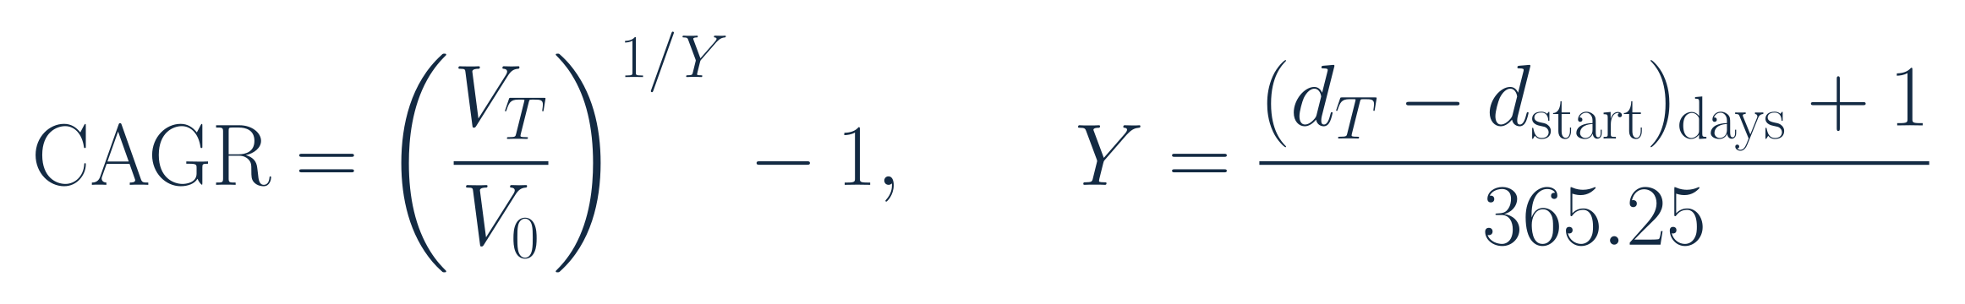
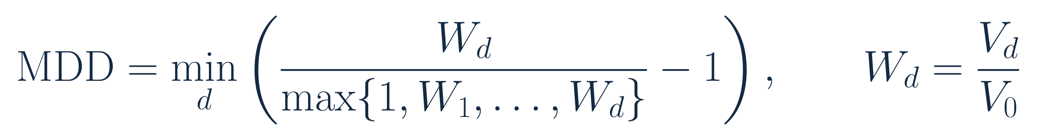
TECHNICAL REFERENCE
Growth and maximum drawdown definitions
Compound annual growth rate (CAGR)
Maximum drawdown (MDD)
V0: continuous opening NAV. VT: ending NAV. W: rebased wealth. Y: actual calendar years. Total return = VT / V0 − 1.
55
Notes:
Speaker 4. Optional Detail.
Technical reference or opening.
Core message: CAGR uses actual calendar time. Drawdown includes opening wealth.
Read-aloud script:
CAGR is compound annual growth rate. It annualizes the ratio of ending to opening wealth using actual elapsed calendar years. Total return is the same wealth ratio minus one without annualization. Opening wealth is the previous point on the continuous strategy NAV path, or one at inception. Maximum drawdown, or MDD, is the smallest signed ratio of wealth to its prior peak minus one. The peak includes opening wealth one. A drawdown closer to zero is shallower. These conventions are identical for all strategies.
Figure explanation: Explain the definitions and comparison on this page.
Sources:
/Users/wangyujing/Desktop/MFE_Macro_Rotation_6Assets/reports/phase4_research_report.md
/Users/wangyujing/Desktop/MFE_Macro_Rotation_6Assets/reports/research_report.md
/Users/wangyujing/Desktop/MFE_Macro_Rotation_6Assets/presentation_assets/final_figures_v2/formulas/svg/F08_calendar-time_cagr.svg
/Users/wangyujing/Desktop/MFE_Macro_Rotation_6Assets/presentation_assets/final_figures_v2/formulas/svg/F10_maximum_drawdown.svg

Slide 56
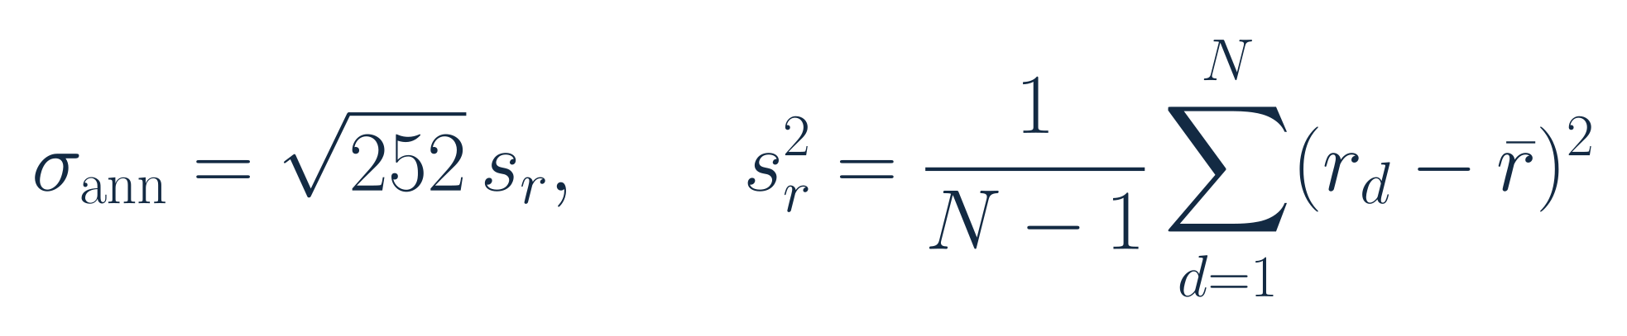
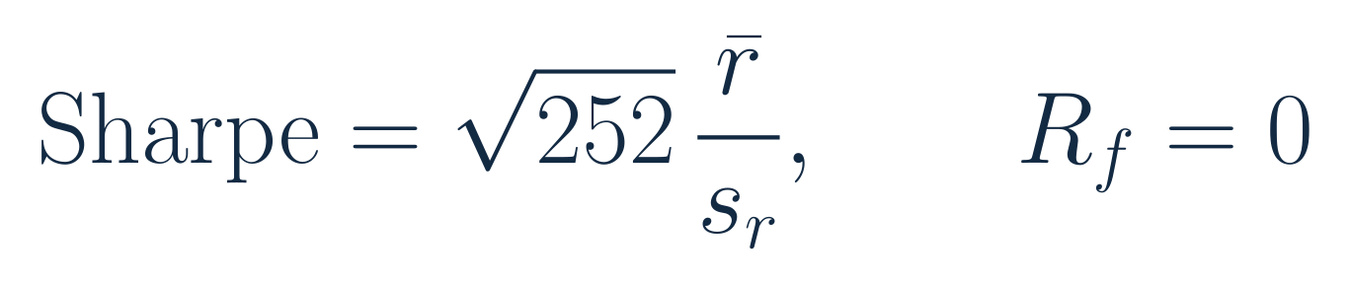
TECHNICAL REFERENCE
Volatility and Sharpe definitions
Annualized volatility
Sharpe ratio
r: net daily portfolio return. Mean is arithmetic. s: sample standard deviation, ddof=1. RF=0.
56
Notes:
Speaker 4. Optional Detail.
Technical reference or opening.
Core message: Both use sample daily standard deviation and square-root-of-252 annualization.
Read-aloud script:
Annualized volatility uses the sample standard deviation of net daily portfolio returns with one degree of freedom adjustment. The Sharpe ratio uses arithmetic mean daily net returns divided by the same sample standard deviation, multiplied by the square root of 252. The reference rate is zero, not BIL. It follows that Sharpe is not CAGR divided by annualized volatility. The fixed 252 convention is retained even though the common valuation grid includes both US and Singapore trading days.
Figure explanation: Explain the definitions and comparison on this page.
Sources:
/Users/wangyujing/Desktop/MFE_Macro_Rotation_6Assets/reports/phase4_research_report.md
/Users/wangyujing/Desktop/MFE_Macro_Rotation_6Assets/reports/research_report.md
/Users/wangyujing/Desktop/MFE_Macro_Rotation_6Assets/presentation_assets/final_figures_v2/formulas/svg/F09_annualized_volatility.svg
/Users/wangyujing/Desktop/MFE_Macro_Rotation_6Assets/presentation_assets/final_figures_v2/formulas/svg/F07_sharpe_ratio.svg

Slide 57
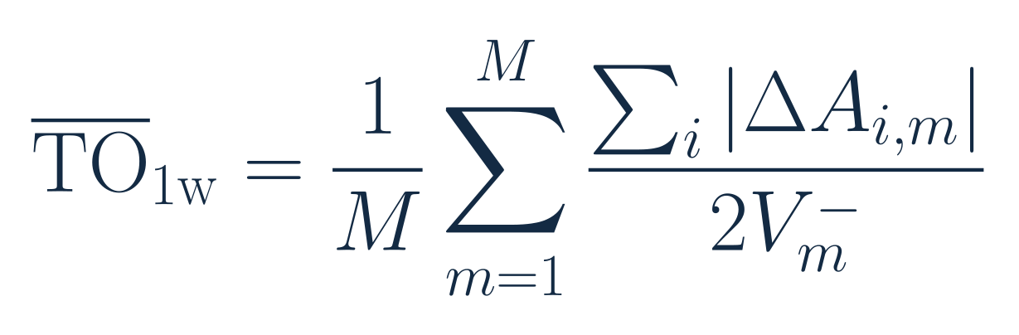
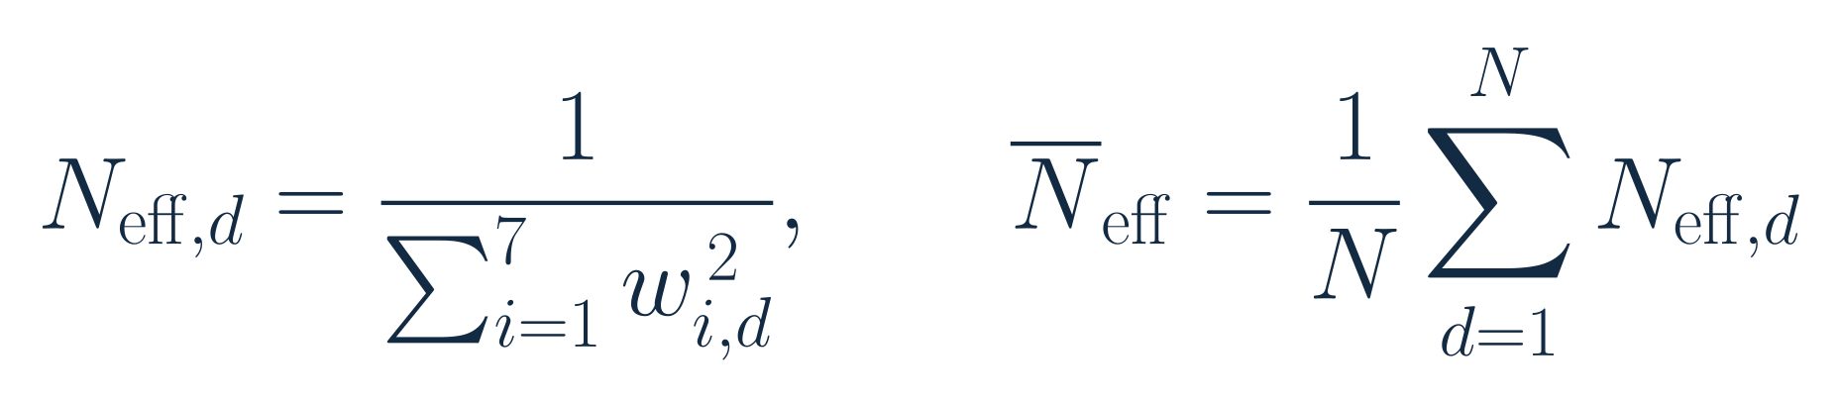
TECHNICAL REFERENCE
Turnover and effective holdings definitions
Average one-way turnover per rebalance
Effective holdings
Delta A: actual currency trades. V-minus: pre-fee NAV. w: actual daily close weights, including BIL.
57
Notes:
Speaker 4. Optional Detail.
Technical reference or opening.
Core message: Use actual trades and daily capital weights, rather than target-weight shortcuts.
Read-aloud script:
Monthly average one-way turnover is the mean across monthly rebalances of the absolute currency trades, divided by twice the pre-fee portfolio value. Initial purchases count, and we do not force terminal liquidation. Effective holdings is the inverse sum of squared actual daily close weights, including BIL, averaged across the period. It is not the number of tickers held and is not calculated from period-average weights. The average effective holdings of MWRP in the main window is 3.44.
Figure explanation: Explain the definitions and comparison on this page.
Sources:
/Users/wangyujing/Desktop/MFE_Macro_Rotation_6Assets/reports/phase4_research_report.md
/Users/wangyujing/Desktop/MFE_Macro_Rotation_6Assets/reports/research_report.md
/Users/wangyujing/Desktop/MFE_Macro_Rotation_6Assets/presentation_assets/final_figures_v2/formulas/svg/F12_monthly_one-way_turnover.svg
/Users/wangyujing/Desktop/MFE_Macro_Rotation_6Assets/presentation_assets/final_figures_v2/formulas/svg/F11_effective_holdings.svg

Slide 58
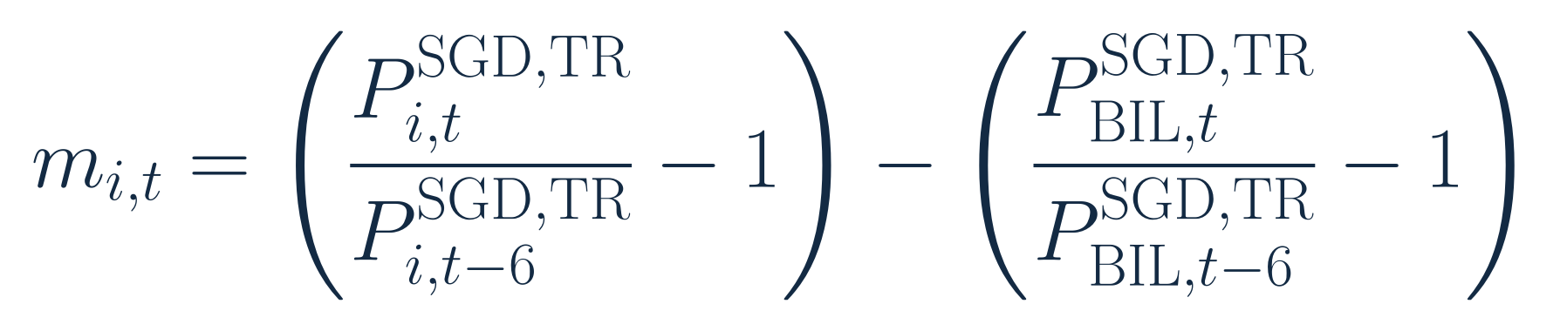
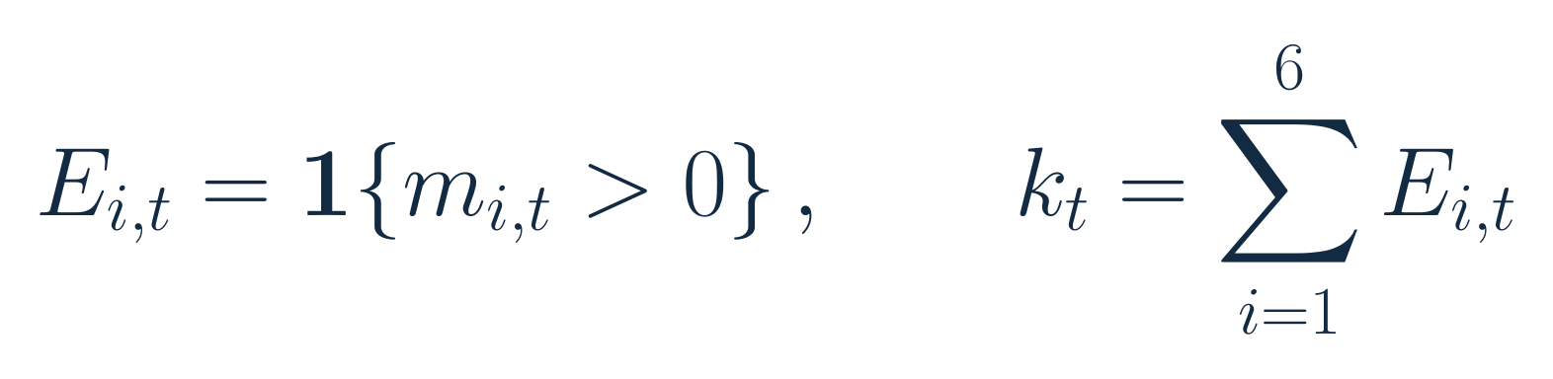
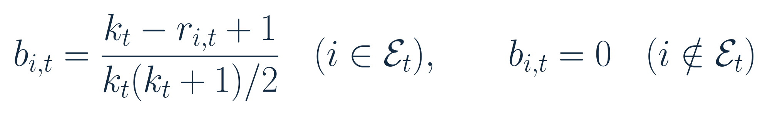
TECHNICAL REFERENCE
MWRP signal and risk-budget formulation
Six-month spread
Eligibility
Risk preferences
58
Notes:
Speaker 2. Optional Detail.
Technical reference or opening.
Core message: A fixed six-month gate and linear rank rule define risk preferences.
Read-aloud script:
This reference brings the three signal formulas together. The six-month SGD return spread relative to BIL determines eligibility. Rank one is strongest among eligible risk assets. The linear budget sums to one over that set. Ties use the fixed source order SPY, ES3, TLT, GLD, IEMG and PDBC. The strategy has no fitted forecast coefficient, budget-power search, top-N adjustment or leverage overlay. The same rule is applied to both historical subperiods.
Figure explanation: Explain the definitions and comparison on this page.
Sources:
/Users/wangyujing/Desktop/MFE_Macro_Rotation_6Assets/reports/phase4_research_report.md
/Users/wangyujing/Desktop/MFE_Macro_Rotation_6Assets/reports/research_report.md
/Users/wangyujing/Desktop/MFE_Macro_Rotation_6Assets/presentation_assets/final_figures_v2/formulas/svg/F01_six-month_excess_momentum.svg
/Users/wangyujing/Desktop/MFE_Macro_Rotation_6Assets/presentation_assets/final_figures_v2/formulas/svg/F02_momentum_eligibility.svg
/Users/wangyujing/Desktop/MFE_Macro_Rotation_6Assets/presentation_assets/final_figures_v2/formulas/svg/F03_momentum-weighted_risk_budget.svg

Slide 59
TECHNICAL REFERENCE
EWMA estimation details
Element | Frozen convention
Initialization | 252 valuation returns, sample covariance
Centering | Prior-day expanding mean
Recursion | Raw Q with lambda = 0.94
Stabilization | 1% diagonal shrinkage, variance floor 1e-12
Allocation | Eligible risk-asset covariance submatrix
No parameter optimization. Fixed annual covariance scaling leaves normalized capital weights unchanged.
59
Notes:
Speaker 3. Optional Detail.
Technical reference or opening.
Core message: Initialization, centering and stabilization are fixed before comparison.
Read-aloud script:
The raw covariance and mean initialize with 252 valuation returns. Each new innovation subtracts the expanding mean available through the previous valuation day. The raw covariance recurses with lambda 0.94, then the mean is updated. The forecast matrix uses fixed one percent shrinkage toward the diagonal and only a diagonal correction required to keep each variance at or above ten to the minus twelve. Annual scaling leaves normalized risk-budget capital weights unchanged. The risk-asset submatrix is used for allocation, with no automatic parameter search.
Figure explanation: Explain the definitions and comparison on this page.
Sources:
/Users/wangyujing/Desktop/MFE_Macro_Rotation_6Assets/reports/phase4_research_report.md
/Users/wangyujing/Desktop/MFE_Macro_Rotation_6Assets/reports/research_report.md
/Users/wangyujing/Desktop/MFE_Macro_Rotation_6Assets/presentation_assets/final_figures_v2/formulas/svg/F04_ewma_covariance_update.svg

Slide 60
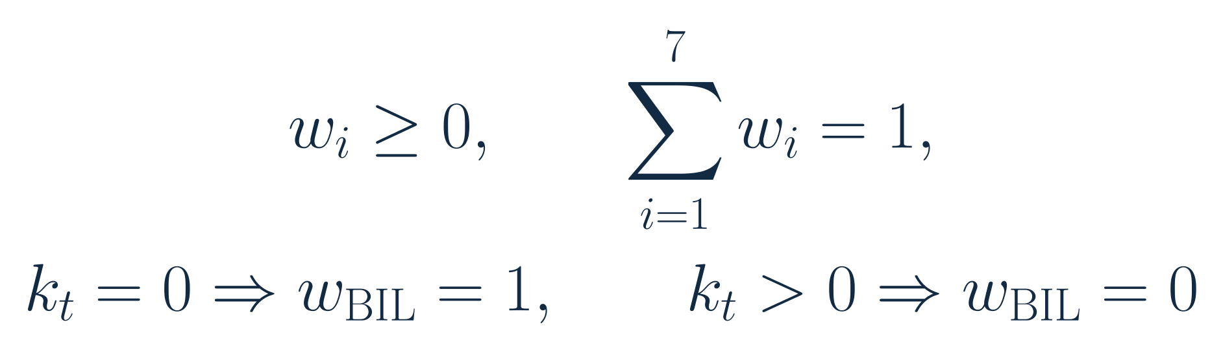
TECHNICAL REFERENCE
Risk-budget optimization and capital constraints
Optimization
Capital constraints and fallback
Estimated risk-contribution formula: Slide 12. No leverage. Eligible sleeve only. k=1: sole asset receives 100%.
60
Notes:
Speaker 3. Optional Detail.
Technical reference or opening.
Core message: Assigned shares are ex ante targets for the eligible risk sleeve.
Read-aloud script:
The optimizer operates only on the eligible assets. Normalizing its positive solution yields long-only capital weights that sum to one. Estimated volatility contributions, divided by portfolio volatility, equal the assigned risk-budget shares. With no eligible risk asset, all capital is BIL. With one eligible asset, all risk and capital go to it. These fallback rules apply to MWRP, MGRP and Gated Equal Weight. Dual instead redirects each failed fifty-percent slot individually. Ex ante risk shares are not future realized guarantees.
Figure explanation: Explain the definitions and comparison on this page.
Sources:
/Users/wangyujing/Desktop/MFE_Macro_Rotation_6Assets/reports/phase4_research_report.md
/Users/wangyujing/Desktop/MFE_Macro_Rotation_6Assets/reports/research_report.md
/Users/wangyujing/Desktop/MFE_Macro_Rotation_6Assets/presentation_assets/final_figures_v2/formulas/svg/F05_risk_budget_optimization.svg
/Users/wangyujing/Desktop/MFE_Macro_Rotation_6Assets/presentation_assets/final_figures_v2/formulas/svg/F06_capital_constraints_and_fallback.svg

Slide 61
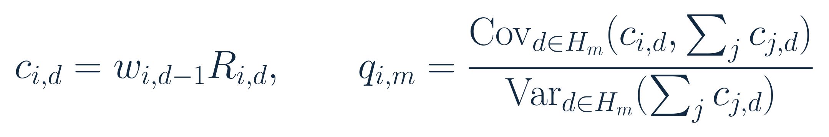
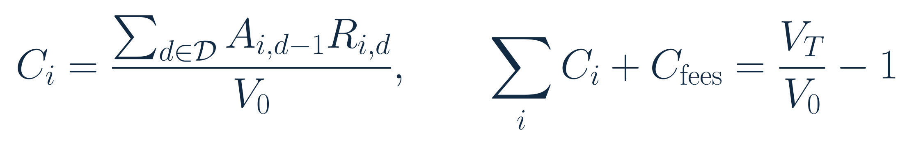
TECHNICAL REFERENCE
Realized risk and P&L use different decompositions
Signed realized risk shares
Additive profit and loss (P&L)
H: exact (entry close, next close] interval. c: gross asset return contribution. Fees excluded from risk, included in P&L.
61
Notes:
Speaker 5. Optional Detail.
Technical reference or opening.
Core message: Risk shares use covariance. P&L contributions reconcile total return.
Read-aloud script:
Realized risk contributions use each asset's lagged actual capital weight times its return. Covariance with the total gross portfolio return is divided by total return variance over the exact execution-to-execution interval. The signed shares sum to one and can be negative or greater than one. P&L attribution instead adds daily currency asset gains and divides by common period opening wealth. Negative transaction costs are a separate contribution. The sum equals net total return, not CAGR. These are different accounting and risk questions, so the quantities should not be interchanged.
Figure explanation: Explain the definitions and comparison on this page.
Sources:
/Users/wangyujing/Desktop/MFE_Macro_Rotation_6Assets/reports/phase4_research_report.md
/Users/wangyujing/Desktop/MFE_Macro_Rotation_6Assets/reports/research_report.md
/Users/wangyujing/Desktop/MFE_Macro_Rotation_6Assets/presentation_assets/final_figures_v2/formulas/svg/F14_realized_risk_contribution.svg
/Users/wangyujing/Desktop/MFE_Macro_Rotation_6Assets/presentation_assets/final_figures_v2/formulas/svg/F15_additive_pandl_attribution.svg

Slide 62
TECHNICAL REFERENCE
Complete performance: historical backtest B
Strategy | Net CAGR | Sharpe | Ann. vol. | MDD | Turnover / rebalance | Effective holdings
Equal Weight | 18.71% | 1.724 | 9.99% | -8.68% | 1.31% | 6.00
EWMA Risk Parity | 16.59% | 1.886 | 8.11% | -8.79% | 8.66% | 4.93
Dual Momentum | 27.26% | 1.667 | 14.76% | -12.47% | 21.92% | 2.00
Gated EW | 22.03% | 1.831 | 10.93% | -8.65% | 18.44% | 4.24
MGRP | 21.25% | 1.978 | 9.74% | -9.66% | 23.35% | 3.65
MWRP | 23.75% | 2.082 | 10.24% | -9.15% | 20.90% | 3.45
Historical B: 2024 Jan–2026 Sep 18. Net of 10 bps per traded side. Effective holdings: daily mean of 1 / sum(w²).
62
Notes:
Recomputed from archived SGD total-return data through 2026-10-19. Source: research/src/evaluation_windows.py, research/outputs/windows/tables/performance.csv and asset_pnl_attribution.csv. Equal Weight uses identical frozen strategy/execution rules. Full quantitative source: .presentation-build/data.json. Retrospective research after strategy selection.

Slide 63
TECHNICAL REFERENCE
Complete performance: historical backtest A
Strategy | Net CAGR | Sharpe | Ann. vol. | MDD | Turnover / rebalance | Effective holdings
Equal Weight | 4.89% | 0.462 | 11.53% | -18.46% | 2.55% | 6.00
EWMA Risk Parity | 4.00% | 0.450 | 9.52% | -15.20% | 9.63% | 4.94
Dual Momentum | 11.24% | 0.796 | 14.36% | -15.55% | 32.84% | 1.96
Gated EW | 5.12% | 0.424 | 13.70% | -15.78% | 31.32% | 3.28
MGRP | 4.64% | 0.412 | 12.70% | -15.14% | 33.21% | 2.99
MWRP | 5.68% | 0.479 | 13.05% | -14.82% | 32.35% | 2.85
Historical A: 2020 Jan–2023 Dec. Net of 10 bps per traded side. Effective holdings: daily mean of 1 / sum(w²).
63
Notes:
Recomputed from archived SGD total-return data through 2026-10-19. Source: research/src/evaluation_windows.py, research/outputs/windows/tables/performance.csv and asset_pnl_attribution.csv. Equal Weight uses identical frozen strategy/execution rules. Full quantitative source: .presentation-build/data.json. Retrospective research after strategy selection.

Slide 64
TECHNICAL REFERENCE
Complete performance: combined historical window
Strategy | Net CAGR | Sharpe | Ann. vol. | MDD | Turnover / rebalance | Effective holdings
Equal Weight | 10.27% | 0.928 | 10.93% | -18.46% | 2.05% | 6.00
EWMA Risk Parity | 8.91% | 0.974 | 8.98% | -15.20% | 9.23% | 4.93
Dual Momentum | 17.45% | 1.154 | 14.53% | -15.55% | 28.40% | 1.97
Gated EW | 11.65% | 0.914 | 12.65% | -15.78% | 26.08% | 3.67
MGRP | 11.06% | 0.942 | 11.60% | -15.14% | 29.19% | 3.26
MWRP | 12.64% | 1.030 | 11.99% | -14.82% | 27.68% | 3.09
Combined history: 2020 Jan–2026 Sep 18. Net of 10 bps per traded side. Effective holdings: daily mean of 1 / sum(w²).
64
Notes:
Recomputed from archived SGD total-return data through 2026-10-19. Source: research/src/evaluation_windows.py, research/outputs/windows/tables/performance.csv and asset_pnl_attribution.csv. Equal Weight uses identical frozen strategy/execution rules. Full quantitative source: .presentation-build/data.json. Retrospective research after strategy selection.

Slide 65
TECHNICAL REFERENCE
Trading assumptions and evidence boundaries
Item | Convention
Signal information | Month-end history, available next day at 06:00 UTC
Execution | Second common fresh-quote trading-day close basket
Returns | Old positions through replacement close, new positions thereafter
Main trading cost | 10 bps per traded side on actual currency trades
Additional scenarios | 5 and 25 bps, all other rules fixed
Fund expenses | Already reflected in adjusted prices
Not explicitly modeled | Investor taxes, separate FX fees, time-varying impact
Continuous holdings across windows. Retrospective test. Partial October coverage to Oct 19.
65
Notes:
Speaker 3. Optional Detail.
Technical reference or opening.
Core message: The close-basket approximation and simplified costs remain material limitations.
Read-aloud script:
Signals become available after the month-end information cutoff. Orders are represented at the second common fresh-quote trading-day close basket, with old holdings retained through replacement. The engine charges ten basis points per traded side to actual currency trades and solves self-financing post-fee holdings. Fund expenses are already reflected in prices. Investor taxes, separate FX charges and time-varying market impact are not explicitly modeled. Historical quote revisions and asynchronous closes remain data limitations. These are retrospective simulations and should not be presented as deployed returns.
Figure explanation: Explain the definitions and comparison on this page.
Sources:
/Users/wangyujing/Desktop/MFE_Macro_Rotation_6Assets/reports/phase4_research_report.md
/Users/wangyujing/Desktop/MFE_Macro_Rotation_6Assets/reports/research_report.md

