Slide 1
NATIONAL UNIVERSITY OF SINGAPORE (NUS)
Which Asset Wins
Next Month?
Momentum-Weighted Risk Parity
for Dynamic Cross-Asset Allocation
FE5209 Financial Econometrics
Group Project - Weiming Alpha
Presentation date: 2 November
01
Notes:
Speaker 1. Quick Slide.
Technical reference or opening.
Core message: Momentum-Weighted Risk Parity for Dynamic Cross-Asset Allocation
Read-aloud script:
Good morning. Our project asks how to allocate across asset classes when both trends and risks change. We study Momentum-Weighted Risk Parity, or MWRP. The objective is a balanced portfolio construction process, rather than the highest possible backtested return. We will explain the economic motivation, show how the econometric model determines capital weights, and compare performance with strong, simple benchmarks. The results are exploratory historical evidence, not live investment performance.
Figure explanation: Explain the definitions and comparison on this page.
Sources:
/Users/wangyujing/Desktop/MFE_Macro_Rotation_6Assets/reports/phase4_research_report.md
/Users/wangyujing/Desktop/MFE_Macro_Rotation_6Assets/reports/research_report.md

Slide 2
01
The Investment Problem
Capture trends while controlling portfolio concentration
02
Notes:
Speaker 1. Quick Slide.
Section question: Why combine momentum with risk allocation?
Core message: Capture trends while controlling portfolio concentration
Read-aloud script:
This section asks: Why combine momentum with risk allocation? Capture trends while controlling portfolio concentration.
Figure explanation: Explain the definitions and comparison on this page.
Sources:
/Users/wangyujing/Desktop/MFE_Macro_Rotation_6Assets/reports/phase4_research_report.md
/Users/wangyujing/Desktop/MFE_Macro_Rotation_6Assets/reports/research_report.md

Slide 3
SECTION 01 INVESTMENT MOTIVATION & UNIVERSE
Six risk exposures and one defensive asset
Risk exposure | ETF ticker | Portfolio role
US equity | SPY | Risk asset
Singapore equity | ES3.SI | Risk asset
Long-term US Treasuries | TLT | Risk asset
Gold | GLD | Risk asset
Emerging markets equity | IEMG | Risk asset
Broad commodities | PDBC | Risk asset
Treasury bills | BIL | Defensive asset
ETF = exchange-traded fund. SGD = Singapore dollar. USD = United States dollar.
BIL retains USD/SGD currency risk. It is not risk-free SGD cash.
03
Notes:
Speaker 1. Core Slide.
Section question: Why combine momentum with risk allocation?
Core message: Diversification spans different economic exposures, with all returns measured in SGD.
Read-aloud script:
We use six risk exchange-traded funds, or ETFs. They provide US equities, Singapore equities, long-term US Treasuries, gold, emerging markets equities and broad commodities. BIL, a US Treasury-bill ETF, is the defensive destination. SGD means Singapore dollar and USD means United States dollar. We convert USD assets to SGD total returns so that the portfolio is evaluated from one investor currency. These are distinct exposures, but several still share equity, interest-rate and currency risks. In particular, BIL retains USD against SGD currency risk and should not be described as risk-free SGD cash.
Figure explanation: Explain the definitions and comparison on this page.
Sources:
/Users/wangyujing/Desktop/MFE_Macro_Rotation_6Assets/reports/phase4_research_report.md
/Users/wangyujing/Desktop/MFE_Macro_Rotation_6Assets/reports/research_report.md

Slide 4
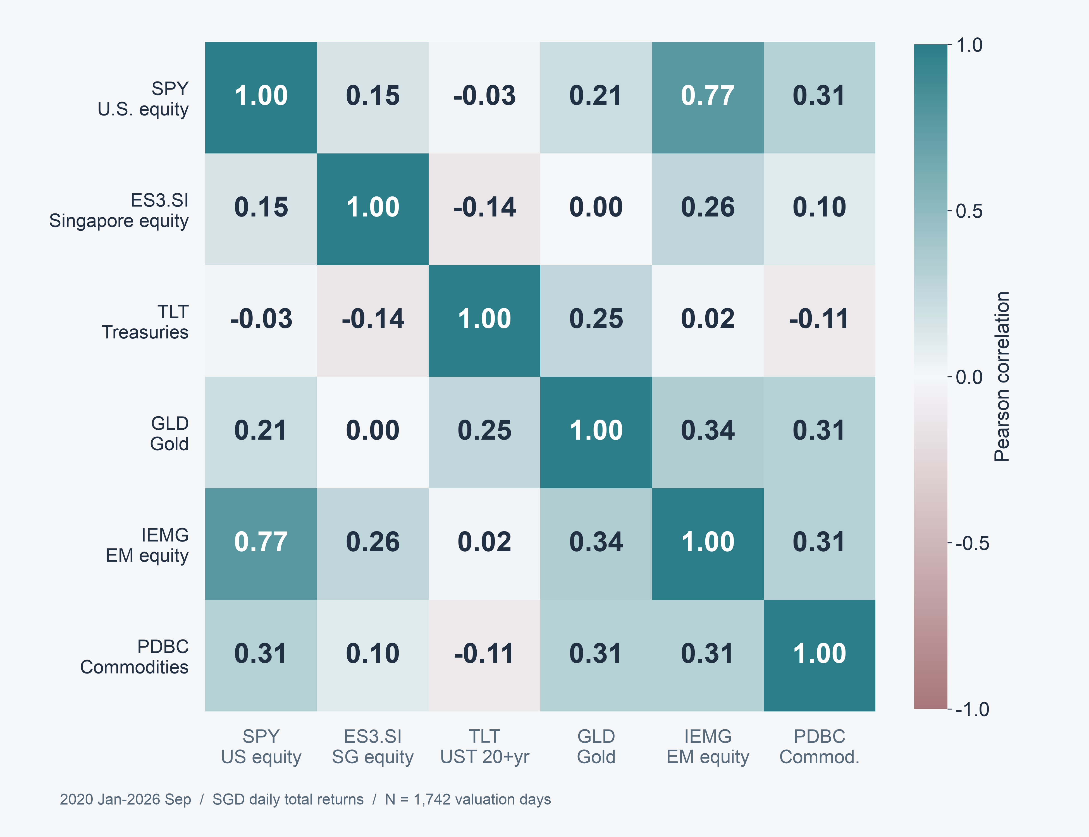
SECTION 01 INVESTMENT MOTIVATION & UNIVERSE
Different return relationships support diversification
Diversification
opportunities
Equity, rate and currency
risks can overlap.
Pearson correlation
2020 Jan–2026 Sep
04
Notes:
Speaker 1. Core Slide.
Section question: Why combine momentum with risk allocation?
Core message: Correlations differ, but do not establish independence.
Read-aloud script:
This matrix uses daily SGD returns over January 2020 to September 2026. Read each cell as a Pearson correlation between minus one and plus one. The differing relationships provide a rationale for combining asset classes. They do not imply independence or a stable hedge in every regime. US and Singapore closes are asynchronous, and converting USD funds to SGD introduces a common currency component. The matrix motivates covariance-aware allocation, but it is not proof that a particular portfolio will have low future risk.
Figure explanation: Correlations differ, but do not establish independence.
Sources:
/Users/wangyujing/Desktop/MFE_Macro_Rotation_6Assets/presentation_assets/final_figures_v2/figures/main/FIG01_Correlation_full.svg
/Users/wangyujing/Desktop/MFE_Macro_Rotation_6Assets/reports/phase4_research_report.md
/Users/wangyujing/Desktop/MFE_Macro_Rotation_6Assets/reports/research_report.md
/Users/wangyujing/Desktop/MFE_Macro_Rotation_6Assets/data/processed/sgd_daily_returns.csv

Slide 5
SECTION 01 INVESTMENT MOTIVATION & UNIVERSE
Momentum selection and equal-risk allocation
Dual Momentum
Equal Risk Contribution (ERC)
Ranks six-month asset returns
Allocates two 50% capital slots
Emphasizes strong winners
Balances forecast risk shares
Uses volatility and co-movement
Does not rank momentum strength
Momentum-Gated Risk Parity (MGRP) adds eligibility to equal-risk allocation.
05
Notes:
Speaker 1. Core Slide.
Section question: Why combine momentum with risk allocation?
Core message: Momentum emphasizes winners. Equal-risk allocation emphasizes forecast diversification.
Read-aloud script:
Dual Momentum ranks the six risk assets by their six-month SGD total return and assigns two equal capital slots. A selected asset must beat BIL over the same lookback, otherwise that slot moves to BIL. This can capture strong trends, but two slots create concentration. Equal Risk Contribution, or ERC, instead sets equal shares of forecast portfolio risk across all six risk assets. It uses covariance information but does not distinguish stronger from weaker momentum. These are useful starting points because their different objectives create a clear investment trade-off.
Figure explanation: Explain the definitions and comparison on this page.
Sources:
/Users/wangyujing/Desktop/MFE_Macro_Rotation_6Assets/reports/phase4_research_report.md
/Users/wangyujing/Desktop/MFE_Macro_Rotation_6Assets/reports/research_report.md

Slide 6
SECTION 01 INVESTMENT MOTIVATION & UNIVERSE
The portfolio-construction question
Can momentum strength improve risk budgeting
without sacrificing too much return?
01
Eligibility
Which assets qualify?
02
Risk preferences
How much forecast risk should each receive?
03
Capital allocation
How much money implements those preferences?
06
Notes:
Speaker 1. Core Slide.
Section question: Why combine momentum with risk allocation?
Core message: Use momentum to express risk preferences, then use covariance to determine capital.
Read-aloud script:
Our research question is whether momentum strength can improve risk budgeting without sacrificing too much return. We separate three decisions: which assets qualify, how much forecast risk each should receive, and how much capital implements those preferences. We compare MWRP with Dual Momentum as a strong investment benchmark. We also compare it with Momentum-Gated Risk Parity, or MGRP, which holds the same eligible set but assigns equal risk budgets. That second comparison helps isolate what momentum weighting changes. Speaker 2 will now explain the rules.
Figure explanation: Explain the definitions and comparison on this page.
Sources:
/Users/wangyujing/Desktop/MFE_Macro_Rotation_6Assets/reports/phase4_research_report.md
/Users/wangyujing/Desktop/MFE_Macro_Rotation_6Assets/reports/research_report.md

Slide 7
02
From Momentum to Portfolio Weights
Eligibility, risk preferences and covariance-based capital allocation
07
Notes:
Speaker 2. Quick Slide.
Section question: How does a momentum signal become a portfolio weight?
Core message: Eligibility, risk preferences and covariance-based capital allocation
Read-aloud script:
This section asks: How does a momentum signal become a portfolio weight? Eligibility, risk preferences and covariance-based capital allocation.
Figure explanation: Explain the definitions and comparison on this page.
Sources:
/Users/wangyujing/Desktop/MFE_Macro_Rotation_6Assets/reports/phase4_research_report.md
/Users/wangyujing/Desktop/MFE_Macro_Rotation_6Assets/reports/research_report.md

Slide 8
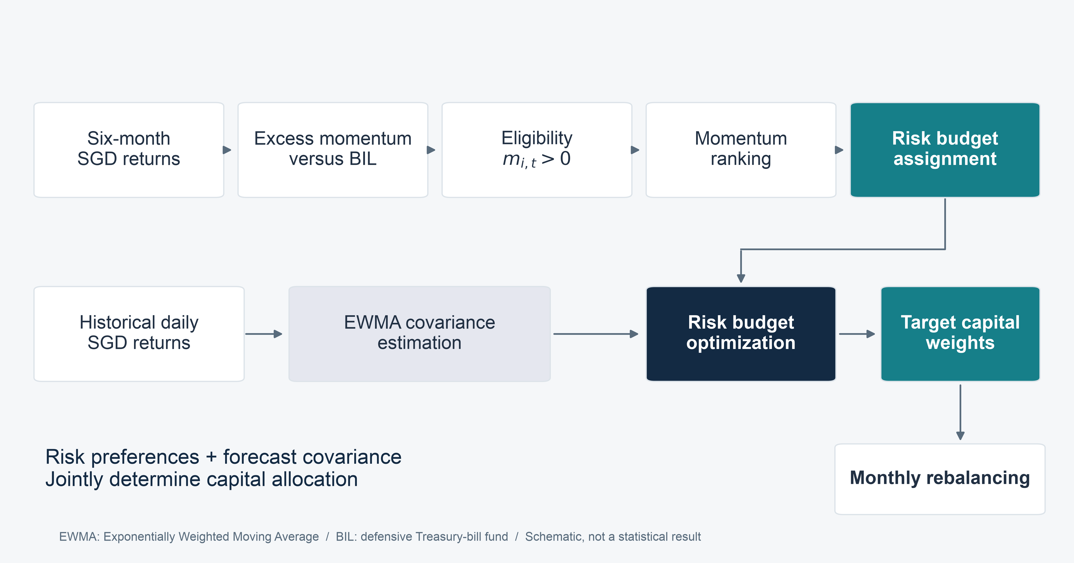
SECTION 02 OUR STRATEGY: MWRP
Momentum sets risk preferences, covariance sets capital
08
Notes:
Speaker 2. Core Slide.
Section question: How does a momentum signal become a portfolio weight?
Core message: The same covariance estimator maps different risk budgets into capital weights.
Read-aloud script:
The pipeline starts with month-end information already available at the signal time. Six-month returns relative to BIL determine eligibility. Eligible assets are ranked by momentum. Their ranks determine target risk budgets. The exponentially weighted moving average, or EWMA, covariance estimate then maps those budgets into capital weights. We hold all eligible assets, stay long only, use no leverage, and rebalance monthly. If no risk asset qualifies, we hold BIL. MWRP changes the risk budgets used by MGRP, while keeping the eligibility rule, covariance estimator and execution engine fixed.
Figure explanation: The same covariance estimator maps different risk budgets into capital weights.
Sources:
/Users/wangyujing/Desktop/MFE_Macro_Rotation_6Assets/presentation_assets/final_figures_v2/figures/main/FIG02_Pipeline_full.svg
/Users/wangyujing/Desktop/MFE_Macro_Rotation_6Assets/reports/phase4_research_report.md
/Users/wangyujing/Desktop/MFE_Macro_Rotation_6Assets/reports/research_report.md
/Users/wangyujing/Desktop/MFE_Macro_Rotation_6Assets/src/strategies.py
/Users/wangyujing/Desktop/MFE_Macro_Rotation_6Assets/src/phase4/models.py

Slide 9
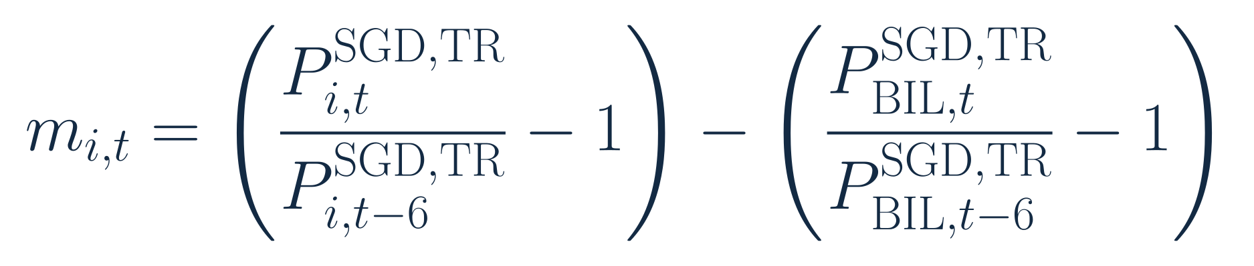
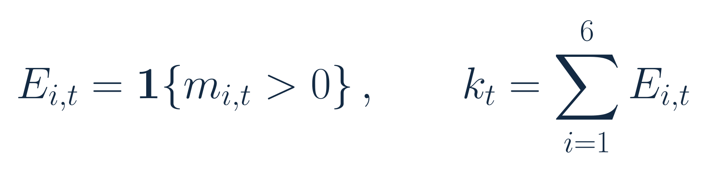
SECTION 02 OUR STRATEGY: MWRP
An asset must beat BIL to qualify
Six-month excess momentum
Eligibility and the number of qualifying risk assets
i: risk asset. t: month-end. P: SGD total-return index. k: eligible count.
Strictly positive spread. No eligible assets: 100% BIL. One eligible asset: 100% capital.
09
Notes:
Speaker 2. Core Slide.
Section question: How does a momentum signal become a portfolio weight?
Core message: Eligibility uses a strictly positive six-month SGD total-return spread.
Read-aloud script:
The first equation defines excess momentum as the asset's six-month simple total return less BIL's return over the same months. The second equation defines the eligibility indicator and counts eligible assets. A zero spread does not qualify because the inequality is strict. The prices are month-end SGD total-return indices, with dividends already reflected in adjusted prices. Subtracting the same BIL return does not change the relative ordering of risk assets. When no asset qualifies, MWRP holds one hundred percent BIL. When only one qualifies, that asset receives all risk and capital.
Figure explanation: Explain the definitions and comparison on this page.
Sources:
/Users/wangyujing/Desktop/MFE_Macro_Rotation_6Assets/reports/phase4_research_report.md
/Users/wangyujing/Desktop/MFE_Macro_Rotation_6Assets/reports/research_report.md
/Users/wangyujing/Desktop/MFE_Macro_Rotation_6Assets/presentation_assets/final_figures_v2/formulas/svg/F01_six-month_excess_momentum.svg
/Users/wangyujing/Desktop/MFE_Macro_Rotation_6Assets/presentation_assets/final_figures_v2/formulas/svg/F02_momentum_eligibility.svg

Slide 10
SECTION 02 OUR STRATEGY: MWRP
Stronger momentum receives a larger risk budget
k = eligible count. r = rank among eligible assets. Rank 1 is strongest.
Eligible rank | 1 | 2 | 3 | 4
Target risk share | 40% | 30% | 20% | 10%
Risk budget is not capital weight
Fixed linear rank rule. Budgets sum to 100%. The four-asset row illustrates the rule.
10
Notes:
Speaker 2. Core Slide.
Section question: How does a momentum signal become a portfolio weight?
Core message: Four eligible assets receive risk budgets of 40%, 30%, 20% and 10%.
Read-aloud script:
Here k is the number of eligible risk assets and r is the rank within that set, with one denoting the strongest momentum. The linear rule gives the strongest asset the largest share of forecast risk. With four eligible assets, the budgets are forty, thirty, twenty and ten percent. The denominator makes them sum to one. This is a fixed rule, not a fitted return forecast or a parameter chosen to maximize recent Sharpe. The key distinction is that these are risk budgets. They are not capital weights, because volatility and covariance also affect the capital required.
Figure explanation: Explain the definitions and comparison on this page.
Sources:
/Users/wangyujing/Desktop/MFE_Macro_Rotation_6Assets/reports/phase4_research_report.md
/Users/wangyujing/Desktop/MFE_Macro_Rotation_6Assets/reports/research_report.md
/Users/wangyujing/Desktop/MFE_Macro_Rotation_6Assets/presentation_assets/final_figures_v2/formulas/svg/F03_momentum-weighted_risk_budget.svg

Slide 11
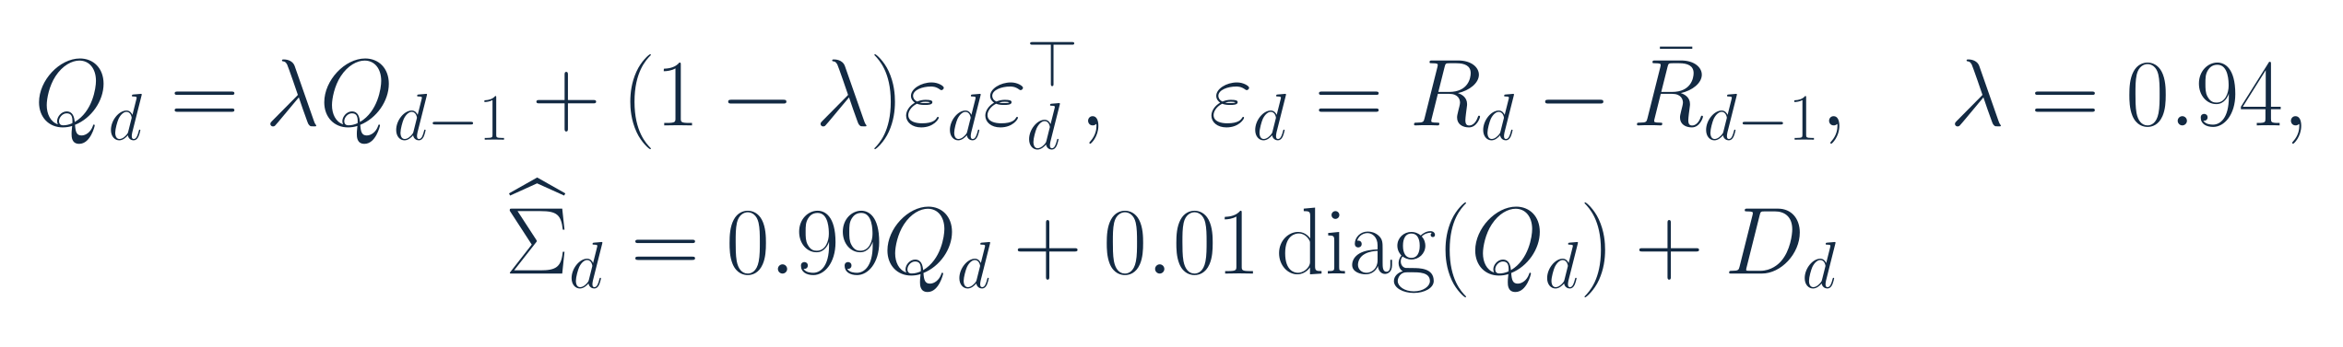
SECTION 02 OUR STRATEGY: MWRP
Recent observations receive more weight in covariance
Exponentially Weighted Moving Average (EWMA)
01
Recent information
lambda = 0.94. Use the prior expanding mean for innovations.
02
Fixed stabilization
Initialize with 252 returns. Apply 1% diagonal shrinkage and a 1e-12 floor.
Q: raw covariance. R: daily asset returns. D: diagonal floor correction. No parameter search.
11
Notes:
Speaker 2. Core Slide.
Section question: How does a momentum signal become a portfolio weight?
Core message: EWMA uses fixed lambda 0.94 and a fixed stabilization method.
Read-aloud script:
EWMA stands for exponentially weighted moving average. The covariance update assigns ninety-four percent weight to the previous raw covariance and six percent to the current innovation outer product. The innovation uses the prior expanding mean, so the centering information was already known. We initialize with two hundred fifty-two valuation returns, then apply fixed one percent diagonal shrinkage and a tiny variance floor. These choices are shared with MGRP and are not optimized for this evaluation period. They provide an adaptive estimate of risk and co-movement, without guaranteeing accurate future volatility.
Figure explanation: Explain the definitions and comparison on this page.
Sources:
/Users/wangyujing/Desktop/MFE_Macro_Rotation_6Assets/reports/phase4_research_report.md
/Users/wangyujing/Desktop/MFE_Macro_Rotation_6Assets/reports/research_report.md
/Users/wangyujing/Desktop/MFE_Macro_Rotation_6Assets/presentation_assets/final_figures_v2/formulas/svg/F04_ewma_covariance_update.svg

Slide 12
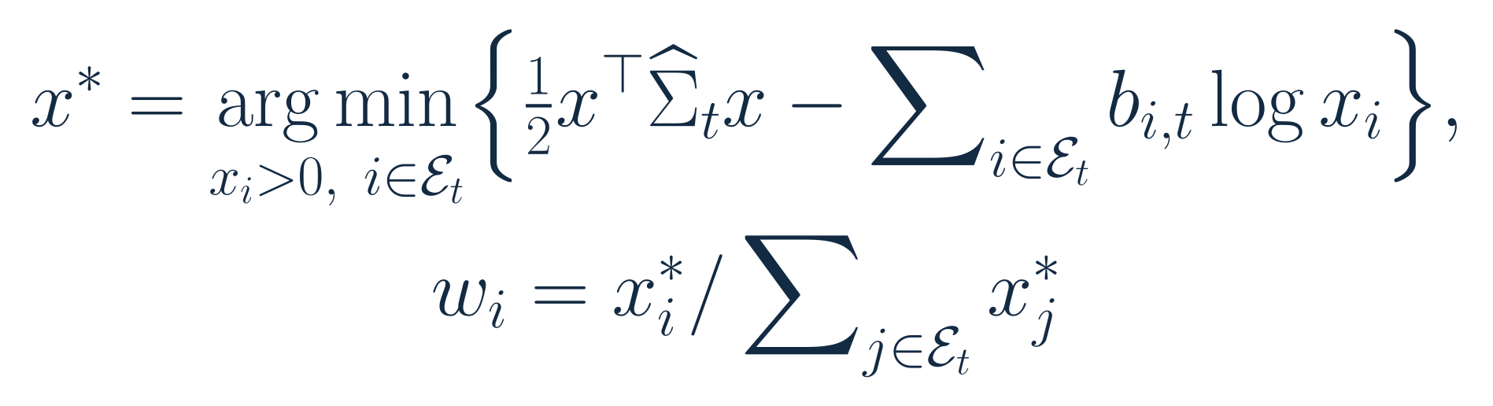
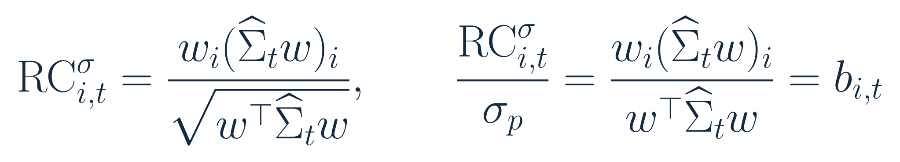
SECTION 02 OUR STRATEGY: MWRP
The optimizer converts risk budgets into capital weights
x: positive optimization variable. w: normalized capital weights. b: assigned risk shares.
Estimated risk shares equal assigned budgets. This equality is ex ante, not a future guarantee.
12
Notes:
Speaker 2. Core Slide.
Section question: How does a momentum signal become a portfolio weight?
Core message: Capital weights implement forecast risk shares while remaining long only and fully invested.
Read-aloud script:
We solve the convex risk-budget objective shown here over eligible assets and normalize the positive solution into capital weights. The first-order conditions imply that each asset's normalized forecast risk contribution equals its assigned budget. The covariance matrix contains both individual volatility and co-movement, so the largest risk budget need not produce the largest capital position. Multiplying the covariance matrix by a common annualization factor does not change normalized weights. These are ex ante targets. The optimizer cannot force future realized risk contributions to equal them.
Figure explanation: Explain the definitions and comparison on this page.
Sources:
/Users/wangyujing/Desktop/MFE_Macro_Rotation_6Assets/reports/phase4_research_report.md
/Users/wangyujing/Desktop/MFE_Macro_Rotation_6Assets/reports/research_report.md
/Users/wangyujing/Desktop/MFE_Macro_Rotation_6Assets/presentation_assets/final_figures_v2/formulas/svg/F05_risk_budget_optimization.svg
/Users/wangyujing/Desktop/MFE_Macro_Rotation_6Assets/presentation_assets/final_figures_v2/formulas/svg/F13_estimated_risk_contribution.svg

Slide 13
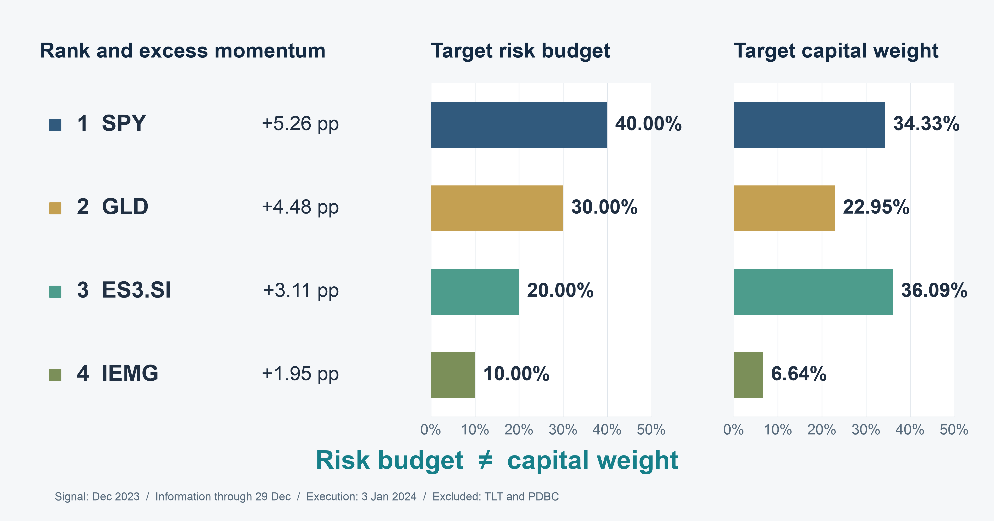
SECTION 02 OUR STRATEGY: MWRP
Risk budgets and capital differ in a real decision
13
Notes:
Speaker 2. Core Slide.
Section question: How does a momentum signal become a portfolio weight?
Core message: SPY has 40.00% of risk and 34.33% of capital. ES3 has 20.00% of risk and 36.09% of capital.
Read-aloud script:
This is the first evaluation execution with at least three eligible assets and complete records, selected without looking at subsequent returns. The information is through 29 December 2023, and execution is 3 January 2024. Four assets qualify. SPY ranks first and receives a forty percent risk budget, but only 34.33 percent of capital. ES3 ranks third and receives twenty percent of risk, yet 36.09 percent of capital. Gold and emerging markets complete the portfolio. This example shows why momentum preferences and covariance-based capital allocation are separate decisions. Speaker 3 will now assess the econometric framework.
Figure explanation: SPY has 40.00% of risk and 34.33% of capital. ES3 has 20.00% of risk and 36.09% of capital.
Sources:
/Users/wangyujing/Desktop/MFE_Macro_Rotation_6Assets/presentation_assets/final_figures_v2/figures/main/FIG03_Rank_Budget_Capital_full.svg
/Users/wangyujing/Desktop/MFE_Macro_Rotation_6Assets/reports/phase4_research_report.md
/Users/wangyujing/Desktop/MFE_Macro_Rotation_6Assets/reports/research_report.md
/Users/wangyujing/Desktop/MFE_Macro_Rotation_6Assets/outputs/phase4/tables/table07_monthly_allocation_decisions.csv

Slide 14
03
Econometric Framework & Validation
Test information timing, covariance forecasts and risk contributions
14
Notes:
Speaker 3. Quick Slide.
Section question: Does the model work as intended, and what remains uncertain?
Core message: Test information timing, covariance forecasts and risk contributions
Read-aloud script:
This section asks: Does the model work as intended, and what remains uncertain? Test information timing, covariance forecasts and risk contributions.
Figure explanation: Explain the definitions and comparison on this page.
Sources:
/Users/wangyujing/Desktop/MFE_Macro_Rotation_6Assets/reports/phase4_research_report.md
/Users/wangyujing/Desktop/MFE_Macro_Rotation_6Assets/reports/research_report.md

Slide 15
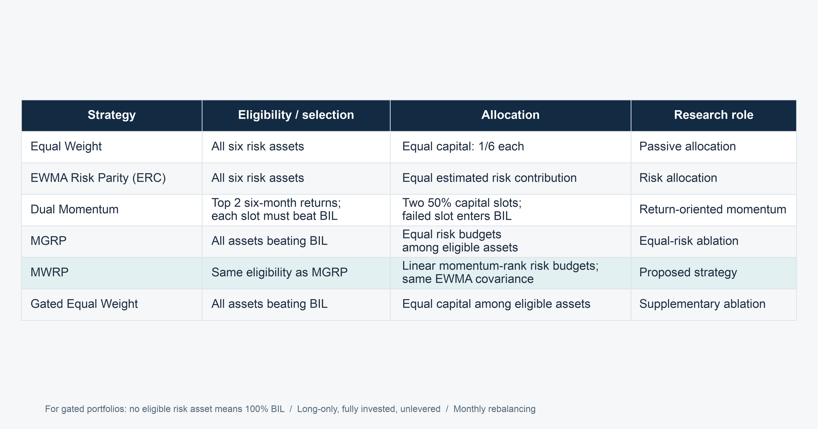
SECTION 03 ECONOMETRIC FRAMEWORK & MODEL DIAGNOSTICS
Benchmarks separate selection from allocation
15
Notes:
Speaker 3. Core Slide.
Section question: Does the model work as intended, and what remains uncertain?
Core message: MGRP versus MWRP is the closest comparison of risk-budget rules.
Read-aloud script:
This table separates each strategy's selection rule from its allocation rule. Equal Weight is our passive benchmark. EWMA Risk Parity tests covariance-based equal risk allocation across all six risk assets. Dual Momentum tests concentrated winner selection. Gated Equal Weight applies momentum eligibility but uses equal capital. MGRP applies the same gate with equal risk budgets, and MWRP changes those budgets according to momentum rank. Comparing MGRP with MWRP holds the asset set and covariance estimate fixed. These component comparisons are descriptive historical contrasts, not independent causal estimates.
Figure explanation: MGRP versus MWRP is the closest comparison of risk-budget rules.
Sources:
/Users/wangyujing/Desktop/MFE_Macro_Rotation_6Assets/presentation_assets/final_figures_v2/figures/main/DES01_Benchmark_Definitions_full.svg
/Users/wangyujing/Desktop/MFE_Macro_Rotation_6Assets/reports/phase4_research_report.md
/Users/wangyujing/Desktop/MFE_Macro_Rotation_6Assets/reports/research_report.md
/Users/wangyujing/Desktop/MFE_Macro_Rotation_6Assets/data/processed/sgd_daily_returns.csv
/Users/wangyujing/Desktop/MFE_Macro_Rotation_6Assets/data/processed/sgd_total_return_indices.csv
/Users/wangyujing/Desktop/MFE_Macro_Rotation_6Assets/outputs/diagnostics/Dual_Momentum_contribution.csv
/Users/wangyujing/Desktop/MFE_Macro_Rotation_6Assets/outputs/diagnostics/Dual_Momentum_daily.csv
/Users/wangyujing/Desktop/MFE_Macro_Rotation_6Assets/outputs/diagnostics/Dual_Momentum_weights.csv
/Users/wangyujing/Desktop/MFE_Macro_Rotation_6Assets/outputs/diagnostics/EWMA_Risk_Parity_contribution.csv
/Users/wangyujing/Desktop/MFE_Macro_Rotation_6Assets/outputs/diagnostics/EWMA_Risk_Parity_daily.csv
/Users/wangyujing/Desktop/MFE_Macro_Rotation_6Assets/outputs/diagnostics/EWMA_Risk_Parity_weights.csv
/Users/wangyujing/Desktop/MFE_Macro_Rotation_6Assets/outputs/diagnostics/Equal_Weight_contribution.csv
/Users/wangyujing/Desktop/MFE_Macro_Rotation_6Assets/outputs/diagnostics/Equal_Weight_daily.csv
/Users/wangyujing/Desktop/MFE_Macro_Rotation_6Assets/outputs/diagnostics/Equal_Weight_weights.csv
/Users/wangyujing/Desktop/MFE_Macro_Rotation_6Assets/outputs/diagnostics/Gated_Equal_Weight_contribution.csv
/Users/wangyujing/Desktop/MFE_Macro_Rotation_6Assets/outputs/diagnostics/Gated_Equal_Weight_daily.csv
/Users/wangyujing/Desktop/MFE_Macro_Rotation_6Assets/outputs/diagnostics/Gated_Equal_Weight_weights.csv
/Users/wangyujing/Desktop/MFE_Macro_Rotation_6Assets/outputs/diagnostics/MGRP-Base_contribution.csv
/Users/wangyujing/Desktop/MFE_Macro_Rotation_6Assets/outputs/diagnostics/MGRP-Base_daily.csv
/Users/wangyujing/Desktop/MFE_Macro_Rotation_6Assets/outputs/diagnostics/MGRP-Base_weights.csv
/Users/wangyujing/Desktop/MFE_Macro_Rotation_6Assets/outputs/phase4/diagnostics/MWRP_contribution.csv
/Users/wangyujing/Desktop/MFE_Macro_Rotation_6Assets/outputs/phase4/diagnostics/MWRP_daily.csv
/Users/wangyujing/Desktop/MFE_Macro_Rotation_6Assets/outputs/phase4/diagnostics/MWRP_weights.csv
/Users/wangyujing/Desktop/MFE_Macro_Rotation_6Assets/outputs/phase4/diagnostics/assigned_predicted_realized_risk.csv
/Users/wangyujing/Desktop/MFE_Macro_Rotation_6Assets/outputs/phase4/diagnostics/forecast_vs_realized_exact_holding_windows.csv
/Users/wangyujing/Desktop/MFE_Macro_Rotation_6Assets/outputs/phase4/tables/table01_three_period_performance.csv
/Users/wangyujing/Desktop/MFE_Macro_Rotation_6Assets/outputs/phase4/tables/table02_annual_returns.csv
/Users/wangyujing/Desktop/MFE_Macro_Rotation_6Assets/outputs/phase4/tables/table06_transaction_cost_sensitivity.csv
/Users/wangyujing/Desktop/MFE_Macro_Rotation_6Assets/outputs/phase4/tables/table07_monthly_allocation_decisions.csv
/Users/wangyujing/Desktop/MFE_Macro_Rotation_6Assets/outputs/tables/annual_performance.csv
/Users/wangyujing/Desktop/MFE_Macro_Rotation_6Assets/outputs/tables/full_2020_Sep2026_performance.csv
/Users/wangyujing/Desktop/MFE_Macro_Rotation_6Assets/outputs/tables/performance_all_cost_scenarios.csv
/Users/wangyujing/Desktop/MFE_Macro_Rotation_6Assets/outputs/tables/performance_main.csv

Slide 16
SECTION 03 ECONOMETRIC FRAMEWORK & MODEL DIAGNOSTICS
SGD total returns use adjusted prices and exchange rates
01
Archived adjusted prices
Distributions and splits are reflected in total-return indices.
02
One investor currency
Translate USD funds using SGD per USD. ES3 remains in SGD.
03
Cross-market valuation
Use information available at the time. Executions require fresh basket quotes.
FX means foreign exchange. Fund expenses are already reflected in prices, without duplicate deduction.
16
Notes:
Speaker 3. Core Slide.
Section question: Does the model work as intended, and what remains uncertain?
Core message: Retain dividends, currency exposure and the original cross-market valuation grid.
Read-aloud script:
The source data are archived daily adjusted ETF prices and the USD to SGD exchange rate. USD fund indices are translated using SGD per USD, while ES3 stays in SGD. Adjusted prices already reflect distributions and splits, so dividends and annual fund expenses are not deducted a second time. The valuation grid combines US and Singapore trading days. On holidays we retain the most recent information available, rather than interpolate from the future. Executions require fresh quotes across the basket and foreign exchange. Historical vendor revisions and asynchronous closes remain limitations of the data.
Figure explanation: Explain the definitions and comparison on this page.
Sources:
/Users/wangyujing/Desktop/MFE_Macro_Rotation_6Assets/reports/phase4_research_report.md
/Users/wangyujing/Desktop/MFE_Macro_Rotation_6Assets/reports/research_report.md

Slide 17
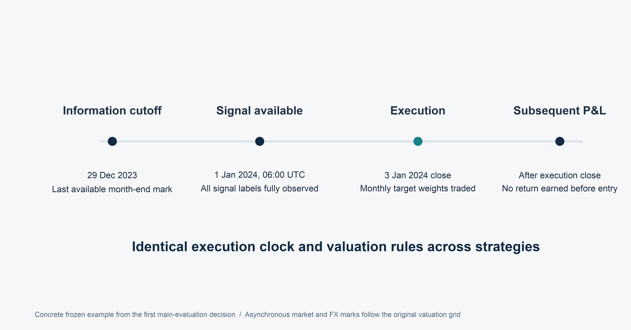
SECTION 03 ECONOMETRIC FRAMEWORK & MODEL DIAGNOSTICS
New positions earn returns only after execution
17
Notes:
Speaker 3. Core Slide.
Section question: Does the model work as intended, and what remains uncertain?
Core message: The signal and execution delay retain the frozen backtest convention.
Read-aloud script:
This timeline makes the information boundary explicit. The December signal uses information through 29 December. It is treated as available at 06:00 UTC on the next day. Execution occurs at the close basket on the second common fresh-quote trading day of January, which is 3 January in this example. Old holdings earn returns until that replacement close. New holdings earn only subsequent returns. This guards against crediting new positions with the execution day's move. However, US and Singapore closes are not simultaneous. The engine is a daily close-basket approximation, not an exact broker execution schedule.
Figure explanation: The signal and execution delay retain the frozen backtest convention.
Sources:
/Users/wangyujing/Desktop/MFE_Macro_Rotation_6Assets/presentation_assets/final_figures_v2/figures/main/DES02_Execution_Clock_full.svg
/Users/wangyujing/Desktop/MFE_Macro_Rotation_6Assets/reports/phase4_research_report.md
/Users/wangyujing/Desktop/MFE_Macro_Rotation_6Assets/reports/research_report.md
/Users/wangyujing/Desktop/MFE_Macro_Rotation_6Assets/data/processed/sgd_daily_returns.csv
/Users/wangyujing/Desktop/MFE_Macro_Rotation_6Assets/data/processed/sgd_total_return_indices.csv
/Users/wangyujing/Desktop/MFE_Macro_Rotation_6Assets/outputs/diagnostics/Dual_Momentum_contribution.csv
/Users/wangyujing/Desktop/MFE_Macro_Rotation_6Assets/outputs/diagnostics/Dual_Momentum_daily.csv
/Users/wangyujing/Desktop/MFE_Macro_Rotation_6Assets/outputs/diagnostics/Dual_Momentum_weights.csv
/Users/wangyujing/Desktop/MFE_Macro_Rotation_6Assets/outputs/diagnostics/EWMA_Risk_Parity_contribution.csv
/Users/wangyujing/Desktop/MFE_Macro_Rotation_6Assets/outputs/diagnostics/EWMA_Risk_Parity_daily.csv
/Users/wangyujing/Desktop/MFE_Macro_Rotation_6Assets/outputs/diagnostics/EWMA_Risk_Parity_weights.csv
/Users/wangyujing/Desktop/MFE_Macro_Rotation_6Assets/outputs/diagnostics/Equal_Weight_contribution.csv
/Users/wangyujing/Desktop/MFE_Macro_Rotation_6Assets/outputs/diagnostics/Equal_Weight_daily.csv
/Users/wangyujing/Desktop/MFE_Macro_Rotation_6Assets/outputs/diagnostics/Equal_Weight_weights.csv
/Users/wangyujing/Desktop/MFE_Macro_Rotation_6Assets/outputs/diagnostics/Gated_Equal_Weight_contribution.csv
/Users/wangyujing/Desktop/MFE_Macro_Rotation_6Assets/outputs/diagnostics/Gated_Equal_Weight_daily.csv
/Users/wangyujing/Desktop/MFE_Macro_Rotation_6Assets/outputs/diagnostics/Gated_Equal_Weight_weights.csv
/Users/wangyujing/Desktop/MFE_Macro_Rotation_6Assets/outputs/diagnostics/MGRP-Base_contribution.csv
/Users/wangyujing/Desktop/MFE_Macro_Rotation_6Assets/outputs/diagnostics/MGRP-Base_daily.csv
/Users/wangyujing/Desktop/MFE_Macro_Rotation_6Assets/outputs/diagnostics/MGRP-Base_weights.csv
/Users/wangyujing/Desktop/MFE_Macro_Rotation_6Assets/outputs/phase4/diagnostics/MWRP_contribution.csv
/Users/wangyujing/Desktop/MFE_Macro_Rotation_6Assets/outputs/phase4/diagnostics/MWRP_daily.csv
/Users/wangyujing/Desktop/MFE_Macro_Rotation_6Assets/outputs/phase4/diagnostics/MWRP_weights.csv
/Users/wangyujing/Desktop/MFE_Macro_Rotation_6Assets/outputs/phase4/diagnostics/assigned_predicted_realized_risk.csv
/Users/wangyujing/Desktop/MFE_Macro_Rotation_6Assets/outputs/phase4/diagnostics/forecast_vs_realized_exact_holding_windows.csv
/Users/wangyujing/Desktop/MFE_Macro_Rotation_6Assets/outputs/phase4/tables/table01_three_period_performance.csv
/Users/wangyujing/Desktop/MFE_Macro_Rotation_6Assets/outputs/phase4/tables/table02_annual_returns.csv
/Users/wangyujing/Desktop/MFE_Macro_Rotation_6Assets/outputs/phase4/tables/table06_transaction_cost_sensitivity.csv
/Users/wangyujing/Desktop/MFE_Macro_Rotation_6Assets/outputs/phase4/tables/table07_monthly_allocation_decisions.csv
/Users/wangyujing/Desktop/MFE_Macro_Rotation_6Assets/outputs/tables/annual_performance.csv
/Users/wangyujing/Desktop/MFE_Macro_Rotation_6Assets/outputs/tables/full_2020_Sep2026_performance.csv
/Users/wangyujing/Desktop/MFE_Macro_Rotation_6Assets/outputs/tables/performance_all_cost_scenarios.csv
/Users/wangyujing/Desktop/MFE_Macro_Rotation_6Assets/outputs/tables/performance_main.csv

Slide 18
SECTION 03 ECONOMETRIC FRAMEWORK & MODEL DIAGNOSTICS
Historical windows test different market environments
Window | Role | Scope
2014–2019 | Data preparation and initialization | Common asset history from Nov 2014
2020–2023 | Historical validation | 48 months, 1,031 portfolio returns
2024 Jan–2026 Sep | Historical evaluation | 33 months, 710 portfolio returns
2020 Jan–2026 Sep | Continuous combined history | 81 months, 1,741 portfolio returns
Exploratory historical research
Rules were developed after historical inspection. No untouched prospective claim.
18
Notes:
Speaker 3. Core Slide.
Section question: Does the model work as intended, and what remains uncertain?
Core message: The full span is continuous history, not a third independent sample.
Read-aloud script:
The common asset history begins in November 2014. The earlier data through 2019 prepare signals and initialize risk estimates. Historical validation covers January 2020 through December 2023, with forty-eight months and 1,031 portfolio return observations. Historical evaluation covers January 2024 through September 2026, with thirty-three months and 710 observations. The continuous combined span contains eighty-one months. Positions carry across period boundaries, with wealth rebased only for display. Because these strategies were developed after examining historical results, neither window should be called untouched prospective evidence. October performance is excluded from the main comparisons.
Figure explanation: Explain the definitions and comparison on this page.
Sources:
/Users/wangyujing/Desktop/MFE_Macro_Rotation_6Assets/reports/phase4_research_report.md
/Users/wangyujing/Desktop/MFE_Macro_Rotation_6Assets/reports/research_report.md

Slide 19
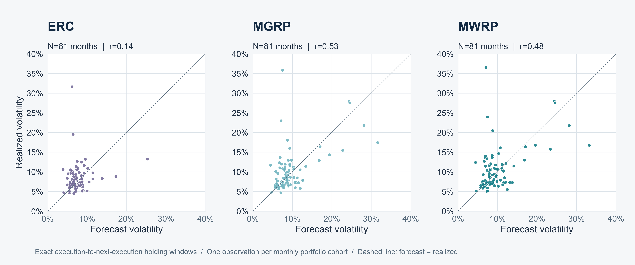
SECTION 03 ECONOMETRIC FRAMEWORK & MODEL DIAGNOSTICS
Covariance forecasts provide imperfect risk information
19
Notes:
Speaker 3. Core Slide.
Section question: Does the model work as intended, and what remains uncertain?
Core message: Forecast-realized correlations are 0.14 for ERC, 0.53 for MGRP and 0.48 for MWRP.
Read-aloud script:
Each point represents one complete execution-to-execution holding interval. Forecast volatility uses the covariance estimate available at entry. Realized volatility uses subsequent gross portfolio contributions over that exact interval. The correlations across eighty-one monthly cohorts are 0.14 for ERC, 0.53 for MGRP and 0.48 for MWRP. Points away from the diagonal show substantial calibration errors. Correlation alone does not establish accurate levels, and the portfolios are themselves selected using the model. We use this diagnostic to show that the covariance estimate contains imperfect information rather than to claim precise forecasting.
Figure explanation: Forecast-realized correlations are 0.14 for ERC, 0.53 for MGRP and 0.48 for MWRP.
Sources:
/Users/wangyujing/Desktop/MFE_Macro_Rotation_6Assets/presentation_assets/final_figures_v2/figures/appendix/APP03_Forecast_Scatter_full.svg
/Users/wangyujing/Desktop/MFE_Macro_Rotation_6Assets/reports/phase4_research_report.md
/Users/wangyujing/Desktop/MFE_Macro_Rotation_6Assets/reports/research_report.md
/Users/wangyujing/Desktop/MFE_Macro_Rotation_6Assets/data/processed/sgd_daily_returns.csv
/Users/wangyujing/Desktop/MFE_Macro_Rotation_6Assets/data/processed/sgd_total_return_indices.csv
/Users/wangyujing/Desktop/MFE_Macro_Rotation_6Assets/outputs/diagnostics/Dual_Momentum_contribution.csv
/Users/wangyujing/Desktop/MFE_Macro_Rotation_6Assets/outputs/diagnostics/Dual_Momentum_daily.csv
/Users/wangyujing/Desktop/MFE_Macro_Rotation_6Assets/outputs/diagnostics/Dual_Momentum_weights.csv
/Users/wangyujing/Desktop/MFE_Macro_Rotation_6Assets/outputs/diagnostics/EWMA_Risk_Parity_contribution.csv
/Users/wangyujing/Desktop/MFE_Macro_Rotation_6Assets/outputs/diagnostics/EWMA_Risk_Parity_daily.csv
/Users/wangyujing/Desktop/MFE_Macro_Rotation_6Assets/outputs/diagnostics/EWMA_Risk_Parity_weights.csv
/Users/wangyujing/Desktop/MFE_Macro_Rotation_6Assets/outputs/diagnostics/Equal_Weight_contribution.csv
/Users/wangyujing/Desktop/MFE_Macro_Rotation_6Assets/outputs/diagnostics/Equal_Weight_daily.csv
/Users/wangyujing/Desktop/MFE_Macro_Rotation_6Assets/outputs/diagnostics/Equal_Weight_weights.csv
/Users/wangyujing/Desktop/MFE_Macro_Rotation_6Assets/outputs/diagnostics/Gated_Equal_Weight_contribution.csv
/Users/wangyujing/Desktop/MFE_Macro_Rotation_6Assets/outputs/diagnostics/Gated_Equal_Weight_daily.csv
/Users/wangyujing/Desktop/MFE_Macro_Rotation_6Assets/outputs/diagnostics/Gated_Equal_Weight_weights.csv
/Users/wangyujing/Desktop/MFE_Macro_Rotation_6Assets/outputs/diagnostics/MGRP-Base_contribution.csv
/Users/wangyujing/Desktop/MFE_Macro_Rotation_6Assets/outputs/diagnostics/MGRP-Base_daily.csv
/Users/wangyujing/Desktop/MFE_Macro_Rotation_6Assets/outputs/diagnostics/MGRP-Base_weights.csv
/Users/wangyujing/Desktop/MFE_Macro_Rotation_6Assets/outputs/phase4/diagnostics/MWRP_contribution.csv
/Users/wangyujing/Desktop/MFE_Macro_Rotation_6Assets/outputs/phase4/diagnostics/MWRP_daily.csv
/Users/wangyujing/Desktop/MFE_Macro_Rotation_6Assets/outputs/phase4/diagnostics/MWRP_weights.csv
/Users/wangyujing/Desktop/MFE_Macro_Rotation_6Assets/outputs/phase4/diagnostics/assigned_predicted_realized_risk.csv
/Users/wangyujing/Desktop/MFE_Macro_Rotation_6Assets/outputs/phase4/diagnostics/forecast_vs_realized_exact_holding_windows.csv
/Users/wangyujing/Desktop/MFE_Macro_Rotation_6Assets/outputs/phase4/tables/table01_three_period_performance.csv
/Users/wangyujing/Desktop/MFE_Macro_Rotation_6Assets/outputs/phase4/tables/table02_annual_returns.csv
/Users/wangyujing/Desktop/MFE_Macro_Rotation_6Assets/outputs/phase4/tables/table06_transaction_cost_sensitivity.csv
/Users/wangyujing/Desktop/MFE_Macro_Rotation_6Assets/outputs/phase4/tables/table07_monthly_allocation_decisions.csv
/Users/wangyujing/Desktop/MFE_Macro_Rotation_6Assets/outputs/tables/annual_performance.csv
/Users/wangyujing/Desktop/MFE_Macro_Rotation_6Assets/outputs/tables/full_2020_Sep2026_performance.csv
/Users/wangyujing/Desktop/MFE_Macro_Rotation_6Assets/outputs/tables/performance_all_cost_scenarios.csv
/Users/wangyujing/Desktop/MFE_Macro_Rotation_6Assets/outputs/tables/performance_main.csv

Slide 20
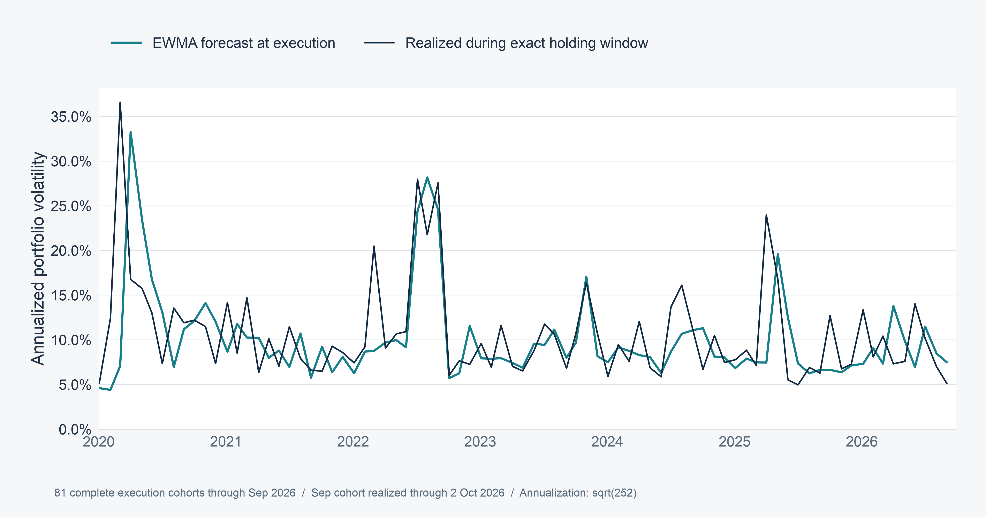
SECTION 03 ECONOMETRIC FRAMEWORK & MODEL DIAGNOSTICS
Forecast risk does not track every future risk change
20
Notes:
Speaker 3. Optional Detail.
Section question: Does the model work as intended, and what remains uncertain?
Core message: The time series reveals deviations that a single calibration coefficient hides.
Read-aloud script:
The time series compares MWRP's entry forecast with realized volatility over the following holding interval. This view shows when the forecast and realization diverge, rather than reducing the relationship to one correlation. A short-memory covariance model can react to recent conditions but still miss later shocks and changing relationships. For the final September 2026 cohort, realization runs through the next execution on 2 October. Those October observations are used only to complete this diagnostic. They are not added to performance ending in September. The incomplete October entry cohort is excluded.
Figure explanation: The time series reveals deviations that a single calibration coefficient hides.
Sources:
/Users/wangyujing/Desktop/MFE_Macro_Rotation_6Assets/presentation_assets/final_figures_v2/figures/appendix/APP03_MWRP_Forecast_Time_Series_full.svg
/Users/wangyujing/Desktop/MFE_Macro_Rotation_6Assets/reports/phase4_research_report.md
/Users/wangyujing/Desktop/MFE_Macro_Rotation_6Assets/reports/research_report.md
/Users/wangyujing/Desktop/MFE_Macro_Rotation_6Assets/data/processed/sgd_daily_returns.csv
/Users/wangyujing/Desktop/MFE_Macro_Rotation_6Assets/data/processed/sgd_total_return_indices.csv
/Users/wangyujing/Desktop/MFE_Macro_Rotation_6Assets/outputs/diagnostics/Dual_Momentum_contribution.csv
/Users/wangyujing/Desktop/MFE_Macro_Rotation_6Assets/outputs/diagnostics/Dual_Momentum_daily.csv
/Users/wangyujing/Desktop/MFE_Macro_Rotation_6Assets/outputs/diagnostics/Dual_Momentum_weights.csv
/Users/wangyujing/Desktop/MFE_Macro_Rotation_6Assets/outputs/diagnostics/EWMA_Risk_Parity_contribution.csv
/Users/wangyujing/Desktop/MFE_Macro_Rotation_6Assets/outputs/diagnostics/EWMA_Risk_Parity_daily.csv
/Users/wangyujing/Desktop/MFE_Macro_Rotation_6Assets/outputs/diagnostics/EWMA_Risk_Parity_weights.csv
/Users/wangyujing/Desktop/MFE_Macro_Rotation_6Assets/outputs/diagnostics/Equal_Weight_contribution.csv
/Users/wangyujing/Desktop/MFE_Macro_Rotation_6Assets/outputs/diagnostics/Equal_Weight_daily.csv
/Users/wangyujing/Desktop/MFE_Macro_Rotation_6Assets/outputs/diagnostics/Equal_Weight_weights.csv
/Users/wangyujing/Desktop/MFE_Macro_Rotation_6Assets/outputs/diagnostics/Gated_Equal_Weight_contribution.csv
/Users/wangyujing/Desktop/MFE_Macro_Rotation_6Assets/outputs/diagnostics/Gated_Equal_Weight_daily.csv
/Users/wangyujing/Desktop/MFE_Macro_Rotation_6Assets/outputs/diagnostics/Gated_Equal_Weight_weights.csv
/Users/wangyujing/Desktop/MFE_Macro_Rotation_6Assets/outputs/diagnostics/MGRP-Base_contribution.csv
/Users/wangyujing/Desktop/MFE_Macro_Rotation_6Assets/outputs/diagnostics/MGRP-Base_daily.csv
/Users/wangyujing/Desktop/MFE_Macro_Rotation_6Assets/outputs/diagnostics/MGRP-Base_weights.csv
/Users/wangyujing/Desktop/MFE_Macro_Rotation_6Assets/outputs/phase4/diagnostics/MWRP_contribution.csv
/Users/wangyujing/Desktop/MFE_Macro_Rotation_6Assets/outputs/phase4/diagnostics/MWRP_daily.csv
/Users/wangyujing/Desktop/MFE_Macro_Rotation_6Assets/outputs/phase4/diagnostics/MWRP_weights.csv
/Users/wangyujing/Desktop/MFE_Macro_Rotation_6Assets/outputs/phase4/diagnostics/assigned_predicted_realized_risk.csv
/Users/wangyujing/Desktop/MFE_Macro_Rotation_6Assets/outputs/phase4/diagnostics/forecast_vs_realized_exact_holding_windows.csv
/Users/wangyujing/Desktop/MFE_Macro_Rotation_6Assets/outputs/phase4/tables/table01_three_period_performance.csv
/Users/wangyujing/Desktop/MFE_Macro_Rotation_6Assets/outputs/phase4/tables/table02_annual_returns.csv
/Users/wangyujing/Desktop/MFE_Macro_Rotation_6Assets/outputs/phase4/tables/table06_transaction_cost_sensitivity.csv
/Users/wangyujing/Desktop/MFE_Macro_Rotation_6Assets/outputs/phase4/tables/table07_monthly_allocation_decisions.csv
/Users/wangyujing/Desktop/MFE_Macro_Rotation_6Assets/outputs/tables/annual_performance.csv
/Users/wangyujing/Desktop/MFE_Macro_Rotation_6Assets/outputs/tables/full_2020_Sep2026_performance.csv
/Users/wangyujing/Desktop/MFE_Macro_Rotation_6Assets/outputs/tables/performance_all_cost_scenarios.csv
/Users/wangyujing/Desktop/MFE_Macro_Rotation_6Assets/outputs/tables/performance_main.csv

Slide 21
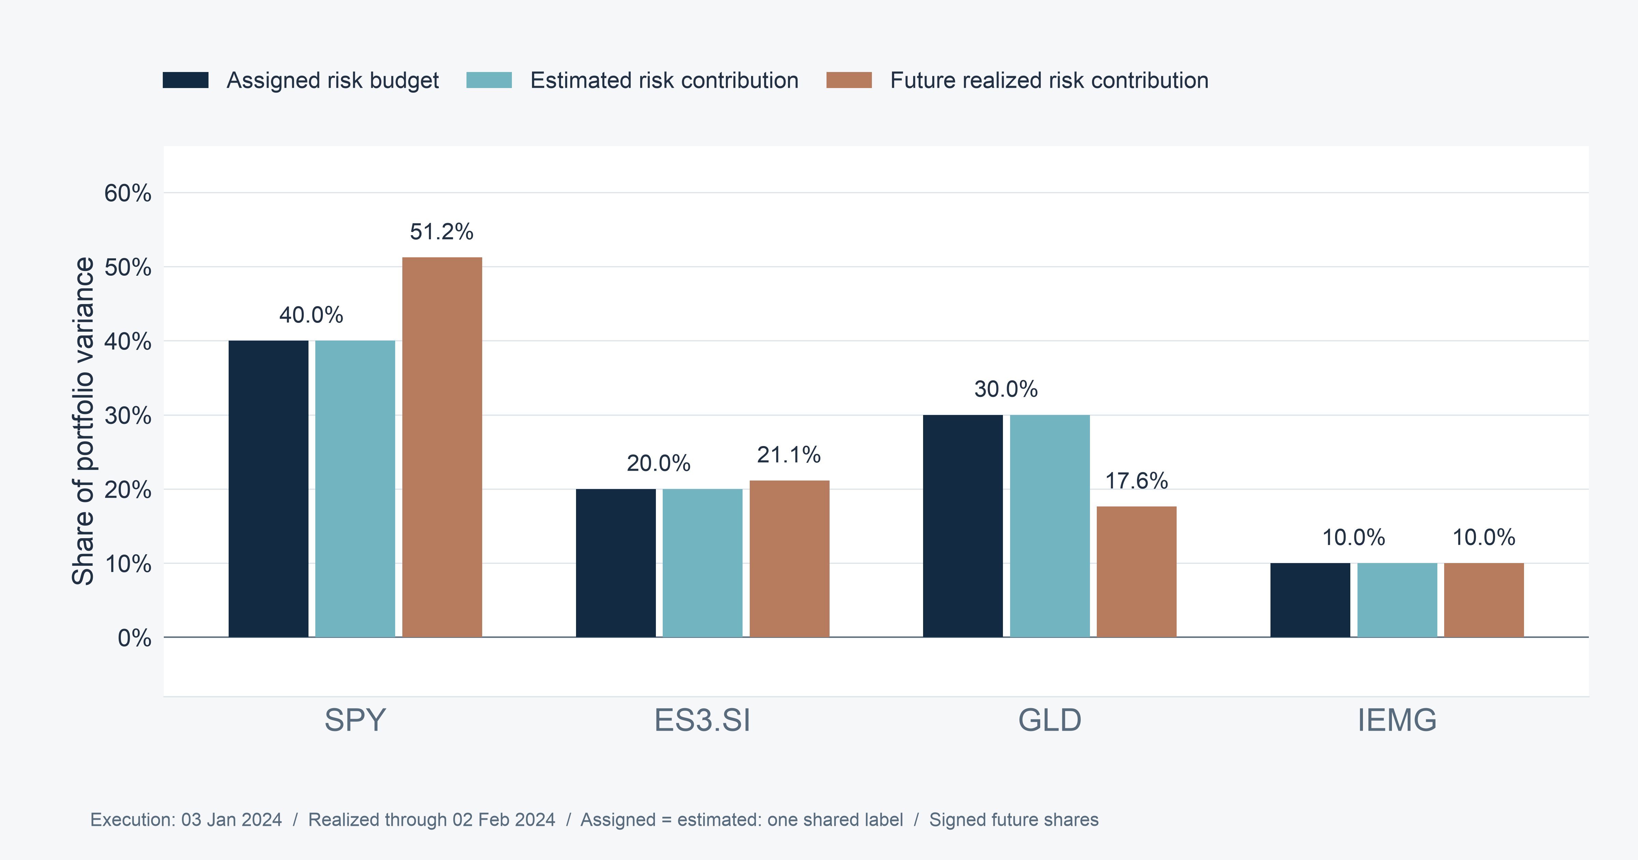
SECTION 03 ECONOMETRIC FRAMEWORK & MODEL DIAGNOSTICS
Estimated risk shares match assigned budgets
21
Notes:
Speaker 3. Core Slide.
Section question: Does the model work as intended, and what remains uncertain?
Core message: Numerical implementation is accurate. Future risk shares can still differ.
Read-aloud script:
The three bars for each asset distinguish assigned risk budget, estimated risk contribution and future realized risk contribution. The first two agree to numerical precision. Across all months, the maximum assigned-versus-estimated share error is about 3.72 times ten to the minus thirteen. That verifies the optimizer implements the intended ex ante problem. Future realized shares, however, can differ materially because returns and co-movements change after execution, and capital weights drift. Correct optimization and accurate forecasting are separate claims. The data support the first much more strongly than the second.
Figure explanation: Numerical implementation is accurate. Future risk shares can still differ.
Sources:
/Users/wangyujing/Desktop/MFE_Macro_Rotation_6Assets/presentation_assets/final_figures_v2/figures/appendix/APP04_First_Eligible_full.svg
/Users/wangyujing/Desktop/MFE_Macro_Rotation_6Assets/reports/phase4_research_report.md
/Users/wangyujing/Desktop/MFE_Macro_Rotation_6Assets/reports/research_report.md
/Users/wangyujing/Desktop/MFE_Macro_Rotation_6Assets/data/processed/sgd_daily_returns.csv
/Users/wangyujing/Desktop/MFE_Macro_Rotation_6Assets/data/processed/sgd_total_return_indices.csv
/Users/wangyujing/Desktop/MFE_Macro_Rotation_6Assets/outputs/diagnostics/Dual_Momentum_contribution.csv
/Users/wangyujing/Desktop/MFE_Macro_Rotation_6Assets/outputs/diagnostics/Dual_Momentum_daily.csv
/Users/wangyujing/Desktop/MFE_Macro_Rotation_6Assets/outputs/diagnostics/Dual_Momentum_weights.csv
/Users/wangyujing/Desktop/MFE_Macro_Rotation_6Assets/outputs/diagnostics/EWMA_Risk_Parity_contribution.csv
/Users/wangyujing/Desktop/MFE_Macro_Rotation_6Assets/outputs/diagnostics/EWMA_Risk_Parity_daily.csv
/Users/wangyujing/Desktop/MFE_Macro_Rotation_6Assets/outputs/diagnostics/EWMA_Risk_Parity_weights.csv
/Users/wangyujing/Desktop/MFE_Macro_Rotation_6Assets/outputs/diagnostics/Equal_Weight_contribution.csv
/Users/wangyujing/Desktop/MFE_Macro_Rotation_6Assets/outputs/diagnostics/Equal_Weight_daily.csv
/Users/wangyujing/Desktop/MFE_Macro_Rotation_6Assets/outputs/diagnostics/Equal_Weight_weights.csv
/Users/wangyujing/Desktop/MFE_Macro_Rotation_6Assets/outputs/diagnostics/Gated_Equal_Weight_contribution.csv
/Users/wangyujing/Desktop/MFE_Macro_Rotation_6Assets/outputs/diagnostics/Gated_Equal_Weight_daily.csv
/Users/wangyujing/Desktop/MFE_Macro_Rotation_6Assets/outputs/diagnostics/Gated_Equal_Weight_weights.csv
/Users/wangyujing/Desktop/MFE_Macro_Rotation_6Assets/outputs/diagnostics/MGRP-Base_contribution.csv
/Users/wangyujing/Desktop/MFE_Macro_Rotation_6Assets/outputs/diagnostics/MGRP-Base_daily.csv
/Users/wangyujing/Desktop/MFE_Macro_Rotation_6Assets/outputs/diagnostics/MGRP-Base_weights.csv
/Users/wangyujing/Desktop/MFE_Macro_Rotation_6Assets/outputs/phase4/diagnostics/MWRP_contribution.csv
/Users/wangyujing/Desktop/MFE_Macro_Rotation_6Assets/outputs/phase4/diagnostics/MWRP_daily.csv
/Users/wangyujing/Desktop/MFE_Macro_Rotation_6Assets/outputs/phase4/diagnostics/MWRP_weights.csv
/Users/wangyujing/Desktop/MFE_Macro_Rotation_6Assets/outputs/phase4/diagnostics/assigned_predicted_realized_risk.csv
/Users/wangyujing/Desktop/MFE_Macro_Rotation_6Assets/outputs/phase4/diagnostics/forecast_vs_realized_exact_holding_windows.csv
/Users/wangyujing/Desktop/MFE_Macro_Rotation_6Assets/outputs/phase4/tables/table01_three_period_performance.csv
/Users/wangyujing/Desktop/MFE_Macro_Rotation_6Assets/outputs/phase4/tables/table02_annual_returns.csv
/Users/wangyujing/Desktop/MFE_Macro_Rotation_6Assets/outputs/phase4/tables/table06_transaction_cost_sensitivity.csv
/Users/wangyujing/Desktop/MFE_Macro_Rotation_6Assets/outputs/phase4/tables/table07_monthly_allocation_decisions.csv
/Users/wangyujing/Desktop/MFE_Macro_Rotation_6Assets/outputs/tables/annual_performance.csv
/Users/wangyujing/Desktop/MFE_Macro_Rotation_6Assets/outputs/tables/full_2020_Sep2026_performance.csv
/Users/wangyujing/Desktop/MFE_Macro_Rotation_6Assets/outputs/tables/performance_all_cost_scenarios.csv
/Users/wangyujing/Desktop/MFE_Macro_Rotation_6Assets/outputs/tables/performance_main.csv

Slide 22
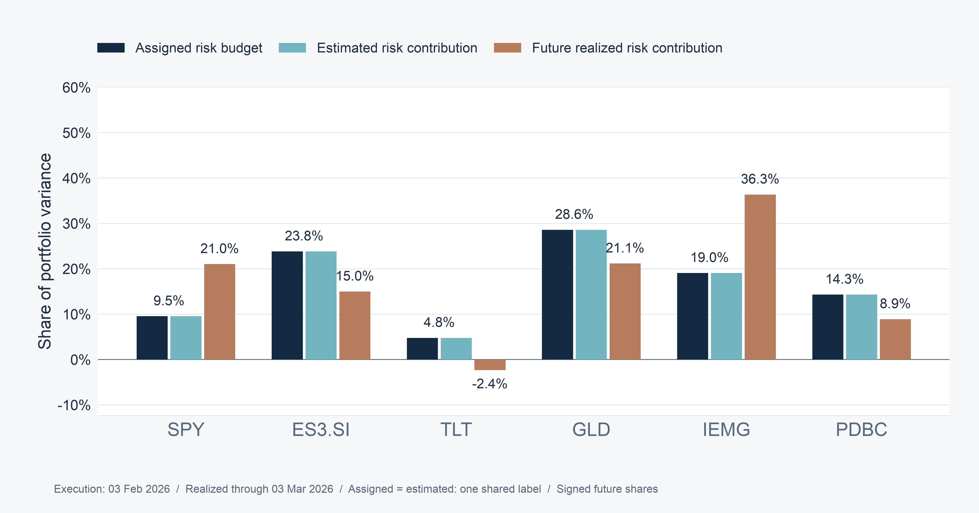
SECTION 03 ECONOMETRIC FRAMEWORK & MODEL DIAGNOSTICS
Realized risk contributions can be negative
22
Notes:
Speaker 3. Optional Detail.
Section question: Does the model work as intended, and what remains uncertain?
Core message: A negative covariance contribution can offset portfolio fluctuations.
Read-aloud script:
This example is selected by an objective rule: the first main-evaluation holding interval with a negative realized contribution. It runs from 3 February to 3 March 2026. TLT's realized share is about minus 2.4 percent. A negative share is possible because we define the contribution through covariance of each asset's gross return contribution with the total portfolio return. It can therefore offset other fluctuations. Signed shares sum to one, but individual values need not lie between zero and one. We retain that sign rather than clip it to make the budget appear to work better.
Figure explanation: A negative covariance contribution can offset portfolio fluctuations.
Sources:
/Users/wangyujing/Desktop/MFE_Macro_Rotation_6Assets/presentation_assets/final_figures_v2/figures/appendix/APP04_First_Negative_Realized_full.svg
/Users/wangyujing/Desktop/MFE_Macro_Rotation_6Assets/reports/phase4_research_report.md
/Users/wangyujing/Desktop/MFE_Macro_Rotation_6Assets/reports/research_report.md
/Users/wangyujing/Desktop/MFE_Macro_Rotation_6Assets/data/processed/sgd_daily_returns.csv
/Users/wangyujing/Desktop/MFE_Macro_Rotation_6Assets/data/processed/sgd_total_return_indices.csv
/Users/wangyujing/Desktop/MFE_Macro_Rotation_6Assets/outputs/diagnostics/Dual_Momentum_contribution.csv
/Users/wangyujing/Desktop/MFE_Macro_Rotation_6Assets/outputs/diagnostics/Dual_Momentum_daily.csv
/Users/wangyujing/Desktop/MFE_Macro_Rotation_6Assets/outputs/diagnostics/Dual_Momentum_weights.csv
/Users/wangyujing/Desktop/MFE_Macro_Rotation_6Assets/outputs/diagnostics/EWMA_Risk_Parity_contribution.csv
/Users/wangyujing/Desktop/MFE_Macro_Rotation_6Assets/outputs/diagnostics/EWMA_Risk_Parity_daily.csv
/Users/wangyujing/Desktop/MFE_Macro_Rotation_6Assets/outputs/diagnostics/EWMA_Risk_Parity_weights.csv
/Users/wangyujing/Desktop/MFE_Macro_Rotation_6Assets/outputs/diagnostics/Equal_Weight_contribution.csv
/Users/wangyujing/Desktop/MFE_Macro_Rotation_6Assets/outputs/diagnostics/Equal_Weight_daily.csv
/Users/wangyujing/Desktop/MFE_Macro_Rotation_6Assets/outputs/diagnostics/Equal_Weight_weights.csv
/Users/wangyujing/Desktop/MFE_Macro_Rotation_6Assets/outputs/diagnostics/Gated_Equal_Weight_contribution.csv
/Users/wangyujing/Desktop/MFE_Macro_Rotation_6Assets/outputs/diagnostics/Gated_Equal_Weight_daily.csv
/Users/wangyujing/Desktop/MFE_Macro_Rotation_6Assets/outputs/diagnostics/Gated_Equal_Weight_weights.csv
/Users/wangyujing/Desktop/MFE_Macro_Rotation_6Assets/outputs/diagnostics/MGRP-Base_contribution.csv
/Users/wangyujing/Desktop/MFE_Macro_Rotation_6Assets/outputs/diagnostics/MGRP-Base_daily.csv
/Users/wangyujing/Desktop/MFE_Macro_Rotation_6Assets/outputs/diagnostics/MGRP-Base_weights.csv
/Users/wangyujing/Desktop/MFE_Macro_Rotation_6Assets/outputs/phase4/diagnostics/MWRP_contribution.csv
/Users/wangyujing/Desktop/MFE_Macro_Rotation_6Assets/outputs/phase4/diagnostics/MWRP_daily.csv
/Users/wangyujing/Desktop/MFE_Macro_Rotation_6Assets/outputs/phase4/diagnostics/MWRP_weights.csv
/Users/wangyujing/Desktop/MFE_Macro_Rotation_6Assets/outputs/phase4/diagnostics/assigned_predicted_realized_risk.csv
/Users/wangyujing/Desktop/MFE_Macro_Rotation_6Assets/outputs/phase4/diagnostics/forecast_vs_realized_exact_holding_windows.csv
/Users/wangyujing/Desktop/MFE_Macro_Rotation_6Assets/outputs/phase4/tables/table01_three_period_performance.csv
/Users/wangyujing/Desktop/MFE_Macro_Rotation_6Assets/outputs/phase4/tables/table02_annual_returns.csv
/Users/wangyujing/Desktop/MFE_Macro_Rotation_6Assets/outputs/phase4/tables/table06_transaction_cost_sensitivity.csv
/Users/wangyujing/Desktop/MFE_Macro_Rotation_6Assets/outputs/phase4/tables/table07_monthly_allocation_decisions.csv
/Users/wangyujing/Desktop/MFE_Macro_Rotation_6Assets/outputs/tables/annual_performance.csv
/Users/wangyujing/Desktop/MFE_Macro_Rotation_6Assets/outputs/tables/full_2020_Sep2026_performance.csv
/Users/wangyujing/Desktop/MFE_Macro_Rotation_6Assets/outputs/tables/performance_all_cost_scenarios.csv
/Users/wangyujing/Desktop/MFE_Macro_Rotation_6Assets/outputs/tables/performance_main.csv

Slide 23
04
Performance Beyond Returns
Compare wealth, risk, trading and capital diversification
23
Notes:
Speaker 4. Quick Slide.
Section question: What does MWRP deliver relative to credible benchmarks?
Core message: Compare wealth, risk, trading and capital diversification
Read-aloud script:
This section asks: What does MWRP deliver relative to credible benchmarks? Compare wealth, risk, trading and capital diversification.
Figure explanation: Explain the definitions and comparison on this page.
Sources:
/Users/wangyujing/Desktop/MFE_Macro_Rotation_6Assets/reports/phase4_research_report.md
/Users/wangyujing/Desktop/MFE_Macro_Rotation_6Assets/reports/research_report.md

Slide 24
SECTION 04 PORTFOLIO PERFORMANCE
MWRP has competitive recent performance
23.39%
2.063
−9.15%
Net compound annual growth rate
Sharpe ratio, reference rate = 0
Maximum drawdown (MDD)
Dual Momentum has the higher net CAGR: 26.64%
MWRP has the highest recent Sharpe among the five core strategies.
2024 Jan–2026 Sep. Net of 10 basis points (bps) per traded side. 1 bp = 0.01 percentage point.
24
Notes:
Speaker 4. Core Slide.
Section question: What does MWRP deliver relative to credible benchmarks?
Core message: Recent Sharpe is strong, while Dual still earns the higher CAGR.
Read-aloud script:
For January 2024 through September 2026, MWRP earns a net compound annual growth rate, or CAGR, of 23.39 percent. Its Sharpe ratio is 2.063, calculated from daily net returns with a zero reference rate, and maximum drawdown is minus 9.15 percent. These are historical results after ten basis points per traded side, where one basis point is one hundredth of a percentage point. MWRP has the highest Sharpe among our five core strategies in this window. It does not have the highest CAGR: Dual earns 26.64 percent. We evaluate that trade-off across several portfolio dimensions.
Figure explanation: Explain the definitions and comparison on this page.
Sources:
/Users/wangyujing/Desktop/MFE_Macro_Rotation_6Assets/reports/phase4_research_report.md
/Users/wangyujing/Desktop/MFE_Macro_Rotation_6Assets/reports/research_report.md

Slide 25
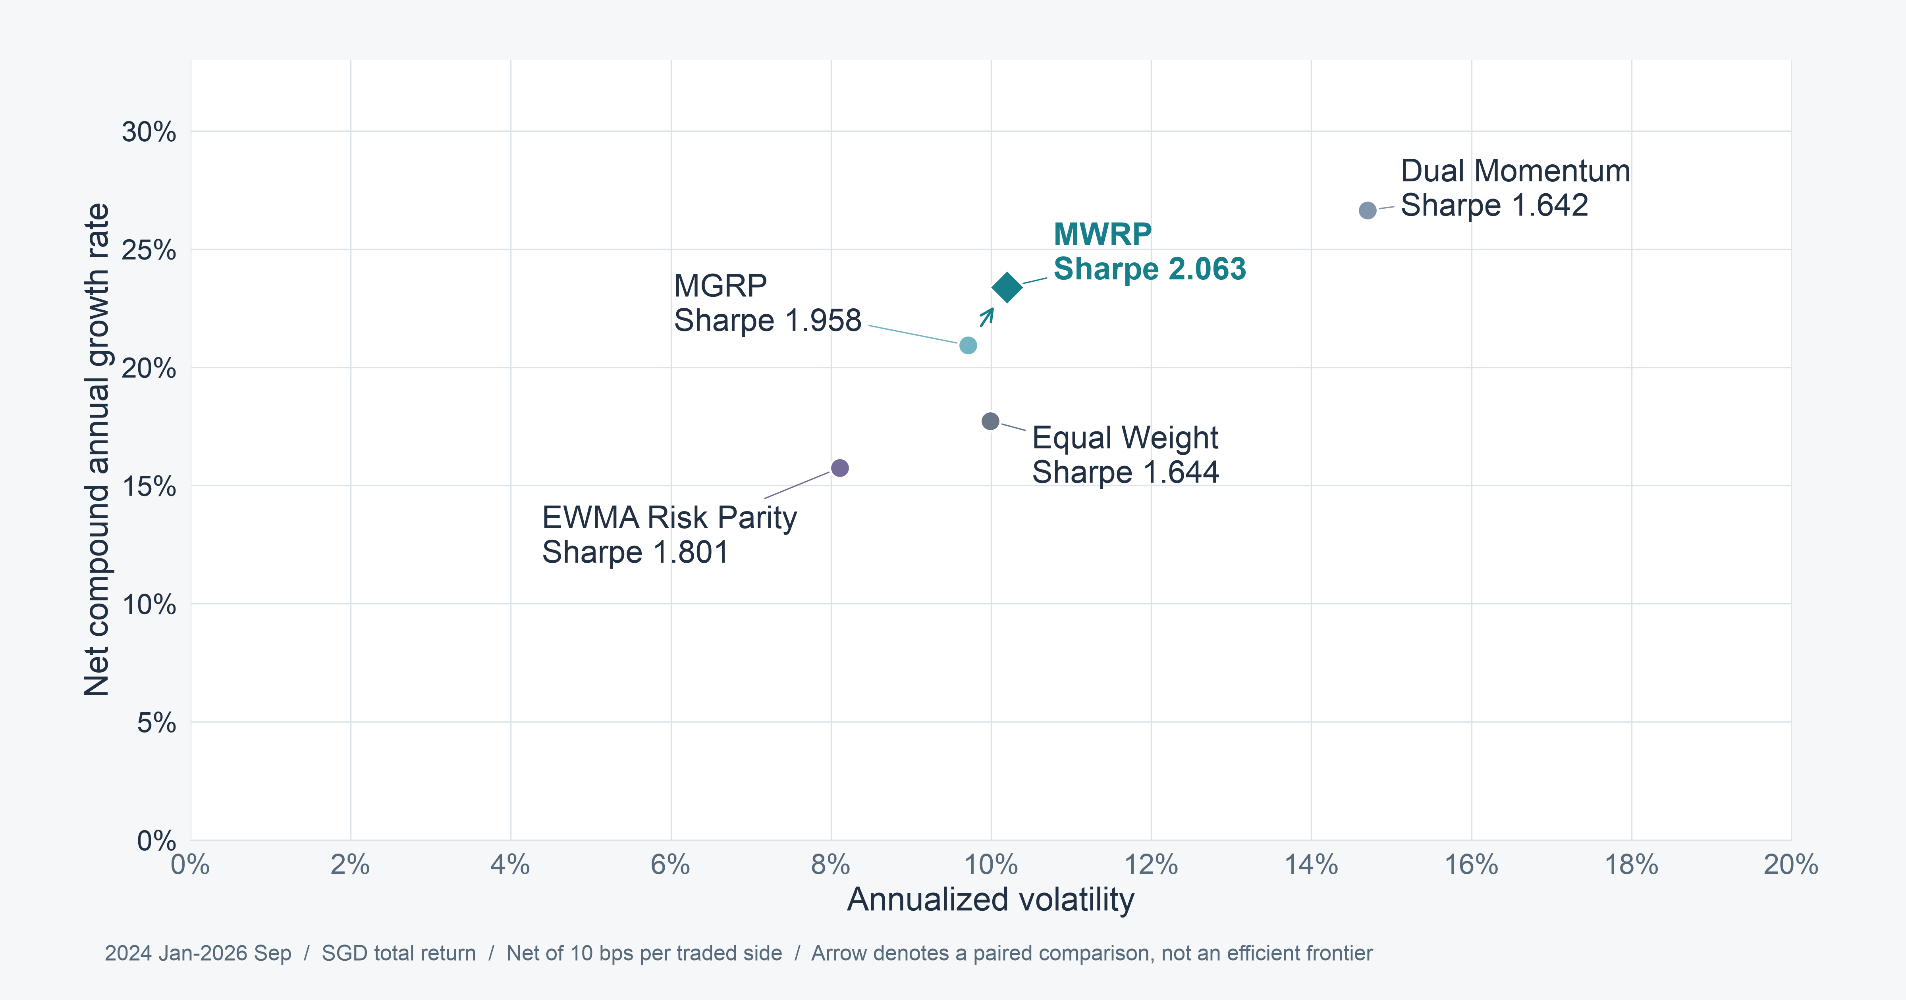
SECTION 04 PORTFOLIO PERFORMANCE
Recent risk-adjusted performance improves with MWRP
25
Notes:
Speaker 4. Core Slide.
Section question: What does MWRP deliver relative to credible benchmarks?
Core message: Dual has higher CAGR. ERC has lower volatility. MWRP offers a competitive recent balance.
Read-aloud script:
The horizontal axis is annualized volatility, and the vertical axis is net CAGR. These are different measurements, so the plot is not a direct Sharpe frontier. Dual is farthest up, with the highest return, but also carries more volatility. ERC has the lowest volatility. MWRP improves on MGRP's return with a modest increase in volatility and has the highest recent daily-return Sharpe. The arrow between MGRP and MWRP illustrates that paired comparison. It is not an estimated efficient frontier. No single strategy is best on every dimension.
Figure explanation: Dual has higher CAGR. ERC has lower volatility. MWRP offers a competitive recent balance.
Sources:
/Users/wangyujing/Desktop/MFE_Macro_Rotation_6Assets/presentation_assets/final_figures_v2/figures/main/FIG04_Risk_Return_evaluation_full.svg
/Users/wangyujing/Desktop/MFE_Macro_Rotation_6Assets/reports/phase4_research_report.md
/Users/wangyujing/Desktop/MFE_Macro_Rotation_6Assets/reports/research_report.md
/Users/wangyujing/Desktop/MFE_Macro_Rotation_6Assets/outputs/phase4/tables/table01_three_period_performance.csv
/Users/wangyujing/Desktop/MFE_Macro_Rotation_6Assets/outputs/tables/performance_main.csv
/Users/wangyujing/Desktop/MFE_Macro_Rotation_6Assets/outputs/tables/full_2020_Sep2026_performance.csv

Slide 26
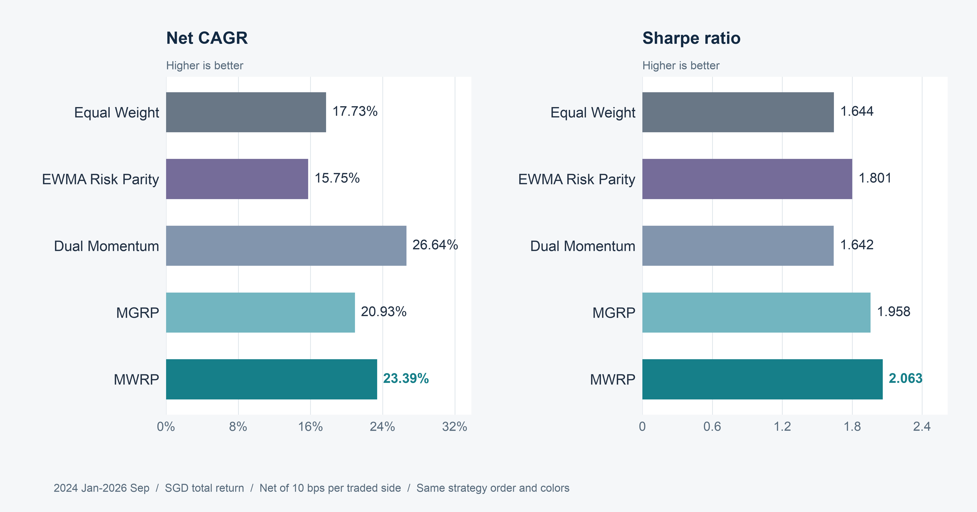
SECTION 04 PORTFOLIO PERFORMANCE
MWRP leads recent Sharpe, Dual leads recent CAGR
26
Notes:
Speaker 4. Core Slide.
Section question: What does MWRP deliver relative to credible benchmarks?
Core message: All five core strategies remain visible in fixed order.
Read-aloud script:
The left panel compares net CAGR and the right panel compares Sharpe using the same strategy order. Equal Weight earns 17.73 percent CAGR. ERC earns 15.75 percent, Dual 26.64 percent, MGRP 20.93 percent and MWRP 23.39 percent. Sharpe rises from 1.958 for MGRP to 2.063 for MWRP, compared with 1.642 for Dual. These are annualized historical metrics for the same thirty-three months. Sharpe uses arithmetic daily returns divided by their sample standard deviation. It is not calculated by dividing CAGR by volatility.
Figure explanation: All five core strategies remain visible in fixed order.
Sources:
/Users/wangyujing/Desktop/MFE_Macro_Rotation_6Assets/presentation_assets/final_figures_v2/figures/main/FIG05_A_Return_Sharpe_full.svg
/Users/wangyujing/Desktop/MFE_Macro_Rotation_6Assets/reports/phase4_research_report.md
/Users/wangyujing/Desktop/MFE_Macro_Rotation_6Assets/reports/research_report.md
/Users/wangyujing/Desktop/MFE_Macro_Rotation_6Assets/data/processed/sgd_daily_returns.csv
/Users/wangyujing/Desktop/MFE_Macro_Rotation_6Assets/data/processed/sgd_total_return_indices.csv
/Users/wangyujing/Desktop/MFE_Macro_Rotation_6Assets/outputs/diagnostics/Dual_Momentum_contribution.csv
/Users/wangyujing/Desktop/MFE_Macro_Rotation_6Assets/outputs/diagnostics/Dual_Momentum_daily.csv
/Users/wangyujing/Desktop/MFE_Macro_Rotation_6Assets/outputs/diagnostics/Dual_Momentum_weights.csv
/Users/wangyujing/Desktop/MFE_Macro_Rotation_6Assets/outputs/diagnostics/EWMA_Risk_Parity_contribution.csv
/Users/wangyujing/Desktop/MFE_Macro_Rotation_6Assets/outputs/diagnostics/EWMA_Risk_Parity_daily.csv
/Users/wangyujing/Desktop/MFE_Macro_Rotation_6Assets/outputs/diagnostics/EWMA_Risk_Parity_weights.csv
/Users/wangyujing/Desktop/MFE_Macro_Rotation_6Assets/outputs/diagnostics/Equal_Weight_contribution.csv
/Users/wangyujing/Desktop/MFE_Macro_Rotation_6Assets/outputs/diagnostics/Equal_Weight_daily.csv
/Users/wangyujing/Desktop/MFE_Macro_Rotation_6Assets/outputs/diagnostics/Equal_Weight_weights.csv
/Users/wangyujing/Desktop/MFE_Macro_Rotation_6Assets/outputs/diagnostics/Gated_Equal_Weight_contribution.csv
/Users/wangyujing/Desktop/MFE_Macro_Rotation_6Assets/outputs/diagnostics/Gated_Equal_Weight_daily.csv
/Users/wangyujing/Desktop/MFE_Macro_Rotation_6Assets/outputs/diagnostics/Gated_Equal_Weight_weights.csv
/Users/wangyujing/Desktop/MFE_Macro_Rotation_6Assets/outputs/diagnostics/MGRP-Base_contribution.csv
/Users/wangyujing/Desktop/MFE_Macro_Rotation_6Assets/outputs/diagnostics/MGRP-Base_daily.csv
/Users/wangyujing/Desktop/MFE_Macro_Rotation_6Assets/outputs/diagnostics/MGRP-Base_weights.csv
/Users/wangyujing/Desktop/MFE_Macro_Rotation_6Assets/outputs/phase4/diagnostics/MWRP_contribution.csv
/Users/wangyujing/Desktop/MFE_Macro_Rotation_6Assets/outputs/phase4/diagnostics/MWRP_daily.csv
/Users/wangyujing/Desktop/MFE_Macro_Rotation_6Assets/outputs/phase4/diagnostics/MWRP_weights.csv
/Users/wangyujing/Desktop/MFE_Macro_Rotation_6Assets/outputs/phase4/diagnostics/assigned_predicted_realized_risk.csv
/Users/wangyujing/Desktop/MFE_Macro_Rotation_6Assets/outputs/phase4/diagnostics/forecast_vs_realized_exact_holding_windows.csv
/Users/wangyujing/Desktop/MFE_Macro_Rotation_6Assets/outputs/phase4/tables/table01_three_period_performance.csv
/Users/wangyujing/Desktop/MFE_Macro_Rotation_6Assets/outputs/phase4/tables/table02_annual_returns.csv
/Users/wangyujing/Desktop/MFE_Macro_Rotation_6Assets/outputs/phase4/tables/table06_transaction_cost_sensitivity.csv
/Users/wangyujing/Desktop/MFE_Macro_Rotation_6Assets/outputs/phase4/tables/table07_monthly_allocation_decisions.csv
/Users/wangyujing/Desktop/MFE_Macro_Rotation_6Assets/outputs/tables/annual_performance.csv
/Users/wangyujing/Desktop/MFE_Macro_Rotation_6Assets/outputs/tables/full_2020_Sep2026_performance.csv
/Users/wangyujing/Desktop/MFE_Macro_Rotation_6Assets/outputs/tables/performance_all_cost_scenarios.csv
/Users/wangyujing/Desktop/MFE_Macro_Rotation_6Assets/outputs/tables/performance_main.csv

Slide 27
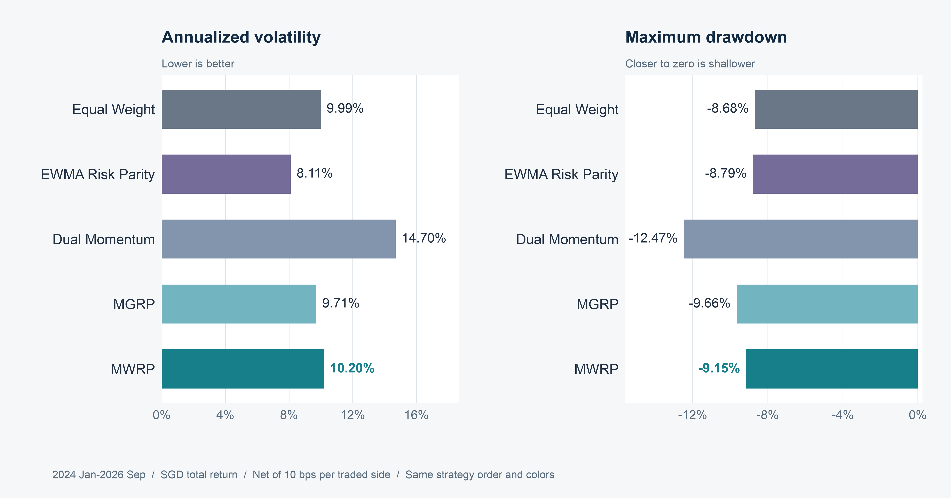
SECTION 04 PORTFOLIO PERFORMANCE
MWRP takes less risk than Dual, but more than MGRP
27
Notes:
Speaker 4. Core Slide.
Section question: What does MWRP deliver relative to credible benchmarks?
Core message: MWRP volatility is 10.20% and maximum drawdown is -9.15%.
Read-aloud script:
MWRP's annualized volatility is 10.20 percent, below Dual's 14.70 percent but above MGRP's 9.71 percent. Its maximum drawdown is minus 9.15 percent, shallower than Dual's minus 12.47 percent and MGRP's minus 9.66 percent. Equal Weight and ERC have shallower recent maximum drawdowns than MWRP, so it would be incorrect to describe MWRP as the safest strategy. Drawdown is a path outcome, not a constraint guaranteed by the risk-budget optimizer. A lower forecast risk concentration does not mechanically imply a smaller realized maximum drawdown.
Figure explanation: MWRP volatility is 10.20% and maximum drawdown is -9.15%.
Sources:
/Users/wangyujing/Desktop/MFE_Macro_Rotation_6Assets/presentation_assets/final_figures_v2/figures/main/FIG05_B_Volatility_Drawdown_full.svg
/Users/wangyujing/Desktop/MFE_Macro_Rotation_6Assets/reports/phase4_research_report.md
/Users/wangyujing/Desktop/MFE_Macro_Rotation_6Assets/reports/research_report.md
/Users/wangyujing/Desktop/MFE_Macro_Rotation_6Assets/data/processed/sgd_daily_returns.csv
/Users/wangyujing/Desktop/MFE_Macro_Rotation_6Assets/data/processed/sgd_total_return_indices.csv
/Users/wangyujing/Desktop/MFE_Macro_Rotation_6Assets/outputs/diagnostics/Dual_Momentum_contribution.csv
/Users/wangyujing/Desktop/MFE_Macro_Rotation_6Assets/outputs/diagnostics/Dual_Momentum_daily.csv
/Users/wangyujing/Desktop/MFE_Macro_Rotation_6Assets/outputs/diagnostics/Dual_Momentum_weights.csv
/Users/wangyujing/Desktop/MFE_Macro_Rotation_6Assets/outputs/diagnostics/EWMA_Risk_Parity_contribution.csv
/Users/wangyujing/Desktop/MFE_Macro_Rotation_6Assets/outputs/diagnostics/EWMA_Risk_Parity_daily.csv
/Users/wangyujing/Desktop/MFE_Macro_Rotation_6Assets/outputs/diagnostics/EWMA_Risk_Parity_weights.csv
/Users/wangyujing/Desktop/MFE_Macro_Rotation_6Assets/outputs/diagnostics/Equal_Weight_contribution.csv
/Users/wangyujing/Desktop/MFE_Macro_Rotation_6Assets/outputs/diagnostics/Equal_Weight_daily.csv
/Users/wangyujing/Desktop/MFE_Macro_Rotation_6Assets/outputs/diagnostics/Equal_Weight_weights.csv
/Users/wangyujing/Desktop/MFE_Macro_Rotation_6Assets/outputs/diagnostics/Gated_Equal_Weight_contribution.csv
/Users/wangyujing/Desktop/MFE_Macro_Rotation_6Assets/outputs/diagnostics/Gated_Equal_Weight_daily.csv
/Users/wangyujing/Desktop/MFE_Macro_Rotation_6Assets/outputs/diagnostics/Gated_Equal_Weight_weights.csv
/Users/wangyujing/Desktop/MFE_Macro_Rotation_6Assets/outputs/diagnostics/MGRP-Base_contribution.csv
/Users/wangyujing/Desktop/MFE_Macro_Rotation_6Assets/outputs/diagnostics/MGRP-Base_daily.csv
/Users/wangyujing/Desktop/MFE_Macro_Rotation_6Assets/outputs/diagnostics/MGRP-Base_weights.csv
/Users/wangyujing/Desktop/MFE_Macro_Rotation_6Assets/outputs/phase4/diagnostics/MWRP_contribution.csv
/Users/wangyujing/Desktop/MFE_Macro_Rotation_6Assets/outputs/phase4/diagnostics/MWRP_daily.csv
/Users/wangyujing/Desktop/MFE_Macro_Rotation_6Assets/outputs/phase4/diagnostics/MWRP_weights.csv
/Users/wangyujing/Desktop/MFE_Macro_Rotation_6Assets/outputs/phase4/diagnostics/assigned_predicted_realized_risk.csv
/Users/wangyujing/Desktop/MFE_Macro_Rotation_6Assets/outputs/phase4/diagnostics/forecast_vs_realized_exact_holding_windows.csv
/Users/wangyujing/Desktop/MFE_Macro_Rotation_6Assets/outputs/phase4/tables/table01_three_period_performance.csv
/Users/wangyujing/Desktop/MFE_Macro_Rotation_6Assets/outputs/phase4/tables/table02_annual_returns.csv
/Users/wangyujing/Desktop/MFE_Macro_Rotation_6Assets/outputs/phase4/tables/table06_transaction_cost_sensitivity.csv
/Users/wangyujing/Desktop/MFE_Macro_Rotation_6Assets/outputs/phase4/tables/table07_monthly_allocation_decisions.csv
/Users/wangyujing/Desktop/MFE_Macro_Rotation_6Assets/outputs/tables/annual_performance.csv
/Users/wangyujing/Desktop/MFE_Macro_Rotation_6Assets/outputs/tables/full_2020_Sep2026_performance.csv
/Users/wangyujing/Desktop/MFE_Macro_Rotation_6Assets/outputs/tables/performance_all_cost_scenarios.csv
/Users/wangyujing/Desktop/MFE_Macro_Rotation_6Assets/outputs/tables/performance_main.csv

Slide 28
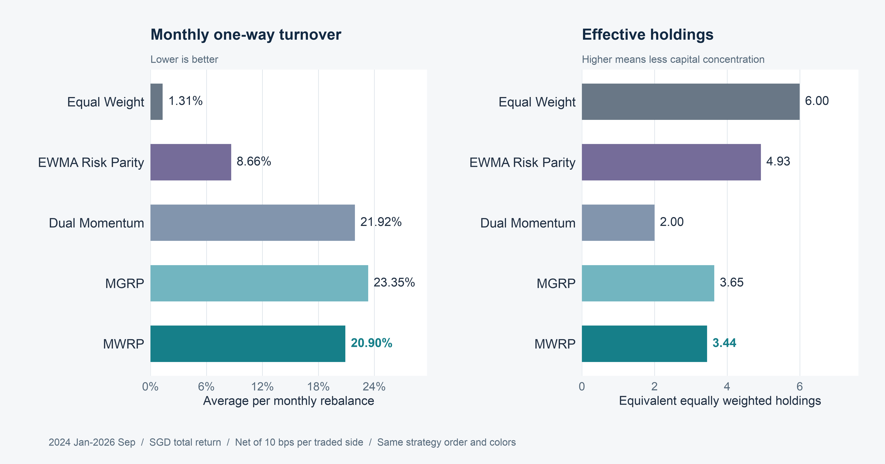
SECTION 04 PORTFOLIO PERFORMANCE
MWRP balances trading intensity and diversification
28
Notes:
Speaker 4. Core Slide.
Section question: What does MWRP deliver relative to credible benchmarks?
Core message: MWRP turns over less than Dual and MGRP, while Equal Weight trades far less.
Read-aloud script:
The turnover measure is monthly average one-way turnover from actual currency trades. MWRP is 20.90 percent, compared with 21.92 percent for Dual and 23.35 percent for MGRP. Equal Weight is much lower at 1.31 percent. Effective holdings measures capital concentration, computed each day as the inverse sum of squared actual capital weights and then averaged. MWRP is 3.44, above Dual's 2.00 but below MGRP's 3.65 and Equal Weight's roughly six. The trade-off is clear: momentum weighting gives up some diversification relative to equal-risk MGRP, while remaining broader than concentrated momentum.
Figure explanation: MWRP turns over less than Dual and MGRP, while Equal Weight trades far less.
Sources:
/Users/wangyujing/Desktop/MFE_Macro_Rotation_6Assets/presentation_assets/final_figures_v2/figures/main/FIG05_C_Turnover_Diversification_full.svg
/Users/wangyujing/Desktop/MFE_Macro_Rotation_6Assets/reports/phase4_research_report.md
/Users/wangyujing/Desktop/MFE_Macro_Rotation_6Assets/reports/research_report.md
/Users/wangyujing/Desktop/MFE_Macro_Rotation_6Assets/data/processed/sgd_daily_returns.csv
/Users/wangyujing/Desktop/MFE_Macro_Rotation_6Assets/data/processed/sgd_total_return_indices.csv
/Users/wangyujing/Desktop/MFE_Macro_Rotation_6Assets/outputs/diagnostics/Dual_Momentum_contribution.csv
/Users/wangyujing/Desktop/MFE_Macro_Rotation_6Assets/outputs/diagnostics/Dual_Momentum_daily.csv
/Users/wangyujing/Desktop/MFE_Macro_Rotation_6Assets/outputs/diagnostics/Dual_Momentum_weights.csv
/Users/wangyujing/Desktop/MFE_Macro_Rotation_6Assets/outputs/diagnostics/EWMA_Risk_Parity_contribution.csv
/Users/wangyujing/Desktop/MFE_Macro_Rotation_6Assets/outputs/diagnostics/EWMA_Risk_Parity_daily.csv
/Users/wangyujing/Desktop/MFE_Macro_Rotation_6Assets/outputs/diagnostics/EWMA_Risk_Parity_weights.csv
/Users/wangyujing/Desktop/MFE_Macro_Rotation_6Assets/outputs/diagnostics/Equal_Weight_contribution.csv
/Users/wangyujing/Desktop/MFE_Macro_Rotation_6Assets/outputs/diagnostics/Equal_Weight_daily.csv
/Users/wangyujing/Desktop/MFE_Macro_Rotation_6Assets/outputs/diagnostics/Equal_Weight_weights.csv
/Users/wangyujing/Desktop/MFE_Macro_Rotation_6Assets/outputs/diagnostics/Gated_Equal_Weight_contribution.csv
/Users/wangyujing/Desktop/MFE_Macro_Rotation_6Assets/outputs/diagnostics/Gated_Equal_Weight_daily.csv
/Users/wangyujing/Desktop/MFE_Macro_Rotation_6Assets/outputs/diagnostics/Gated_Equal_Weight_weights.csv
/Users/wangyujing/Desktop/MFE_Macro_Rotation_6Assets/outputs/diagnostics/MGRP-Base_contribution.csv
/Users/wangyujing/Desktop/MFE_Macro_Rotation_6Assets/outputs/diagnostics/MGRP-Base_daily.csv
/Users/wangyujing/Desktop/MFE_Macro_Rotation_6Assets/outputs/diagnostics/MGRP-Base_weights.csv
/Users/wangyujing/Desktop/MFE_Macro_Rotation_6Assets/outputs/phase4/diagnostics/MWRP_contribution.csv
/Users/wangyujing/Desktop/MFE_Macro_Rotation_6Assets/outputs/phase4/diagnostics/MWRP_daily.csv
/Users/wangyujing/Desktop/MFE_Macro_Rotation_6Assets/outputs/phase4/diagnostics/MWRP_weights.csv
/Users/wangyujing/Desktop/MFE_Macro_Rotation_6Assets/outputs/phase4/diagnostics/assigned_predicted_realized_risk.csv
/Users/wangyujing/Desktop/MFE_Macro_Rotation_6Assets/outputs/phase4/diagnostics/forecast_vs_realized_exact_holding_windows.csv
/Users/wangyujing/Desktop/MFE_Macro_Rotation_6Assets/outputs/phase4/tables/table01_three_period_performance.csv
/Users/wangyujing/Desktop/MFE_Macro_Rotation_6Assets/outputs/phase4/tables/table02_annual_returns.csv
/Users/wangyujing/Desktop/MFE_Macro_Rotation_6Assets/outputs/phase4/tables/table06_transaction_cost_sensitivity.csv
/Users/wangyujing/Desktop/MFE_Macro_Rotation_6Assets/outputs/phase4/tables/table07_monthly_allocation_decisions.csv
/Users/wangyujing/Desktop/MFE_Macro_Rotation_6Assets/outputs/tables/annual_performance.csv
/Users/wangyujing/Desktop/MFE_Macro_Rotation_6Assets/outputs/tables/full_2020_Sep2026_performance.csv
/Users/wangyujing/Desktop/MFE_Macro_Rotation_6Assets/outputs/tables/performance_all_cost_scenarios.csv
/Users/wangyujing/Desktop/MFE_Macro_Rotation_6Assets/outputs/tables/performance_main.csv

Slide 29
SECTION 04 PORTFOLIO PERFORMANCE
Recent wealth gains come with different drawdown paths
29
Notes:
Speaker 4. Core Slide.
Section question: What does MWRP deliver relative to credible benchmarks?
Core message: Net asset value and drawdown are derived from actual daily portfolio wealth.
Read-aloud script:
NAV means net asset value. Each path starts from one for display, using the actual continuous strategy wealth and transaction costs. Dual finishes with the greatest recent wealth. MWRP grows more than MGRP while experiencing a smaller worst drawdown in this particular window. The lower panel shows each strategy's percentage decline from its running peak, including initial wealth one. The curves are not reconstructed from summary statistics. Positions are not reset at January 2024. This distinction matters because the portfolio enters the evaluation window with actual inherited holdings.
Figure explanation: Net asset value and drawdown are derived from actual daily portfolio wealth.
Sources:
/Users/wangyujing/Desktop/MFE_Macro_Rotation_6Assets/presentation_assets/final_figures_v2/figures/main/FIG06_NAV_Drawdown_evaluation_full.svg
/Users/wangyujing/Desktop/MFE_Macro_Rotation_6Assets/reports/phase4_research_report.md
/Users/wangyujing/Desktop/MFE_Macro_Rotation_6Assets/reports/research_report.md
/Users/wangyujing/Desktop/MFE_Macro_Rotation_6Assets/outputs/diagnostics/Equal_Weight_daily.csv
/Users/wangyujing/Desktop/MFE_Macro_Rotation_6Assets/outputs/diagnostics/Dual_Momentum_daily.csv
/Users/wangyujing/Desktop/MFE_Macro_Rotation_6Assets/outputs/diagnostics/MGRP-Base_daily.csv
/Users/wangyujing/Desktop/MFE_Macro_Rotation_6Assets/outputs/phase4/diagnostics/MWRP_daily.csv

Slide 30
SECTION 04 PORTFOLIO PERFORMANCE
The full history favors Dual in accumulated wealth
30
Notes:
Speaker 4. Core Slide.
Section question: What does MWRP deliver relative to credible benchmarks?
Core message: The 2020-2026 span includes the less favorable validation period.
Read-aloud script:
The full historical wealth chart is essential because it includes the earlier environment where our proposed approach was less competitive. From January 2020 through September 2026, Dual's CAGR is 17.26 percent and Sharpe is 1.146. MWRP's are 12.56 percent and 1.025. MWRP still improves on MGRP, whose CAGR is 10.99 percent, but it does not catch Dual over the whole span. The combined chart is continuous history composed of the two subperiods. It is not a third independent validation. Any claim about superiority needs to identify the metric and period.
Figure explanation: The 2020-2026 span includes the less favorable validation period.
Sources:
/Users/wangyujing/Desktop/MFE_Macro_Rotation_6Assets/presentation_assets/final_figures_v2/figures/appendix/APP06_Five_Core_Full_NAV_full.svg
/Users/wangyujing/Desktop/MFE_Macro_Rotation_6Assets/reports/phase4_research_report.md
/Users/wangyujing/Desktop/MFE_Macro_Rotation_6Assets/reports/research_report.md
/Users/wangyujing/Desktop/MFE_Macro_Rotation_6Assets/data/processed/sgd_daily_returns.csv
/Users/wangyujing/Desktop/MFE_Macro_Rotation_6Assets/data/processed/sgd_total_return_indices.csv
/Users/wangyujing/Desktop/MFE_Macro_Rotation_6Assets/outputs/diagnostics/Dual_Momentum_contribution.csv
/Users/wangyujing/Desktop/MFE_Macro_Rotation_6Assets/outputs/diagnostics/Dual_Momentum_daily.csv
/Users/wangyujing/Desktop/MFE_Macro_Rotation_6Assets/outputs/diagnostics/Dual_Momentum_weights.csv
/Users/wangyujing/Desktop/MFE_Macro_Rotation_6Assets/outputs/diagnostics/EWMA_Risk_Parity_contribution.csv
/Users/wangyujing/Desktop/MFE_Macro_Rotation_6Assets/outputs/diagnostics/EWMA_Risk_Parity_daily.csv
/Users/wangyujing/Desktop/MFE_Macro_Rotation_6Assets/outputs/diagnostics/EWMA_Risk_Parity_weights.csv
/Users/wangyujing/Desktop/MFE_Macro_Rotation_6Assets/outputs/diagnostics/Equal_Weight_contribution.csv
/Users/wangyujing/Desktop/MFE_Macro_Rotation_6Assets/outputs/diagnostics/Equal_Weight_daily.csv
/Users/wangyujing/Desktop/MFE_Macro_Rotation_6Assets/outputs/diagnostics/Equal_Weight_weights.csv
/Users/wangyujing/Desktop/MFE_Macro_Rotation_6Assets/outputs/diagnostics/Gated_Equal_Weight_contribution.csv
/Users/wangyujing/Desktop/MFE_Macro_Rotation_6Assets/outputs/diagnostics/Gated_Equal_Weight_daily.csv
/Users/wangyujing/Desktop/MFE_Macro_Rotation_6Assets/outputs/diagnostics/Gated_Equal_Weight_weights.csv
/Users/wangyujing/Desktop/MFE_Macro_Rotation_6Assets/outputs/diagnostics/MGRP-Base_contribution.csv
/Users/wangyujing/Desktop/MFE_Macro_Rotation_6Assets/outputs/diagnostics/MGRP-Base_daily.csv
/Users/wangyujing/Desktop/MFE_Macro_Rotation_6Assets/outputs/diagnostics/MGRP-Base_weights.csv
/Users/wangyujing/Desktop/MFE_Macro_Rotation_6Assets/outputs/phase4/diagnostics/MWRP_contribution.csv
/Users/wangyujing/Desktop/MFE_Macro_Rotation_6Assets/outputs/phase4/diagnostics/MWRP_daily.csv
/Users/wangyujing/Desktop/MFE_Macro_Rotation_6Assets/outputs/phase4/diagnostics/MWRP_weights.csv
/Users/wangyujing/Desktop/MFE_Macro_Rotation_6Assets/outputs/phase4/diagnostics/assigned_predicted_realized_risk.csv
/Users/wangyujing/Desktop/MFE_Macro_Rotation_6Assets/outputs/phase4/diagnostics/forecast_vs_realized_exact_holding_windows.csv
/Users/wangyujing/Desktop/MFE_Macro_Rotation_6Assets/outputs/phase4/tables/table01_three_period_performance.csv
/Users/wangyujing/Desktop/MFE_Macro_Rotation_6Assets/outputs/phase4/tables/table02_annual_returns.csv
/Users/wangyujing/Desktop/MFE_Macro_Rotation_6Assets/outputs/phase4/tables/table06_transaction_cost_sensitivity.csv
/Users/wangyujing/Desktop/MFE_Macro_Rotation_6Assets/outputs/phase4/tables/table07_monthly_allocation_decisions.csv
/Users/wangyujing/Desktop/MFE_Macro_Rotation_6Assets/outputs/tables/annual_performance.csv
/Users/wangyujing/Desktop/MFE_Macro_Rotation_6Assets/outputs/tables/full_2020_Sep2026_performance.csv
/Users/wangyujing/Desktop/MFE_Macro_Rotation_6Assets/outputs/tables/performance_all_cost_scenarios.csv
/Users/wangyujing/Desktop/MFE_Macro_Rotation_6Assets/outputs/tables/performance_main.csv

Slide 31
SECTION 04 PORTFOLIO PERFORMANCE
MWRP distributes capital more broadly than Dual
31
Notes:
Speaker 4. Core Slide.
Section question: What does MWRP deliver relative to credible benchmarks?
Core message: Actual daily close weights include market drift and use consistent asset colors.
Read-aloud script:
Both panels show actual daily close capital weights, not just monthly targets. The asset colors remain fixed, so changes in exposure can be compared directly. Dual has two principal capital positions, while MWRP spreads capital across all eligible assets according to its risk budgets and covariance estimates. Main-period BIL weight is zero for both, so defensive allocation does not explain their recent difference. MWRP is more diversified on average, but this does not imply a cap on individual asset weights. The largest observed MWRP position reaches 63.78 percent during the main evaluation.
Figure explanation: Actual daily close weights include market drift and use consistent asset colors.
Sources:
/Users/wangyujing/Desktop/MFE_Macro_Rotation_6Assets/presentation_assets/final_figures_v2/figures/main/FIG07_Dual_vs_MWRP_evaluation_full.svg
/Users/wangyujing/Desktop/MFE_Macro_Rotation_6Assets/reports/phase4_research_report.md
/Users/wangyujing/Desktop/MFE_Macro_Rotation_6Assets/reports/research_report.md
/Users/wangyujing/Desktop/MFE_Macro_Rotation_6Assets/data/processed/sgd_daily_returns.csv
/Users/wangyujing/Desktop/MFE_Macro_Rotation_6Assets/data/processed/sgd_total_return_indices.csv
/Users/wangyujing/Desktop/MFE_Macro_Rotation_6Assets/outputs/diagnostics/Dual_Momentum_contribution.csv
/Users/wangyujing/Desktop/MFE_Macro_Rotation_6Assets/outputs/diagnostics/Dual_Momentum_daily.csv
/Users/wangyujing/Desktop/MFE_Macro_Rotation_6Assets/outputs/diagnostics/Dual_Momentum_weights.csv
/Users/wangyujing/Desktop/MFE_Macro_Rotation_6Assets/outputs/diagnostics/EWMA_Risk_Parity_contribution.csv
/Users/wangyujing/Desktop/MFE_Macro_Rotation_6Assets/outputs/diagnostics/EWMA_Risk_Parity_daily.csv
/Users/wangyujing/Desktop/MFE_Macro_Rotation_6Assets/outputs/diagnostics/EWMA_Risk_Parity_weights.csv
/Users/wangyujing/Desktop/MFE_Macro_Rotation_6Assets/outputs/diagnostics/Equal_Weight_contribution.csv
/Users/wangyujing/Desktop/MFE_Macro_Rotation_6Assets/outputs/diagnostics/Equal_Weight_daily.csv
/Users/wangyujing/Desktop/MFE_Macro_Rotation_6Assets/outputs/diagnostics/Equal_Weight_weights.csv
/Users/wangyujing/Desktop/MFE_Macro_Rotation_6Assets/outputs/diagnostics/Gated_Equal_Weight_contribution.csv
/Users/wangyujing/Desktop/MFE_Macro_Rotation_6Assets/outputs/diagnostics/Gated_Equal_Weight_daily.csv
/Users/wangyujing/Desktop/MFE_Macro_Rotation_6Assets/outputs/diagnostics/Gated_Equal_Weight_weights.csv
/Users/wangyujing/Desktop/MFE_Macro_Rotation_6Assets/outputs/diagnostics/MGRP-Base_contribution.csv
/Users/wangyujing/Desktop/MFE_Macro_Rotation_6Assets/outputs/diagnostics/MGRP-Base_daily.csv
/Users/wangyujing/Desktop/MFE_Macro_Rotation_6Assets/outputs/diagnostics/MGRP-Base_weights.csv
/Users/wangyujing/Desktop/MFE_Macro_Rotation_6Assets/outputs/phase4/diagnostics/MWRP_contribution.csv
/Users/wangyujing/Desktop/MFE_Macro_Rotation_6Assets/outputs/phase4/diagnostics/MWRP_daily.csv
/Users/wangyujing/Desktop/MFE_Macro_Rotation_6Assets/outputs/phase4/diagnostics/MWRP_weights.csv
/Users/wangyujing/Desktop/MFE_Macro_Rotation_6Assets/outputs/phase4/diagnostics/assigned_predicted_realized_risk.csv
/Users/wangyujing/Desktop/MFE_Macro_Rotation_6Assets/outputs/phase4/diagnostics/forecast_vs_realized_exact_holding_windows.csv
/Users/wangyujing/Desktop/MFE_Macro_Rotation_6Assets/outputs/phase4/tables/table01_three_period_performance.csv
/Users/wangyujing/Desktop/MFE_Macro_Rotation_6Assets/outputs/phase4/tables/table02_annual_returns.csv
/Users/wangyujing/Desktop/MFE_Macro_Rotation_6Assets/outputs/phase4/tables/table06_transaction_cost_sensitivity.csv
/Users/wangyujing/Desktop/MFE_Macro_Rotation_6Assets/outputs/phase4/tables/table07_monthly_allocation_decisions.csv
/Users/wangyujing/Desktop/MFE_Macro_Rotation_6Assets/outputs/tables/annual_performance.csv
/Users/wangyujing/Desktop/MFE_Macro_Rotation_6Assets/outputs/tables/full_2020_Sep2026_performance.csv
/Users/wangyujing/Desktop/MFE_Macro_Rotation_6Assets/outputs/tables/performance_all_cost_scenarios.csv
/Users/wangyujing/Desktop/MFE_Macro_Rotation_6Assets/outputs/tables/performance_main.csv

Slide 32
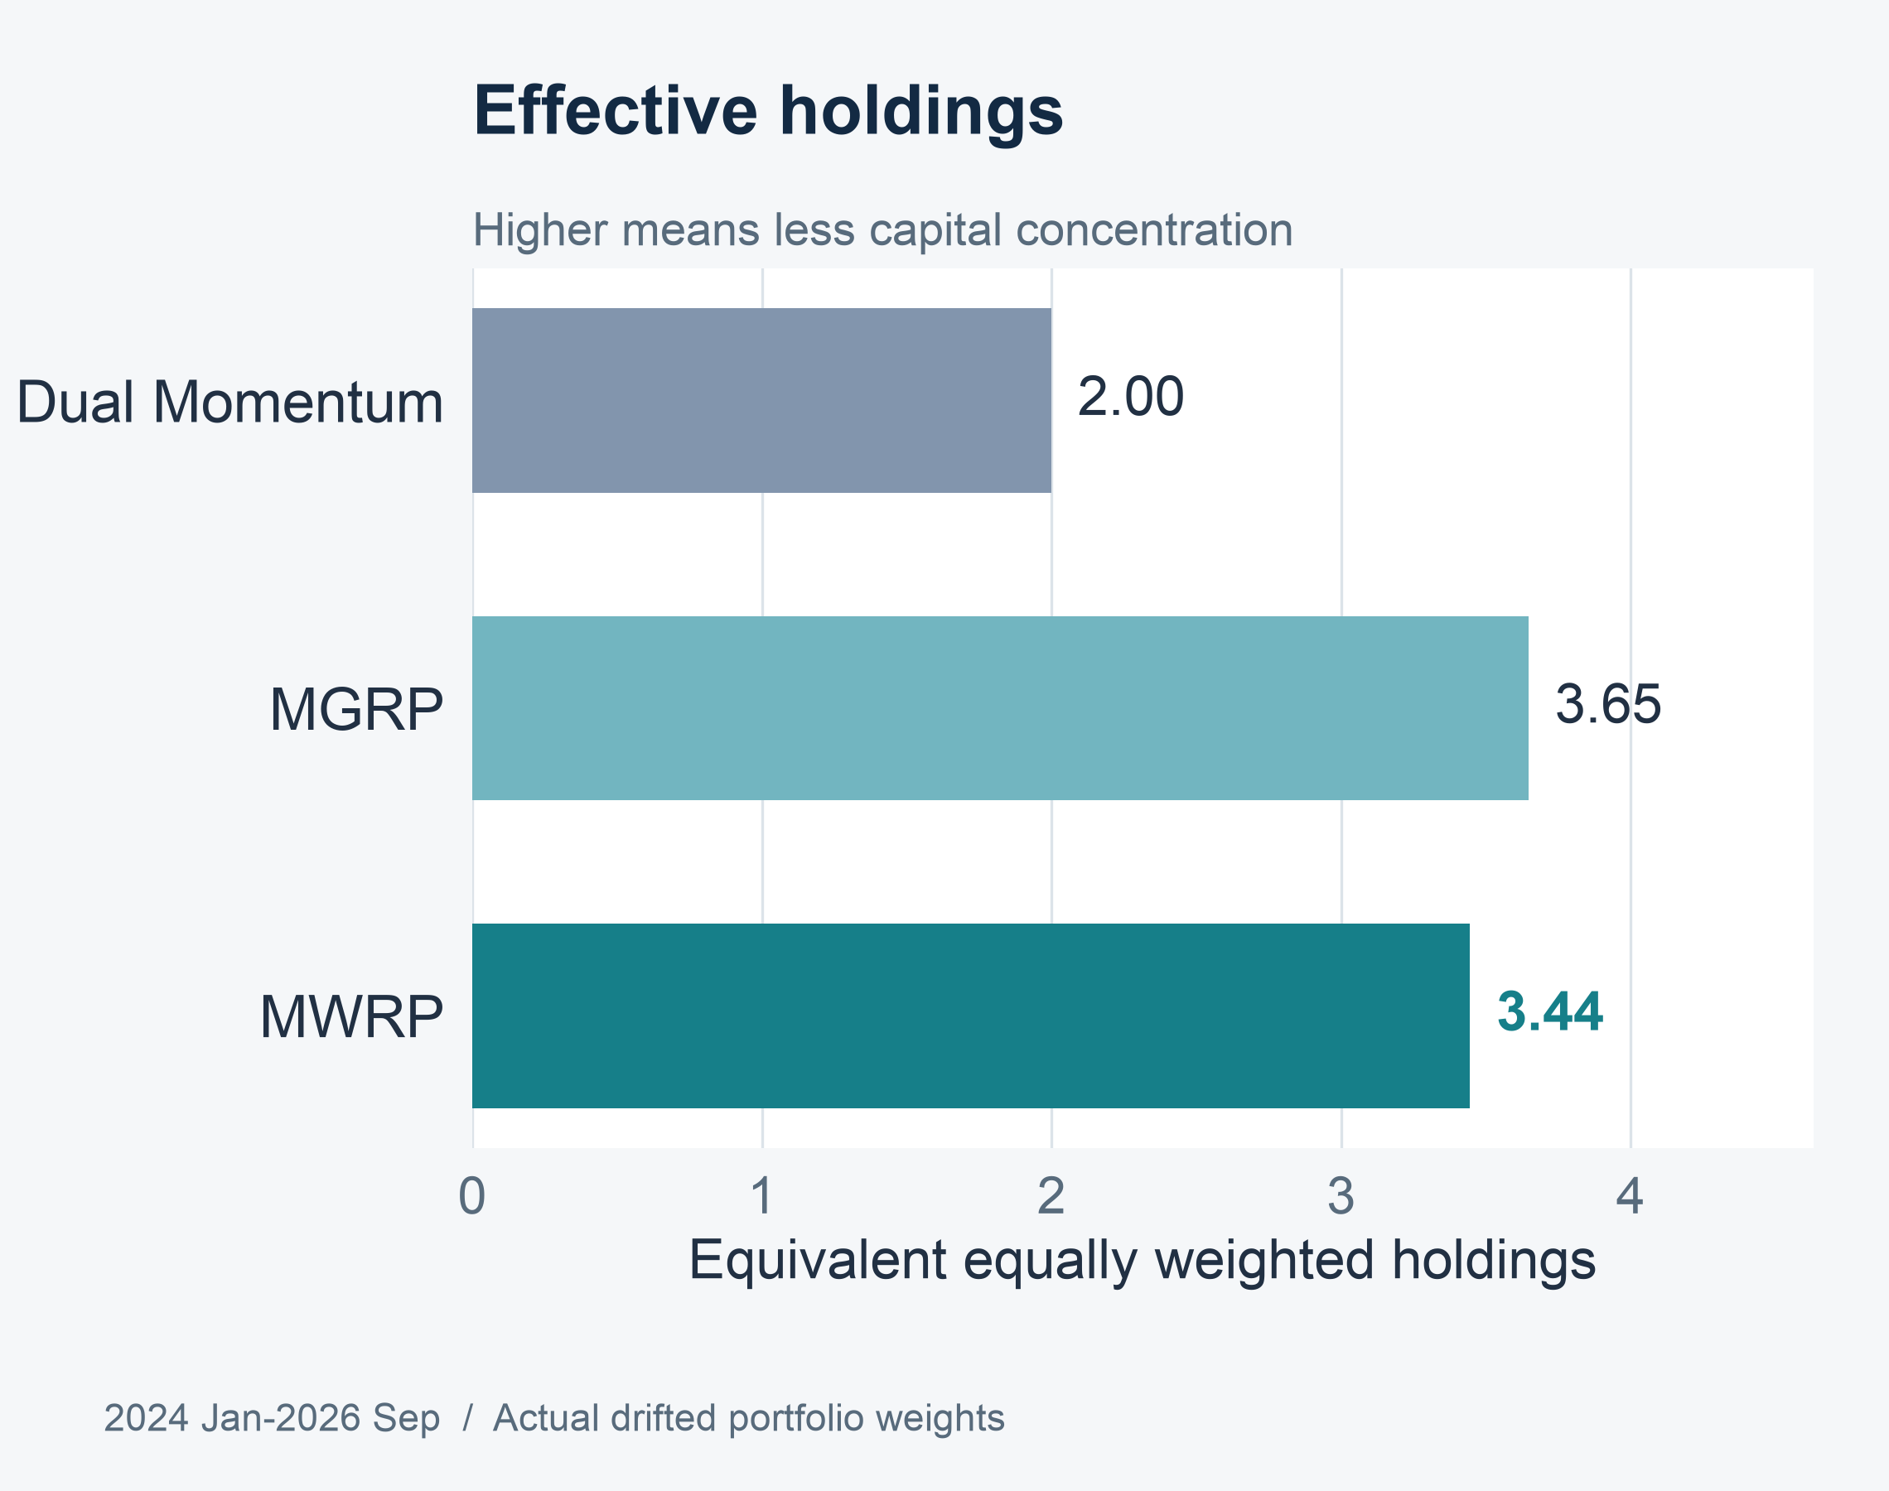
SECTION 04 PORTFOLIO PERFORMANCE
Diversification is an average, not a position limit
MWRP capital concentration
41.12%
Mean largest actual
capital position
63.78%
Peak single-asset weight
2024 Jan–2026 Sep
32
Notes:
Speaker 4. Quick Slide.
Section question: What does MWRP deliver relative to credible benchmarks?
Core message: MWRP averages 3.44 effective holdings, yet its peak single-asset weight reaches 63.78%.
Read-aloud script:
The bars compare average effective holdings, calculated from actual daily close weights. MWRP averages 3.44, between Dual at about two and MGRP at 3.65. This measure of average diversification is not a position limit. MWRP's mean largest daily capital position is 41.12 percent, and its peak single-asset position reaches 63.78 percent during the main evaluation. MWRP and MGRP hold the same eligible set, yet have different capital concentration. Capital diversification also differs from risk diversification, which depends on covariance. We should therefore qualify the claim that MWRP is more balanced.
Figure explanation: MWRP averages 3.44 effective holdings, yet its peak single-asset weight reaches 63.78%.
Sources:
/Users/wangyujing/Desktop/MFE_Macro_Rotation_6Assets/presentation_assets/final_figures_v2/figures/panels/FIG08_Effective_Holdings_half.svg
/Users/wangyujing/Desktop/MFE_Macro_Rotation_6Assets/reports/phase4_research_report.md
/Users/wangyujing/Desktop/MFE_Macro_Rotation_6Assets/reports/research_report.md
/Users/wangyujing/Desktop/MFE_Macro_Rotation_6Assets/data/processed/sgd_daily_returns.csv
/Users/wangyujing/Desktop/MFE_Macro_Rotation_6Assets/data/processed/sgd_total_return_indices.csv
/Users/wangyujing/Desktop/MFE_Macro_Rotation_6Assets/outputs/diagnostics/Dual_Momentum_contribution.csv
/Users/wangyujing/Desktop/MFE_Macro_Rotation_6Assets/outputs/diagnostics/Dual_Momentum_daily.csv
/Users/wangyujing/Desktop/MFE_Macro_Rotation_6Assets/outputs/diagnostics/Dual_Momentum_weights.csv
/Users/wangyujing/Desktop/MFE_Macro_Rotation_6Assets/outputs/diagnostics/EWMA_Risk_Parity_contribution.csv
/Users/wangyujing/Desktop/MFE_Macro_Rotation_6Assets/outputs/diagnostics/EWMA_Risk_Parity_daily.csv
/Users/wangyujing/Desktop/MFE_Macro_Rotation_6Assets/outputs/diagnostics/EWMA_Risk_Parity_weights.csv
/Users/wangyujing/Desktop/MFE_Macro_Rotation_6Assets/outputs/diagnostics/Equal_Weight_contribution.csv
/Users/wangyujing/Desktop/MFE_Macro_Rotation_6Assets/outputs/diagnostics/Equal_Weight_daily.csv
/Users/wangyujing/Desktop/MFE_Macro_Rotation_6Assets/outputs/diagnostics/Equal_Weight_weights.csv
/Users/wangyujing/Desktop/MFE_Macro_Rotation_6Assets/outputs/diagnostics/Gated_Equal_Weight_contribution.csv
/Users/wangyujing/Desktop/MFE_Macro_Rotation_6Assets/outputs/diagnostics/Gated_Equal_Weight_daily.csv
/Users/wangyujing/Desktop/MFE_Macro_Rotation_6Assets/outputs/diagnostics/Gated_Equal_Weight_weights.csv
/Users/wangyujing/Desktop/MFE_Macro_Rotation_6Assets/outputs/diagnostics/MGRP-Base_contribution.csv
/Users/wangyujing/Desktop/MFE_Macro_Rotation_6Assets/outputs/diagnostics/MGRP-Base_daily.csv
/Users/wangyujing/Desktop/MFE_Macro_Rotation_6Assets/outputs/diagnostics/MGRP-Base_weights.csv
/Users/wangyujing/Desktop/MFE_Macro_Rotation_6Assets/outputs/phase4/diagnostics/MWRP_contribution.csv
/Users/wangyujing/Desktop/MFE_Macro_Rotation_6Assets/outputs/phase4/diagnostics/MWRP_daily.csv
/Users/wangyujing/Desktop/MFE_Macro_Rotation_6Assets/outputs/phase4/diagnostics/MWRP_weights.csv
/Users/wangyujing/Desktop/MFE_Macro_Rotation_6Assets/outputs/phase4/diagnostics/assigned_predicted_realized_risk.csv
/Users/wangyujing/Desktop/MFE_Macro_Rotation_6Assets/outputs/phase4/diagnostics/forecast_vs_realized_exact_holding_windows.csv
/Users/wangyujing/Desktop/MFE_Macro_Rotation_6Assets/outputs/phase4/tables/table01_three_period_performance.csv
/Users/wangyujing/Desktop/MFE_Macro_Rotation_6Assets/outputs/phase4/tables/table02_annual_returns.csv
/Users/wangyujing/Desktop/MFE_Macro_Rotation_6Assets/outputs/phase4/tables/table06_transaction_cost_sensitivity.csv
/Users/wangyujing/Desktop/MFE_Macro_Rotation_6Assets/outputs/phase4/tables/table07_monthly_allocation_decisions.csv
/Users/wangyujing/Desktop/MFE_Macro_Rotation_6Assets/outputs/tables/annual_performance.csv
/Users/wangyujing/Desktop/MFE_Macro_Rotation_6Assets/outputs/tables/full_2020_Sep2026_performance.csv
/Users/wangyujing/Desktop/MFE_Macro_Rotation_6Assets/outputs/tables/performance_all_cost_scenarios.csv
/Users/wangyujing/Desktop/MFE_Macro_Rotation_6Assets/outputs/tables/performance_main.csv

Slide 33
SECTION 04 PORTFOLIO PERFORMANCE
The same fee rate produces different cumulative costs
Strategy | Fees / opening wealth | Gross minus net CAGR
Dual Momentum | 2.26% | 0.67 pp
MGRP | 1.90% | 0.68 pp
MWRP | 1.78% | 0.62 pp
Fees depend on actual trades and the wealth path.
CAGR drag is an annualized difference between gross and net wealth paths.
2024 Jan–2026 Sep. Uniform 10 bps per traded side. Cumulative fee amounts are not CAGR differences.
33
Notes:
Speaker 4. Quick Slide.
Section question: What does MWRP deliver relative to credible benchmarks?
Core message: Costs paid and annualized return drag are different measurements.
Read-aloud script:
The strategies pay the same ten-basis-point rate on each traded side. Over the recent period, cumulative fees relative to common opening wealth are 2.26 percent for Dual, 1.90 percent for MGRP and 1.78 percent for MWRP. The corresponding differences between gross and net CAGR are 0.67, 0.68 and 0.62 percentage points. These are different quantities. Fee amounts depend on the wealth path and trade sizes, while CAGR drag is an annualized difference between two compounded paths. Lower average turnover need not produce the same ranking of every fee metric. Speaker 5 will now examine the allocation decisions behind the performance.
Figure explanation: Explain the definitions and comparison on this page.
Sources:
/Users/wangyujing/Desktop/MFE_Macro_Rotation_6Assets/reports/phase4_research_report.md
/Users/wangyujing/Desktop/MFE_Macro_Rotation_6Assets/reports/research_report.md

Slide 34
05
Where Does the Improvement Come From?
Separate eligibility, allocation and momentum-weighted risk preferences
34
Notes:
Speaker 5. Quick Slide.
Section question: Which portfolio decisions explain the historical improvement?
Core message: Separate eligibility, allocation and momentum-weighted risk preferences
Read-aloud script:
This section asks: Which portfolio decisions explain the historical improvement? Separate eligibility, allocation and momentum-weighted risk preferences.
Figure explanation: Explain the definitions and comparison on this page.
Sources:
/Users/wangyujing/Desktop/MFE_Macro_Rotation_6Assets/reports/phase4_research_report.md
/Users/wangyujing/Desktop/MFE_Macro_Rotation_6Assets/reports/research_report.md

Slide 35
SECTION 05 ECONOMIC ATTRIBUTION & STRATEGY COMPONENTS
Eligibility and allocation have distinct historical effects
35
Notes:
Speaker 5. Core Slide.
Section question: Which portfolio decisions explain the historical improvement?
Core message: Gated Equal Weight helps distinguish capital weighting from risk weighting.
Read-aloud script:
This component comparison includes Equal Weight, Gated Equal Weight, MGRP and MWRP. Moving from Equal Weight to Gated Equal Weight changes eligibility. Moving from Gated Equal Weight to MGRP changes equal capital into equal risk allocation over the same qualifying set. Moving from MGRP to MWRP changes equal risk budgets into momentum-weighted budgets. The pattern differs across periods, so we should not add the steps as if they were independent causal effects. The closest test of our innovation is MGRP versus MWRP, because eligibility and covariance are held constant.
Figure explanation: Gated Equal Weight helps distinguish capital weighting from risk weighting.
Sources:
/Users/wangyujing/Desktop/MFE_Macro_Rotation_6Assets/presentation_assets/final_figures_v2/figures/appendix/APP02_Component_Ablation_full.svg
/Users/wangyujing/Desktop/MFE_Macro_Rotation_6Assets/reports/phase4_research_report.md
/Users/wangyujing/Desktop/MFE_Macro_Rotation_6Assets/reports/research_report.md
/Users/wangyujing/Desktop/MFE_Macro_Rotation_6Assets/data/processed/sgd_daily_returns.csv
/Users/wangyujing/Desktop/MFE_Macro_Rotation_6Assets/data/processed/sgd_total_return_indices.csv
/Users/wangyujing/Desktop/MFE_Macro_Rotation_6Assets/outputs/diagnostics/Dual_Momentum_contribution.csv
/Users/wangyujing/Desktop/MFE_Macro_Rotation_6Assets/outputs/diagnostics/Dual_Momentum_daily.csv
/Users/wangyujing/Desktop/MFE_Macro_Rotation_6Assets/outputs/diagnostics/Dual_Momentum_weights.csv
/Users/wangyujing/Desktop/MFE_Macro_Rotation_6Assets/outputs/diagnostics/EWMA_Risk_Parity_contribution.csv
/Users/wangyujing/Desktop/MFE_Macro_Rotation_6Assets/outputs/diagnostics/EWMA_Risk_Parity_daily.csv
/Users/wangyujing/Desktop/MFE_Macro_Rotation_6Assets/outputs/diagnostics/EWMA_Risk_Parity_weights.csv
/Users/wangyujing/Desktop/MFE_Macro_Rotation_6Assets/outputs/diagnostics/Equal_Weight_contribution.csv
/Users/wangyujing/Desktop/MFE_Macro_Rotation_6Assets/outputs/diagnostics/Equal_Weight_daily.csv
/Users/wangyujing/Desktop/MFE_Macro_Rotation_6Assets/outputs/diagnostics/Equal_Weight_weights.csv
/Users/wangyujing/Desktop/MFE_Macro_Rotation_6Assets/outputs/diagnostics/Gated_Equal_Weight_contribution.csv
/Users/wangyujing/Desktop/MFE_Macro_Rotation_6Assets/outputs/diagnostics/Gated_Equal_Weight_daily.csv
/Users/wangyujing/Desktop/MFE_Macro_Rotation_6Assets/outputs/diagnostics/Gated_Equal_Weight_weights.csv
/Users/wangyujing/Desktop/MFE_Macro_Rotation_6Assets/outputs/diagnostics/MGRP-Base_contribution.csv
/Users/wangyujing/Desktop/MFE_Macro_Rotation_6Assets/outputs/diagnostics/MGRP-Base_daily.csv
/Users/wangyujing/Desktop/MFE_Macro_Rotation_6Assets/outputs/diagnostics/MGRP-Base_weights.csv
/Users/wangyujing/Desktop/MFE_Macro_Rotation_6Assets/outputs/phase4/diagnostics/MWRP_contribution.csv
/Users/wangyujing/Desktop/MFE_Macro_Rotation_6Assets/outputs/phase4/diagnostics/MWRP_daily.csv
/Users/wangyujing/Desktop/MFE_Macro_Rotation_6Assets/outputs/phase4/diagnostics/MWRP_weights.csv
/Users/wangyujing/Desktop/MFE_Macro_Rotation_6Assets/outputs/phase4/diagnostics/assigned_predicted_realized_risk.csv
/Users/wangyujing/Desktop/MFE_Macro_Rotation_6Assets/outputs/phase4/diagnostics/forecast_vs_realized_exact_holding_windows.csv
/Users/wangyujing/Desktop/MFE_Macro_Rotation_6Assets/outputs/phase4/tables/table01_three_period_performance.csv
/Users/wangyujing/Desktop/MFE_Macro_Rotation_6Assets/outputs/phase4/tables/table02_annual_returns.csv
/Users/wangyujing/Desktop/MFE_Macro_Rotation_6Assets/outputs/phase4/tables/table06_transaction_cost_sensitivity.csv
/Users/wangyujing/Desktop/MFE_Macro_Rotation_6Assets/outputs/phase4/tables/table07_monthly_allocation_decisions.csv
/Users/wangyujing/Desktop/MFE_Macro_Rotation_6Assets/outputs/tables/annual_performance.csv
/Users/wangyujing/Desktop/MFE_Macro_Rotation_6Assets/outputs/tables/full_2020_Sep2026_performance.csv
/Users/wangyujing/Desktop/MFE_Macro_Rotation_6Assets/outputs/tables/performance_all_cost_scenarios.csv
/Users/wangyujing/Desktop/MFE_Macro_Rotation_6Assets/outputs/tables/performance_main.csv

Slide 36
SECTION 05 ECONOMIC ATTRIBUTION & STRATEGY COMPONENTS
Momentum-weighted budgets improve on MGRP
36
Notes:
Speaker 5. Core Slide.
Section question: Which portfolio decisions explain the historical improvement?
Core message: Recent return and Sharpe improve, with modestly higher volatility and concentration.
Read-aloud script:
All differences here are MWRP minus MGRP for January 2024 through September 2026. Net CAGR increases by 2.46 percentage points and Sharpe by 0.104. The signed maximum-drawdown difference is positive 0.50 percentage points, meaning a shallower drawdown. Monthly turnover falls by 2.44 percentage points. Those benefits have a cost: annualized volatility rises by 0.48 percentage points, and effective holdings fall by about 0.20. The values use full underlying precision before rounding, so differences between rounded headline levels can look slightly different. The evidence supports an improved historical trade-off, not a free improvement on every metric.
Figure explanation: Recent return and Sharpe improve, with modestly higher volatility and concentration.
Sources:
/Users/wangyujing/Desktop/MFE_Macro_Rotation_6Assets/presentation_assets/final_figures_v2/figures/main/FIG09_Incremental_Value_full.svg
/Users/wangyujing/Desktop/MFE_Macro_Rotation_6Assets/reports/phase4_research_report.md
/Users/wangyujing/Desktop/MFE_Macro_Rotation_6Assets/reports/research_report.md
/Users/wangyujing/Desktop/MFE_Macro_Rotation_6Assets/data/processed/sgd_daily_returns.csv
/Users/wangyujing/Desktop/MFE_Macro_Rotation_6Assets/data/processed/sgd_total_return_indices.csv
/Users/wangyujing/Desktop/MFE_Macro_Rotation_6Assets/outputs/diagnostics/Dual_Momentum_contribution.csv
/Users/wangyujing/Desktop/MFE_Macro_Rotation_6Assets/outputs/diagnostics/Dual_Momentum_daily.csv
/Users/wangyujing/Desktop/MFE_Macro_Rotation_6Assets/outputs/diagnostics/Dual_Momentum_weights.csv
/Users/wangyujing/Desktop/MFE_Macro_Rotation_6Assets/outputs/diagnostics/EWMA_Risk_Parity_contribution.csv
/Users/wangyujing/Desktop/MFE_Macro_Rotation_6Assets/outputs/diagnostics/EWMA_Risk_Parity_daily.csv
/Users/wangyujing/Desktop/MFE_Macro_Rotation_6Assets/outputs/diagnostics/EWMA_Risk_Parity_weights.csv
/Users/wangyujing/Desktop/MFE_Macro_Rotation_6Assets/outputs/diagnostics/Equal_Weight_contribution.csv
/Users/wangyujing/Desktop/MFE_Macro_Rotation_6Assets/outputs/diagnostics/Equal_Weight_daily.csv
/Users/wangyujing/Desktop/MFE_Macro_Rotation_6Assets/outputs/diagnostics/Equal_Weight_weights.csv
/Users/wangyujing/Desktop/MFE_Macro_Rotation_6Assets/outputs/diagnostics/Gated_Equal_Weight_contribution.csv
/Users/wangyujing/Desktop/MFE_Macro_Rotation_6Assets/outputs/diagnostics/Gated_Equal_Weight_daily.csv
/Users/wangyujing/Desktop/MFE_Macro_Rotation_6Assets/outputs/diagnostics/Gated_Equal_Weight_weights.csv
/Users/wangyujing/Desktop/MFE_Macro_Rotation_6Assets/outputs/diagnostics/MGRP-Base_contribution.csv
/Users/wangyujing/Desktop/MFE_Macro_Rotation_6Assets/outputs/diagnostics/MGRP-Base_daily.csv
/Users/wangyujing/Desktop/MFE_Macro_Rotation_6Assets/outputs/diagnostics/MGRP-Base_weights.csv
/Users/wangyujing/Desktop/MFE_Macro_Rotation_6Assets/outputs/phase4/diagnostics/MWRP_contribution.csv
/Users/wangyujing/Desktop/MFE_Macro_Rotation_6Assets/outputs/phase4/diagnostics/MWRP_daily.csv
/Users/wangyujing/Desktop/MFE_Macro_Rotation_6Assets/outputs/phase4/diagnostics/MWRP_weights.csv
/Users/wangyujing/Desktop/MFE_Macro_Rotation_6Assets/outputs/phase4/diagnostics/assigned_predicted_realized_risk.csv
/Users/wangyujing/Desktop/MFE_Macro_Rotation_6Assets/outputs/phase4/diagnostics/forecast_vs_realized_exact_holding_windows.csv
/Users/wangyujing/Desktop/MFE_Macro_Rotation_6Assets/outputs/phase4/tables/table01_three_period_performance.csv
/Users/wangyujing/Desktop/MFE_Macro_Rotation_6Assets/outputs/phase4/tables/table02_annual_returns.csv
/Users/wangyujing/Desktop/MFE_Macro_Rotation_6Assets/outputs/phase4/tables/table06_transaction_cost_sensitivity.csv
/Users/wangyujing/Desktop/MFE_Macro_Rotation_6Assets/outputs/phase4/tables/table07_monthly_allocation_decisions.csv
/Users/wangyujing/Desktop/MFE_Macro_Rotation_6Assets/outputs/tables/annual_performance.csv
/Users/wangyujing/Desktop/MFE_Macro_Rotation_6Assets/outputs/tables/full_2020_Sep2026_performance.csv
/Users/wangyujing/Desktop/MFE_Macro_Rotation_6Assets/outputs/tables/performance_all_cost_scenarios.csv
/Users/wangyujing/Desktop/MFE_Macro_Rotation_6Assets/outputs/tables/performance_main.csv

Slide 37
SECTION 05 ECONOMIC ATTRIBUTION & STRATEGY COMPONENTS
Momentum weighting changes participation, not eligibility
01
Same eligible set and defensive timing
MGRP and MWRP change allocation, not the list of qualifying assets.
02
33 of 33 recent months have different target weights
Average allocation distance: 13.18%. This is not turnover.
03
The strongest momentum asset is largest in capital only 10/33 months
30.30%. Covariance still determines how risk preferences become money.
Source: frozen Phase 4 monthly decisions and report. Validation target weights differ in 41/48 months.
37
Notes:
Speaker 5. Core Slide.
Section question: Which portfolio decisions explain the historical improvement?
Core message: The leading momentum asset is not always the largest capital position.
Read-aloud script:
MWRP and MGRP have the same eligible assets and BIL timing. In all thirty-three recent months, momentum weighting changes target capital weights. Their average allocation distance is 13.18 percent, measured as half the absolute difference between the two target weight vectors. That is a distance between strategies, not trading turnover. The strongest momentum asset is the largest MWRP capital position in only ten of thirty-three months, or 30.30 percent. Covariance therefore has a material role in capital allocation. In validation, only forty-one of forty-eight months differ because zero-asset and single-asset cases naturally coincide.
Figure explanation: Explain the definitions and comparison on this page.
Sources:
/Users/wangyujing/Desktop/MFE_Macro_Rotation_6Assets/reports/phase4_research_report.md
/Users/wangyujing/Desktop/MFE_Macro_Rotation_6Assets/reports/research_report.md

Slide 38
SECTION 05 ECONOMIC ATTRIBUTION & STRATEGY COMPONENTS
MWRP increases participation in the commodity trend
38
Notes:
Speaker 5. Core Slide.
Section question: Which portfolio decisions explain the historical improvement?
Core message: PDBC validation contribution increases from 9.73 pp to 12.43 pp.
Read-aloud script:
The commodity example covers 2020 through 2023. PDBC's average actual capital weight rises from 19.52 percent for MGRP to 20.45 percent for MWRP. Its cumulative profit-and-loss contribution rises from 9.73 to 12.43 percentage points of common opening wealth. Both methods select PDBC in thirty of forty-eight months. The improvement therefore comes from participation strength and timing rather than a higher selection frequency. Dual's PDBC contribution is larger at 26.29 percentage points, despite selecting it in fewer months. We retain the full exposure scale, including episodes at one hundred percent.
Figure explanation: PDBC validation contribution increases from 9.73 pp to 12.43 pp.
Sources:
/Users/wangyujing/Desktop/MFE_Macro_Rotation_6Assets/presentation_assets/final_figures_v2/figures/main/FIG10_A_PDBC_Participation_full.svg
/Users/wangyujing/Desktop/MFE_Macro_Rotation_6Assets/reports/phase4_research_report.md
/Users/wangyujing/Desktop/MFE_Macro_Rotation_6Assets/reports/research_report.md
/Users/wangyujing/Desktop/MFE_Macro_Rotation_6Assets/data/processed/sgd_daily_returns.csv
/Users/wangyujing/Desktop/MFE_Macro_Rotation_6Assets/data/processed/sgd_total_return_indices.csv
/Users/wangyujing/Desktop/MFE_Macro_Rotation_6Assets/outputs/diagnostics/Dual_Momentum_contribution.csv
/Users/wangyujing/Desktop/MFE_Macro_Rotation_6Assets/outputs/diagnostics/Dual_Momentum_daily.csv
/Users/wangyujing/Desktop/MFE_Macro_Rotation_6Assets/outputs/diagnostics/Dual_Momentum_weights.csv
/Users/wangyujing/Desktop/MFE_Macro_Rotation_6Assets/outputs/diagnostics/EWMA_Risk_Parity_contribution.csv
/Users/wangyujing/Desktop/MFE_Macro_Rotation_6Assets/outputs/diagnostics/EWMA_Risk_Parity_daily.csv
/Users/wangyujing/Desktop/MFE_Macro_Rotation_6Assets/outputs/diagnostics/EWMA_Risk_Parity_weights.csv
/Users/wangyujing/Desktop/MFE_Macro_Rotation_6Assets/outputs/diagnostics/Equal_Weight_contribution.csv
/Users/wangyujing/Desktop/MFE_Macro_Rotation_6Assets/outputs/diagnostics/Equal_Weight_daily.csv
/Users/wangyujing/Desktop/MFE_Macro_Rotation_6Assets/outputs/diagnostics/Equal_Weight_weights.csv
/Users/wangyujing/Desktop/MFE_Macro_Rotation_6Assets/outputs/diagnostics/Gated_Equal_Weight_contribution.csv
/Users/wangyujing/Desktop/MFE_Macro_Rotation_6Assets/outputs/diagnostics/Gated_Equal_Weight_daily.csv
/Users/wangyujing/Desktop/MFE_Macro_Rotation_6Assets/outputs/diagnostics/Gated_Equal_Weight_weights.csv
/Users/wangyujing/Desktop/MFE_Macro_Rotation_6Assets/outputs/diagnostics/MGRP-Base_contribution.csv
/Users/wangyujing/Desktop/MFE_Macro_Rotation_6Assets/outputs/diagnostics/MGRP-Base_daily.csv
/Users/wangyujing/Desktop/MFE_Macro_Rotation_6Assets/outputs/diagnostics/MGRP-Base_weights.csv
/Users/wangyujing/Desktop/MFE_Macro_Rotation_6Assets/outputs/phase4/diagnostics/MWRP_contribution.csv
/Users/wangyujing/Desktop/MFE_Macro_Rotation_6Assets/outputs/phase4/diagnostics/MWRP_daily.csv
/Users/wangyujing/Desktop/MFE_Macro_Rotation_6Assets/outputs/phase4/diagnostics/MWRP_weights.csv
/Users/wangyujing/Desktop/MFE_Macro_Rotation_6Assets/outputs/phase4/diagnostics/assigned_predicted_realized_risk.csv
/Users/wangyujing/Desktop/MFE_Macro_Rotation_6Assets/outputs/phase4/diagnostics/forecast_vs_realized_exact_holding_windows.csv
/Users/wangyujing/Desktop/MFE_Macro_Rotation_6Assets/outputs/phase4/tables/table01_three_period_performance.csv
/Users/wangyujing/Desktop/MFE_Macro_Rotation_6Assets/outputs/phase4/tables/table02_annual_returns.csv
/Users/wangyujing/Desktop/MFE_Macro_Rotation_6Assets/outputs/phase4/tables/table06_transaction_cost_sensitivity.csv
/Users/wangyujing/Desktop/MFE_Macro_Rotation_6Assets/outputs/phase4/tables/table07_monthly_allocation_decisions.csv
/Users/wangyujing/Desktop/MFE_Macro_Rotation_6Assets/outputs/tables/annual_performance.csv
/Users/wangyujing/Desktop/MFE_Macro_Rotation_6Assets/outputs/tables/full_2020_Sep2026_performance.csv
/Users/wangyujing/Desktop/MFE_Macro_Rotation_6Assets/outputs/tables/performance_all_cost_scenarios.csv
/Users/wangyujing/Desktop/MFE_Macro_Rotation_6Assets/outputs/tables/performance_main.csv

Slide 39
SECTION 05 ECONOMIC ATTRIBUTION & STRATEGY COMPONENTS
A larger gold allocation helps explain recent gains
39
Notes:
Speaker 5. Core Slide.
Section question: Which portfolio decisions explain the historical improvement?
Core message: Gold contribution increases from 18.34 pp to 23.66 pp, below Dual's 47.30 pp.
Read-aloud script:
In the recent period, gold's average actual weight rises from 17.31 percent under MGRP to 21.15 percent under MWRP. Its cumulative contribution rises from 18.34 to 23.66 percentage points, a gain of 5.32 percentage points. Both methods select gold in thirty of thirty-three months, so again the eligibility frequency is unchanged. Dual's contribution is 47.30 percentage points, much higher because its positions and holding months differ. These contributions are additive profit and loss relative to opening wealth. They are not annualized asset CAGRs and should not be described that way.
Figure explanation: Gold contribution increases from 18.34 pp to 23.66 pp, below Dual's 47.30 pp.
Sources:
/Users/wangyujing/Desktop/MFE_Macro_Rotation_6Assets/presentation_assets/final_figures_v2/figures/main/FIG10_B_GLD_Participation_full.svg
/Users/wangyujing/Desktop/MFE_Macro_Rotation_6Assets/reports/phase4_research_report.md
/Users/wangyujing/Desktop/MFE_Macro_Rotation_6Assets/reports/research_report.md
/Users/wangyujing/Desktop/MFE_Macro_Rotation_6Assets/data/processed/sgd_daily_returns.csv
/Users/wangyujing/Desktop/MFE_Macro_Rotation_6Assets/data/processed/sgd_total_return_indices.csv
/Users/wangyujing/Desktop/MFE_Macro_Rotation_6Assets/outputs/diagnostics/Dual_Momentum_contribution.csv
/Users/wangyujing/Desktop/MFE_Macro_Rotation_6Assets/outputs/diagnostics/Dual_Momentum_daily.csv
/Users/wangyujing/Desktop/MFE_Macro_Rotation_6Assets/outputs/diagnostics/Dual_Momentum_weights.csv
/Users/wangyujing/Desktop/MFE_Macro_Rotation_6Assets/outputs/diagnostics/EWMA_Risk_Parity_contribution.csv
/Users/wangyujing/Desktop/MFE_Macro_Rotation_6Assets/outputs/diagnostics/EWMA_Risk_Parity_daily.csv
/Users/wangyujing/Desktop/MFE_Macro_Rotation_6Assets/outputs/diagnostics/EWMA_Risk_Parity_weights.csv
/Users/wangyujing/Desktop/MFE_Macro_Rotation_6Assets/outputs/diagnostics/Equal_Weight_contribution.csv
/Users/wangyujing/Desktop/MFE_Macro_Rotation_6Assets/outputs/diagnostics/Equal_Weight_daily.csv
/Users/wangyujing/Desktop/MFE_Macro_Rotation_6Assets/outputs/diagnostics/Equal_Weight_weights.csv
/Users/wangyujing/Desktop/MFE_Macro_Rotation_6Assets/outputs/diagnostics/Gated_Equal_Weight_contribution.csv
/Users/wangyujing/Desktop/MFE_Macro_Rotation_6Assets/outputs/diagnostics/Gated_Equal_Weight_daily.csv
/Users/wangyujing/Desktop/MFE_Macro_Rotation_6Assets/outputs/diagnostics/Gated_Equal_Weight_weights.csv
/Users/wangyujing/Desktop/MFE_Macro_Rotation_6Assets/outputs/diagnostics/MGRP-Base_contribution.csv
/Users/wangyujing/Desktop/MFE_Macro_Rotation_6Assets/outputs/diagnostics/MGRP-Base_daily.csv
/Users/wangyujing/Desktop/MFE_Macro_Rotation_6Assets/outputs/diagnostics/MGRP-Base_weights.csv
/Users/wangyujing/Desktop/MFE_Macro_Rotation_6Assets/outputs/phase4/diagnostics/MWRP_contribution.csv
/Users/wangyujing/Desktop/MFE_Macro_Rotation_6Assets/outputs/phase4/diagnostics/MWRP_daily.csv
/Users/wangyujing/Desktop/MFE_Macro_Rotation_6Assets/outputs/phase4/diagnostics/MWRP_weights.csv
/Users/wangyujing/Desktop/MFE_Macro_Rotation_6Assets/outputs/phase4/diagnostics/assigned_predicted_realized_risk.csv
/Users/wangyujing/Desktop/MFE_Macro_Rotation_6Assets/outputs/phase4/diagnostics/forecast_vs_realized_exact_holding_windows.csv
/Users/wangyujing/Desktop/MFE_Macro_Rotation_6Assets/outputs/phase4/tables/table01_three_period_performance.csv
/Users/wangyujing/Desktop/MFE_Macro_Rotation_6Assets/outputs/phase4/tables/table02_annual_returns.csv
/Users/wangyujing/Desktop/MFE_Macro_Rotation_6Assets/outputs/phase4/tables/table06_transaction_cost_sensitivity.csv
/Users/wangyujing/Desktop/MFE_Macro_Rotation_6Assets/outputs/phase4/tables/table07_monthly_allocation_decisions.csv
/Users/wangyujing/Desktop/MFE_Macro_Rotation_6Assets/outputs/tables/annual_performance.csv
/Users/wangyujing/Desktop/MFE_Macro_Rotation_6Assets/outputs/tables/full_2020_Sep2026_performance.csv
/Users/wangyujing/Desktop/MFE_Macro_Rotation_6Assets/outputs/tables/performance_all_cost_scenarios.csv
/Users/wangyujing/Desktop/MFE_Macro_Rotation_6Assets/outputs/tables/performance_main.csv

Slide 40
SECTION 05 ECONOMIC ATTRIBUTION & STRATEGY COMPONENTS
Asset P&L reconciles the improvement in total return
Asset / cost | MGRP | MWRP
SPY | +8.17 pp | +8.14 pp
ES3.SI | +30.77 pp | +33.51 pp
TLT | −2.18 pp | −1.92 pp
GLD | +18.34 pp | +23.66 pp
IEMG | +13.19 pp | +11.76 pp
PDBC | +2.22 pp | +4.83 pp
BIL | 0.00 pp | 0.00 pp
Trading costs | −1.90 pp | −1.78 pp
Net total return | +68.62% | +78.20%
2024 Jan–2026 Sep. Additive P&L (profit and loss) / opening wealth. Not CAGR. Rounded cells may not sum exactly.
40
Notes:
Speaker 5. Core Slide.
Section question: Which portfolio decisions explain the historical improvement?
Core message: Contributions reflect exposure timing and wealth paths, not average weights alone.
Read-aloud script:
This table accounts for total return by asset and fees over the main evaluation. ES3 and gold are the largest positive contributors to MWRP. Compared with MGRP, gold adds about 5.32 percentage points, ES3 adds about 2.74, and PDBC adds about 2.61. IEMG contributes less, illustrating that not every shift is favorable. Asset contributions plus negative transaction costs reconcile to net total returns of 68.62 percent for MGRP and 78.20 percent for MWRP. The accounting difference includes portfolio wealth paths and compounding. Average exposure alone cannot establish why profit and loss changed. Speaker 1 will now discuss robustness and limitations.
Figure explanation: Explain the definitions and comparison on this page.
Sources:
/Users/wangyujing/Desktop/MFE_Macro_Rotation_6Assets/reports/phase4_research_report.md
/Users/wangyujing/Desktop/MFE_Macro_Rotation_6Assets/reports/research_report.md

Slide 41
06
Robustness & Final Takeaways
Show less favorable periods and define the limits of the evidence
41
Notes:
Speaker 1. Quick Slide.
Section question: How far should the historical findings be trusted?
Core message: Show less favorable periods and define the limits of the evidence
Read-aloud script:
This section asks: How far should the historical findings be trusted? Show less favorable periods and define the limits of the evidence.
Figure explanation: Explain the definitions and comparison on this page.
Sources:
/Users/wangyujing/Desktop/MFE_Macro_Rotation_6Assets/reports/phase4_research_report.md
/Users/wangyujing/Desktop/MFE_Macro_Rotation_6Assets/reports/research_report.md

Slide 42
SECTION 06 ROBUSTNESS, LIMITATIONS & CONCLUSION
Annual outcomes vary across market environments
42
Notes:
Speaker 1. Core Slide.
Section question: How far should the historical findings be trusted?
Core message: 2026 contains January through September only.
Read-aloud script:
The cells show net total returns for each calendar year, with 2026 containing only January through September. They are not annualized CAGRs. MWRP improves on MGRP in each full year from 2020 through 2025, although the 2023 difference is tiny. In the partial 2026 period, MWRP earns 19.52 percent, below MGRP's 20.62 percent. Dual also has strong earlier results and positive returns in 2022 and 2023 when MWRP is negative. This annual view warns against extrapolating the recent average into a claim that momentum weighting helps in every environment.
Figure explanation: 2026 contains January through September only.
Sources:
/Users/wangyujing/Desktop/MFE_Macro_Rotation_6Assets/presentation_assets/final_figures_v2/figures/main/FIG11_Five_Core_full.svg
/Users/wangyujing/Desktop/MFE_Macro_Rotation_6Assets/reports/phase4_research_report.md
/Users/wangyujing/Desktop/MFE_Macro_Rotation_6Assets/reports/research_report.md
/Users/wangyujing/Desktop/MFE_Macro_Rotation_6Assets/data/processed/sgd_daily_returns.csv
/Users/wangyujing/Desktop/MFE_Macro_Rotation_6Assets/data/processed/sgd_total_return_indices.csv
/Users/wangyujing/Desktop/MFE_Macro_Rotation_6Assets/outputs/diagnostics/Dual_Momentum_contribution.csv
/Users/wangyujing/Desktop/MFE_Macro_Rotation_6Assets/outputs/diagnostics/Dual_Momentum_daily.csv
/Users/wangyujing/Desktop/MFE_Macro_Rotation_6Assets/outputs/diagnostics/Dual_Momentum_weights.csv
/Users/wangyujing/Desktop/MFE_Macro_Rotation_6Assets/outputs/diagnostics/EWMA_Risk_Parity_contribution.csv
/Users/wangyujing/Desktop/MFE_Macro_Rotation_6Assets/outputs/diagnostics/EWMA_Risk_Parity_daily.csv
/Users/wangyujing/Desktop/MFE_Macro_Rotation_6Assets/outputs/diagnostics/EWMA_Risk_Parity_weights.csv
/Users/wangyujing/Desktop/MFE_Macro_Rotation_6Assets/outputs/diagnostics/Equal_Weight_contribution.csv
/Users/wangyujing/Desktop/MFE_Macro_Rotation_6Assets/outputs/diagnostics/Equal_Weight_daily.csv
/Users/wangyujing/Desktop/MFE_Macro_Rotation_6Assets/outputs/diagnostics/Equal_Weight_weights.csv
/Users/wangyujing/Desktop/MFE_Macro_Rotation_6Assets/outputs/diagnostics/Gated_Equal_Weight_contribution.csv
/Users/wangyujing/Desktop/MFE_Macro_Rotation_6Assets/outputs/diagnostics/Gated_Equal_Weight_daily.csv
/Users/wangyujing/Desktop/MFE_Macro_Rotation_6Assets/outputs/diagnostics/Gated_Equal_Weight_weights.csv
/Users/wangyujing/Desktop/MFE_Macro_Rotation_6Assets/outputs/diagnostics/MGRP-Base_contribution.csv
/Users/wangyujing/Desktop/MFE_Macro_Rotation_6Assets/outputs/diagnostics/MGRP-Base_daily.csv
/Users/wangyujing/Desktop/MFE_Macro_Rotation_6Assets/outputs/diagnostics/MGRP-Base_weights.csv
/Users/wangyujing/Desktop/MFE_Macro_Rotation_6Assets/outputs/phase4/diagnostics/MWRP_contribution.csv
/Users/wangyujing/Desktop/MFE_Macro_Rotation_6Assets/outputs/phase4/diagnostics/MWRP_daily.csv
/Users/wangyujing/Desktop/MFE_Macro_Rotation_6Assets/outputs/phase4/diagnostics/MWRP_weights.csv
/Users/wangyujing/Desktop/MFE_Macro_Rotation_6Assets/outputs/phase4/diagnostics/assigned_predicted_realized_risk.csv
/Users/wangyujing/Desktop/MFE_Macro_Rotation_6Assets/outputs/phase4/diagnostics/forecast_vs_realized_exact_holding_windows.csv
/Users/wangyujing/Desktop/MFE_Macro_Rotation_6Assets/outputs/phase4/tables/table01_three_period_performance.csv
/Users/wangyujing/Desktop/MFE_Macro_Rotation_6Assets/outputs/phase4/tables/table02_annual_returns.csv
/Users/wangyujing/Desktop/MFE_Macro_Rotation_6Assets/outputs/phase4/tables/table06_transaction_cost_sensitivity.csv
/Users/wangyujing/Desktop/MFE_Macro_Rotation_6Assets/outputs/phase4/tables/table07_monthly_allocation_decisions.csv
/Users/wangyujing/Desktop/MFE_Macro_Rotation_6Assets/outputs/tables/annual_performance.csv
/Users/wangyujing/Desktop/MFE_Macro_Rotation_6Assets/outputs/tables/full_2020_Sep2026_performance.csv
/Users/wangyujing/Desktop/MFE_Macro_Rotation_6Assets/outputs/tables/performance_all_cost_scenarios.csv
/Users/wangyujing/Desktop/MFE_Macro_Rotation_6Assets/outputs/tables/performance_main.csv

Slide 43
SECTION 06 ROBUSTNESS, LIMITATIONS & CONCLUSION
MWRP improves on MGRP across both subperiods
43
Notes:
Speaker 1. Core Slide.
Section question: How far should the historical findings be trusted?
Core message: Dual leads validation CAGR and Sharpe. Recent Sharpe leadership is period dependent.
Read-aloud script:
In validation, MWRP's CAGR is 5.68 percent versus MGRP's 4.64 percent, and Sharpe is 0.479 versus 0.412. In the recent evaluation, the corresponding values are 23.39 versus 20.93 percent, and 2.063 versus 1.958. The incremental direction is consistent across the two non-overlapping subperiods. Dual, however, earns 11.24 percent and a Sharpe of 0.796 in validation, leading both. These are descriptive comparisons from a research process influenced by historical observations. Directional consistency across two windows is useful evidence, but it is not a statistical proof of a stable future premium.
Figure explanation: Dual leads validation CAGR and Sharpe. Recent Sharpe leadership is period dependent.
Sources:
/Users/wangyujing/Desktop/MFE_Macro_Rotation_6Assets/presentation_assets/final_figures_v2/figures/main/FIG12_A_Cross_Period_full.svg
/Users/wangyujing/Desktop/MFE_Macro_Rotation_6Assets/reports/phase4_research_report.md
/Users/wangyujing/Desktop/MFE_Macro_Rotation_6Assets/reports/research_report.md
/Users/wangyujing/Desktop/MFE_Macro_Rotation_6Assets/data/processed/sgd_daily_returns.csv
/Users/wangyujing/Desktop/MFE_Macro_Rotation_6Assets/data/processed/sgd_total_return_indices.csv
/Users/wangyujing/Desktop/MFE_Macro_Rotation_6Assets/outputs/diagnostics/Dual_Momentum_contribution.csv
/Users/wangyujing/Desktop/MFE_Macro_Rotation_6Assets/outputs/diagnostics/Dual_Momentum_daily.csv
/Users/wangyujing/Desktop/MFE_Macro_Rotation_6Assets/outputs/diagnostics/Dual_Momentum_weights.csv
/Users/wangyujing/Desktop/MFE_Macro_Rotation_6Assets/outputs/diagnostics/EWMA_Risk_Parity_contribution.csv
/Users/wangyujing/Desktop/MFE_Macro_Rotation_6Assets/outputs/diagnostics/EWMA_Risk_Parity_daily.csv
/Users/wangyujing/Desktop/MFE_Macro_Rotation_6Assets/outputs/diagnostics/EWMA_Risk_Parity_weights.csv
/Users/wangyujing/Desktop/MFE_Macro_Rotation_6Assets/outputs/diagnostics/Equal_Weight_contribution.csv
/Users/wangyujing/Desktop/MFE_Macro_Rotation_6Assets/outputs/diagnostics/Equal_Weight_daily.csv
/Users/wangyujing/Desktop/MFE_Macro_Rotation_6Assets/outputs/diagnostics/Equal_Weight_weights.csv
/Users/wangyujing/Desktop/MFE_Macro_Rotation_6Assets/outputs/diagnostics/Gated_Equal_Weight_contribution.csv
/Users/wangyujing/Desktop/MFE_Macro_Rotation_6Assets/outputs/diagnostics/Gated_Equal_Weight_daily.csv
/Users/wangyujing/Desktop/MFE_Macro_Rotation_6Assets/outputs/diagnostics/Gated_Equal_Weight_weights.csv
/Users/wangyujing/Desktop/MFE_Macro_Rotation_6Assets/outputs/diagnostics/MGRP-Base_contribution.csv
/Users/wangyujing/Desktop/MFE_Macro_Rotation_6Assets/outputs/diagnostics/MGRP-Base_daily.csv
/Users/wangyujing/Desktop/MFE_Macro_Rotation_6Assets/outputs/diagnostics/MGRP-Base_weights.csv
/Users/wangyujing/Desktop/MFE_Macro_Rotation_6Assets/outputs/phase4/diagnostics/MWRP_contribution.csv
/Users/wangyujing/Desktop/MFE_Macro_Rotation_6Assets/outputs/phase4/diagnostics/MWRP_daily.csv
/Users/wangyujing/Desktop/MFE_Macro_Rotation_6Assets/outputs/phase4/diagnostics/MWRP_weights.csv
/Users/wangyujing/Desktop/MFE_Macro_Rotation_6Assets/outputs/phase4/diagnostics/assigned_predicted_realized_risk.csv
/Users/wangyujing/Desktop/MFE_Macro_Rotation_6Assets/outputs/phase4/diagnostics/forecast_vs_realized_exact_holding_windows.csv
/Users/wangyujing/Desktop/MFE_Macro_Rotation_6Assets/outputs/phase4/tables/table01_three_period_performance.csv
/Users/wangyujing/Desktop/MFE_Macro_Rotation_6Assets/outputs/phase4/tables/table02_annual_returns.csv
/Users/wangyujing/Desktop/MFE_Macro_Rotation_6Assets/outputs/phase4/tables/table06_transaction_cost_sensitivity.csv
/Users/wangyujing/Desktop/MFE_Macro_Rotation_6Assets/outputs/phase4/tables/table07_monthly_allocation_decisions.csv
/Users/wangyujing/Desktop/MFE_Macro_Rotation_6Assets/outputs/tables/annual_performance.csv
/Users/wangyujing/Desktop/MFE_Macro_Rotation_6Assets/outputs/tables/full_2020_Sep2026_performance.csv
/Users/wangyujing/Desktop/MFE_Macro_Rotation_6Assets/outputs/tables/performance_all_cost_scenarios.csv
/Users/wangyujing/Desktop/MFE_Macro_Rotation_6Assets/outputs/tables/performance_main.csv

Slide 44
SECTION 06 ROBUSTNESS, LIMITATIONS & CONCLUSION
Risk and drawdown comparisons also depend on period
44
Notes:
Speaker 1. Quick Slide.
Section question: How far should the historical findings be trusted?
Core message: MWRP raises volatility versus MGRP, while realized maximum drawdown improves.
Read-aloud script:
This view keeps a common scale for the same risk measure across both subperiods. MWRP has slightly higher volatility than MGRP in both windows, but its observed maximum drawdown is shallower. In validation, MWRP's drawdown is minus 14.82 percent versus MGRP's minus 15.14 percent. The improvement is modest. Relative to Dual, MWRP takes less volatility in both periods, but its return and Sharpe advantage does not persist in validation. Risk budgeting changes the investment trade-off. It does not dominate concentrated momentum in every regime.
Figure explanation: MWRP raises volatility versus MGRP, while realized maximum drawdown improves.
Sources:
/Users/wangyujing/Desktop/MFE_Macro_Rotation_6Assets/presentation_assets/final_figures_v2/figures/main/FIG12_B_Cross_Period_full.svg
/Users/wangyujing/Desktop/MFE_Macro_Rotation_6Assets/reports/phase4_research_report.md
/Users/wangyujing/Desktop/MFE_Macro_Rotation_6Assets/reports/research_report.md
/Users/wangyujing/Desktop/MFE_Macro_Rotation_6Assets/data/processed/sgd_daily_returns.csv
/Users/wangyujing/Desktop/MFE_Macro_Rotation_6Assets/data/processed/sgd_total_return_indices.csv
/Users/wangyujing/Desktop/MFE_Macro_Rotation_6Assets/outputs/diagnostics/Dual_Momentum_contribution.csv
/Users/wangyujing/Desktop/MFE_Macro_Rotation_6Assets/outputs/diagnostics/Dual_Momentum_daily.csv
/Users/wangyujing/Desktop/MFE_Macro_Rotation_6Assets/outputs/diagnostics/Dual_Momentum_weights.csv
/Users/wangyujing/Desktop/MFE_Macro_Rotation_6Assets/outputs/diagnostics/EWMA_Risk_Parity_contribution.csv
/Users/wangyujing/Desktop/MFE_Macro_Rotation_6Assets/outputs/diagnostics/EWMA_Risk_Parity_daily.csv
/Users/wangyujing/Desktop/MFE_Macro_Rotation_6Assets/outputs/diagnostics/EWMA_Risk_Parity_weights.csv
/Users/wangyujing/Desktop/MFE_Macro_Rotation_6Assets/outputs/diagnostics/Equal_Weight_contribution.csv
/Users/wangyujing/Desktop/MFE_Macro_Rotation_6Assets/outputs/diagnostics/Equal_Weight_daily.csv
/Users/wangyujing/Desktop/MFE_Macro_Rotation_6Assets/outputs/diagnostics/Equal_Weight_weights.csv
/Users/wangyujing/Desktop/MFE_Macro_Rotation_6Assets/outputs/diagnostics/Gated_Equal_Weight_contribution.csv
/Users/wangyujing/Desktop/MFE_Macro_Rotation_6Assets/outputs/diagnostics/Gated_Equal_Weight_daily.csv
/Users/wangyujing/Desktop/MFE_Macro_Rotation_6Assets/outputs/diagnostics/Gated_Equal_Weight_weights.csv
/Users/wangyujing/Desktop/MFE_Macro_Rotation_6Assets/outputs/diagnostics/MGRP-Base_contribution.csv
/Users/wangyujing/Desktop/MFE_Macro_Rotation_6Assets/outputs/diagnostics/MGRP-Base_daily.csv
/Users/wangyujing/Desktop/MFE_Macro_Rotation_6Assets/outputs/diagnostics/MGRP-Base_weights.csv
/Users/wangyujing/Desktop/MFE_Macro_Rotation_6Assets/outputs/phase4/diagnostics/MWRP_contribution.csv
/Users/wangyujing/Desktop/MFE_Macro_Rotation_6Assets/outputs/phase4/diagnostics/MWRP_daily.csv
/Users/wangyujing/Desktop/MFE_Macro_Rotation_6Assets/outputs/phase4/diagnostics/MWRP_weights.csv
/Users/wangyujing/Desktop/MFE_Macro_Rotation_6Assets/outputs/phase4/diagnostics/assigned_predicted_realized_risk.csv
/Users/wangyujing/Desktop/MFE_Macro_Rotation_6Assets/outputs/phase4/diagnostics/forecast_vs_realized_exact_holding_windows.csv
/Users/wangyujing/Desktop/MFE_Macro_Rotation_6Assets/outputs/phase4/tables/table01_three_period_performance.csv
/Users/wangyujing/Desktop/MFE_Macro_Rotation_6Assets/outputs/phase4/tables/table02_annual_returns.csv
/Users/wangyujing/Desktop/MFE_Macro_Rotation_6Assets/outputs/phase4/tables/table06_transaction_cost_sensitivity.csv
/Users/wangyujing/Desktop/MFE_Macro_Rotation_6Assets/outputs/phase4/tables/table07_monthly_allocation_decisions.csv
/Users/wangyujing/Desktop/MFE_Macro_Rotation_6Assets/outputs/tables/annual_performance.csv
/Users/wangyujing/Desktop/MFE_Macro_Rotation_6Assets/outputs/tables/full_2020_Sep2026_performance.csv
/Users/wangyujing/Desktop/MFE_Macro_Rotation_6Assets/outputs/tables/performance_all_cost_scenarios.csv
/Users/wangyujing/Desktop/MFE_Macro_Rotation_6Assets/outputs/tables/performance_main.csv

Slide 45
SECTION 06 ROBUSTNESS, LIMITATIONS & CONCLUSION
Recent findings persist across trading-cost scenarios
45
Notes:
Speaker 1. Core Slide.
Section question: How far should the historical findings be trusted?
Core message: Compare fixed 5, 10 and 25 bps per traded side.
Read-aloud script:
The panels compare five, ten and twenty-five basis points per traded side without changing any signal or portfolio rule. The main presentation uses ten. MWRP's improvement over MGRP is retained across these specified scenarios, so it is not merely an artifact of one fee assumption. Dual remains an important comparator, and higher costs penalize active trading. A basis-point charge is a simplified implementation assumption. It does not explicitly model changing spreads, market impact, taxes or a separate foreign-exchange conversion charge. The result is a sensitivity check, not evidence that all real implementation costs have been captured.
Figure explanation: Compare fixed 5, 10 and 25 bps per traded side.
Sources:
/Users/wangyujing/Desktop/MFE_Macro_Rotation_6Assets/presentation_assets/final_figures_v2/figures/appendix/APP05_Costs_evaluation_full.svg
/Users/wangyujing/Desktop/MFE_Macro_Rotation_6Assets/reports/phase4_research_report.md
/Users/wangyujing/Desktop/MFE_Macro_Rotation_6Assets/reports/research_report.md
/Users/wangyujing/Desktop/MFE_Macro_Rotation_6Assets/data/processed/sgd_daily_returns.csv
/Users/wangyujing/Desktop/MFE_Macro_Rotation_6Assets/data/processed/sgd_total_return_indices.csv
/Users/wangyujing/Desktop/MFE_Macro_Rotation_6Assets/outputs/diagnostics/Dual_Momentum_contribution.csv
/Users/wangyujing/Desktop/MFE_Macro_Rotation_6Assets/outputs/diagnostics/Dual_Momentum_daily.csv
/Users/wangyujing/Desktop/MFE_Macro_Rotation_6Assets/outputs/diagnostics/Dual_Momentum_weights.csv
/Users/wangyujing/Desktop/MFE_Macro_Rotation_6Assets/outputs/diagnostics/EWMA_Risk_Parity_contribution.csv
/Users/wangyujing/Desktop/MFE_Macro_Rotation_6Assets/outputs/diagnostics/EWMA_Risk_Parity_daily.csv
/Users/wangyujing/Desktop/MFE_Macro_Rotation_6Assets/outputs/diagnostics/EWMA_Risk_Parity_weights.csv
/Users/wangyujing/Desktop/MFE_Macro_Rotation_6Assets/outputs/diagnostics/Equal_Weight_contribution.csv
/Users/wangyujing/Desktop/MFE_Macro_Rotation_6Assets/outputs/diagnostics/Equal_Weight_daily.csv
/Users/wangyujing/Desktop/MFE_Macro_Rotation_6Assets/outputs/diagnostics/Equal_Weight_weights.csv
/Users/wangyujing/Desktop/MFE_Macro_Rotation_6Assets/outputs/diagnostics/Gated_Equal_Weight_contribution.csv
/Users/wangyujing/Desktop/MFE_Macro_Rotation_6Assets/outputs/diagnostics/Gated_Equal_Weight_daily.csv
/Users/wangyujing/Desktop/MFE_Macro_Rotation_6Assets/outputs/diagnostics/Gated_Equal_Weight_weights.csv
/Users/wangyujing/Desktop/MFE_Macro_Rotation_6Assets/outputs/diagnostics/MGRP-Base_contribution.csv
/Users/wangyujing/Desktop/MFE_Macro_Rotation_6Assets/outputs/diagnostics/MGRP-Base_daily.csv
/Users/wangyujing/Desktop/MFE_Macro_Rotation_6Assets/outputs/diagnostics/MGRP-Base_weights.csv
/Users/wangyujing/Desktop/MFE_Macro_Rotation_6Assets/outputs/phase4/diagnostics/MWRP_contribution.csv
/Users/wangyujing/Desktop/MFE_Macro_Rotation_6Assets/outputs/phase4/diagnostics/MWRP_daily.csv
/Users/wangyujing/Desktop/MFE_Macro_Rotation_6Assets/outputs/phase4/diagnostics/MWRP_weights.csv
/Users/wangyujing/Desktop/MFE_Macro_Rotation_6Assets/outputs/phase4/diagnostics/assigned_predicted_realized_risk.csv
/Users/wangyujing/Desktop/MFE_Macro_Rotation_6Assets/outputs/phase4/diagnostics/forecast_vs_realized_exact_holding_windows.csv
/Users/wangyujing/Desktop/MFE_Macro_Rotation_6Assets/outputs/phase4/tables/table01_three_period_performance.csv
/Users/wangyujing/Desktop/MFE_Macro_Rotation_6Assets/outputs/phase4/tables/table02_annual_returns.csv
/Users/wangyujing/Desktop/MFE_Macro_Rotation_6Assets/outputs/phase4/tables/table06_transaction_cost_sensitivity.csv
/Users/wangyujing/Desktop/MFE_Macro_Rotation_6Assets/outputs/phase4/tables/table07_monthly_allocation_decisions.csv
/Users/wangyujing/Desktop/MFE_Macro_Rotation_6Assets/outputs/tables/annual_performance.csv
/Users/wangyujing/Desktop/MFE_Macro_Rotation_6Assets/outputs/tables/full_2020_Sep2026_performance.csv
/Users/wangyujing/Desktop/MFE_Macro_Rotation_6Assets/outputs/tables/performance_all_cost_scenarios.csv
/Users/wangyujing/Desktop/MFE_Macro_Rotation_6Assets/outputs/tables/performance_main.csv

Slide 46
SECTION 06 ROBUSTNESS, LIMITATIONS & CONCLUSION
Cost sensitivity does not remove the validation gap
46
Notes:
Speaker 1. Optional Detail.
Section question: How far should the historical findings be trusted?
Core message: Dual remains stronger in the earlier environment.
Read-aloud script:
The same cost scenarios are applied to the earlier validation window. MWRP continues to improve on MGRP, but the gap to Dual is not solved by changing the fee assumption. This distinction is important: the innovation has a positive paired comparison with its equal-risk parent, while the investment comparison with concentrated momentum remains less favorable in this period. We did not select a cost rate to make MWRP appear best. All headline comparisons use the same ten-basis-point baseline and the same execution engine.
Figure explanation: Dual remains stronger in the earlier environment.
Sources:
/Users/wangyujing/Desktop/MFE_Macro_Rotation_6Assets/presentation_assets/final_figures_v2/figures/appendix/APP05_Costs_validation_full.svg
/Users/wangyujing/Desktop/MFE_Macro_Rotation_6Assets/reports/phase4_research_report.md
/Users/wangyujing/Desktop/MFE_Macro_Rotation_6Assets/reports/research_report.md
/Users/wangyujing/Desktop/MFE_Macro_Rotation_6Assets/data/processed/sgd_daily_returns.csv
/Users/wangyujing/Desktop/MFE_Macro_Rotation_6Assets/data/processed/sgd_total_return_indices.csv
/Users/wangyujing/Desktop/MFE_Macro_Rotation_6Assets/outputs/diagnostics/Dual_Momentum_contribution.csv
/Users/wangyujing/Desktop/MFE_Macro_Rotation_6Assets/outputs/diagnostics/Dual_Momentum_daily.csv
/Users/wangyujing/Desktop/MFE_Macro_Rotation_6Assets/outputs/diagnostics/Dual_Momentum_weights.csv
/Users/wangyujing/Desktop/MFE_Macro_Rotation_6Assets/outputs/diagnostics/EWMA_Risk_Parity_contribution.csv
/Users/wangyujing/Desktop/MFE_Macro_Rotation_6Assets/outputs/diagnostics/EWMA_Risk_Parity_daily.csv
/Users/wangyujing/Desktop/MFE_Macro_Rotation_6Assets/outputs/diagnostics/EWMA_Risk_Parity_weights.csv
/Users/wangyujing/Desktop/MFE_Macro_Rotation_6Assets/outputs/diagnostics/Equal_Weight_contribution.csv
/Users/wangyujing/Desktop/MFE_Macro_Rotation_6Assets/outputs/diagnostics/Equal_Weight_daily.csv
/Users/wangyujing/Desktop/MFE_Macro_Rotation_6Assets/outputs/diagnostics/Equal_Weight_weights.csv
/Users/wangyujing/Desktop/MFE_Macro_Rotation_6Assets/outputs/diagnostics/Gated_Equal_Weight_contribution.csv
/Users/wangyujing/Desktop/MFE_Macro_Rotation_6Assets/outputs/diagnostics/Gated_Equal_Weight_daily.csv
/Users/wangyujing/Desktop/MFE_Macro_Rotation_6Assets/outputs/diagnostics/Gated_Equal_Weight_weights.csv
/Users/wangyujing/Desktop/MFE_Macro_Rotation_6Assets/outputs/diagnostics/MGRP-Base_contribution.csv
/Users/wangyujing/Desktop/MFE_Macro_Rotation_6Assets/outputs/diagnostics/MGRP-Base_daily.csv
/Users/wangyujing/Desktop/MFE_Macro_Rotation_6Assets/outputs/diagnostics/MGRP-Base_weights.csv
/Users/wangyujing/Desktop/MFE_Macro_Rotation_6Assets/outputs/phase4/diagnostics/MWRP_contribution.csv
/Users/wangyujing/Desktop/MFE_Macro_Rotation_6Assets/outputs/phase4/diagnostics/MWRP_daily.csv
/Users/wangyujing/Desktop/MFE_Macro_Rotation_6Assets/outputs/phase4/diagnostics/MWRP_weights.csv
/Users/wangyujing/Desktop/MFE_Macro_Rotation_6Assets/outputs/phase4/diagnostics/assigned_predicted_realized_risk.csv
/Users/wangyujing/Desktop/MFE_Macro_Rotation_6Assets/outputs/phase4/diagnostics/forecast_vs_realized_exact_holding_windows.csv
/Users/wangyujing/Desktop/MFE_Macro_Rotation_6Assets/outputs/phase4/tables/table01_three_period_performance.csv
/Users/wangyujing/Desktop/MFE_Macro_Rotation_6Assets/outputs/phase4/tables/table02_annual_returns.csv
/Users/wangyujing/Desktop/MFE_Macro_Rotation_6Assets/outputs/phase4/tables/table06_transaction_cost_sensitivity.csv
/Users/wangyujing/Desktop/MFE_Macro_Rotation_6Assets/outputs/phase4/tables/table07_monthly_allocation_decisions.csv
/Users/wangyujing/Desktop/MFE_Macro_Rotation_6Assets/outputs/tables/annual_performance.csv
/Users/wangyujing/Desktop/MFE_Macro_Rotation_6Assets/outputs/tables/full_2020_Sep2026_performance.csv
/Users/wangyujing/Desktop/MFE_Macro_Rotation_6Assets/outputs/tables/performance_all_cost_scenarios.csv
/Users/wangyujing/Desktop/MFE_Macro_Rotation_6Assets/outputs/tables/performance_main.csv

Slide 47
SECTION 06 ROBUSTNESS, LIMITATIONS & CONCLUSION
Momentum adds value through the allocation decision
01
Momentum has economic value in this history
Concentrated winner selection earns high returns but accepts higher volatility.
02
Momentum-weighted budgets improve on equal-risk MGRP
Return, Sharpe and observed drawdown improve in both historical subperiods.
03
The advantage over Dual depends on the period
Recent Sharpe leadership does not imply full-history superiority.
47
Notes:
Speaker 1. Core Slide.
Section question: How far should the historical findings be trusted?
Core message: The research supports a portfolio-construction insight with visible trade-offs.
Read-aloud script:
Our first lesson is that momentum contains useful historical investment information, but concentrated momentum portfolios accept greater exposure to a few return paths. Second, weighting risk budgets by momentum improves on equal-risk MGRP across both historical subperiods in return, Sharpe and observed maximum drawdown. Third, the econometric model has a real allocation role: the strongest momentum asset is usually not the largest capital weight. Finally, recent MWRP performance is competitive, but it does not establish superiority over Dual across market regimes. These conclusions are supported by paired rules, actual capital paths and attribution rather than by one attractive Sharpe number.
Figure explanation: Explain the definitions and comparison on this page.
Sources:
/Users/wangyujing/Desktop/MFE_Macro_Rotation_6Assets/reports/phase4_research_report.md
/Users/wangyujing/Desktop/MFE_Macro_Rotation_6Assets/reports/research_report.md

Slide 48
SECTION 06 ROBUSTNESS, LIMITATIONS & CONCLUSION
Historical evidence leaves material uncertainty
Limitation | Implication
Historical strategy-selection bias | No independent prospective evidence
Limited ETF universe | Results may not generalize to other assets
Asynchronous market and FX closes | Daily basket execution is an approximation
Simplified costs and taxes | Actual investor implementation may differ
Imperfect covariance forecasts | Future risk shares can miss assigned targets
BIL retains USD/SGD risk | Defensive does not mean risk-free in SGD
Next step: freeze the rules and compare future, previously unobserved months.
48
Notes:
Speaker 1. Core Slide.
Section question: How far should the historical findings be trusted?
Core message: Treat the strategy as a research result, with prospective performance still untested.
Read-aloud script:
There are six central limitations. The design was selected after historical research. The asset universe is limited. US, Singapore and currency closing marks are asynchronous. A simple basis-point fee does not cover every investor's taxes, spreads or market impact. Covariance forecasts are imperfect. And BIL retains USD against SGD risk. We do not report statistical significance that was never established. The combined period also reuses the two subperiods rather than providing new independent evidence. The clearest next step is to freeze the rule and compare MWRP with Dual on future, previously unobserved months, rather than continue tuning historical performance.
Figure explanation: Explain the definitions and comparison on this page.
Sources:
/Users/wangyujing/Desktop/MFE_Macro_Rotation_6Assets/reports/phase4_research_report.md
/Users/wangyujing/Desktop/MFE_Macro_Rotation_6Assets/reports/research_report.md

Slide 49
CONCLUSION
Momentum informs
risk preferences.
Econometrics determines
capital allocation.
A more balanced approach to cross-asset momentum investing,
with competitive recent returns and improved recent risk-adjusted performance.
Historical advantages depend on the period. Dual leads full-history CAGR and Sharpe.
49
Notes:
Speaker 1. Core Slide.
Section question: How far should the historical findings be trusted?
Core message: Econometrics determines capital allocation.
Read-aloud script:
Momentum informs risk preferences. Econometrics determines capital allocation. MWRP offers a more balanced approach to cross-asset momentum investing, with competitive recent returns and improved recent risk-adjusted performance. It improves on equal-risk MGRP in both historical subperiods, while taking slightly more volatility and concentration. It does not outperform Dual's return over the full history, and its recent Sharpe leadership is not universal. Our contribution is a transparent portfolio construction process and a fair account of its trade-offs. Thank you. We are happy to discuss the assumptions, risk diagnostics and detailed results in the technical reference.
Figure explanation: Explain the definitions and comparison on this page.
Sources:
/Users/wangyujing/Desktop/MFE_Macro_Rotation_6Assets/reports/phase4_research_report.md
/Users/wangyujing/Desktop/MFE_Macro_Rotation_6Assets/reports/research_report.md

Slide 50
REFERENCE
Technical
Reference
Definitions, implementation details and complete results
50
Notes:
Speaker 1. Optional Detail.
Technical reference or opening.
Core message: Definitions, implementation details and complete results
Read-aloud script:
The following pages are for reference and questions. They define the fund universe, strategy rules, mathematical notation, metric conventions and trading assumptions. They do not introduce additional strategies or alter any frozen results.
Figure explanation: Explain the definitions and comparison on this page.
Sources:
/Users/wangyujing/Desktop/MFE_Macro_Rotation_6Assets/reports/phase4_research_report.md
/Users/wangyujing/Desktop/MFE_Macro_Rotation_6Assets/reports/research_report.md

Slide 51
TECHNICAL REFERENCE
ETF ticker dictionary
Ticker | Official fund name | Quote
SPY | State Street SPDR S&P 500 ETF Trust | USD
ES3.SI | State Street SPDR Straits Times Index ETF | SGD
TLT | iShares 20+ Year Treasury Bond ETF | USD
GLD | SPDR Gold Shares | USD
IEMG | iShares Core MSCI Emerging Markets ETF | USD
PDBC | Invesco Optimum Yield Diversified Commodity Strategy No K-1 ETF | USD
BIL | State Street SPDR Bloomberg 1-3 Month T-Bill ETF | USD
ES3.SI is the vendor symbol. SGX exchange code: ES3. BIL is the defensive asset.
51
Notes:
Speaker 1. Optional Detail.
Technical reference or opening.
Core message: Official fund names and quotation currencies
Read-aloud script:
ETF means exchange-traded fund. The fund names and currencies are listed here so the portfolio exposures can be identified precisely. ES3.SI is the vendor symbol for the SGX fund with exchange code ES3. Six funds are risk assets and BIL is the defensive asset. PDBC provides broad commodity exposure through a futures-based strategy. All strategy results are translated to SGD total returns, including the currency exposure of BIL.
Figure explanation: Explain the definitions and comparison on this page.
Sources:
/Users/wangyujing/Desktop/MFE_Macro_Rotation_6Assets/reports/phase4_research_report.md
/Users/wangyujing/Desktop/MFE_Macro_Rotation_6Assets/reports/research_report.md

Slide 52
TECHNICAL REFERENCE
Strategy definitions
Strategy | Eligible set / selection | Allocation
Equal Weight (EW) | All six risk assets | Equal capital
EWMA Risk Parity (ERC) | All six risk assets | Equal forecast risk shares
Dual Momentum | Return Top 2, then compare to BIL | Two 50% capital slots
Gated Equal Weight | All assets with return above BIL | Equal capital among eligible
MGRP | Same eligible set | Equal forecast risk shares
MWRP | Same eligible set | Linear momentum-rank risk shares
MGRP = Momentum-Gated Risk Parity. Frozen source label: MGRP-Base.
For Gated EW, MGRP and MWRP: no eligible assets means 100% BIL. Dual redirects each failed slot.
52
Notes:
Speaker 2. Optional Detail.
Technical reference or opening.
Core message: Selection and allocation rules distinguish the six comparisons.
Read-aloud script:
Equal Weight allocates one sixth of capital to each of the six risk assets. EWMA Risk Parity allocates equal forecast risk across all six. Dual Momentum selects two return-ranked assets and redirects each failed half-capital slot to BIL. Gated Equal Weight gives equal capital to all eligible assets. MGRP gives those assets equal risk budgets. MWRP gives them linear momentum-rank budgets. For the last three, BIL receives all capital only when no risk asset qualifies. MGRP refers to the frozen MGRP-Base version, without a volatility target.
Figure explanation: Explain the definitions and comparison on this page.
Sources:
/Users/wangyujing/Desktop/MFE_Macro_Rotation_6Assets/reports/phase4_research_report.md
/Users/wangyujing/Desktop/MFE_Macro_Rotation_6Assets/reports/research_report.md

Slide 53
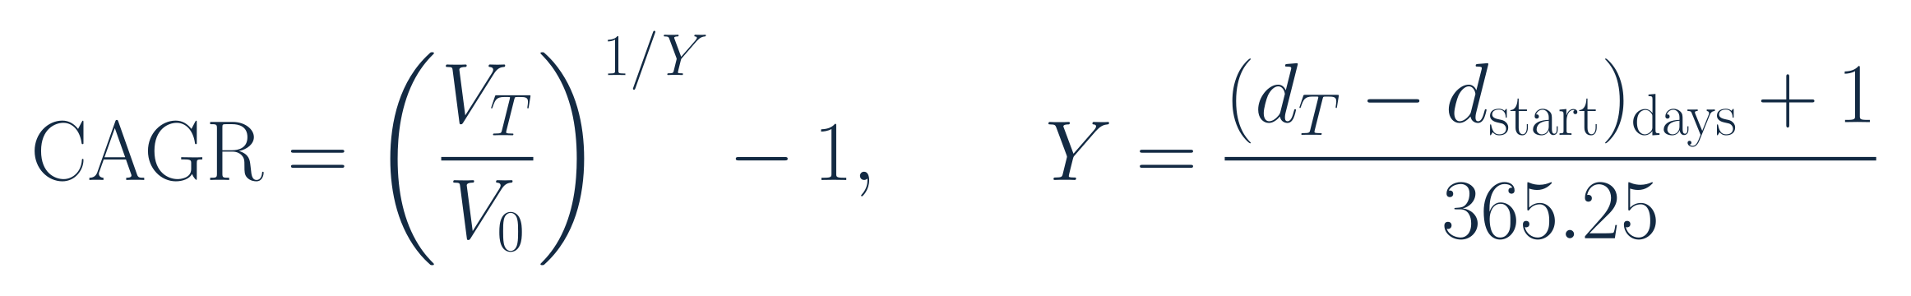
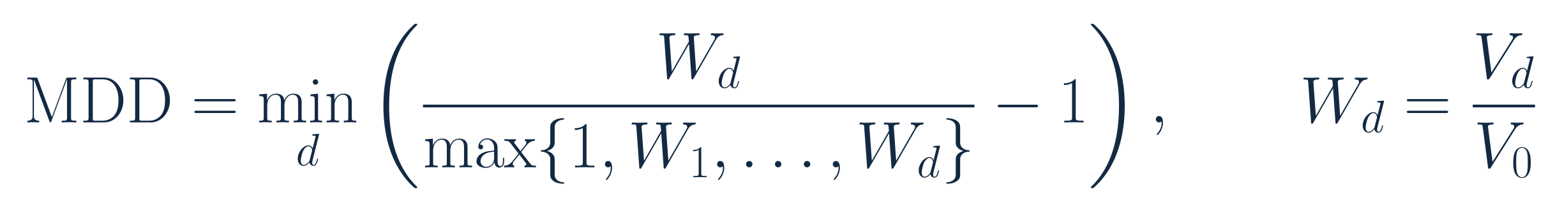
TECHNICAL REFERENCE
Growth and maximum drawdown definitions
Compound annual growth rate (CAGR)
Maximum drawdown (MDD)
V0: continuous opening NAV. VT: ending NAV. W: rebased wealth. Y: actual calendar years. Total return = VT / V0 − 1.
53
Notes:
Speaker 4. Optional Detail.
Technical reference or opening.
Core message: CAGR uses actual calendar time. Drawdown includes opening wealth.
Read-aloud script:
CAGR is compound annual growth rate. It annualizes the ratio of ending to opening wealth using actual elapsed calendar years. Total return is the same wealth ratio minus one without annualization. Opening wealth is the previous point on the continuous strategy NAV path, or one at inception. Maximum drawdown, or MDD, is the smallest signed ratio of wealth to its prior peak minus one. The peak includes opening wealth one. A drawdown closer to zero is shallower. These conventions are identical for all strategies.
Figure explanation: Explain the definitions and comparison on this page.
Sources:
/Users/wangyujing/Desktop/MFE_Macro_Rotation_6Assets/reports/phase4_research_report.md
/Users/wangyujing/Desktop/MFE_Macro_Rotation_6Assets/reports/research_report.md
/Users/wangyujing/Desktop/MFE_Macro_Rotation_6Assets/presentation_assets/final_figures_v2/formulas/svg/F08_calendar-time_cagr.svg
/Users/wangyujing/Desktop/MFE_Macro_Rotation_6Assets/presentation_assets/final_figures_v2/formulas/svg/F10_maximum_drawdown.svg

Slide 54
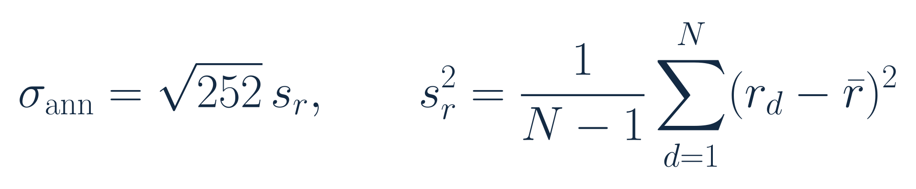
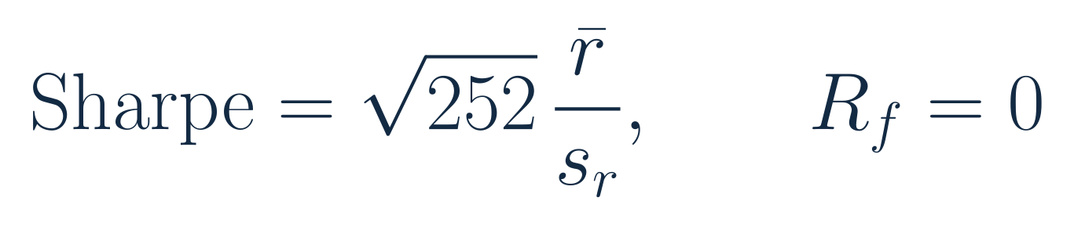
TECHNICAL REFERENCE
Volatility and Sharpe definitions
Annualized volatility
Sharpe ratio
r: net daily portfolio return. Mean is arithmetic. s: sample standard deviation, ddof=1. RF=0.
54
Notes:
Speaker 4. Optional Detail.
Technical reference or opening.
Core message: Both use sample daily standard deviation and square-root-of-252 annualization.
Read-aloud script:
Annualized volatility uses the sample standard deviation of net daily portfolio returns with one degree of freedom adjustment. The Sharpe ratio uses arithmetic mean daily net returns divided by the same sample standard deviation, multiplied by the square root of 252. The reference rate is zero, not BIL. It follows that Sharpe is not CAGR divided by annualized volatility. The fixed 252 convention is retained even though the common valuation grid includes both US and Singapore trading days.
Figure explanation: Explain the definitions and comparison on this page.
Sources:
/Users/wangyujing/Desktop/MFE_Macro_Rotation_6Assets/reports/phase4_research_report.md
/Users/wangyujing/Desktop/MFE_Macro_Rotation_6Assets/reports/research_report.md
/Users/wangyujing/Desktop/MFE_Macro_Rotation_6Assets/presentation_assets/final_figures_v2/formulas/svg/F09_annualized_volatility.svg
/Users/wangyujing/Desktop/MFE_Macro_Rotation_6Assets/presentation_assets/final_figures_v2/formulas/svg/F07_sharpe_ratio.svg

Slide 55
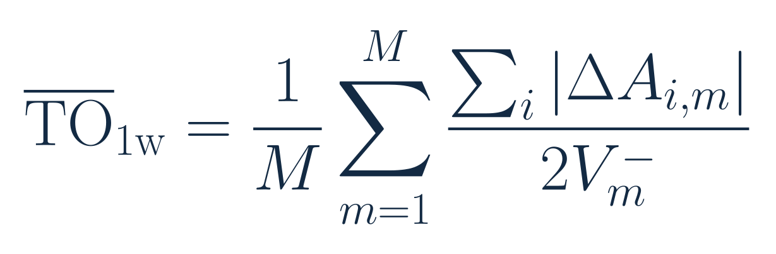
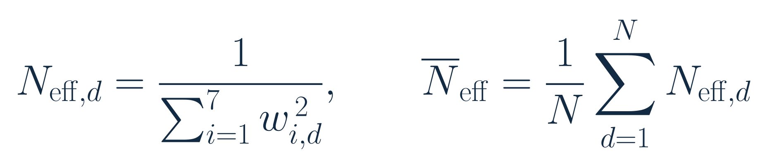
TECHNICAL REFERENCE
Turnover and effective holdings definitions
Monthly average one-way turnover
Effective holdings
Delta A: actual currency trades. V-minus: pre-fee NAV. w: actual daily close weights, including BIL.
55
Notes:
Speaker 4. Optional Detail.
Technical reference or opening.
Core message: Use actual trades and daily capital weights, rather than target-weight shortcuts.
Read-aloud script:
Monthly average one-way turnover is the mean across monthly rebalances of the absolute currency trades, divided by twice the pre-fee portfolio value. Initial purchases count, and we do not force terminal liquidation. Effective holdings is the inverse sum of squared actual daily close weights, including BIL, averaged across the period. It is not the number of tickers held and is not calculated from period-average weights. The average effective holdings of MWRP in the main window is 3.44.
Figure explanation: Explain the definitions and comparison on this page.
Sources:
/Users/wangyujing/Desktop/MFE_Macro_Rotation_6Assets/reports/phase4_research_report.md
/Users/wangyujing/Desktop/MFE_Macro_Rotation_6Assets/reports/research_report.md
/Users/wangyujing/Desktop/MFE_Macro_Rotation_6Assets/presentation_assets/final_figures_v2/formulas/svg/F12_monthly_one-way_turnover.svg
/Users/wangyujing/Desktop/MFE_Macro_Rotation_6Assets/presentation_assets/final_figures_v2/formulas/svg/F11_effective_holdings.svg

Slide 56
TECHNICAL REFERENCE
MWRP signal and risk-budget formulation
Six-month spread
Eligibility
Risk preferences
56
Notes:
Speaker 2. Optional Detail.
Technical reference or opening.
Core message: A fixed six-month gate and linear rank rule define risk preferences.
Read-aloud script:
This reference brings the three signal formulas together. The six-month SGD return spread relative to BIL determines eligibility. Rank one is strongest among eligible risk assets. The linear budget sums to one over that set. Ties use the fixed source order SPY, ES3, TLT, GLD, IEMG and PDBC. The strategy has no fitted forecast coefficient, budget-power search, top-N adjustment or leverage overlay. The same rule is applied to both historical subperiods.
Figure explanation: Explain the definitions and comparison on this page.
Sources:
/Users/wangyujing/Desktop/MFE_Macro_Rotation_6Assets/reports/phase4_research_report.md
/Users/wangyujing/Desktop/MFE_Macro_Rotation_6Assets/reports/research_report.md
/Users/wangyujing/Desktop/MFE_Macro_Rotation_6Assets/presentation_assets/final_figures_v2/formulas/svg/F01_six-month_excess_momentum.svg
/Users/wangyujing/Desktop/MFE_Macro_Rotation_6Assets/presentation_assets/final_figures_v2/formulas/svg/F02_momentum_eligibility.svg
/Users/wangyujing/Desktop/MFE_Macro_Rotation_6Assets/presentation_assets/final_figures_v2/formulas/svg/F03_momentum-weighted_risk_budget.svg

Slide 57
TECHNICAL REFERENCE
EWMA estimation details
Element | Frozen convention
Initialization | 252 valuation returns, sample covariance
Centering | Prior-day expanding mean
Recursion | Raw Q with lambda = 0.94
Stabilization | 1% diagonal shrinkage, variance floor 1e-12
Allocation | Eligible risk-asset covariance submatrix
No parameter optimization. Fixed annual covariance scaling leaves normalized capital weights unchanged.
57
Notes:
Speaker 3. Optional Detail.
Technical reference or opening.
Core message: Initialization, centering and stabilization are fixed before comparison.
Read-aloud script:
The raw covariance and mean initialize with 252 valuation returns. Each new innovation subtracts the expanding mean available through the previous valuation day. The raw covariance recurses with lambda 0.94, then the mean is updated. The forecast matrix uses fixed one percent shrinkage toward the diagonal and only a diagonal correction required to keep each variance at or above ten to the minus twelve. Annual scaling leaves normalized risk-budget capital weights unchanged. The risk-asset submatrix is used for allocation, with no automatic parameter search.
Figure explanation: Explain the definitions and comparison on this page.
Sources:
/Users/wangyujing/Desktop/MFE_Macro_Rotation_6Assets/reports/phase4_research_report.md
/Users/wangyujing/Desktop/MFE_Macro_Rotation_6Assets/reports/research_report.md
/Users/wangyujing/Desktop/MFE_Macro_Rotation_6Assets/presentation_assets/final_figures_v2/formulas/svg/F04_ewma_covariance_update.svg

Slide 58
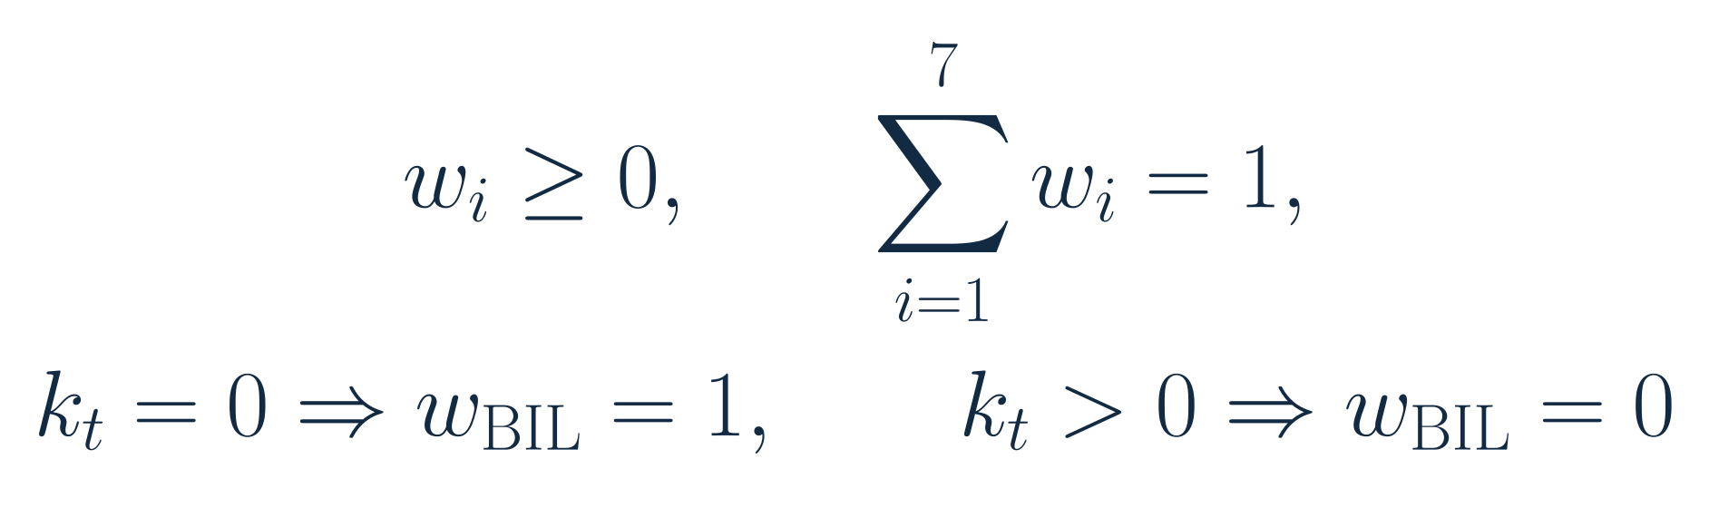
TECHNICAL REFERENCE
Risk-budget optimization and capital constraints
Optimization
Capital constraints and fallback
Estimated risk-contribution formula: Slide 12. No leverage. Eligible sleeve only. k=1: sole asset receives 100%.
58
Notes:
Speaker 3. Optional Detail.
Technical reference or opening.
Core message: Assigned shares are ex ante targets for the eligible risk sleeve.
Read-aloud script:
The optimizer operates only on the eligible assets. Normalizing its positive solution yields long-only capital weights that sum to one. Estimated volatility contributions, divided by portfolio volatility, equal the assigned risk-budget shares. With no eligible risk asset, all capital is BIL. With one eligible asset, all risk and capital go to it. These fallback rules apply to MWRP, MGRP and Gated Equal Weight. Dual instead redirects each failed fifty-percent slot individually. Ex ante risk shares are not future realized guarantees.
Figure explanation: Explain the definitions and comparison on this page.
Sources:
/Users/wangyujing/Desktop/MFE_Macro_Rotation_6Assets/reports/phase4_research_report.md
/Users/wangyujing/Desktop/MFE_Macro_Rotation_6Assets/reports/research_report.md
/Users/wangyujing/Desktop/MFE_Macro_Rotation_6Assets/presentation_assets/final_figures_v2/formulas/svg/F05_risk_budget_optimization.svg
/Users/wangyujing/Desktop/MFE_Macro_Rotation_6Assets/presentation_assets/final_figures_v2/formulas/svg/F06_capital_constraints_and_fallback.svg

Slide 59
TECHNICAL REFERENCE
Realized risk and P&L use different decompositions
Signed realized risk shares
Additive profit and loss (P&L)
H: exact (entry close, next close] interval. c: gross asset return contribution. Fees excluded from risk, included in P&L.
59
Notes:
Speaker 5. Optional Detail.
Technical reference or opening.
Core message: Risk shares use covariance. P&L contributions reconcile total return.
Read-aloud script:
Realized risk contributions use each asset's lagged actual capital weight times its return. Covariance with the total gross portfolio return is divided by total return variance over the exact execution-to-execution interval. The signed shares sum to one and can be negative or greater than one. P&L attribution instead adds daily currency asset gains and divides by common period opening wealth. Negative transaction costs are a separate contribution. The sum equals net total return, not CAGR. These are different accounting and risk questions, so the quantities should not be interchanged.
Figure explanation: Explain the definitions and comparison on this page.
Sources:
/Users/wangyujing/Desktop/MFE_Macro_Rotation_6Assets/reports/phase4_research_report.md
/Users/wangyujing/Desktop/MFE_Macro_Rotation_6Assets/reports/research_report.md
/Users/wangyujing/Desktop/MFE_Macro_Rotation_6Assets/presentation_assets/final_figures_v2/formulas/svg/F14_realized_risk_contribution.svg
/Users/wangyujing/Desktop/MFE_Macro_Rotation_6Assets/presentation_assets/final_figures_v2/formulas/svg/F15_additive_pandl_attribution.svg

Slide 60
TECHNICAL REFERENCE
Complete performance: recent evaluation
60
Notes:
Speaker 4. Optional Detail.
Technical reference or opening.
Core message: Six strategies, January 2024 through September 2026.
Read-aloud script:
This table provides the complete six-strategy comparison for the main evaluation period. It retains Gated Equal Weight as the component benchmark. Net CAGR, total return, Sharpe, volatility, signed maximum drawdown, monthly average one-way turnover and effective holdings all use the frozen conventions. MWRP's main-period Sharpe is the highest of these six, while Dual has the highest CAGR. Gated Equal Weight has the shallowest maximum drawdown in this broader comparison.
Figure explanation: Six strategies, January 2024 through September 2026.
Sources:
/Users/wangyujing/Desktop/MFE_Macro_Rotation_6Assets/presentation_assets/final_figures_v2/figures/appendix/APP01_Performance_evaluation_full.svg
/Users/wangyujing/Desktop/MFE_Macro_Rotation_6Assets/reports/phase4_research_report.md
/Users/wangyujing/Desktop/MFE_Macro_Rotation_6Assets/reports/research_report.md
/Users/wangyujing/Desktop/MFE_Macro_Rotation_6Assets/data/processed/sgd_daily_returns.csv
/Users/wangyujing/Desktop/MFE_Macro_Rotation_6Assets/data/processed/sgd_total_return_indices.csv
/Users/wangyujing/Desktop/MFE_Macro_Rotation_6Assets/outputs/diagnostics/Dual_Momentum_contribution.csv
/Users/wangyujing/Desktop/MFE_Macro_Rotation_6Assets/outputs/diagnostics/Dual_Momentum_daily.csv
/Users/wangyujing/Desktop/MFE_Macro_Rotation_6Assets/outputs/diagnostics/Dual_Momentum_weights.csv
/Users/wangyujing/Desktop/MFE_Macro_Rotation_6Assets/outputs/diagnostics/EWMA_Risk_Parity_contribution.csv
/Users/wangyujing/Desktop/MFE_Macro_Rotation_6Assets/outputs/diagnostics/EWMA_Risk_Parity_daily.csv
/Users/wangyujing/Desktop/MFE_Macro_Rotation_6Assets/outputs/diagnostics/EWMA_Risk_Parity_weights.csv
/Users/wangyujing/Desktop/MFE_Macro_Rotation_6Assets/outputs/diagnostics/Equal_Weight_contribution.csv
/Users/wangyujing/Desktop/MFE_Macro_Rotation_6Assets/outputs/diagnostics/Equal_Weight_daily.csv
/Users/wangyujing/Desktop/MFE_Macro_Rotation_6Assets/outputs/diagnostics/Equal_Weight_weights.csv
/Users/wangyujing/Desktop/MFE_Macro_Rotation_6Assets/outputs/diagnostics/Gated_Equal_Weight_contribution.csv
/Users/wangyujing/Desktop/MFE_Macro_Rotation_6Assets/outputs/diagnostics/Gated_Equal_Weight_daily.csv
/Users/wangyujing/Desktop/MFE_Macro_Rotation_6Assets/outputs/diagnostics/Gated_Equal_Weight_weights.csv
/Users/wangyujing/Desktop/MFE_Macro_Rotation_6Assets/outputs/diagnostics/MGRP-Base_contribution.csv
/Users/wangyujing/Desktop/MFE_Macro_Rotation_6Assets/outputs/diagnostics/MGRP-Base_daily.csv
/Users/wangyujing/Desktop/MFE_Macro_Rotation_6Assets/outputs/diagnostics/MGRP-Base_weights.csv
/Users/wangyujing/Desktop/MFE_Macro_Rotation_6Assets/outputs/phase4/diagnostics/MWRP_contribution.csv
/Users/wangyujing/Desktop/MFE_Macro_Rotation_6Assets/outputs/phase4/diagnostics/MWRP_daily.csv
/Users/wangyujing/Desktop/MFE_Macro_Rotation_6Assets/outputs/phase4/diagnostics/MWRP_weights.csv
/Users/wangyujing/Desktop/MFE_Macro_Rotation_6Assets/outputs/phase4/diagnostics/assigned_predicted_realized_risk.csv
/Users/wangyujing/Desktop/MFE_Macro_Rotation_6Assets/outputs/phase4/diagnostics/forecast_vs_realized_exact_holding_windows.csv
/Users/wangyujing/Desktop/MFE_Macro_Rotation_6Assets/outputs/phase4/tables/table01_three_period_performance.csv
/Users/wangyujing/Desktop/MFE_Macro_Rotation_6Assets/outputs/phase4/tables/table02_annual_returns.csv
/Users/wangyujing/Desktop/MFE_Macro_Rotation_6Assets/outputs/phase4/tables/table06_transaction_cost_sensitivity.csv
/Users/wangyujing/Desktop/MFE_Macro_Rotation_6Assets/outputs/phase4/tables/table07_monthly_allocation_decisions.csv
/Users/wangyujing/Desktop/MFE_Macro_Rotation_6Assets/outputs/tables/annual_performance.csv
/Users/wangyujing/Desktop/MFE_Macro_Rotation_6Assets/outputs/tables/full_2020_Sep2026_performance.csv
/Users/wangyujing/Desktop/MFE_Macro_Rotation_6Assets/outputs/tables/performance_all_cost_scenarios.csv
/Users/wangyujing/Desktop/MFE_Macro_Rotation_6Assets/outputs/tables/performance_main.csv

Slide 61
TECHNICAL REFERENCE
Complete performance: historical validation
61
Notes:
Speaker 4. Optional Detail.
Technical reference or opening.
Core message: Six strategies, January 2020 through December 2023.
Read-aloud script:
This is the earlier validation table. Dual leads CAGR and Sharpe. MWRP improves on MGRP but remains below Dual on those investment measures. Keep this page available when discussing whether the recent results are regime dependent. All costs, metric definitions and execution rules match the recent-period table.
Figure explanation: Six strategies, January 2020 through December 2023.
Sources:
/Users/wangyujing/Desktop/MFE_Macro_Rotation_6Assets/presentation_assets/final_figures_v2/figures/appendix/APP01_Performance_validation_full.svg
/Users/wangyujing/Desktop/MFE_Macro_Rotation_6Assets/reports/phase4_research_report.md
/Users/wangyujing/Desktop/MFE_Macro_Rotation_6Assets/reports/research_report.md
/Users/wangyujing/Desktop/MFE_Macro_Rotation_6Assets/data/processed/sgd_daily_returns.csv
/Users/wangyujing/Desktop/MFE_Macro_Rotation_6Assets/data/processed/sgd_total_return_indices.csv
/Users/wangyujing/Desktop/MFE_Macro_Rotation_6Assets/outputs/diagnostics/Dual_Momentum_contribution.csv
/Users/wangyujing/Desktop/MFE_Macro_Rotation_6Assets/outputs/diagnostics/Dual_Momentum_daily.csv
/Users/wangyujing/Desktop/MFE_Macro_Rotation_6Assets/outputs/diagnostics/Dual_Momentum_weights.csv
/Users/wangyujing/Desktop/MFE_Macro_Rotation_6Assets/outputs/diagnostics/EWMA_Risk_Parity_contribution.csv
/Users/wangyujing/Desktop/MFE_Macro_Rotation_6Assets/outputs/diagnostics/EWMA_Risk_Parity_daily.csv
/Users/wangyujing/Desktop/MFE_Macro_Rotation_6Assets/outputs/diagnostics/EWMA_Risk_Parity_weights.csv
/Users/wangyujing/Desktop/MFE_Macro_Rotation_6Assets/outputs/diagnostics/Equal_Weight_contribution.csv
/Users/wangyujing/Desktop/MFE_Macro_Rotation_6Assets/outputs/diagnostics/Equal_Weight_daily.csv
/Users/wangyujing/Desktop/MFE_Macro_Rotation_6Assets/outputs/diagnostics/Equal_Weight_weights.csv
/Users/wangyujing/Desktop/MFE_Macro_Rotation_6Assets/outputs/diagnostics/Gated_Equal_Weight_contribution.csv
/Users/wangyujing/Desktop/MFE_Macro_Rotation_6Assets/outputs/diagnostics/Gated_Equal_Weight_daily.csv
/Users/wangyujing/Desktop/MFE_Macro_Rotation_6Assets/outputs/diagnostics/Gated_Equal_Weight_weights.csv
/Users/wangyujing/Desktop/MFE_Macro_Rotation_6Assets/outputs/diagnostics/MGRP-Base_contribution.csv
/Users/wangyujing/Desktop/MFE_Macro_Rotation_6Assets/outputs/diagnostics/MGRP-Base_daily.csv
/Users/wangyujing/Desktop/MFE_Macro_Rotation_6Assets/outputs/diagnostics/MGRP-Base_weights.csv
/Users/wangyujing/Desktop/MFE_Macro_Rotation_6Assets/outputs/phase4/diagnostics/MWRP_contribution.csv
/Users/wangyujing/Desktop/MFE_Macro_Rotation_6Assets/outputs/phase4/diagnostics/MWRP_daily.csv
/Users/wangyujing/Desktop/MFE_Macro_Rotation_6Assets/outputs/phase4/diagnostics/MWRP_weights.csv
/Users/wangyujing/Desktop/MFE_Macro_Rotation_6Assets/outputs/phase4/diagnostics/assigned_predicted_realized_risk.csv
/Users/wangyujing/Desktop/MFE_Macro_Rotation_6Assets/outputs/phase4/diagnostics/forecast_vs_realized_exact_holding_windows.csv
/Users/wangyujing/Desktop/MFE_Macro_Rotation_6Assets/outputs/phase4/tables/table01_three_period_performance.csv
/Users/wangyujing/Desktop/MFE_Macro_Rotation_6Assets/outputs/phase4/tables/table02_annual_returns.csv
/Users/wangyujing/Desktop/MFE_Macro_Rotation_6Assets/outputs/phase4/tables/table06_transaction_cost_sensitivity.csv
/Users/wangyujing/Desktop/MFE_Macro_Rotation_6Assets/outputs/phase4/tables/table07_monthly_allocation_decisions.csv
/Users/wangyujing/Desktop/MFE_Macro_Rotation_6Assets/outputs/tables/annual_performance.csv
/Users/wangyujing/Desktop/MFE_Macro_Rotation_6Assets/outputs/tables/full_2020_Sep2026_performance.csv
/Users/wangyujing/Desktop/MFE_Macro_Rotation_6Assets/outputs/tables/performance_all_cost_scenarios.csv
/Users/wangyujing/Desktop/MFE_Macro_Rotation_6Assets/outputs/tables/performance_main.csv

Slide 62
TECHNICAL REFERENCE
Complete performance: continuous full history
62
Notes:
Speaker 4. Optional Detail.
Technical reference or opening.
Core message: Six strategies, January 2020 through September 2026.
Read-aloud script:
The combined period is a continuous wealth path, not the average of subperiod CAGRs. It is also not an independent third sample. Dual has 17.26 percent CAGR and a Sharpe of 1.146. MWRP has 12.56 percent and 1.025. This table reinforces the main conclusion: MWRP provides a transparent alternative with competitive recent risk-adjusted performance, rather than universal outperformance.
Figure explanation: Six strategies, January 2020 through September 2026.
Sources:
/Users/wangyujing/Desktop/MFE_Macro_Rotation_6Assets/presentation_assets/final_figures_v2/figures/appendix/APP01_Performance_combined_full.svg
/Users/wangyujing/Desktop/MFE_Macro_Rotation_6Assets/reports/phase4_research_report.md
/Users/wangyujing/Desktop/MFE_Macro_Rotation_6Assets/reports/research_report.md
/Users/wangyujing/Desktop/MFE_Macro_Rotation_6Assets/data/processed/sgd_daily_returns.csv
/Users/wangyujing/Desktop/MFE_Macro_Rotation_6Assets/data/processed/sgd_total_return_indices.csv
/Users/wangyujing/Desktop/MFE_Macro_Rotation_6Assets/outputs/diagnostics/Dual_Momentum_contribution.csv
/Users/wangyujing/Desktop/MFE_Macro_Rotation_6Assets/outputs/diagnostics/Dual_Momentum_daily.csv
/Users/wangyujing/Desktop/MFE_Macro_Rotation_6Assets/outputs/diagnostics/Dual_Momentum_weights.csv
/Users/wangyujing/Desktop/MFE_Macro_Rotation_6Assets/outputs/diagnostics/EWMA_Risk_Parity_contribution.csv
/Users/wangyujing/Desktop/MFE_Macro_Rotation_6Assets/outputs/diagnostics/EWMA_Risk_Parity_daily.csv
/Users/wangyujing/Desktop/MFE_Macro_Rotation_6Assets/outputs/diagnostics/EWMA_Risk_Parity_weights.csv
/Users/wangyujing/Desktop/MFE_Macro_Rotation_6Assets/outputs/diagnostics/Equal_Weight_contribution.csv
/Users/wangyujing/Desktop/MFE_Macro_Rotation_6Assets/outputs/diagnostics/Equal_Weight_daily.csv
/Users/wangyujing/Desktop/MFE_Macro_Rotation_6Assets/outputs/diagnostics/Equal_Weight_weights.csv
/Users/wangyujing/Desktop/MFE_Macro_Rotation_6Assets/outputs/diagnostics/Gated_Equal_Weight_contribution.csv
/Users/wangyujing/Desktop/MFE_Macro_Rotation_6Assets/outputs/diagnostics/Gated_Equal_Weight_daily.csv
/Users/wangyujing/Desktop/MFE_Macro_Rotation_6Assets/outputs/diagnostics/Gated_Equal_Weight_weights.csv
/Users/wangyujing/Desktop/MFE_Macro_Rotation_6Assets/outputs/diagnostics/MGRP-Base_contribution.csv
/Users/wangyujing/Desktop/MFE_Macro_Rotation_6Assets/outputs/diagnostics/MGRP-Base_daily.csv
/Users/wangyujing/Desktop/MFE_Macro_Rotation_6Assets/outputs/diagnostics/MGRP-Base_weights.csv
/Users/wangyujing/Desktop/MFE_Macro_Rotation_6Assets/outputs/phase4/diagnostics/MWRP_contribution.csv
/Users/wangyujing/Desktop/MFE_Macro_Rotation_6Assets/outputs/phase4/diagnostics/MWRP_daily.csv
/Users/wangyujing/Desktop/MFE_Macro_Rotation_6Assets/outputs/phase4/diagnostics/MWRP_weights.csv
/Users/wangyujing/Desktop/MFE_Macro_Rotation_6Assets/outputs/phase4/diagnostics/assigned_predicted_realized_risk.csv
/Users/wangyujing/Desktop/MFE_Macro_Rotation_6Assets/outputs/phase4/diagnostics/forecast_vs_realized_exact_holding_windows.csv
/Users/wangyujing/Desktop/MFE_Macro_Rotation_6Assets/outputs/phase4/tables/table01_three_period_performance.csv
/Users/wangyujing/Desktop/MFE_Macro_Rotation_6Assets/outputs/phase4/tables/table02_annual_returns.csv
/Users/wangyujing/Desktop/MFE_Macro_Rotation_6Assets/outputs/phase4/tables/table06_transaction_cost_sensitivity.csv
/Users/wangyujing/Desktop/MFE_Macro_Rotation_6Assets/outputs/phase4/tables/table07_monthly_allocation_decisions.csv
/Users/wangyujing/Desktop/MFE_Macro_Rotation_6Assets/outputs/tables/annual_performance.csv
/Users/wangyujing/Desktop/MFE_Macro_Rotation_6Assets/outputs/tables/full_2020_Sep2026_performance.csv
/Users/wangyujing/Desktop/MFE_Macro_Rotation_6Assets/outputs/tables/performance_all_cost_scenarios.csv
/Users/wangyujing/Desktop/MFE_Macro_Rotation_6Assets/outputs/tables/performance_main.csv

Slide 63
TECHNICAL REFERENCE
Trading assumptions and evidence boundaries
Item | Convention
Signal information | Month-end history, available next day at 06:00 UTC
Execution | Second common fresh-quote trading-day close basket
Returns | Old positions through replacement close, new positions thereafter
Main trading cost | 10 bps per traded side on actual currency trades
Additional scenarios | 5 and 25 bps, all other rules fixed
Fund expenses | Already reflected in adjusted prices
Not explicitly modeled | Investor taxes, separate FX fees, time-varying impact
Retrospective simulation. Asynchronous market closes remain a material approximation.
63
Notes:
Speaker 3. Optional Detail.
Technical reference or opening.
Core message: The close-basket approximation and simplified costs remain material limitations.
Read-aloud script:
Signals become available after the month-end information cutoff. Orders are represented at the second common fresh-quote trading-day close basket, with old holdings retained through replacement. The engine charges ten basis points per traded side to actual currency trades and solves self-financing post-fee holdings. Fund expenses are already reflected in prices. Investor taxes, separate FX charges and time-varying market impact are not explicitly modeled. Historical quote revisions and asynchronous closes remain data limitations. These are retrospective simulations and should not be presented as deployed returns.
Figure explanation: Explain the definitions and comparison on this page.
Sources:
/Users/wangyujing/Desktop/MFE_Macro_Rotation_6Assets/reports/phase4_research_report.md
/Users/wangyujing/Desktop/MFE_Macro_Rotation_6Assets/reports/research_report.md

Slide 64
TECHNICAL REFERENCE
Group member contributions
Member | Presentation responsibility | Actual contribution
[Member 1] | Sections 01 and 06 | [To be confirmed]
[Member 2] | Section 02 | [To be confirmed]
[Member 3] | Section 03 | [To be confirmed]
[Member 4] | Section 04 | [To be confirmed]
[Member 5] | Section 05 | [To be confirmed]
Presentation responsibilities do not establish who performed the research.
64
Notes:
Speaker 1. Optional Detail.
Technical reference or opening.
Core message: Names and actual contributions remain to be confirmed.
Read-aloud script:
This page is a placeholder for the team's confirmed names and actual contributions. Presentation assignments are not statements about who performed the research. Speaker 1 presents the investment motivation and returns for robustness and the conclusion. Speaker 2 explains the strategy. Speaker 3 covers the econometric framework. Speaker 4 presents portfolio performance. Speaker 5 explains attribution and components. Please replace each placeholder with the agreed factual contribution before submission.
Figure explanation: Explain the definitions and comparison on this page.
Sources:
/Users/wangyujing/Desktop/MFE_Macro_Rotation_6Assets/reports/phase4_research_report.md
/Users/wangyujing/Desktop/MFE_Macro_Rotation_6Assets/reports/research_report.md

