Slide 1

Multimedia algorithm implementation MVP 1 – Week 15
Project plan
Tomas STRAND
Candice PERSIL

Slide 2






Interface description
Supported OS
Software

Slide 3
Research
Schroeder reverberators
SATREV -> comb filters into all pass filters
JCREV -> all pass filters into comb filters
Moorer – improvement of schroeder design
How to create a reverb
Different types of reverbs
Modifiable parameters

Slide 4
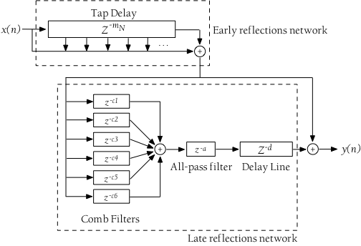
Base Algorithm The MOORER design
Tapped delay line for early reflections
A 1st order low-pass filter in the feedback loop of the 6 comb filters for absorption effects of air

Slide 5
Key facts for Inplementation
Type of artificial reverberation -> Delay networks
Simulated using delay lines, filters and feedback connections
Use of feedback loop around the structure -> more natural decay
More comb filters > more better reverberation
Different decay times for left and right for a more natural sound

Slide 6
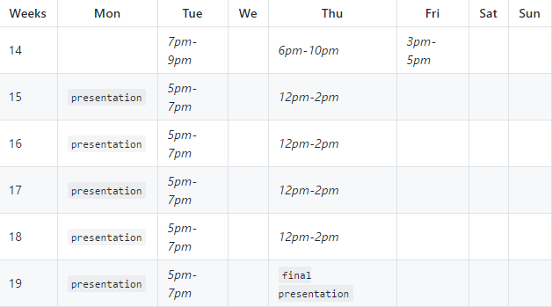
Schedule
Meetings to gather individual work

Slide 7
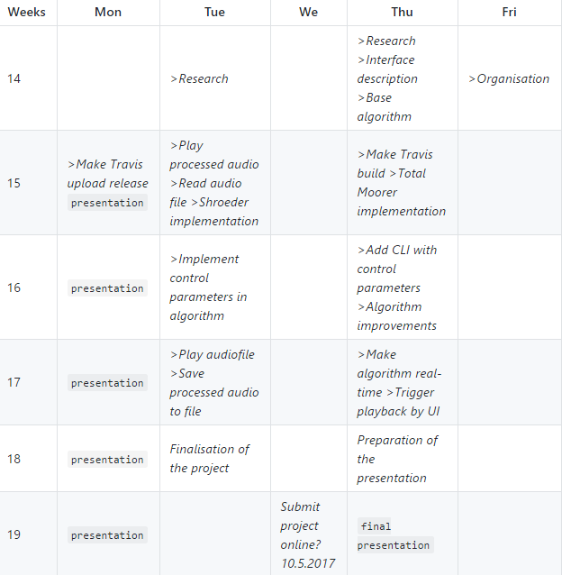
Schedule
Internal due dates for tasks

Slide 8
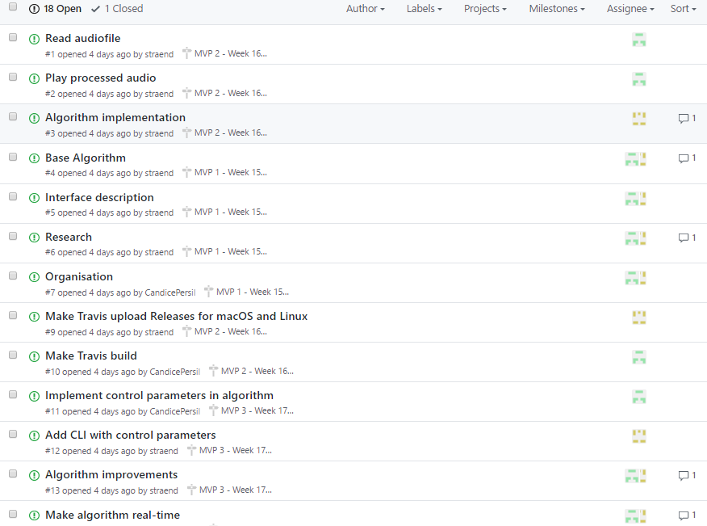
Tasks - Issues

