Slide 1
Neshto shantavo
TeamNavyPier
PHP Basics Team Project
Software University, Sofia
18 December 2014

Slide 2
Testing details
Web: https://neshto.shantavo.com
GitHub: https://github.com/TeamNavyPier/NeshtoShantavo
Test account I:
user: test1
pass: test1
Test account 1I:
user: test@shantavo.com
pass: demo123

Slide 3
The idea
We are an online photo gallery that aims to be the home for the pictures that show the world around us from a different - shantav - angle
We are not the typical online photo album and catalogue service, e.g. Picasso, Flickr, etc.
We let people show the strange things they see everyday and share them with the community
and with Facebbok, Twitter, etc. too
Visit us at https://neshto.shantavo.com

Slide 4
Basic Functionality
User registration and login
Upload pictures
in Albums
in Categories
Vote and comment on pictures
Share pictures on Facebook, Twitter, LinkedIn, email, Google+
Administration:
Delete users / pictures / comments
Add, delete, modify photo categories

Slide 5
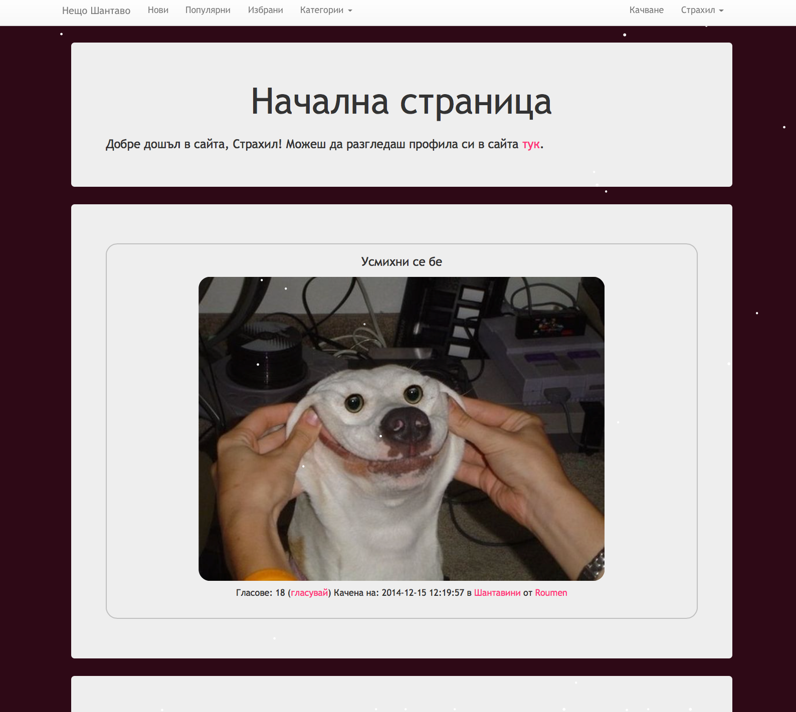

Slide 6
the team
Румен Дамянов:
Бек-енд, уеб дизайн, хостинг
Теодор Пенев:
Уеб дизайн и оформление, организация на проекта
Страхил Руйчев:
Уеб дизайн и оформление, организация
Йордан Георгиев:
Уеб дизайн и оформление, организация

Slide 7
technologies used
Trello - idea generation and voting, team organisation, task management
GitHub - team collaboration, CVS
PHP, Laravel - server-side development
HTML, CSS, Bootstrap - design of the web site, DOM manipulation
NginX / Apache, MySQL / Redis, CloudFlare (SSL, IPV6 etc.) - server side scripts, database, etc.

Slide 8
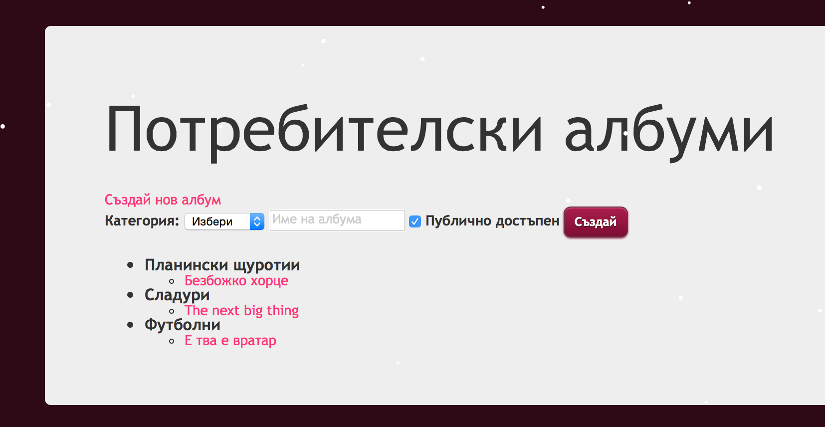
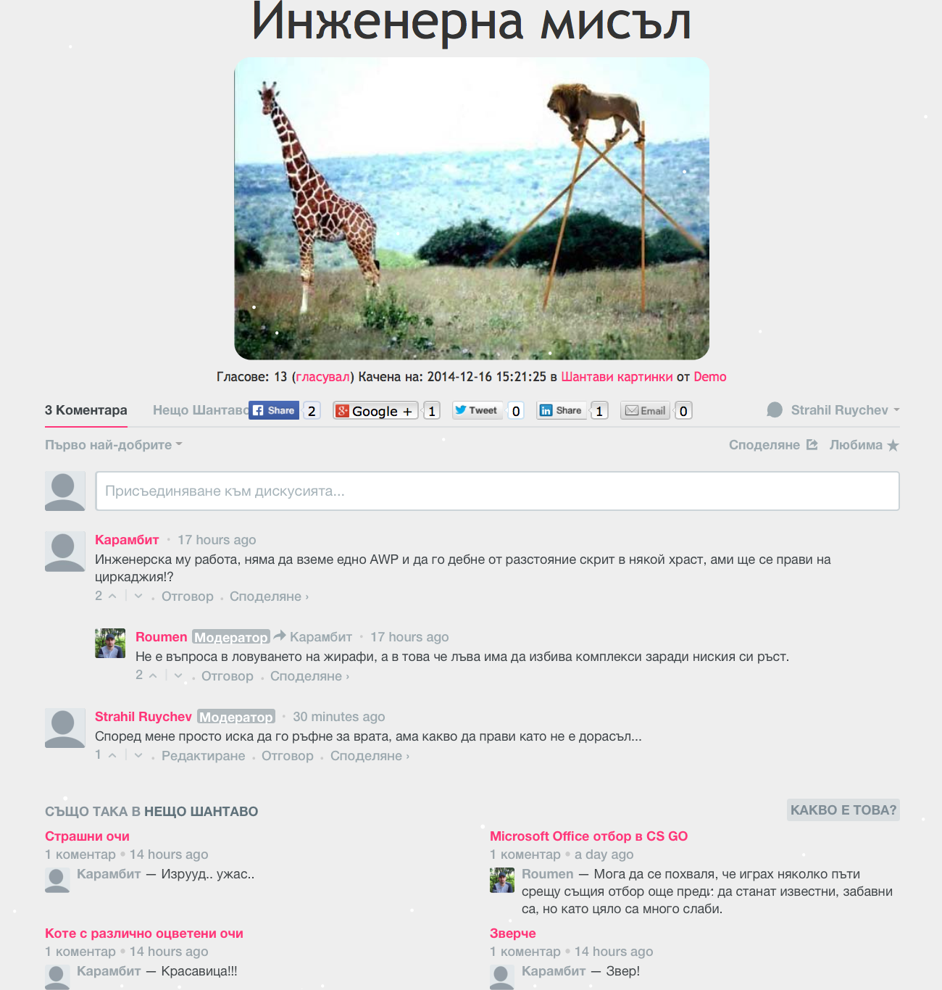
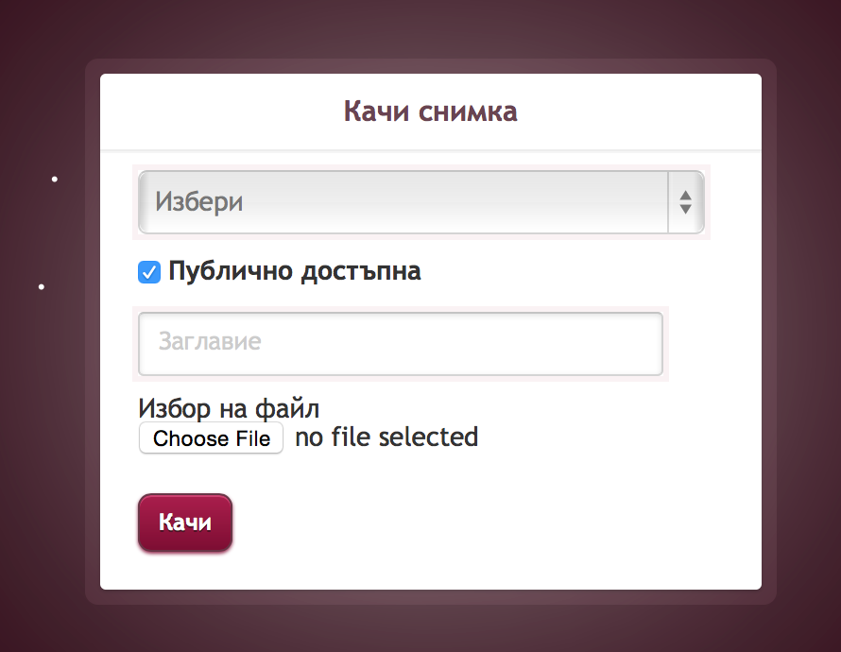

Slide 9
Thanks for your attention…
teamnavypier

