Slide 1
Straightway
A Presentation for Non-Techies

Slide 2

What is Straightway?
A Communication Platform
Free
Private
Anonymous
Noncommercial
Decentralized

Slide 3

What can I do with Straightway?
Enable applications
Social media feed
Mail & messenger
File sharing
Searching
Online conferencing
Equal and secret ballot

Slide 4

Additional Benefits of Straightway
No registration
Spam prevention by design
Fast download
“Forget” unpopular content after some time
Strong end-to-end encryption
Strong obfuscation of meta data

Slide 5
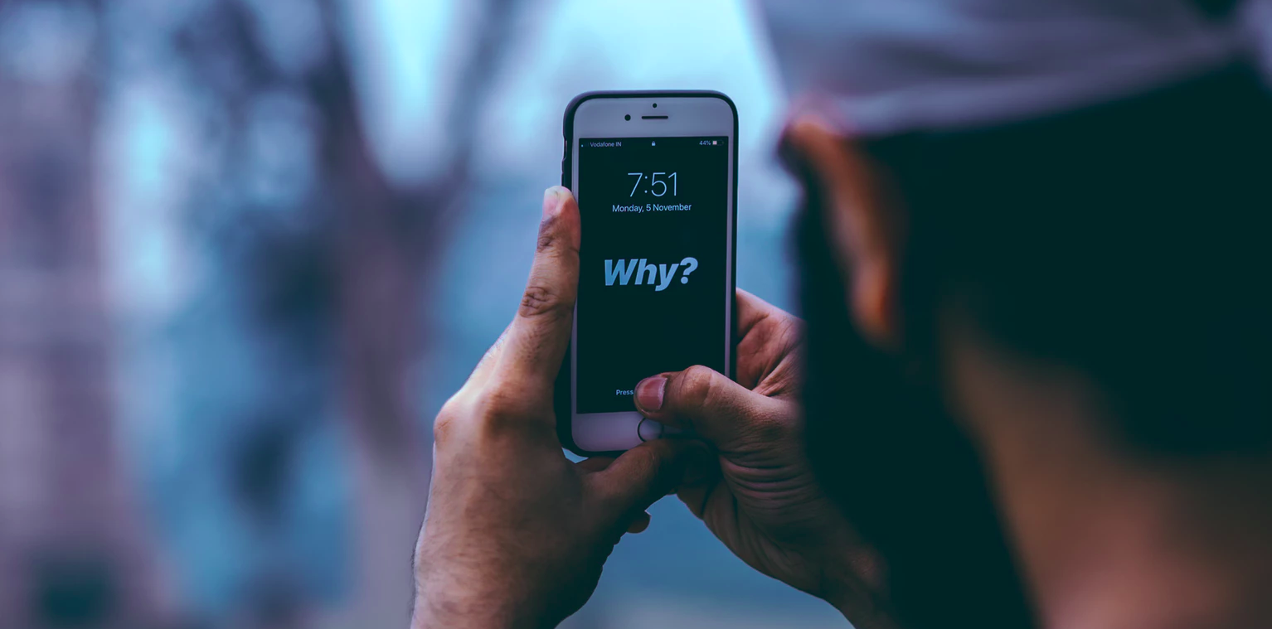
Why do we need Straightway?
Users want social media!
Popular platforms
  Hold very private data!
  Have bad privacy
  Have commercial interests
  Have bad data security
  Leak private data
  Try to lock-in users in their ecosystem
  Ignore political restrictions

Slide 6

Why do we need Straightway?
Straightway empowers the users!
  Technical approach to achieve privacy and data security
  The user decides who can see what
  No need to trust a provider who can see everything
  Completely open source code

Slide 7
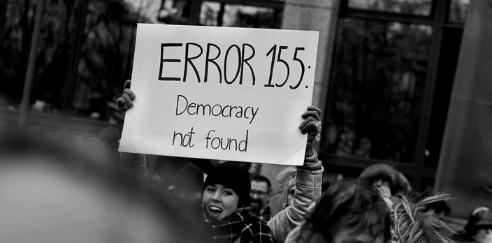
Straightway is a Political Statement!

