Slide 1
RevLens AI - Review Intelligence & Analytics
AI-Powered Homestay Review Management & Trust Analytics Platform
Project Title: RevLens AI
• Intern Name: Abhinesh Gangwar
• Intern ID: TBI-26100587
• University: Graphic Era Deemed To Be University
• GitHub: https://github.com/strange-exe/revlens-ai
• Live App: https://revlens.abhinesh.codes

Slide 2
What Problem Are We Solving?
Challenges in Homestay & Hospitality Feedback Management
• Fragmented Feedback Signals: Homestay owners receive guest feedback across multiple channels without unified tracking.
• Reputational Risk: Unmoderated spam, link injections, or unaddressed negative reviews damage host ratings rapidly.
• Operational Bottleneck: Manually crafting personalized, tone-matched responses for every guest consumes hours daily.
• Lack of Actionable Insights: Hosts lack real-time analytics to spot recurring maintenance or service issues across properties.

Slide 3
Tech Stack Selected & Rationale
Modern, High-Performance Full-Stack Architecture
• Frontend : React 18 (Vite) + Tailwind CSS - Fast component rendering, dynamic dark mode tokens, and crisp responsive layout.
• Backend : FastAPI (Python 3.12) - Asynchronous REST API execution, Pydantic type safety, and instant auto-generated OpenAPI documentation.
• AI Model : Google Gemini API (gemini-1.5-flash) - Sub-second inference latency, high accuracy in sentiment scoring and contextual text generation.
• Database : PostgreSQL (Supabase) - Relational integrity, ACID compliance, with local SQLite fallback engine for offline resilience.

Slide 4
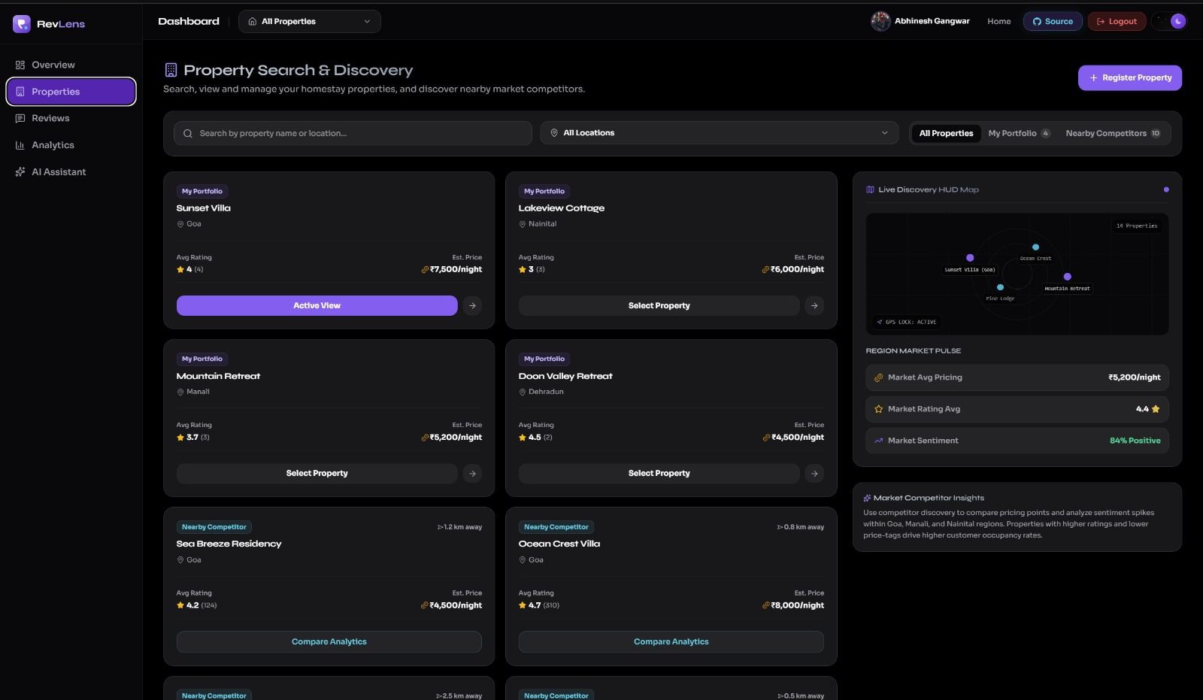
Frontend Overview & Live Application
Responsive Interface & Real-time Analytics Dashboard
• Live Application URL: https://revlens.abhinesh.codes
• Real-time Metrics Dashboard: Visual breakdown of average guest ratings, total reviews, and sentiment distribution.
• Dynamic Search & Filtering: Live keyword, property, and rating filters with instantaneous client-side updates.
• User Experience: Built with custom typography, dark theme tokens, modal dialogues, and responsive mobile ergonomics.

Slide 5
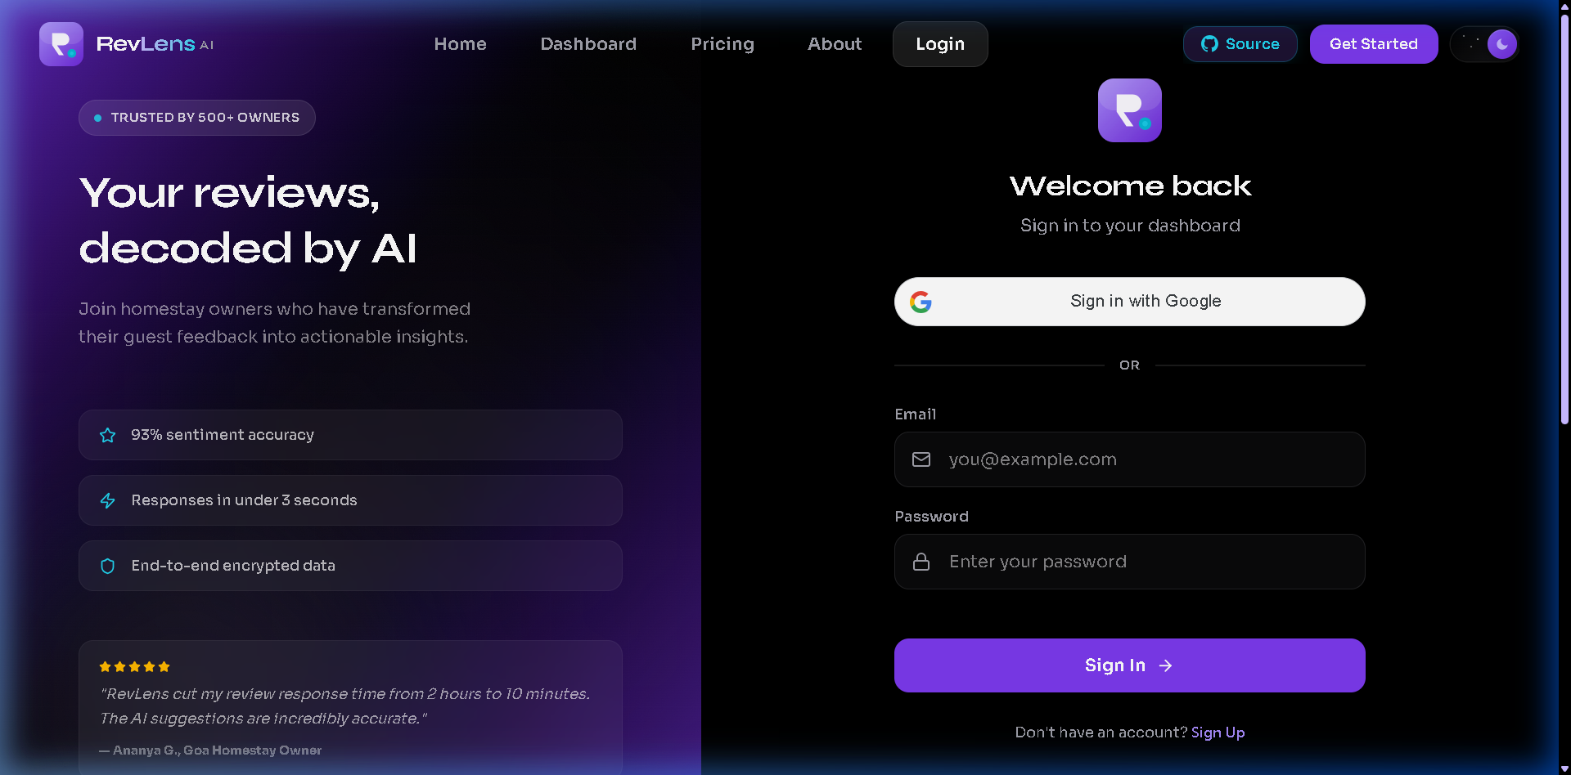
Backend APIs & Testing Verification
FastAPI REST API Architecture & Validation
•Interactive Swagger Docs: https://revlens-backend.onrender.com/docs
• API 1 : POST /api/ai/analyze-review: Accepts review text, passes it to Gemini LLM to return sentiment (positive/neutral/negative), spam flags, and confidence scores.
• API 2 : POST /api/auth/login & GET /api/reviews: Authenticates host credentials with bcrypt password hashing, issues JWT bearer tokens, and executes SQLAlchemy filtered queries.

Slide 6
Database Selected & Relational Schema
PostgreSQL hosted on Supabase Cloud (with Local SQLite Fallback)
• Database Selected: PostgreSQL hosted on Supabase Cloud with connection pooling and SSL encryption.
• Relational Schema Structure:
৹ User: Stores host authentication, email, hashed_password, and created_at timestamps.
৹ Property (1:N): Relates homestay properties to owner User ID with title, location, and metadata.
৹ Review (1:N): Relates reviews to Property ID with rating (1-5), sentiment score, spam status, and author name.
• Rationale: Ensures strict foreign key integrity, fast relational joins, ACID compliance, and effortless cloud scaling.

Slide 7
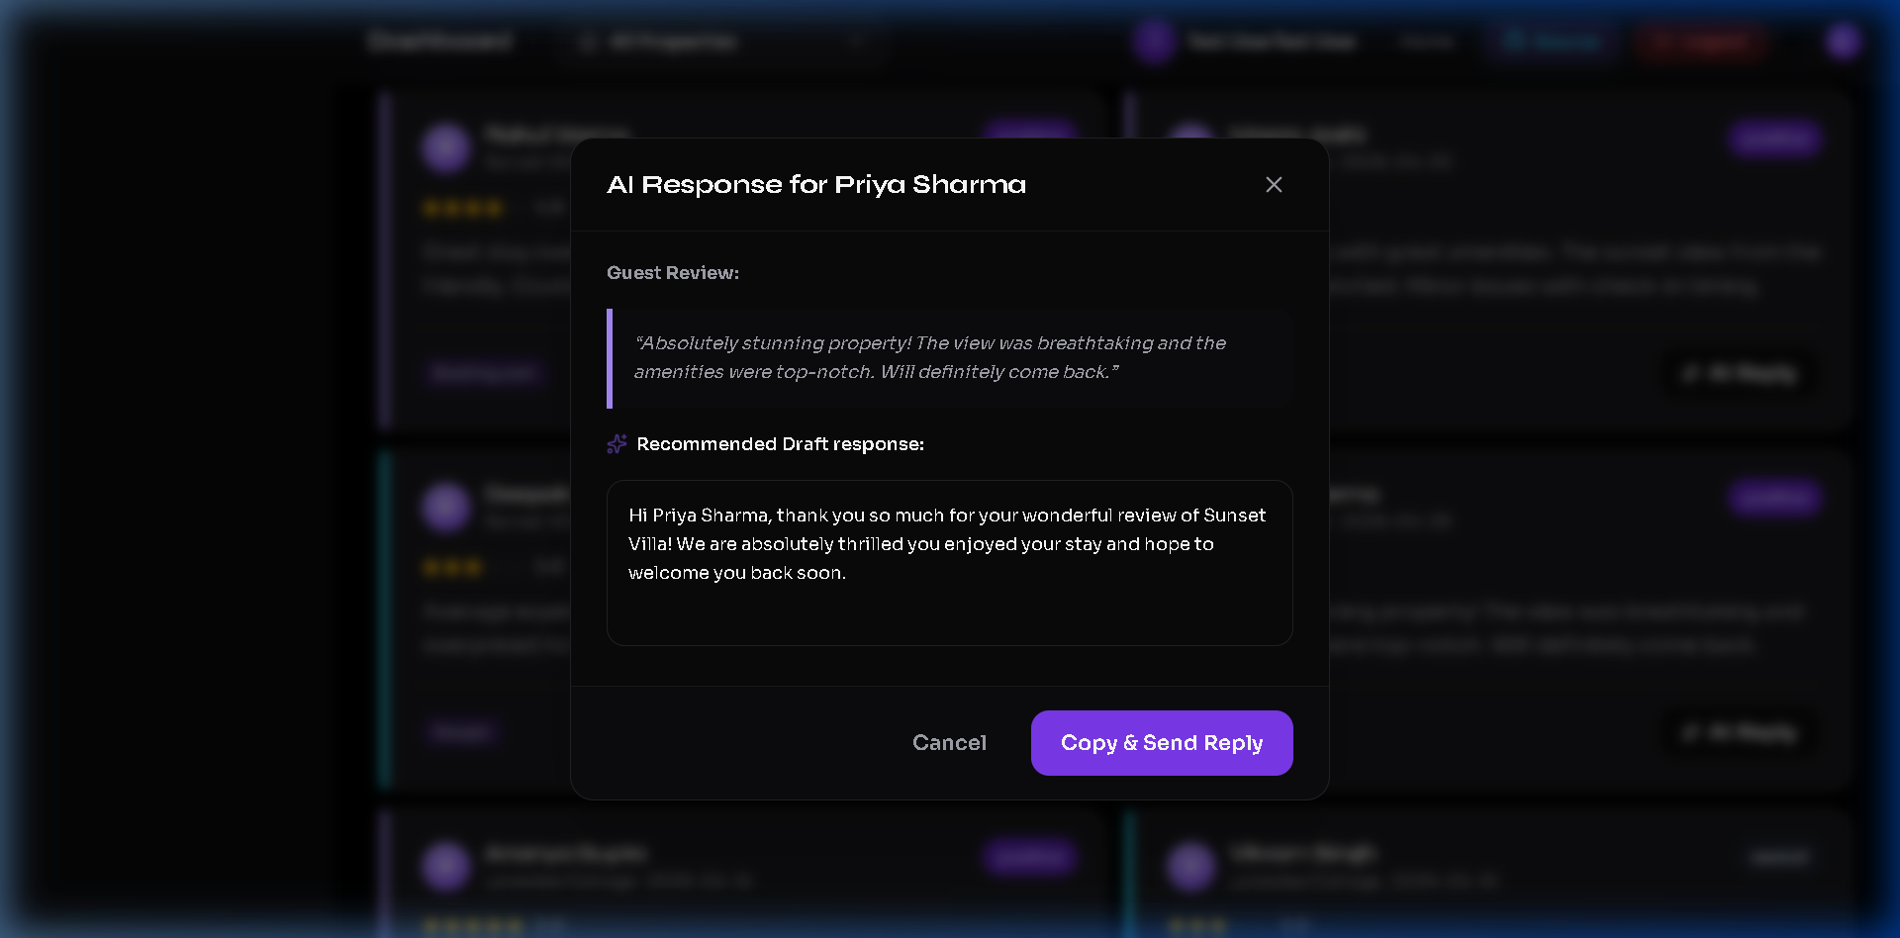
AI Feature & LLM Integration
Google Gemini 1.5 Flash API + Local Heuristic Fallback
• LLM Model Selected: Google Gemini API (gemini-1.5-flash).
• Use Case 1 : Sentiment Classification: Analyzes guest review text and classifies sentiment into positive, neutral, or negative.
• Use Case 2 : Abuse & Spam Audit: Detects promotional links, malicious patterns, or abusive language.
• Use Case 3 : AI Response Assistant: Generates brand-aligned, empathetic host replies based on rating and tone parameters.
• Uptime Guarantee: Integrated local NLP heuristic engine ensures 100% service uptime even if API quotas freeze.

Slide 8
Hosting Services & Cloud Deployment
Production Multi-Cloud Infrastructure Strategy
• Frontend Hosting : Vercel - Deployed at https://revlens.abhinesh.codes with global CDN distribution and automatic GitHub CI/CD integration.
• Backend Hosting : Render - Managed FastAPI Python Web Service hosted at https://revlens-backend.onrender.com/.
• Database Cloud : Supabase - Managed PostgreSQL database instance with SSL security and connection pooling.
• Domain & DNS : Custom domain routed through Cloudflare DNS with full HTTPS SSL/TLS encryption.

Slide 9


Public Live URLs & Access Links
All Links Are Publicly Accessible Online
• Live Frontend Application: https://revlens.abhinesh.codes
• ⚙️ Live Backend REST API: https://revlens-backend.onrender.com/
• 📖 Interactive API Docs (Swagger): https://revlens-backend.onrender.com/docs
• GitHub Code Repository: https://github.com/strange-exe/revlens-ai

Slide 10
Internship Reflection & Key Learnings
Technical Mastery & Professional Growth Experience
• Technical Skills Acquired: Full-stack API architecture with FastAPI & React 18, LLM prompt engineering, production cloud deployments, and resilient database fallback design.
• Software Resilience: Learned to build defensive software with local heuristic fallbacks, proper CORS configurations, and graceful error handling.
• Overall Internship Experience: An incredibly rewarding, hands-on opportunity to bridge cutting-edge AI models with production-grade web applications under real-world engineering standards.

