Slide 1
Speech-to-Text transcription
Group 8
Anubhav Sharma
Edwin Chen
TrungLam Nguyen
April 7, 2026

Slide 2




APPLIED DEEP LEARNING — COURSE PROJECT
Introduction
Speech-to-Text (STT) transcription
What is the problem?
Converting spoken language into text accurately and efficiently — bridging human speech with machine understanding through end-to-end deep learning.
Existing solutions
Classical (HMM-GMM): Hand-crafted features + Hidden Markov Models for decoding.
End-to-end DNN: DeepSpeech / DeepSpeech2 — CNN + RNN + CTC loss.
Transformers: Wav2Vec2, Whisper — large self-supervised.
Real-world applications
Automatic video and meeting transcription
Automotive voice control
Virtual assistant for customer services
Challenges
Acoustic variability: accents, speaking rates, background noise.
Aligning variable-length audio frames with shorter text targets.
High data and compute requirements for training from scratch.
Generalisation across unseen speakers and domains.
01 / 04
Notes:
Our project focuses on speech to text, the task of converting spoken language into written text using deep learning. Our goal is to implement a speech-to-text model that is inspired by the well-known DeepSpeech2 paper and evaluate the impact of architectural choices.
This is a well-studied problem with several existing approaches. Traditional systems relied on Hidden Markov Model, but modern solutions like DeepSpeech, OpenAI's Whisper have shifted toward end-to-end deep learning models.
Speech-to-text powers many real world applications, from automatic video transcription to virtual assistant, and recently AI agents.
However, key challenges remain. For example, acoustic variability like accents, speaking rates, background noise, or high computation cost, they can all degrade the model quality.

Slide 3
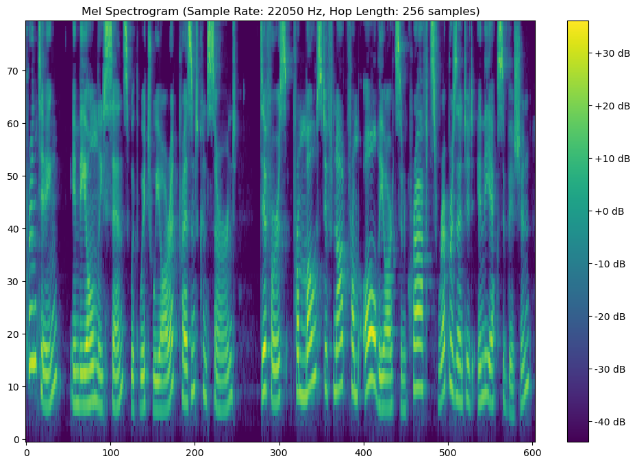
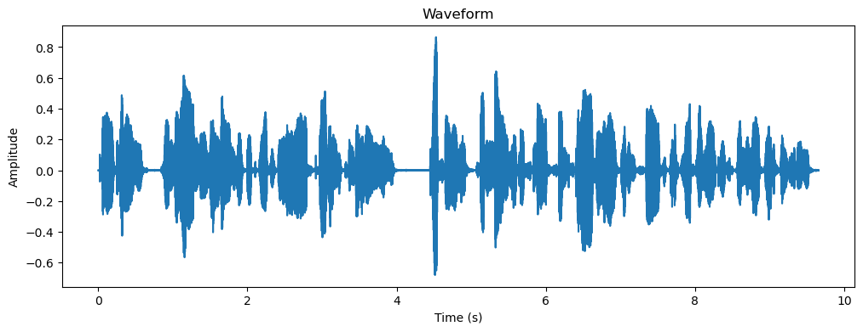
SPEECH-TO-TEXT ARCHITECTURE
02 / 04
DeepSpeech2
Our Adaptations
Text Output
Reduced dataset and model size to work with limited compute
Custom preprocessing: mel-spectrogram
Experimentation with other temporal models
Key Changes
CTC Decoder
Greedy/Beam+LM
Prediction Head (FC Layer + Log-Softmax)
Temporal Encoder
GRU + Look Ahead Conv/BiGRU
or
LSTM
or
Conformer
Sequence-to-sequence alignment
Complex task requires large models for decent generalisation
Limited compute for training general STT models
⚠ Known Challenges
Feature Extractor (CNN)
Preprocessing (Spectrogram)
Mel-Spectrogram
Audio (LibriSpeech)
LJ Speech
Notes:
We implemented a baseline speech-to-text architecture based on DeepSpeech2 that begins with a data preprocessing step, converting raw audio into spectrograms. A CNN block then extracts features from the spectrograms, and the temporal model learns time-sequential relations across features. The encoded state sequences from the temporal model is then converted into a sequence of character probabilities by the prediction head and the CTC (Connectionist Temporal Classification) decoder constructs all valid alignments and outputs the character sequence with the highest confidence.
The original DeepSpeech2 authors trained on LibriSpeech (~100-500hrs of audio from multiple speakers) however, due to the limited compute we had access to, we worked with the smaller LJ Speech dataset (~24hrs audio from single speaker).
We also introduced an additional preprocessing step that reduced the spectrogram frequencies to the frequencies humans are sensitive to.
We also experimented with other temporal models such as LSTM and Conformer.

Slide 4
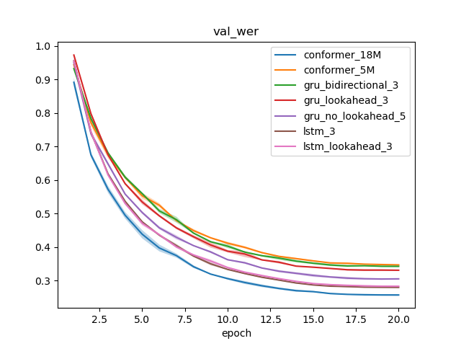
ANALYSIS — DATASET, TRAINING & PERFORMANCE
03 / 04
Dataset & Split
Training Process
Inference
LJ Speech 24h single speaker subset
80 / 10 / 10 train / val / test
22.5 kHz mono WAV, normalized
80-bin Log-mel spectrogram features
Params
Hyperparams
Greedy decoding
Beam Search + KenLM
Optimizer: Adam
Scheduler: OneCycleLR
Loss: CTCLoss
Epochs: 20
Batch Size: 32
Hidden layers: [3, 5]
Argmax at each timestep
3-gram LM trained on LibriSpeech, top-50 beam comparison
= S + D + I
N
Performance
VAL
TEST
Performance Metrics
Architecture | Loss | CER | WER (no LM) | WER (with LM)
GRU (3 hidden layers, unidirectional) | 0.32 | 1.11% | 35.2% | 29.8%
GRU (5 hidden layers, unidirectional) | 0.27 | 9.9% | 29.9% | 28.2%
GRU (3 hidden layers, lookahead convolution) | 0.31 | 10.7% | 33.2% | 29.5%
GRU (3 hidden layers, bidirectional) | 0.31 | 11.0% | 33.7% | 29.2%
LSTM (3 hidden layers) | 0.26 | 9.2% | 27.7% | 27.8%
Conformer (5M) | 0.34 | 11.2% | 34.6% | 29.7%
Conformer (18M) | 0.29 | 8.63% | 25.2% | 28.5%
Character Error Rate
Word Error Rate
S = substitutions,
D = Deletions,
I = Insertions,
N = Total reference objects
Notes:
"This slide walks through the full experimental pipeline — from how we set up our data, to how we trained, to how we measured performance.
We trained on a 24-hour subset of LJ Speech — a single-speaker, studio-quality English corpus. We split it 80/10/10 for train, validation, and test. All audio is 22.5 kHz mono WAV, normalized, and converted into 80-bin log-mel spectrogram features before being fed into the model.
We used Adam with a OneCycleLR scheduler, which ramps up and then anneals the learning rate across 20 epochs at batch level. We used a Connectionist Temporal Classification loss which let us train without needing frame-level transcription alignment. Our batch size was set to 32 given compute constraints, and, we ran every architecture over three independent random seeds and averaged across them.
For inference, we first used greedy decoding taking the argmax of model output at each timestep which was fast but suboptimal. We then implemented beam search augmented with a 3-gram language model trained on LibriSpeech, comparing the top 50 beams at each step. The LM consistently brought WER down by 4 to 6 percentage points.
Our primary metrics are character error rate and word error rate which are common for benchmarking. Looking at the table: our strongest result came from the 18M Conformer at 25.2% WER with the language model. The LSTM was the most stable trainer with the lowest validation loss, hitting 27.8% WER. The Conformer, while architecturally the most expressive, had a marginally higher loss, which we attribute to it requiring more data and tuning to reach its potential. The WER history graph on the left confirms all models converge smoothly within 20 epochs.

Slide 5
TEAM CONTRIBUTIONS & FUTURE WORK
04 / 04
Individual Contributions
Member | Role | Key Contributions
Anubhav Sharma | Data + Optimization | Dataset curation, preprocessing, LSTM implementation, model performance and training optimization
Edwin Chen | Architecture Design | Research and implementation of baseline Deep Speech 2 and Conformer architecture.
Trung Lam Nguyen | Model Evaluation | CNN implementation, data loader optimization, model training and benchmarking,
Plans for Future Work
🔡 Language Model Integration
📊 Scale Training Data
🎙 Noise Robustness
Train on full 960h LibriSpeech and explore multilingual CommonVoice
Environmental noise augmentation and speaker adaptation
Couple acoustic model with fine-tuned n-gram or transformer LM for rescoring
Thank you — Questions?

