Slide 1
J
a programming language
Tracy Harms
tracy@kaleidic.com
@kaleidic

Slide 2
Kenneth E. Iverson
Roger Hui
(and select advisors)
J first released in 1990

Slide 3
What sort of problem does J fit well?

Slide 4
subtraction!

Slide 5
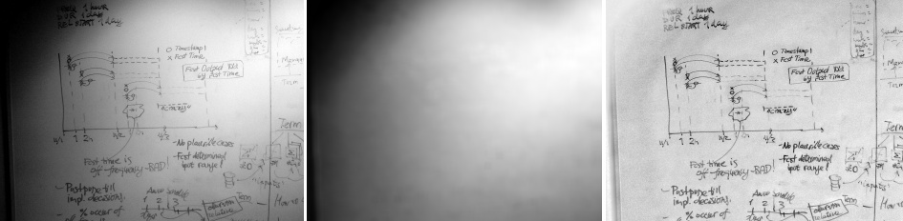
subtraction:

Slide 6
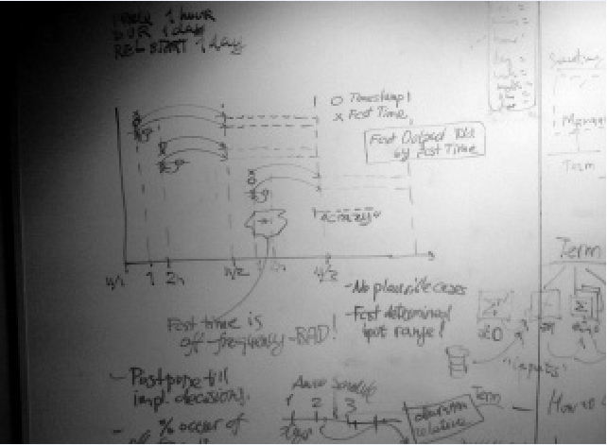

Slide 7
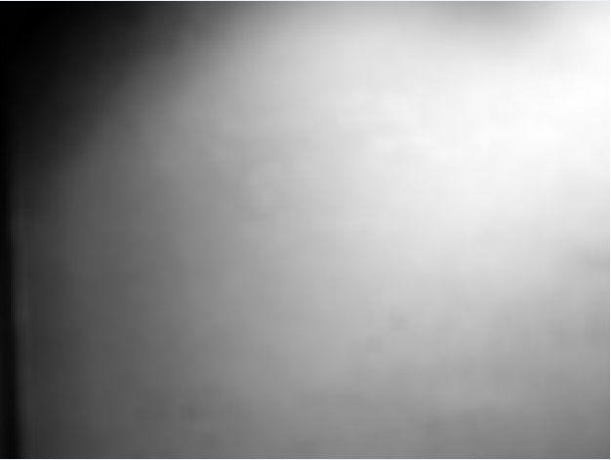

Slide 8
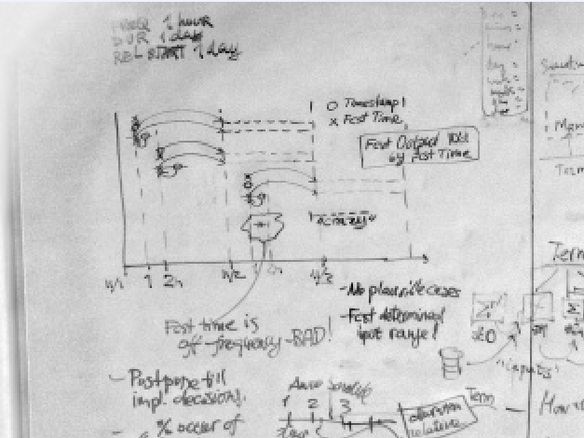

Slide 9
load'media/platimg' NB. image reader
load'viewmat plot'
NB. gray scale viewer
viewgray=: (16b010101*i.256)&viewmat
glwh=: 3 : 'wd''pmovex '',(*0 0,y-glqwh_jgl2_@$@#)&.".wd''qformx'''
viewwh=: glwh@|.@$ [ viewgray
$M=: 16bff (17 b.) readimg jpath'-temp\input.jpg'
1200 1600
viewwh M
$R=: |:_5(+/%#)\|: _5(+/%#)\ M NB. reduced large image
240 320
viewwh R
'surface;mesh 0' plot R NB. notice features below smooth light
S=: |: _10(>./)\|: _10(>./)\ M NB. apply max filter to remove features
Z=: 2#"1]2#S NB. restore size
W=: |: 8(+/%#)\|: 8(+/%#)\ Z NB. smooth with moving average
viewwh W
viewwh N=: (($W){.R) - W NB. remove shadow

Slide 10
load'media/platimg' NB. image reader
load'viewmat plot'
NB. gray scale viewer
viewgray=: (16b010101*i.256)&viewmat
glwh=: 3 : 'wd''pmovex '',(*0 0,y-glqwh_jgl2_@$@#)&.".wd''qformx'''
viewwh=: glwh@|.@$ [ viewgray
$M=: 16bff (17 b.) readimg jpath'-temp\input.jpg'
1200 1600
viewwh M
$R=: |:_5(+/%#)\|: _5(+/%#)\ M NB. reduced large image
240 320
viewwh R
'surface;mesh 0' plot R NB. notice features below smooth light
S=: |: _10(>./)\|: _10(>./)\ M NB. apply max filter to remove features
Z=: 2#"1]2#S NB. restore size
W=: |: 8(+/%#)\|: 8(+/%#)\ Z NB. smooth with moving average
viewwh W
viewwh N=: (($W){.R) - W NB. remove shadow

Slide 11
(($W){.R) - W

Slide 12
load'media/platimg' NB. image reader
load'viewmat plot'
NB. gray scale viewer
viewgray=: (16b010101*i.256)&viewmat
glwh=: 3 : 'wd''pmovex '',(*0 0,y-glqwh_jgl2_@$@#)&.".wd''qformx'''
viewwh=: glwh@|.@$ [ viewgray
$M=: 16bff (17 b.) readimg jpath'-temp\input.jpg'
1200 1600
viewwh M
$R=: |:_5(+/%#)\|: _5(+/%#)\ M NB. reduced large image
240 320
viewwh R
'surface;mesh 0' plot R NB. notice features below smooth light
S=: |: _10(>./)\|: _10(>./)\ M NB. apply max filter to remove features
Z=: 2#"1]2#S NB. restore size
W=: |: 8(+/%#)\|: 8(+/%#)\ Z NB. smooth with moving average
viewwh W
viewwh N=: (($W){.R) - W NB. remove shadow

Slide 13
load'media/platimg' NB. image reader
load'viewmat plot'
NB. gray scale viewer
viewgray=: (16b010101*i.256)&viewmat
glwh=: 3 : 'wd''pmovex '',(*0 0,y-glqwh_jgl2_@$@#)&.".wd''qformx'''
viewwh=: glwh@|.@$ [ viewgray
$M=: 16bff (17 b.) readimg jpath'-temp\input.jpg'
1200 1600
viewwh M
$R=: |:_5(+/%#)\|: _5(+/%#)\ M NB. reduced large image
240 320
viewwh R
'surface;mesh 0' plot R NB. notice features below smooth light
S=: |: _10(>./)\|: _10(>./)\ M NB. apply max filter to remove features
Z=: 2#"1]2#S NB. restore size
W=: |: 8(+/%#)\|: 8(+/%#)\ Z NB. smooth with moving average
viewwh W
viewwh N=: (($W){.R) - W NB. remove shadow

Slide 14
load'media/platimg' NB. image reader
load'viewmat plot'
NB. gray scale viewer
viewgray=: (16b010101*i.256)&viewmat
glwh=: 3 : 'wd''pmovex '',(*0 0,y-glqwh_jgl2_@$@#)&.".wd''qformx'''
viewwh=: glwh@|.@$ [ viewgray
$M=: 16bff (17 b.) readimg jpath'-temp\input.jpg'
1200 1600
viewwh M
$R=: |:_5(+/%#)\|: _5(+/%#)\ M NB. reduced large image
240 320
viewwh R
'surface;mesh 0' plot R NB. notice features below smooth light
S=: |: _10(>./)\|: _10(>./)\ M NB. apply max filter to remove features
Z=: 2#"1]2#S NB. restore size
W=: |: 8(+/%#)\|: 8(+/%#)\ Z NB. smooth with moving average
viewwh W
viewwh N=: (($W){.R) - W NB. remove shadow

Slide 15
load'media/platimg' NB. image reader
load'viewmat plot'
NB. gray scale viewer
viewgray=: (16b010101*i.256)&viewmat
glwh=: 3 : 'wd''pmovex '',(*0 0,y-glqwh_jgl2_@$@#)&.".wd''qformx'''
viewwh=: glwh@|.@$ [ viewgray
$M=: 16bff (17 b.) readimg jpath'-temp\input.jpg'
1200 1600
viewwh M
$R=: |:_5(+/%#)\|: _5(+/%#)\ M NB. reduced large image
240 320
viewwh R
'surface;mesh 0' plot R NB. notice features below smooth light
S=: |: _10(>./)\|: _10(>./)\ M NB. apply max filter to remove features
Z=: 2#"1]2#S NB. restore size
W=: |: 8(+/%#)\|: 8(+/%#)\ Z NB. smooth with moving average
viewwh W
viewwh N=: (($W){.R) - W NB. remove shadow

Slide 16
load'media/platimg' NB. image reader
load'viewmat plot'
NB. gray scale viewer
viewgray=: (16b010101*i.256)&viewmat
glwh=: 3 : 'wd''pmovex '',(*0 0,y-glqwh_jgl2_@$@#)&.".wd''qformx'''
viewwh=: glwh@|.@$ [ viewgray
$M=: 16bff (17 b.) readimg jpath'-temp\input.jpg'
1200 1600
viewwh M
R=: |: _5(+/%#)\ |: _5(+/%#)\ M
viewwh R
'surface;mesh 0' plot R NB. notice features below smooth light
S=: |: _10(>./)\ |: _10(>./)\ M NB. apply max filter to remove features
Z=: 2#"1]2#S NB. restore size
W=: |: 8(+/%#)\ |: 8(+/%#)\ Z NB. smooth with moving average
viewwh W
viewwh N=: (($W){.R) - W NB. remove shadow

Slide 17
load'media/platimg' NB. image reader
load'viewmat plot'
NB. gray scale viewer
viewgray=: (16b010101*i.256)&viewmat
glwh=: 3 : 'wd''pmovex '',(*0 0,y-glqwh_jgl2_@$@#)&.".wd''qformx'''
viewwh=: glwh@|.@$ [ viewgray
$M=: 16bff (17 b.) readimg jpath'-temp\input.jpg'
1200 1600
viewwh M
R=: |: _5(+/%#)\ |: _5(+/%#)\ M
viewwh R
'surface;mesh 0' plot R NB. notice features below smooth light
S=: |: _10(>./)\ |: _10(>./)\ M NB. apply max filter to remove features
Z=: 2#"1]2#S NB. restore size
W=: |: 8(+/%#)\ |: 8(+/%#)\ Z NB. smooth with moving average
viewwh W
viewwh N=: (($W){.R) - W NB. remove shadow

Slide 18
load'media/platimg' NB. image reader
load'viewmat plot'
NB. gray scale viewer
viewgray=: (16b010101*i.256)&viewmat
glwh=: 3 : 'wd''pmovex '',(*0 0,y-glqwh_jgl2_@$@#)&.".wd''qformx'''
viewwh=: glwh@|.@$ [ viewgray
$M=: 16bff (17 b.) readimg jpath'-temp\input.jpg'
1200 1600
viewwh M
R=: |: _5(+/%#)\ |: _5(+/%#)\ M
viewwh R
'surface;mesh 0' plot R NB. notice features below smooth light
S=: |: _10(>./)\ |: _10(>./)\ M NB. apply max filter to remove features
Z=: 2#"1]2#S NB. restore size
W=: |: 8(+/%#)\ |: 8(+/%#)\ Z NB. smooth with moving average
viewwh W
viewwh N=: (($W){.R) - W NB. remove shadow

Slide 19
load'media/platimg' NB. image reader
load'viewmat plot'
NB. gray scale viewer
viewgray=: (16b010101*i.256)&viewmat
glwh=: 3 : 'wd''pmovex '',(*0 0,y-glqwh_jgl2_@$@#)&.".wd''qformx'''
viewwh=: glwh@|.@$ [ viewgray
$M=: 16bff (17 b.) readimg jpath'-temp\input.jpg'
1200 1600
viewwh M
R=: |: _5(+/%#)\ |: _5(+/%#)\ M
viewwh R
'surface;mesh 0' plot R NB. notice features below smooth light
S=: |: _10(>./)\ |: _10(>./)\ M NB. apply max filter to remove features
Z=: 2#"1]2#S NB. restore size
W=: |: 8(+/%#)\ |: 8(+/%#)\ Z NB. smooth with moving average
viewwh W
viewwh N=: (($W){.R) - W NB. remove shadow

Slide 20
load'media/platimg' NB. image reader
load'viewmat plot'
NB. gray scale viewer
viewgray=: (16b010101*i.256)&viewmat
glwh=: 3 : 'wd''pmovex '',(*0 0,y-glqwh_jgl2_@$@#)&.".wd''qformx'''
viewwh=: glwh@|.@$ [ viewgray
$M=: 16bff (17 b.) readimg jpath'-temp\input.jpg'
1200 1600
viewwh M
R=: |: _5(+/%#)\ |: _5(+/%#)\ M
viewwh R
'surface;mesh 0' plot R NB. notice features below smooth light
S=: |: _10(>./)\ |: _10(>./)\ M NB. apply max filter to remove features
Z=: 2#"1]2#S NB. restore size
W=: |: 8(+/%#)\ |: 8(+/%#)\ Z NB. smooth with moving average
viewwh W
viewwh N=: (($W){.R) - W NB. remove shadow

Slide 21
load'media/platimg' NB. image reader
load'viewmat plot'
NB. gray scale viewer
viewgray=: (16b010101*i.256)&viewmat
glwh=: 3 : 'wd''pmovex '',(*0 0,y-glqwh_jgl2_@$@#)&.".wd''qformx'''
viewwh=: glwh@|.@$ [ viewgray
$M=: 16bff (17 b.) readimg jpath'-temp\input.jpg'
1200 1600
viewwh M
R=: |: _5(+/%#)\ |: _5(+/%#)\ M
viewwh R
'surface;mesh 0' plot R NB. notice features below smooth light
S=: |: _10(>./)\ |: _10(>./)\ M NB. apply max filter to remove features
Z=: 2#"1]2#S NB. restore size
W=: |: 8(+/%#)\ |: 8(+/%#)\ Z NB. smooth with moving average
viewwh W
viewwh N=: (($W){.R) - W NB. remove shadow

Slide 22
load'media/platimg' NB. image reader
load'viewmat plot'
NB. gray scale viewer
viewgray=: (16b010101*i.256)&viewmat
glwh=: 3 : 'wd''pmovex '',(*0 0,y-glqwh_jgl2_@$@#)&.".wd''qformx'''
viewwh=: glwh@|.@$ [ viewgray
$M=: 16bff (17 b.) readimg jpath'-temp\input.jpg'
1200 1600
viewwh M
R=: |: _5(+/%#)\ |: _5(+/%#)\ M
S=: |: _10(>./)\ |: _10(>./)\ M
Z=: 2#"1]2#S
W=: |: 8(+/%#)\ |: 8(+/%#)\ Z
N=: (($W){.R) - W

Slide 23
M=: 16bff (17 b.) readimg jpath'-temp\input.jpg'
R=: |: _5(+/%#)\ |: _5(+/%#)\ M
S=: |: _10(>./)\ |: _10(>./)\ M
Z=: 2#"1]2#S
W=: |: 8(+/%#)\ |: 8(+/%#)\ Z
N=: (($W){.R) - W

Slide 24
Background removal calculation by Oleg Kobchenko
http://www.jsoftware.com/jwiki/OlegKobchenko/Background%20Removal

Slide 25
*
A noun is a collection.
Nouns are regular.
A verb applies across a whole noun.

Slide 26
Over fifty years of refinement
“APL is an array language with a highly-functional flavour, and a rich set of carefully-thought-out array operations.”
Simon Peyton Jones

Slide 27
1957
chalkboards

Slide 28
1957
chalkboards
mathematical notation
to express computation

Slide 29
1957
1962
chalkboards
a book

Slide 30
1957
1962
chalkboards
a book
A Programming Language

Slide 31
1957
1962
1964
chalkboards
a book
a paper

Slide 32
1957
1962
1964
chalkboards
a book
a paper
a formal description of the
IBM System/360 series machine architecture and functionality

Slide 33
1957
1962
1964
1966
chalkboards
a book
a paper
interpreters

Slide 34
1957
1962
1964
1966
chalkboards
a book
a paper
interpreters
APL

Slide 35
1957
1962
1964
1966
1968
chalkboards
a book
a paper
interpreters
release
APL

Slide 36
1957
1962
1964
1966
1968
...
chalkboards
a book
a paper
interpreters
release
...
APL

Slide 37
1957
1962
1964
1966
1968
...
1989
chalkboards
a book
a paper
interpreters
release
...
redesign
APL
J

Slide 38
1957
1962
1964
1966
1968
...
1989
...
2011
chalkboards
a book
a paper
interpreters
release
...
redesign
...
open source
APL
J

Slide 39
example verb: average

Slide 40
MyList=: 7 4 6 8 2 3
MyList
7 4 6 8 2 3

Slide 41
MyList=: 7 4 6 8 2 3
MyList
7 4 6 8 2 3
+/MyList
30
# MyList
6

Slide 42
MyList=: 7 4 6 8 2 3
MyList
7 4 6 8 2 3
+/MyList
30
# MyList
6
30 % 6
5
÷

Slide 43
+/MyList
30
# MyList
6
(+/MyList) % (#MyList)
5

Slide 44
+/MyList
30
# MyList
6
(+/MyList) % (#MyList)
5
(+/ % #) MyList
5

Slide 45
+/MyList
30
# MyList
6
(+/MyList) % (#MyList)
5
(+/ % #) MyList
5
average=: +/ % #
average MyList
5

Slide 46
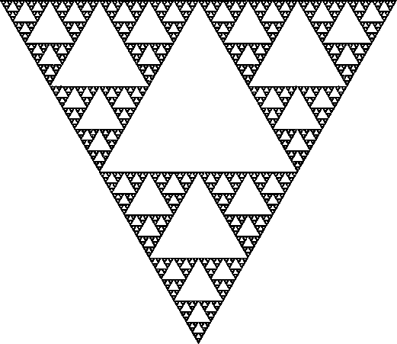
verb trains

Slide 47

verb trains

Slide 48
average=: +/ % #
+/
#
%

Slide 49
average=: +/ % #
+/
#
%

Slide 50
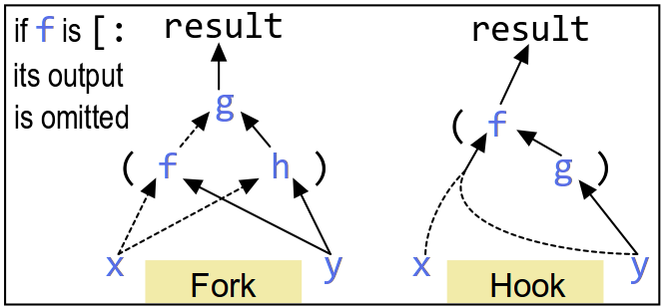
f g h f g

Slide 51
isLeap=: 0 -/@:= 4 100 400 |/ ]
isLeap=: 0 -/@:= 4 100 400 |/ ]
isLeap 1900 1996 1997 2000
0 1 0 1

Slide 52
isLeap=: 0 -/@:= 4 100 400 |/ ]

Slide 53
isLeap=: 0 -/@:= 4 100 400 |/ ]
4 100 400"_
]
|/

Slide 54
isLeap=: 0 -/@:= 4 100 400 |/ ]
4 100 400
]
0:
|/
-/@:=

Slide 55
isLeap=: 0 -/@:= 4 100 400 |/ ]
4 100 400
]
0:
|/
-/@:=

Slide 56
isLeap=: 0 -/@:= 4 100 400 |/ ]
4 100 400"_
]
0"_
|/
-/@:=

Slide 57
*
A verb train is denoted by adjacency.
A fork is a HOF. Adjacent verbs are its arguments.
Branching & converging.

Slide 58
verb: numeronym

Slide 59
verb: numeronym
internationalization
i18n

Slide 60
# 'word'
4
{.'word'
w
{:'word'
d

Slide 61
# 'word'
4
{.'word'
w
{:'word'
d
( {. , {: ) 'word'
wd

Slide 62
# 'word'
4
{.'word'
w
{:'word'
d
( {. , {: ) 'word'
wd
'w2d'
w2d

Slide 63
'w2d'
w2d
'w','2','d'
w2d

Slide 64
'w2d'
w2d
'w','2','d'
w2d
'w',2,'d'
|domain error
| 'w',2 ,'d'

Slide 65
'w2d'
w2d
'w','2','d'
w2d
'w',2,'d'
|domain error
| 'w',2 ,'d'
": 2 NB. ": means format
2

Slide 66
'w2d'
w2d
'w','2','d'
w2d
'w',2,'d'
|domain error
| 'w',2 ,'d‘
": 2 NB. ": means format
2
'2' = ": 2
1

Slide 67
'w2d'
w2d
'w','2','d'
w2d
'w',2,'d'
|domain error
| 'w',2 ,'d‘
": 2 NB. ": means format
2
'2' = ": 2
1
'w',(": 2),'d'
w2d

Slide 68
'w',(": 2),'d'
w2d
{. , ": , {: NB. kinda

Slide 69
'w',(": 2),'d'
w2d
{. , ": , {: NB. kinda
# 'internationalization'
20
(#-2:) 'internationalization'
18

Slide 70
'w',(": 2),'d'
w2d
{. , ": , {: NB. kinda
# 'internationalization'
20
(#-2:) 'internationalization'
18
datatype (#-2:) 'text'
integer
datatype ([: ": #-2:) 'text'
literal

Slide 71
middle=: [: ": #-2:

Slide 72
middle=: [: ": #-2:
numeronym=: {. , middle , {:

Slide 73
middle=: [: ": #-2:
numeronym=: {. , middle , {:
numeronym 'internationalization'
i18n
success!

Slide 74
middle=: [: ": #-2:
numeronym=: {. , middle , {:
numeronym 'internationalization'
i18n
NB. but short words, ewww...
numeronym&> ;:'by the way'
b0y
t1e
w1y

Slide 75
middle=: [: ": #-2:
numeronym=: {. , middle , {:
long=: #>3:
n7m=: ]`numeronym @. long

Slide 76
middle=: [: ": #-2:
numeronym=: {. , middle , {:
long=: #>3:
n7m=: ]`numeronym @. long
n7m &> ;:'alphabetize if you will'
a9e
if
you
w2l

Slide 77
middle=: [: ": #-2:
numeronym=: {. , middle , {:
long=: #>3:
n7m=: ]`numeronym @. long
substitutability

Slide 78
middle=: [: ": #-2:
numeronym=: {. , middle , {:
long=: #>3:
n7m=: ]`({.,middle,{:) @. long

Slide 79
middle=: [: ": #-2:
long=: #>3:
n7m=: ]`({.,middle,{:) @. (#>3:)

Slide 80
middle=: [: ": #-2:
n7m=: ]`({.,([: ": #-2:),{:) @. (#>3:)

Slide 81
n7m=: ]`({.,([: ": #-2:),{:) @. (#>3:)

Slide 82
www.jsoftware.com

Slide 83
J
Thank you!
Tracy Harms
tracy@kaleidic.com
@kaleidic

Slide 84
Special thanks to Emerging Languages Camp 2013
for the invitation to speak.
http://emerginglangs.com/about.html
Code and image credit:
“Unshadow” background removal
http://www.jsoftware.com/jwiki/OlegKobchenko/Background%20Removal
Sierpinski fractal
http://www.zeuscat.com/andrew/chaos/sierpinski.clear.gif
Fork-and-hook diagram
http://www.jsoftware.com/jwiki/Books#J_Reference_Card
Leap-year qualifier
http://jsoftware.com/help/phrases/date_time.htm

