Slide 1


Slide 2
renormalize

Slide 3
Four days in the life of a developer

Slide 4
Four days in (my life)

Slide 5
Day 1
Wake up with brilliant idea.
I’m going to start my next business and it’s going to be big!

Slide 6
Day 2
Idea still brilliant. Good sign!
Setup my app (Rails? SEQUEL?), model a few central application objects like a user with his list of orders, items and every login he ever made.

Slide 7
Day 3
Ok ,got my app… next to mysql... using the ORM…
Crap, every object just exploded into 1000 little pieces; 1000 tables. What was that curse word? NORMALIZATION? Why oh Codd, Why???

Slide 8
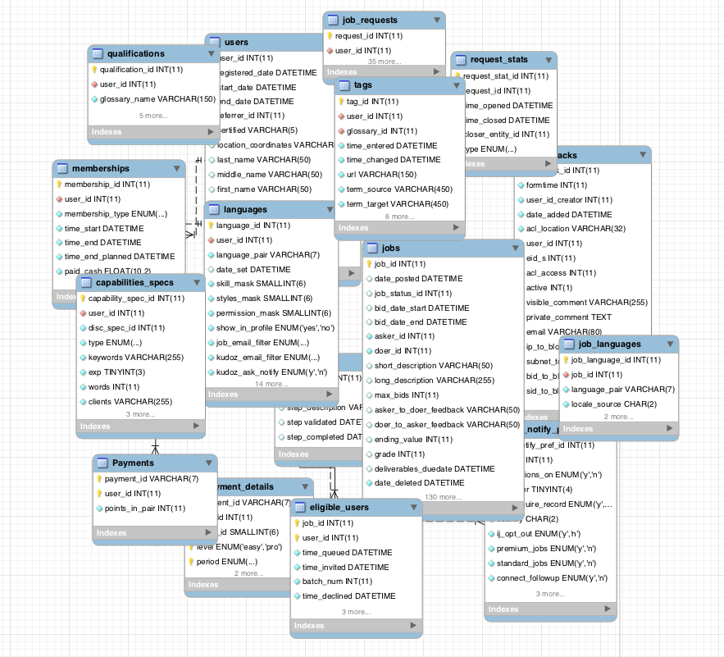

Slide 9
Day 4
Hmm... Been there before. I know if I don’t handle this now I’ll live to regret this when traffic crashes my database.
Think, think, think,

Slide 10
Less tables?
Yeah right when do you ever store less…

Slide 11
Denormalize to materialized views? Good for queries but writes would suck…

Slide 12
Serialize the objects into a blob in mysql! But what about queries? Do everything in the app?

Slide 13
memcache to cache object? Doesn’t work for dynamic data.

Slide 14
Drop SQL? Mongo? Couchbase? Redis? Tokyo?

Slide 15
Driving me nuts.
I know the value of SQL, but seriously…

Slide 16
Hold on! Rewind please.
Let’s take another look at that schema…

Slide 18
My objects are there, just exploded into so many tables. If only there was a way to expose that…

Slide 19
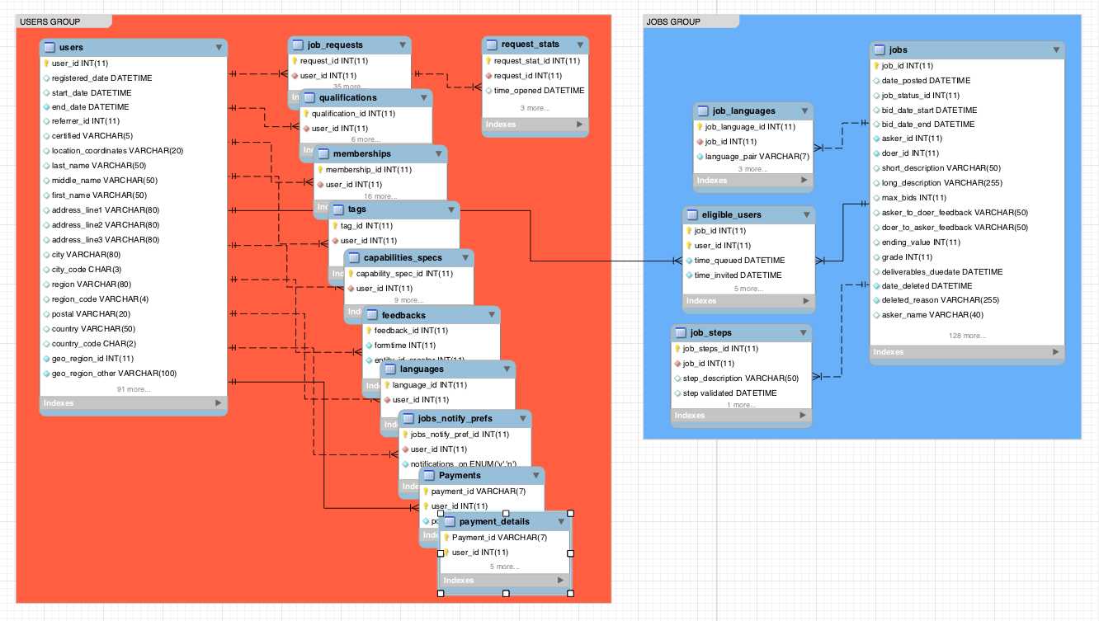
Something like: table-grouping
Table groups map to objects

Slide 20
Core concept: table-grouping
Job request row
Request stats row
User row
Job request row
Request stats row
Qualification row
Qualification row
Membership row
Tag row
Tag row
Tag row
Capabilities row

Slide 21

As if shuffling rows…

Slide 22
Data from the tables within a group is interleaved
Logical table 1: user
t1.c1
t1.c2
t1.c3
Logical table 2: order
t2.c1
t2.c2
t2.c3
Logical table 3: item
t3.c1
t3.c2
t3.c3
1
John
Way
10
1/4
ship
Logically same schema and SQL
102
1212
gift
11
2/7
send
2
Ari
Weil
12
6/10
pick
101
2323
mom
100
3434
dad
Table btree
Table Group
Table btree
Table btree
physical data is interleaved in one btree!

Slide 23
Traditionally logical tables = physical tables
My conclusion: Keep SQL and logical layer, rethink physical layout without redundancy.

Slide 24
It’s nice

Slide 25
Because
JSON + SQL

Slide 26
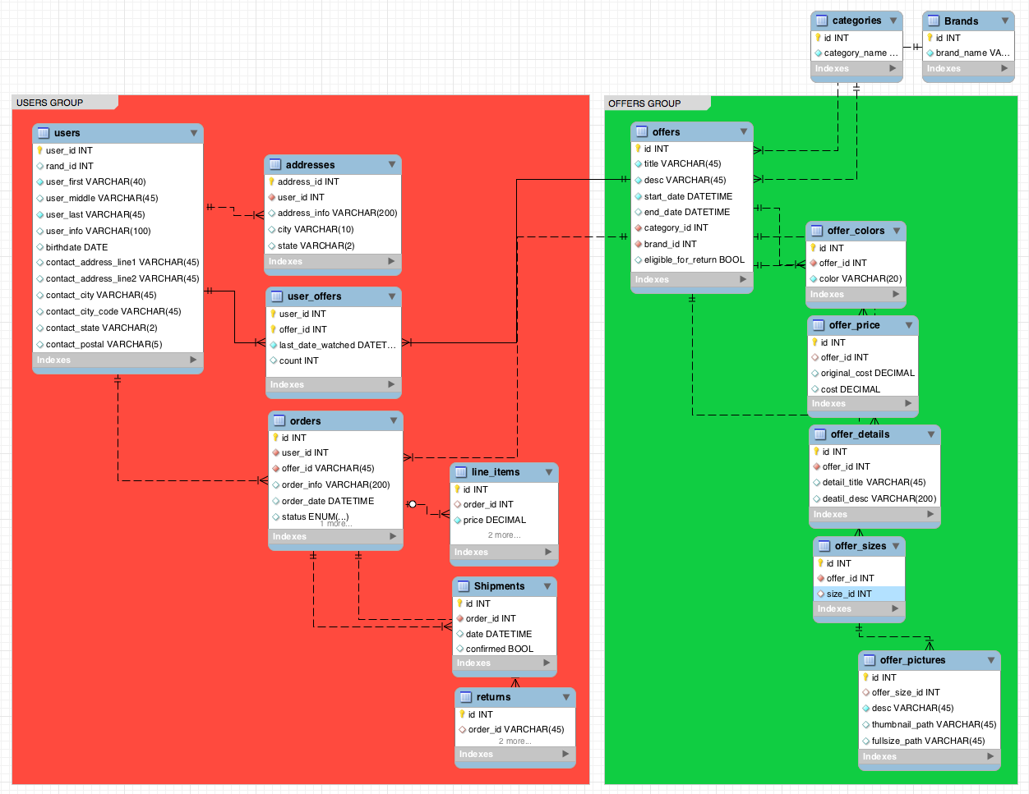
eCommerce

Slide 27
Nice for ORMs

Slide 28
Because
JSON + SQL
Fast localized transaction

Slide 29
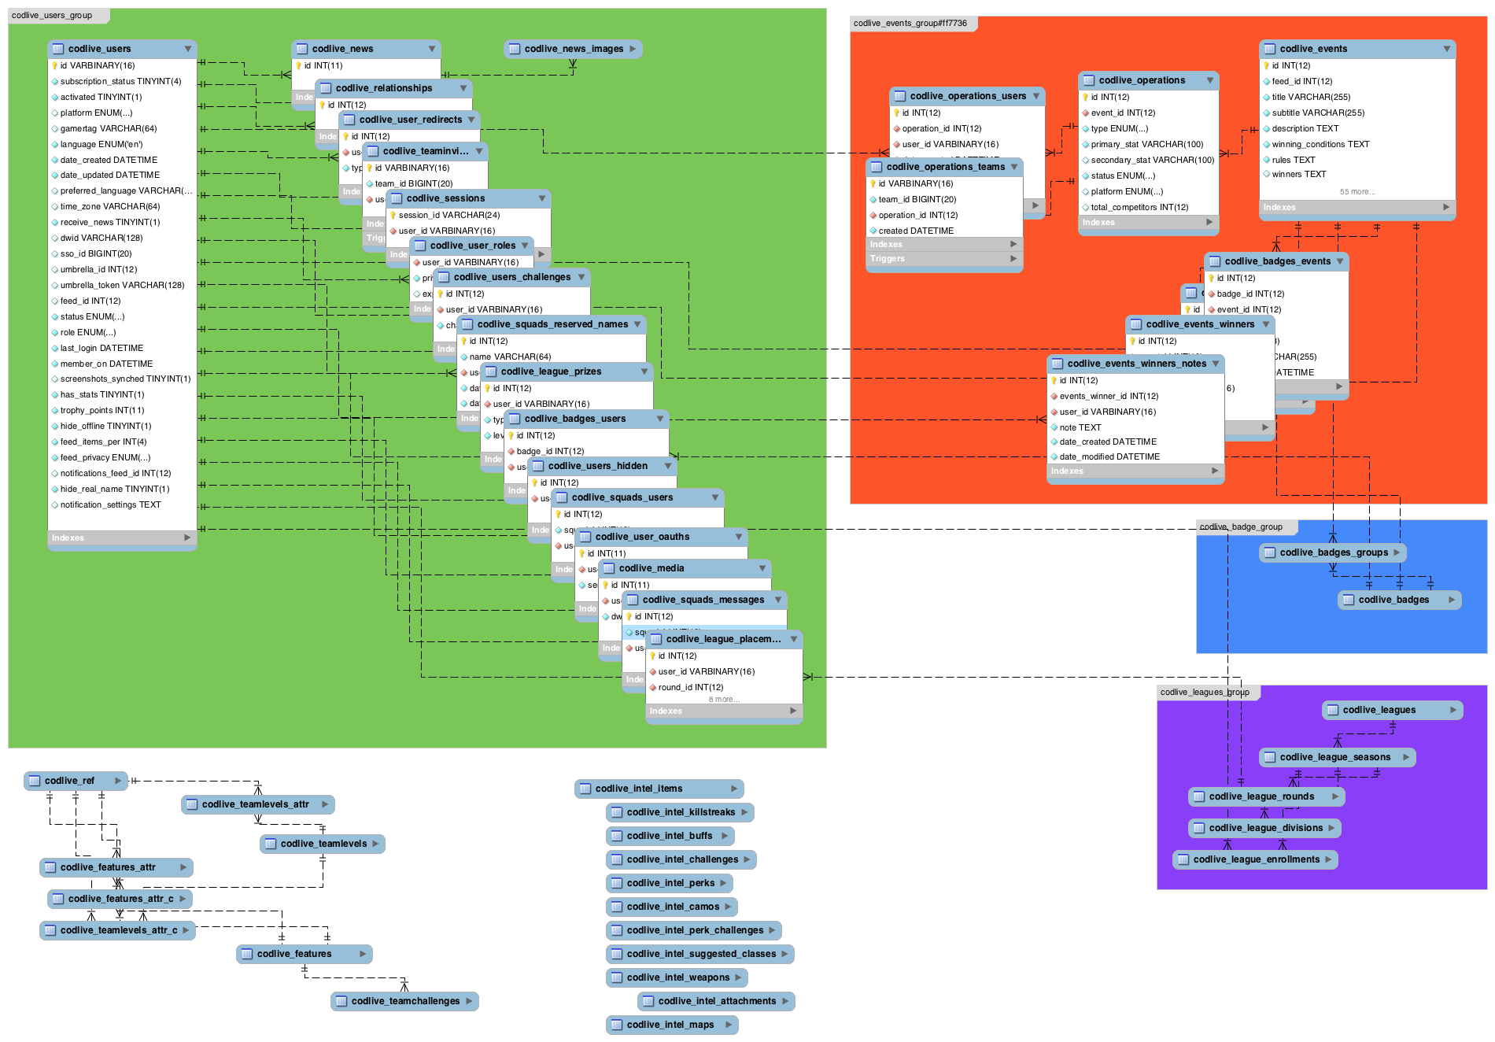
Gaming

Slide 30
Because
JSON + SQL
Fast localized transaction
Operational + Analytical

Slide 31
SELECT u.id , o.date, ....
FROM users u JOIN orders o ON u.id = o.u_id JOIN items i ON o.id = i.o_id
WHERE u.status = 'stuck' AND i.type = 'Book'
ORDER BY o.latestChange DESC
LIMIT 50

Slide 32

Relational
10
Project Results
Sort
9
Temp Table
8
7
2 Joins
4
6
2 Table Accesses
2
3
5
1
3 Index Accesses

Slide 33
Akiban
Project Results
3
1 Group Access
2
1 Group Index Access
1

Slide 34
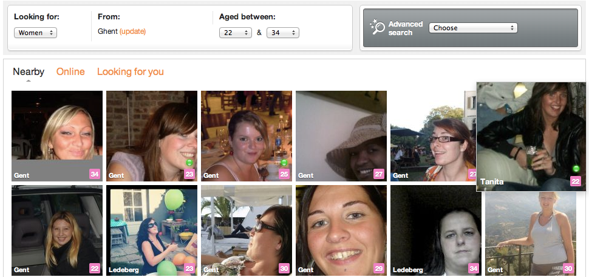
Finding the right match?

Slide 35
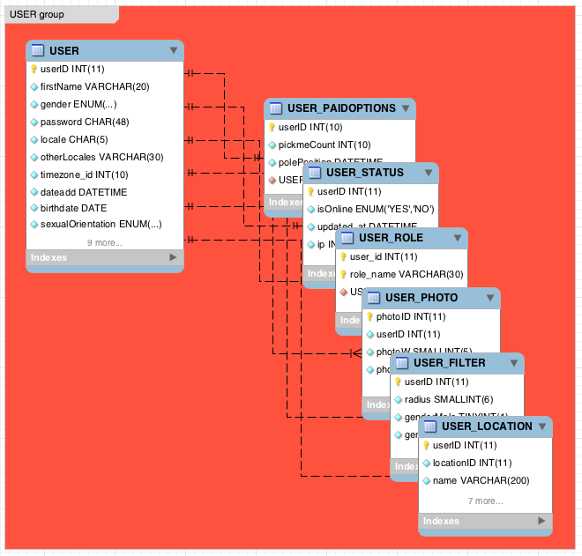
One of the largest dating websites
Notes:
Example: one of the worlds largest dating websites;

Slide 36
Because
JSON + SQL
Fast localized transaction
Operational + Analytical
Natural way to scale

Slide 37

Use stand alone…
Akiban Server

Slide 38

Or alongside mysql
MySQL Master
Akiban Server
Replication
MySQL adapter
MyISAM / InnoDB Storage

Slide 39
Table grouping is a new physical data structure
→ efficient object access
→ fast SQL query execution because joins are free
akiban.com/downloads

Slide 40
ori@akiban.com
irc.freenode.net, #akiban

