Slide 1

ClassroomAR
By: Tim Curry Daniel Darcy Stephen Fedele

Slide 2
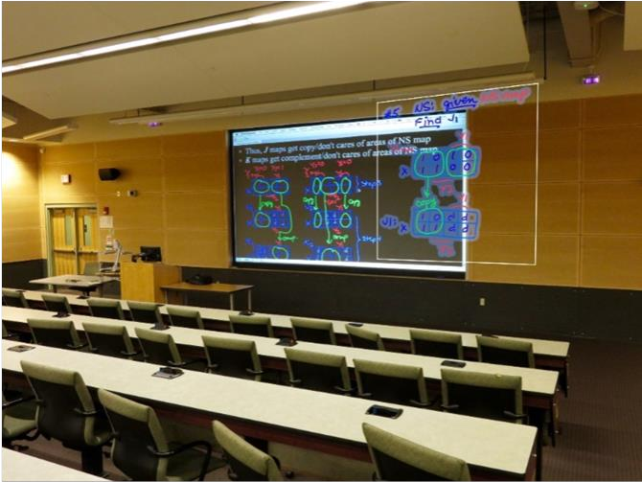
Background
Problem: Finding a purpose in the Internet world for lecture halls.
Goal: Implement an augmented reality presentation tool (ARPT)

Slide 3
Design Decisions
A-Frame
  Web framework for building virtual reality experiences.
AR.js
  Augmented reality web solution that runs right in your browser!
ARToolKit
  For AR marker generation

Slide 9
ClassroomAR

