Slide 1
P2P Patrol (Using Multiple IDSs)

Slide 2
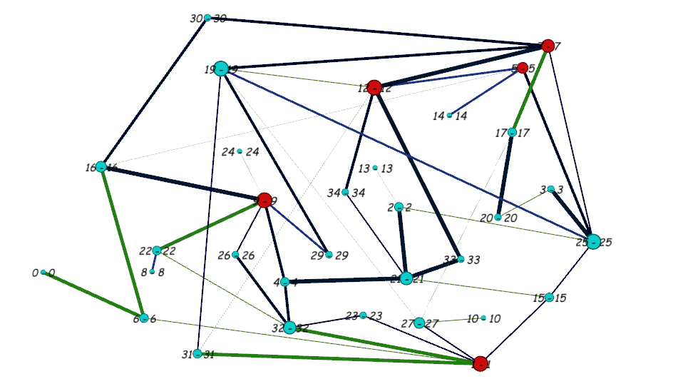
Scenario
Red colored nodes are super peer
which needs to be protected
Blue ones are the peers
Weights are assigned to the target
nodes based on the uptime , amount
traffic flowing through them , etc.
Weights to the edges are also
given based on the amount of
traffic flow.

Slide 3
Objectives
Super peers need to be protected from possible attacks
Each (super) peer has an IDS equipped but we want to avoid running IDSs on all peers all the time (conserve resources)
The task is to generate a monitoring schedule among peers that ensures minimum success of attacks.

Slide 4
Proposed Solutions:
Trivial solution :
Run IDS on the target nodes with some probability distribution which would ensure minimal successful attacks.
Non-trivial solution :
The trivial solution would always ensure minimum attacks but running IDS on target nodes would decline its performance , so apart from running IDS on the target nodes , IDS should be run on the leaf nodes (peers) with some probability distribution.

Slide 5
Calculating probability distributions :
Attacker strategies includes all the paths which lead to target nodes
Defender strategies includes the combination of peers/super-peers
Let say the attacker successfully attacks the target nodes he gets a payoff p , then the defender get the payoff of -p .
We then calculate Nash Equilibrium for given set of strategies and then we get a probability distribution of strategies the defender should follow to keep the attacker indifferent.

Slide 6
Attacker’s Best Response
Attacker chooses the best path (the path which gives maximum payoff ) .
If the chosen path increases the value of the game the path is added to final attacker’s set of strategies,
else its discarded.

Slide 7
Defender’s Best Response
Defender chooses such a combination of nodes which the attacker visited more number of times in the previous attacks .

Slide 8
Algorithm used ...
while all attacker or defender strategies are finished :
if cur_value >= prev_value :
defender adds strategy
else:
attacker adds strategy
build the payoff matrix and calculate the nash-equilibrium
calculate the value of the game using the above probability dist
update cur_value and prev_value
return probability dist of defender’s strategies

Slide 9
Sample Demo
The graph contains 35
nodes and 50 edges
The attacker can enter
only from the following
nodes 0,6,8,10,21,26
payoff(1) = 24
payoff(9) = 18
payoff(5) = 17
payoff(12)=32
payoff(7) =34

Slide 10
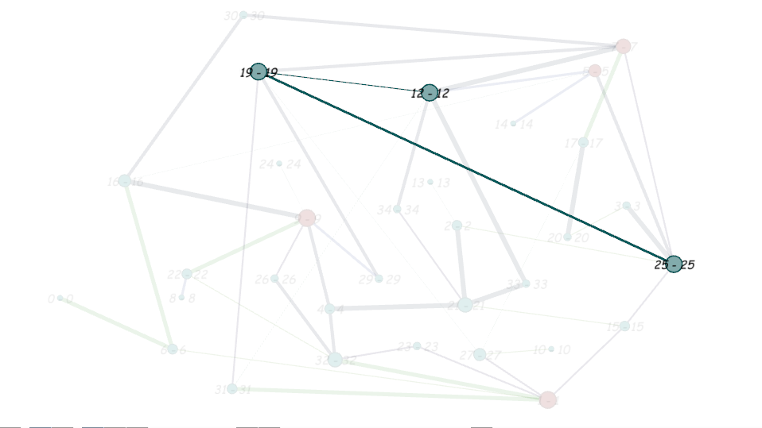
Sample strategies….
Let say the attacker chooses path
25->19->12
The payoff , the attacker receives for a successful attack = payoff(12) + W25-19 + W19-12
The payoff , the attacker receives for an unsuccessful attack = 0
Whatever payoff the attacker gets the defender gets -ve of it ( as its a
zero-sum game)

Slide 11
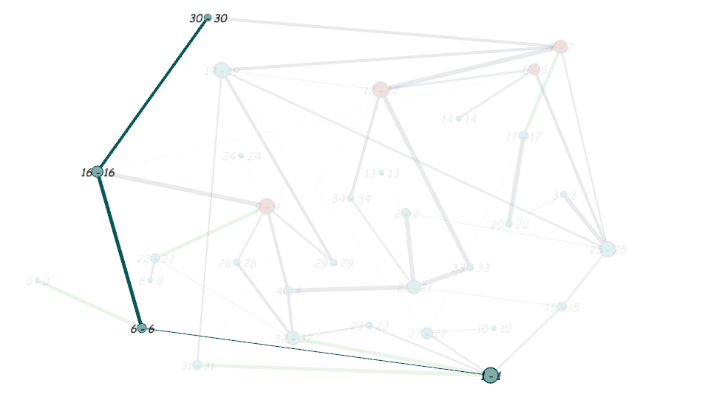
Sample strategies….
Similarly if the attacker chooses the path 30->16->6->1
For a successful attack the attacker gets a payoff = payoff(1) + W30-16 + W16-6 + W6-1
and 0 , if the he gets caught

Slide 12
Trivial Solution(5C3 combi for 3IDS)

Slide 13
Trivial Solution...

Slide 14
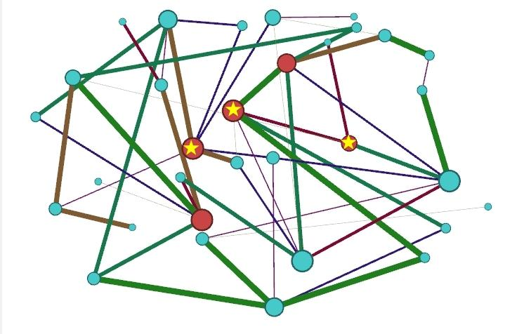
Trivial Solution ...

Slide 15
Non-Trivial Solution(30C3 comb for 3 IDS)

Slide 16
Non-Trivial Solution

Slide 17
Non-Trivial Solution

Slide 18
Trivial Solution
Number of IDS | Value of the game | Probability distribution
1 | 24.151747088 | 0.2452 ← [1] 0.0 ← [5] 0.2991 ← [7] 0.1823 ← [9] 0.2732 ← [12]
2 | 17.2453919008 | 0.1421 ← [1, 5] 0.3189 ← [1, 7] 0.0 ← [5, 12],[7, 9] 0.0 ← [1, 9] 0.0 ← [5, 7],[1, 12] 0.0578 ← [7, 9] 0.1227 ← [7, 12] 0.3582 ← [9, 12]

Slide 19
Trivial Solution
Number of IDS | Value of the Game | Probability Distribution
3 | 11.496927936 | 0.3459 ← [1, 5,7] 0.0 ← [1, 5, 9] 0.0432 ← [1, 5, 12] 0.0 ← [1, 7, 9] 0.0 ← [1, 7, 12] 0.2515 ← [1, 9, 12] 0.0 ← [5, 7, 9] 0.0 ← [5, 7, 12] 0.0388 ← [5, 9, 12] 0.3204 ← [7, 9, 12]
4 | 5.748463968 | 0.1729 ← [1, 5, 7, 9] 0.1946 ← [1, 5, 7, 12] 0.1668 ← [1, 5, 9, 12] 0.2859 ← [1, 7, 9, 12] 0.1796 ← [5, 7, 9, 12]

Slide 20
Non-Trivial Solution
Number of IDS | Value of the game | probability distribution
1 | 25.5533980604 | 0.5214 ← [3] 0.4258 ← [4] 0.0304 ← [21] 0.0221 ← [25]
2 | 17.6287540688 | 0.0904 ← [0, 3] 0.0844 ← [3, 21] 0.2693 ← [6, 19] 0.0074 ← [8, 19] 0.0454 ← [6, 21] 0.0071 ← [6, 32] 0.0064 ← [8, 21] 0.2334 ← [10, 32] 0.0531 ← [15, 32] 0.2025 ← [21, 32]

Slide 21
Non-Trivial Solution
Number of IDS | Value of the game | Probability distribution
3 | 14.444206962 | 0.0417 ← [0, 2, 27] 0.0098 ← [0, 8, 25] 0.0606 ← [0, 10, 25] 0.0855 ← [0, 21, 27] 0.1778 ← [0, 2, 32] 0.1781 ← [8, 10, 25] 0.1778 ← [0, 3, 32] 0.0907 ← [0, 10, 32] 0.1775 ← [2, 26, 27]
4 | 13.2551757339 | 0.0038 ← [0, 8, 26, 27] 0.3096 ← [0, 3, 26, 27] 0.0420 ← [0, 2, 21, 32] 0.2968 ← [0, 8, 10, 21] 0.0241 ← [0, 2, 8, 21] 0.0908 ← [0, 2, 3, 21] 0.2325 ← [31, 32, 33, 34]

