Slide 1
The problem
Hide the seed word

Slide 2
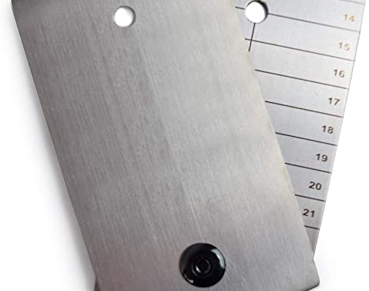
Is that a solution ?
Yeah it’s durable , but what happens if the thief get your precious “metal thing”. When will you notice the loss? How much time left for you to transfer your Bitcoin to another wallet ?
You run out of time , right?
Let’s see an alternative …

Slide 3
A book
We created a software where you hide your seeds among other 2048 words of BIP39. You place the words according to the page, row and column. For example (2,10,7) means that the word is on the 2nd page, 10th row and 7th column. The program has the ability to be installed and run offline for security reasons. Finally you locally print the book as many copies you like, and erase the file from the computer. We suggest placing the book in at least 2 locations. And let's not forget the dual purpose of the software. Hide the seed but also to give us reaction time from the moment we notice the theft.

Slide 4
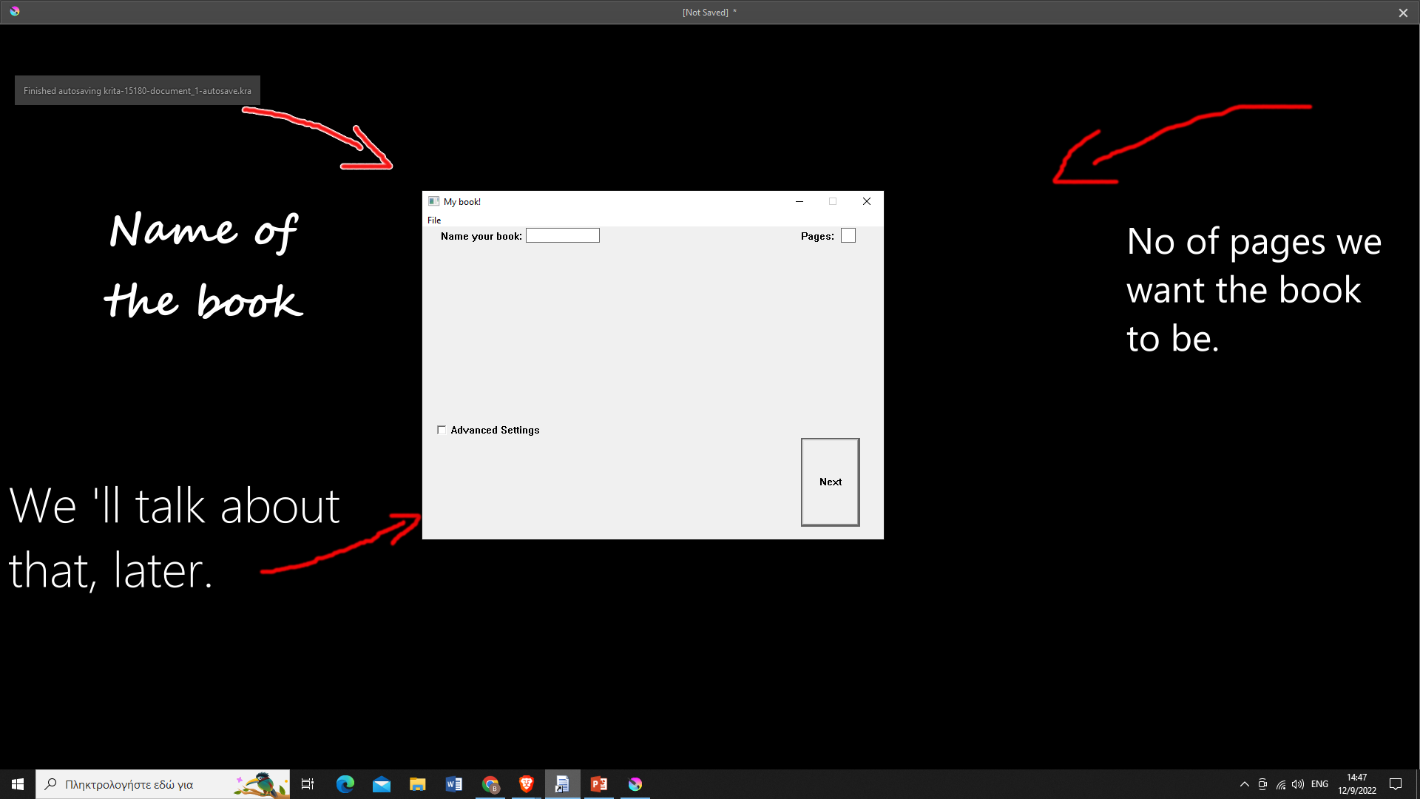
Ok, let’s create a book from scratch.
After install the software off line, you see that picture. Beware! We have unplugged the network cable or wifi adaptor. We work until the end, off line.
Let’s name “my book!” and 24 pages.

Slide 5
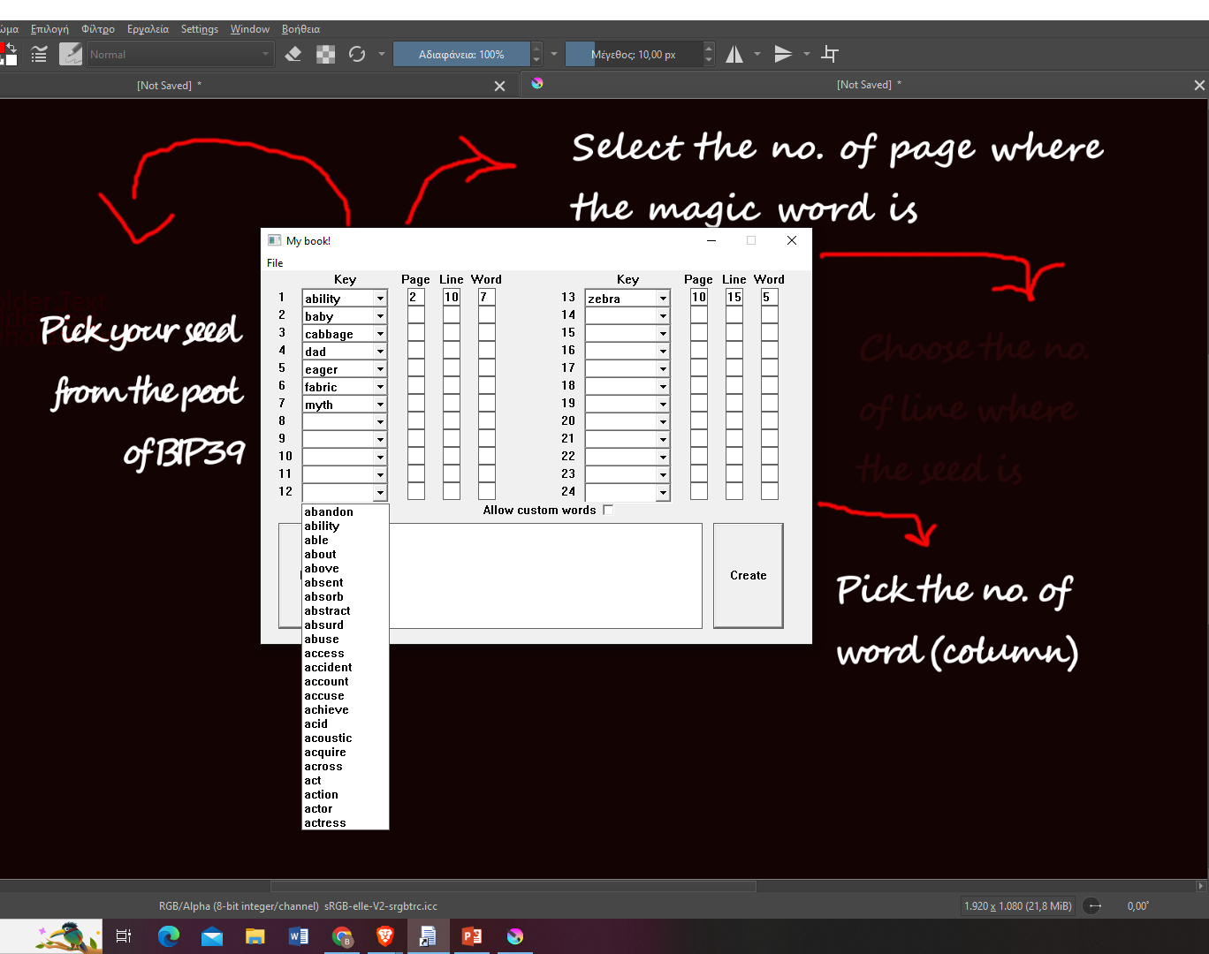
Let’s create
We pick carefully the right word. We can use the BIP39 Pool or we can manually type the word (in case of passphrase )
We put the page where the word is.
The same with the line , and finally with the column.

Slide 6
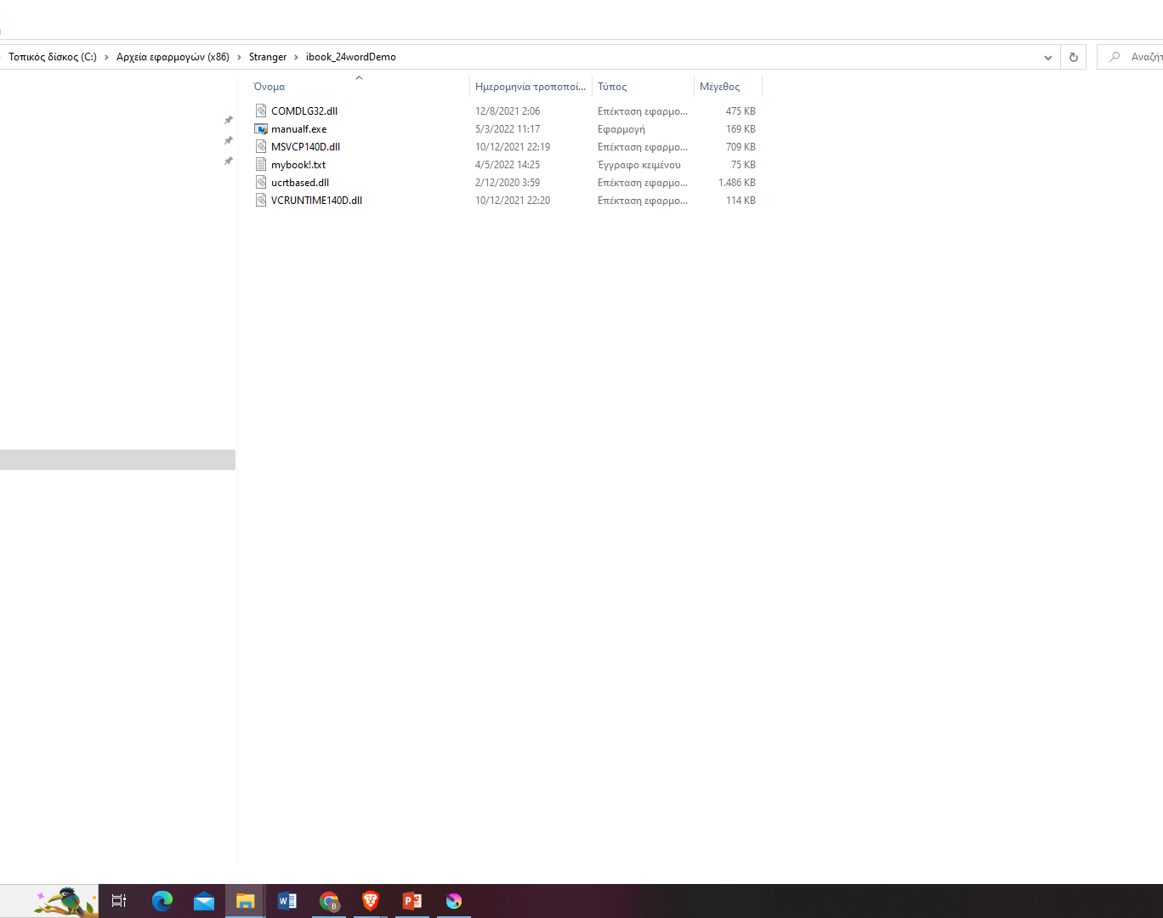
Finally
A .txt document is created
Our Book is in there
We print locally as many times as we like,
And we delete.
We plug in the machine with the network
That’s it!

Slide 7
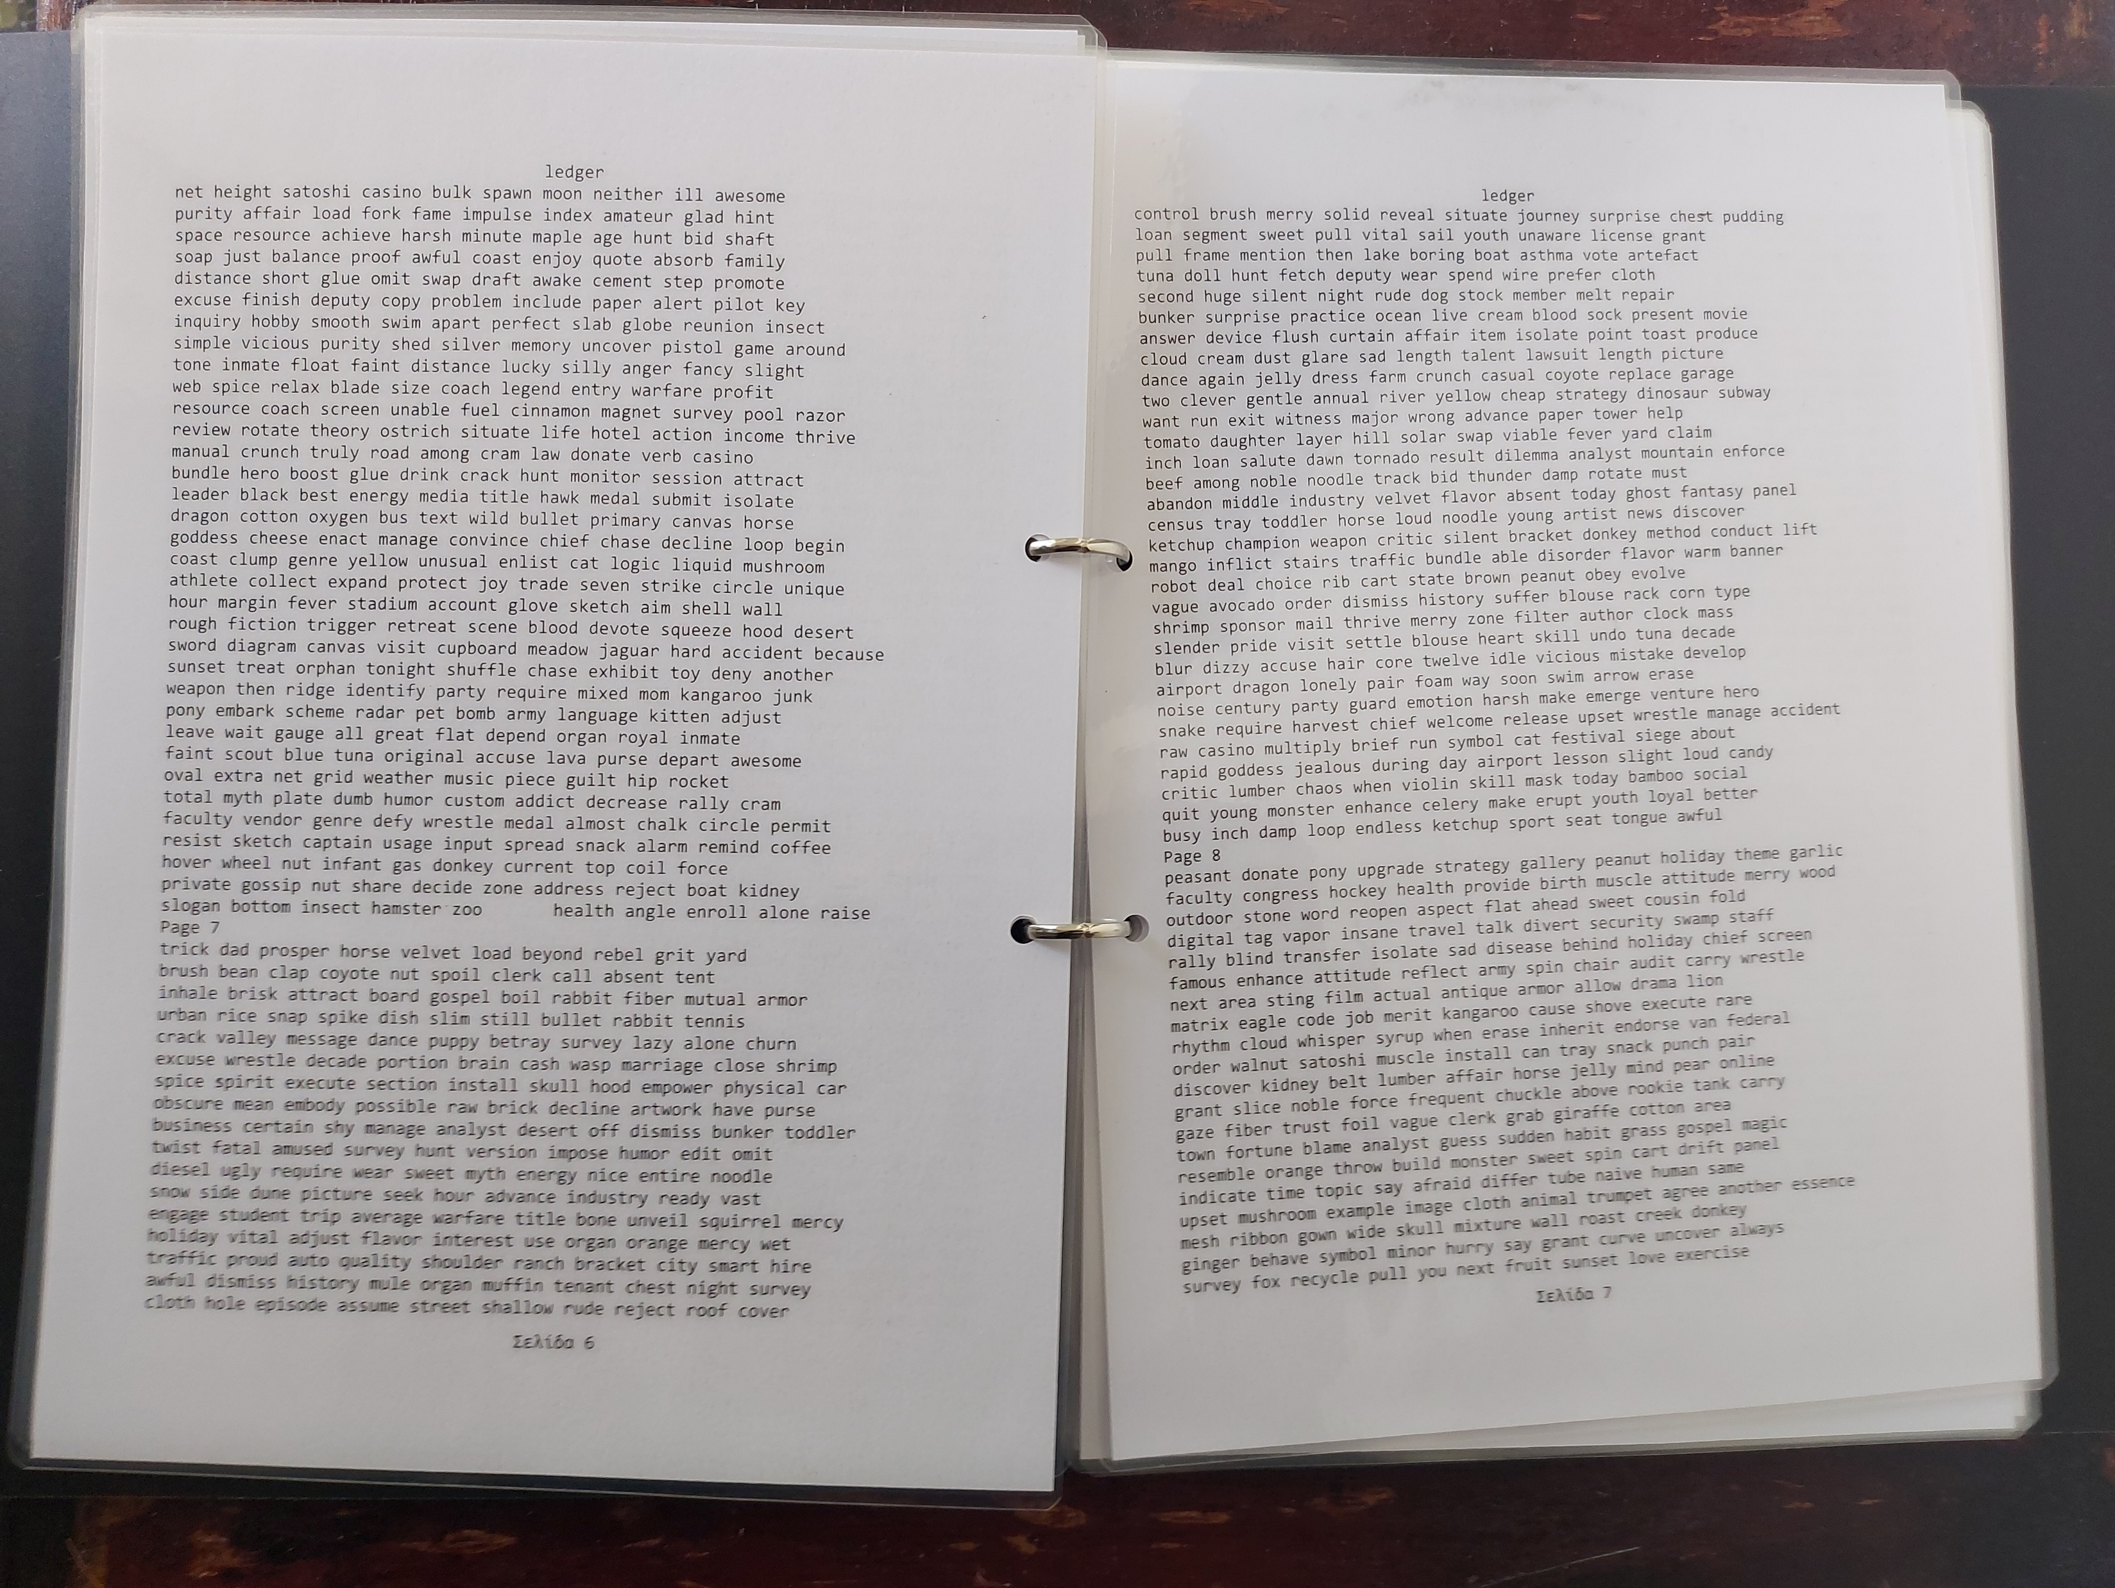
Voila!
Now you see the printed book. 10 words in each row (columns) and 48 rows in each page. On these 2 pages are some of my seed words. Maybe none of them or perhaps all of them. There may also be more seed phrases than 1 cold wallet. Can you guess? I always Keep it on the bookcase above my desk. You can come and get it! Even if that happens I will notice it soon enough to transfer my coin to another wallet. Thanks for watching.

