Slide 1

BikeHub
Community driven ride tracking and incident reporting

Slide 2
User Stories
Create a BikeHub Account (username, password, profile)
Add bikes, rides, and incidents (theft/accident) (Bikewise/BikeIndex API)
Remove bicycles/ delete account
View ride/incident history (possible map) (Strava/OSM API)
Update/remove user’s bicycles only
Comment on all incidents
Resolve user’s incidents only
Comment on all rides
Leaderboard/metrics

Slide 3
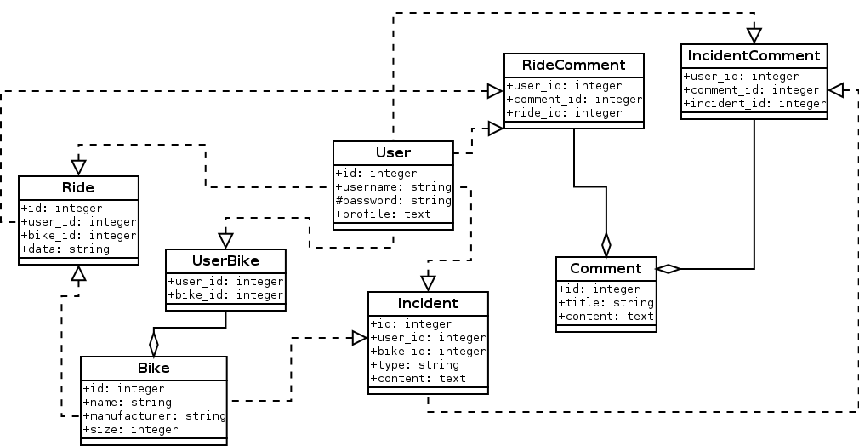
UML

Slide 4
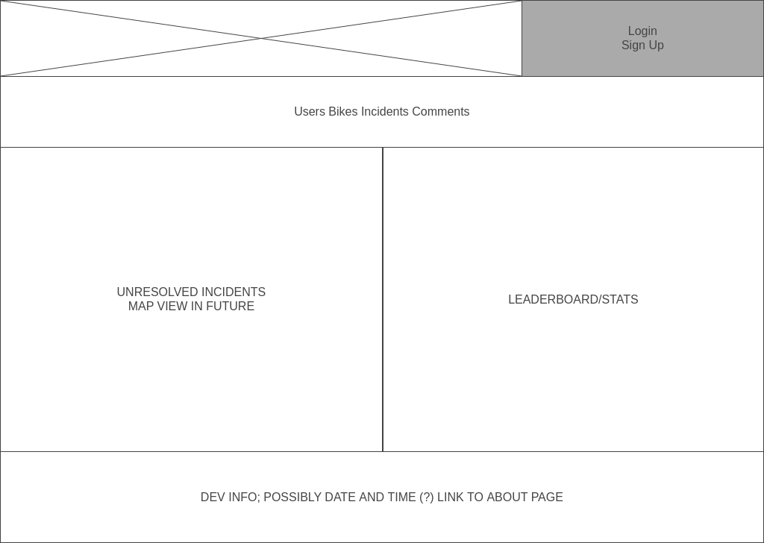
Wireframes: Home

Slide 5
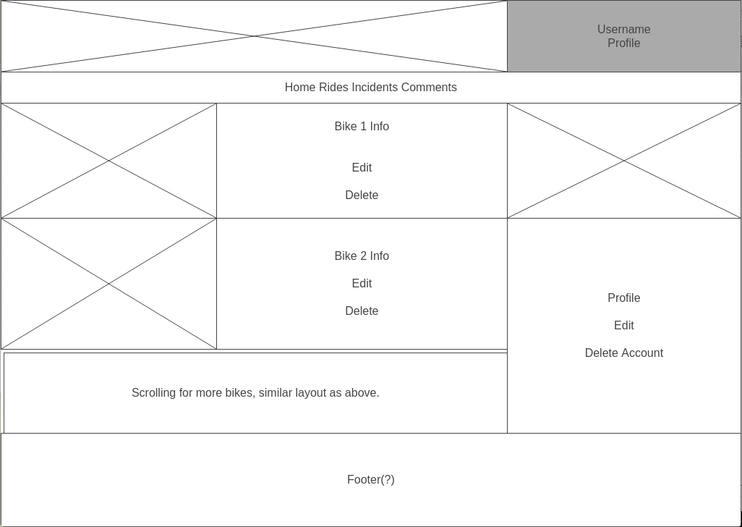
Wireframes: Profile

Slide 6
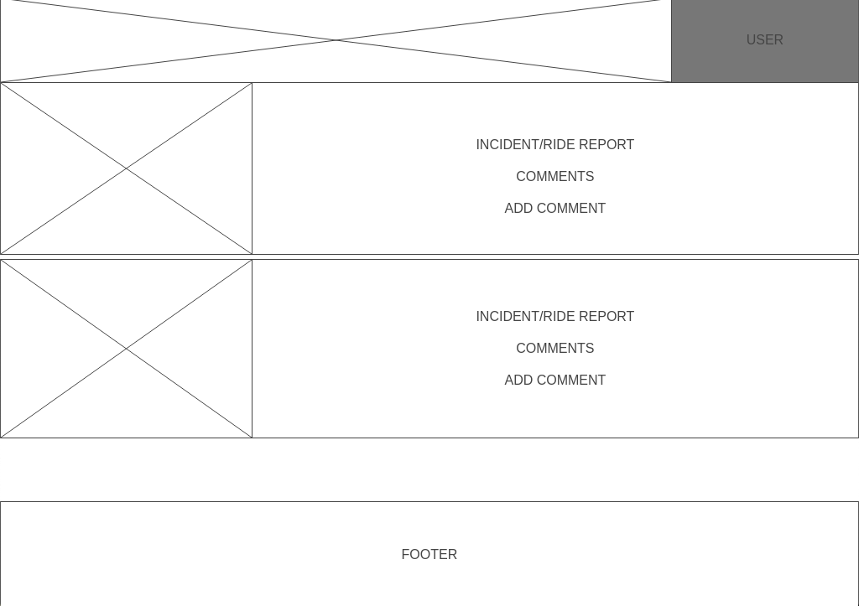
Wireframes: View

