Slide 1
Portable Alpha Analysis
Investment Committee Report

Slide 2
Executive Summary
Key Results:
• Annualized Return: 1.51%
• Annualized Volatility: 0.68%
• Shortfall Probability: 0.00%
• Value at Risk (95%): -0.20%
Key Parameters:
• N_SIMULATIONS: 1000
• N_MONTHS: 12
• analysis_mode: returns

Slide 3
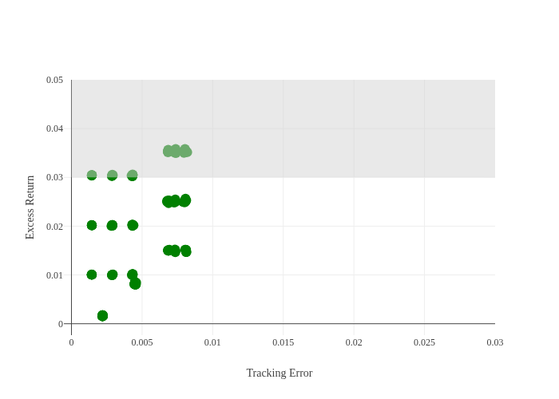

Slide 4
Appendix: Model Parameters
Simulation Settings:
N_SIMULATIONS: 1000
N_MONTHS: 12
analysis_mode: returns
Return Assumptions:
mu_H: 0.0400
mu_E: 0.0500
mu_M: 0.0300
Volatility Assumptions:
sigma_H: 0.0100
sigma_E: 0.0200
sigma_M: 0.0200
Correlation Assumptions:
rho_idx_H: 0.0500
rho_idx_E: 0.0000
rho_idx_M: 0.0000
rho_H_E: 0.1000
rho_H_M: 0.1000
rho_E_M: 0.0000

