Slide 1
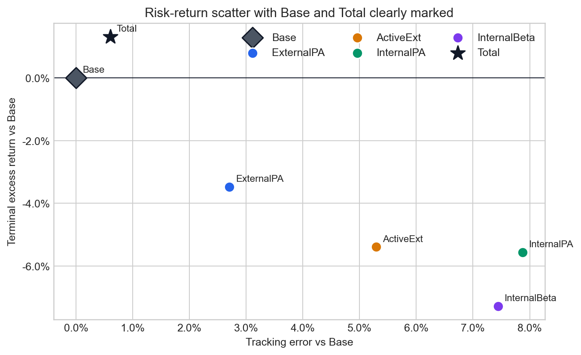
REORIENTATION
Portable Alpha + Active Extension
Runnable notebook plus companion deck for reading the math, running the model, and avoiding misuse.
Executes end to end against pa_core.
Uses same-seed scenarios for parameter effects.
Saves notebook figures under docs/tutorial/figs/.
Makes limitations prominent before use.
Portable Alpha Tutorial
01

Slide 2
PROJECT
A Monte Carlo workbench for beta, alpha, financing, and sleeve sizing
pa_core/
dashboard/
pa CLI
Agents, joint draws, covariance repair, financing, metrics, reporting, and viz.
Seven Streamlit pages: asset library, portfolio builder, wizard, results, grid, stress lab, logs.
Single runs, sweeps, sensitivity, sleeve suggestions, packet exports, and dashboard launch.
Core interpretation: sleeves emit fund-level contribution returns. Total is overlay contribution, not Base plus overlays.
Portable Alpha Tutorial
02

Slide 3
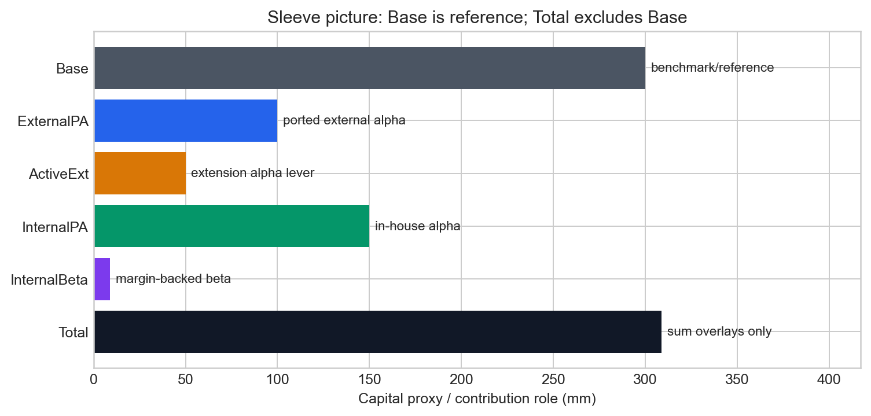
SLEEVES
The sleeve picture separates reference return from overlay contribution
Base is the benchmark/reference mix; Total sums ExternalPA, ActiveExt, InternalPA, and InternalBeta contributions only.
Portable Alpha Tutorial
03

Slide 4
FINANCE IDEA
Portable alpha ports skill onto beta, but financing and capacity decide whether it pays
Beta
Alpha
Implementation
Index exposure or efficient beta implementation.
External, internal, or extension manager skill stream.
Financing, margin, active share, TC decay, and tail behavior.
The model shows what has to be true for assumed alpha to survive risk, cost, and capital constraints.
Portable Alpha Tutorial
04

Slide 5
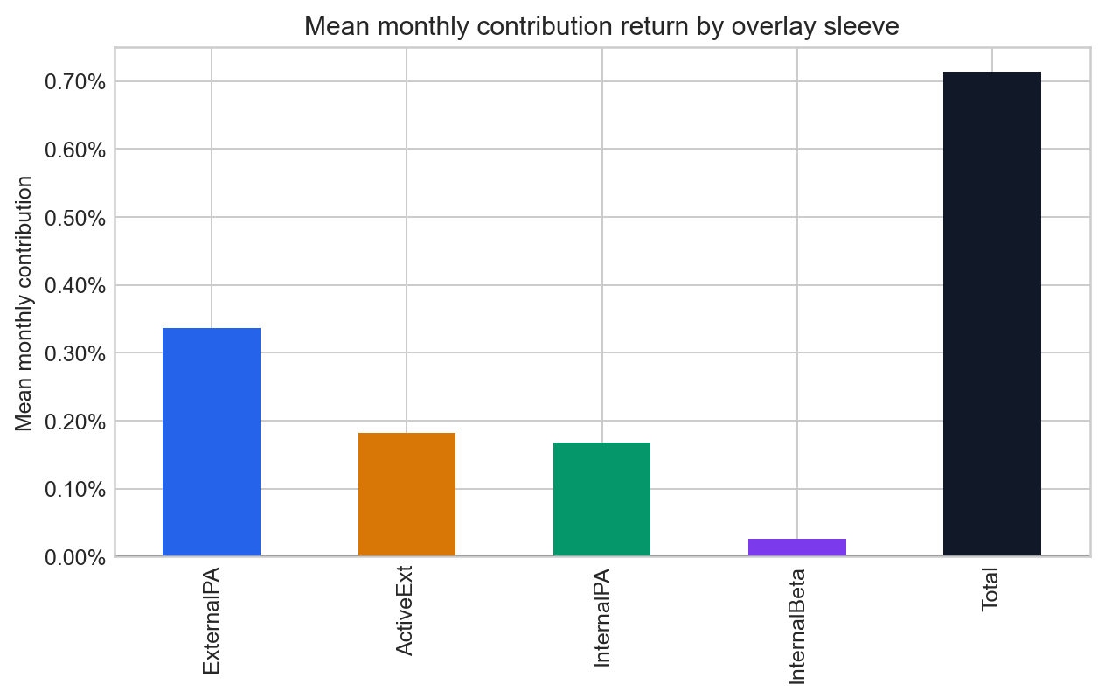
SLEEVE MATH
Sleeve outputs are contribution returns, already scaled to the fund
Equations to read
ExternalPA: r = w(r_beta - f) + (w*theta) r_M
ActiveExt: r = w(r_beta - f) + (w*s) r_E
InternalPA: r = a r_H - f_ipa
Base: r = w_beta(r_beta - f) + w_alpha r_H
Total = sum overlay sleeves, excluding Base
Plain-English read
Read each term as fund-level contribution, not standalone manager performance.
Portable Alpha Tutorial
05

Slide 6
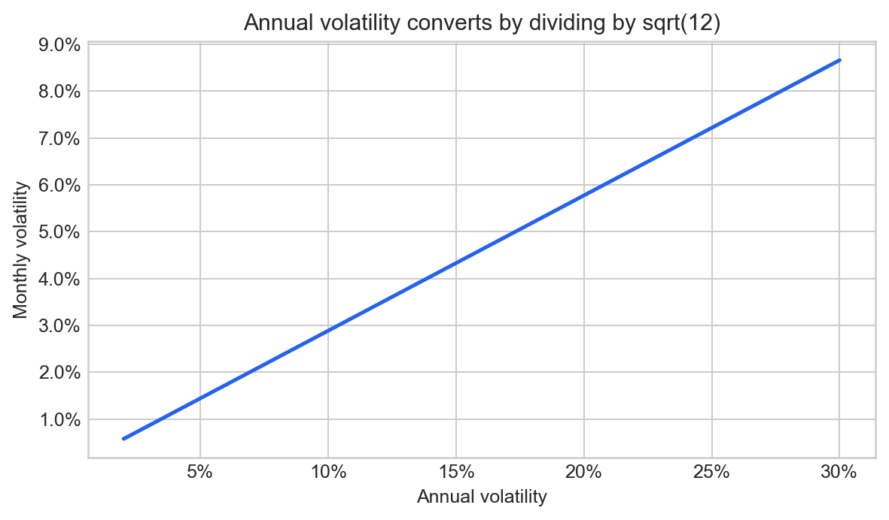
DRAWS
Annual inputs become monthly draws before the engine compounds paths
Equations to read
mu_m = mu_a / 12 by default
sigma_m = sigma_a / sqrt(12)
Sigma_m = Sigma_a / 12
r ~ Normal(mu, Sigma)
Student-t scale = sqrt((df - 2) / df)
Plain-English read
Mean conversion is a convention; volatility and covariance follow variance scaling.
Portable Alpha Tutorial
06

Slide 7
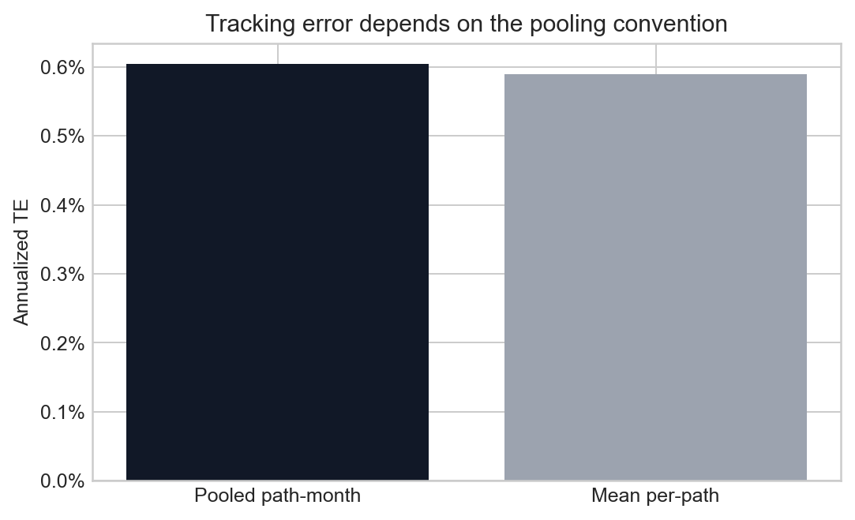
RISK MATH
Covariance repair and TE definitions shape the headline risk numbers
Equations to read
Sigma = (sigma sigma^T) o C
nearest-PSD repair clips negative eigenvalues
Sigma_hat = (1 - delta) S + delta T
TE = std(r - r_bench) * sqrt(12)
Code TE pools all path x month draws
Plain-English read
The audit nuance is not cosmetic: pooled and per-path TE can differ.
Portable Alpha Tutorial
07

Slide 8
HEADLINE CHART
The risk-return scatter should identify every sleeve and call out Base and Total
Good version: TE on x, terminal excess return on y, visible legend, and distinct Base/Total markers.
Portable Alpha Tutorial
08

Slide 9
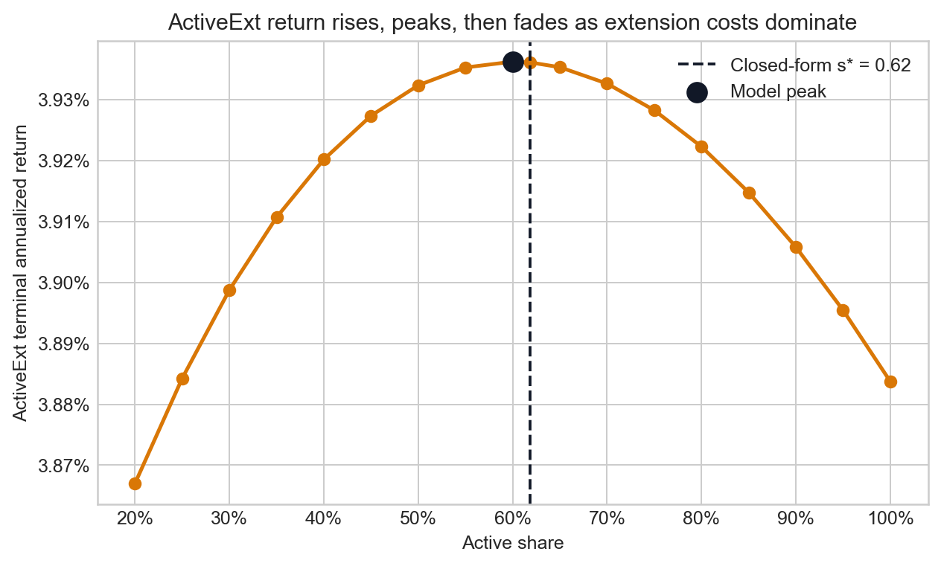
CAPACITY
The transfer coefficient turns active share from a linear lever into a capacity question
Equations to read
TC(s) = 1 / (1 + kappa*s)
alpha_gross(s) = s*mu / (1 + kappa*s)
s* = (sqrt(mu/c) - 1) / kappa
Example: mu=0.05/12, c=0.0026, kappa=0.43, s* approx 0.62
Plain-English read
More active share still increases risk linearly, while expected alpha rises more slowly.
Portable Alpha Tutorial
09

Slide 10
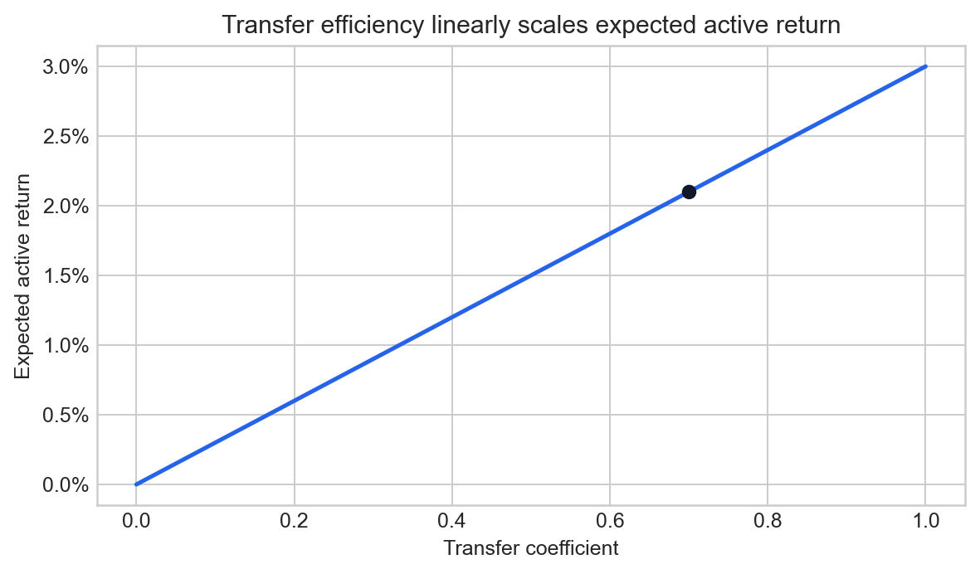
FUNDAMENTAL LAW
TC is the bridge from portfolio constraints to expected active return
Equations to read
IR = IC * sqrt(BR) * TC
alpha = IR * sigma_active
IC = skill
BR = breadth
TC = transfer of ideal views into the portfolio
Plain-English read
The TC decay in 3g lowers IR as active share rises.
Portable Alpha Tutorial
10

Slide 11
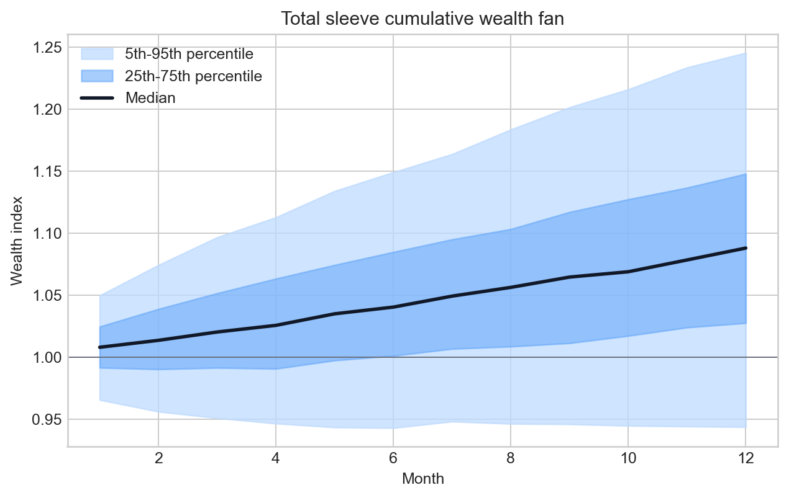
PATHS
The Total wealth fan shows the range of compounded outcomes, not just a point estimate
Median, interquartile band, and 5th-95th band make path uncertainty visible.
Portable Alpha Tutorial
11

Slide 12
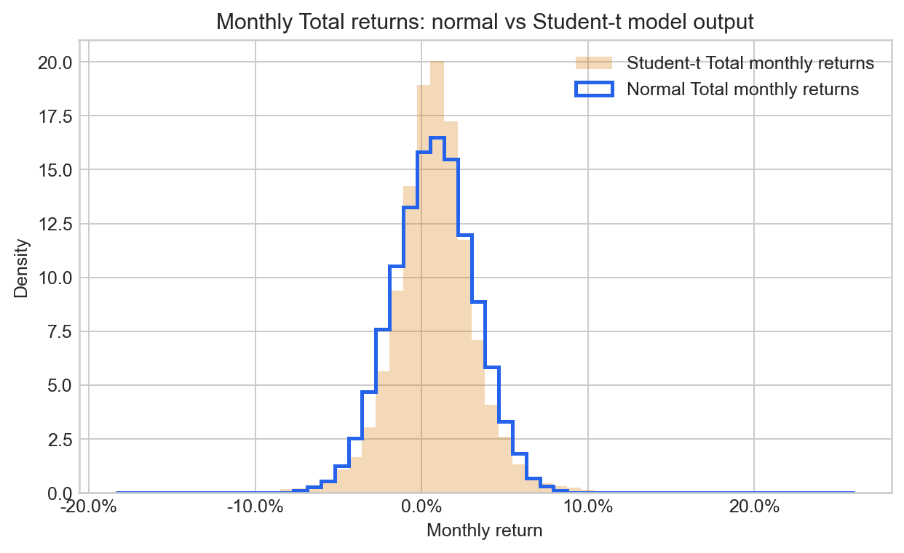
TAILS
Normal and Student-t assumptions can produce similar vol but different left tails
Distribution choice and copula choice are model assumptions, not facts.
Portable Alpha Tutorial
12

Slide 13
WORKFLOW
A user can move from wizard to CLI to Results to board-pack export
1. Wizard
2. CLI
3. Results
4. Export
Load data, set capital, returns, financing, regimes, export YAML.
Run single scenarios or sweeps with fixed seeds and workbook outputs.
Inspect headline, fan, path distribution, diagnostics, comparisons.
Use --pptx or --packet for board-pack-ready artifacts.
Analysis modes: returns, capital, alpha_shares, vol_mult. Add sensitivity and sleeve optimization for robustness and feasible allocation.
Portable Alpha Tutorial
13

Slide 14
MODES
The sweep and optimization surfaces answer different user questions
returns
Sensitivity to alpha and volatility assumptions.
capital
How sleeve allocation moves return and risk.
alpha_shares
How theta and active share change risk/return.
vol_mult
What happens when alpha-stream volatilities are stressed.
suggest/optimize
Which feasible combinations meet TE, breach, CVaR, and shortfall constraints.
Portable Alpha Tutorial
14

Slide 15
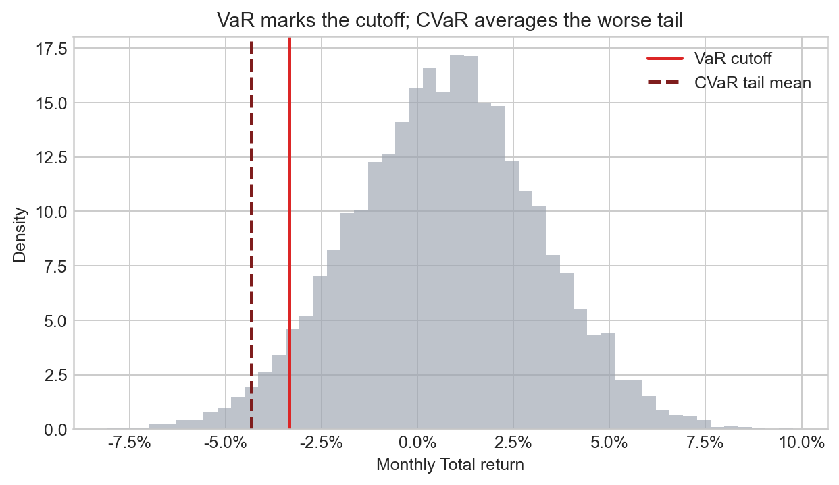
LIMITATIONS
The model is a scenario workbench, not proof a strategy will work
Gross of fees: fee and implementation layers can erase simulated value.
Total excludes Base: overlay contribution is not whole-fund return.
broadcast financing understates dispersion relative to per_path.
Regimes are honored in run_single but not in sweeps.
TC decay and active-share capacity are assumptions requiring calibration.
Portable Alpha Tutorial
15

Slide 16
MISUSE CHECKS
Ask these before showing the result to colleagues
Can every alpha, vol, correlation, financing, and TC assumption be sourced?
Are the results net of the costs the fund actually pays?
Did tail-sensitive work use per_path financing?
If regimes matter, was the result from a regime-aware run rather than a sweep?
Are Total and Base labeled so no one confuses overlay contribution with whole-fund return?
Would the conclusion survive lower alpha, higher financing, higher stress correlation, and fatter tails?
Portable Alpha Tutorial
16

Slide 17
RUN IT
Reproduce the tutorial and change one assumption at a time
jupyter nbconvert --to notebook --execute --inplace docs/tutorial/PortableAlpha_Tutorial.ipynb
pa run --config examples/scenarios/active_extension_diminishing_returns.yml --index data/sp500tr_fred_divyield.csv --output Outputs.xlsx
pa run --config config/params_template.yml --index data/sp500tr_fred_divyield.csv --sensitivity --packet --output Results.xlsx
Use same seeds for parameter comparisons. Change one parameter at a time when explaining cause and effect.
Portable Alpha Tutorial
17

