Slide 1
Portable Alpha Analysis
Investment Committee Report

Slide 2
Executive Summary
Key Results:
• Annualized Return: 1.46%
• Annualized Volatility: 0.68%
• Shortfall Probability: 0.00%
• Value at Risk (95%): -0.21%
Key Parameters:
• N_SIMULATIONS: 1000
• N_MONTHS: 12
• analysis_mode: returns

Slide 3
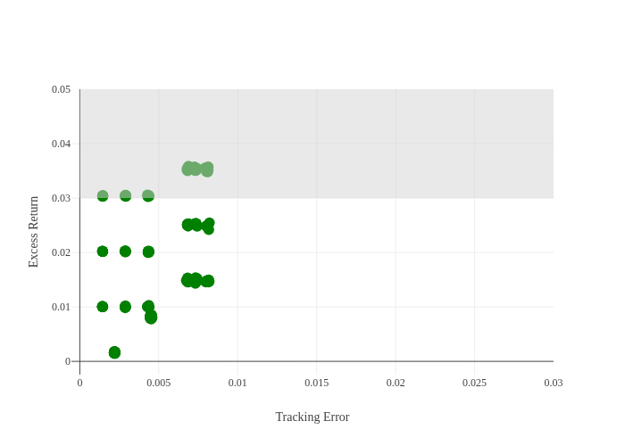

Slide 4
Appendix: Model Parameters
Simulation Settings:
Return Assumptions:
Volatility Assumptions:
Correlation Assumptions:

