Slide 1
Firefox Wayland post mortem
Martin Stránský
http://people.redhat.com/stransky/

Slide 2
Firefox Wayland state
Developed on Fedora (Gnome), paid by Red Hat.
Shipped as stable since Firefox 121.0 (8 months ago).
20% of users are on Wayland (XWayland before)
Fedora, Arch Linux, Ubuntu 22.04+
Started 10 years ago after switch to Gtk3 (Bug 635134)
ESR128 / Thunderbird 128 / RHEL
Mutter (GNOME)
Kwin (KDE)
Sway, Weston etc.

Slide 3
Firefox Wayland pros
Security (app sandbox)
HiDPI support, multi-monitor
Works better on Xwayland (D&D, popups etc.)

Slide 4
Firefox Wayland cons
Popups
Focus
Testing (Fedora)

Slide 5
Firefox Wayland state
Patient is stable
Fixing protocol corner cases & minor issues
Issues:
  Missing automated testing (Nightly)
  Missing PIP Always-on-top
  Can’t place/move toplevel window
  Can’t get toplevel window position
    Session restore
  Different focus handling
    Focus steal / focus transfer

Slide 6
Main road blocks
Various Wayland compositor bugs (D&D popup rendering)
  Different implementations at Mutter, KWin, Sway etc.
General Gtk3/Wayland integration
  wl_output, data devices
Rendering to GtkWidget (Gtk3)
  wl_subsurface, mContainer
Multi-thread rendering (WebRender/ Compositor / GtkMain thread events)
  Offscreen rendering, missing wl_surface (before/after creation)
  Frame callbacks, VSync
Clipboard – async/sync
D&D
Wayland protocol “freeze" – ping (wayland-proxy), broken pipe
  Gtk3 event loop issue?

Slide 7
Wayland popup nigthmare
wl_subsurface
  Can be placed anywhere (direct placement)
  May drift away from screen, invisible
xdg_popup/xdg_positioner
  Move-to-rect
  Strict hierarchy, one parent, one child
  Can’t be directly moved/resized by Gtk3
    hide/move/show
  Popup child/parent must be adjacent
    Mutter silently fails to show it otherwise
  Connecting unrelated popups & tooltips
    Mutter loves to terminate Firefox if there’s any error in popup chain

Slide 8
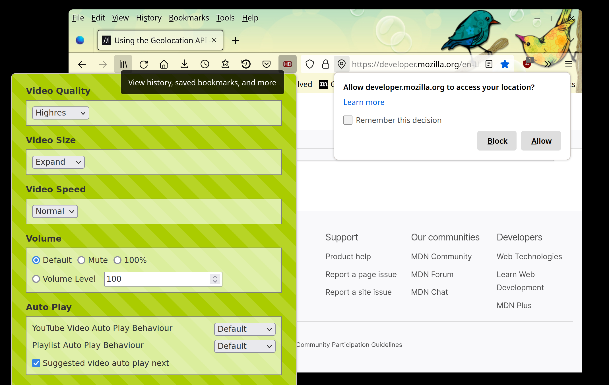
Connecting unrelated popups to popup chain

Slide 9
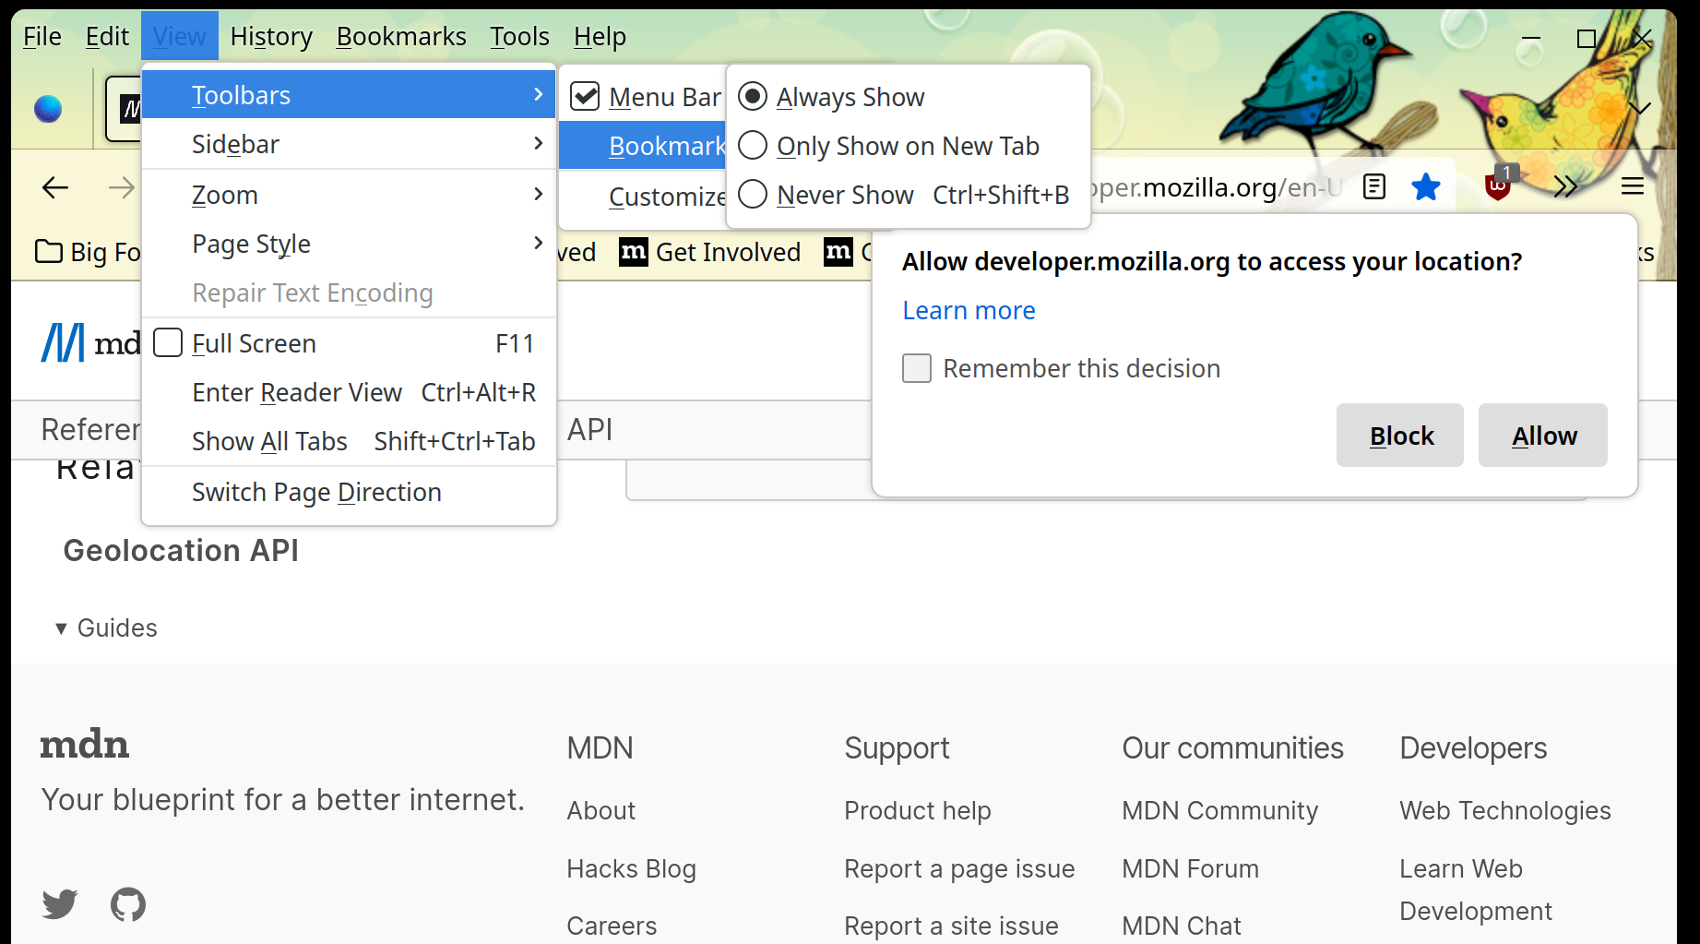
Connecting natural popup chain & independent popup

Slide 10
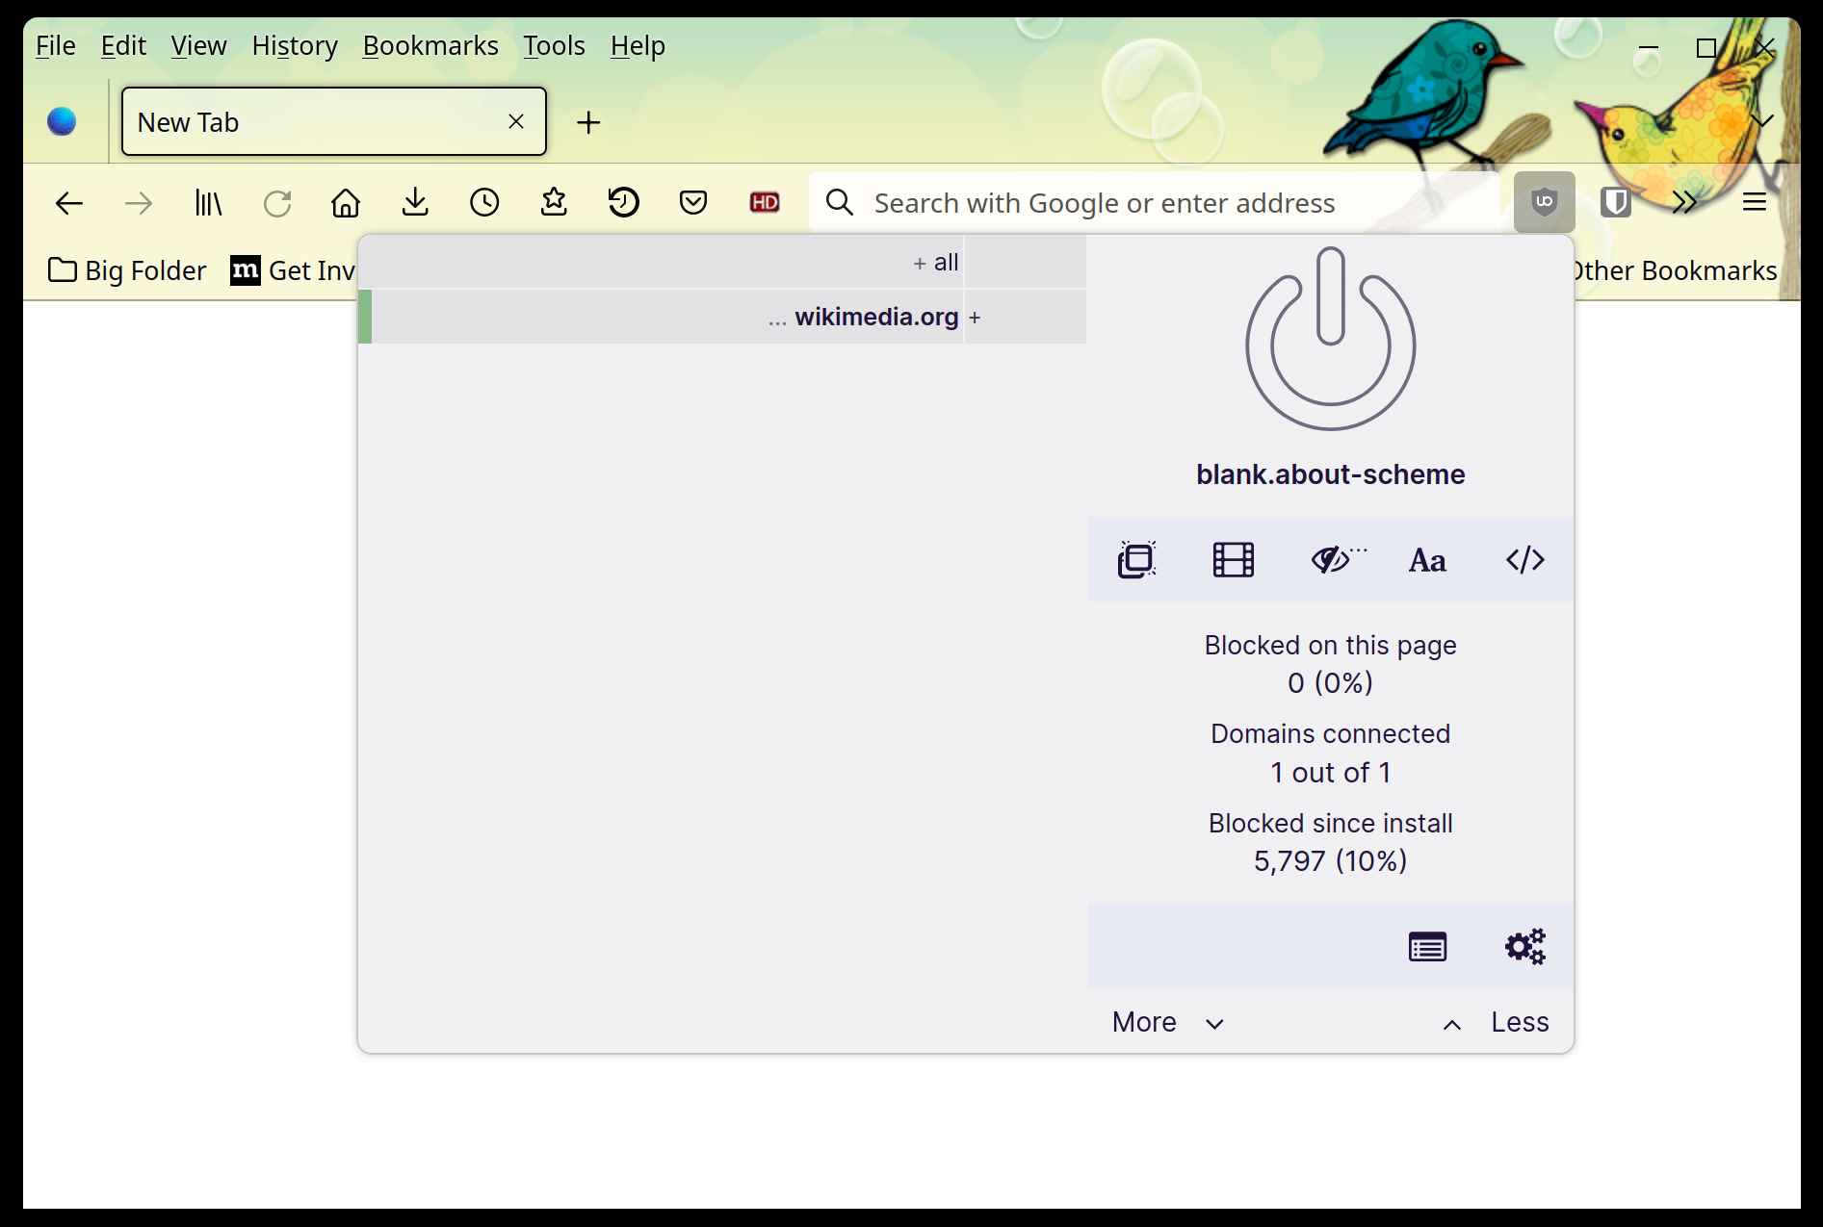
xdg_positioner popup resize

Slide 11
Further development
Gtk3 limitations (missing direct rendering, popups resize/move)
  Move to Gtk4 or backport to Gtk3
Update automated upstream testing
Fix proxy to process pings

Slide 12






THANK YOU
plus.google.com/+RedHat
facebook.com/redhatinc
linkedin.com/company/red-hat
twitter.com/RedHat
youtube.com/user/RedHatVideos

