Slide 1
Firefox & Wayland
Martin Stránský
http://people.redhat.com/stransky/

Slide 2
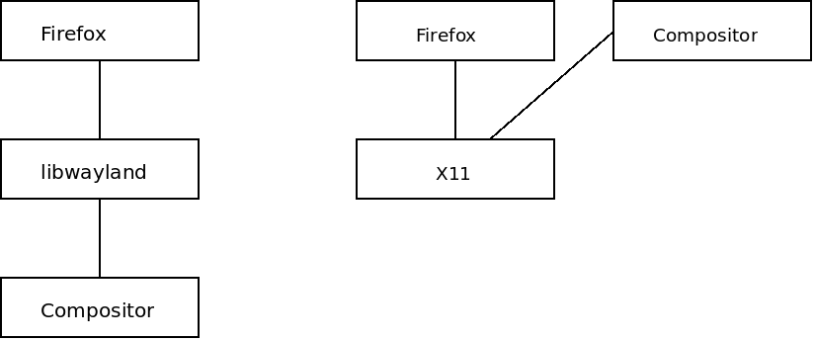
Architecture overview
Wayland compositors – mutter, kwim, sway...

Slide 3
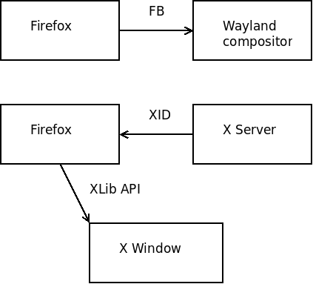
Architecture
Window is defined by wl_surface
Shared via. SHM (mmap), GL
Defines Window size
Position can’t be set
  Issued with popup/child windows
Window can’t be shared with different process (easily).
XID/Xlib – global X Window handle
Shared via. XID
Resized/positioned by Xlib
XWindow can be shared.

Slide 4
X11 vs. Wayland
Network transparent
Global XID
Shareable XID (GPU)
Window can be positioned
Parent/child XWindow from different process (XEmbed)
Insecure
Fine tuned
Local frame buffer
Restricted ownership (shm)
Can be restricted (sandbox)
Can be faster (direct draw)
Can be lighter (Embedded systems…)
Can’t run flash and other NPAPI plugins (missing Xembed).

Slide 5
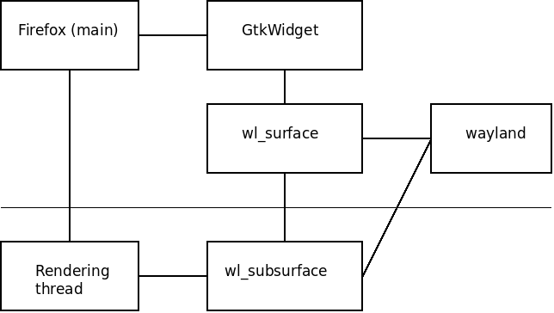
Firefox rendering on Wayland

Slide 6
Firefox Wayland specific issues
Async rendering from non-main thread (Gtk+ does not like that)
Sync clipboard and drag&drop
Popup placement/positioning
WebRTC – desktop sharing (PipeWire)
Broken flash
HiDPI multi-monitor issues
OpenGL/WebRenderer

Slide 7
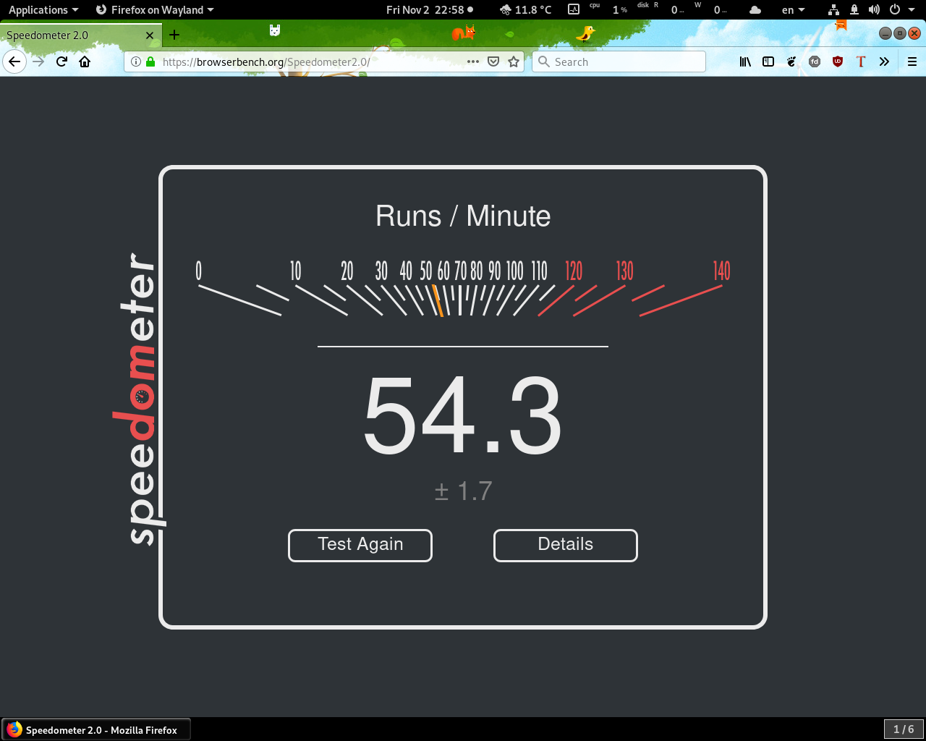
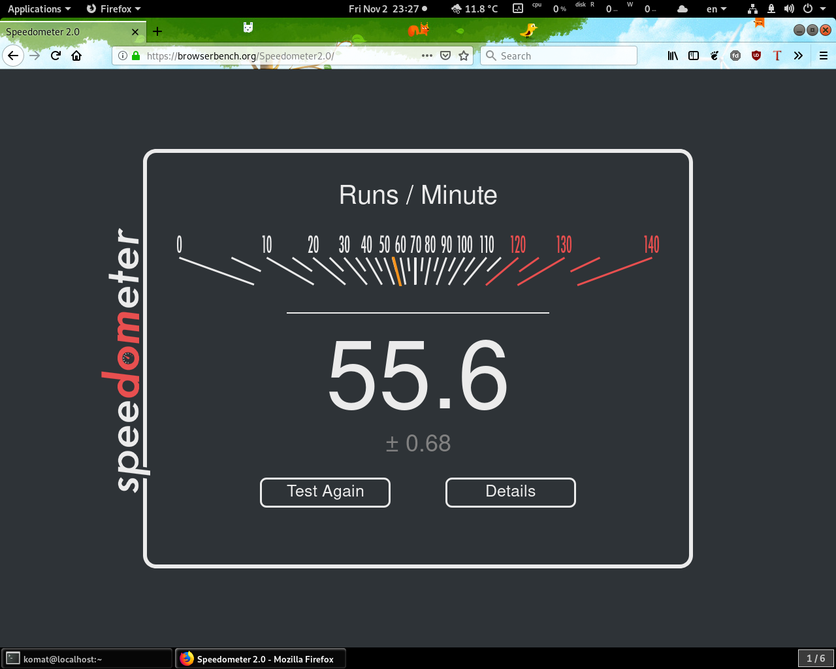
Firefox Wayland vs. X11 performance

Slide 8
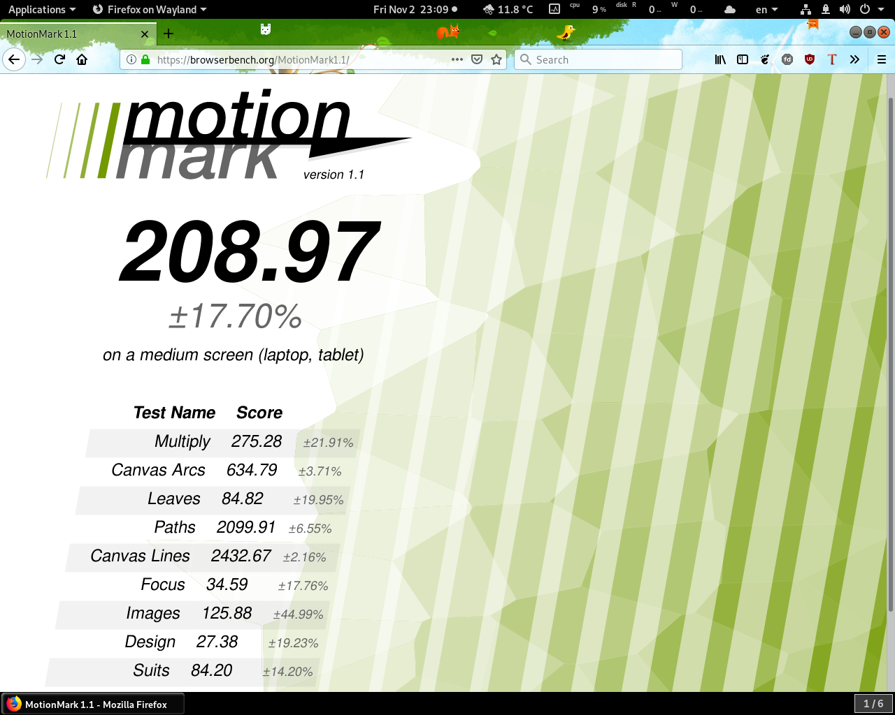
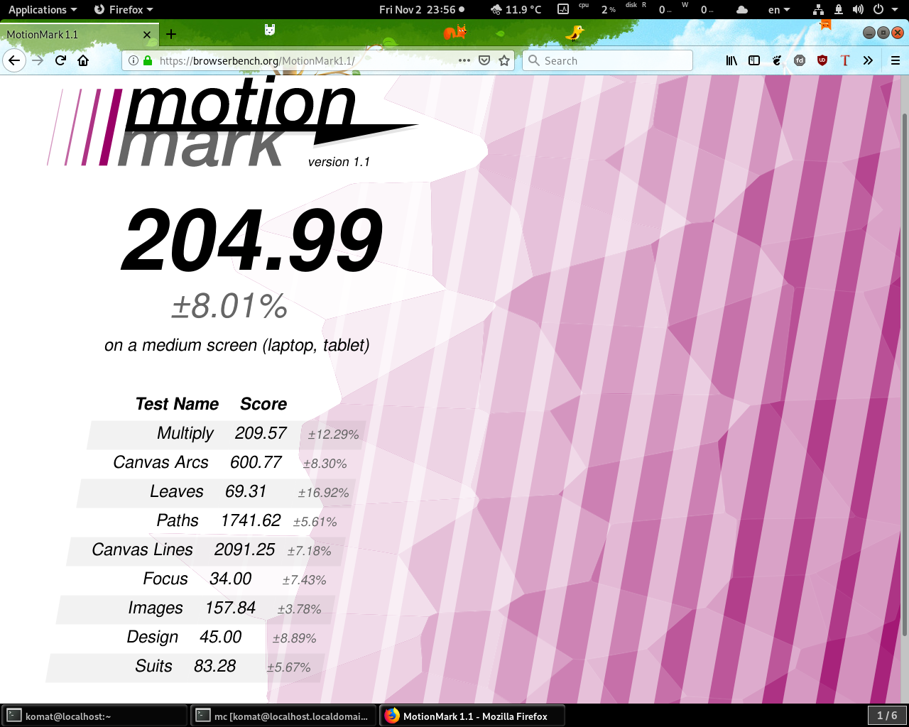
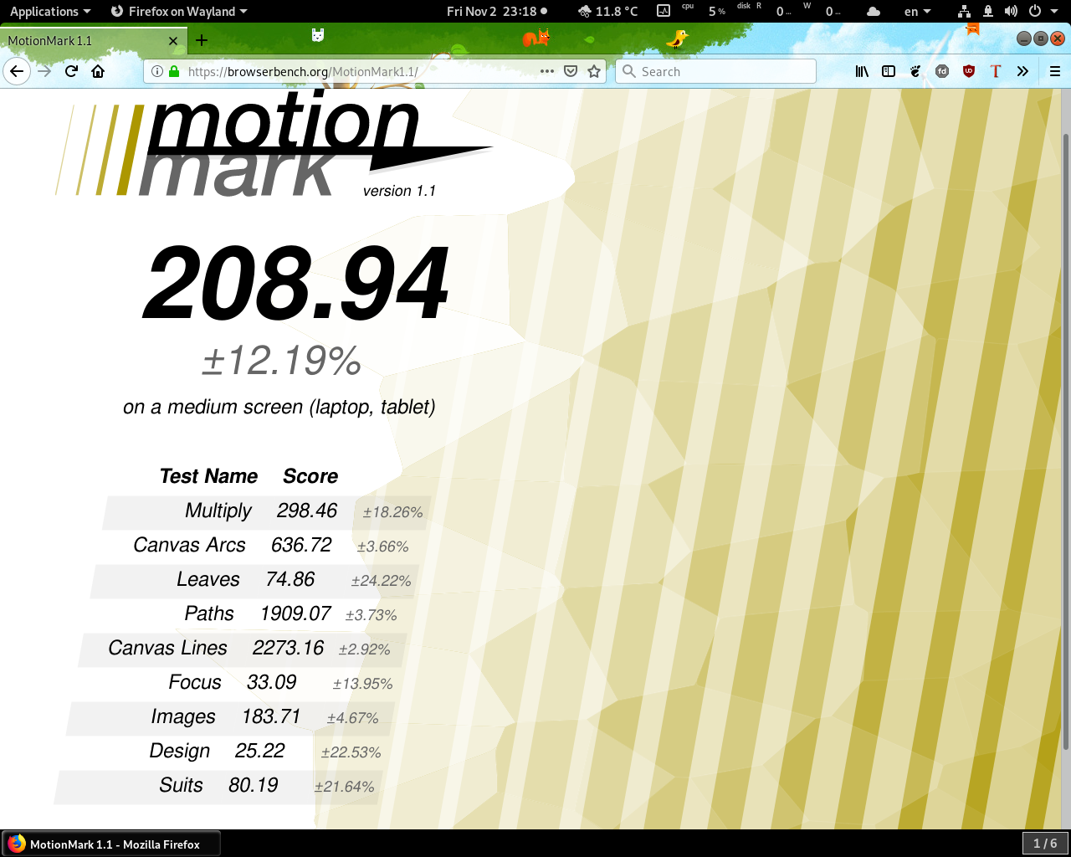
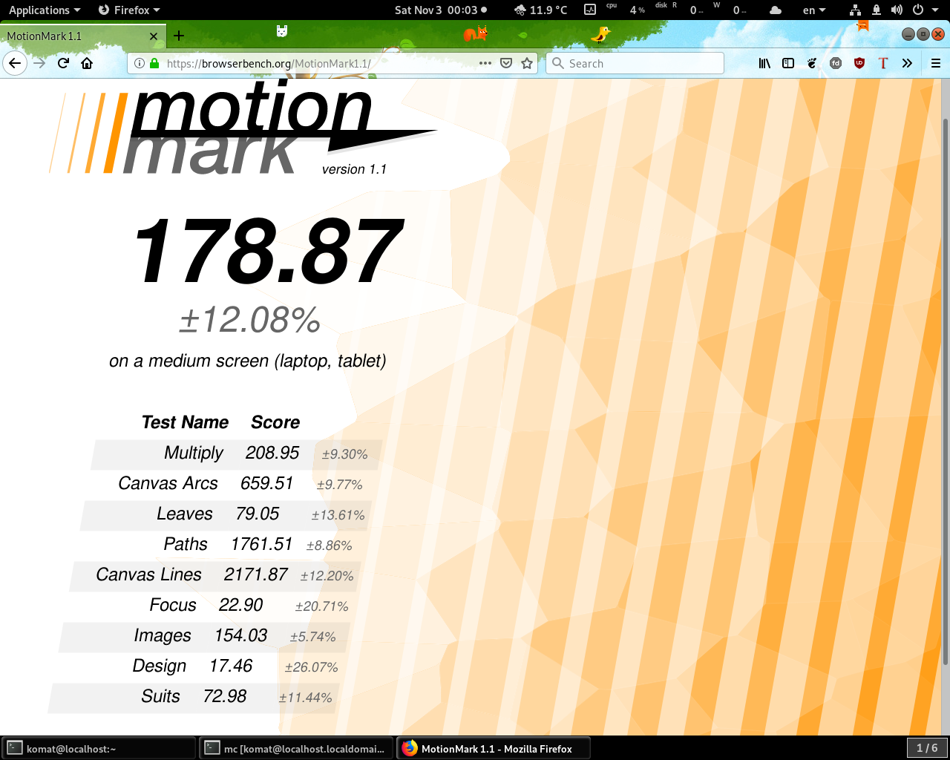
Firefox Wayland vs. X11 performance

Slide 9
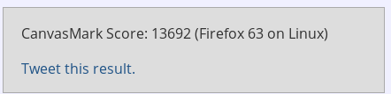
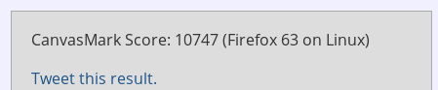
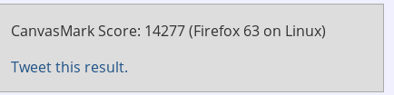
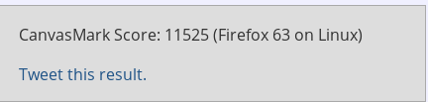
Firefox Wayland vs. X11 performance

Slide 10
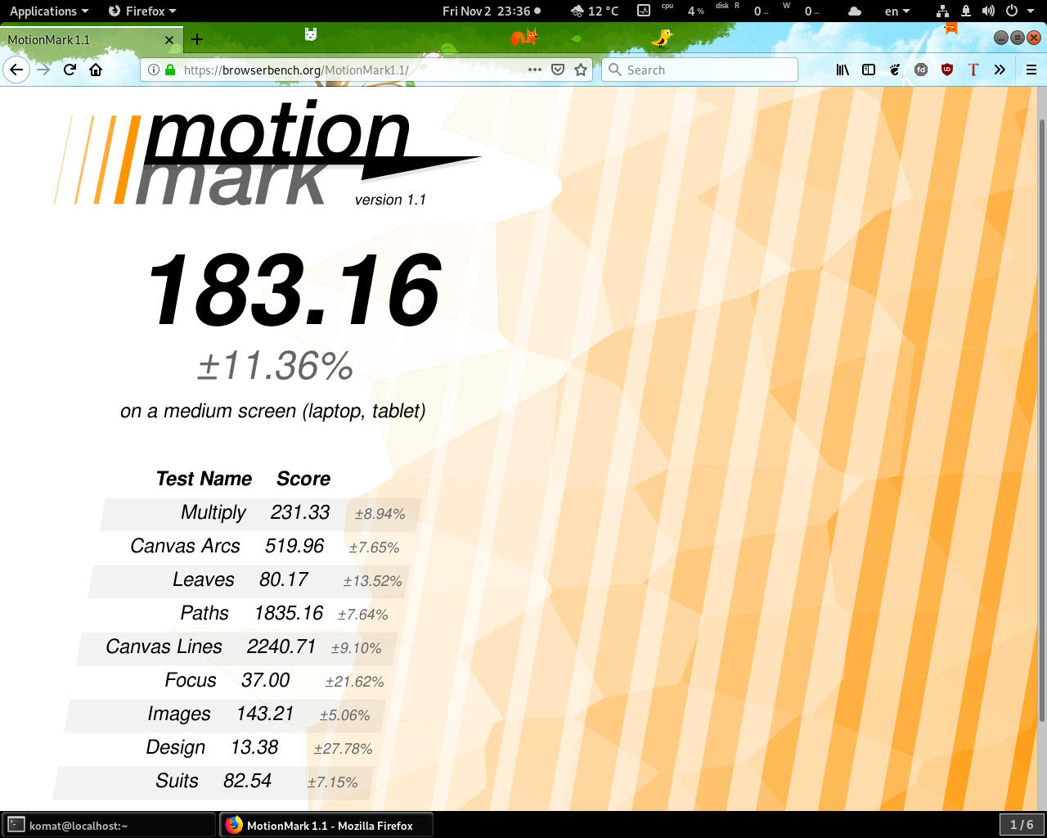
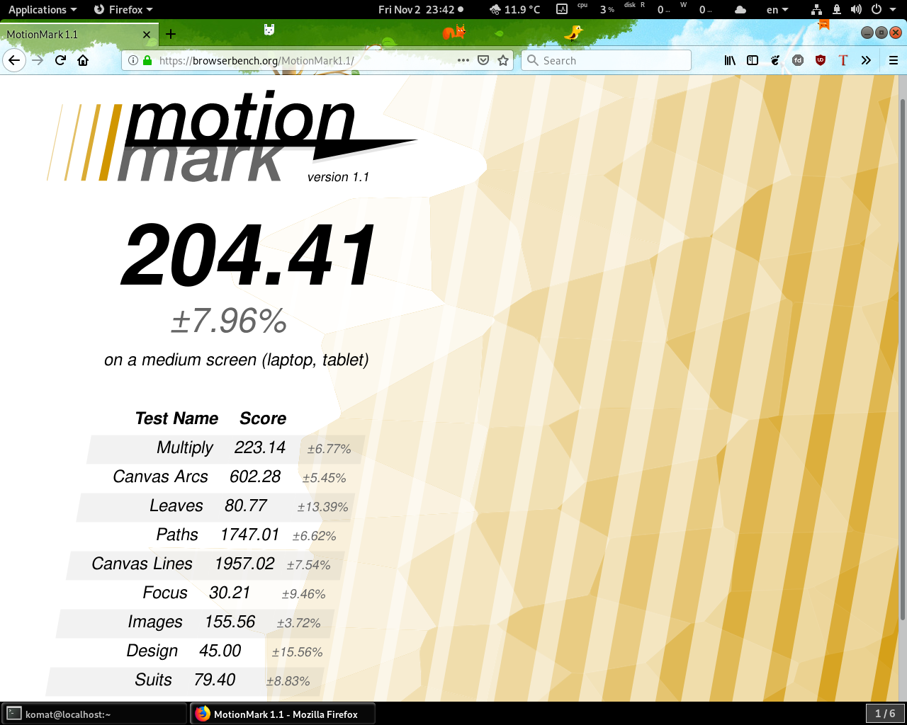
Firefox X11 Software vs. OpenGL
(Skylake GT2)

Slide 11
Firefox Wayland state
Default on Fedora 30 (firefox-x11)
Optional on Fedora 28/29 (firefox-wayland)
Mozilla gtk 3.10 update and built by default (GDK_BACKEND)

Slide 12
There’s even more...
Clang vs. gcc (PGO/LTO)
Firefox flatpak (https://firefox-flatpak.mojefedora.cz/)
Titlebar rendering
Gtk3 port

Slide 13
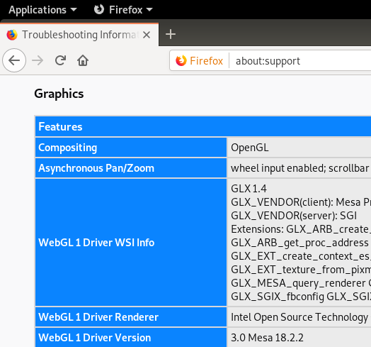
HW acceleration on Linux
layers.acceleration.force-enabled

Slide 14
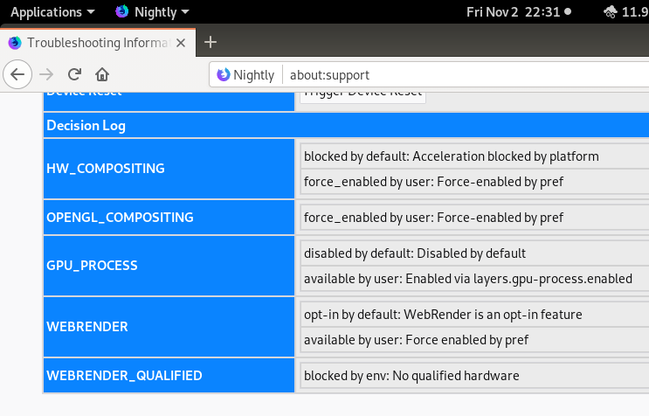
HW acceleration on Linux
Hidden option “layers.gpu-process.enabled”

Slide 15






THANK YOU
plus.google.com/+RedHat
facebook.com/redhatinc
linkedin.com/company/red-hat
twitter.com/RedHat
youtube.com/user/RedHatVideos

