Slide 1
SE Linux
Martin Stransky
SE Linux looser
stransky@redhat.com

Slide 2
SE Linux - Where does it sleep?
Application
Policy
System call
Policy loader
KERNEL
Security module
Loaded policy
Call handler

Slide 3
What does it eat?
All system calls
  capability - chown, kill, set_uid, set_gid...
  processes - fork, transition, sigchld, sigkill, sigstop, execmem, execstack,...
  system - ipc_info, syslog_read, syslog_mod
  security - load_policy, compute_relabel, setenforce...
  filesystem - mount, remount, unmount, getattr...
  file - ioctl, read, write, create, unlink, execute...
  dir - all from file + add_name, remove_name, search...
  fd - use
  socket - bind, connect, listen, accept, recvfrom, read, write...
  ....
It’s independent on classic UNIX access control (uid, gid)

Slide 4
So what the hell is it?
FLASK Architecture – restrictions based on resources
Access to files (/proc,/etc,/home...)
Application
Filesystems (mount,...)
Socket interface (bind, connect,...)
File interface (open, read, write...)
Other system resources
SE Linux policy

Slide 5
Resources (1) - FLASK
    flask/security_classes
    flask/access_vectors
    flask/initial_sids
# file-related classes
class filesystem
class file
class dir
class fd
class lnk_file
class chr_file
class blk_file
class sock_file
class fifo_file
# network-related classes
class socket
class tcp_socket
class udp_socket
class rawip_socket
common socket
{
# inherited from file
ioctl
read
write
lock
append
# socket-specific
bind
connect
listen
accept
recv_msg
send_msg
}
# Define initial security
# identifiers
sid kernel
sid security
sid unlabeled
sid fs
sid file
sid file_labels
sid init
sid any_socket
sid port
sid netif
sid netmsg
sid tcp_socket

Slide 6
Resources (2) - SID
An integer identifier for object in system
Passive entries are called “Objects”
  files, dirs, sockets
Active entries are called “Subjects”
  processes
Every type of Object and Subject has his own SID (security identifier)
Security decisions are based on:
  SID of subject (who wants to make somethink)
  SID of target
  Type of target (file, process, socket...)

Slide 7
Security context
Persistent representation of SID (stored on filesystem for files, attached to proccesses)
Format user : role : type
  type the most important component, all security decisions are based on type of object – approximately equivalent SID
  role a set of types
  user a set of roles
system_u : system_r : sendmail_t
  sendmail_t type (or domain) for sendmail process
  system_r general role for processes
  system_u general user (for system processes)
system_u : object_r : bin_t
  bin_t type for file in /bin, object_t is a general role for files

Slide 8
Owerview
type (domain)
role
type (domain)
role
type (domain)
user
role
type (domain)
user
role
type (domain)

Slide 9
Security context – specification (1)
Initial contexts (SIDs) – for processes / files after boot
File Contexts Configuration – file_contexts, *.fc files
Filesystem Labeling Behaviors & Genfs Contexts
sid kernel system_u : system_r : kernel_t
sid init system_u : system_r : init_t
sid proc system_u : object_r : proc_t
/bin(|/.*) system_u : object_r : bin_t
/bin/login system_u : object_r : login_exec_t
/bin/bash system_u : object_r : shell_exec_t
fs_use_xattr ext3 system_u : object_r : fs_t;
fs_use_task pipefs system_u : object_r : fs_t;
fs_use_trans tmpfs system_u : object_r : tmpfs_t;
genfscon proc / system_u : object_r: proc_t

Slide 10
Security context – specification (2)
Network Object Contexts
  portcon - bind, send, receive from port
  netifcon - context for interface & packet from interface
  nodecon - for hosts
# Ports
portcon tcp 80 system_u : object_r : http_port_t
portcon tcp 8080 system_u : object_r : http_port_t
# Network interfaces
netifcon eth0 system_u : object_r : netif_eth0_t system_u : object_r : netmsg_eth0_t
netifcon eth1 system_u : object_r : netif_eth1_t system_u : object_r : netmsg_eth1_t
# Nodes
nodecon 10.33.10.66 255.255.255.255 system_u:object_r:node_zeus_t
nodecon 10.33.10.0 255.255.255.0 system_u:object_r:node_any_t

Slide 11
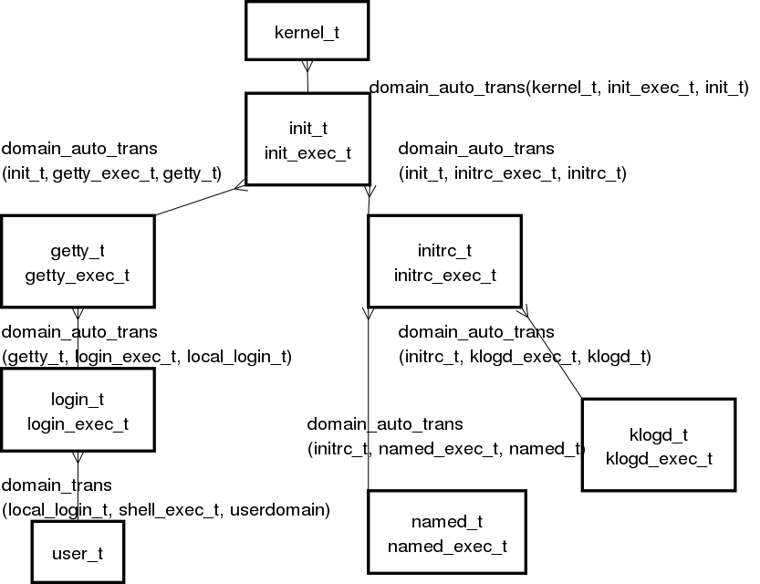
Security context – specification (3)

Slide 12
Security model (TE)
Type Enforcement (TE)
Decisions based on pair of types (domains)
  can sendmail_t (process) access to user_home_t (file)?
  type of target (user_home_t) is important (different rules for files, sockets..)
Transitions rules
  what’s type (domain) for new file in user_home_dir_t (directory)?
  what’s type for process created by sendmail_t?
Access rules
  can sendmail_t (process) read user_home_t (file)?
  can sendmail_t (process) create new file in user_home_t (dir)?

Slide 13
Security model (RBAC)
Role-Based Access Control (RBAC)
  user : role : type - user_u : system_r : unconfined_t
controls transitions between roles
  authorizes each user for a set of roles
  authorizes each role for a set of TE types (domains)
for processes
  maintains a role attribute in the security context
  works with TE – restrictions
for objects (files, dirs, sockets...)
  the role attribute is typically set to a generic object_r role and is unused
User ->XXX

Slide 14
Security model (MLS)
Multi-Level Security (MLS)

Slide 15
TE rules – Type Declarations
/tmp system_u : object_r : tmp_t
Attribute declarations – sets of types, for policy configuration
Type (domain) declarations
attribute domain;
attribute file_type;
attribute mountpoint;
attribute tmpfile;
type etc_t, file_type;
type home_root_t, file_type, mountpoint;
type httpd_exec_t, file_type, entry_type;
type alsa_t, domain;

Slide 16
TE rules – Transition Rules (1)
Defines type (domain) for new objects (files, processes)
/tmp system_u : object_r : tmp_t
/tmp/sshd_file system_u : object_r : sshd_tmp_t
source type (sshd_t)
TE
target type (tmp_t)
new type (sshd_tmp_t)
class of new object (file)

Slide 17
TE rules – Transition Rules (2)
Defines type (domain) for new objects (files, processes)
/tmp system_u : object_r : tmp_t
/tmp/neco system_u : object_r : sshd_tmp_t
type_transition sshd_t tmp_t : { dir file lnk_file sock_file fifo_file } sshd_tmp_t;
type_transition sshd_t shell_exec_t:process user_t;
file_type_auto_trans(sshd_t, tmp_t, sshd_tmp_t)
domain_auto_trans(sshd_t, shell_exec_t, user_t)
source type (sshd_t)
TE
target type (tmp_t)
new type (sshd_tmp_t)
class of new object (file)

Slide 18
TE rules – Change Rules
The same syntax as type_transition
Used only by applications (logging, changing type of terminal...)
type_change user_t tty_device_t : chr_file user_tty_device_t;
type_change sysadm_t tty_device_t : chr_file sysadm_tty_device_t;

Slide 19
TE rules - Access Vector Rules (1)
source type (sshd_t)
TE
target type (sshd_exec_t)
Result (allowed / denied)
class of target object (file)
operations (write, execute)
allow sshd_t sshd_exec_t:file { read execute entrypoint };
allow sshd_t sshd_tmp_t:file { create read write getattr setattr link unlink rename };
allow sshd_t user_t:process transition;
allow sshd_t sshd_tmp_t:file create_file_perms;
allow sshd_t sshd_tmp_t:dir create_dir_perms;

Slide 20
TE rules - Access Vector Rules (2)
source type (sshd_t)
TE
allowed / denied
audited / isn’t audited
target type (sshd_exec_t)
class of target object (file)
operations (write, execute)
dontaudit - don’t audit specified action (disable AVC logging)
auditallow - audit specified action (enable AVC logging)
allow - allow specified action
auditallow ping_t any_socket_t:rawip_socket sendto;
allow ping_t any_socket_t:rawip_socket sendto;
dontaudit portmap_t reserved_port_type:tcp_socket name_bind;

Slide 21
TE rules – m4 macros examples (1)
Combination of transition & permissions rules
Allowed (but not default) transitions
Automatic (default) transitions
domain_trans(initrc_t,acct_exec_t,acct_t);
allow initrc_t acct_exec_t:file { getattr read execute };
allow initrc_t acct_t:process transition;
domain_auto_trans(initrc_t,acct_exec_t,acct_t);
domain_trans(initrc_t,acct_exec_t,acct_t);
type_transition initrc_t acct_exec_t:process acct_t;
domain_auto_trans(sshd_t, shell_exec_t, user_t)
domain_trans(sshd_t, shell_exec_t, sysadm_t)

Slide 22
TE rules – m4 macros examples (2)
domain_trans() Authorizes a domain transition
domain_auto_trans() Authorizes a domain transition and makes it the default
can_network() Authorizes a domain to create UDP and TCP sockets and to access the network.
can_exec() Authorizes a domain to execute a type without changing domains.
file_type_trans() Authorizes a file type transition

Slide 23
RBAC - Role Declarations and Dominance
sendmail: system_u : system_r : sendmail_t
Role Declarations – role in system and autorized types (domains) for this role
Role Dominance – hierarchy in roles
  role has all types (domains) of roles that it dominates
role system_r types { kernel_t initrc_t getty_t klogd_t };
role user_r types { user_t user_netscape_t };

Slide 24
RBAC - Role Allow / Transition Rules
sendmail: system_u : system_r : sendmail_t
Specifies authorized transitions between roles, it’s based on the pair of roles
Restricted by constraints
Role is changed by SELinux aware applications (newrole, run_init)
New role, based on current role (sysadm_r) and type (sshd_exec_t)
allow system_r { user_r sysadm_r };
allow user_r sysadm_r;
allow sysadm_r system_r;
role_transition sysadm_r sshd_exec_t system_r;

Slide 25
RBAC – Roles in system
sendmail: system_u : system_r : sendmail_t
system_r - for all system processes (daemons)
user_r - for ordinary users (after login)
sysadm_r - administrators (must be entered manually by new_role)
new_role - utility for changing role
run_init - utility which runs rc scripts in new role

Slide 26
Users Declarations (1)
sendmail: system_u : system_r : sendmail_t
user system_u roles system_r;
user root roles { staff_r sysadm_r };
user jdoe roles user_r;
staff_r
root
sysadm_r
jdoe
user_r
system_u
system_r

Slide 27
Users Declarations (2)
sendmail: system_u : system_r : sendmail_t
user field in security context remains unchanged by default
can be controlled by the constraints configuration
user_u is used for generic non-privileged users (can be removed), users file
Independent on /etc/passwd
the user field can only be set by certain domains such login
staff_r
root
sysadm_r
user_u
user_r

Slide 28
Constraints (1)
applied to TE (type transition, access) and RBAC (role transition)
applied to pair of security contexts
can be checked all components of security context
constrain class action condition;
file, dir,
process...
read, write,
execute, transition...
role_2 == role_2
type_2 == file_type
sendmail: system_u : system_r : sendmail_t
CON
allowed,
denied
class (file, process), action (read, transition)
/tmp system_u : object_r : tmp_t

Slide 29
Constraints (2)
constrain class action condition;
U1 : R1 : T1 (source)
u1 == u2 or
t1 == privuser
allowed,
denied
class (process), action (transition)
U2 : R2 : T2 (target / new type)
constrain process transition ( u1 == u2 or t1 == privuser );
constrain process transition ( r1 == r2 or t1 == privrole );
constrain dir_file_class_set { create relabelto relabelfrom } ( u1 == u2 or t1 == privowner );

Slide 30
FC5 News – Multi Level Security (MLS)
Based on Bell-LaPadula (BLP)
  Resources are marked by sensitivity
  Applications can only read / write to appropriate resources
top secret data
no read (read up)
no write
application with
secret classification
secret data
read / write
unclassified data
read only
no write (write down)

Slide 31
MLS – Selinux security context extension
Security context extension
user : role : type : classification : category
s0 - s2
c0 - c255
s0 < s1 < s2
c0 != c1 != c2 ...
root root : system_r : unconfined_t : s0-s2 : c0.c255
joe user_u:system_r:unconfined_t : s0
~/notes user_u : object_r : user_home_t : s0
~/mbox user_u : object_r : user_home_t : s1

Slide 32
MLS – Constraints policy configuration
user : role : type : classification : category
root root : system_r : unconfined_t : s0-s2 : c0.c255
joe user_u:system_r:unconfined_t : s0
~/notes user_u : object_r : user_home_t : s0
~/mbox user_u : object_r : user_home_t : s1

Slide 33
MCS – Multi-Category Security
Uses only category field of MLS extension (classification is s0 only)
Similar to ACL
Category of process and resource must match
user : role : type : classification : category
c0 - c255
~/myfile root : object_r : user_home_t : s0 : c1
user: root : system_r : unconfined_t : s0 : c0,c1,c2,c3

Slide 34
LSM - Linux Security Module

Slide 35
AVC Messages
Make audit allow – pro vsechny hlasky

Slide 41
Resources

