Slide 1
ANZ
Task 1: Exploratory Data Analysis

Slide 2
Summary
The data contains a lot of Null values in different columns, but for some dimension it is not really very critical. For example for our purpose in avg searching it was not important. But for map building we have 1/3 of missing values.
Transactions | Value
Total | 12043
Avg per account | 120.43

Slide 3
Day of the week importance for transactions

Slide 4
Day of the week importance for transactions

Slide 5
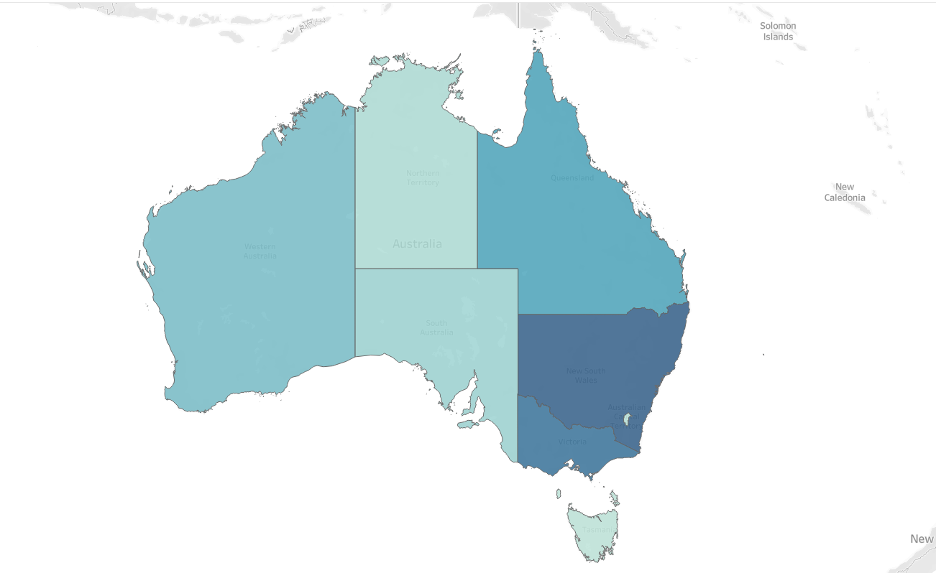
Region distribution for transaction

