Slide 1
361D1 – Battleships UI Sketch
Franz-Philippe Garcia
Benjamin Lewis
Bill Tyros
NB: In this UI Sketch, we assume that the player will be playing on a PC. However, please note that our descriptions concerning how the player will interact with the game (e.g. select a ship by clicking on it vs. tapping it) can easily be extended, without much difficulty, to other platforms if we decide to support multiple platforms.
October 11, 2013

Slide 2
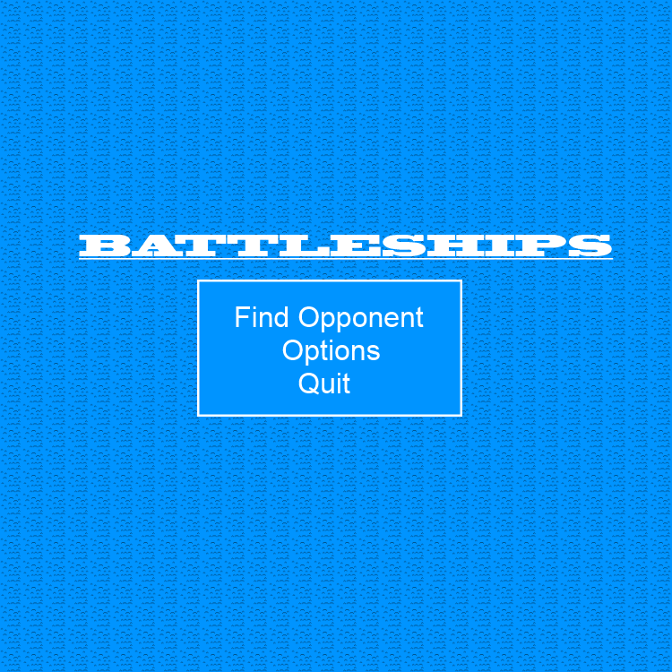
After launching the game, the player is presented with a simple main menu and given three choices.
The player can find an opponent to play against, change their options/settings (change username, set graphics options, ...) or quit the game.

Slide 3
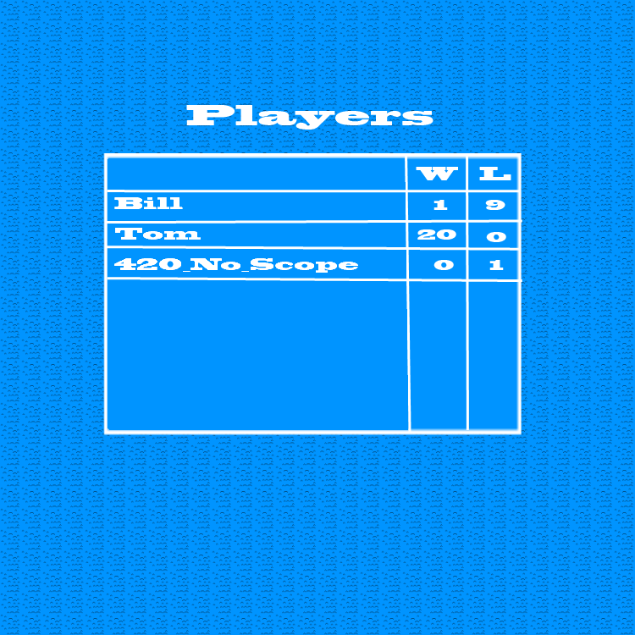
After clicking the Find Opponent button, the player is presented with a list of players waiting for opponents.
The player can select another player's username (set in the options) to invite that player for a match.
The player can also simply wait passively until another player invites them for a match.

Slide 4
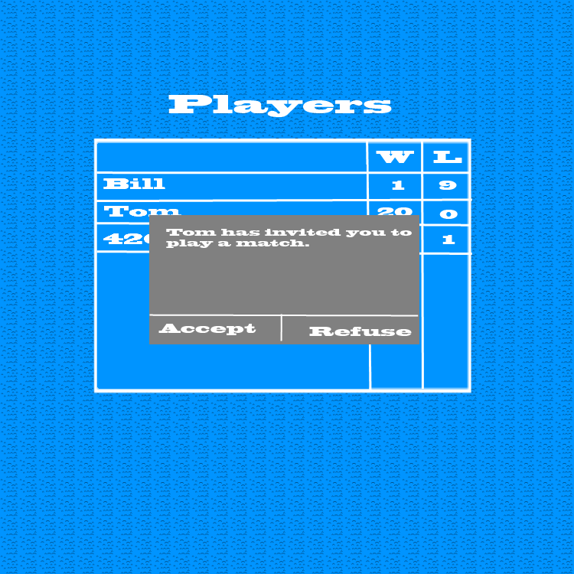
Upon receiving a room invite the player is notified and informed of the other player's name and stats.
The player can either accept or refuse the invitation.
a room
W: 20, L: 0

Slide 5
If the receiving player accepts the invite, then both players are sent to a private room for chatting and setting up a game.
The players are shown:
A list of personal settings such as player color, …
A new game button
A list of previously saved games between the two of them.
The players can change their personal settings as desired. They can then either click on the new game button to start a new game or click on one of their previously saved games to continue it.
MISSING PICTURE

Slide 6
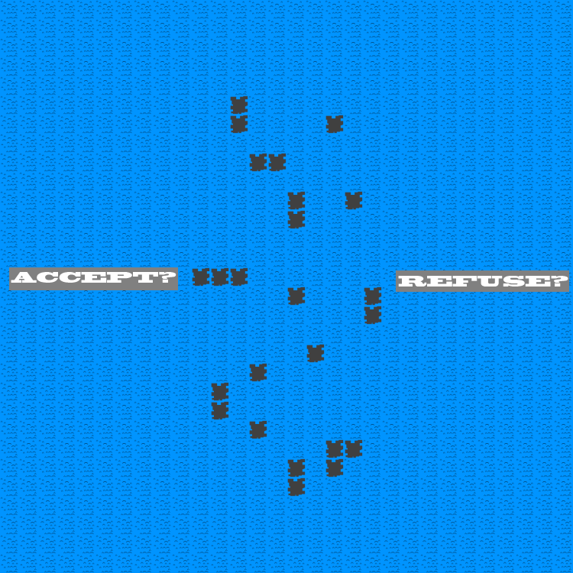
During the reef setup phase, a reef is generated and both players are asked to either accept or refuse the generated reef.
If both players accept then the game moves on to the ship setup phase.
If either player refuses then a new reef is generated and the process repeats.

Slide 7
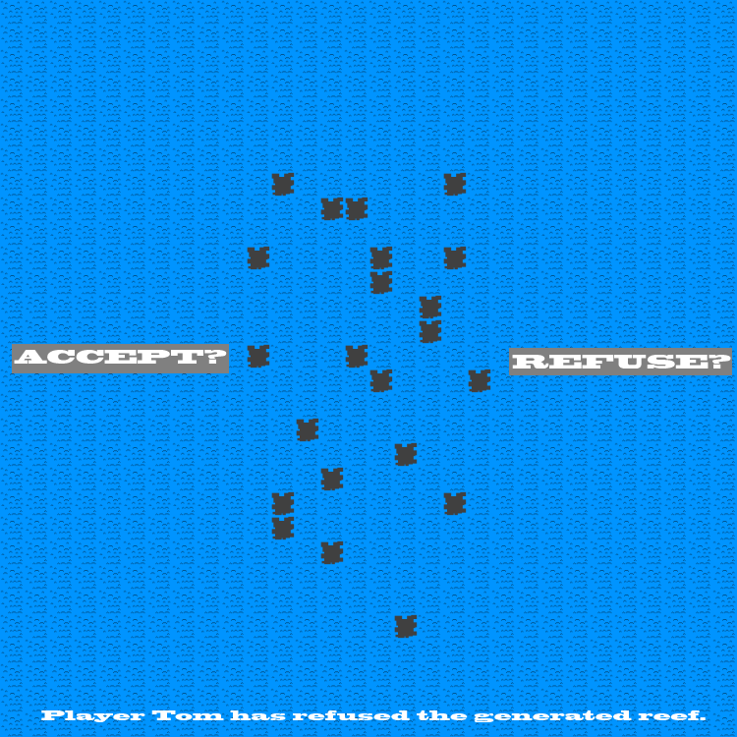
New Reef Generated!
If either player refuses then both players are notified of the newly generated reef and the refusing player's username.

Slide 8
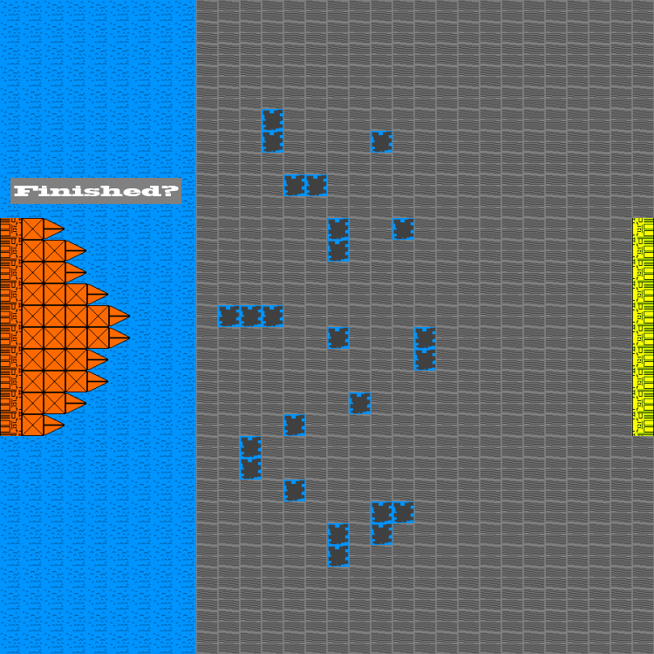
During the ship setup phase, each player will be shown an limited view of the map.
The player can choose a ship to move by clicking it (it will be highlighted).
To move the chosen ship, the player can click on a base tile to move the chosen ship to that dock.
If there's already a ship docked on that tile then the two ships will switch places.

Slide 9
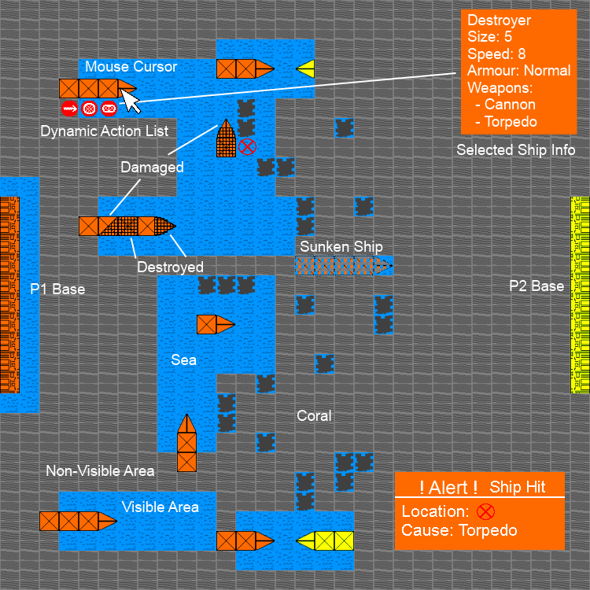
During their turn, the player can hover their cursor over a ship to display info about the ship and to display a dynamic action list (changes depending on what the ship can do currently).
In between turns, players may receive notifications about ships hit, ships sunk, collisions, ...

Slide 10
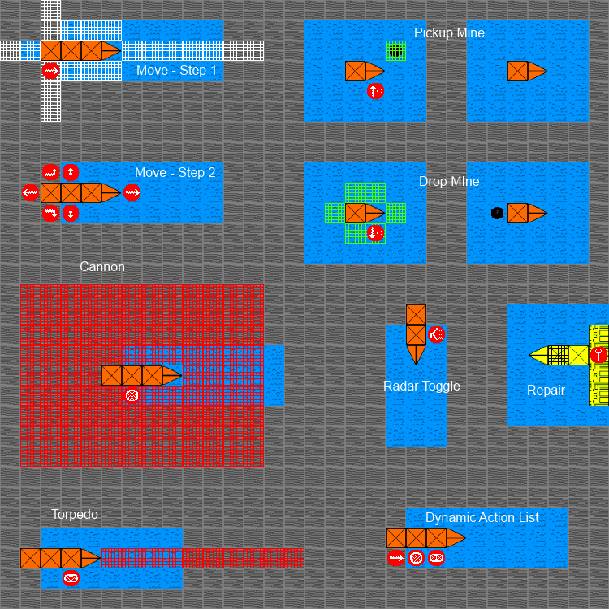
When hovering the cursor over a ship, a dynamic list of action icons is displayed beside the ship.
When hovering over an icon, all the others fade out and more information is displayed about the action in particular.
When the icon is clicked, either the action occurs right away (Torpedo, Repair, Radar Toggle, …) or the player might click once or twice more to specify more information on how the action should be performed (Move, Pickup/Drop Mine, Cannon, ...)

Slide 11
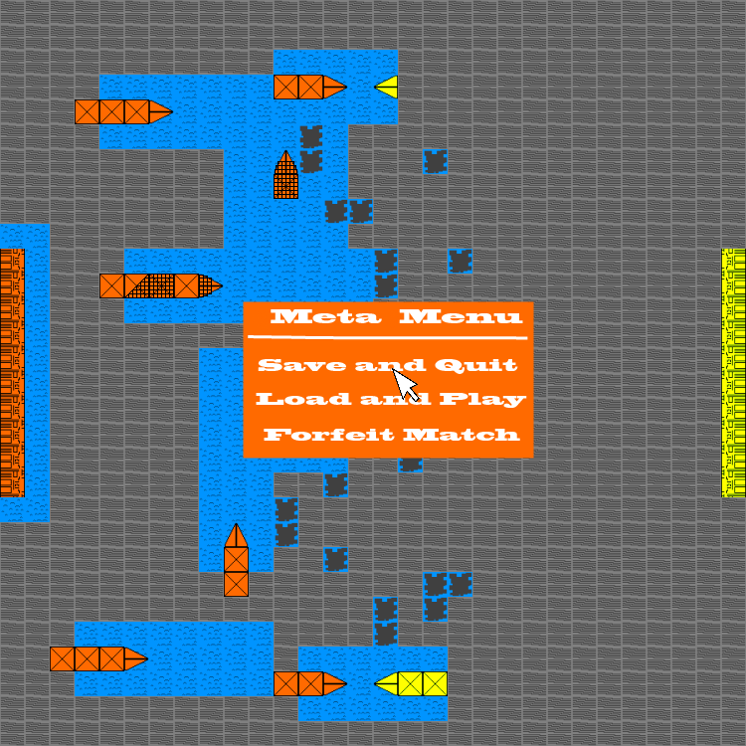
The Meta/Pause Menu is accessed by pressing Escape by default.
It will “pause” (not allow the other player to make any moves) the game.
It allows the player to save the game for later or to forfeit the match.

Slide 12
Loading …
The player will encounter the loading screen when starting a new match with another player or loading a saved match.

