Slide 1
NLP Final Project - Group 12
Identifying and Categorizing Offensive Language in Social Media
Pranav Goyal(2017078) Tanish Jain(2017115) Vidit Jain(2017121)

Slide 2
Problem Statement and Definition
We would be working on “Identifying and Categorizing Offensive Language in Social Media” which is SemEval 2019 - Task 6.
Our model would be able to:
Identify offensive user generated social media posts
Categorize offensive posts as targeted or untargeted

Slide 3
Motivation and Background
Offensive language is pervasive in social media. It can damage the social media website’s reputation and also it can be hurtful for the person or group of persons on whom the offensive comment is targeted on. To tackle this problem, NLP based approaches have been adopted to identify offensive comments, aggression, and hate speech in user-generated social media content. This topic has attracted significant attention in recent years as evidenced in recent publications (Waseem et al. 2017; Davidson et al., 2017, Malmasi and Zampieri, 2018, Kumar et al. 2018) and workshops such as AWL and TRAC.
We aim to work on this further.

Slide 4
Datasets
The publicly available dataset, Offensive Language Identification Dataset(OLID) that we used had around 13.5k training samples and 860 testing samples. It consists of tweet ids and the tweets itself with the labels of the three tasks in the training data and the labels of each task in testing data. The data of tweets is often uncertain and has many concerns worth worrying. The users on Twitter tend to use slang language, abbreviations, commit spelling mistakes, use an alphabet repeated times in a word to express an emotion, use capital letters for some or all words, etc. Working on such a dataset to identify offense becomes hard. That's what makes it exciting.

Slide 5
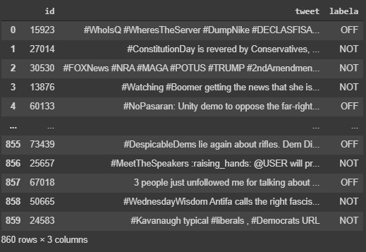
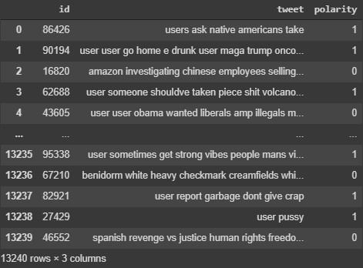
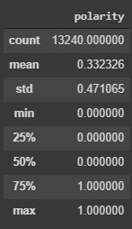
Test Data
Training Data
← Description

Slide 6
Pre-processing techniques
We used various pre-processing techniques. We use one online emoji project on Github which could map the emoji unicode to substituted phrase. We treat such phrases as regular English phrase thus it could maintain their semantic meanings, especially when the dataset size is limited. The HashTag becomes a popular culture across multi social networks, including Twitter, Instagram, Facebook etc. In order to detect whether the HashTag contains profanity words, we apply word segmentation using one open source on Github. One typical example would be ‘#LunaticLeft’ is segmented as ‘Lunatic Left’ which is obviously offensive in this case. We then removed all the punctuation marks except the exclamation marks and the question marks as these often describe sentiments. Bert itself also performs many pre-processing steps including tokenization, converting the characters to lowercase and many more.

Slide 7
Our Solution Sketch
For task A, we used BERT which we came across, after some experiments. BERT-Large, Uncased (Whole Word Masking) has 24-layers, 1024-hidden, 16-heads and 340 million parameters and it is the result of the research done by Google. We trained it using the GPU facilities provided by Google Colaboratory. It took 1-2 hours to train the model. We refined the model to work on our dataset, provided by SemEval. We obtained an accuracy of about 81.9 %, less than 1% short of the state of the art accuracy reported to SemEval by the leading performer of task A.

Slide 8
For task B, we used BERT again, due to it’s impressive performance. This time we got a slightly worse score of for the binary classification problem of Targetted/ Untargetted. This time we used our own CNN network on top of BERT. The primary idea of this network was to work with varying filter sizes to capture contexts of varying sizes and concatenate the output to obtain a larger context.

Slide 9
Results
The accuracy we obtained in Task A using Bert-large-uncased was about 84.63% on the testing data and F1-Score was 0.81925105. The state-of-the-art F1-Score for Task A is about 0.823, so we obtained an F1-Score which was quite close to the state-of-the-art F1-Score. But we could not improve it to more than that.
The state-of-the-art F1-Score for Task B is 0.755. The F1-Score that we obtained for Task B was near to 0.68.

Slide 10
Conclusion & Discussion
We used an advanced model ,i.e., Bert which was made by Google. It is an example of the result of the most researched upon subject by Google and with it we obtained good F1-Scores. We have already achieved a very high accuracy in identifying offensive language on tweets, that is something with many factors that are not there in normal natural language. More research that will be done in due time will definitely lead to a higher F1-Score and this technology would be used in various fields. The future of natural language processing would be even better.

