Slide 1
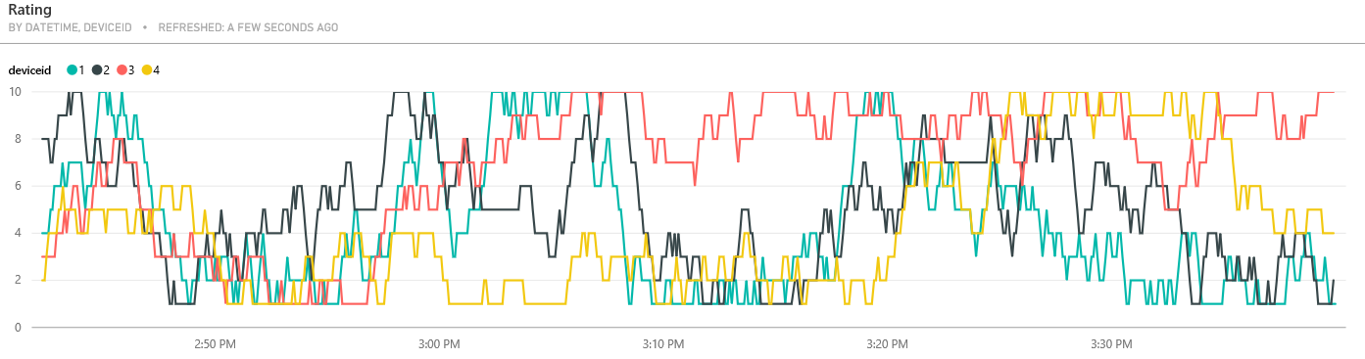
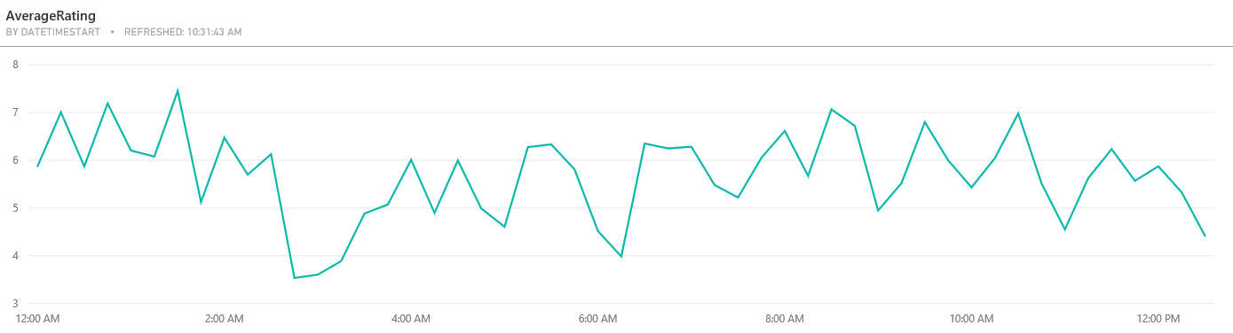
Real time visualization
Predictive visualization

Slide 2
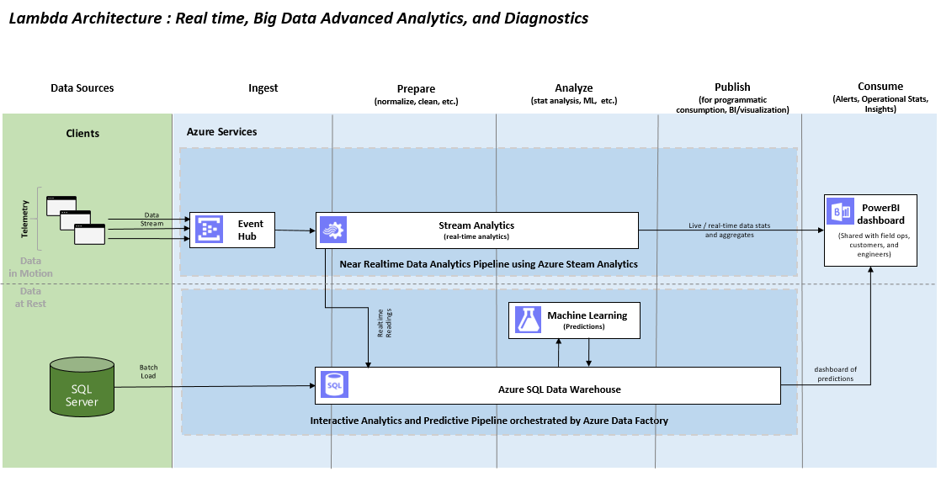
Real time data pipeline
Predictive data pipeline

