Slide 1
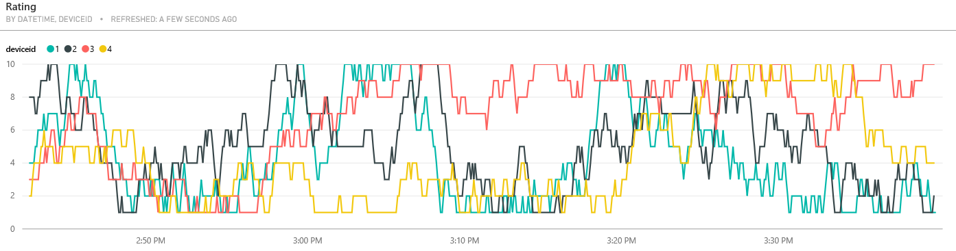
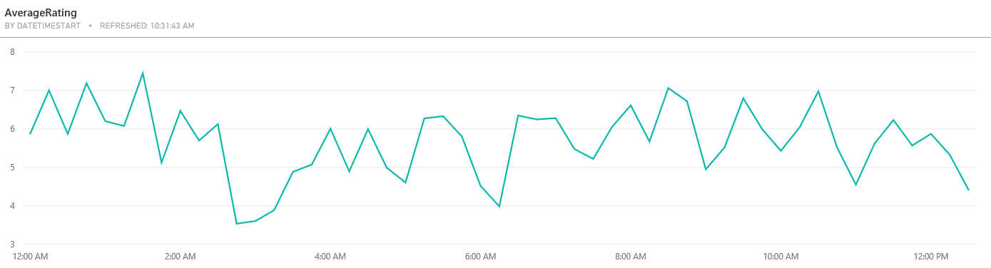
Real time visualization
Predictive visualization

Slide 2
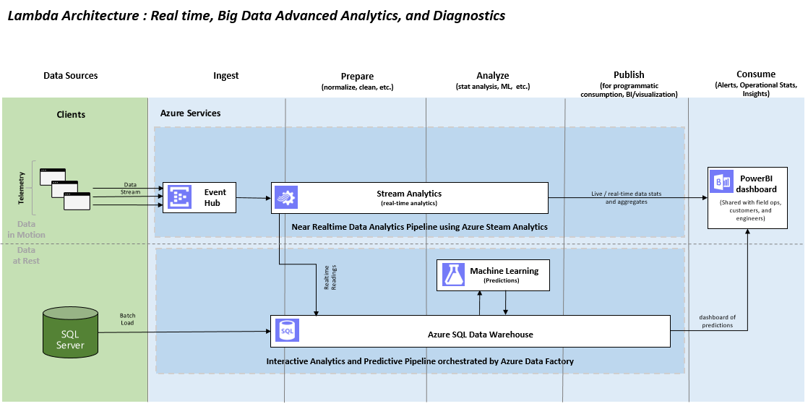
Real time data pipeline
Predictive data pipeline

Slide 3
YB
ZB
EB
PB
TB
GB
1985
1990
1995
2000
2005
2010
2015
2020

