Slide 1


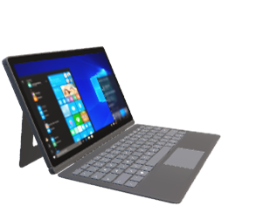
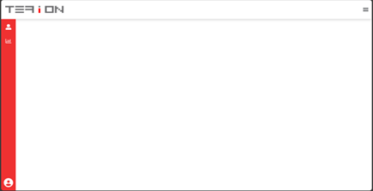



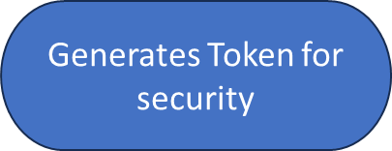















Slide 3







Ui Design
Dashboard
Architecture Diagram
Cloud Service
Database
Frontend Engine
Version Control
Server

