Slide 1


Intro to Python for O&G
E-Challenge Machine Learning Version
Workshop I
Instructor: Felix Gallo
June 2021

Slide 2
CONTENT:
Open-Source Background in O&G Industry
Use Case: Well Log Formats & Seismic Data
Open-Source Libraries:
DLISIO
LASIO
SEGY-IO
SPE Ecuador Section

Slide 3

Open-Source Background in O&G Industry
What is Open-Source?
Software that is released under a license which allows it to be freely used, modified, and shared along with the source code.
Bruce Perens & Eric Raymond, 1998.
SPE Ecuador Section

Slide 4

Open-Source Background in O&G Industry
Why Open-Source?
The predecessor idea of Open-Source was originally free-software.
Born in the late 70’s and early 80’s as an answer to the restrictions and limitations of the proprietary software business model.
And the mail goal is to obtain software that guarantee user’s freedom for any purpose.
SPE Ecuador Section

Slide 5
Open-Source Background in O&G Industry
Why Open-Source?
It was a way to rebrand the free software movement to emphasize the business potential of sharing and collaborating on software source code.
Security
Affordability
Transparency
Perpetuity
Interoperability
Flexibility
Core value: gaining efficiency.
Create a community of developers with different perspectives and skillsets, can exponentially increase the scope of projects.
https://en.wikipedia.org/wiki/Open_source
SPE Ecuador Section

Slide 6





Open-Source Background in O&G Industry
SPE Ecuador Section

Slide 7
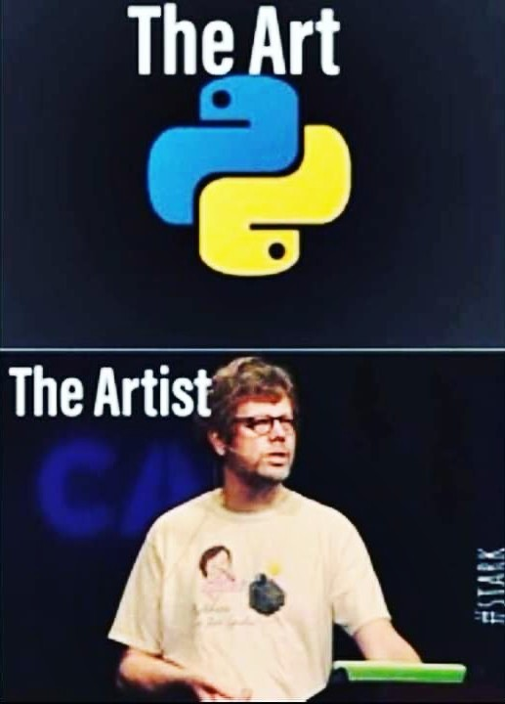
Open-Source Background in O&G Industry
SPE Ecuador Section

Slide 8



Open-Source Background in O&G Industry
Traditionally very conservative and protective with information & software
“Share – unfriendly”
Jørgen Kvalsvik, may 14th
https://www.oilandgasbigdata.com/news/shell-drills-into-big-data-analytics
https://databricks.com/blog/2017/06/23/parallelizing-large-simulations-apache-sparkr-databricks.html
SPE Ecuador Section

Slide 9

https://www.equinor.com/en/what-we-do/norwegian-continental-shelf-platforms/volve.html#
https://www.discovervolve.com/2020/03/05/how-to-access-the-volve-dataset/
SPE Ecuador Section

Slide 10
Use Case: Well Log Formats
Digital Log Interchange Standard - API RP66, 1991
Old Binary Format
Not be entirely compatible with another dialects
DLIS
Log ASCII Standard - Canadian Well Logging Society, 1990
Pure text files
Requires a lot more storage space than DLIS files
LAS
Petroware, 2019
Text-based JSON format
Most widely-used programming languages have libraries for it
JSON Well Log Format
SPE Ecuador Section

Slide 11
Use Case: Seismic Data
Society of Exploration Geophysicists, 1975
Messy Format
High disk memory
SEG-Y
SPE Ecuador Section

Slide 12
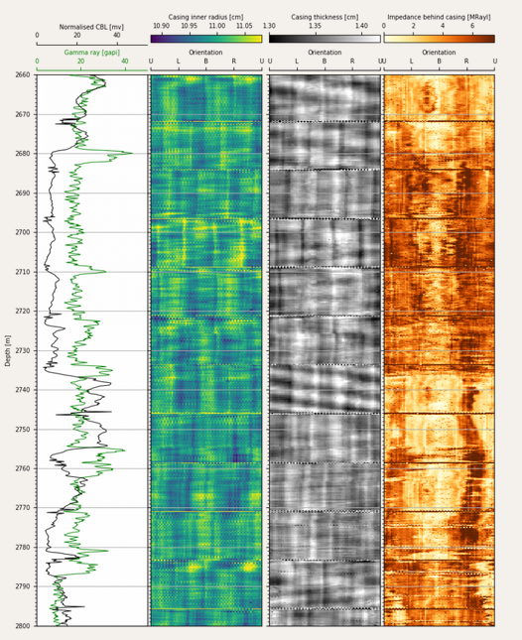
https://erlend-viggen.no/dlis-files/
SPE Ecuador Section

