Slide 1
ERAS Letter of Recommendation (LoR) Process
2013 ERAS Season

Slide 2

Purpose of this Presentation
This presentation is designed to give an overview of the ERAS LoR process and the roles of applicants, LoR Authors, and medical schools within that process.

Slide 3
ERAS LoR Process Overview
Applicants finalize LoR Author entries in MyERAS and generate Letter Request Forms for each letter.
Applicants deliver an LoR Request Form for each letter to their LoR Author(s). These forms instruct the author how to get their letter into the ERAS system.
LoR Authors create their letters and choose to either upload them directly to ERAS using the LoR Portal or submit them to the Designated Dean’s Offices for uploading.
Applicants assign the letter to programs they would like to apply to.
Medical schools and programs will be able to view LoRs in their software regardless of how the letter was uploaded to ERAS.

Slide 4
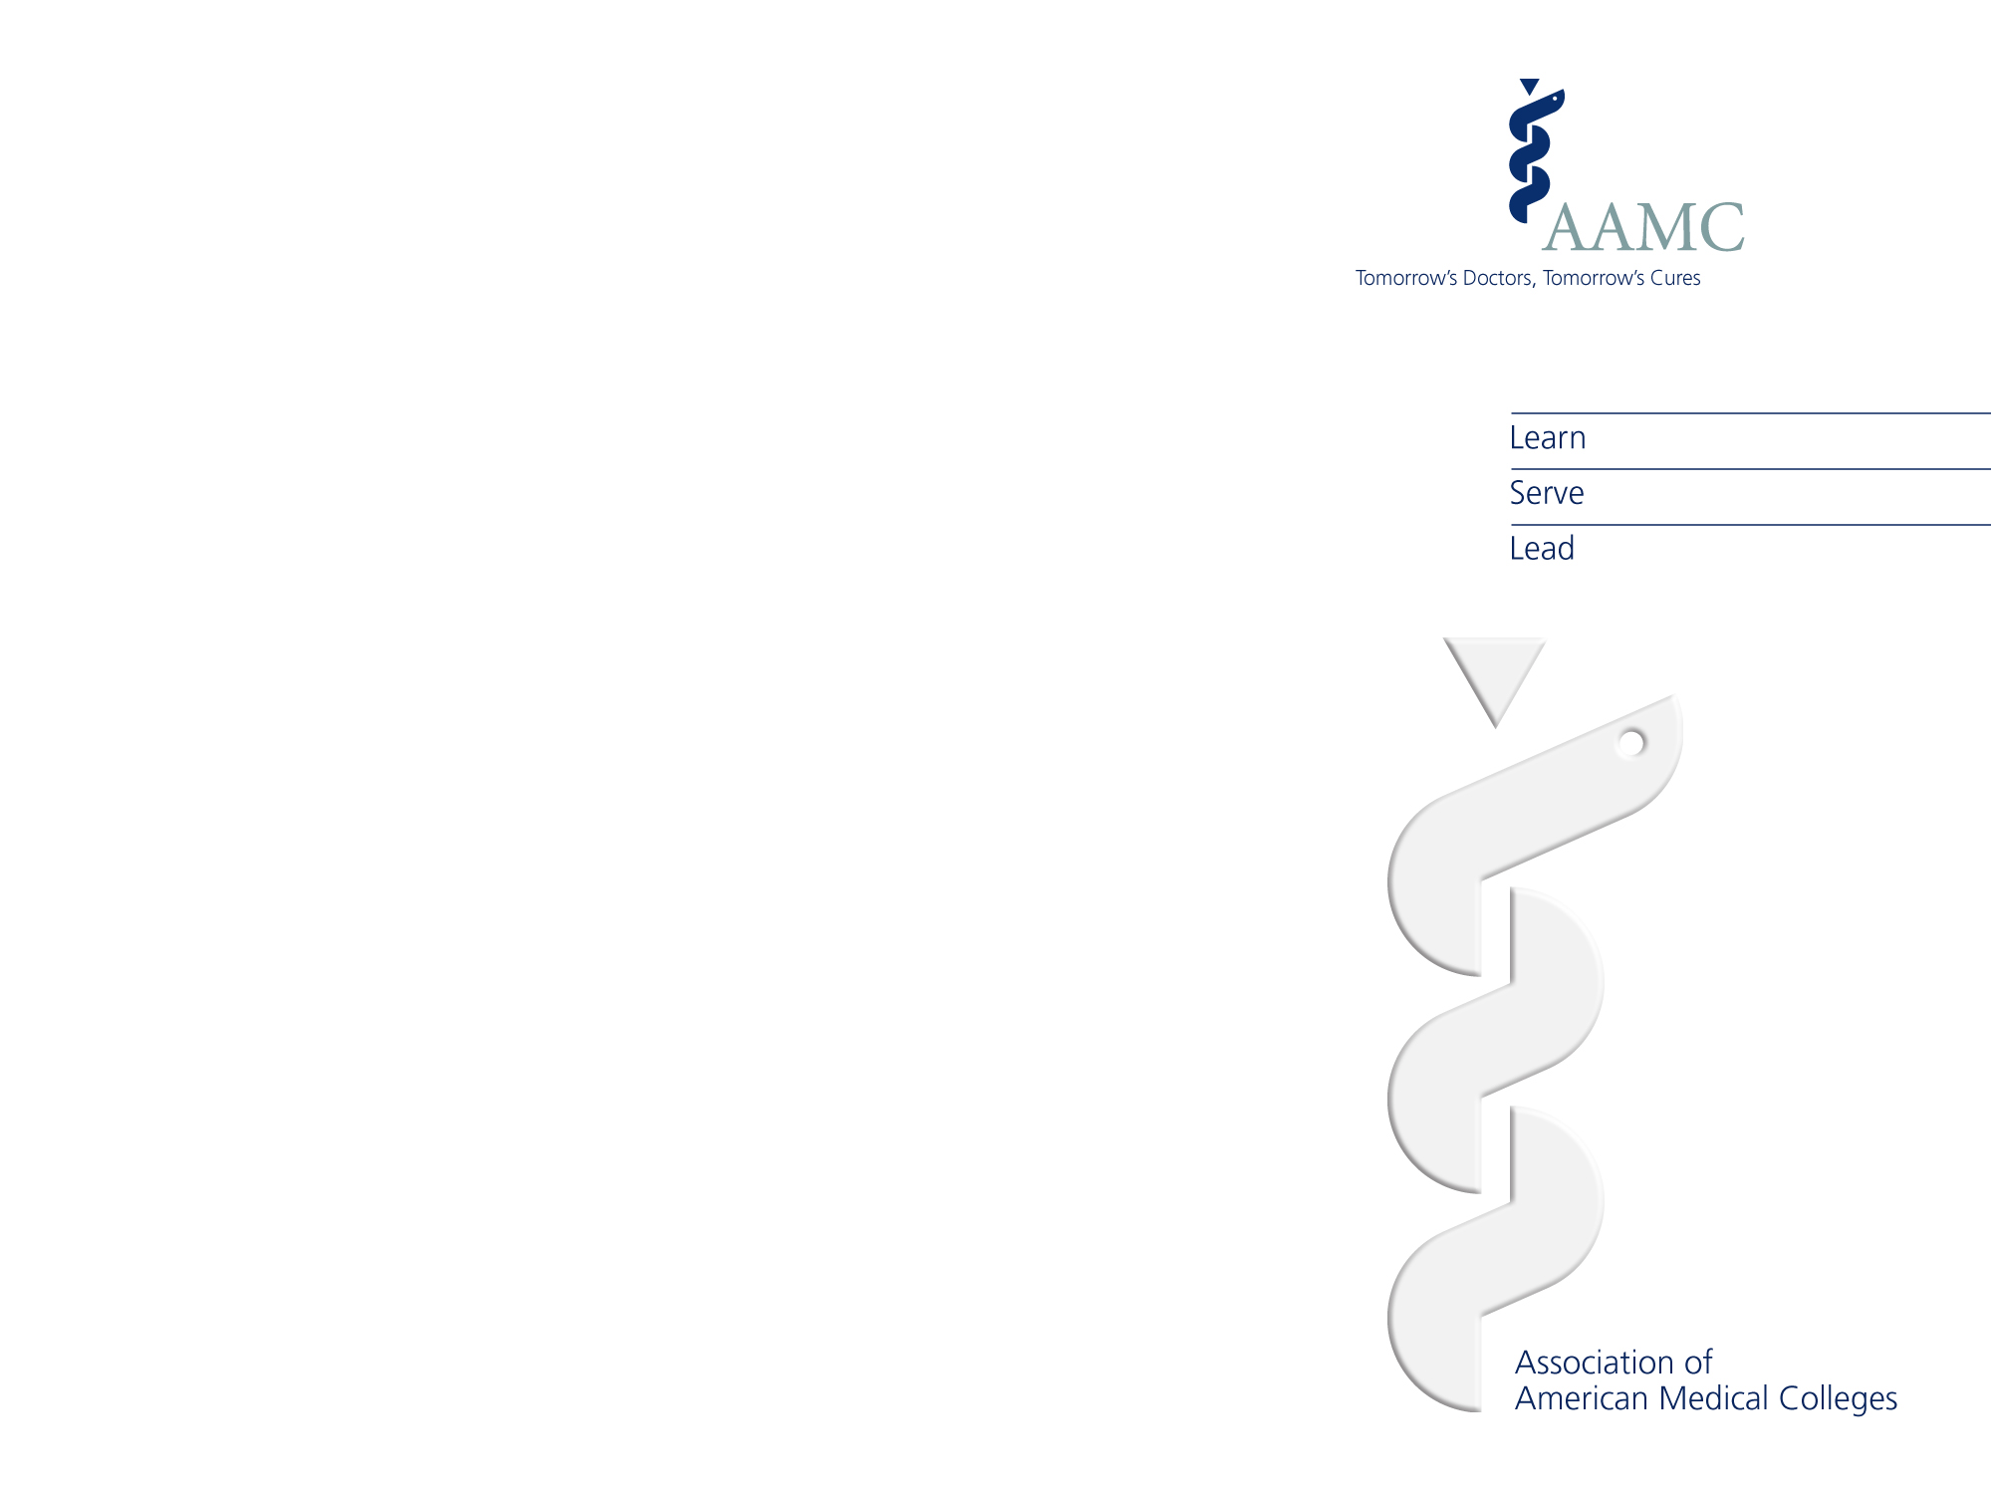
Applicant’s Role in the LoR Process

Slide 5
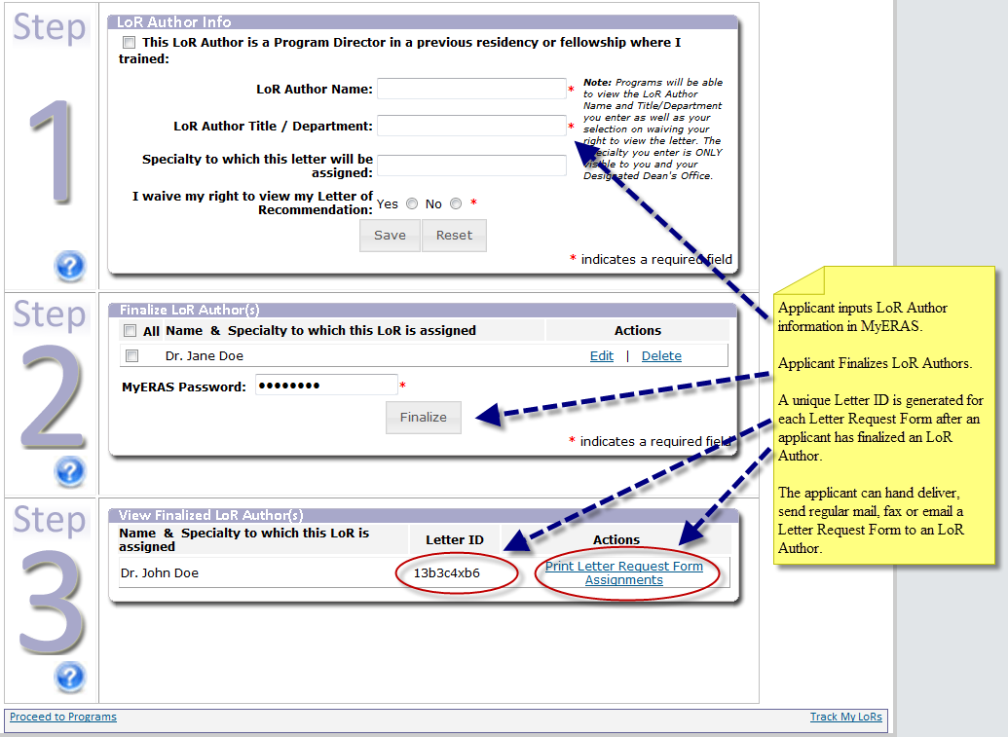
Applicants Finalize LoR Authors in MyERAS

Slide 6
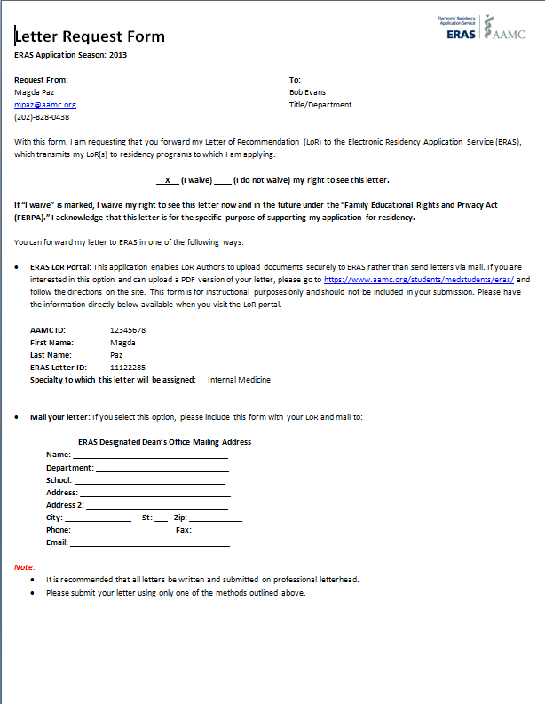
Applicant Delivers LoR Request Form to LoR Author
Applicants can hand deliver, send via regular mail, fax, or email a Letter Request Form to their LoR Author.
The Letter Request Form includes all details needed for an LoR Author to submit an LoR to ERAS on behalf of an applicant.
Letter Request Forms contain a unique letter ID; therefore, it should not be duplicated.

Slide 7
LoR Author’s Role in the LoR Process
LoR Author’s Role in the LoR Process

Slide 8
LoR Author Chooses Method for Uploading Their Letter
ERAS asks that LoR Authors use only one of the following methods to submit their letters:
Upload letters directly using the ERAS LoR Portal
Send letters to the Designated Dean’s Office for uploading
ERAS recommends all letters be signed and submitted on professional letterhead.
Only LORs should be uploaded to ERAS, never the Letter Request Forms.
All LoRs will be watermarked once they are uploaded to the ERAS PostOffice to indicate the source of the upload and the date/time it was made available in the ERAS PostOffice.

Slide 9
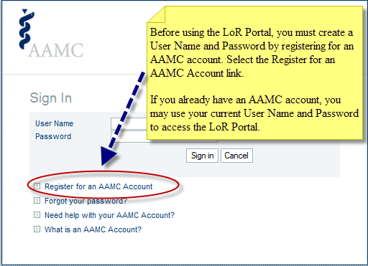
Author Chooses to Upload Directly Using the LoR Portal
Have the Letter Request Form from the applicant available.
Both a user name and password are required to log into the LoR Portal.
If an author uses the LoR Portal to send an LoR to ERAS, it does not need to go to the Designated Dean’s Office.
Please see the LoR Portal User Guide for detailed instructions on how to create a user name and password, as well as how to use the LoR Portal.

Slide 10
Quick Facts About the LoR Portal
Once a letter has been uploaded for an applicant, it cannot be edited or deleted.
Revised versions of LoRs will be pre-pended (attached) to the original LoR, allowing programs and medical schools to view the most recent version of the letter first and any subsequent versions in descending order of upload.
Do not upload the LoR Request Form if using the LoR Portal.
For more detailed instructions on using the Portal, please see the LoR Portal User Guide.

Slide 11
Author Chooses to send the LoR to the Designated Dean’s Office for upload
LoR Authors can hand deliver, fax, or email their letter and Letter Request Form to the Designated Dean’s Office.
Please include the Letter Request Form with your LoR when mailing it to the Designated Dean’s Office.
If an Author sends the LoR to the applicant’s Designated Dean’s Office, it does not need to be uploaded using the LoR Portal.

Slide 12
Designated Dean’s Offices Role in the LoR Process
Designated Dean’s Offices Role in the LoR Process

Slide 13
Designated Dean’s Offices Role in the LoR Process
Using the DWS software, Designated Dean’s Offices will still have the capability to upload LoRs they receive from LoR Authors.
The Designated Dean’s Office will be able to view LoRs received from the LoR Portal in the DWS.
For more detailed information about working with LoRs in the DWS, please consult the DWS User Guide: https://www.aamc.org/download/139498/data/dws_user_guide.pdf

Slide 14
More Detailed Information
Medical Schools
https://www.aamc.org/services/eras/medical-schools/resources/
Applicants
https://www.aamc.org/students/medstudents/eras/residency/140552/resources.html
Letter of Recommendation Authors
https://www.aamc.org/eras/lorp

Slide 15
ERAS Contact Information
Medical Schools
Email: erashelp@aamc.org
Phone: 202-862-6249
Applicants
Email: myeras@aamc.org
Phone: 202-862-6264
LoR Authors
Email: eraslorportal@aamc.org
Phone: 202-862-6249
Help Desk Hours of Operation
Monday-Friday
8 a.m. - 6 p.m. ET

