Slide 1
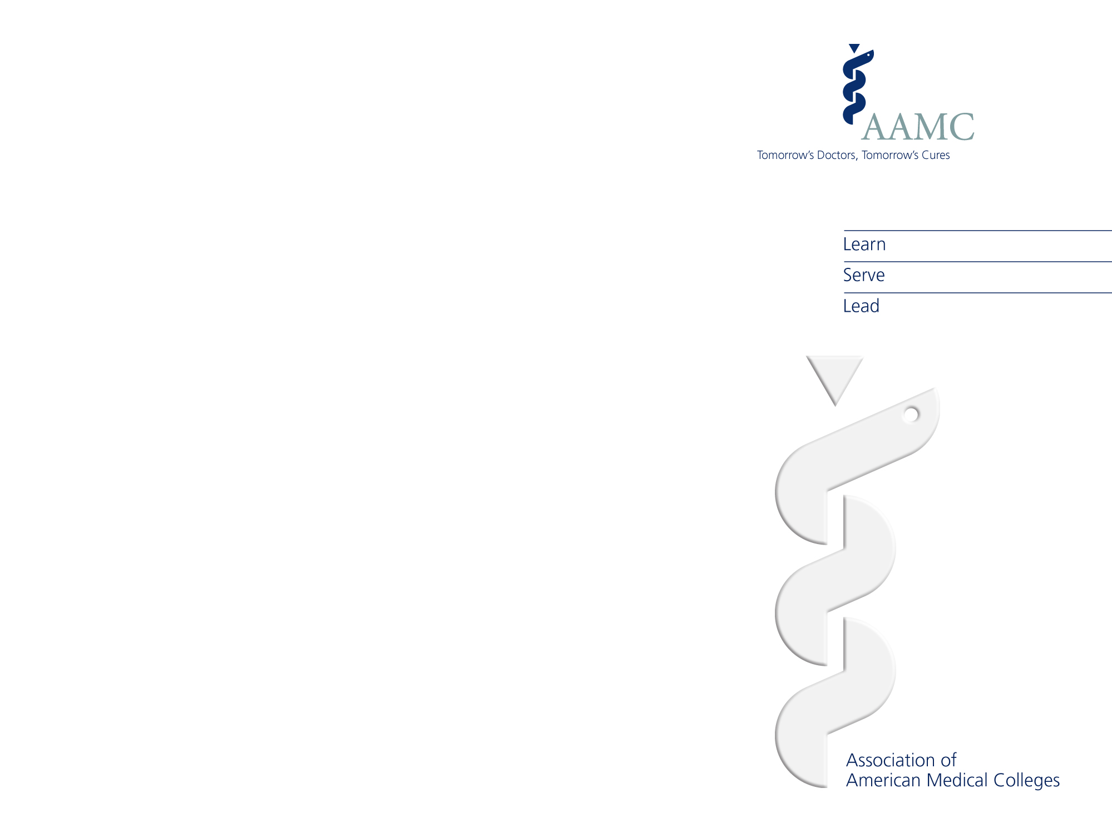
ERAS (Electronic Residency Application Service)
MyERAS 2013 Season

Slide 2

About ERAS The Electronic Residency Application Service (ERAS®) is a service that transmits the MyERAS application and supporting documentation from applicants and their Designated Dean's Office to program directors. ERAS consists of MyERAS, Dean's Office Workstation (DWS), Program Director's Workstation (PDWS), and ERAS Post Office.

Slide 3
MyERAS 2013 Season
General Information

Slide 4
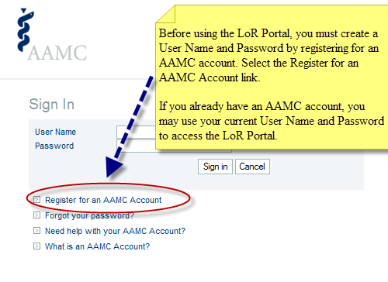
MyERAS 2013 Enhancements
ERAS LoR Portal Version 1.0
ERAS is pleased to offer the Letter of Recommendation Portal (LoR Portal) Version 1.0 for the ERAS 2013 season. This new tool gives LoR Authors the option to upload LoRs on your behalf via the web, as opposed to having to mail your LoRs to your Designated Dean’s Office.

Slide 5
MyERAS 2013 Enhancements (cont’d.)
Application Changes
Profile
Citizenship: Non-U.S. Citizens (Foreign National options) – By selecting Yes to Visa Sponsorship, the system will automatically list your Expected Visa/Employment Authorization as H-1B and J-1.
NRMP Participation is now a required question.
ECFMG Certification question has been removed. This information will come directly from the ECFMG.
NBOME ID is now a required field for Osteopathic applicants.
Examinations
The Examinations tab has been removed. Applicants will no longer be required to self-report their USMLE and/or COMLEX scores since this information is available in the USMLE and COMLEX transcript applicants release to programs.
Language Fluency
The Language Fluency tab was added to allow applicants to indicate language fluency in more detail.
Race and Ethnicity
The Race and Ethnicity tabs have been replaced with the Self-Identification tab to meet AAMC Data Collection standards.

Slide 6
MyERAS 2013 Enhancements (cont’d.)
LoR Coversheets
LoR coversheets are no longer available in MyERAS or on our Web site. LoR coversheets have been replaced with Letter Request Forms. Applicants must enter and finalize LoRs on the Letter of Recommendation tab in MyERAS to generate a unique Letter Request Form for each LoR Author. The Letter Request Form provides instructions for LoR Authors on how to submit LoR(s) via the LoR Portal or by mail.
Trailing Links
Trailing links have been added to give applicants easy access to some of the most frequently used tools and features in MyERAS. These links are accessible no matter where you are in MyERAS.
Dashboard
The Dashboard tab was created to give applicants a better overview of the work they have completed in their MyERAS application. ERAS Resource links are also available on the Dashboard for easy access.
Programs Tab
In an effort to make the Programs tab easier to navigate, we have consolidated the 9 sub-tabs into 4 sub-tabs.
Payment
ERAS will no longer accept payment for ERAS Fees using a check. We will only allow payments to be made using a credit card (Visa and MasterCard Only).
ERAS 2013 fee increase (see fee schedule on next slide).

Slide 7

Fees and Billing
Residency Applicants:
ERAS processing fees are based on the number of programs applied to per specialty. MyERAS automatically calculates these fees and allows you to pay online. ERAS fees are the same for all residency and osteopathic applicants, although the fee structure is applied separately for those applying to ACGME-accredited and AOA-accredited programs.
The ERAS processing fee is dependent on the number of programs per specialty. The schedule is as follows:
Note: Military programs, regardless of specialty, are treated as a single specialty.
Residency: Up to 10: $92 11-20: $9 each 21-30: $15 each 31+: $25 each
Fellowship Applicants:
ERAS processing fees are based on the number of fellowship programs applied to. MyERAS automatically calculates these fees and allows you to pay online. The ERAS fellowship processing fee is based on the number of applications. The schedule is as follows:
Fellowship: Up to 10: $105 11-20: $10 each 21-30: $15 each 31+: $25 each

Slide 8
Fees and Billing (cont’d.)
Payment Methods
Credit Card (Visa or Master Card only)*
Note: Applicants who pay their ERAS fees using a credit card will see those charges reflected as "AAMC Fees" on their credit card statement.
Consequences of Non-Payment
If your account remains unpaid at the end of the season (May 31), ERAS will contact your Designated Dean's Office and other ERAS business partners (EFDO, ECFMG) and prohibit access to ERAS (including future seasons) until your debt is satisfied. Moreover, if you refuse to satisfy your debt, you will not be allowed to use other AAMC services.
Refund Policy
ERAS does not offer refunds for any reason. Refunds will not be given for applications sent to non-participating programs.
Although we make every effort to ensure that our data is up-to-date, programs may not always communicate to ERAS their intention to accept applications, or a program's status may change. Therefore, it is your responsibility to confirm that you meet all eligibility requirements and program deadlines before applying by contacting programs directly.
ERAS' primary role is to deliver your application and supporting documents to designated programs. This is no different than placing a stamp on an envelope and requesting USPS deliver the packet to a destination. Once you apply to a program and submit payment through MyERAS, service has been rendered and your application has been delivered.

Slide 9
MyERAS 2013 Season
Registration

Slide 10
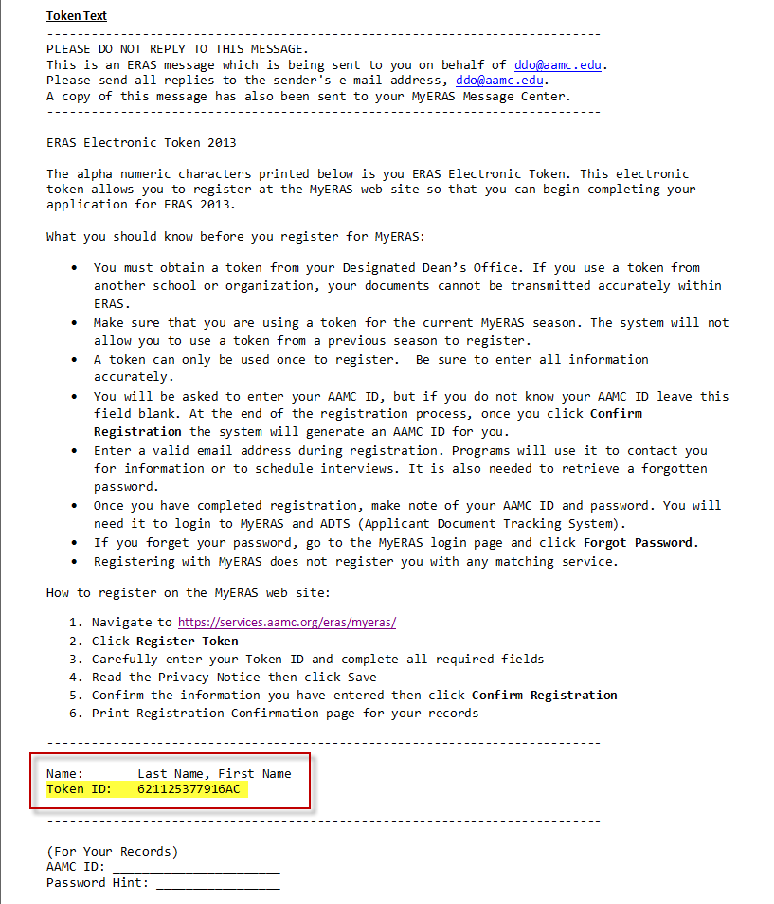
MyERAS 2013 Registration
You must register for the ERAS 2013 season before you can begin working on your application.
You will need an ERAS 2013 Token to register on the MyERAS Web site. Contact your Designated Dean’s Office to obtain an ERAS 2013 Token.
The token can be printed and distributed in person or by e-mail. The token text provides you with information you should know before you register, step-by-step instructions on how to register and your token ID.

Slide 11
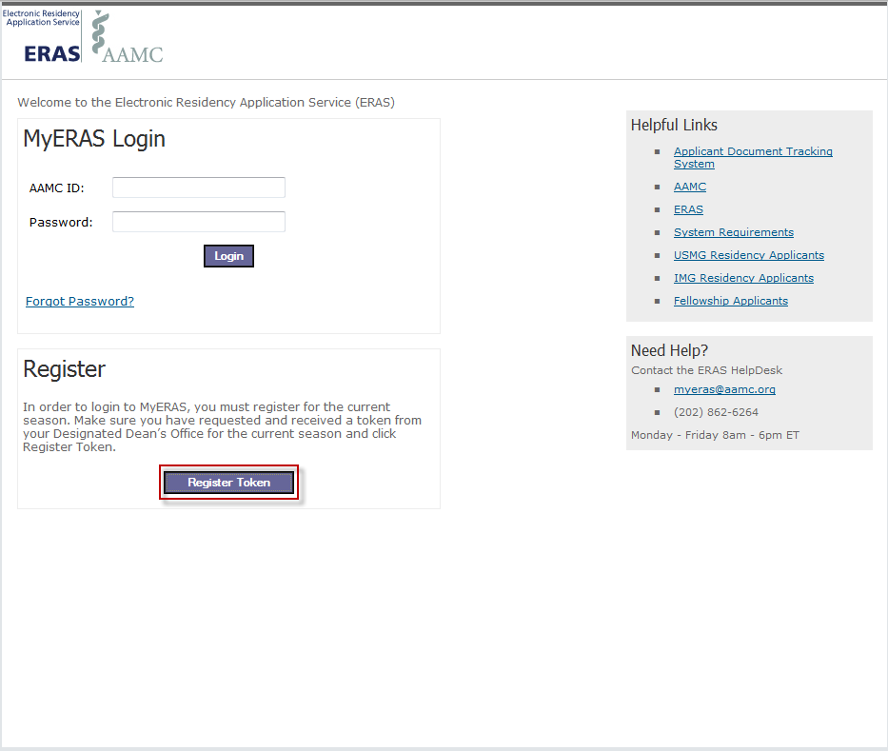
MyERAS 2013 Registration (cont’d.)
The MyERAS login page is where you can register and login to your MyERAS application.
Once you have an ERAS 2013 Token ID, go to the MyERAS login page and click Register Token.
Left Navigation:
Helpful Links to different resources and audience specific information are available in the left navigation of the MyERAS login page.
If you have any technical issues or need assistances, the ERAS Help Desk contact information and hours of operation are available right below the Helpful Links.

Slide 12
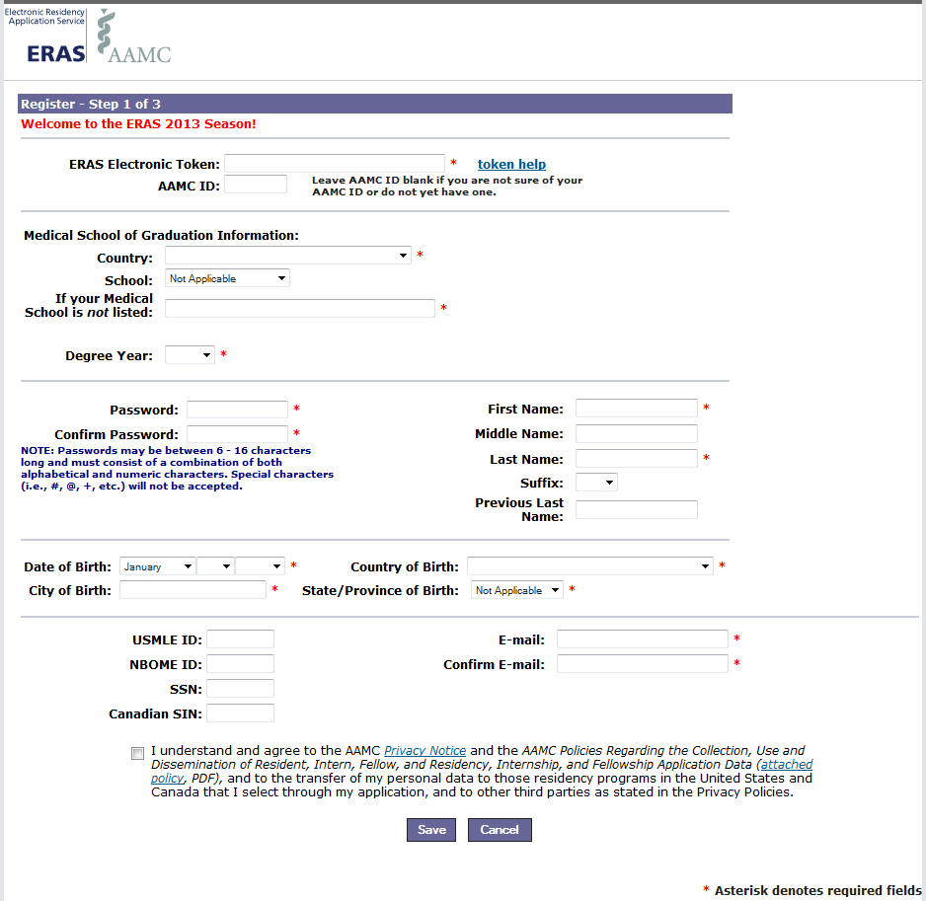
MyERAS 2013 Registration (cont’d.)
On the Registration page, enter your ERAS 2013 Token ID and fill in all required fields. Save and confirm the information you entered is correct.
Note:
NBOME ID is a required field for Osteopathic (D.O.) applicants.
USMLE ID is a required field for IMG applicants.
Note:
Registering with ERAS does not register you with the NRMP. ERAS is a separate entity from the NRMP. You may use ERAS without using the NRMP; however, if you intend to participate in the NRMP Match, you must contact the NRMP directly to ascertain eligibility and participation requirements. Visit the NRMP Web site at www.nrmp.org or call 1-866-617-5838 for further details.

Slide 13
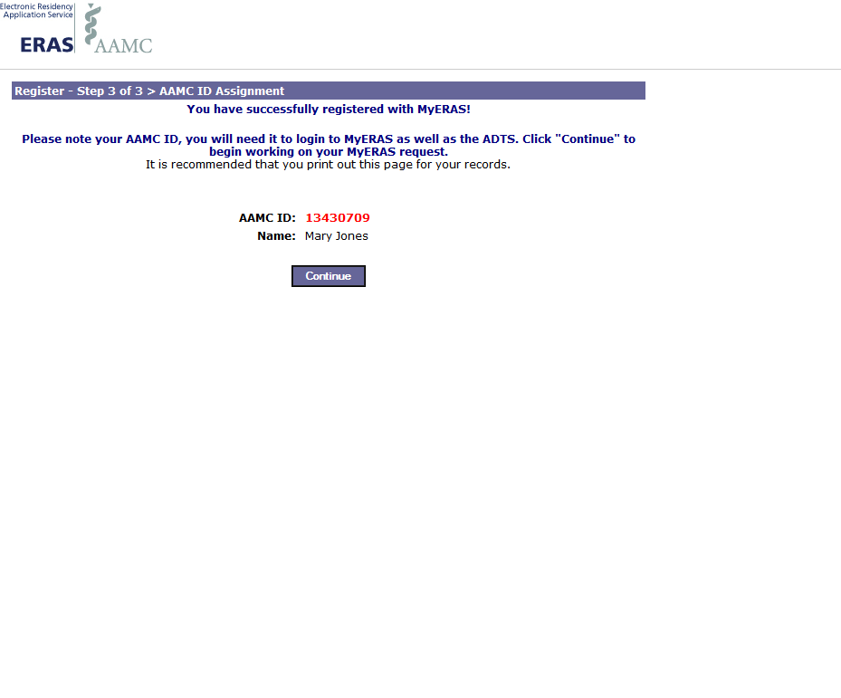
MyERAS 2013 Registration (cont’d.)
You will know you have completed the MyERAS registration when you see this page.
It is recommended that you print out this page for your records.
Clicking Continue will automatically log you into your MyERAS application and you may begin working on your application.

Slide 14
MyERAS 2013 Season
MyERAS Application Overview

Slide 15
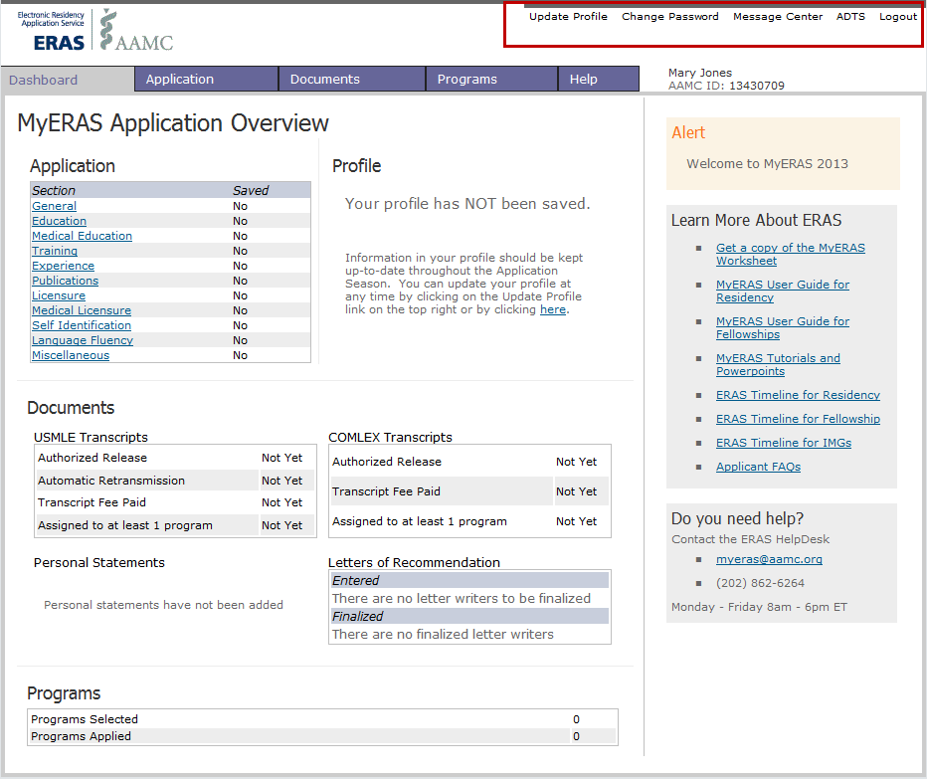
MyERAS: Trailing Links
Trailing links to some of the most frequently used tools are available in the upper right hand corner of MyERAS. These links are easily accessible to you from anywhere within the MyERAS site.

Slide 16

Trailing Links
Update Profile
Your Profile contains information that may be updated at any time during the application season, even after the MyERAS application has been certified and submitted. It is essential that you keep this tab updated with your most current information throughout the season.
Change Password
Use this section to change your password after registering.
Message Center
Any messages sent by a participating program via the Program Director’s Workstation (PDWS) software, as well as any messages sent by ERAS staff, will be listed in the Message Center. These messages are also sent to the applicant’s e-mail account on file.
ADTS
ADTS is the Applicant Document Tracking System. It allows you to track the status of your MyERAS application and supporting documents.
Logout
Use to securely exit the MyERAS application.

Slide 17
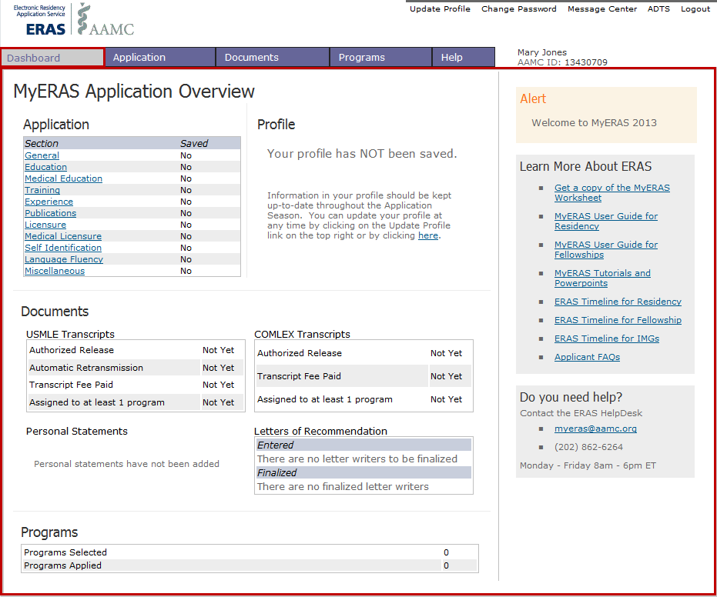
MyERAS: Dashboard Tab
The Dashboard is broken up into two sections.
MyERAS Application Overview:
This area provides you with an overview of the progress you have made in your application.
Right-Navigation:
Displays MyERAS alerts, provides easy access to ERAS resource material, and displays the ERAS HelpDesk contact information and hours of operation.

Slide 18
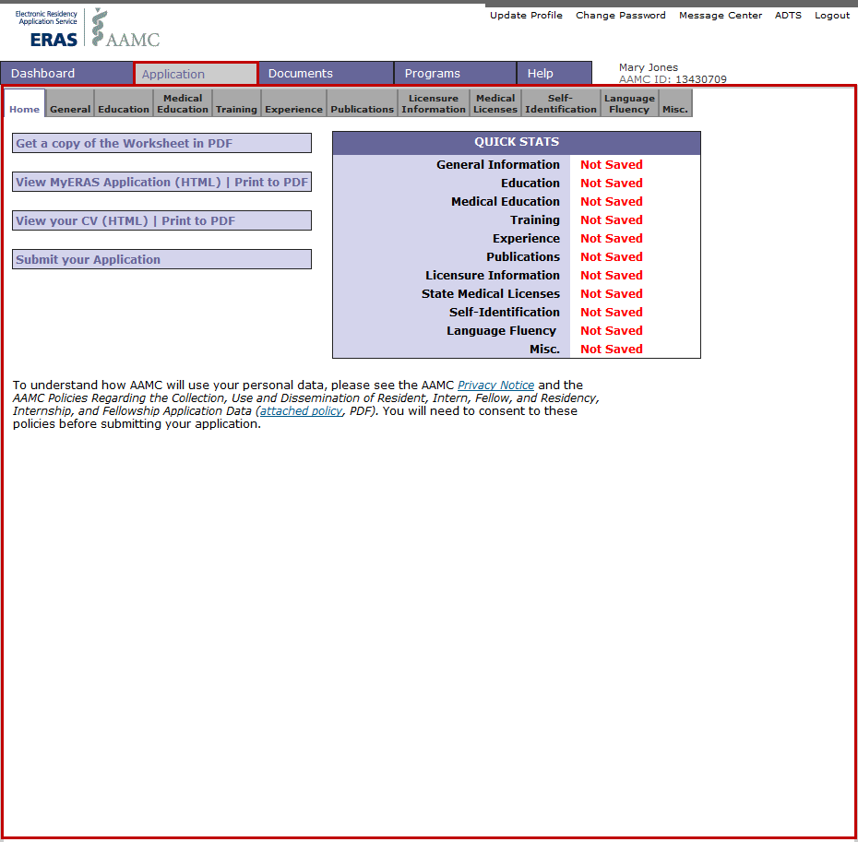
MyERAS: Application Tab
The Application tab includes your: education, work, other experiences, awards/honors received, publications, etc.
You do not have to complete the entire application at one time. Each tab of the application has a Save button, which enables you to save your information until you are ready to begin working again.
You may change information in your application at any time before you certify and submit it. You may only certify and submit your application once. Once your application is completed, certified, and submitted to ERAS, your application will be locked and you may not make any changes.

Slide 19
Application Sub-tabs
Home
Contains Quick Stats; PDF of the MyERAS application and CV; the ability to view the application in the MyERAS application or CV format; it is also where you will certify and submit the application.
General
Allows entries for present mailing address, birth information, gender, and any military service, experience, or obligations.
Education
Allows entries for undergraduate and graduate school(s) attended.
Medical Education
Allows entries for medical school(s) attended.
Training
Allows entries for each residency, fellowship and/or osteopathic internship training completed or currently attending.
Experience
Allows entries for work, volunteer, and/or research experience(s) attempted, completed, or currently attending.
Publications
Allows entries for publications.

Slide 20
Application Sub-tabs (cont’d.)
Licensure Information
This tab contains questions concerning malpractice cases, termination of medical license, felonies or criminal offenses, board certification, and DEA Registration.
Medical Licenses
This tab is used to list any state medical licenses obtained.
Self-Identification
This tab allows you to indicate how you self-identify. (Optional)
Note: You are not required to indicate how you self-indentify. If you choose not to indicate this information, you must at least select “Prefer not to say” and click Save. You will not be penalized for selecting this response. If you are a citizen of a European country, please do not provide a response and select “Prefer not to say” and click Save.
Language Fluency
This tab allows you to indicate each language that you speak and rate your proficiency in that language.
Miscellaneous
Consists of two questions asking if the applicant has any limiting aspects, and if medical education/training was extended or interrupted for any reason. This page also allows entries for hobbies and interests, medical school awards, other awards/accomplishments, and membership in honorary/professional societies.
Note for IMGs Only: You will be able to indicate if you will provide a MSPE and/or a medical school transcript to the ECFMG on the Miscellaneous tab.

Slide 21
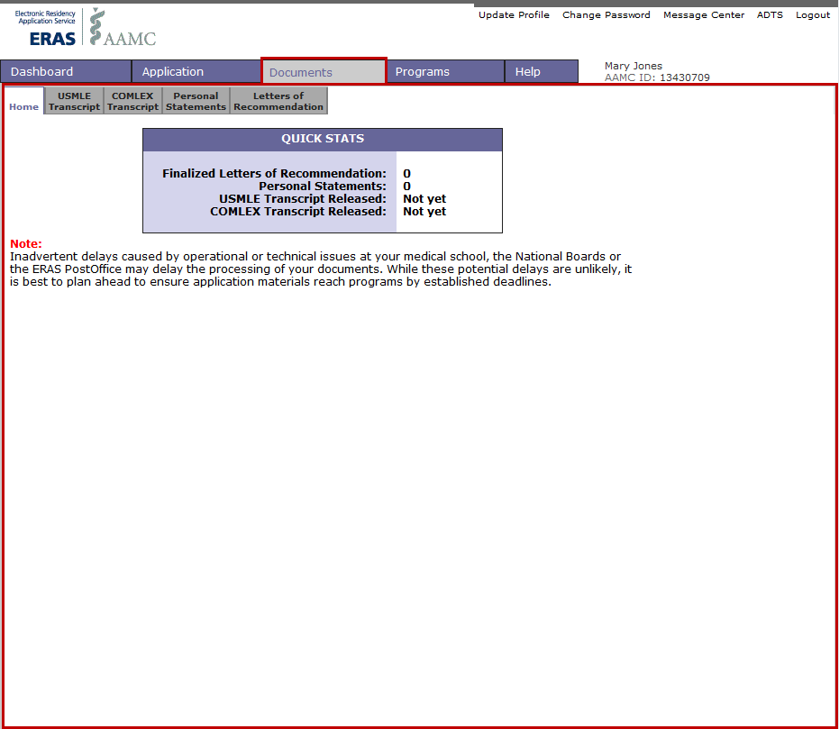
MyERAS: Documents Tab
This is where you may create personal statement(s); identify the people who will write your letter of recommendation (LoRs); print Letter Request Forms; and release your COMLEX and/or USMLE transcripts.

Slide 22
Documents Sub-tabs
Home
Contains Quick Stats about the work you completed on the Documents tab.
USMLE Transcript
This is the tab where you will authorize the release of your USMLE transcript and transmit your requests to the NBME. Your transcript will only be transmitted to programs to which your USMLE transcript has been assigned.
COMLEX Transcript (Osteopathic Applicants)
Under this tab, you will authorize the release of your COMLEX transcript and transmit your requests to the NBOME. Your transcript will only be transmitted to programs to which your COMLEX transcript has been assigned.
Personal Statements
Your personal statements may be created, viewed, edited, and printed in this tab.
Letters of Recommendation (LoRs)
Here you can create a list of LoR Authors who will write LoRs on your behalf. Once you have entered your LoR Author(s) information and finalized them, you will need to print and distribute the Letter Request Form to each individual LoR Author.
Note: LoR Authors writing LoRs on behalf of U.S. graduates applying to residency programs and fellowship applicants (both USGs & IMGs) can use the ERAS LoR Portal to upload LoRs. LoR Authors writing LoRs on behalf of International Medical Graduates (IMGs) applying to residency must use the ECFMG ERAS Letter Writer Portal (LWP).
Note: LoR Authors that choose to use the ERAS LoR Portal will need to create an AAMC Account in order to upload LoRs. Applicants should not create these accounts for their LoR Authors. LoR Authors should create their own accounts using their own personal information.

Slide 23
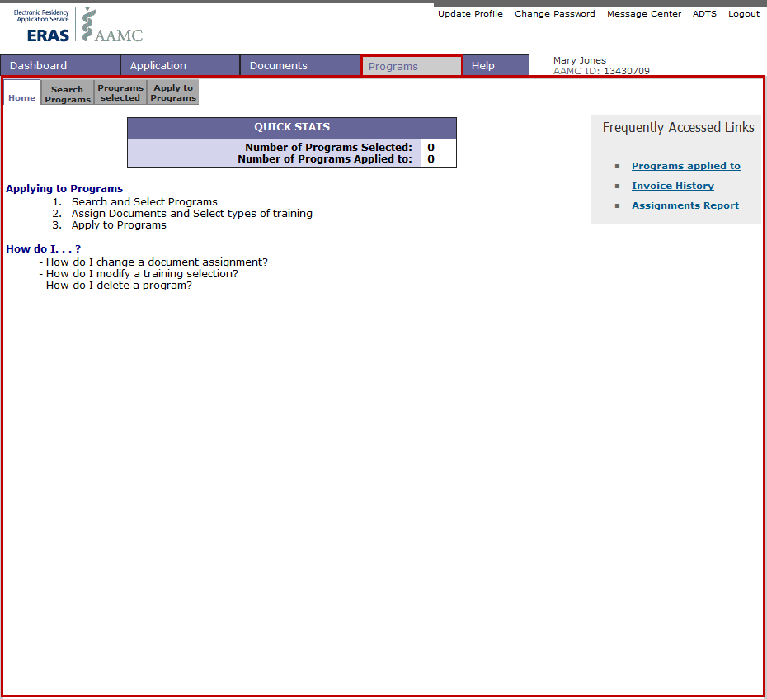
MyERAS: Programs Tab
This is where you will select programs of interest, assign documents to programs, pay fees, and apply to programs.

Slide 24
Programs Sub-tabs
The Programs tab consists of the following sub-tabs:
Home
Contains Quick Stats on the number of programs selected and programs applied to.
Search Programs
Applicants can search for programs by Accreditation ID (ACGME or AOA) or State and Specialty. After successfully searching for participating programs, applicants may select a program, select training type(s), and assign supporting documents. The programs that are “grayed out” are not participating in ERAS this season. You cannot apply to these programs using ERAS.
Note: Osteopathic (D.O.) applicants will be able to search for both ACGME and AOA programs.
Note: If a program is grayed out when searching programs, it means they are either not participating, no longer accepting applications, or closed. You should contact all programs directly regarding their participation status with ERAS.
Programs Selected
Lists programs you are interested in and to which you are currently assigning documents. These programs have not yet received your application. You may add or delete programs from the Programs Selected tab at your discretion. You may select programs before you certify and submit your application.
Apply to Programs
Lists selected programs and allows applicants to apply to these programs or preview an invoice for programs you wish to apply.

Slide 25
Programs Sub-tabs (cont’d.)
Note: You must certify and submit your MyERAS application before you can apply to programs.
Note: No refunds will be given for applications sent to programs not participating in ERAS or whose deadlines have passed.
The final invoice for any payment transaction is only generated once, it is recommended that you print a copy for your records.
The right navigation of the Programs tab consists of the following informative links:
Programs applied to
Lists programs that have been applied to. Applicants can click on each program to view/edit document assignments.
Invoice History
Is a summarized history of all ERAS fees broken down by specialty and the USMLE/COMLEX transcript fees.
Assignments Report
Displays training selections and documents that are currently assigned to both Selected and Applied to programs.
Note: Before certifying and submitting your application, be sure to review all sections for missing or incorrect information, misspelled words, or gaps. Use the Dashboard as another “final” check to review your application.

Slide 26
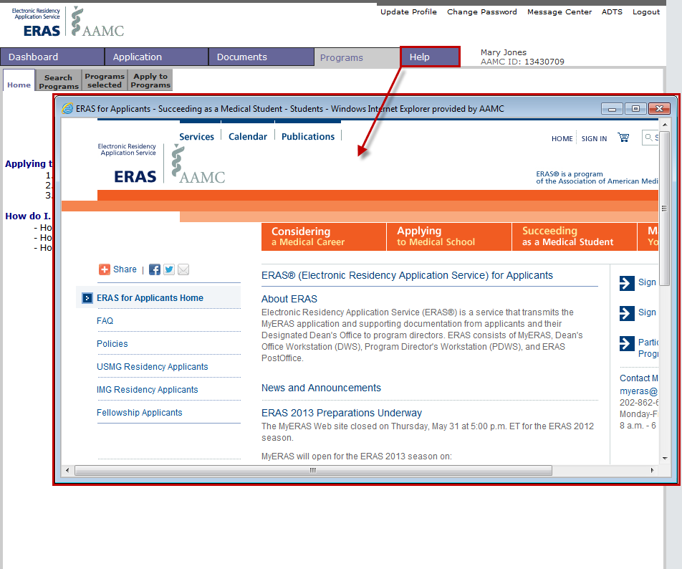
MyERAS: Help Tab
Clicking on the Help tab will open a new window and link you to the ERAS for Applicant home page on our Web site.
Navigate the Web site to find answers to questions you may have about the MyERAS application, ERAS Policies, Participating Specialties & Programs, News and Announcements, and much more.
To find audience specific information, click on the link in the left navigation that applies to you. The audience links are as follows:
USMG Residency Applicants
IMG Residency Applicants
Fellowship Applicants

Slide 27
MyERAS 2013 Season
Helpful Tips & ERAS Support

Slide 28
Helpful Tips for Applicants
ERAS does not receive or handle any applicant documents. All supporting documents are received, scanned, and uploaded by your Designated Dean’s Office. LoRs can be uploaded by LoR Authors via the ERAS LoR Portal as well.
All applicants have a Designated Dean’s Office. Please refer to the user guide for more information.
To get started, you will need to register for MyERAS 2013. This means you will need to contact your Designated Dean’s Office to receive a token, as well as supporting documents instructions.
You will not be able to log into MyERAS 2013 with your login information from a previous season.
If you do not already have or have forgotten your AAMC ID, the system will automatically generate an AAMC ID when you complete your MyERAS registration.
If you decide to register with the NRMP to participate in the Match, please ensure that the AAMC ID used to log into the NRMP Web site is the same AAMC ID used to log into MyERAS. If you have two different AAMC IDs, contact us immediately.
You will not have access to your ERAS documents from any previous ERAS season. We purge our database at the end of every season to make room for the upcoming season’s applicant data. We encourage you to print or save your data before the season ends.
ERAS does not set program application deadlines or requirements. Individual programs set deadlines and requirements. You should contact programs directly for this information.
You must certify and submit your MyERAS application before you can apply to programs.

Slide 29
Helpful Tips for Applicants (cont’d)
Once you have certified and submitted your application, you will not be able to make any changes to your application. You can, however, update the information listed in your Profile at any time throughout the season.
For LoRs, you must enter and finalize LoR Author(s). When you finalize a LoR Author, the system will generate a personalized Letter Request Form that you will need to provide to the LoR Author. You can do this by e-mail, regular mail, fax, or in person.
Once you have released your USMLE and/or COMLEX transcript, assigned it to program(s), and paid the transcript fee, it will take 3-5 business days to upload it to the ERAS PostOffice from the date your request was received.
When new transcript scores are uploaded, the most recent upload date will display in ADTS.
If a program is grayed out when selecting programs, it means that they are not participating, no longer accepting applications, or closed. You should contact all programs directly regarding their participation status with ERAS.
Remember to check the Message Center and the ADTS frequently to monitor the progress and status of your application.
Some programs have state requirements to which they must adhere that prevent selection of IMGs. Contact the programs directly to find out their requirements prior to applying.

Slide 30

ERAS Support
Need Help?
Contact the ERAS HelpDesk by phone or via email:
8 a.m. - 6 p.m. ET, Monday-Friday
myeras@aamc.org
202-862-6264

Slide 31


