Slide 1
“Product Categorization and Matching Using Deep Learning Techniques”
Ioannis Daskalopoulos
Industry Supervisor: Konstantinos Pechlivanis
Academic Supervisor: Prodromos Malakasiotis

Slide 2

The Setting
Unstructured product data
Title: VICHY SLOW AGE CREME
Description: 50 SPF 30 ml
Image URL: www.e-farmakeio.gr/images/123
Last Sale: 30-12-2018
E-business Consulting
Title: NIVEA AFTER SHVE BALSAM
Description: 3582
Image URL:
Last Sale: 3/25/18

Slide 3
The Setting
Unstructured product data
Title: VICHY SLOW AGE CREME
Description: 50 SPF 30 ml
Image URL: www.e-farmakeio.gr/images/123
Last Sale: 30-12-2018
E-business Consulting
Grammatical mistakes
Title: NIVEA AFTER SHVE BALSAM
Description: 3582
Image URL:
Last Sale: 3/25/18

Slide 4
The Setting
Unstructured product data
Title: VICHY SLOW AGE CREME
Description: 50 SPF 30 ml
Image URL: www.e-farmakeio.gr/images/123
Last Sale: 30-12-2018
E-business Consulting
Grammatical mistakes
Empty fields
Title: NIVEA AFTER SHVE BALSAM
Description: 3582
Image URL:
Last Sale: 3/25/18

Slide 5
The Setting
Unstructured product data
Title: VICHY SLOW AGE CREME
Description: 50 SPF 30 ml
Image URL: www.e-farmakeio.gr/images/123
Last Sale: 30-12-2018
E-business Consulting
Grammatical mistakes
Empty fields
Wrong data types
Title: NIVEA AFTER SHVE BALSAM
Description: 3582
Image URL:
Last Sale: 3/25/18

Slide 6
The Setting
Unstructured product data
Title: VICHY SLOW AGE CREME
Description: 50 SPF 30 ml
Image URL: www.e-farmakeio.gr/images/123
Last Sale: 30-12-2018
E-business Consulting
Grammatical mistakes
Empty fields
Wrong data types
Different Formats
Title: NIVEA AFTER SHVE BALSAM
Description: 3582
Image URL:
Last Sale: 3/25/18

Slide 7

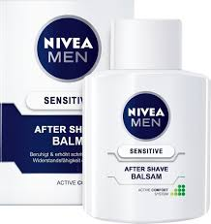
The Solution
Categories
Vichy slow age creme SPF 30 from 2 vendors
Brand
Product Type
Nivea after shave balsam from 5 vendors
Product Line

Slide 8
The Solution
Product Categorization
Categories
Vichy slow age creme SPF 30 from 2 vendors
Brand
Product Type
Nivea after shave balsam from 5 vendors
Product Line

Slide 9
The Solution
Product Matching
Categories
Vichy slow age creme SPF 30 from 2 vendors
Brand
Product Type
Nivea after shave balsam from 5 vendors
Product Line

Slide 10

Contribution
Image Embeddings
Text Embeddings

Slide 11

Contribution
Automated matching
Image Embeddings
Text Embeddings

Slide 12
Contribution
Automated matching
Image Embeddings
Manual matching
Text Embeddings

Slide 13
Contribution
Automated matching
Image Embeddings
Manual matching
Text Embeddings
Suggest new product

Slide 14
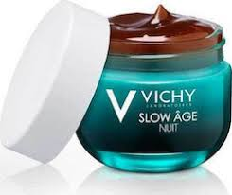
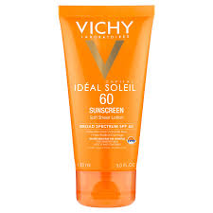
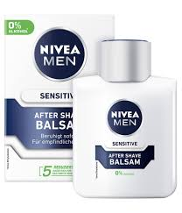
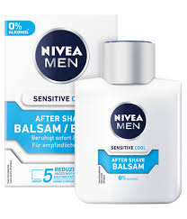
Product Categorization
Product Images

Slide 15
Product Categorization
Product Images
Product ID: 34712
Image URL: https://www.myfarmakeio.gr/product123/image1
Brand: 52
Product Type: 1879
Product Line: 6766
Barcode: 11320

Slide 16

Product Categorization
Product Images
Brand
Vichy
Nivea

Slide 17

Product Categorization
Product Images
Brand
Product Type
Vichy
Nivea
Creme
Sunscreen
After Shave

Slide 18
Product Categorization
Product Images
Brand
Product Type
Product Line
Vichy
Nivea
Creme
Sunscreen
Face Care
Men’s Care
After Shave

Slide 19
Product Categorization
Product Images
Brand
Product Type
Product Line
Vichy
Nivea
Creme
Sunscreen
Face Care
Men’s Care
After Shave

Slide 20



Our Approach
Crawler
Database

Slide 21

Our Approach
Deep Neural Network
Crawler
Database
Models
BR
PL
PT
BR = Brand
PT = Product Type
PL = Product Line

Slide 22




Our Approach
Brand
Deep Neural Network
Product Type
Crawler
Database
Models
BR
PL
PT
Product Line
BR = Brand
PT = Product Type
PL = Product Line

Slide 23
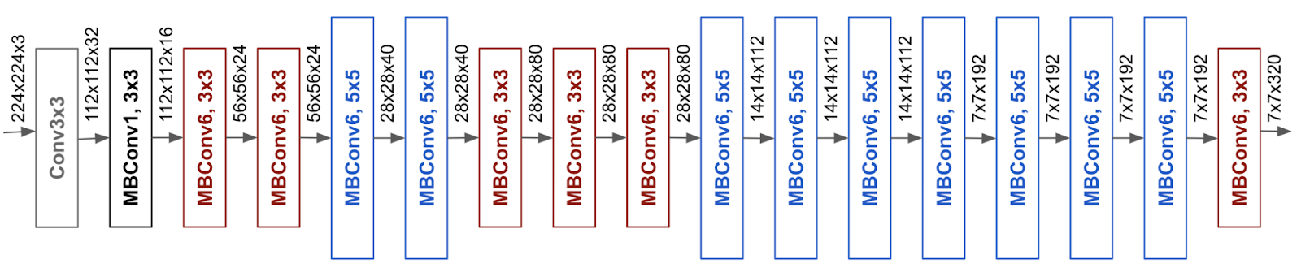
The model
EfficientNet B0

Slide 24
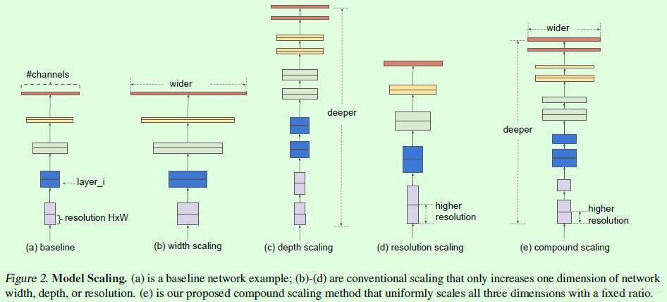
Compound Scaling

Slide 25
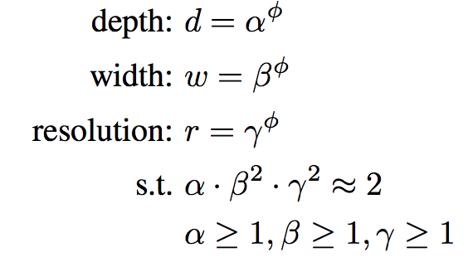
Compound Scaling

Slide 26
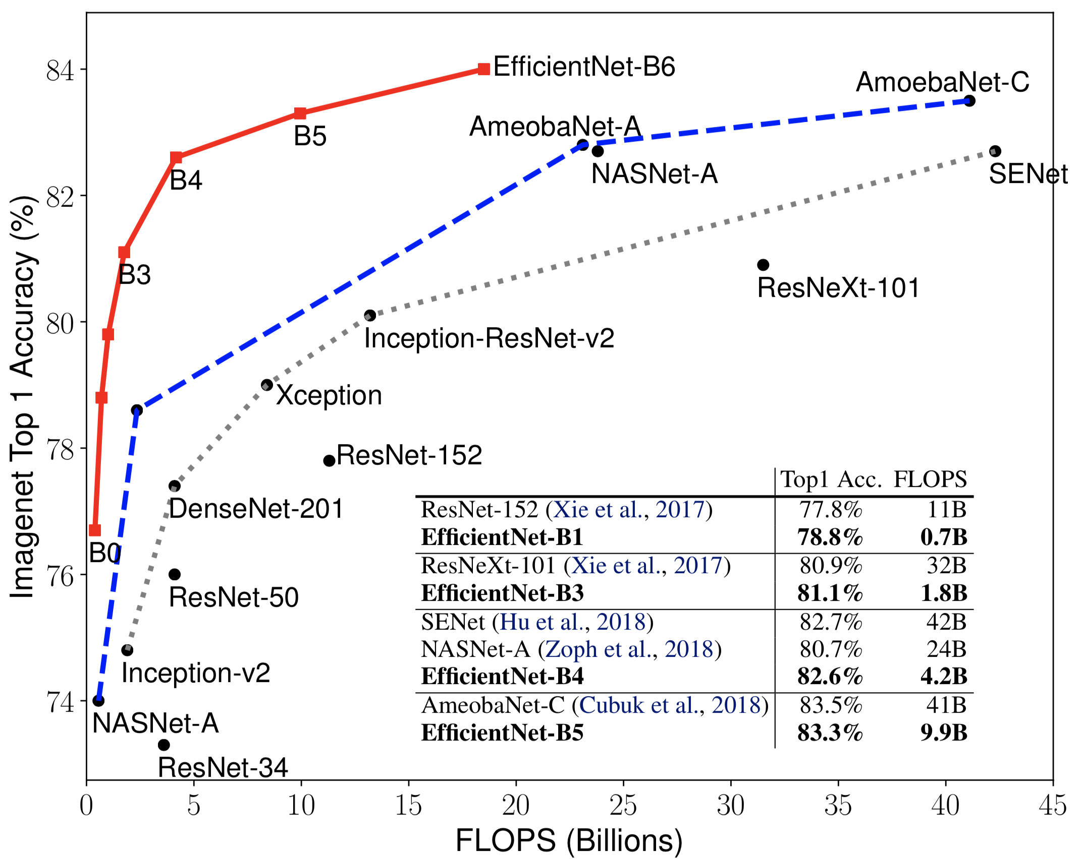
Model Comparison

Slide 27
Model Comparison
Architectures | Brand (Accuracy)
DenseNet | 0.833
Inception Resnet-V2 | 0.841
NasNet | 0.823
EfficientNet B3 | 0.840
EfficientNet B5 | 0.865
Model of choice

Slide 28
The Experiments
First Dataset
270K products

Slide 29
The Experiments
Second Dataset
340K products
First Dataset
270K products

Slide 30
The Experiments
Datasets
Product Type
Product Line
Brand
At least 10 images/ class
At least 10 images/ class
At least 10 images/ class
1st Subset

Slide 31
The Experiments
Datasets
Product Type
Product Line
Brand
At least 10 images/ class
At least 10 images/ class
At least 10 images/ class
1st Subset
At least 50 images/ class
At least 50 images/ class
At least 50 images/ class
2nd Subset

Slide 32
The Experiments
Datasets
Product Type
Product Line
Brand
At least 10 images/ class
At least 10 images/ class
At least 10 images/ class
1st Subset
At least 50 images/ class
At least 50 images/ class
At least 50 images/ class
2nd Subset
At least 100 images/ - class
At least 100 images/ class
At least 100 images/ class
3rd Subset

Slide 33
The Experiments
3 single-task models
Datasets
Product Type
Product Line
Product Type
Product Line
Brand
Brand
At least 10 images/ class
At least 10 images/ class
At least 10 images/ class
At least 50 images/ class
At least 50 images/ class
At least 50 images/ class
At least 100 images/ - class
At least 100 images/ class
At least 100 images/ class

Slide 34
The Experiments
3 single-task models
Datasets
Product Type
Product Line
Product Type
Product Line
Brand
Brand
At least 10 images/ class
At least 10 images/ class
At least 10 images/ class
multitask model
At least 50 images/ class
At least 50 images/ class
At least 50 images/ class
At least 100 images/ class
At least 100 images/ class
Brand &
Product Type &
Product Line
At least 100 images/ - class

Slide 35
Experimental Setup
Optimizer: Adabound
Starting Learning rate: 0.001
Final Learning rate: 0.1
Loss Function: Categorical s Crossentropy
Dataset 1: Hyperparameters
Resolution | 112x112
Width Coefficient | 1.6
Depth Coefficient | 2.2
Epochs | 15
Batch Size | 32

Slide 36
1st Dataset: Number of classes per subset
Labels | At Least 10 Images/class | At Least 50 Images/class | At Least 100 Images/class
Brand | 1779 | 648 | 387
Product Type | 950 | 728 | 574
Product Line | 2650 | 787 | 372

Slide 37
1st Dataset: Accuracy for both Models
Single Task Models
Multitask Model
Labels | At Least 10 Images/class | At Least 50 Images/class | At Least 100 Images/class
Brand | 0.9378 | 0.9448 | 0.9541
Product Type | 0.8792 | 0.9210 | 0.9366
Product Line | 0.9250 | 0.9456 | 0.9531
Labels | At Least 10 Images/class | At Least 10 Images/class | At Least 10 Images/class
Brand | 0.9255 | 0.9328 | 0.9398
Product Type | 0.8850 | 0.9190 | 0.9301
Product Line | 0.9238 | 0.9342 | 0.9434

Slide 38

Product Matching
VICHY SLOW AGE
CREME SPF30 50 ML
3337875552066
3337875552066

Slide 39
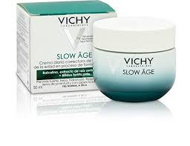
Product Matching
???
VICHY SLOW AGE
CREME SPF30 50 ML
???
???
???
???
3337875552066
3337875552066
???

Slide 40
Product Matching
VICHY SLOW AGE
CREME SPF30 50 ML
VICHY SLOW AGE
CREME SPF30 50 ML
3337875552066
VICHY SLOW AGE
NUIT
3337875730673
AFTER SHAVE BALSAM
SENSITIVE SKIN
3337875552066
3337875552066
8750375189456

Slide 41
Our Approach
TrainedModels
Database
BR
PL
PT
BR = Brand
PT = Product Type
PL = Product Line

Slide 42
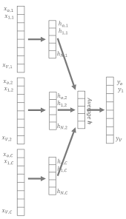
Our Approach
TrainedModels
Image Embeddings
Database
BR
PL
PT
BR = Brand
PT = Product Type
PL = Product Line

Slide 43
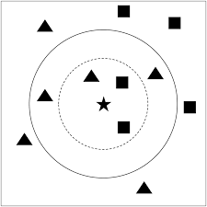

Our Approach
TrainedModels
Image Embeddings
Matched Products
Database
KNN
BR
PL
PT
BR = Brand
PT = Product Type
PL = Product Line

Slide 44
1st Dataset: Accuracy for the Multitask Model
Number of Neighbors | At Least 10 Images/class | At Least 50 Images/class | At Least 100 Images/class
1 | 0.7521 | 0.7422 | 0.7456
2 | 0.4952 | 0.4898 | 0.4913

Slide 45
Conclusions
Product Categorization
EfficientNet produces high performance/calculations ratio
Product Matching

Slide 46
Conclusions
Product Categorization
EfficientNet produces high performance/calculations ratio
Training converges before 15 epochs
Product Matching

Slide 47
Conclusions
Product Categorization
EfficientNet produces high performance/calculations ratio
Training converges before 15 epochs
Multitask Model more efficient wrt training time/performance
Product Matching

Slide 48
Conclusions
Product Categorization
EfficientNet produces high performance/calculations ratio
Training converges before 15 epochs
Multitask Model more efficient wrt training time/performance
Brand & Product line steadily perform better than Product Type
Product Matching

Slide 49
Conclusions
Product Categorization
EfficientNet produces high performance/calculations ratio
Training converges before 15 epochs
Multitask Model more efficient wrt training time/performance
Brand & Product line steadily perform better than Product Type
Product Matching
Single task models do not result in meaningful embeddings. Only the multiclass model does

Slide 50
Conclusions
Product Categorization
EfficientNet produces high performance/calculations ratio
Training converges before 15 epochs
Multitask Model more efficient wrt training time/performance
Brand & Product line steadily perform better than Product Type
Product Matching
Single task models do not result in meaningful embeddings. Only the multiclass model does
1NN better option for matching embeddings

Slide 51
Conclusions
Product Categorization
EfficientNet produces high performance/calculations ratio
Training converges before 15 epochs
Multitask Model more efficient wrt training time/performance
Brand & Product line steadily perform better than Product Type
Product Matching
Single task models do not result in meaningful embeddings. Only the multiclass model does
1NN better option for matching embeddings
The 3 labels do not differentiate perfectly the products

Slide 52
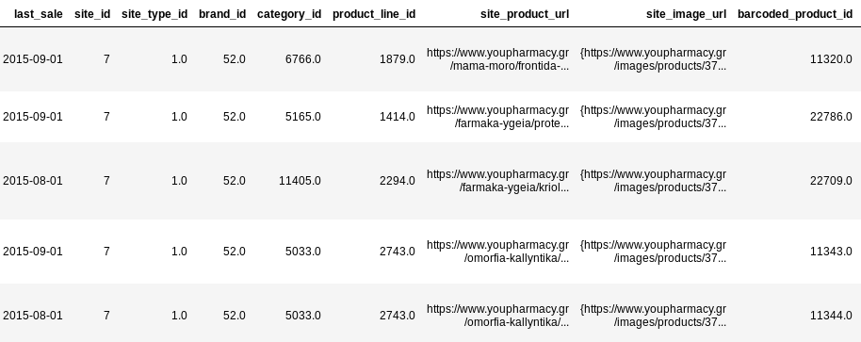
Future work
Add More Labels

Slide 53
Future work
Add More Labels
Deal with the problematic subset as classification task

Slide 54
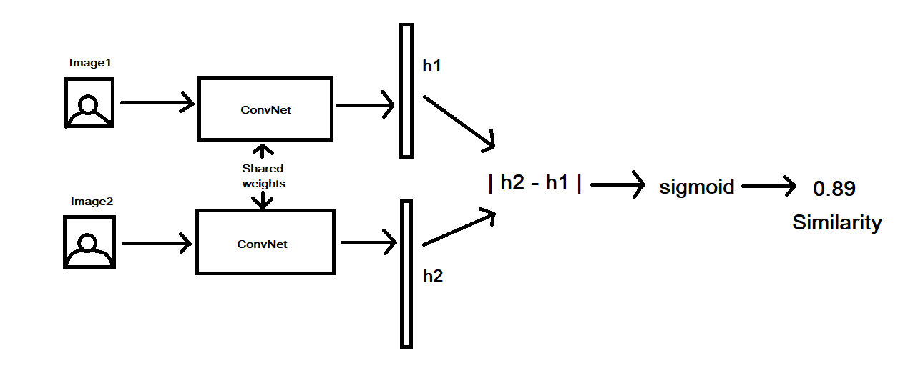
Future work
Siamese Network

Slide 55


Slide 56
Model Comparison (Accuracy)
Architectures | Brand | Product Type | Product Line
DenseNet | 0.833 | 0.702 | 0.808
Inception ResNet-V2 | 0.841 | 0.732 | 0.836
NasNet | 0.823 | 0.730 | 0.811
EfficientNet B3 | 0.840 | 0.724 | 0.825
EfficientNet B5 | 0.865 | 0.738 | 0.862

Slide 57
1st Dataset: Number of classes per subset
Labels | At Least 10 Images/class | At Least 50 Images/class | At Least 100 Images/class
Brand | 1779 | 648 | 387
Product Type | 950 | 728 | 574
Product Line | 2650 | 787 | 372

Slide 58
2nd Dataset: Number of classes per subset
Labels | At Least 10 Images/class | At Least 50 Images/class | At Least 100 Images/class
Brand | 1995 | 725 | 441
Product Type | 980 | 753 | 619
Product Line | 3081 | 998 | 497

Slide 59
Categorization Hyperparameters
Dataset 1
Dataset 2
Resolution | 112x112
Width Coefficient | 1.6
Depth Coefficient | 2.2
Epochs | 15
Batch Size | 32
Resolution | 224x224
Width Coefficient | 1.6
Depth Coefficient | 2.2
Epochs | 15
Batch Size | 8

Slide 60
1st Dataset: Accuracy for the Single Task Model
Labels | At Least 10 Images/class | At Least 50 Images/class | At Least 100 Images/class
Brand | 0.9378 | 0.9448 | 0.9541
Product Type | 0.8792 | 0.9210 | 0.9366
Product Line | 0.9250 | 0.9456 | 0.9531

Slide 61
2nd Dataset: Accuracy for the Single Task Model
Labels | At Least 10 Images/class | At Least 50 Images/class | At Least 100 Images/class
Brand | 0.9462 | 0.9568 | 0.9648
Product Type | 0.8969 | 0.9337 | 0.9511
Product Line | 0.9323 | 0.9535 | 0.9596

Slide 62
1st Dataset: Accuracy for the Multitask Model
Labels | At Least 10 Images/class | At Least 50 Images/class | At Least 100 Images/class
Brand | 0.9255 | 0.9328 | 0.9398
Product Type | 0.8850 | 0.9190 | 0.9301
Product Line | 0.9238 | 0.9342 | 0.9434

Slide 63
2nd Dataset: Accuracy for the Multitask Model
Labels | At Least 10 Images/class | At Least 50 Images/class | At Least 100 Images/class
Brand | 0.9405 | 0.9460 | 0.9576
Product Type | 0.9112 | 0.9294 | 0.9481
Product Line | 0.9303 | 0.9384 | 0.9447

Slide 64
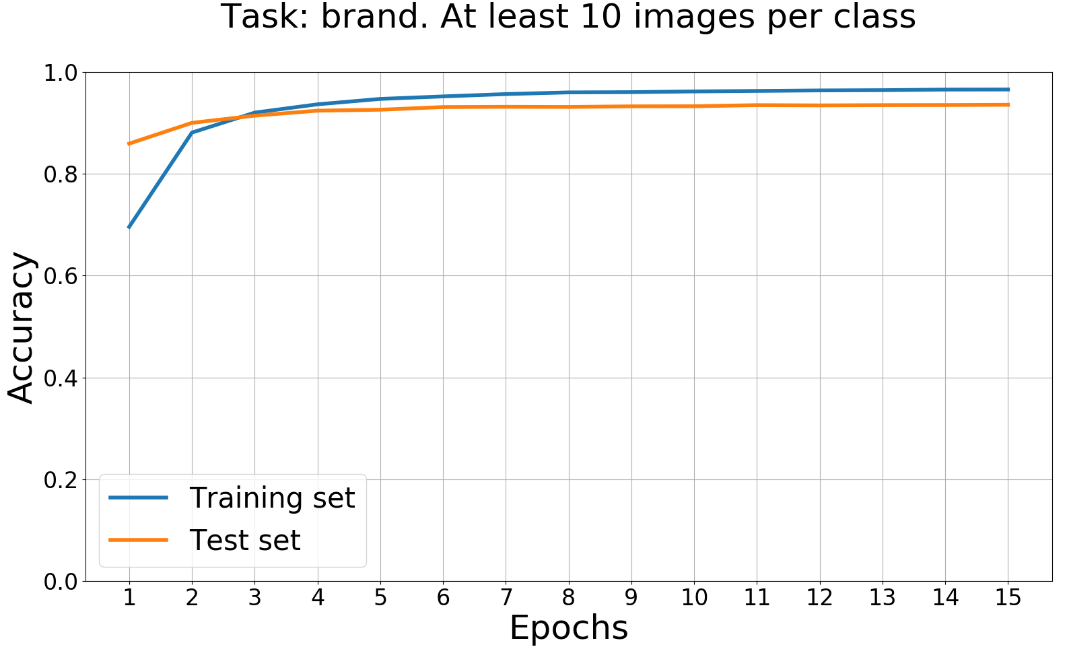
Training Curves for Dataset 1

Slide 65
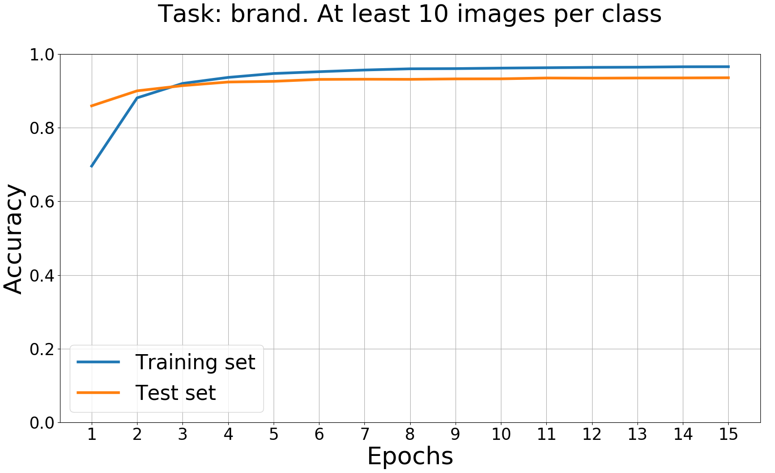
Training Curves for Dataset 2

Slide 66
1st Dataset: Accuracy for the Multitask Model
Number of Neighbors | At Least 10 Images/class | At Least 50 Images/class | At Least 100 Images/class
1 | 0.7521 | 0.7422 | 0.7456
2 | 0.4952 | 0.4898 | 0.4913

Slide 67
2nd Dataset: Accuracy for the Multitask Model
Number of Neighbors | At Least 10 Images/class | At Least 50 Images/class | At Least 100 Images/class
1 | 0.7516 | 0.7440 | 0.7458
2 | 0.5038 | 0.4990 | 0.5002

