Slide 1
Container Deep Dive
RED HAT OPENSHIFT ENTERPRISE 4
Steve Ovens
Architect - Solutions and Technology Praactice
Oct 2022

Slide 2
What we’ll be discussing today
CGroups
Linux Capabilities
Namespaces
AGENDA

Slide 3
CGroups - Managing Access To Resources
RED HAT OPENSHIFT ENTERPRISE 4

Slide 4
What Is This In Context of OCP
OpenShift has Requests and Limits
Ever wonder how that works?
CGroups control the resources a pod can consume
CGroups = Requests/Limits
CGroups

Slide 5
What Are CGroups & Why You Should Care
Linux Kernel is responsible for all hardware interaction
i.e. the amount of RAM a system has to divide up amongst processes
This is great when all applications play well together
But what if they don’t?
OOM Killer!
CGroups
Notes:
Well, the OOM process acts as a last line of defense before your system comes crashing down around you. It's useful to a point, but since the kernel can control which processes must survive the OOM, it can also determine which applications cannot consume too much RAM in the first place.
OOM kills things randomly

Slide 6
What Are CGroups & Why You Should Care
Kernel facility which provides access to hardware
You can limit the amount of a given resource an application can consume
CGroups control:
The number of CPU shares per process.
The limits on memory per process.
Block Device I/O per process.
Which network packets are identified as the same type so that another application can enforce network traffic rules.
CGroups

Slide 7
4 Main Tasks of CGroups
Resource Limiting
Prioritization
Accounting
Process Control
CGroups
Notes:
Resource Limiting
cgroups allow an administrator to ensure that programs running on the system stay within certain acceptable boundaries for CPU, RAM, block device I/O, and device groups.
Also prevents passing of information from one processe to another via named pipe
Prioritization
you are merely saying that regardless of how many resources are available, process X will always have more time on the system than process Y.
Accounting
While accounting is turned off by default for most enterprise versions, turning it on allows you to see what processes inside of which cgroup are consuming which types or resources.
Process Control
You can freeze and move a process to another computer. (Without the PID namespace this can cause problems)

Slide 8
Device groups (inside of CGroups)
Read hardware address
Write to hardware address mknod
CGroups
Notes:
The read/write operations are fairly self-explanatory, so let's take a moment to look at the mknod functionality in a Linux system.

Slide 9
A Bit About MKNOD
Designed to populate /dev
Everything from hdds to USB interfaces
This used to be populated on installation
Primarily used to create named pipes
CGroups
Notes:
Named pipes are a facility to read and write information between processes similar to writing information out to a file

Slide 10
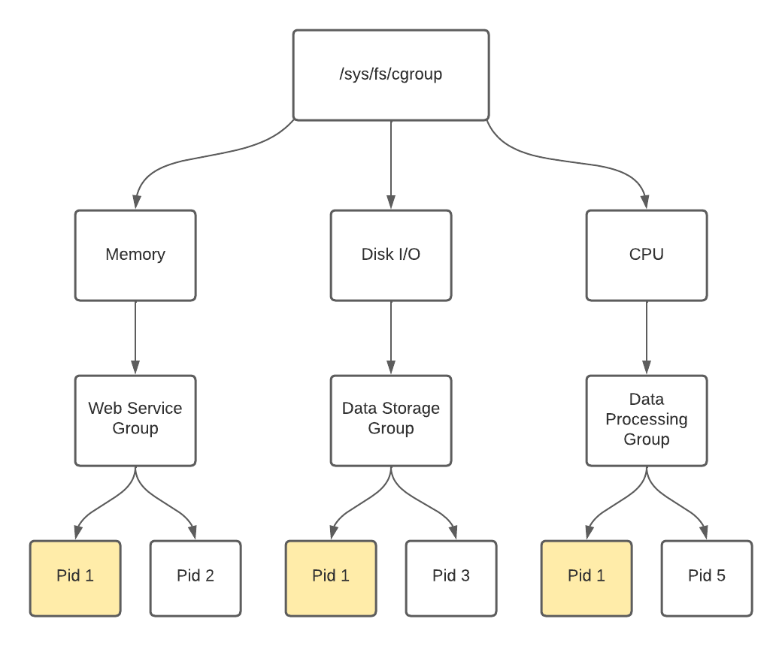
How Do CGroups Work?
CGroups
Notes:
In the diagram above, you can see that it is possible to have PID 1 in memory, disk i/o, and cpu control groups.
The cgroups are created per resource type and have no association with each other.
Like GIDs, these groups are assigned a numeric value upon creation and not a friendly name.
Under the hood, the kernel uses these values to determine resource allocation.
To think of it another way, assume that each cgroup name, once attached to a controller, is renamed to the name of the controller plus the name of your choosing. So a group called database in the memory controller can actually be thought to be memory-database.
There is no relation to a database group associated with the controller cpu as the friendly name can be thought of as cpu-database.

Slide 11
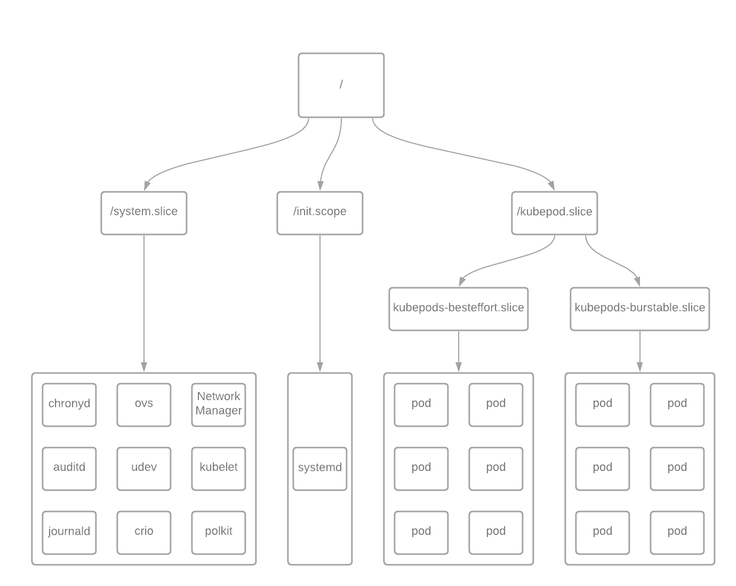
How Do Shares Work?
CGroups
Notes:
CPU time is determined by dividing the cgroup's CPUShares by the total number of defined CPUShares on the system

Slide 12
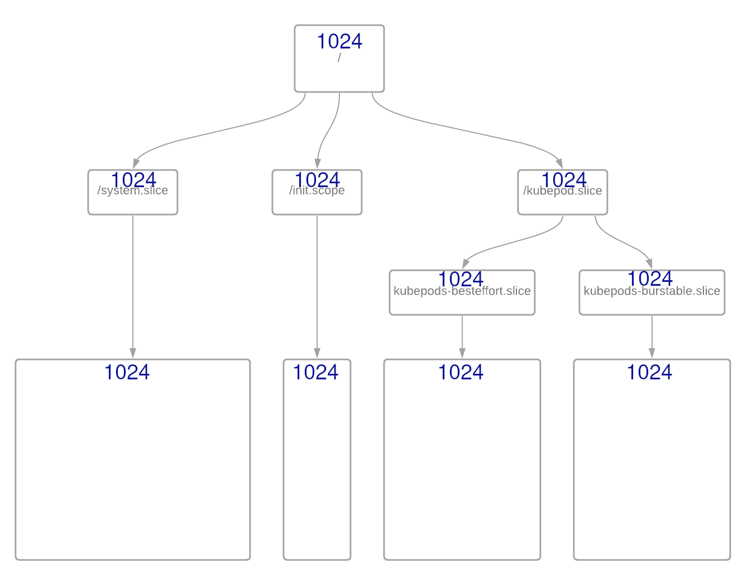
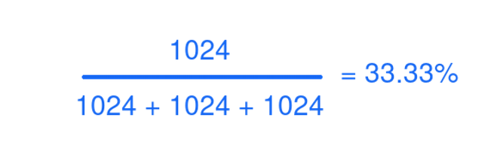
How Do CGroups Work?
CGroups
Notes:
In RHEL, this begins with the root / cgroup with 1024 shares and 100% of CPU resources.
The rest of the resources are divided equally amongst the groups /system.slice, /init.scope, and /kubepod.slice, each with an equal weight of 1024 by default, as seen above

Slide 13
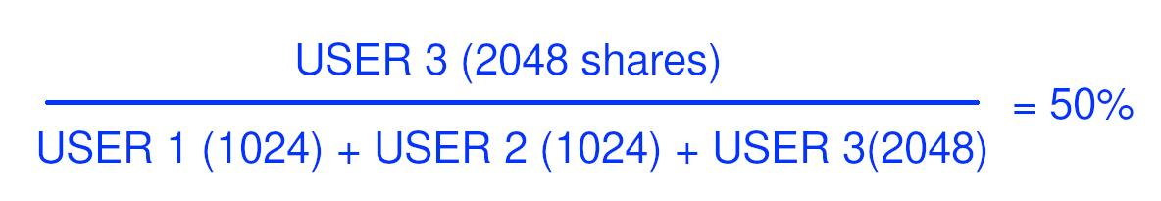
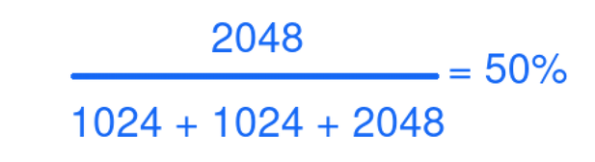
Let’s Try It!
CPU Shares Math
Tasks:
Create load with cat /dev/urandom
Create Cgroups Directories
Mount CGroups
Apply CGroups to active PIDs
CGroups
Notes:
mkdir -p /my_cgroups/{memory,cpusets,cpu}
mount -t cgroup -o memory none /my_cgroups/memory
mount -t cgroup -o cpu,cpuacct none /my_cgroups/cpu
mount -t cgroup -o cpuset none /my_cgroups/cpusets
mkdir -p /my_cgroups/cpu/{user1,user2,user3}
# Set the number of CPU shares
echo 2048 > /my_cgroups/cpu/user1/cpu.shares
echo 1024 > /my_cgroups/cpu/user2/cpu.shares
echo 1024 > /my_cgroups/cpu/user3/cpu.shares
#echo 768 > /my_cgroups/cpu/user2/cpu.shares
#echo 512 > /my_cgroups/cpu/user3/cpu.shares
# generate some load
cat /dev/urandom > /dev/null
# note the pids
ps aux |grep sha256sum
# add pids to /my_cgroups/cpu/user{1,2,3}
echo 1570 > /my_cgroups/cpu/user1/tasks
echo 1571 > /my_cgroups/cpu/user2/tasks
echo 1572 > /my_cgroups/cpu/user3/tasks

Slide 14
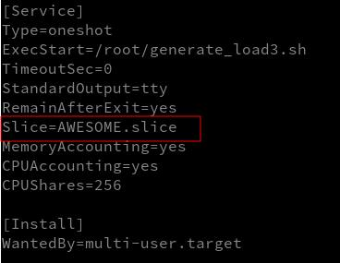
Bonus: Doing It With systemd
CGroups
Notes:
You can include the `Slice` option in the systemd service file
Dont forget you might need to add SELinux Context to your files:
semanage fcontext -a -t bin_t /root/generate_load3.sh
restorecon -Rvv /root/generate_load3.sh
run `systemd-cgtop` to see the accounting

Slide 15
Linux Capabilities
RED HAT OPENSHIFT ENTERPRISE 4

Slide 16
What Is This In Context of OCP
We need to run “stuff”
Don’t want to run as root
Regular users might not be good enough
Container cannot “sudo”
Capabilities = Permission Model for containers
CGroups

Slide 17
Traditional DAC on *nix
Traditional DAC is through users/groups setuid and setgid bits can be set on binaries to provide more access (i.e. passwd util)
Capabilities break permissions down into 40 different categories
Capabilities
Notes:
DAC - Discretionary Access Control
passwd utility interacts with the /etc/shadow file which requires root access
Not all apps are as stress tested as passwd
chance of creating security hole
Check how many Capabilities your kernel has:
cat /proc/sys/kernel/cap_last_cap

Slide 18
Capabilities - Granular Control
As of Linux Kernel 5.15 there are 40 capabilities
Capabilities are tied to a user namespace
Each namespace will have its own capabilities that only apply to themselves
Capabilities
Notes:
examples of capabilities:
cap_CHOWN
cap_mknod
cap_net_admin
cap_sys_admin
Some distros have a package called pscap
good resource: https://hackernoon.com/whats-the-big-deal-with-linux-capabilities

Slide 19
Capabilities Sets - Applied Capabilities
A capability set determines how a capability can be assigned to a thread
There are 5 in total but we really only care about 2
Effective: These are capabilities that are active. You are allowed to perform this action
Permitted: These are not yet active but the process can decide to elevate its permissions into effective capabilities
Capabilities
Notes:
Capability Sets
Effective
Permitted
Inherited - Inherited from the process/shell launched from
Bounded - a way of constraining inheritence
Ambient - A default set for any files that do not have standard DAC applied

Slide 20
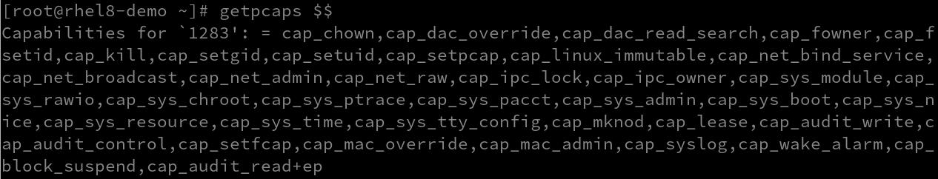

Sample Capabilities RHEL 8
Capabilities
Notes:
In RHEL 9 and more leading edge distros there is a space after the colon. This whitespace is interchangeable with the keyword all.
As you may have guessed, this means that all the capabilities available on the system are granted in both the Effective and Permitted capability sets
These are tied to a user namespace
This means it has the potential to have all capabilities in a namespace… except for inheritance…
A namespace cannot be given more permissions on a system than the creating process has
A non-root process cannot elevate its capabilities to the root level

Slide 21
Namespaces: User
RED HAT OPENSHIFT ENTERPRISE 4

Slide 22
What Is This In Context of OCP
Processes are associated with users
What if I need the same user for lots of “stuff”
What if I want a random UID
How are permissions assigned per pod?
User namespace = Container UID mapping
User Namespace

Slide 23
Theory
As discussed UIDs are part of the Linux security strategy
The user namespace is what allows the container to have a different set of permissions than the host itself
Every container inherits permissions from the user who created the namespace
User Namespace

Slide 24
Theory
Doesn’t this give too much power?
How do you really know what a user is doing?
User Namespace

Slide 25
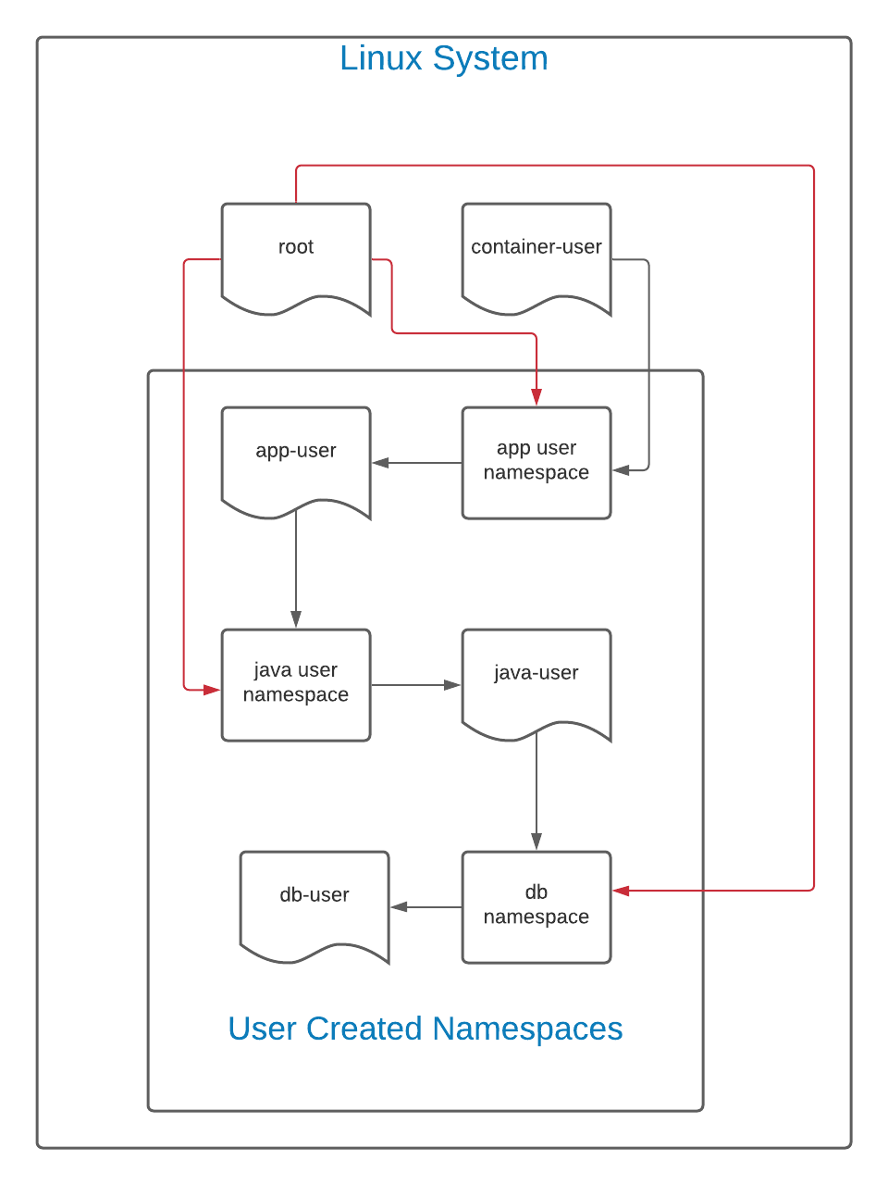
Overview
User Namespace
Notes:
In this diagram, the black lines indicate the flow of creation. The user container-user creates a namespace for a user called app-user. In theory, this would be a web front end or other application. Next, app-user creates a user namespace for java-user. In this namespace, java-user creates a namespace for db-user.
As this is a hierarchy, container-user can see and access all files created by any of the namespaces spawned from its UID. Similarly, because the root user on the Linux system can see and interact with all files on a system, including those created by container-user, the root user (represented by the red line) can have total authority over all namespaces.
However, the reverse is not true. The db-user user, in this case, cannot see or interact with anything above it. If the ID mapping is kept the same (the default policy), app-user, java-user, and db-user all have the same UID. However, although they share the same UID, db-user cannot interact with java-user, which cannot interact with app-user, and so on.
Any permissions granted in a user namespace only apply in its own namespace and possibly namespaces below it.

Slide 26
Important Notes
By default there is no user mapping into a new namespace
This results in the user being given the id of 65534(nobody)
It is possible to create a detailed UID mapping before hand
There is a flag that will do a root user mapping for you
User Namespace

Slide 27
Let’s Try It!
Tasks:
Create User Namespace with no UID mapping with root mapping
Investigate file permissions in user namespace
User Namespace
Notes:
# user mapping as regular user
## This is the nobody user
PS1='\u@app-user$ ' unshare -U
cat /proc/$$/uid_map
—----------------------------------
# This is the root user being created from a normal user
PS1='\u@app-user$ ' unshare -Ur
cat /proc/$$/uid_map
—-------------------------------
# This is the nested namespace creation
root@app-user$ PS1='\u@java-user$ ' unshare -Ur
root@java-user$ cat /proc/$$/uid_map
0 0 1
—----------------------------------------------------
# as user 1
user1@rhel8-demo$ unshare -Ur
cd /tmp
touch user1_file
ls -l
# as user2
user2@rhel8-demo$ unshare -Ur
cd /tmp/
ls
echo "user2" >> user1_file

Slide 28
Let’s Try It!
Tasks:
Process interaction?
Investigate nested user namespaces getpcaps messing with UIDs
User Namespace
Notes:
# As user1
user1@rhel8-demo$ unshare -Ur
sleep 1000
# as user2
user2@rhel8-demo$ unshare -Ur
ps aux |grep "sleep 1000" |head -n 1
SLEEP_PID=$(ps aux |grep "sleep 1000" |head -n 1 |awk '{ print $2}')
kill -9 $SLEEP_PID
—--------------------------------------------------
# As a regular user create the first namespace
PS1='\u@app-user$ ' unshare -Ur
cat /proc/$$/uid_map
# create the second namespace from inside the first
root@app-user$ PS1='\u@java-user$ ' unshare -Ur
root@java-user$ cat /proc/$$/uid_map
—---------------------------------------------
# Process creation
## Shell 1
PS1='\u@app-user$ ' unshare -Ur
sleep 100000
## Shell 2
PID=$(ps aux |grep "sleep 1000" |grep -v grep |awk '{print $2}')
readlink /proc/${PID}/ns/user
readlink /proc/$$/ns/user
—---------------------------------------
# run getpcaps from any user namespace
getpcaps
—---------------------------------------
# You can only write to the mapping once
unshare -U
touch UID_test
watch ‘ls -l’
# from the root user in another shell
## find the PID of the BASH process
ps aux |grep bash |grep user1
echo "1000 1000 1" > /proc/<pid>/uid_map

Slide 29
Inheritance Reminder
By default everything inherits from the root user’s namespace that user namespace owns everything by default
Nothing can have higher privileges than initial process
User Namespace

Slide 30
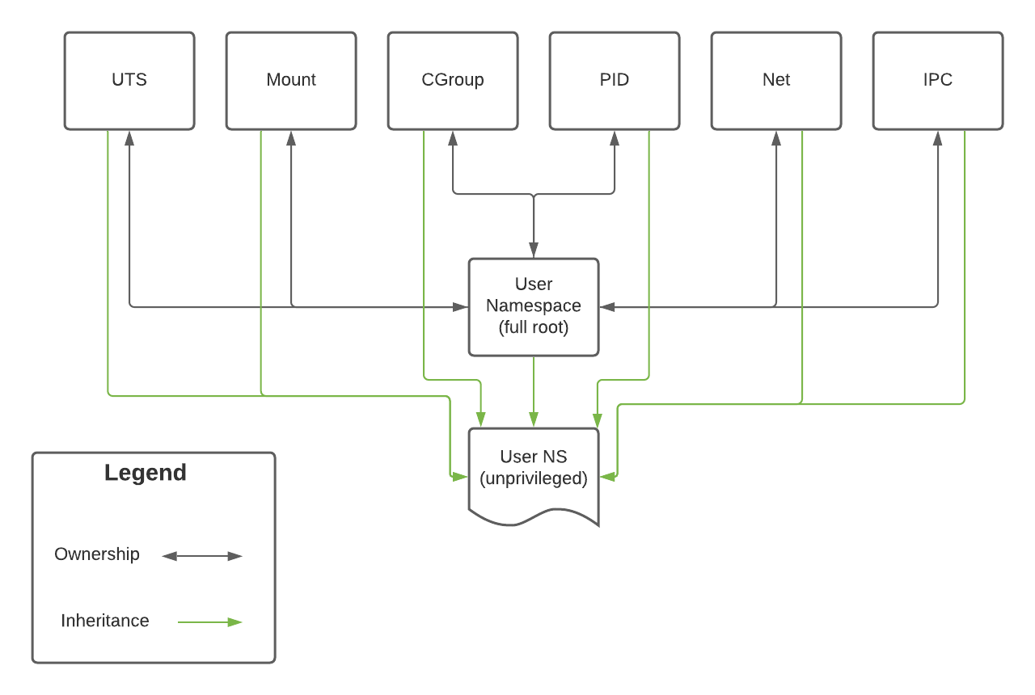
User Namespace
Notes:
The original, full root user namespace owns all of the namespaces on a system in the diagram.
This relationship has the potential to be bi-directional.
If a process running in the net namespace runs as root, it can impact all other processes owned by the root user namespace.
However, while creating an unprivileged user namespace allows that new user namespace to access resources in other namespaces, it may not alter them as it does not own them.
Thus, while a process in the unprivileged namespace can ping an IP (which relies on the net namespace), it may not change the host's network configuration.

Slide 31
Summary
Important… especially from permissions inheritance explains file permissions in containers they are most effective in combination
User Namespace

Slide 32
Namespaces: Mount
RED HAT OPENSHIFT ENTERPRISE 4

Slide 33
What Is This In Context of OCP
Containers need discrete FS
Should only access their own files
“chroot” not good enough
Mount Namespace = Container File System separation
Container Overlay Directory = Mount NS root
Mount Namespace

Slide 34
Theory
Creating a new mount space creates a copy of all mount points at the time the namespace is created
Poorly configured mnt namespaces WILL impact the host
Mount propagate by default because of a kernel feature called shared subtree
There is metadata on each mount point that determines whether it will get propogated
Mount Namespace
Notes:
Mounts propagate by default because of a feature in the kernel called the shared subtree.
This allows every mount point to have its own propagation type associated with it.
This metadata determines whether new mounts under a given path are propagated to other mount points.
If your optical disk automatically mounted under /cdrom, the contents would only be visible in other namespaces if the appropriate propagation type is set.

Slide 35
Theory - Peer Groups
peer group → a group of vfsmounts that propagate events to each other
Events → mounting a network share or unmounting an optical device
Groups determine what can be seen
Mount Namespace
Notes:
Peer groups are linked with mount states

Slide 36
Theory - Mount State
Mount state determines which groups receive events
States are per mount point
There are 5
Container engines use private mount points
Mount Namespace
Notes:
Why is this important, you ask?
when it comes to the mount namespace, peer groups are often the deciding factor as to whether or not a mount is visible and can be interacted with.
A mount state determines whether a member in a peer group can receive the event
shared - A mount that belongs to a peer group. Any changes that occur will propagate through all members of the peer group.
slave - One-way propagation. The master mount point will propagate events to a slave, but the master will not see any actions the slave takes.
shared and slave - Indicates that the mount point has a master, but it also has its own peer group. The master will not be notified of changes to a mount point, but any peer group members downstream will.
private - Does not receive or forward any propagation events.
unbindable - Does not receive or forward any propagation events and cannot be bind mounted.

Slide 37
Theory - chroot?
chroot is often thought of as having extra security benefits. chroot can be very secure chroot does restrict Linux capabilities chroot does not limit system calls to the kernel. potent to escape a chroot
Mount Namespace
Notes:
A carefully constructed chroot can be very secure. However, chroot does not modify or restrict Linux capabilities
a sufficiently skilled aggressor could potentially escape a chroot that has not been well thought through

Slide 38
Let’s Try It!
Tasks:
Create an MNT namespace
Create tmpfs (or other) mount point
Can Host see it?
Mount Namespace
Notes:
# Create the namespace and explore:
PS1='\u@new-mnt$ ' unshare --user --mount --map-root-user
df -h
ls /
# Inside the namespace create tmpfs
root@new-mnt$ mount -t tmpfs tmpfs /mnt
findmnt |grep mnt
└─/mnt tmpfs tmpfs rw,relatime,seclabel,uid=1000,gid=1000
# outside the namespace
[root@rhel8-demo ~]# findmnt |grep mnt

Slide 39
Hold On…
I thought MNT was supposed to protect me?!?
How do containers use MNT? pivot_root → Unmount the root file system
Mount Namespace

Slide 40
Let’s Try It!
Tasks:
Download an environment
Change ownership of environment to UID
Create Mount Namespace pivot_root
Mount Namespace
Notes:
# As root user
export CONTAINER_ROOT_FOLDER=/container_practice
mkdir -p ${CONTAINER_ROOT_FOLDER}/fakeroot
cd ${CONTAINER_ROOT_FOLDER}
wget https://dl-cdn.alpinelinux.org/alpine/v3.17/releases/x86_64/alpine-minirootfs-20221110-x86_64.tar.gz
tar xvf alpine-minirootfs-20221110-x86_64.tar.gz -C fakeroot
chown container-user. -R ${CONTAINER_ROOT_FOLDER}/fakeroot
su - container-user
export CONTAINER_ROOT_FOLDER=/container_practice
PS1='\u@new-mnt$ ' unshare -Urm
# inside namespace
findmnt
mount --bind ${CONTAINER_ROOT_FOLDER}/fakeroot ${CONTAINER_ROOT_FOLDER}/fakeroot
cd ${CONTAINER_ROOT_FOLDER}/fakeroot
mkdir old_root
pivot_root . old_root
findmnt
PATH=/bin:/sbin:$PATH
umount -l /old_root
# apk is the package manager in
apk -h

Slide 41
Important Notes
/proc is not included in the mnt namespace it’s a special file system that is tied into the PID namespace
Because of Linux Capabilities in the user namespace you cannot mount /proc
Mount Namespace

Slide 42
Find Overlays In OpenShift
Debug the node and chroot /host
You can use crictl to find pods and containers
Mount Namespace
crictl inspect $(crictl ps -qa) | \
jq '{PODNAME: .info.runtimeSpec.annotations."io.kubernetes.pod.name", MOUNTPOINT: .info.runtimeSpec.annotations."io.kubernetes.cri-o.MountPoint"}'
Notes:
crictl inspect $(crictl ps -qa) | \
jq '{PODNAME: .info.runtimeSpec.annotations."io.kubernetes.pod.name", MOUNTPOINT: .info.runtimeSpec.annotations."io.kubernetes.cri-o.MountPoint"}'

Slide 43
Remember…
Containers need discrete FS & only access their own files
Mount Namespace = Container File System seperation
Containers use pivot_root in order to hide the root MNT namespace
When Troubleshooting, you can use nsenter OR attempt to find the overlay directory
Mount Namespace

Slide 44
Namespaces: PID
RED HAT OPENSHIFT ENTERPRISE 4

Slide 45
What Is This In Context of OCP
Container isolation demands no access to other PIDs
With knowledge a PID can do damage
Excessive PIDs complicate containers
PID Namespace = Container process seperation
Graceful shutdown is sent to container’s primary PID
PID Namespace
Notes:
Container isolation demands no access to other PIDs
With knowledge a PID can do damage
Excessive PIDs complicate containers
PID Namespace = Container process seperation
Graceful shutdown is sent to container’s primary PID

Slide 46
Theory
PID - Process IDs
PIDs identify processes so that the system can track them uniquely
These are stored in a special file system: procfs
Tooling expects this to be mounted under /proc
PID Namespace allows for process isolation
Guarenteed to not have conflicting PID
Remember Freezer?
PID Namespace
Notes:
When a process is created on most Unix-like operating systems, it is given a specific numeric identifier called a process ID (PID).
This PID helps to identify a process uniquely even if there are two processes that share the same human-readable name.
For instance, if there are multiple ssh sessions active on a system and you need to close a specific connection, the PID provides a way for the administrator to ensure the correct session is closed.
Freezer is a kernel facility that allows for the “freezing” of a container so that you can migrate it to a new host
it is then thawed with the exact same PID structure
OpenShift does not use Freezer!

Slide 47
Theory
PID 1 is which ever process initiates the namespace
Graceful signals will be sent to PID 1 in a container
SIGKILL sent to remaining processes in NS
PID Namespace

Slide 48
Let’s Try It As User
Tasks:
Create a sleep process as root in the Root NS
Create User Namespace with root mapping and view PIDs
Create PID NS and attempt to kill a process
PID Namespace
Notes:
#### as container-user on host
sleep 99999 &
#### create namespace as container-user
PS1='\u@PID # ' unshare --fork --user --map-root-user --pid /bin/bash
ps aux |grep sleep
kill -9 976
sleep 77777 &
# demonstrate that all pids are visible from the current PID namespace
ps -ef

Slide 49
Let’s Try It As User
Tasks: using lsns
Look at /proc & NSPid
PID Namespace
Notes:
### On the host
lsns |grep bash
NS TYPE NPROCS PID USER COMMAND
4026532952 pid 4 11634 root /bin/bash
4026532954 pid 4 11655 root /bin/bash
# take the pid and look at NSPID
sudo cat /proc/11655/status |grep NSpid
NSpid: 11655 6 1
# nsenter into the NS and see the pid

Slide 50
Let’s Try It As User
Tasks:
Start a sleep process in the container
Look for sleep in Root NS
Recreate NS and mount /proc
PID Namespace
Notes:
##### From another shell
ps aux |grep sleep
# Exit the container and create one with the mount namespace
PS1='\u@PID$ ' unshare --fork --user --map-root-user --pid --mount /bin/bash
ps aux
mount -t proc proc /proc
#alternative way use –mount-proc
PS1='\u@PID$ ' unshare --fork --user --map-root-user --pid --mount-proc /bin/bash

Slide 51
Remember…
Container isolation demands no access to other PIDs
Excessive PIDs complicate containers
PID Namespace = Container process seperation
Graceful shutdown is sent to container’s primary PID
PID Namespace

Slide 52
Namespaces: UTS
RED HAT OPENSHIFT ENTERPRISE 4

Slide 53
What Is This In Context of OCP
Humans use hostnames for tracking
Some processes want hostnames
Unique hostnames desirable for containers
UTS Namespace = Unique hostnames per container
UTS Namespace

Slide 54
Theory
UTS - Unix Time Sharing
Legacy from way back
Today controls sethostname setdomainname uname
UTS Namespace

Slide 55
Theory
There are several usecases where you want different hostnames unique log identification webservers/certificate sensitive applications network identification
UTS Namespace

Slide 56
Let’s Try It As Root!
Tasks: use hostnamectl observe results
Investigate file permissions in user namespace
Investigate nested user namespaces
UTS Namespace
Notes:
unshare --uts
# verify hostname
hostname
hostnamectl set-hostname tux
# observe hostname has not changed
hostname
# ssh back into the host
# observe hostname has changed on the host but not namespace
hostname
# systemd does not execute sethostname, it connects to a socket which is connected to the root namespace
# systemd relies on /run, so the solution is to mount overtop of it
#disable systemd in namespace
unshare --fork --mount --uts /bin/bash
mount -t tmpfs tmpfs /run
hostnamectl set-hostname bastion.stratus.lab

Slide 57
Let’s Try It As User
Important Notes
RHEL configures POLKIT differently than other Linux distros.
Therefore you should always mount over directories you wish to prevent access to
Tasks:
Create User Namespace with root mapping and the mount namespace try to change host name with hostnamectl
UTS Namespace
Notes:
#### As container-user
unshare --map-root-user --user --mount --uts --fork /bin/bash
hostnamectl set-hostname tux
Could not set property: Access denied
#### as root user
lsns |grep bash
nsenter -a -t 1403

Slide 58
Remember…
We want unique hostnames for logging
UTS Namespace = Unique hostnames per container
UTS Namespace

Slide 59
Namespaces: Net
RED HAT OPENSHIFT ENTERPRISE 4

Slide 60
What Is This In Context of OCP
Containers need their own IPs
Containers should not impact other network functions
Might want VPN or other similar tech
Net Namespace = Discrete networking for containers
Net Namespace

Slide 61
Theory
Net - Controls Networking Stack
Primary controls via the following commands: ip link ip netns
You need a virtual switch of some sort for anything interesting
Net Namespace

Slide 62
Theory
Users Can Create But Not Modify Interfaces In Other Namespaces
Can Segregate:
VPNs
DNS/DHCP
Host From Outside World
Net Namespace

Slide 63
Theory
We are going to create 2 namespaces
Using a point to point link or a “crossover cable”
It will look like this:
Net Namespace

Slide 64
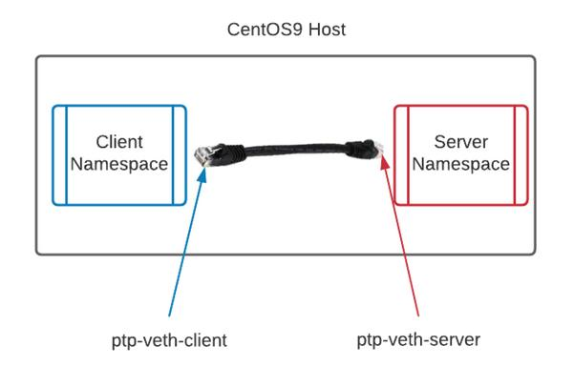
Theory
Net Namespace

Slide 65
Let’s Try It!
Tasks:
Create Variables to make life easier
Create 2 namespaces
Create 2 veth pairs and assign them to namespaces
Give each interface IPs
Run Python webserver in one and curl from another
Start DHCP
Net Namespace
Notes:
# create the variables file
cat << EOF >> vars
namespace1=client
namespace2=server
command='python3 -m http.server'
ip_address1="10.10.10.10/24"
ip_address2='10.10.10.20/24'
interface1=veth-client
interface2=veth-server
EOF
#source the variable file
. vars
ip netns add $namespace1
ip netns add $namespace2
# ensure the namespaces now exist
ip netns list
# View the network interfaces in one of the namespaces
sudo ip netns exec $namespace2 ip ad
# create the veth devices on the host
ip link add ptp-$interface1 type veth peer name ptp-$interface2
# view the ends of the “ethernet cable” on the host
ip link
# assign the ends of the “cable” to their respective ns
ip link set ptp-$interface1 netns $namespace1
ip link set ptp-$interface2 netns $namespace2
# look inside the namespace at the nics
ip netns exec $namespace2 ip ad
# assign all the nics IPs and bring the nics up
ip netns exec $namespace1 ip addr add $ip_address1 dev ptp-$interface1
ip netns exec $namespace2 ip addr add $ip_address2 dev ptp-$interface2
ip netns exec $namespace1 ip link set dev ptp-$interface1 up
ip netns exec $namespace2 ip link set dev ptp-$interface2 up
# verify that the link is up with an IP
ip netns exec $namespace2 ip ad
# start the webserver
ip netns exec $namespace2 $command &
# try and retrieve the webserver response
ip netns exec $namespace1 curl `echo $ip_address2 |awk -F '/' '{print $1}'`:8000
### Begin DHCP section
# assign variables for DHCP
ip_range_start='10.10.10.100'
ip_range_end='10.10.10.150'
netmask='255.255.255.0'
# dnsmasq requires the loopback interface to be functional so we need to bring it up
ip netns exec $namespace2 ip addr add 127.0.0.1/8 dev lo
ip netns exec $namespace2 ip link set lo up
# verify that the link is up with an IP
ip netns exec $namespace2 ip ad
# start dnsmasq
ip netns exec $namespace2 dnsmasq --interface=ptp-$interface2 --dhcp-range=$ip_range_start,$ip_range_end,$netmask
### REMINDER files can be overwritten from the container
# DHCP will overwrite resolv.conf so create a blank one for the namespace
# if you create a directory for each namespace and create a blank resolv.conf the container will use this instead of the host’s
mkdir -p /etc/netns/{$namespace1,$namespace2}
touch /etc/netns/$namespace1/resolv.conf
# we need to delete the IP address to make way for DHCP lease
ip netns exec $namespace1 ip addr del $ip_address1 dev ptp-$interface1
ip netns exec $namespace1 dhclient ptp-$interface1
# verify that the link is up with an IP
ip netns exec $namespace1 ip ad
# try to add IP to host for communication
ip addr add 10.10.10.30/24 dev enp1s0
# try to ping namespace2… this will fail because we created a ptp link between ns
ping 10.10.10.20
# reboot the host to clear the NS
reboot

Slide 66
Theory
Point to point is interesting…
How does Kubernetes Work?
Like actual networking, we need a switch
Net Namespace

Slide 67
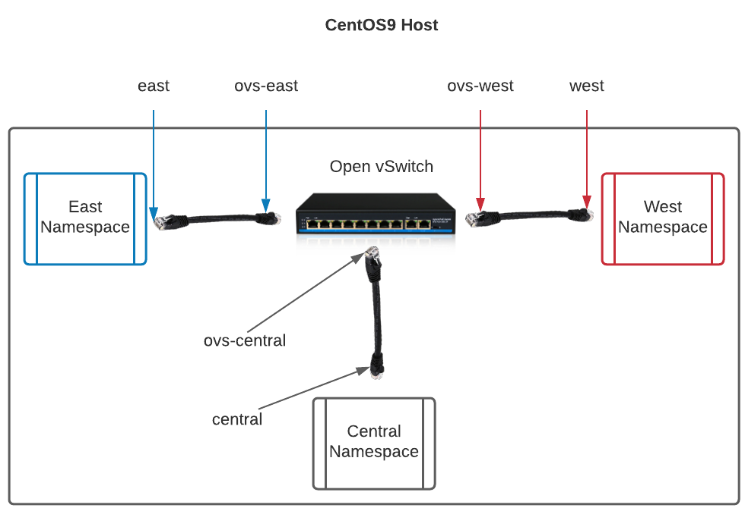
Theory
Net Namespace

Slide 68
Let’s Try It!
Tasks:
Setup the variables create the namespaces connect veth pairs to OpenvSwitch ping namespaces review arp table
Connect host to vSwitch
Net Namespace
Notes:
# Create the variables for easier scripting
namespace1=east
namespace2=west
namespace3=central
command='python3 -m http.server'
ip_address1="10.10.10.10/24"
ip_address2='10.10.10.20/24'
ip_address3='10.10.10.30/24'
interface1=east
interface2=west
interface3=central
# we are going to create the network namespaces
ip netns add $namespace1
ip netns add $namespace2
ip netns add $namespace3
# we need to start openvswitch
systemctl start openvswitch
# we are going to create a bridge device for the virtual switch
ovs-vsctl add-br NAMESPACE-DEMO
# we are going to create our “ethernet pairs”
ip link add $interface1 type veth peer name ovs-$interface1
ip link add $interface2 type veth peer name ovs-$interface2
ip link add $interface3 type veth peer name ovs-$interface3
# Attach one end to the namespace
ip link set $interface1 netns $namespace1
ip link set $interface2 netns $namespace2
ip link set $interface3 netns $namespace3
# View the network interfaces in one of the namespaces
sudo ip netns exec $namespace2 ip ad
# attach the other end to the virtual switch
ovs-vsctl add-port NAMESPACE-DEMO ovs-$interface1
ovs-vsctl add-port NAMESPACE-DEMO ovs-$interface2
ovs-vsctl add-port NAMESPACE-DEMO ovs-$interface3
# give the namespaces their IPs
ip netns exec $namespace1 ip addr add $ip_address1 dev $interface1
ip netns exec $namespace2 ip addr add $ip_address2 dev $interface2
ip netns exec $namespace3 ip addr add $ip_address3 dev $interface3
# bring the interfaces up
ip netns exec $namespace1 ip link set dev $interface1 up
ip netns exec $namespace2 ip link set dev $interface2 up
ip netns exec $namespace3 ip link set dev $interface3 up
# View the network interfaces in one of the namespaces
sudo ip netns exec $namespace2 ip ad
# start the webserver
ip netns exec $namespace2 $command &
# bring up the interfaces on the virtual switch
ip link set dev ovs-$interface1 up
ip link set dev ovs-$interface2 up
ip link set dev ovs-$interface3 up
# Let’s ping some namespaces from inside other namespaces
ip netns exec $namespace3 ping -c 2 10.10.10.20
ip netns exec $namespace1 ping -c 2 10.10.10.20
# try pinging from the host
ping -c 2 10.10.10.20
# try and retrieve the webserver response from a container
ip netns exec $namespace3 curl `echo $ip_address2 |awk -F '/' '{print $1}'`:8000
# see if you can do the same from the host
curl `echo $ip_address2 |awk -F '/' '{print $1}'`:8000
# Let’s look at an arp table or two
ip netns exec $namespace1 arp
ip netns exec $namespace2 arp
# NAMESPACE-DEMO if exists?
ip link show
# add an IP to the host port and bring the interface up
ip addr add 10.10.10.40/24 dev NAMESPACE-DEMO
ip link set dev NAMESPACE-DEMO up
# run the curl to verify that the host can now access the webserver
curl `echo $ip_address2 |awk -F '/' '{print $1}'`:8000

Slide 69
Remember…
Containers need their own IPs
Net Namespace = Discrete networking for containers
Containers should not impact other network functions
Net Namespace

