Slide 1
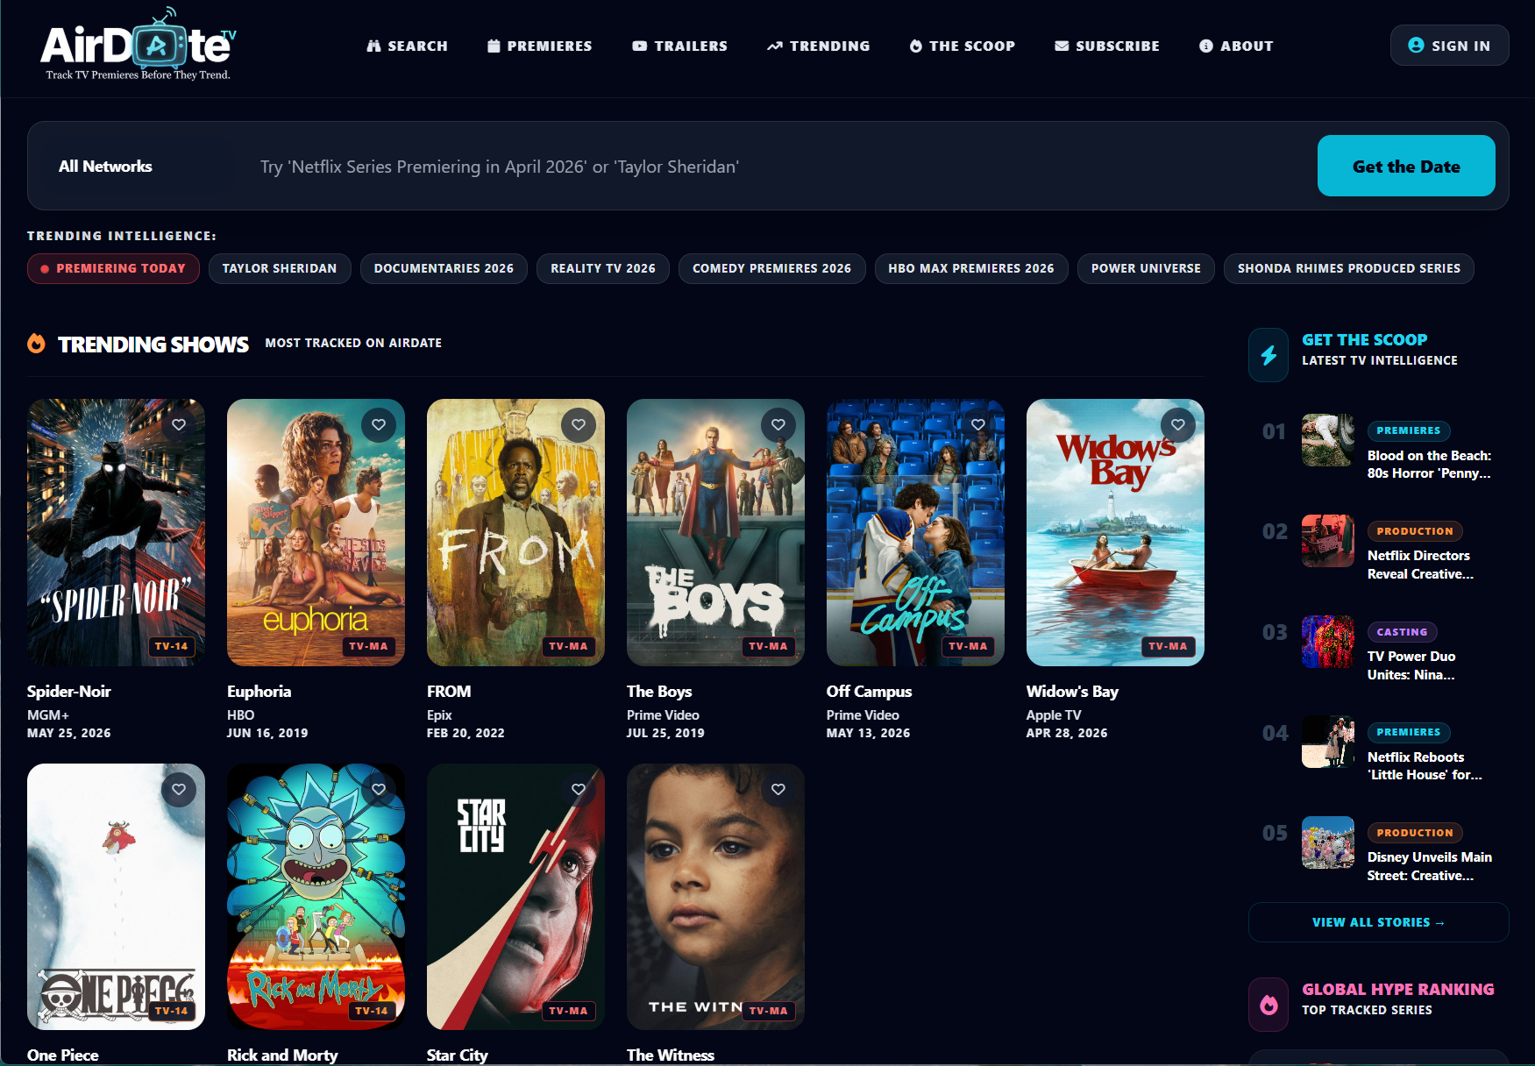


KENYON JOHNSTON
AirDate.TV · kenyonjohnston.com · linkedin.com/in/kenyonjohnston · kenyonjohnston@gmail.com
AI PRODUCT LEADER • STREAMING TECHNOLOGY • BUILDER
“Most Product Managers talk about products they’ve managed. I build products.”
WHY I'M DIFFERENT
Built & launched AirDate.TV — an AI-native TV discovery platform, solo, 0→1
Led enterprise streaming products at Warner Bros. Discovery (90M+ subscribers)
Leading AI & cloud platform modernization at Koch Industries
M.S., Artificial Intelligence & Machine Learning — Colorado State University Global
3x AWS Certified • Built on Bedrock, SageMaker, RAG, Agentic AI
AI PRODUCT PORTFOLIO
AirDate.TV
Verdict AI
AI TV Discovery
Media Decision Intelligence
AI Sports Forecasting
HOW I BUILD — PRODUCT LIFECYCLE OWNED END-TO-END
AIRDATE.TV — AI-POWERED TELEVISION INTELLIGENCE
HoopsIQ
1
VISION
→
2
DESIGN & AI
→
3
BUILD & SHIP
→
4
SCALE & ITERATE
Discovery, strategy, roadmap
UX, AI search, architecture
Cloud infra, launch, GTM
Data, growth, retention
EXPERIENCE & STACK
WARNER BROS. DISCOVERY
KOCH INDUSTRIES
AWS
CLAUDE · ANTHROPIC
COLORADO STATE UNIV. GLOBAL
VISIT SITE
LINKEDIN

