Slide 1

E-Portfolio Florian Straub

Slide 2




Table of contents
Basic knowledge
What is ?
How does it work?
How do I use it?
Hands-On
Creating our first app
Implementing our app in Java

Slide 3

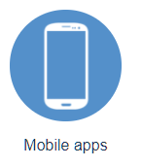
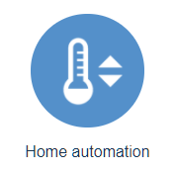
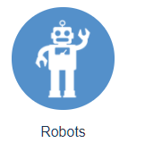
What is ?
founded in 2013
bought by acebook in 2015
Easy communication with an app through speech or text

Slide 4
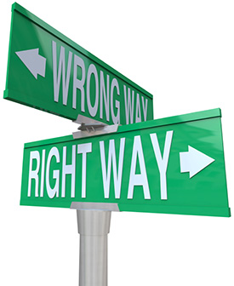


How does it work? - Short Overview
following user-defined rules
machine learning
Simultaneous use of both $→$ easy creation of trainable prototypes

Slide 5
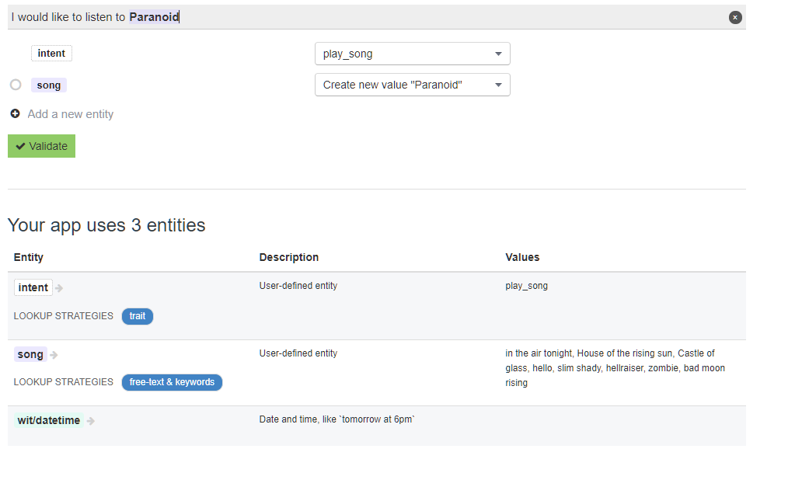
How does it work? - Entities
Built-in Expressions
Date and Time
Location
Numbers
Temperature
Custom Entities
Trait
Intent
Free Text
Message body, contact name
Keywords
Burger, Country, Room

Slide 6
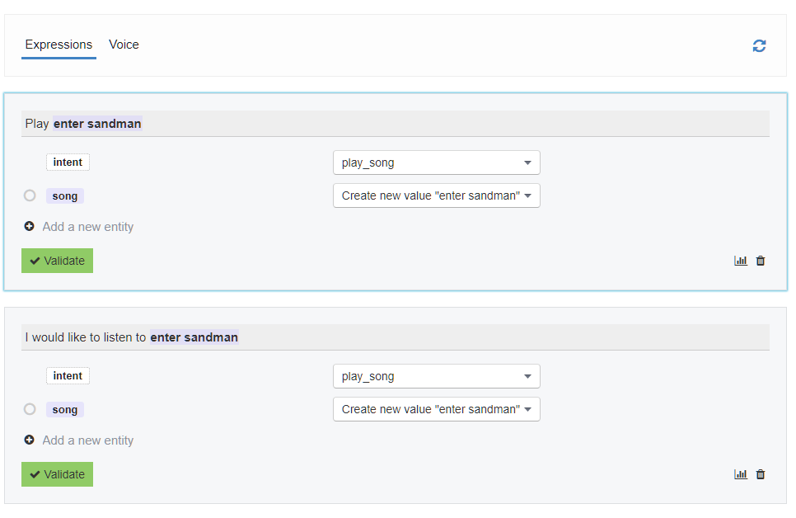
How does it work? - Learning

Slide 7
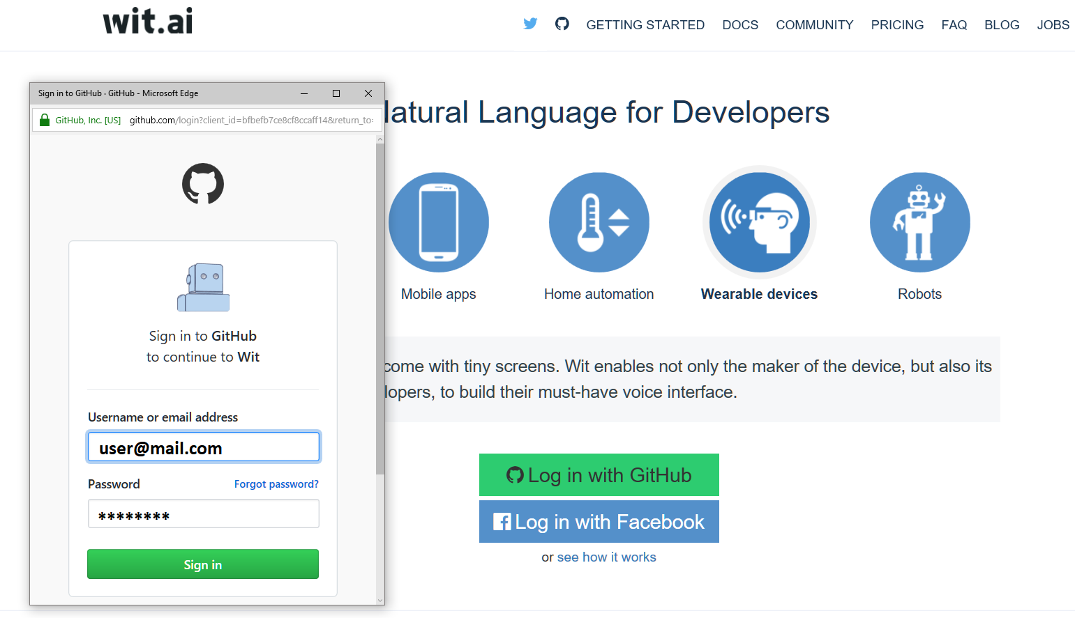
How do I use it?

Slide 8
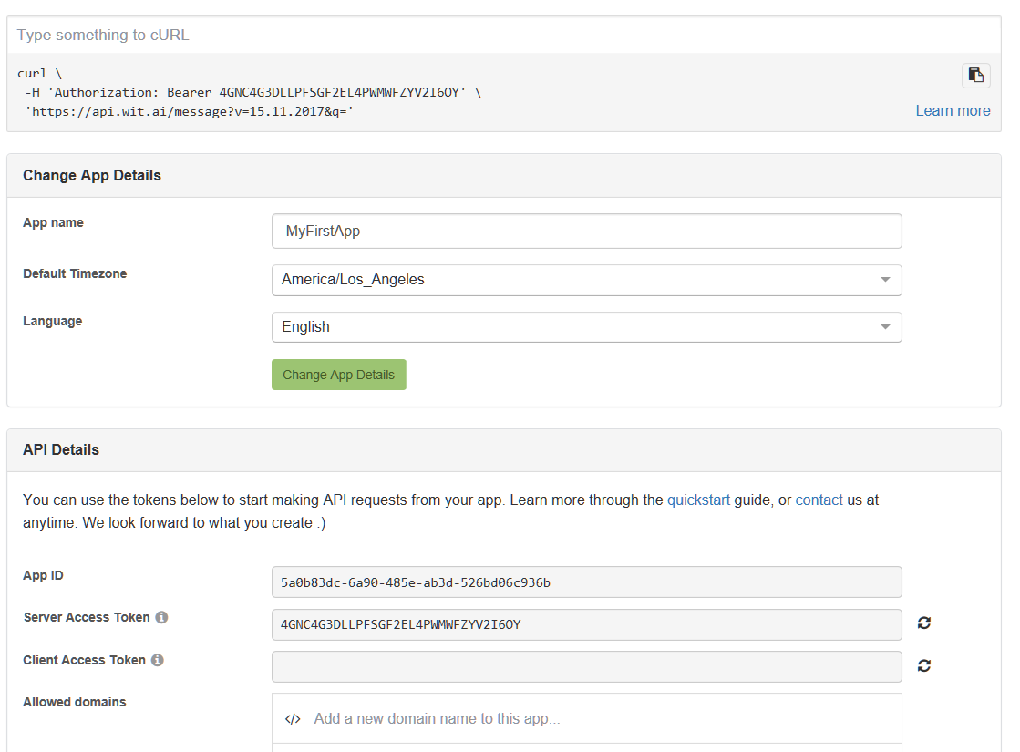
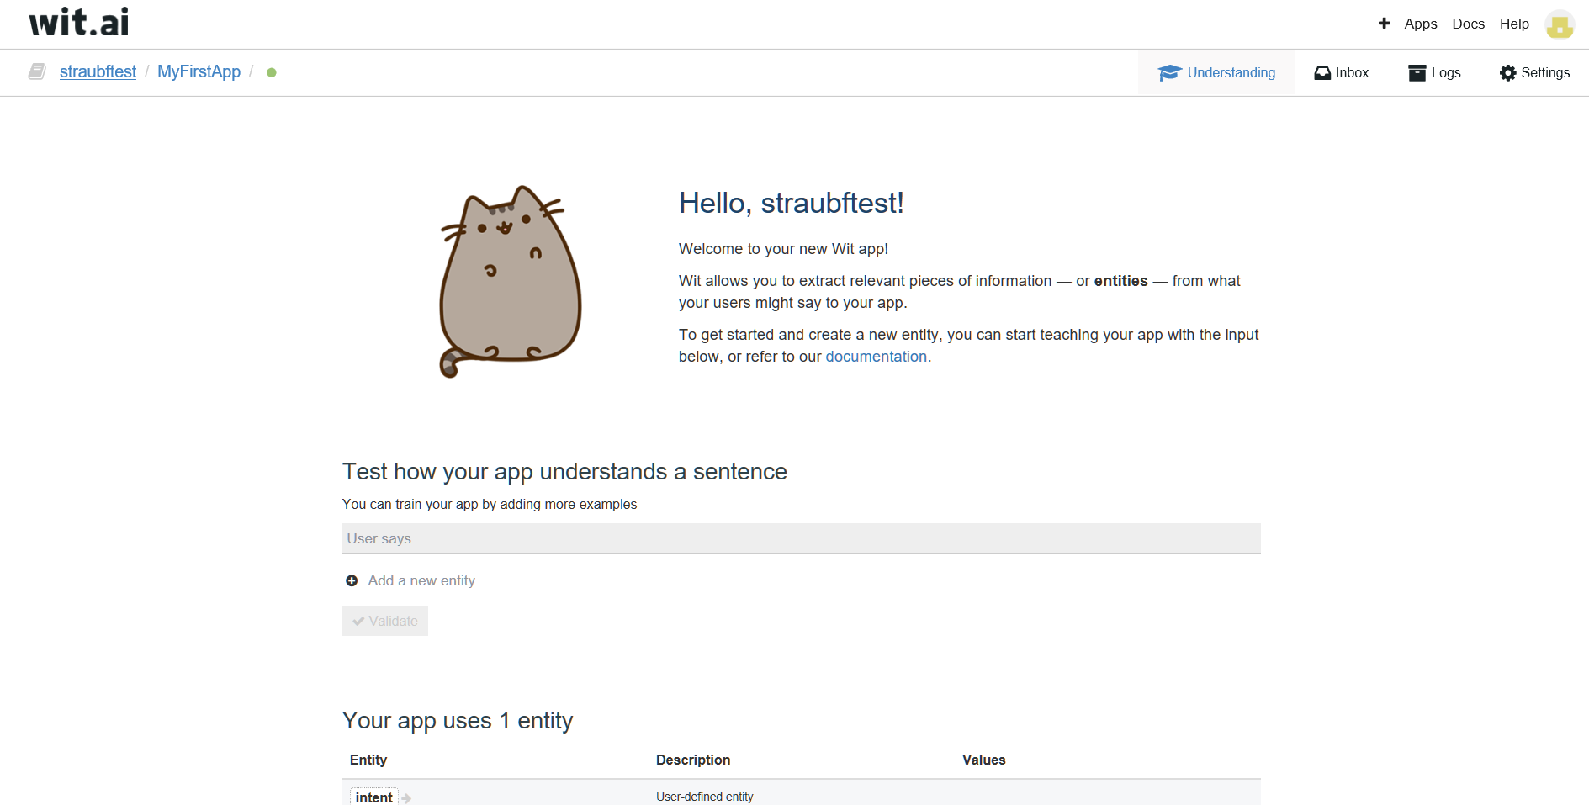
How do I use it?

Slide 9

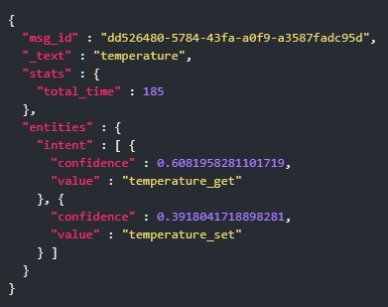
How do I use it?
Integration:
Node.js
Python
Ruby
HTTP API

Slide 10
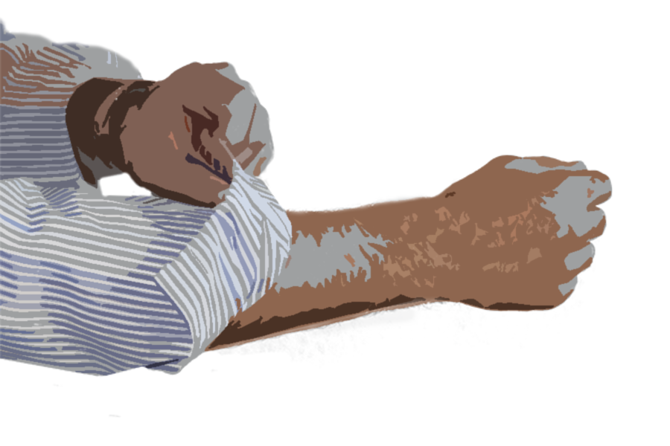
Hands - On

Slide 11


