Slide 1
Wasm+Golang
By Javokhir Nematov
For 06.08.2023

Slide 2
What is wasm
WebAssembly has huge implications for the web platform – it provides a way to run code written in multiple languages on the web at near native speed, with client apps running on the web that previously couldn’t have done so.
It can generate the WebAssembly binary or text format. It is written in Java itself and can be integrated with other Java build tools.
With around 40 languages that can compile to WebAssembly, developers can finally use their favorite language on the Web. WebAssembly does not replace JavaScript; in fact, some JavaScript code is required to load WebAssembly modules. WebAssembly runs in all major browsers and in all platforms.

Slide 3
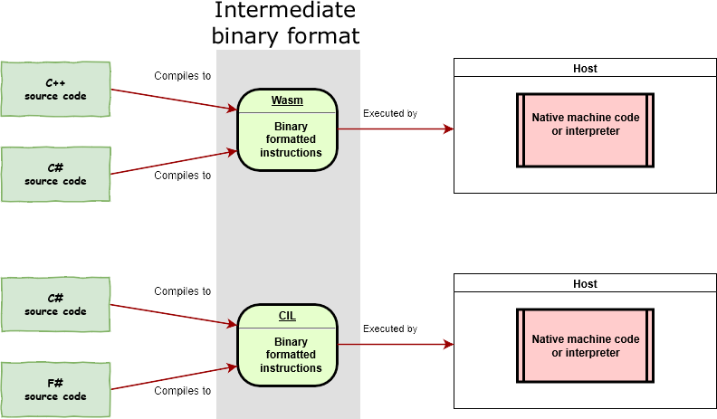
More about Wasm
Wasm is an instructions set that is formatted in a specific binary format. Any host that adheres to this specification is therefore capable of reading binaries and executing them either interpreted, or by compiling directly to machine language specific to the device. Wasm is akin to the common instructions set that .NET source code compiles to. Just like .NET, Wasm can be generated from higher languages such as C#.

Slide 4
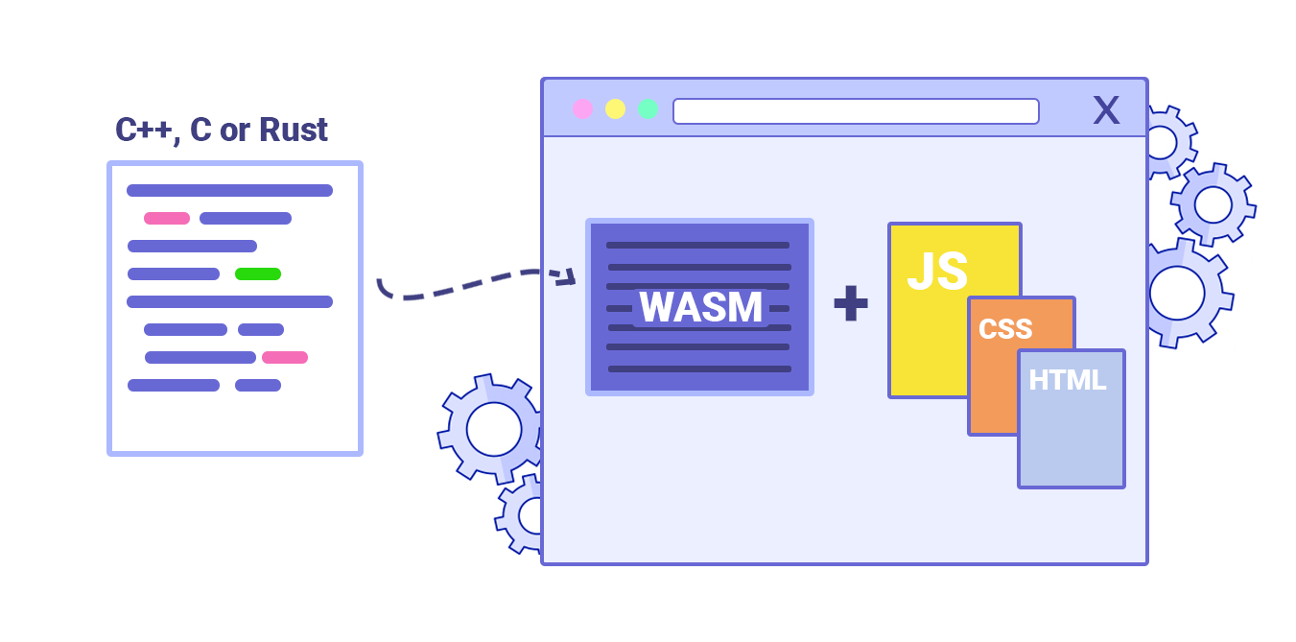
How and Why
In every browser, whether you use Chrome, Firefox, Edge, or Safari, code is interpreted and executed by a JavaScript engine-which only runs JavaScript. Unfortunately, JavaScript is not ideal for every task we want to perform. That’s where WebAssembly steps in.
WebAssembly is a new type of code that can be run in modern browsers. It was created to get better performance on the web. It’s a low-level binary format that has a small size, so it’s fast load and execute. You don’t write WebAssembly, you compile other higher level languages to it.
Assembly typically refers to humanly readable languages that are similar to machine code. Machine code is what your processor understands, a bunch of numbers.

Slide 5
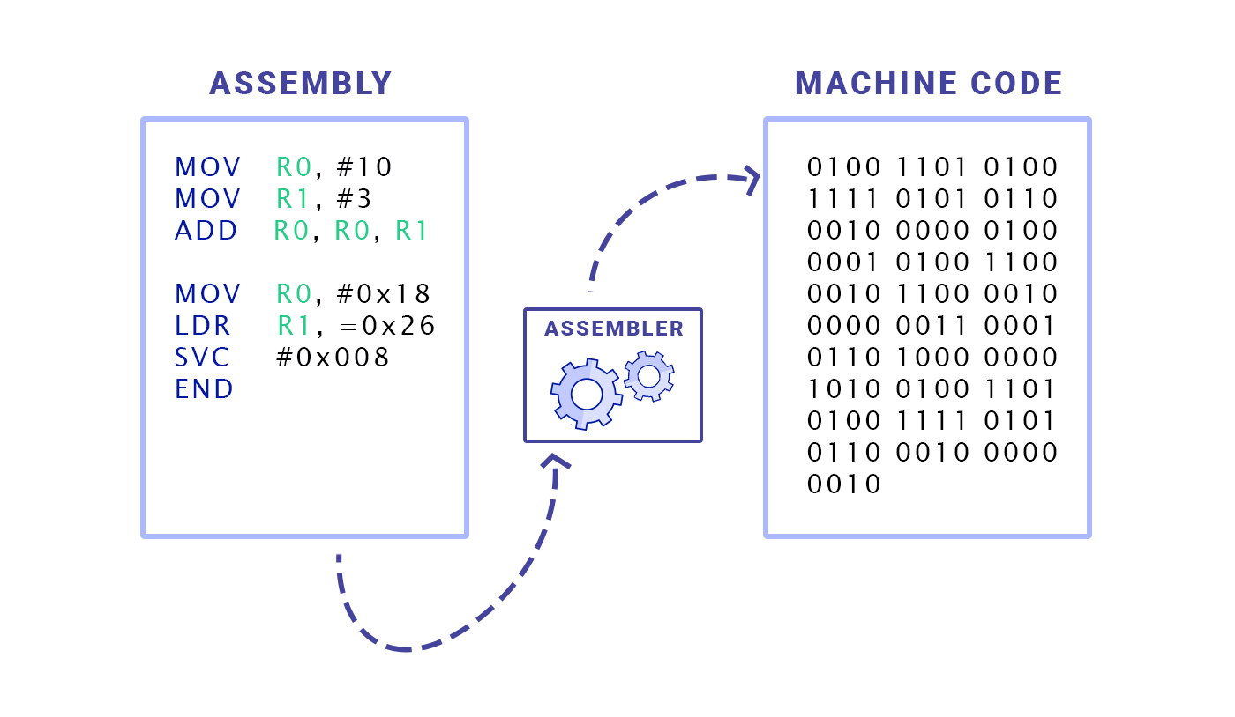
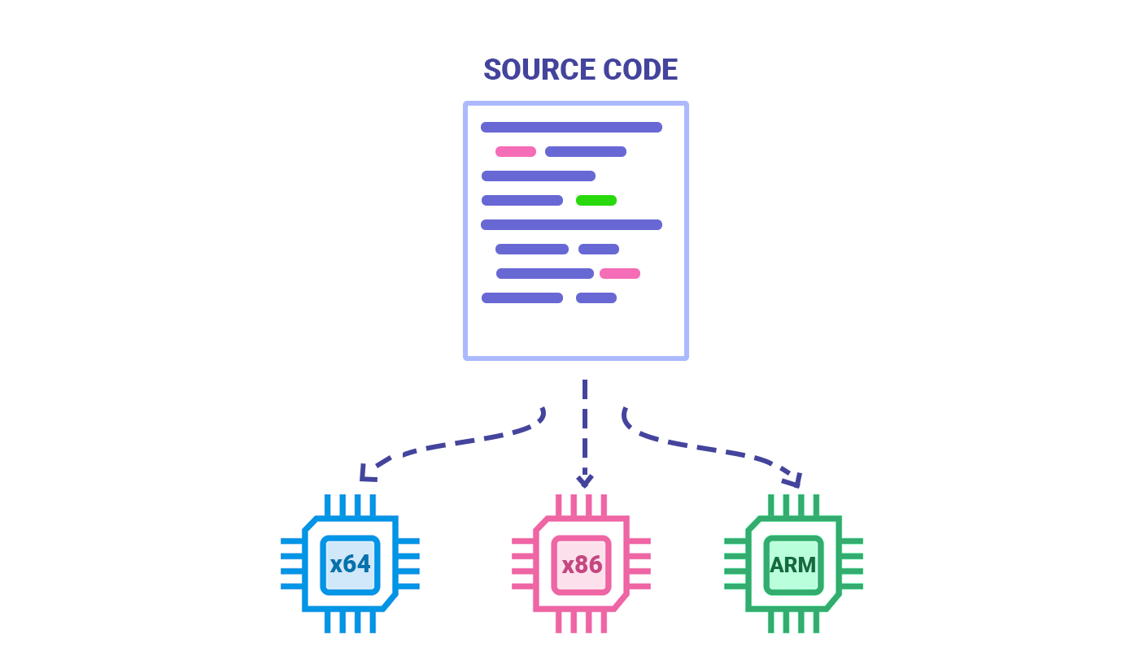
Assembly languages and machine code Every highe level programming language gets translated down to machine code in order to run on the processor. Different kinds of processor architectures need different machine code and different kinds of assembly for each of them.
Compiling source code for different processor architectures
Despite its name, WebAssembly is not quite an assembly language because it’s not meant for any specific machine. It’s for the browsers, and when you’re delivering code to be executed in the browser, you don’t know what kinds of machines will your code be running.

Slide 6
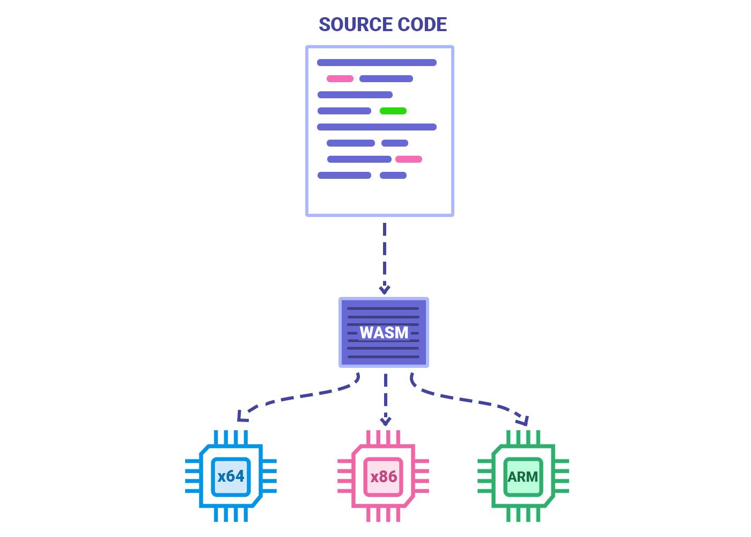
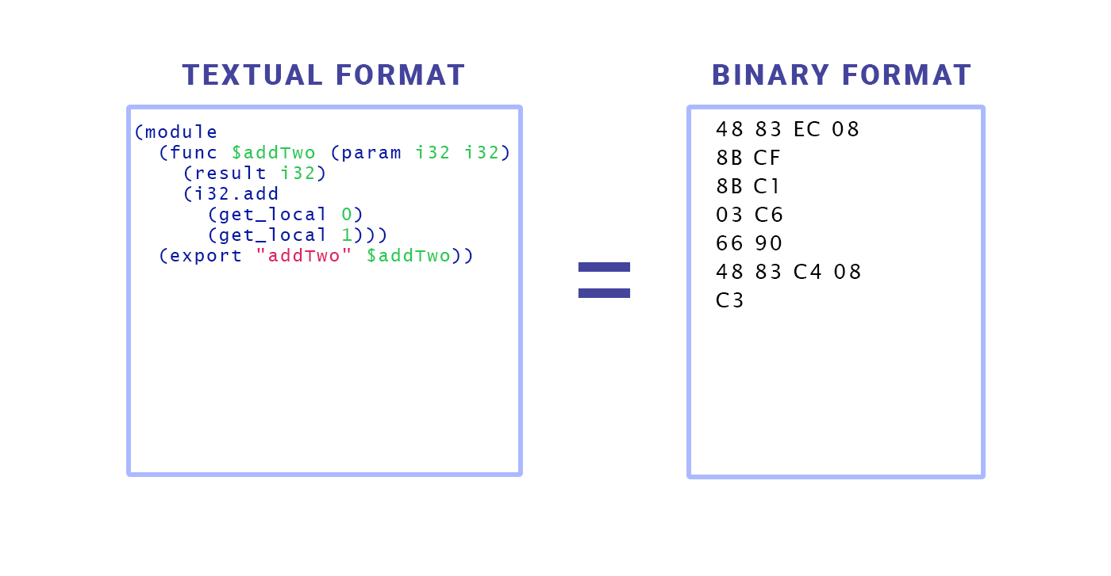
WebAssembly as an intermediary compiler target
WebAssembly is a language for a conceptual machine that’s the least common denominator of the popular real world hardware. When the browser downloads the WebAssembly code it can quickly turn it to any machine’s assembly.
WebAssembly textual and binary format
What WebAssembly enables you to do is to take things like C, C++ or Rust code and compile it into what is called a WebAssembly module. You can load that into your web application and call it from Javascript.

Slide 7
Why we need WebAssembly
Think about the cases where you need to use software outside of the browser: video games, video editing, 3D rendering, or music production. These applications do a lot of calculations and require a high degree of performance. That kind of performance is hard to get from JavaScript. JavaScript started as a simple scripting language meant to bring some interactivity to the web full of lightweight hypertext documents. It was designed to be easy to learn and write, but it wasn’t designed to be fast. Over the years, browsers added optimizations in the way they interpret JavaScript that brought major performance improvements. As it got faster, the list of things that you could do in the browser started expanding. New APIs brought things like interactive graphics, video streaming, offline browsing and many more. In turn, more and more rich applications, that were previously native-only, started coming to the web. Today you can easily edit documents and send emails from a browser, but there are areas where JavaScript performance is still a struggle.

Slide 8
How to use WebAssembly with Go in the browser
We will be making a simple Go hashing program, were we can SHA512 hash values with Go in the browser.
Let’s start with the directory structure:
go-wasm-example
├── static
└── cmd
├── server
└── wasm

Slide 9
Create a main.go file in go-wasm-example/cmd/wasm and add the following code to it:
package main
import (
"crypto"
_ "crypto/sha512"
"encoding/hex"
"fmt"
"syscall/js"
)
func main() {
done := make(chan struct{}, 0)
js.Global().Set("wasmHash", js.FuncOf(hash))
<-done
}
func hash(this js.Value, args []js.Value) interface{} {
h := crypto.SHA512.New()
h.Write([]byte(args[0].String()))
return hex.EncodeToString(h.Sum(nil))
}

Slide 10
The code done := make(chan struct{}, 0) & <-done is a Go channel, a channel waits for data to be sent to it and is used to keep the program running.
The js.Global().Set("wasmHash", hash) function will create a global JS function exposing the Go hash function to JavaScript.
In the hash function you see (this js.Value, args []js.Value) the argument from JS are passed as an array.
To type cast the value from the argument you use .String() or .Int() you can read more about this in the syscall/js docs
To be able to compile it to WASM you need to add GOOS=js GOARCH=wasm to the build command. This tells Go to compile to a .wasm file.
GOOS=js GOARCH=wasm go build –o static/main.wasm cmd/wasm/main.go
For wasm_exec.js, you should run this command: cp "$(go env GOROOT)/misc/wasm/wasm_exec.js" ./static

Slide 11
You can see whole of code from go-wasm-example directory… .

