Slide 1











Analytics Service
Analysis Services
Event Hub Clusters
Streak Analytics Jobs
HD Insights Cluster
Azure Data Explorer Clusters
Data Factories
Data Lake Analytics
Data Lake Storage Gen1
Log Analytics Workspaces
Azure Data Bricks
Event Hubs

Slide 2
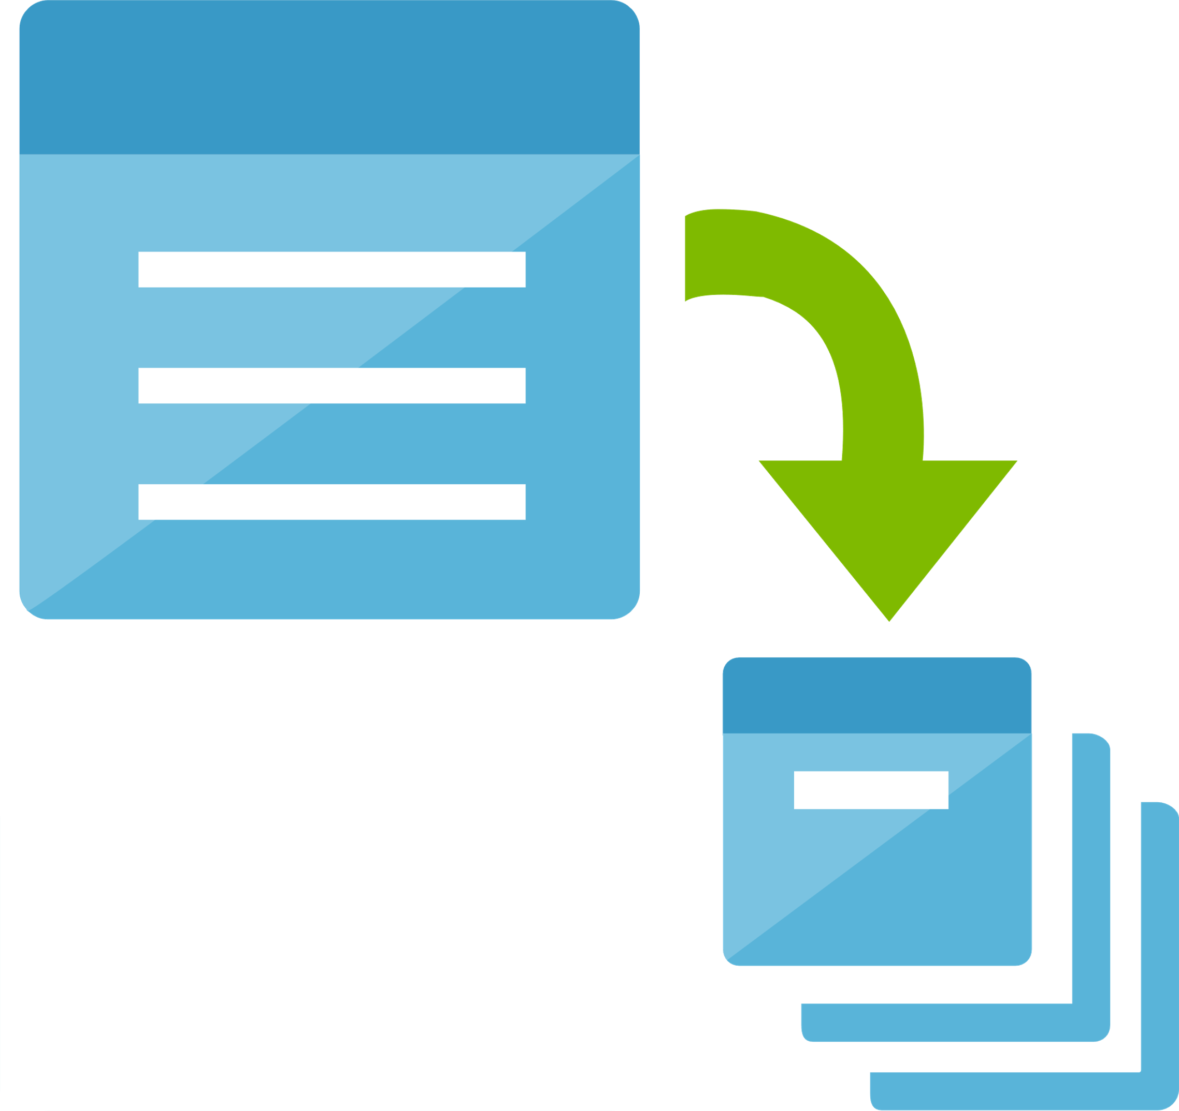









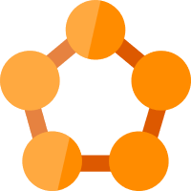

Compute Service
Batch Accounts
Cloud Simple Virtual Machines
Cloud Simple Virtual Machines
Disk Snapshots
Function Apps
Cloud Services Classic
Cloud Services
Disks
Mesh Applications
SAP HANA on Azure
Service Fabric Clusters
VM Images

Slide 3




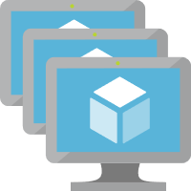






Compute Services
Availability Sets
OS Images Classic
VM Non- Azure
VM Classic
VM Scale Sets
VM
VM Linux
VM Linux Non- Azure
VM Windows Non- Azure
VM Windows Azure
Non Azure Machine

Slide 4



Container Service
Container Registries
Container Instances
Kubernetes Services

Slide 5

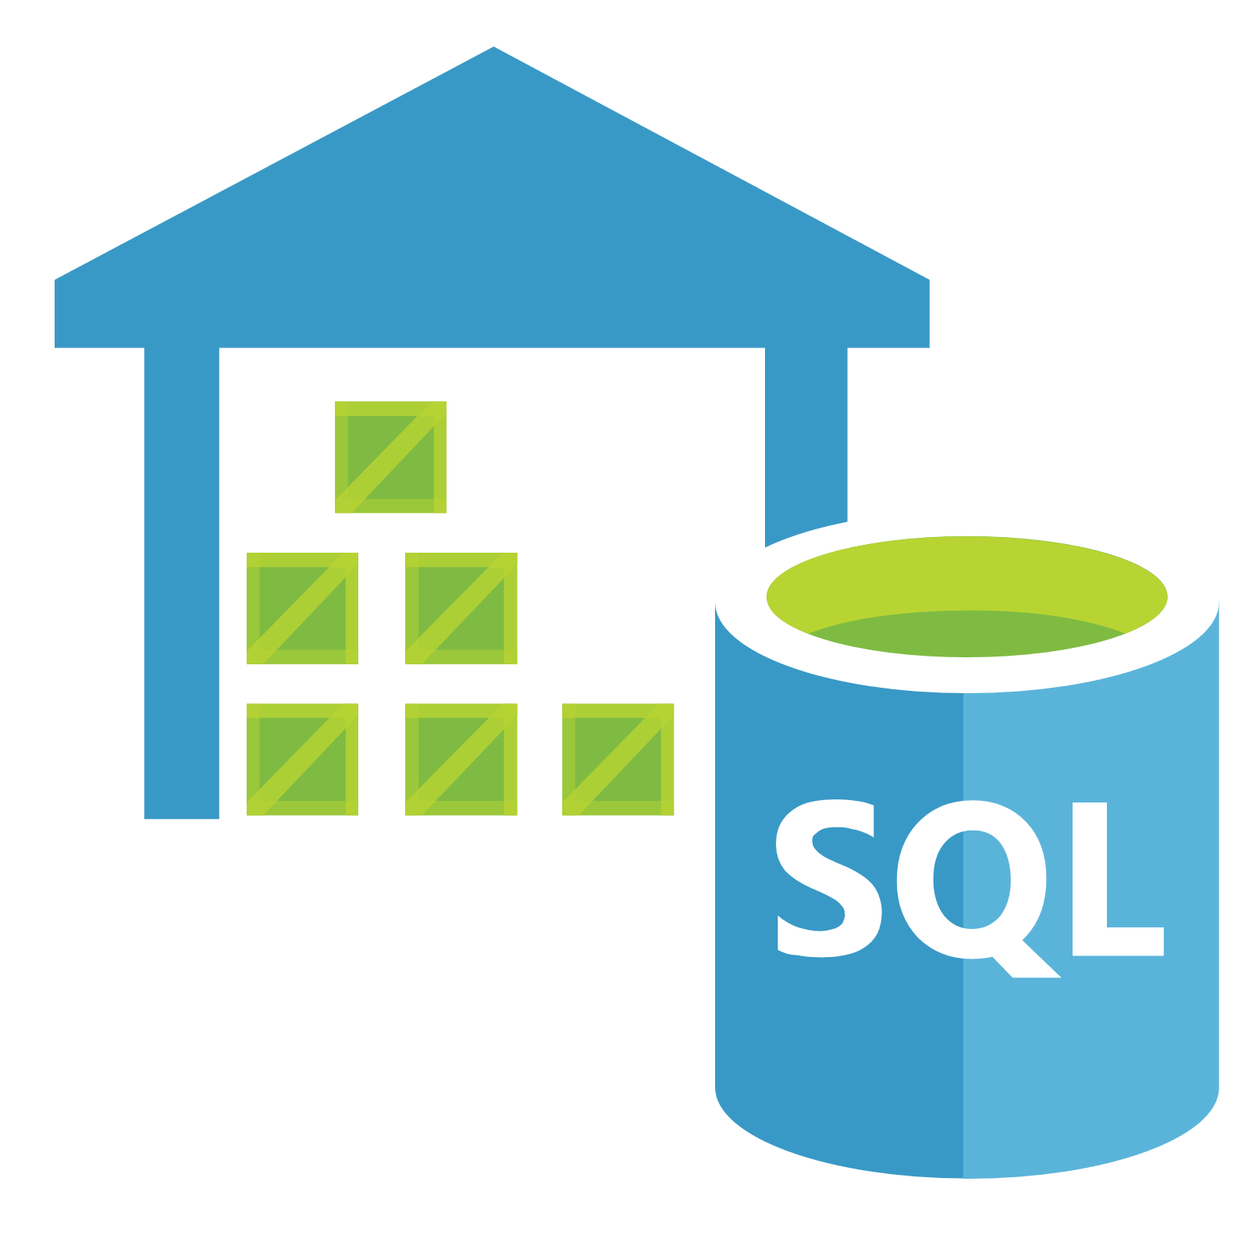
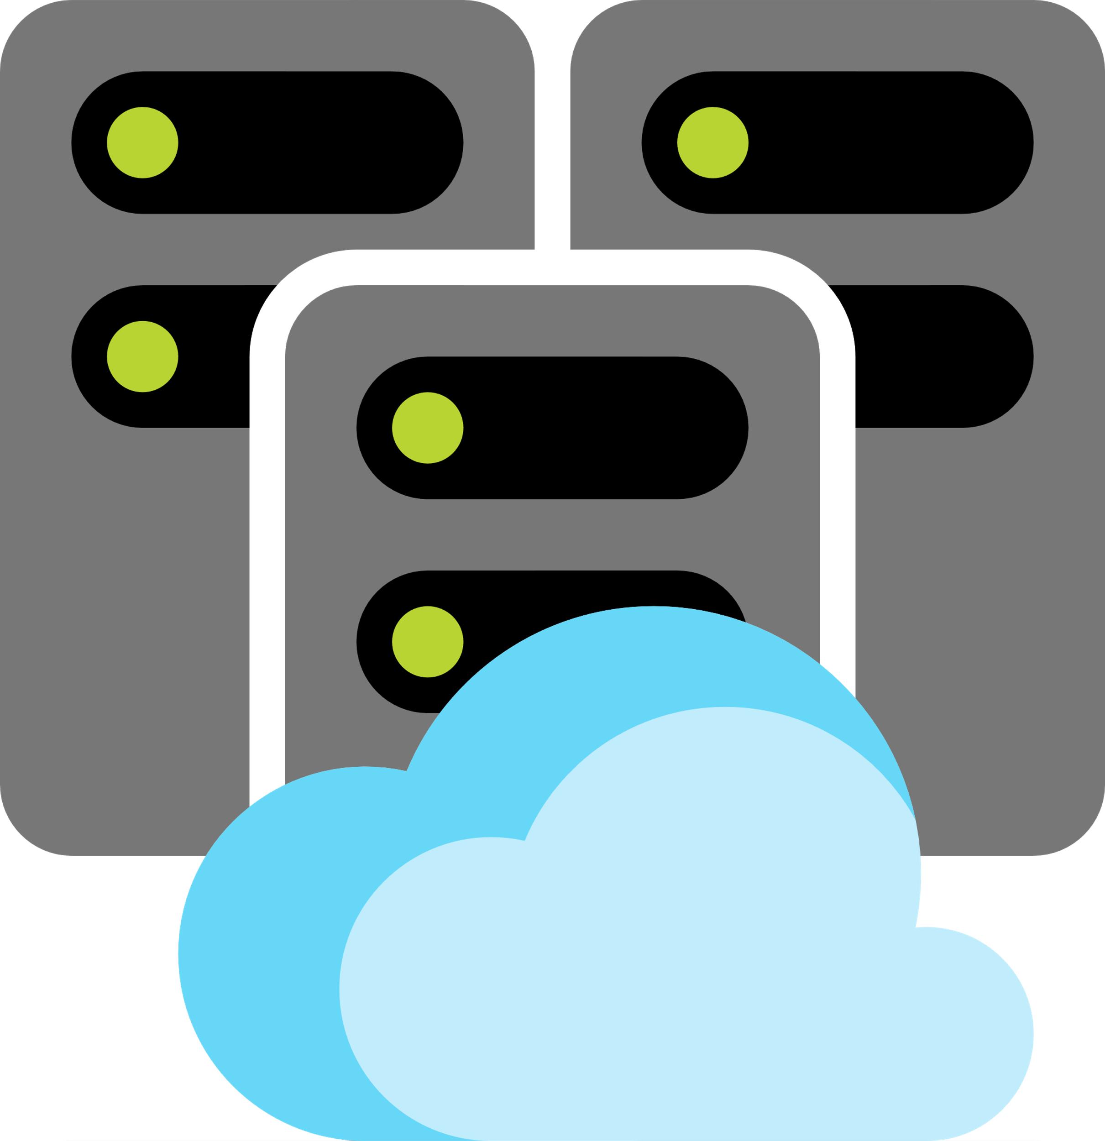
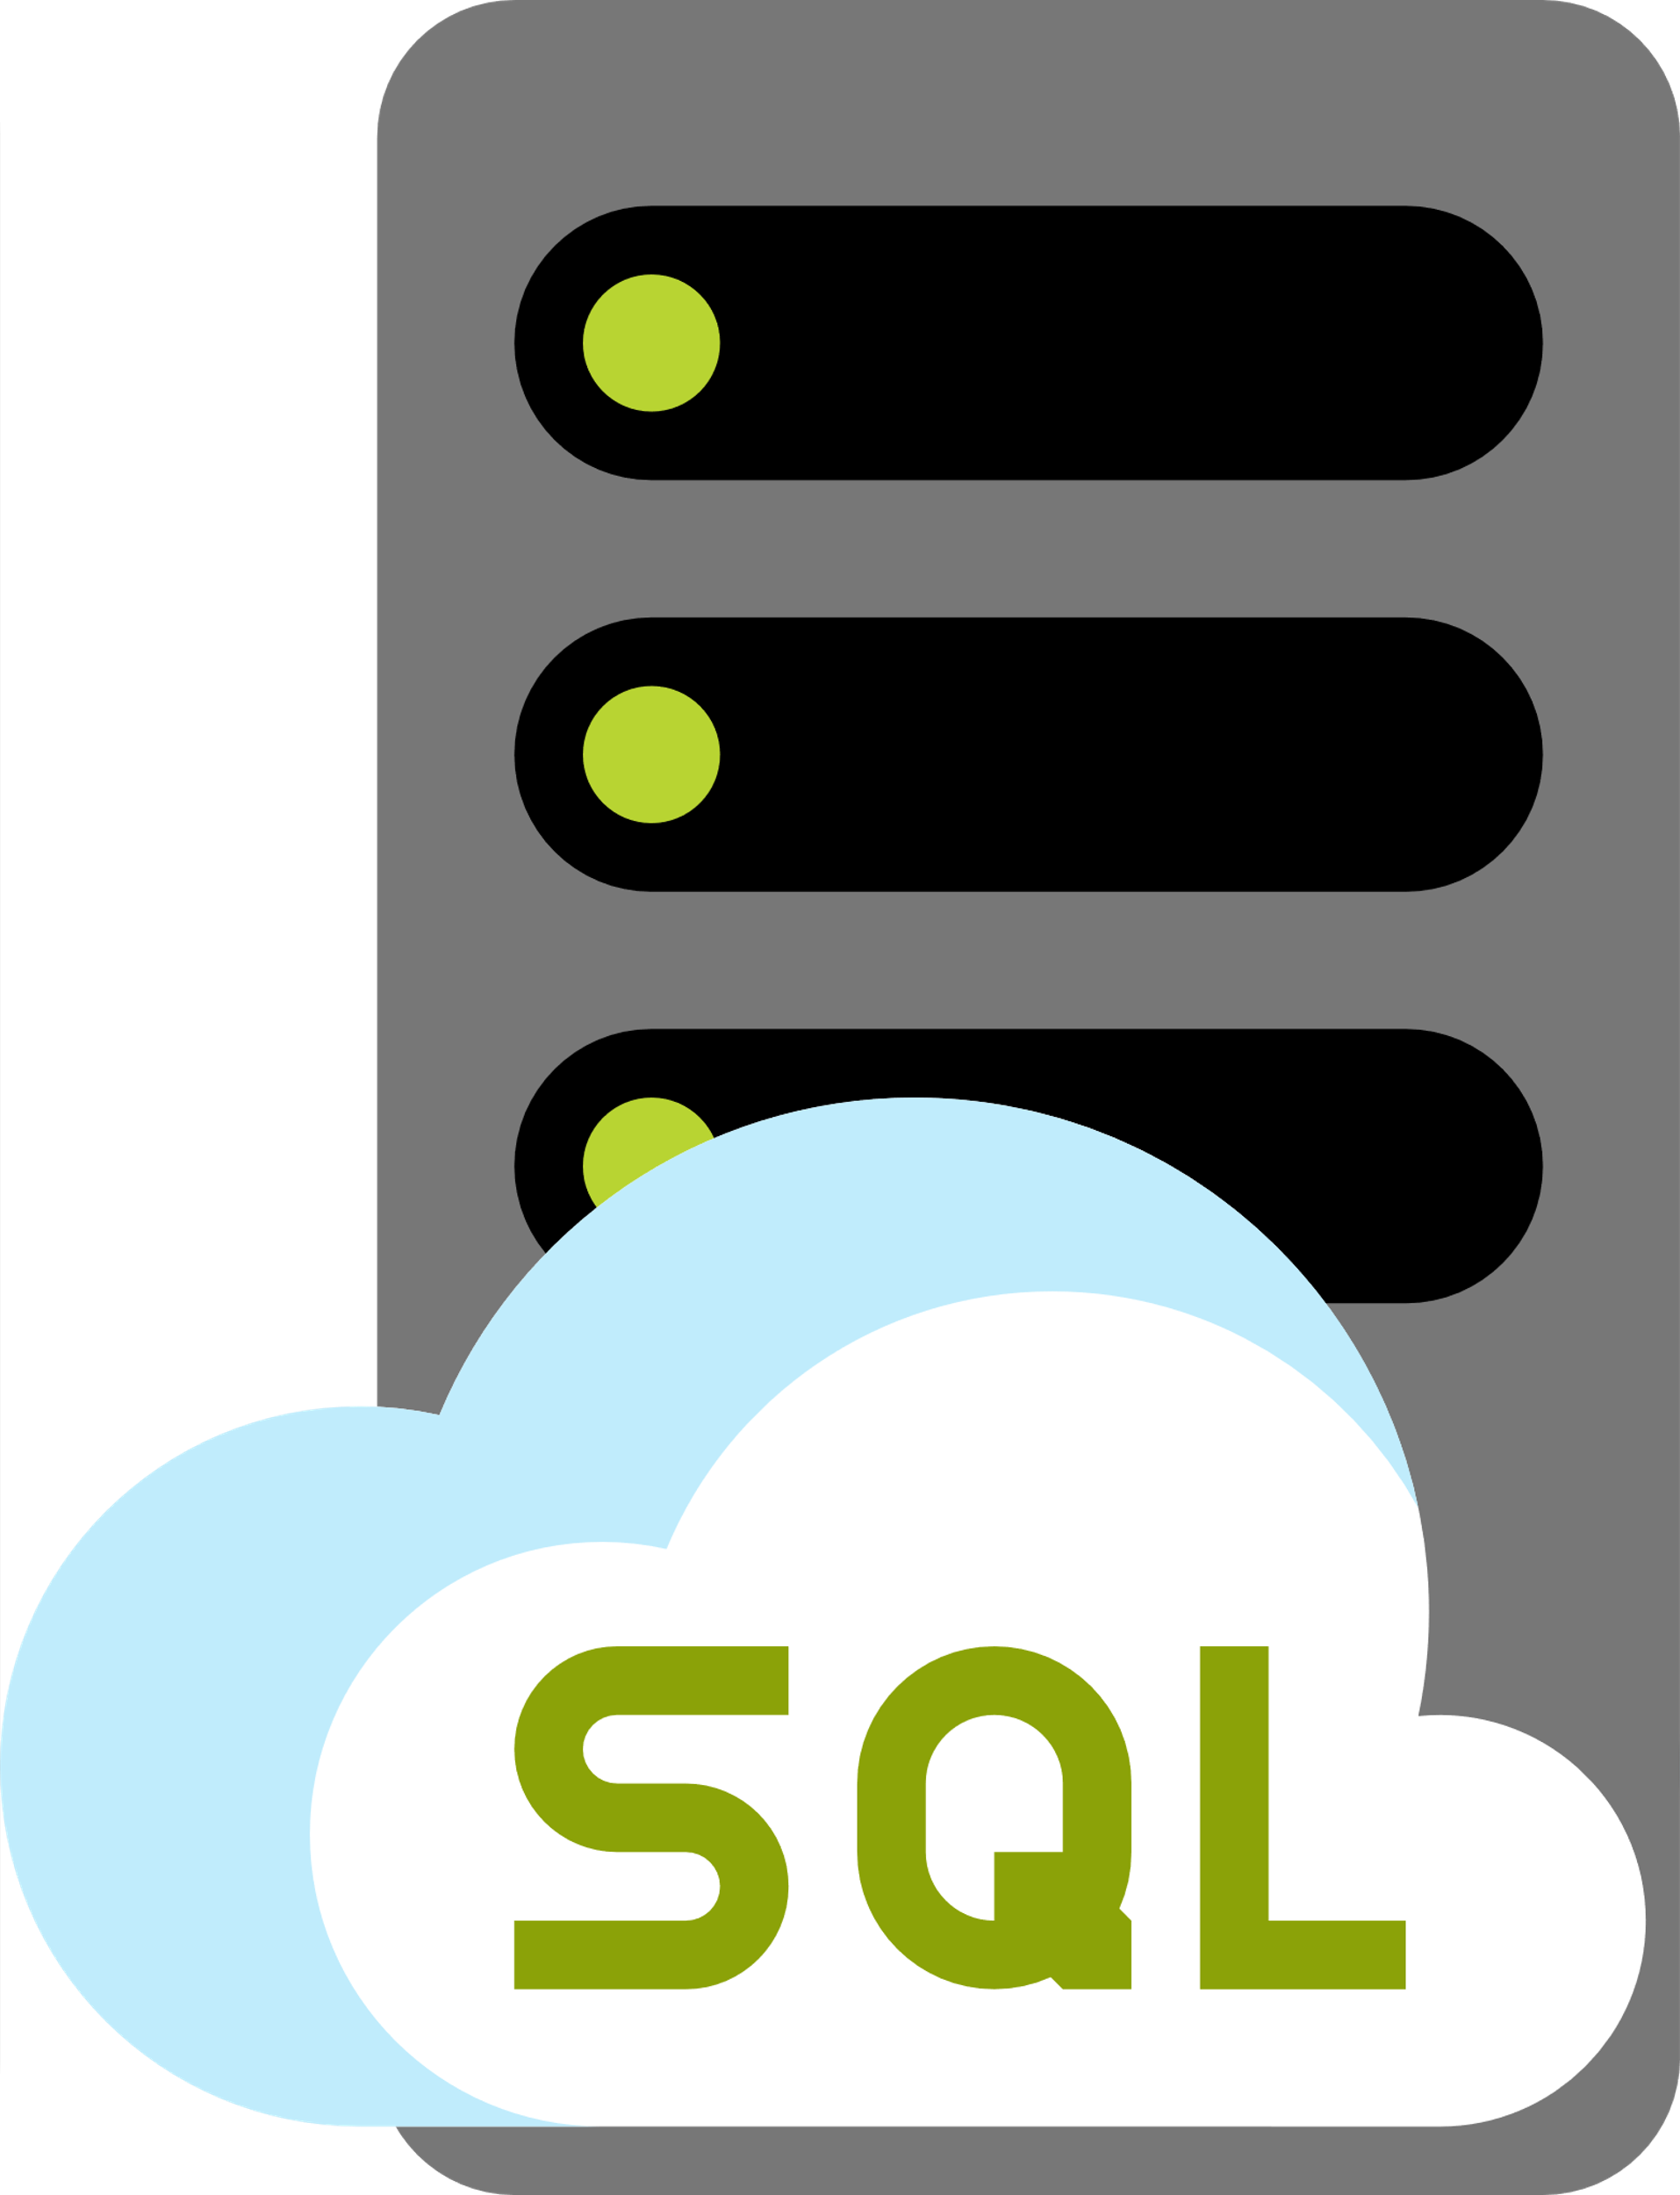















Database Service
Managed Databases
Azure SQL Datawarehouse
Virtual Clusters
SQL Managed Instances
Azure Cache
For Redis
Azure Cache plus
Redis
Azure Cosmos DB
Azure Database for
MariaDB servers
Data Lake
Elastic Database Pools
Azure Database for
MySQL servers
Azure Database for PostgreSQL servers
Azure Database Generic
Blob Storage
SQL Databases
SQL Servers
SQL Server Stretch Databases
Virtual Data Center
Elastic Job Agents

Slide 6








Devops Service
Azure Artifacts
Application Insights
Azure Boards
Azure DevTest Labs
Azure Pipelines
Azure DevOps
Azure Repos
Azure Test Plans

Slide 7












General Service
All Resources
Help Support
Developer Tools
Marketplace
Information
Reservations
Recent
Azure home
Quick Start Center
Resource
Resource Groups
Service Health

Slide 8










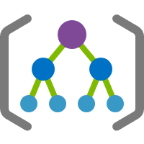


General Service
Tag
Tags
User Resource
User Privacy
User Icon
User Health Icon
Support
Support Requests
Two User Icon
Shared Dashboard
Subscriptions
Management Groups
What’s New
Templates

Slide 9













Identity Service
Access Review
Active Directory Connect Health
Active Directory
Azure AD Domain Services
Azure AD
Identity Protection
Azure Information Protection
Azure AD B2C
App Registrations
Enterprise Applications
Managed Identities
Azure AD Privileged
Identity Management
Conditional Access
Identity governance

Slide 10













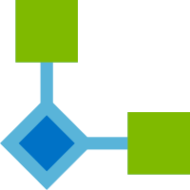
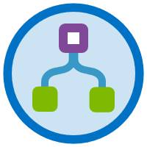

Integration Service
Logic Apps
SendGrid Accounts
App Configuration
API Management Services
Service Catalog Managed
Application Definitions
Azure API
For FHIR
Azure Data Catalog
Azure Service
Bus Relays
Azure Service Bus
Azure StorSimple
Device Managers
Event Grid Domains
Event Grid Subscriptions
Event Grid Topics
Integration
Accounts
Logic Apps
Custom Connector
Integration Service
Environments
Software as a Service (SaaS)

Slide 11










Internet of Things
Data Provisioning Service
Azure Maps
Azure Digital Twins
Azure IoT Hub
Azure IoT Hub Security
Azure Sphere
IoT Central Applications
Windows2010 IoT Core Services
Time Series
Insights environments
Time Series Insights
Events Sources

Slide 12












Intune Service
Client Apps
Dedicated Event Hub
Devices Compliance
Devices Config
Devices Groups
eBooks
Enrolment
Intune App Protection
Exchange On-Premises Access
Managed Desktops
Software Update
Tools
Security Baselines

Slide 13








AI & ML
Cognitive Services
MachineLearningStudio
Workspaces
BOTServices
Genomics Accounts
MachineLearningStudio
WebServices
MachineLearningService
Workspaces
BatchAI
MachineLearningStudio
WebService Plans

Slide 14


















Blue Prints
Managed Applications
Metrics
Monitor
Network Watcher
Recovery Services Vaults
Resource Graph Explorer
Policy
Scheduler Job Collections
Solutions

