Slide 1
climate Change
& THE RISE OF MISINFORMATION
Beatrice Valentine | May 2024
Notes:
Title

Slide 2
Overview
Greenhouse gas emissions around the world
Canada’s impact on pollution levels
Generational effects of social media use
Notes:
Introduction

Slide 3
Pollution Around the World
Highest CO2 per capita:
China
USA
India
Country | China | USA | India
CO2 Emissions | 10,432,751,400 | 5,011,686,600 | 2,533,638,100
Population | 1,401,889,681 | 327,210,198 | 1,338,636,340
Share of World | 29.18% | 14.02% | 7.09%
Greenland emits the lowest amount of CO2 per capita.
Worldwide CO2 Emissions in 2016 (Worldometer, 2016)

Slide 4
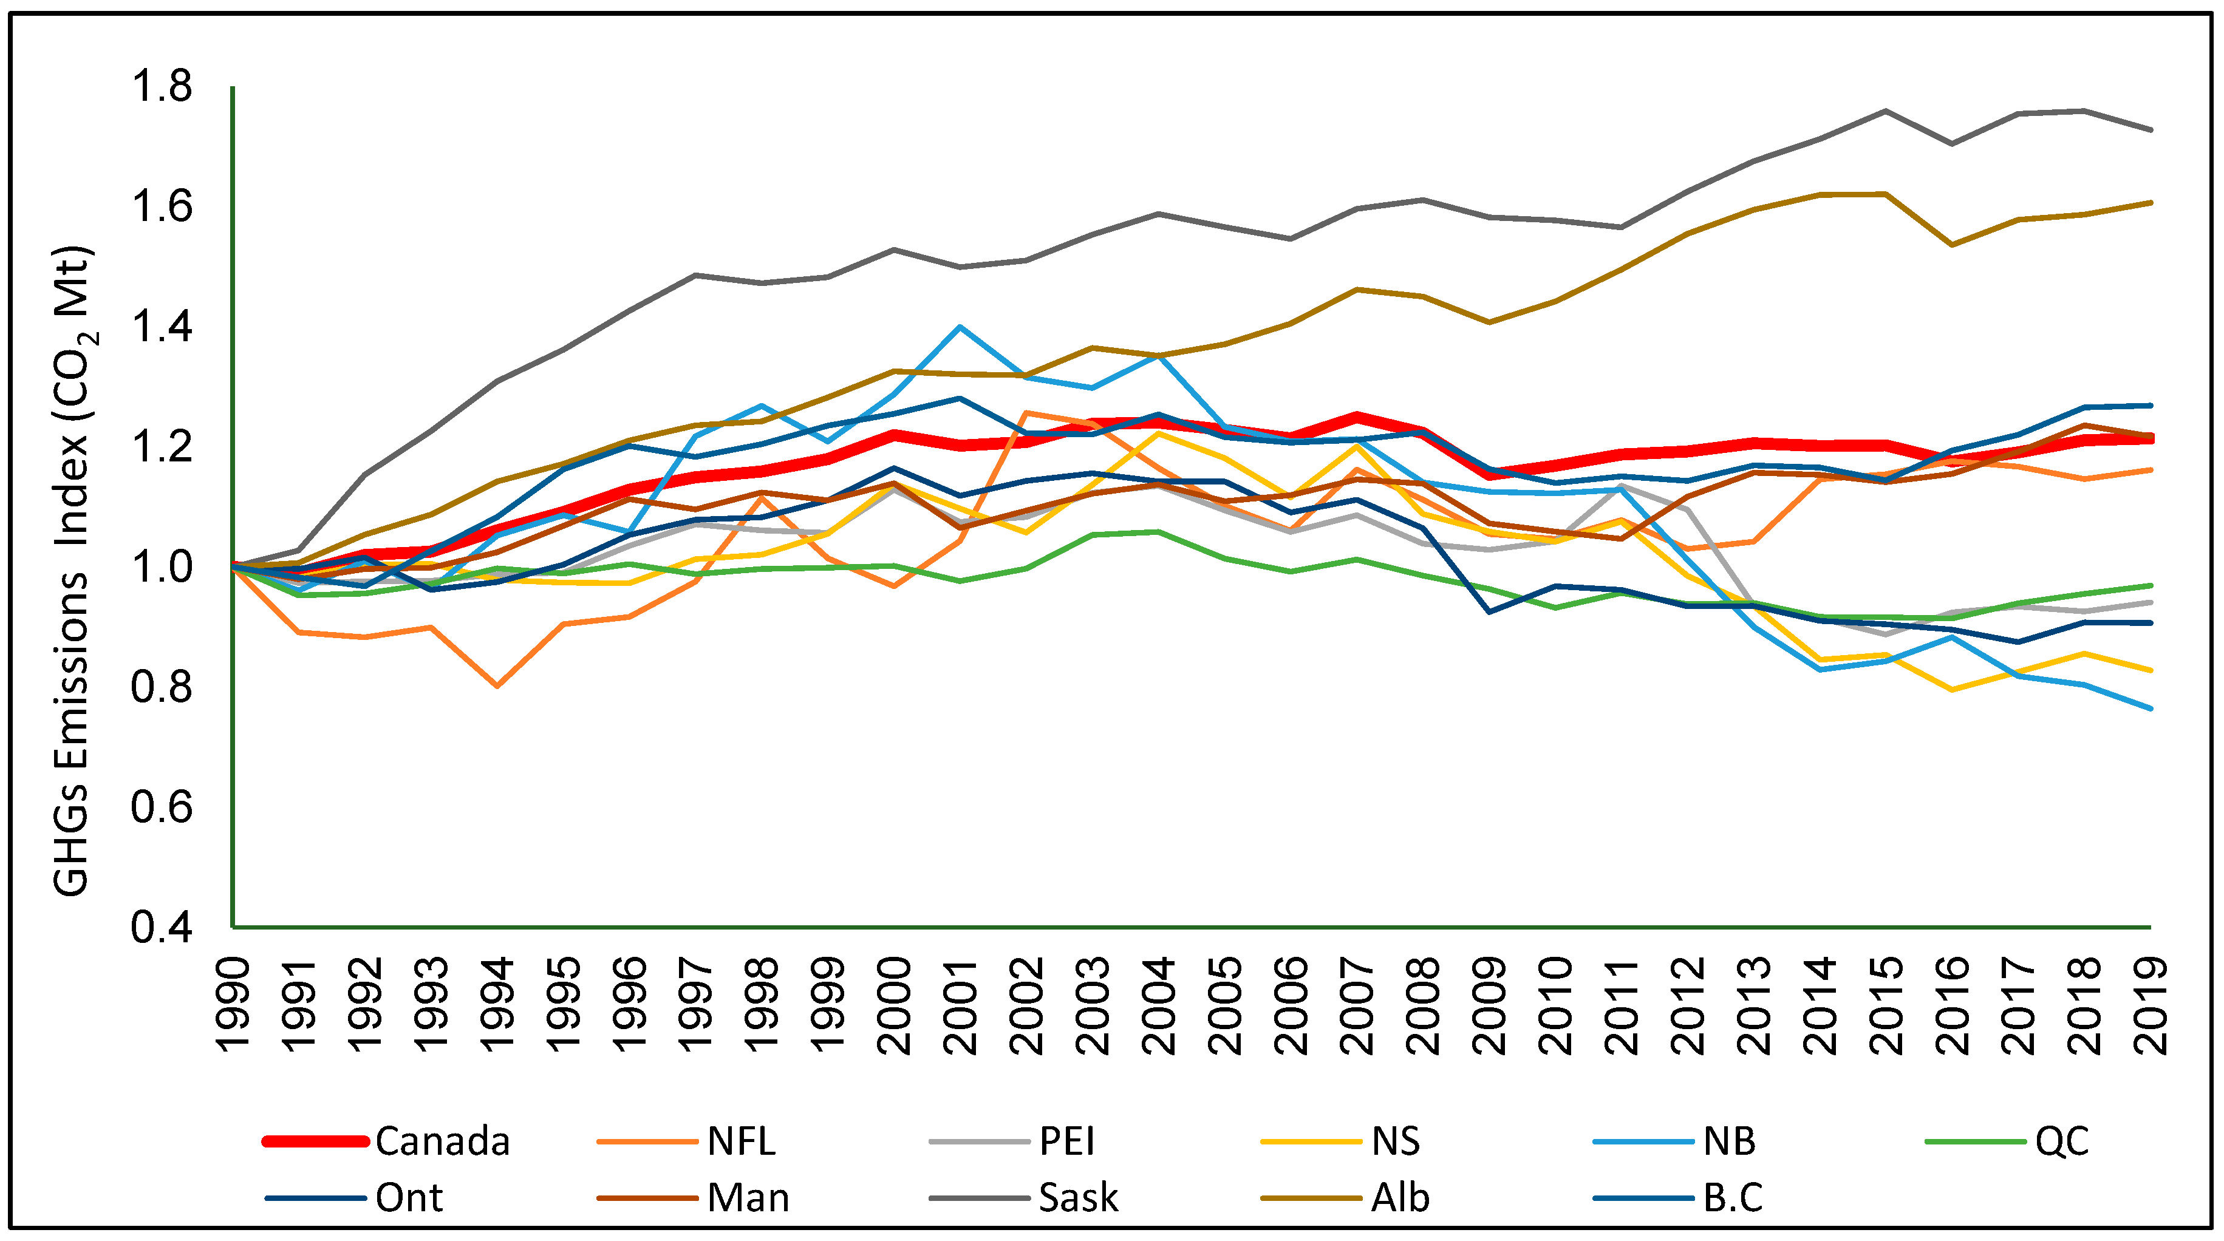
Canada’s Impact
Household emissions have decreased in recent years.
In 1997, Canadian households emitted 11.49 tons of CO2 on average
In 2009, the average fell 16%
Emission sources include:
Gasoline
Natural Gas
Electricity
Greenhouse gas emissions in Canada from 1990-2019 (Government of Canada, 2021)

Slide 5

A Generational Divide
In light of concerns about fake news regarding climate change and other topics, researchers and media providers have been searching for ways to limit its spread and influence.
47% of Americans report that they use social media to check the news “sometimes” or “often”, with Facebook being the most popular platform for this purpose.
Older adults in particular are a vulnerable population for online risks.
Photo by Christin Hume @ Unsplash (2018)

Slide 6
References
Fercovic, J. a. (2016). Comparing household greenhouse gas emissions across Canadian cities. Retrieved from ScienceDirect: https://www.sciencedirect.com/science/article/abs/pii/S0166046216300783
Government of Canada. (2021). National Inventory Report 1990–2019: Greenhouse Gas Sources and Sinks in Canada. Gatineau, QC, Canada: Environment and Climate Change Canada.
Haider, A. (2024). The Determinants of Greenhouse Gas Emissions: Empirical Evidence from Canadian Provinces. Halifax, NB: Department of Economics, Dalhousie University.
Hume, C. (2018). Person using laptop computer photo. Retrieved from Unsplash: https://unsplash.com/photos/person-using-laptop-computer-Hcfwew744z4
Lauren Lutzke, C. D. (2019). Priming critical thinking: Simple interventions limit the influence of fake news about climate change on Facebook. Retrieved from ScienceDirect: https://www.sciencedirect.com/science/article/abs/pii/S0959378019307009
Vargas-Bianchi, L. M.-C.-N.-Z. (2023). 'No, auntie, that's false': Challenges and resources of female baby boomers dealing with fake news on Facebook. Retrieved from First Monday: https://firstmonday.org/ojs/index.php/fm/article/view/12678/10818
Worldometer. (2016). Carbon Dioxide (CO2) Emissions by Country. Retrieved from Worldometer: https://www.worldometers.info/co2-emissions/co2-emissions-by-country/
Notes:
References

