Slide 1

Tokyo Disneyland
小组成员：吕茜茜
杨 雪
祝华菁
蒋 珍

Slide 2
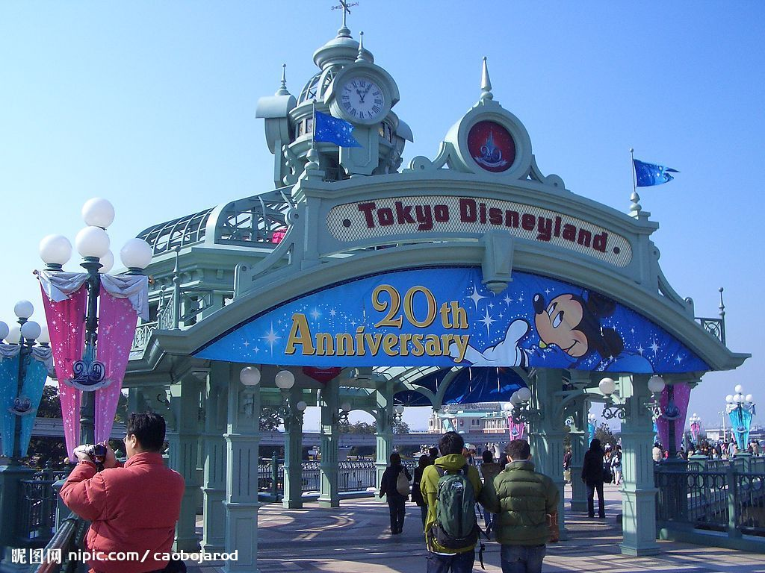
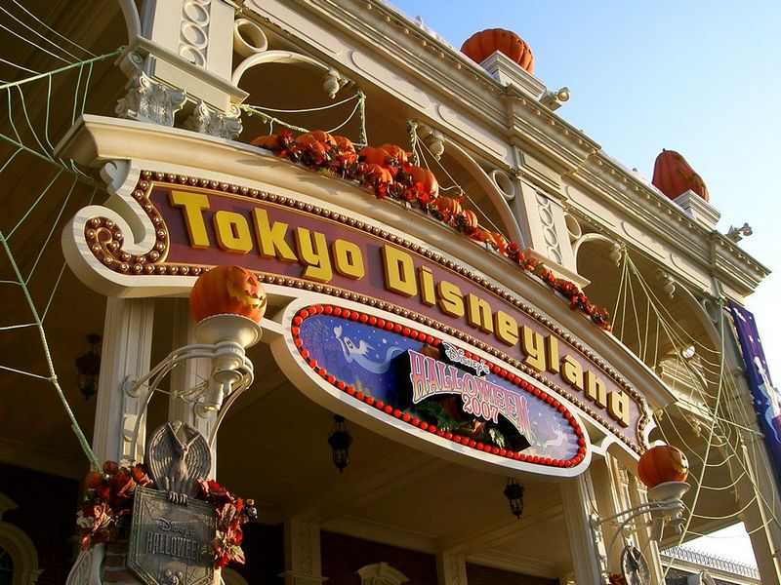

Slide 3
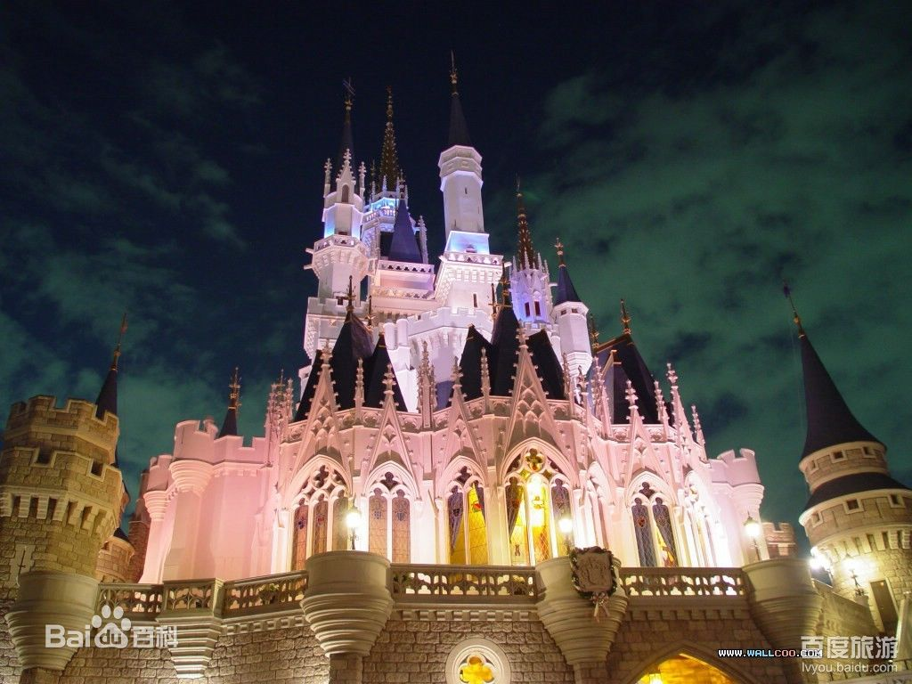

Slide 4
It was Tokyo's nastiest winter day in four years.Arctic winds and eight inches of snow lashed the city.Roads were clogged and trains slowed down. But the bad weather didn’t keep 13,200 hardy souls from Tokyo Disneyland.Mikki Mausu,better known outside Janpan as Mickey Mouse,had taken the country by storm.
那是东京四年来最严寒的冬天。伴随着北极风而来的四英尺厚的雪冲击了整个城市。道路都堵住了，列车缓慢行驶着。但是恶劣的天气并没有影响到东京迪士尼13200坚毅的灵魂，在日本家喻户晓的米奇老鼠暴风似的席卷了整个城市。
1.nasty:肮脏的；下流的；卑鄙的；下贱的
比较级:nastier 最高级：nastiest
2.lash: 鞭打；冲击；猛烈的拍击
3.clog：阻塞；障碍
4.slow down：减速；放慢速度；使……慢下来

Slide 5
Located on a fridge of reclaimed shoreline in Urayasu City on the outskirts of Tokyo,the park opened to the public on April 15,1983.
In less than one year ,over 10 million people had passed through its gates,an attendence figure that has been bettered every single year.
坐落在东京郊区千叶县浦安市再生海岸线的一座桥上，公园于1983年4月15号向公众开放。在不到一年的时间里，超过1000万的游客通过了它的大门，每年的考核数据已经被虐。
1.reclaimed：回收的，再生的
2.shoreline：海岸线
3.Urayasu City ：千叶县浦安市

Slide 6
On August 13,1983, 93,000 people helped set a one-day attendence record that easily eclipsed the old records established at the two parent U.S.parks.Four years later,records again toppled as the turnstile clicked.The total this time:111,500.
1983年8月13日,93000人帮助创建了为期一天的出席记录,该记录很容易的超越了母国-美国两个迪士尼乐园的记录。四年后,当十字转门推动，记录再次被颠覆。这一次的总数为:111500。
1.topple:推翻；颠覆
2.turnstile：十字转门

Slide 7
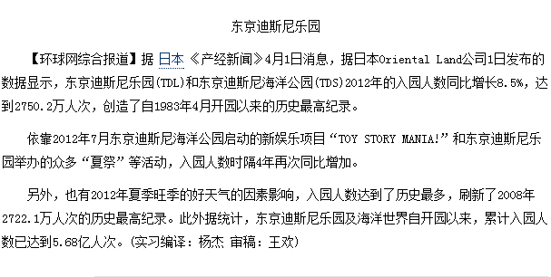

Slide 8
The steady cash flow pushed revenues for fical year 1989 to $768 million,up 17 percent from 1988.By 1988,approximately 50 million people,or nearly half of Japan’s population,had visited Tokyo Disneyland since its opening.
稳定的现金流推动了财政紧缩年1989年的收入达到7.68亿美元,较1988年增长17%。截止1988年，自东京迪士尼开业以来，相当于日本一半的人口，也就是大约5千万的人次来此游玩过。

Slide 9
The 204-acre Tokyo Disneyland is owned and operated by Oriental Land under license from the Walt Disney Co. The 45 contract gives Disney 10 percent of admissions and 5 percent of food and merchangise sales,plus lidensing fees.Disney opted to take no equity in the project and put no money down for construction.
占地204英亩的东京迪斯尼乐园由经过华特迪士尼公司许可的
东方乐园公司所有和经营。他们签署的45年合约中，迪士尼公司可以得到10%的入场费、5%的食物和商品的销售额外加授权费。而迪士尼公司在迪士尼乐园的建设中不占任何股权也不做任何的投资。

Slide 10
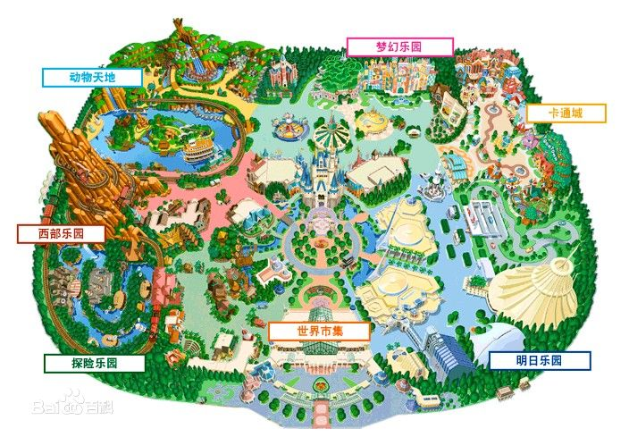
东京迪士尼乐园游览图

Slide 11
“I have never had the slightest doubt about the success of Disneyland
in Japan,” said Masatomo Takahashi president of Oriental Land Company.
东方乐园的董事长说：“对于日本迪士尼乐园的成功，我从未有过丝毫的怀疑”。
Oriental Land was so confident of the success of Disney in Japan that it financed the park entirely with debt. borrowing ¥180 billion($1.5billion at February 1988 exchange rates).
东方乐园对于日本迪斯尼的成功是如此的自信,因为它被1800亿元以债务融资公园 （以1988年二月时的汇率算，是15亿美元）。
exchange rates 外汇汇率

Slide 12
Soon after Tokyo Disneyland opened April 1983,
five Shinto priests held a solemn dedication ceremony near Cinder- ella's castle.
不久之后，日本于1983年四月就开了迪士尼乐园，并且在五神道教祭司灰姑娘的城堡附近举行了庄严的奉献仪式。
It is the only overtly Japanese ritual seen so far in this sprawling
theme park.
到目前为止，在这个庞大的主题公园，这是唯一公开的日本仪式。
Overtly 公开地，明显地 ritual 仪式

Slide 13
What visitor’s see is pure Americana. All signs are in English, with only small katakana translations.
参观者是纯粹的美国人，而且所有的标语都是用英文写的，在英文下面只有小小的片假名（即日本语言字母表）作为翻译。
Most of the food is American-style, and the attractions are cloned from Disney’s U.S. parks.
乐园里大多数的食物都是美国的饮食风格，而且其中的景点也都是克隆美国迪士尼乐园的。

Slide 14
Disney also held firm on two fundamentals that strike the Japanese as
strangeno alcohol is allowed and no food may be brought in from outside the park.
迪斯尼公司也持有两个基本点，那就是允许不含酒精的饮料带入，而且没有食物也可以从外面的公园买后进入。（人性化政策）
On opening day, the Tokyo park discovered that almost 100 public telephones were placed too high for Japanese guests to reach them comfortably. And many hungry customers found countertops above their reach at the park’s snack stands.
在乐园开放的那天，他们发现几乎有100部公共电话被放置在很高的地方，以至于游客不能很方便的使用。而且很多饿了的游客也发现在乐园里的零食站的台面超过了他们所能承受的范围。（遇到的障碍）

Slide 15
大家也知道日本与美国的关系，所以日本对于美国的文化与风俗是相当推崇的，日本迪士尼的的种种风格更是毫不例外。对于日本迪士尼，他们毫不掩饰的效仿美国，克隆美国，比如说园内的麦当劳、肯德基，这些都是很受年轻人欢迎的；然而却也遇到了一些小状况，就像我在上文翻译的，在完全的克隆美国迪士尼的时候，他们忽略了本国人民的一些客观因素，例如身高问题，导致本国人民用户体验的不完善，不过我想，在日本这样一个善于学习的国家，这些问题应该很快就会被解决吧。
在不断学习中进步！

Slide 16
日本迪士尼乐园无疑是目前最成功的，在资金方面，美国本部甚至没有丝毫的投入，只是指导和建造经营而已。那么大家可能也会很疑惑，日本迪士尼为什么会这么成功呢？
2008年，金融危机席卷了全世界，多少家公司倒闭，多少家企业破产，在这样一个经济萧条的大环境下，日本迪士尼不但毫发未损的活了下来，并且创造了历史年参观人数的最高纪录1700万人次。
我想，他最大的成功，是人心经营的成功。在当时如此不确定的时代，迪士尼却能给那些垂头丧气的人带来欢乐、光明、梦想，给他们带来信心、幸福、勇气。因为他们以“造梦”为宗旨，为人间制造“天堂”，当那些艰苦的工薪阶层在“朝九晚五”的平庸中挣扎时，而迪士尼乐园的世界，却能让他们暂时摆脱平庸的束缚！
用户体验做到了极致！

Slide 17
Still,local sensibilities dicated a few changes. A Japanese restaurant was added to please older patrons.The Nautilus submarine is missing.More areas are covered to protect against rain and snow.
然而，当地民情决定了一些变化。比如开了日本餐馆来讨年老顾客的欢心，“鹦鹉螺号”潜艇逐步地消失，更多的地方设计为室内免受雨雪的干扰。
Lines for attractions had to be redesigned so that people walking through the park did not cross in front of patrons waiting to ride an attraction .”it’s very discourteous in Japan to have people cross in front of somebody else.”explained James B.Cora,managing director of operations for the Tokyo project.
经典路线的重新设计，避免出现漫步穿越公园的人于准备骑行于某景点的顾客面前交叉走过。“在日本从别人面前交叉走过这种行为是极为失礼的。”东京项目运营部总经理James B cora 如是解释道。

Slide 18
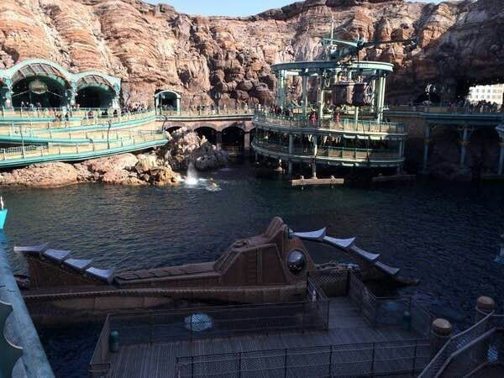

Slide 19
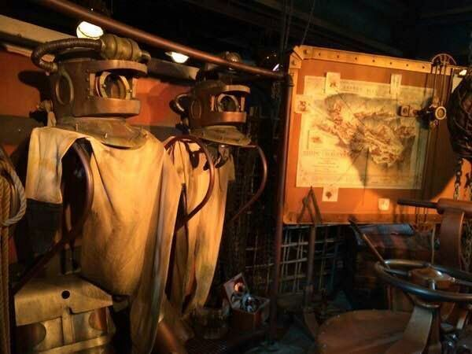

Slide 20
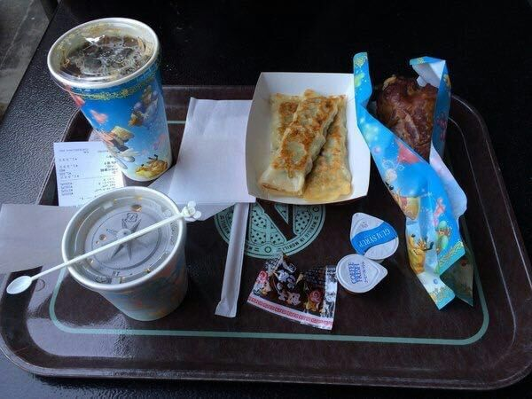

Slide 21
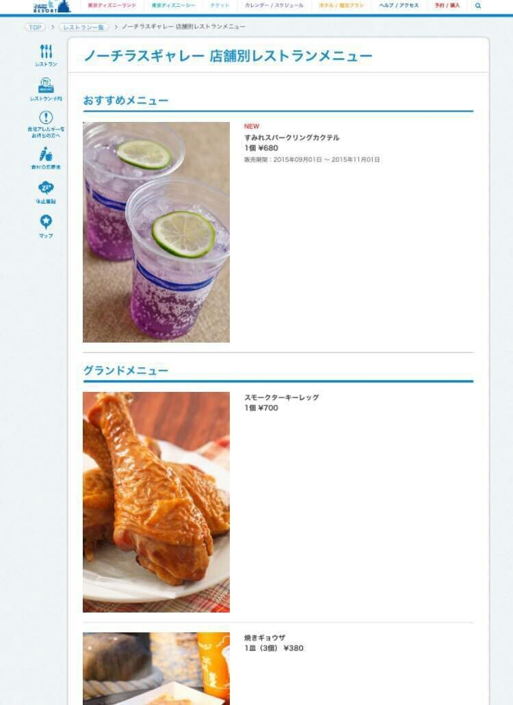

Slide 22
The biggest differences between Japan and American have come in slogans and ad copy.Although English is often used .it’s “japanized”english—the sort that would have native speakers shaking their head while the japanese nod happily in recognition “let’s spring”was the motto for one of their highly successful ad campaigns.
日本和美国最大的差异来自于标语和广告语。尽管，它们经常用英语表达，但却是一种“日本式”英语。是那种会让以英语为母语的人摇头难以接受，日本人却点头欣然理解的语言。“let's spring"就是一个他们大获成功的广告宣传的经典语录。

Slide 23
Pogue, visiting frequently from his base in California supervised seven resident American Disney managers who work side by side with Japanese counterparts from Oriental Land Co. to keep the park in turn with the Disney doctrine American it may be,but Tokyo Disney land appeals to such deep—seated japanese passions as cleanliness,order,standing service,and technological wizardry.
Pouge,频繁视察位于加利福利亚的（迪士尼）大本营，指导过七位驻美迪士尼经理的他，与东方乐园株式会社的日本方面负责人携手合作，致力于使此公园逐步贴近“迪士尼主义”，它也许是美国人的，但在日本的迪士尼乐园展现出了日本人在某些方面根深蒂固的热爱，例如整洁，秩序，杰出的服务和魔幻般的工艺。

Slide 24
Japanese executives are impressed by Disney’s detailed training manuals ,which teach employees how to make visitors feel like VIPs.Most worth emulating .say the Japanese ,is Disney’s ability to make even the lowliest job seem glamorous,”they have change the image of dirty work .”said Hakuhodo Institute’s Sekizawa.
日本高管也被迪士尼的训练手册所震撼，它用来授予员工如何使顾客感受到VIP的待遇。最值得效仿的的地方是，迪士尼有一种使最平凡的工作都看似深富魅力的本领。“他们改变了对苦活的映像”，博报堂的光泽英彦如是说。

Slide 25
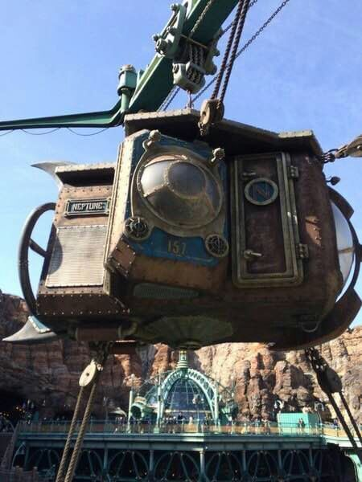

Slide 26
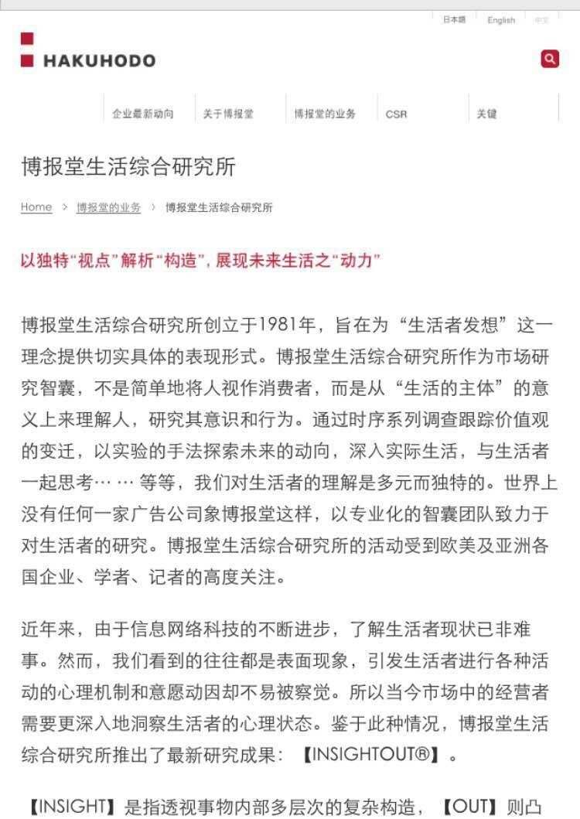

Slide 27
Encounter 遭遇
Slaughter 屠杀
rustic-looking 土气的
Crew 全体人员
Firsthand 直接的
Escalate 升级
Oriental land 东方乐园公司
Disney-MGM 迪士尼米高梅影城
dispose 解决
Trash 垃圾
trash compactor 垃圾压缩机
relent 温和/缓和/减轻
Frontierland 边域世界
Anaheim 阿纳海姆
yen 日元
demographics 人口统计资料
map out 筹划
stake 资助 赌注

Slide 28
Disney Company did encounter a few unique cultural problems when developing Tokyo Disneyland.
迪斯尼公司在发展东京迪斯尼乐园时遇到了一些独特的文化问题。
The problem: how to dispose of some 250 tons of trash that would be generated weekly by Tokyo Disneyland visitors.
问题：如何处理一些250吨的垃圾，这些垃圾将由东京迪斯尼乐园游客每周生成。
The standard Disney solution: trash compactors.
迪士尼的标准解决方案：垃圾压实机。
The Japanese proposal: pigs to eat the trash and be slaughtered and sold at a profit.
日本提议：猪吃垃圾，被宰杀和销售利润。
James B. Cora and his team of some 150 operations experts did a little calculating and pointed out that it would take 100000 pigs to do the job.And then there would be the smell.
杰姆斯B.科拉和他的团队有150运营专家做了一个小小的计算指出它会带100000头猪来做这项工作。然后会有异味。
The Japanese relented.
日本让步了。

Slide 29
The Japanese were also uneasy about a rustic-looking Westernland. Tokyo’s version of Frontierland. “The Japanese like everything fresh and new when they put it in,” said Cora. ”They kept painting the wood and we kept saying, ’No, it’s got to look old.’” Finally the Disney crew took the Japanese to Anaheim to give them a firsthand look at the Old West.
日本也对质朴的westernland不安。东京版的边疆。“日本人喜欢一切新鲜的事物，”科拉。“他们不停地画木，我们不停地说，“不，这看起来过时了。”最后，迪士尼船员把日本海姆给他们亲眼看看古老西部。

Slide 30
Tokyo Disneyland opened just as the yen escalated in value against the dollar and the income level of the Japanese registered a phenomenal improvement. During this era of affluence , Tokyo Disneyland triggered an interest in leisure. Its great success spurred the construction of “ leisurelands throughout the country. This created an increase in the Japanese people’s orientation toward leisure. But demographics are the real key to Tokyo Disneyland’s success. Thirty million Japanese live within 30 miles of the park. There are three times more than the number of people in the same proximity to Anaheim’s Disneyland. With the park proven such an unqualified hit and nearing capacity Oriental Land and Disney mapped out plans for a version of the Disney-MGM studio tour next door. This time, Disney talked about taking a 50 percent stake in the project.

Slide 31
东京迪斯尼乐园的价值与美元的价值和日本的收入水平有了显著的改善，这一过程就打开了。在这个富裕的时代，东京迪斯尼乐园引发了对休闲的兴趣。其杰出的成功刺激了“全国leisurelands建设。这创造了日本民众对休闲的取向的增加。但人口统计数据是东京迪斯尼乐园成功的关键。三千万日本人生活在30英里的公园里。有三次以上在同一距离的人数到阿纳海姆的迪斯尼乐园。随着园区证明这样一个不合格的打接近容量东方土地和迪士尼映射为一个版的迪士尼米高梅工作室的隔壁的计划。这一次，迪斯尼谈到了在该项目中的百分之50的股份。

Slide 32

The end
Thank you for your
watching and listenning

