Slide 1
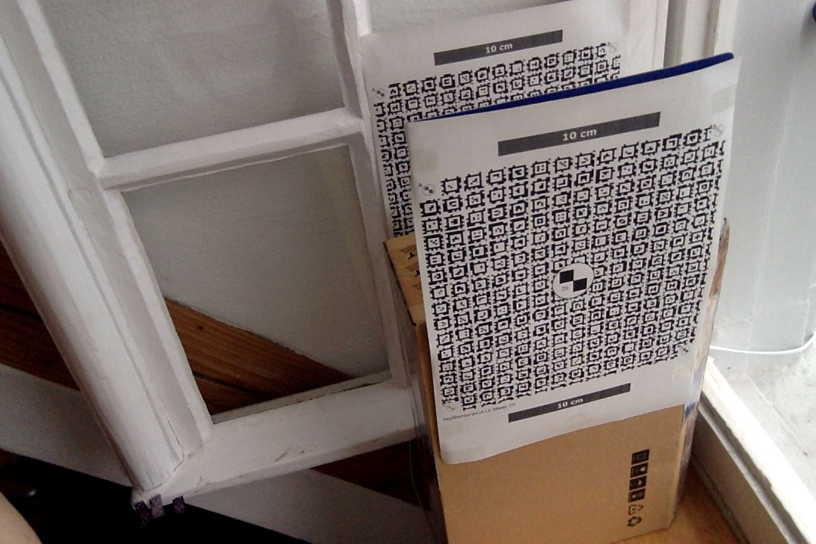
These sheets of paper have been printed from PDF files. Although they look similar, Z0 and Z1 are composed of different April Tags which can be uniquely identified and whose position on the page is known. By placing these sheets at known locations in the environment, a calibration (mapping between 3D world coordinate and 2D pixel coordinate) can be determined automatically.
Plane Z0, defines z=0 plane in coordinate system.
Plane Z1, defines z=15cm in coordinate system.
Note: this was a quick “home lab” demonstration in which the goal was to illustrate the calibration process but in which data quality is lower than ideal because the paper sheets are not as planar as ideal and their precision of being exactly 15cm apart is questionable. Furthermore, it would be more natural to define the Z coordinate as vertical.
When printing the PDF files, ensure that the scale bars are rendered at the correct size.

