Slide 1
IoT Data Aggregation Pipeline

Slide 2
Development Team
Name
  Team GR
Members
  Gabriel Rodriguez (rodrigg2@mail.uc.edu)
  Peter Kroeger (peter14mail@gmail.com)

Slide 3
Project Purpose
The purpose of this project is to devise a data pipeline template that can collect atmospheric data from the interior of multiple facilities. This will be accomplished by sending real time atmospheric data from a network of IoT devices to a self-hosted, facility-specific server. The server will then aggregate the collected data and send each batch to a central SQL database. Note that this database will be used to store data from other facilities as well. Additionally, there will be a headless web API that authorized users can use to query batches of data from the database.

Slide 4
Project Goals
Develop a data pipeline template that can be implemented and extended by others
Demonstrate the benefits of implementing a data pipeline in house (affordable, extensible, easy to maintain)
Evaluate emerging technology

Slide 5
User Stories - 1/2
As a system administrator, I want a system that is easy to set up and maintain, so that I can more easily stay up to date with other tasks.
As a data analyst, I want a data pipeline that allows me to quickly access and view data, so that I can more easily make decisions based on the data collected.

Slide 6
User Stories - 2/2
As a systems engineer, I want a data pipeline that is easy to extend, so that I can add and remove functionality as system requirements change.
As a project manager, I want a data pipeline that is cheap to operate, so that my team can have a larger portion of funding available.

Slide 7
Project Constraints
Limited budget
Security
Licensing
Interdisciplinary knowledge

Slide 8
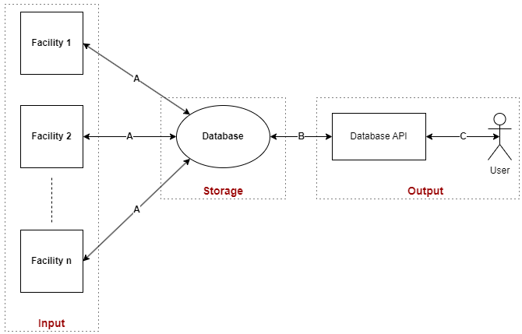
Design Diagram D0

Slide 9
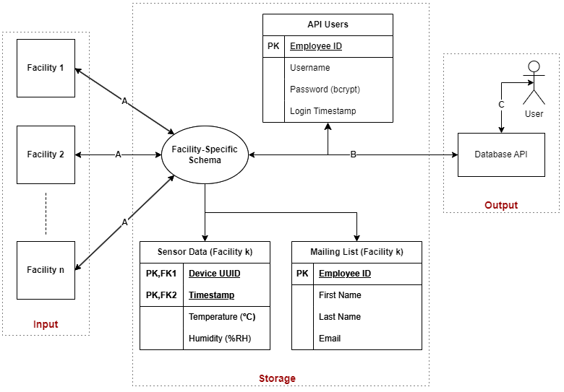
Design Diagram D1

Slide 10
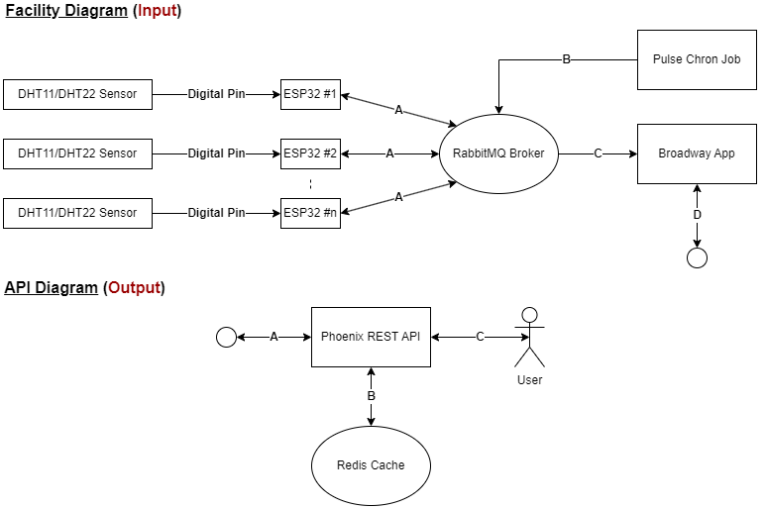
Design Diagram D2

Slide 11
Current Project State
RabbitMQ Message Broker
  MQTT and TLS enabled
  Automated user configuration
Firmware Proof-of-Concept (POC)
  Failed attempts with Rust on ESP (std and no_std)
  Success with ESP-IDF and Platform IO

Slide 12
End of Term Deliverables
Wrap-up Firmware POC
  Upgrade MQTT version from v3.1 to v5
  Update project documentation
Create Local Server POC, along with pertinent documentation

Slide 13
Proposed Expo Demo
Poster illustrating each subsystem
An example IoT device to let the audience hold
A potential live demo of the API

